Slide 1


The Principles of the CLIQ System
E. Ravaioli
Conceptual Design Review of the Magnet Circuits for the HL-LHC
21 March 2016

Slide 2

Current change
CLIQ – Coupling-Loss Induced Quench
Magnetic field change
Coupling losses (Heat)
Temperature rise
QUENCH
3/21/2016

Slide 3
CLIQ applied to a 14 m LHC main dipole

Slide 4
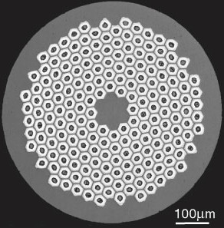
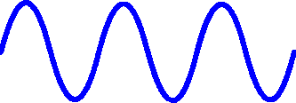
Main CLIQ heating mechanism:
inter-filament coupling loss
More effective heat deposition with respect to conventional technology based on thermal diffusion
Faster and more homogeneous quench initiation
SC
Lower hot-spot temperature
Cu

Slide 5
Main advantages and disadvantages
Advantages
More effective heat generation directly in the superconductor
Robust electrical design, easier implementation and repair
Faster quench initiation
  More homogeneous temperature distribution
  Lower hot-spot temperature
Lower failure risk
Less dependent on magnet, cable, strand parameters
Easy repair solution for a magnet with damaged quench heaters
Possible to avoid the installation of quench heaters
Disadvantages
Additional current lead(s) connected to the magnet (pulse current for <100 ms)
Energy deposited very homogeneously in the coil (inefficient at low current)
CLIQ connected directly to the main circuit
  Voltage to ground distribution, in particular if several magnets
  AC currents introduced
  Need to install parallel elements
  Integration with an energy-extraction system is possible but it needs to be carefully studied
Additional mechanical stresses due to the introduced current need to be analyzed

Slide 6
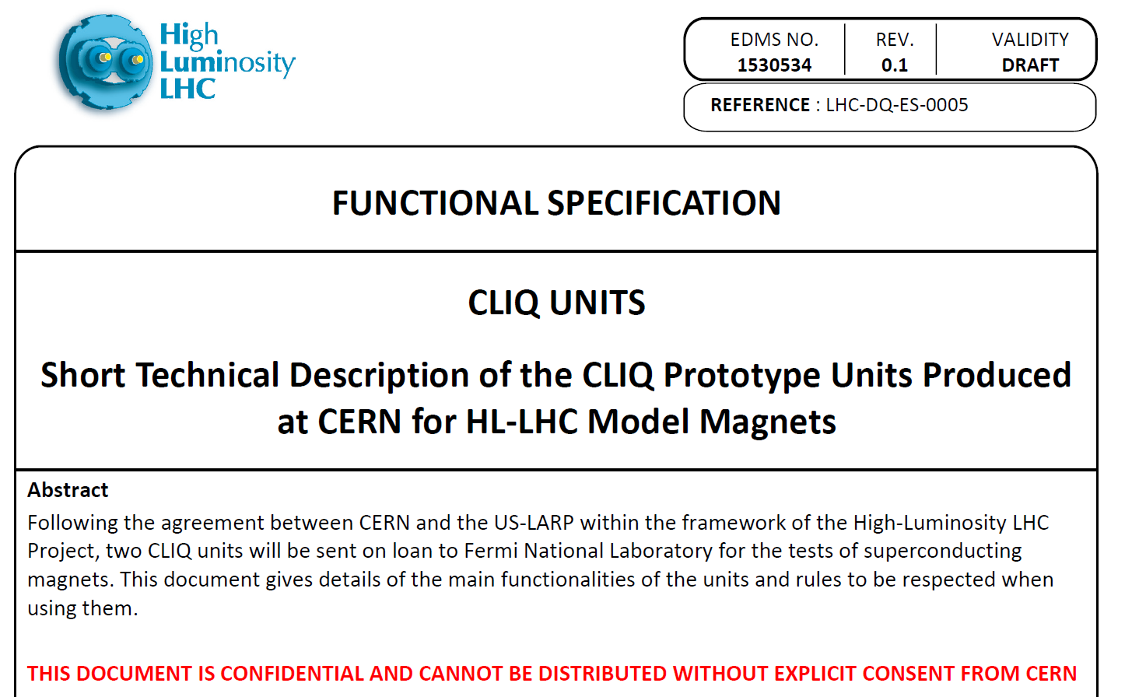
CLIQ units
More detail tomorrow in Knud’s talk
  CLIQ technology tested successfully on magnets of different size (from small-scale test magnets to full-scale accelerator magnets), inductance (from a few mH to a few H), type of superconductor (Nb-Ti, Nb3Sn), cable/strand parameters.

Slide 7
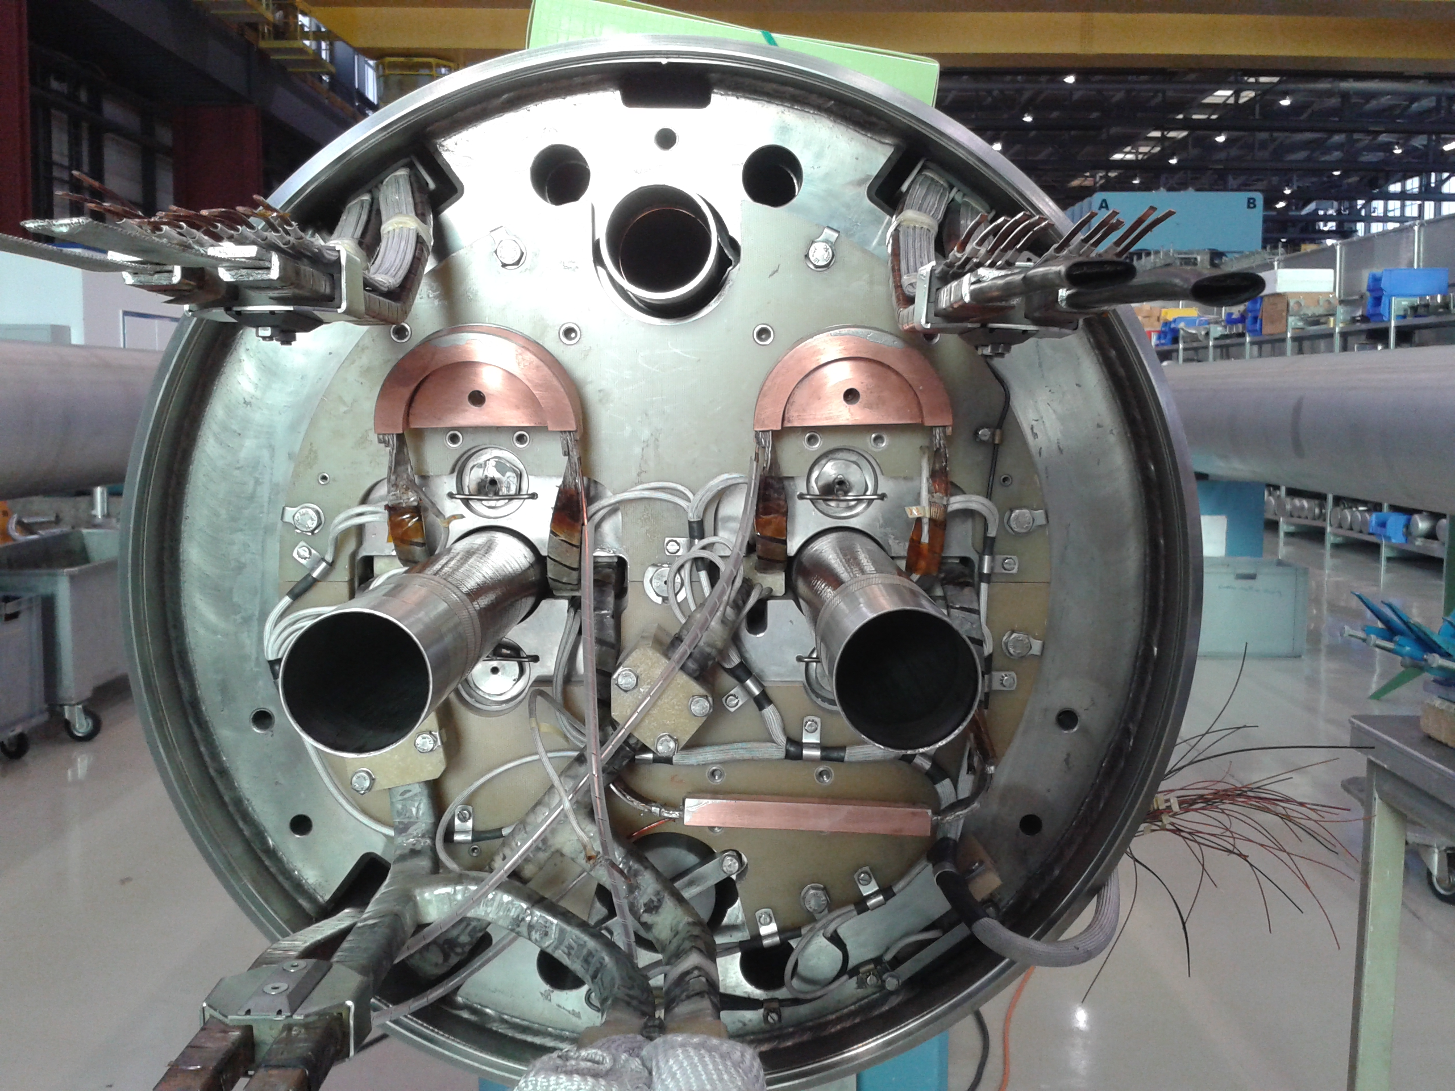
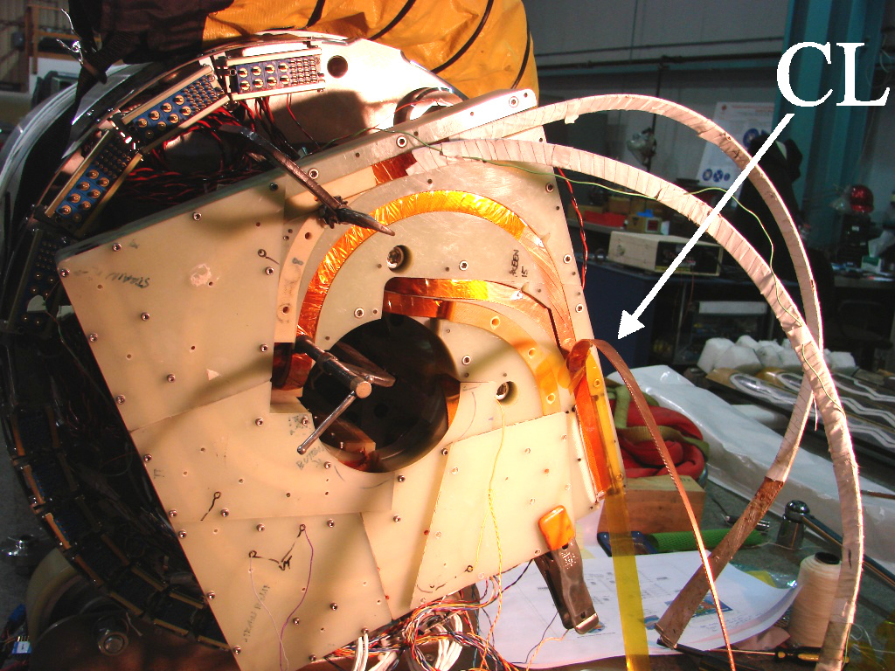
CLIQ terminals and leads
  Need to carry only pulsed currents (<100-200 ms)
  Minimize their resistance (superconducting cable is a nice solution)
  Secure connection (Lorentz forces will act on them)
Aug 2015: full-size 15 m LHC main dipole
2014: H02b
Courtesy of Dan Cheng

Slide 8
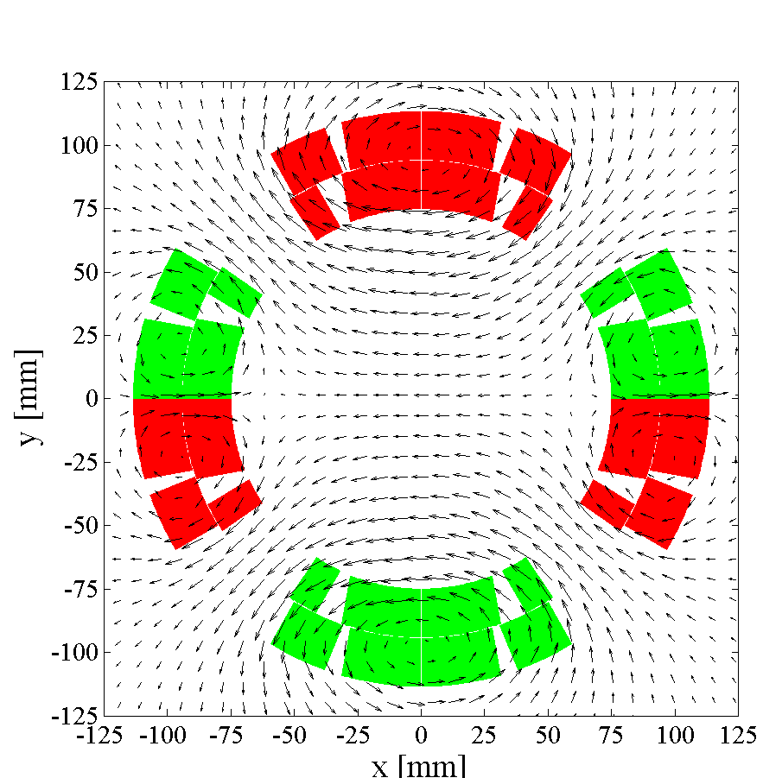
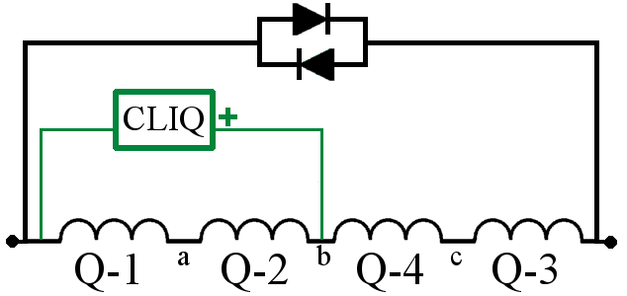
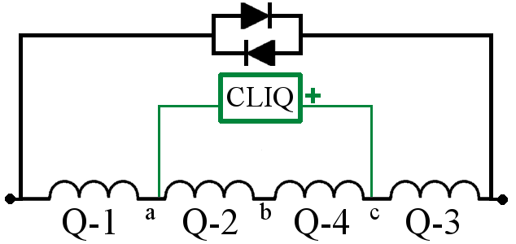
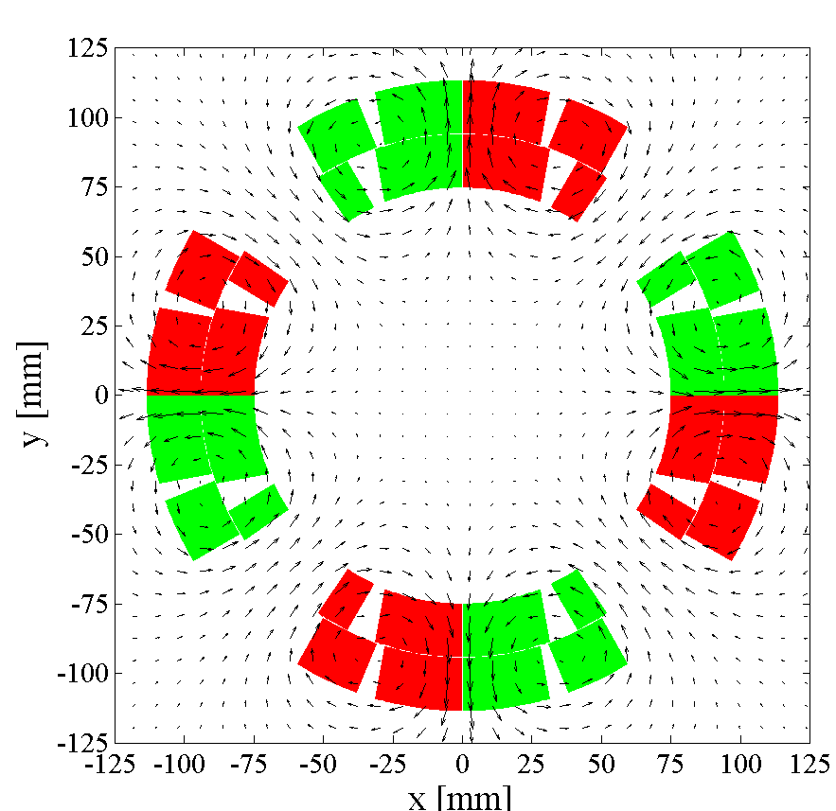
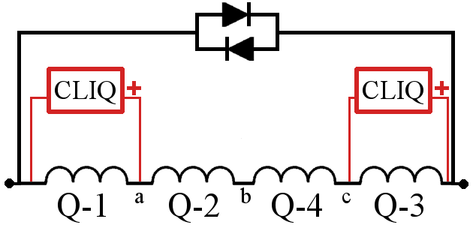
CLIQ configuration
2
1
3
4
2
1
3
4

Slide 9
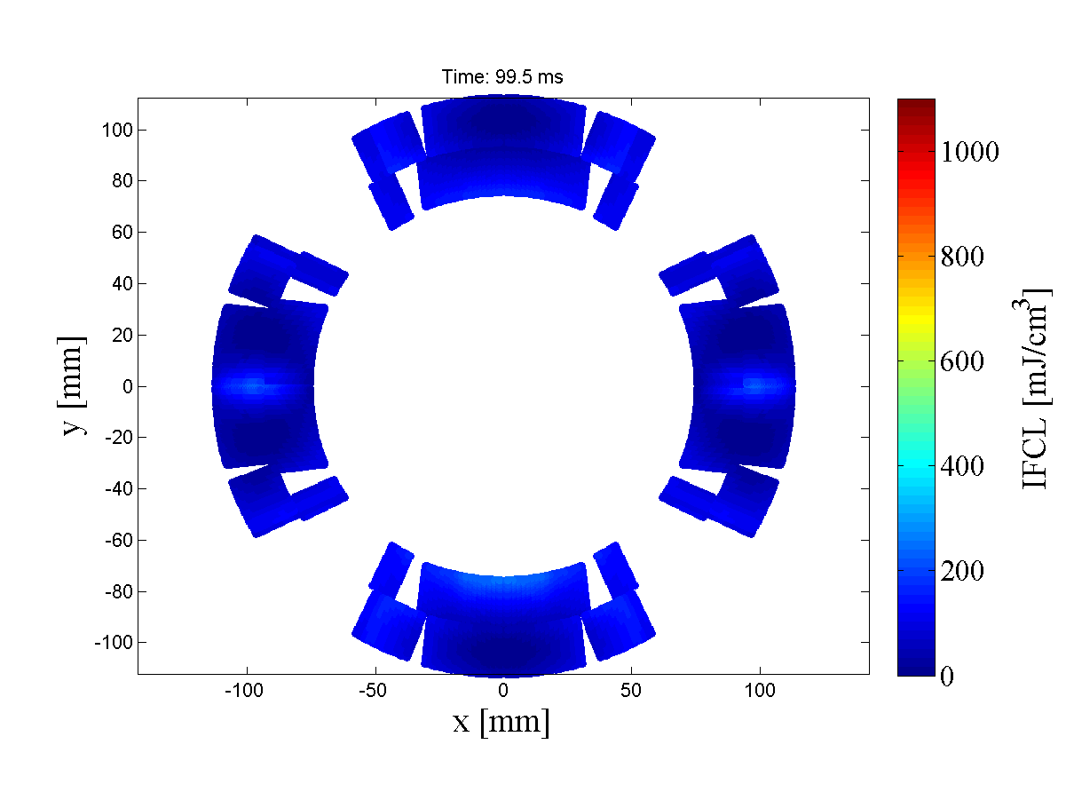
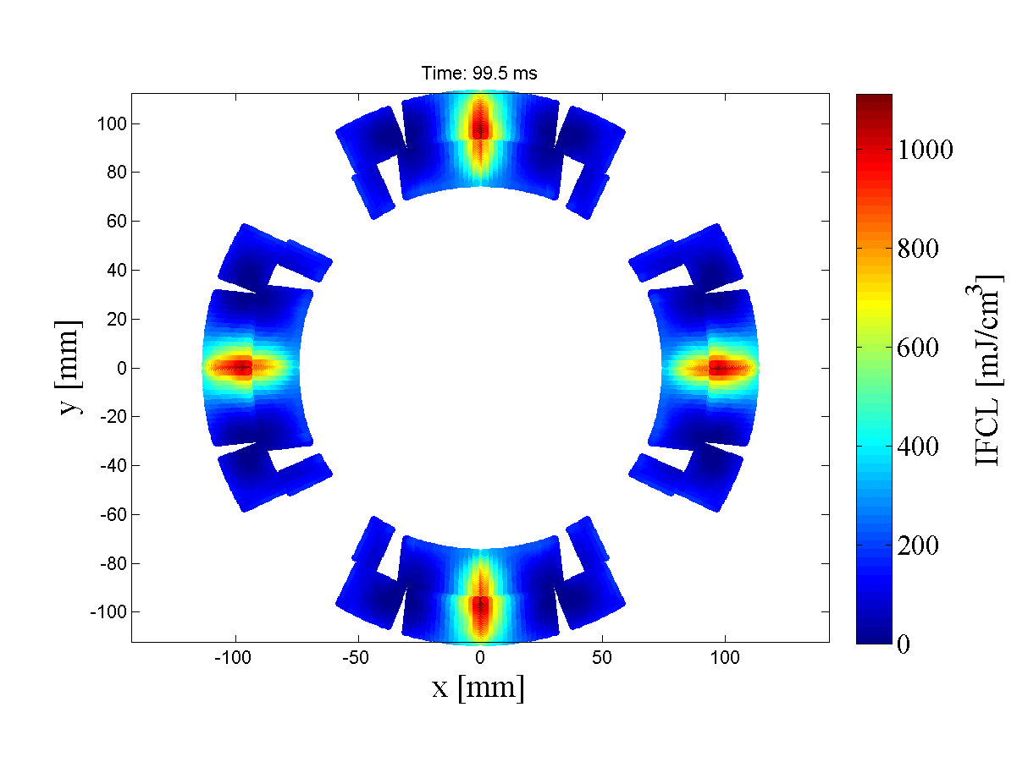
CLIQ configuration
2
1
3
4
2
1
3
4

Slide 10
Scaling of CLIQ performance
At high current
Low energy needed to start the quench
High energy density, needs to be quick!
→ POWER is the key parameter
  CLIQ effectiveness
  → Coil geometry
  → Position of CLIQ connections
  → Electrical order of the poles
  → Conductor parameters
  → etc…
(Number of CLIQ units)^2
(Charging voltage)^2
(magnetic length)^-2 (fixed by design)
At low current
High energy needed to start the quench
Low energy density, velocity not critical
→ ENERGY is the key parameter
Number of CLIQ units
(Charging voltage)^2
Capacitance of each unit
Magnetic length
# of CLIQ units
Capacitance

Slide 11
CLIQ – Summary
  Faster energy deposition | More robust system
  Needs studies for integration in the magnet system
  CLIQ’s main ingredients
      Inter-filament coupling loss (Conductor)
      Units (Charging voltage, Capacitance)
      Terminals and leads (Resistance)
      Configuration (Effectiveness)
  CLIQ technology tested successfully on magnets with very different characteristics (MQXC2, HQ02b, MQY, MB,…)
  Simulation studies ongoing for the protection of future magnets (MQXF, 11 T, D1, D2, Q4, FCC magnets,…)

