Slide 1

HL-LHC MAGNETS
CERN, 21st March 2016
Circuit review
E. Todesco, F. Savary
CERN, Geneva Switzerland
On behalf of WP3 and WP11

Slide 2
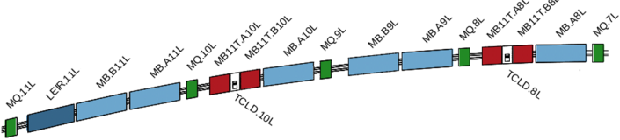
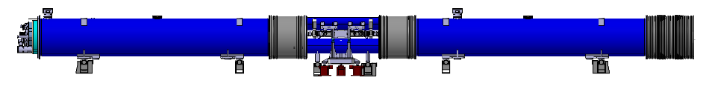
11 T
To create space in the dispersion suppressor regions of LHC, i.e. a room temperature beam vacuum sector, to install additional collimators, needed to cope with beam intensities that are larger than nominal
Replace a standard 14.3-m-long main dipole by a pair 5.5-m-long 11 T dipoles producing the same integrated field of 119 T m at 11.85 kA
LS3
LS2
5.5 m
~15 m

Slide 3
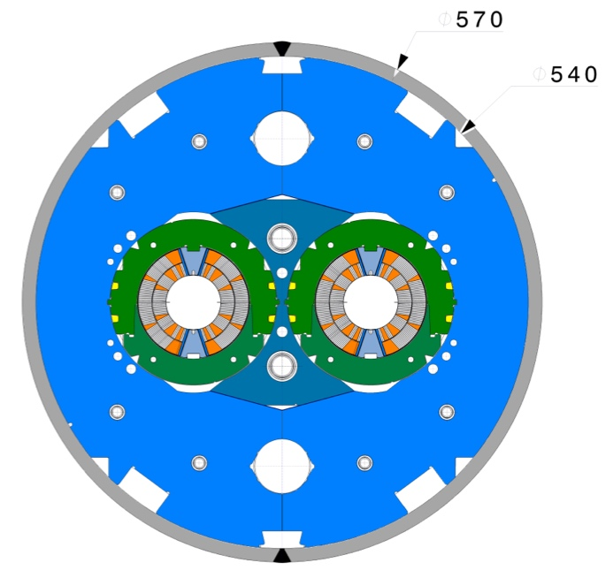
11 T
Nb₃Sn, 11.5 T peak field, 2 magnets of 5.5 m
  Detection:
    Variable thresholds needed (flux jumps at low field) [J. Steckert this review]
  Protection: OL quench heaters
    CLIQ and interlayers heaters are being studied to create
    redundancy [S. Izquierdo Bermudez, this review]
  Current: 11.8 kA, inductance of one unit (two magnets) ∼130 mH
  Energy per 11-m-long magnet is 8.9 MJ
  Main challenges
    First Nb₃Sn installed in accelerator
    To be in series with dipoles
    [S. Yammine, this review]
    A trim is used to compensate the different
      saturation path w.r.t. the main Nb-Ti dipoles
  Two units (four magnets) for LS2 in IP7
  Two units (four magnets) for LS3 in IP7
D1 cross-section

Slide 4
11 T - STATUS
Short model program at CERN and (initially) FNAL
  At CERN, two short (2 m long) models built, tested, and assembled in double aperture have been successfully tested
  Long magnet is the main next challenge
Quench performance of 11 T short models single aperture (MBHS) and double (MBHD) [F. Savary, G. Willering et al.]

Slide 5
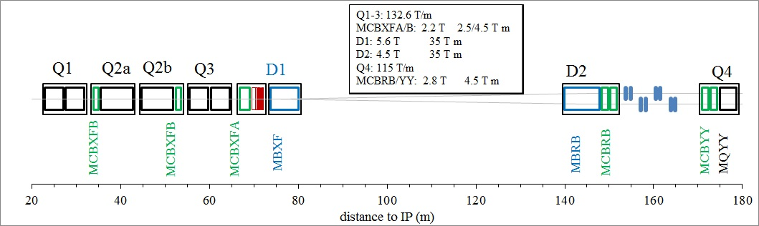
WP3 LAY OUT
IR magnets: to reduce β* by a factor four in LS3 (2024)
  www.cern.ch/hilumi/wp3 (look on the document page)
    Hilumi book
    Technical design report
  Two points IP1 and IP5 to be equipped, two sides, plus spares
    Minimum of two spares (example Q4, D1 and D2 will be 4+2)
    To be installed in LS3 (2024)
The HL LHC layout from Q1 to Q4

Slide 6

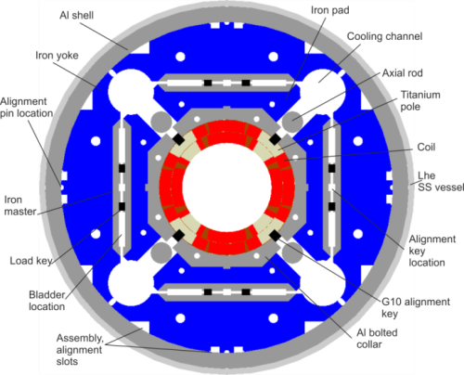
TRIPLET
Nb₃Sn (the only one in WP3), 11.5 T peak field, 7 m long
  Detection:
    Variable thresholds needed (flux jumps at low field) [J. Steckert this review]
    100 mV at high field is a must, 10 ms validation time
  Protection: OL quench heaters
    Plus inner layer heaters and/or CLIQ to create
    redundancy [G. Ambrosio, E. Ravaioli this review]
  Current: 16.5 kA, inductance ∼140/120 mH
  Energy per 7-m-long magnet is 8 MJ
  Presently Q1-Q3 in series and Q2a Q2b in series
    One circuit option under cosideration
QXF cross-section

Slide 7

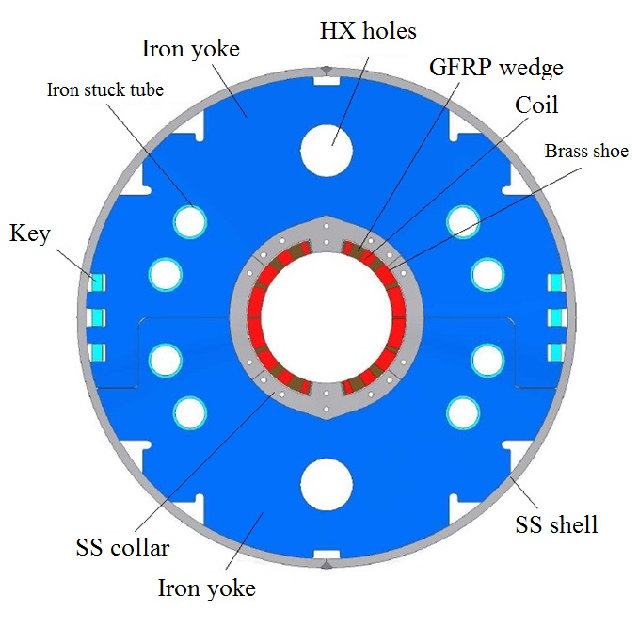
SEPARATION DIPOLE D1 (MBXF)
Nb-Ti, 5.6 T operational field, 6.2 m
  LHC dipole outer layer cable
  Detection: as in the LHC
  Protection: quench heaters [T. Nakamoto, this review]
    CLIQ option
  Current: 11.8 kA, inductance ∼25 mH
    Energy per magnet is ∼2 MJ
D1 cross-section

Slide 8
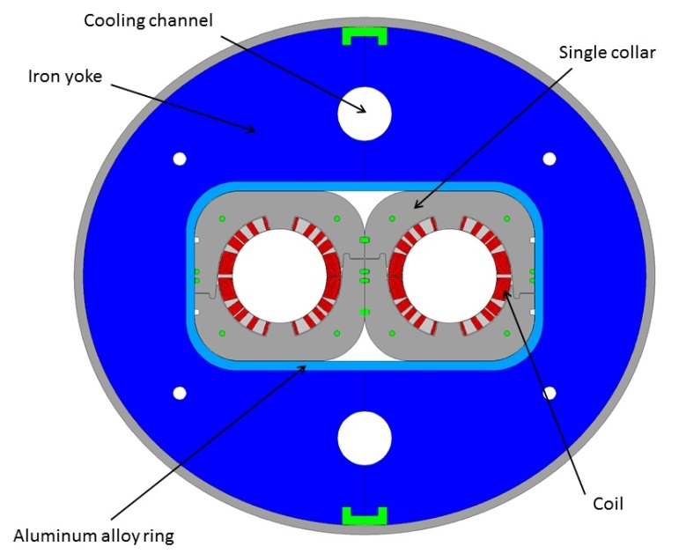

RECOMBINATION DIPOLE D2 (MBRD)
Nb-Ti, 4.5 T operational field, 7.8 m
  Two apertures in series
  LHC dipole outer layer cable
  Detection: as in the LHC
  Protection: quench heaters
  [P. Fabbricatore, this review]
  Current: 12 kA, inductance ∼27 mH
      Energy per magnet is ∼ 2 MJ
To save on power converters we are exploring the possibility of having D1 and D2 in series [F. Rodriguez Mateos, this review]
D2 cross-section

Slide 9
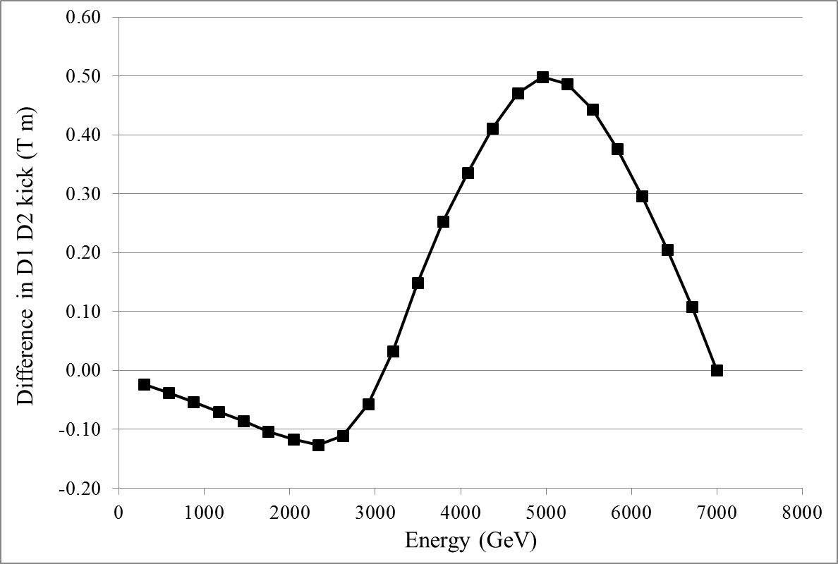
D1 AND D2 IN SERIES ?
If D1 and D2 were in series, we would have to compensate for a maximum integrated field of 0.5 T m
  Over 35 T m, i.e. 1.5%
  Coud be done with increased strength from correctors (from 5 to 5.5 T m) or via a trim

Slide 10
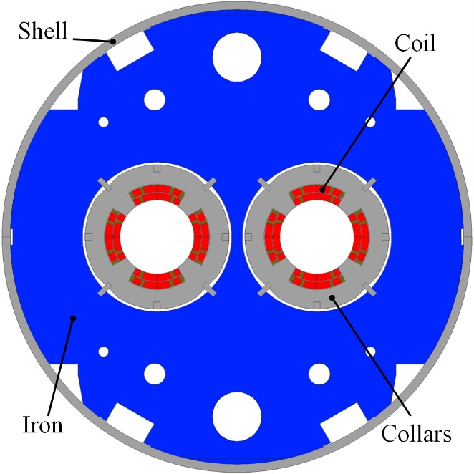

TWO IN ONE APERTURE Q4 (MQYY)
Nb-Ti, 6 T peak field, 3.8 m
  Two apertures independently powered
  LHC MQM cable (8 mm width), two layers
  Detection: as in the LHC
  This magnet is very similar to LHC MQM
    Only larger aperture (from 56 to 90 mm)
  Protection: quench heaters
    CLIQ option
  Current: 4.6 kA, inductance 38 mH
  Energy per magnet (two apertures) is 0.8 MJ
Q4 cross-section
[Rifflet, Segreti, Felice]

Slide 11
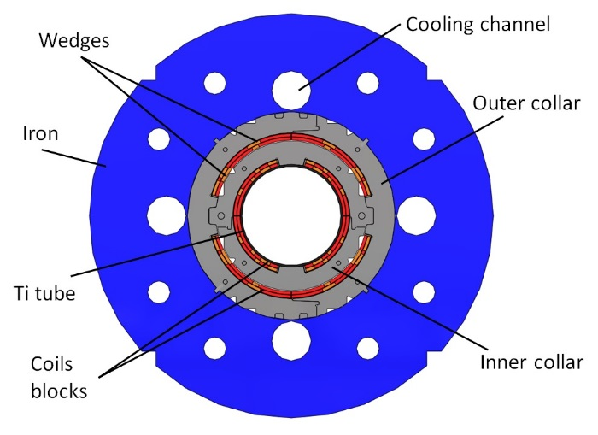

ORBIT CORRECTORS (MCBXFA/B)
Nb-Ti, nested, 2.1 T field in each plane, 2/1 m
  Each plane independently powered
  Cable used for corrector of S LHC (4.5 mm width)
  Protection [F. Toral, this review]
    Target is having self protected magnets
  Current: 1.5 kA, inductance 20 to 50 mH
  Energy in 2-m-long magnet is 0.2 MJ
Single aperture orbit corrector
Cross-section

Slide 12
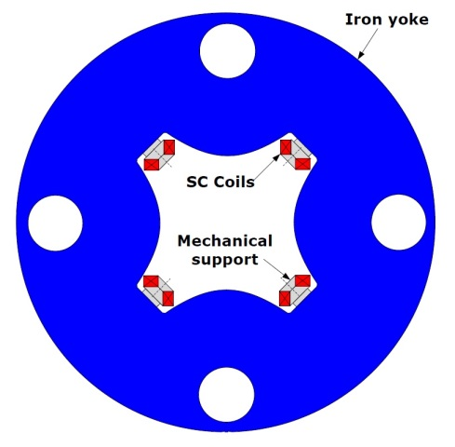
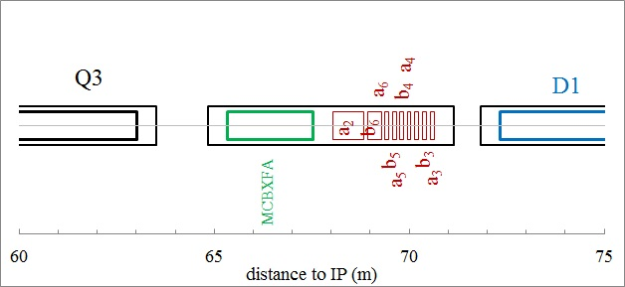

HIGH ORDER CORRECTORS
Nb-Ti superferric, 3 T peak field, 0.8 m
  Coils made with a strand
  Protection: study ongoing [G. Volpini, this review]
  Current: 0.18 kA, inductance 1200 mH

Slide 13
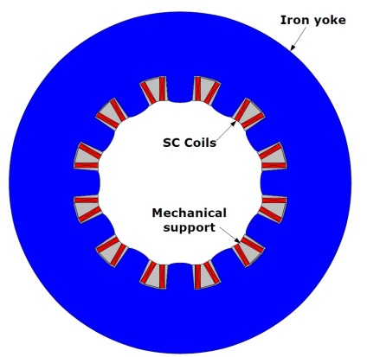
HIGH ORDER CORRECTORS
Nb-Ti superferric, 2 T peak field, ∼0.5 m
  Coils made with a strand
  Protection: self protected [G. Volpini, this review]
  Current: 0.17 kA, inductance 230 mH

Slide 14
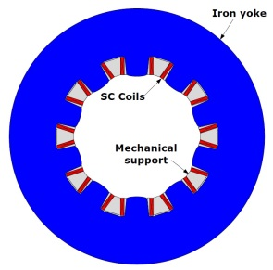
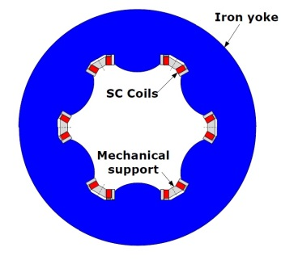
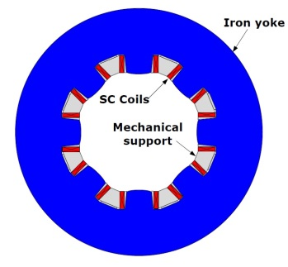
HIGH ORDER CORRECTORS
Nb-Ti superferric, 2 T peak field, ∼0.1 m
  Coils made with a strand
  Protection: self protected [G. Volpini, this review]
  Current: 0.12-0.16 kA, inductance 50-150 mH

Slide 15
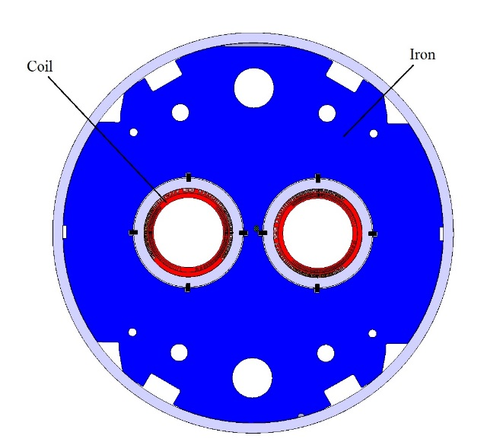
D2 ORBIT CORRECTORS (MCBRD)
Nb-Ti, 2.63 T field, 1.9 m, 5 T m integrated field
  Each aperture independently powered
  This will be a canted design, with 430 A current
    never installed HEP particle accelerators
    Detection and protection: as in the single aperture orbit correctors, but without the complication given by nested
  Target: self protected magnets [G. De Rijk, this review]
  Current: 0.43 kA, inductance 0.8 H
Double aperture orbit corrector
cross-section [G. Kirby, J. Rysti]

Slide 16
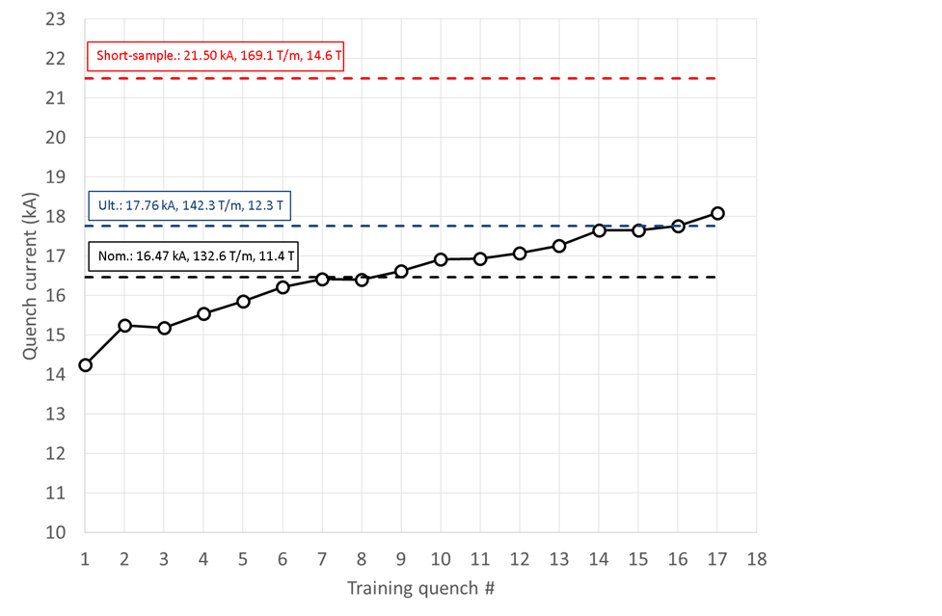
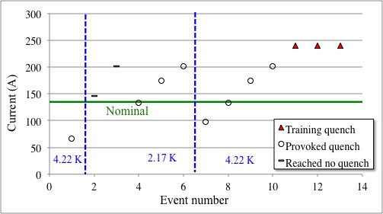
STATUS
  Two WP3 magnets successfully tested: sextupole corrector and short model triplet
  Triplet: first long to be tested in end 2017 – important date for protection validation
Test of the first sextupole prototype [G. Volpini]
Test of the first MQXF short model [G. Chlachidze]

Slide 17
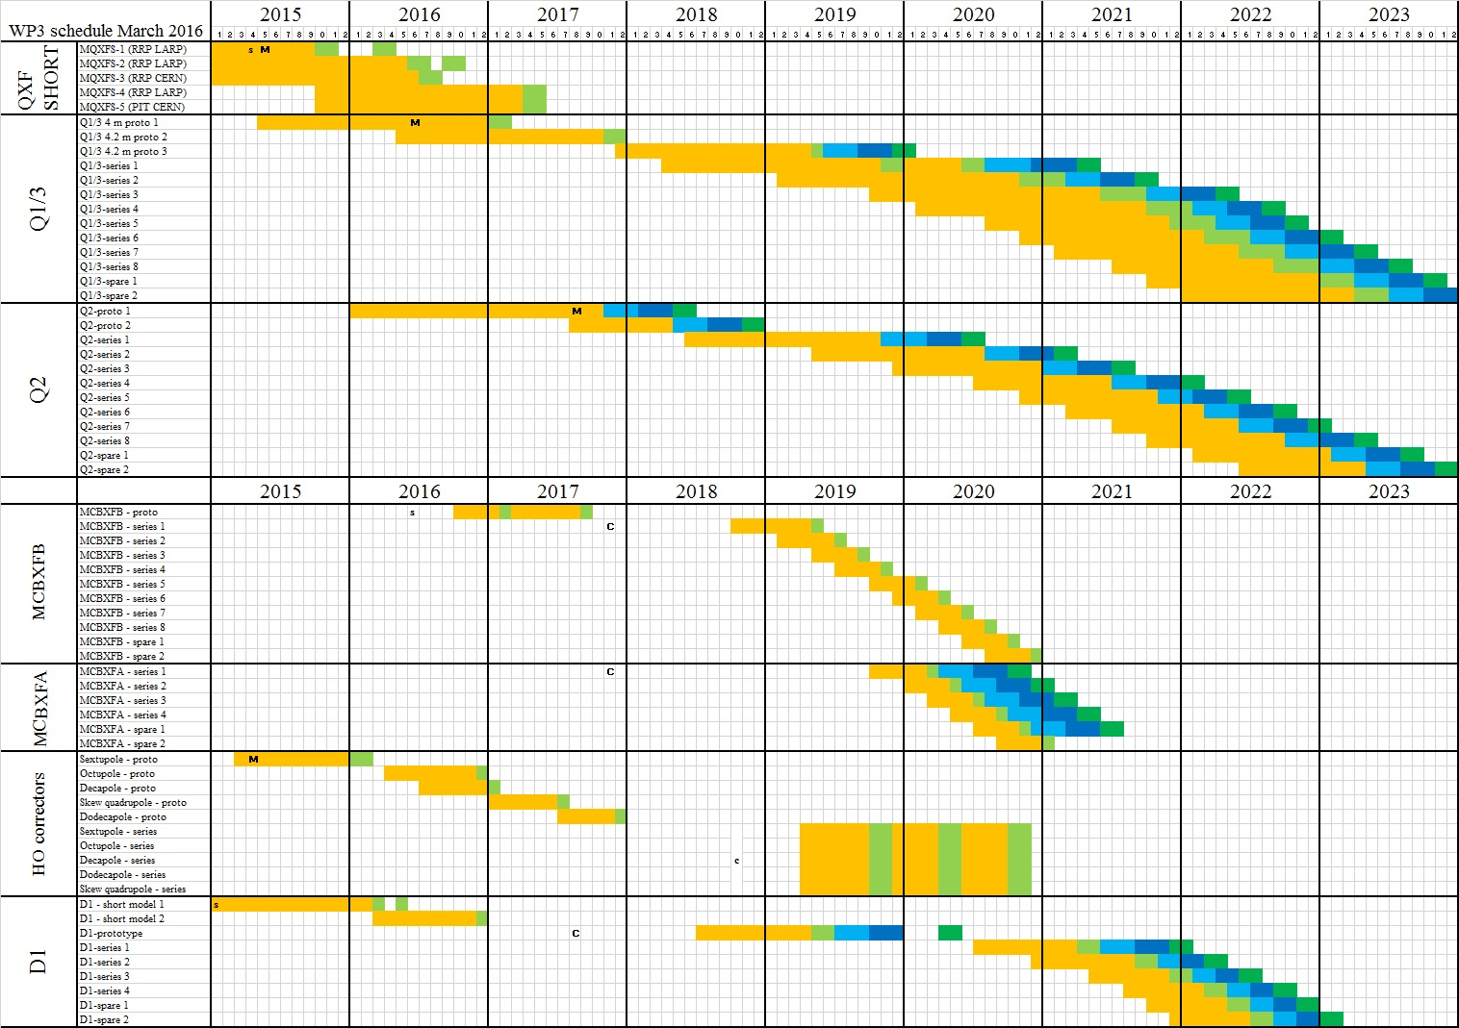

SCHEDULE

Slide 18
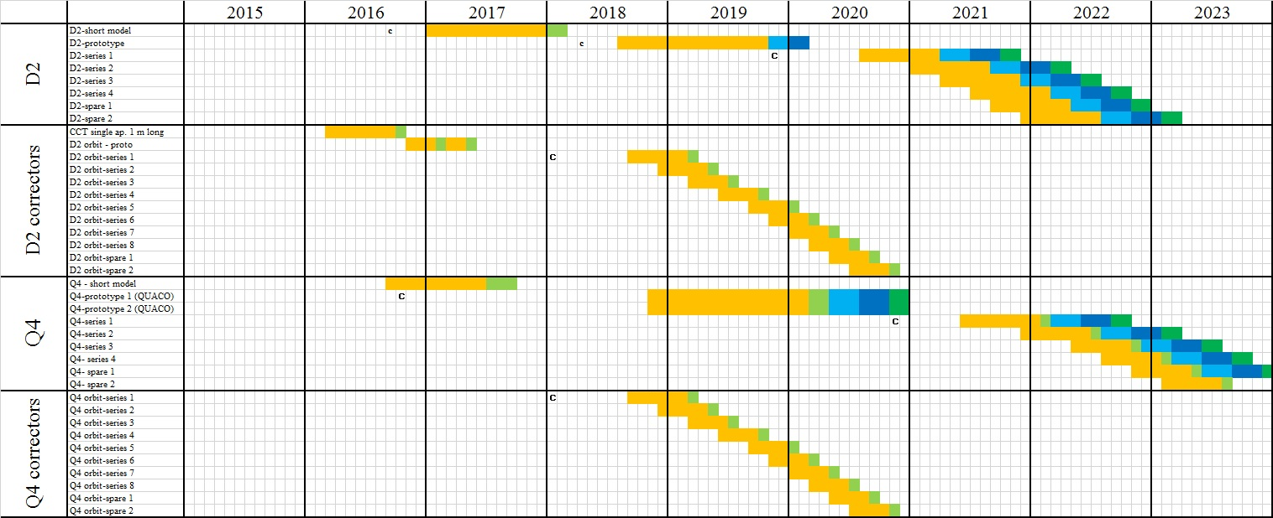
SCHEDULE

Slide 19
SUMMARY
11 T is in series with the main dipoles
  Interaction with existing system to be carefully evaluated
11 T and QXF protection challenges very similar
  Much tougher than the Nb-Ti LHC dipoles
All IR magnets are individually powered except
  Triplet: four magnets on two circuits (possibly on one)
  D1 and D2 possibly in series
Moreover
  D2-Q4 correctors, and Q4 have apertures independently powered
  Single aperture orbit correctors are nested (H and V) with independently powered apertures
For protection, 11 T and triplet is the big challenge
  Main magnets in Nb-Ti protected with heaters
    Their challenge is similar to LHC main magnets

