Slide 1
Integration of powering and protection system
INTEGRATION: M. Alcaide, J.P. Corso, C. Magnier, S. Maridor, B. Vazquez de Prada, I. Zurbano
D. Duarte, P. Ferracin, H. Prin, E. Todesco,
R. Calaga, F. Killing, E. Montesinos and the whole WP4
A. Masi, A. Rossi, S. Redaelli and the whole WP5
A. Ballarino, A. Jacquemod, V. Parma and the whole WP6a
J.P. Burnet, C. Coupat and the whole WP6b
F. Rodriguez Mateos, D. Wollmann WP7
S. Claudet WP9
G. Arduini, M. Fitterer: WP2
Vibration : M. Fitterer, M. Guinchard Lukasz Jerzy Lacny, J. Wennigner (BE-ABP+EN-MME)
WP17: EN-EL: Gerard Cumer, Nuno Dos Santos, Jean-Claude Guillaume
EN-CV: M. Battistin, F. Boralho, P. Pepinster
EN-HE: C. Bertone, B. Feral, R. Rinaldesi, I. Ruehl
GS-ASE: T. Hakulinen, S. De Luca, P. Ninin
GS-SE: J. Osborne, P. Mattelaer
T. Otto
DGS-RP: C. Adorisio
DGS-SEE: J. Gascon
And many others
Prepared by P. Fessia

Slide 2
Summary
The environment and the integration objectives
The 11 T at Point 7
Point 1 and Point 5
  The adopted approach and the related constraints
  General view of the underground integration of the powering system
    “Technical service” side
    “Machine” side
  Initial consideration on the protection system
  Installation constraints

Slide 3
The environment and the integration objectives

Slide 4

Integration objectives
Peak performance
Availability
Provide best as possible operation environment for equipment
Allow all necessary equipment to operate together
Reduce intervention time
Reduce risk of failure
Scheduling constraints
LHC operation constraints
Existing LHC environment integration constraints
Budgeting constraints
Safety constraints

Slide 5
The 11 T at Point 7

Slide 6
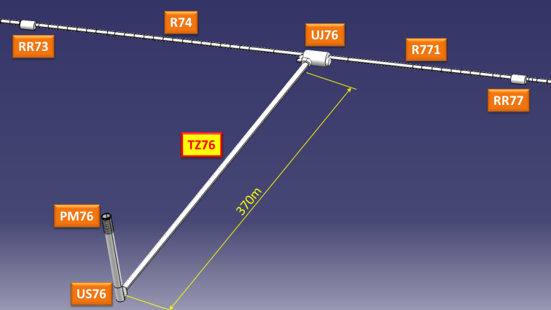
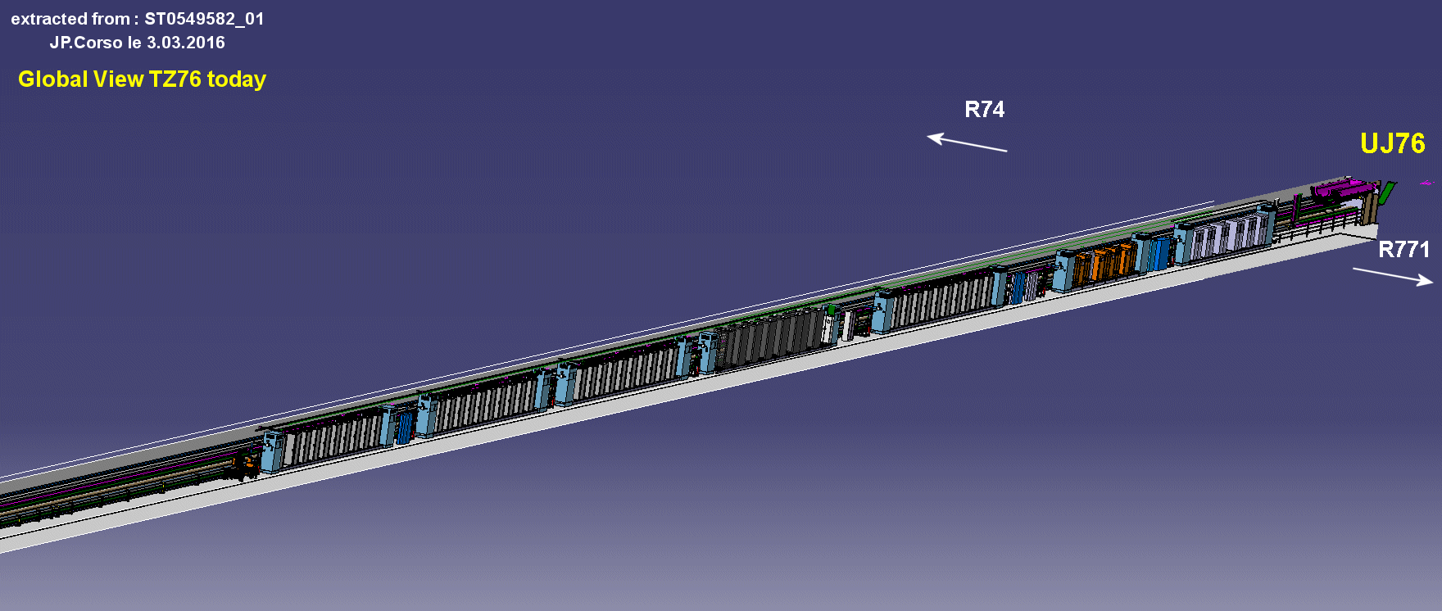
Point 7 Trim PC and Protection. Preliminary study
IP7
A9
A20
Possible areas for new converter
 | A9 option | A20 option
MB.B8L7 | 440 | 550
MB.B8R7 | 360 | 470

Slide 7
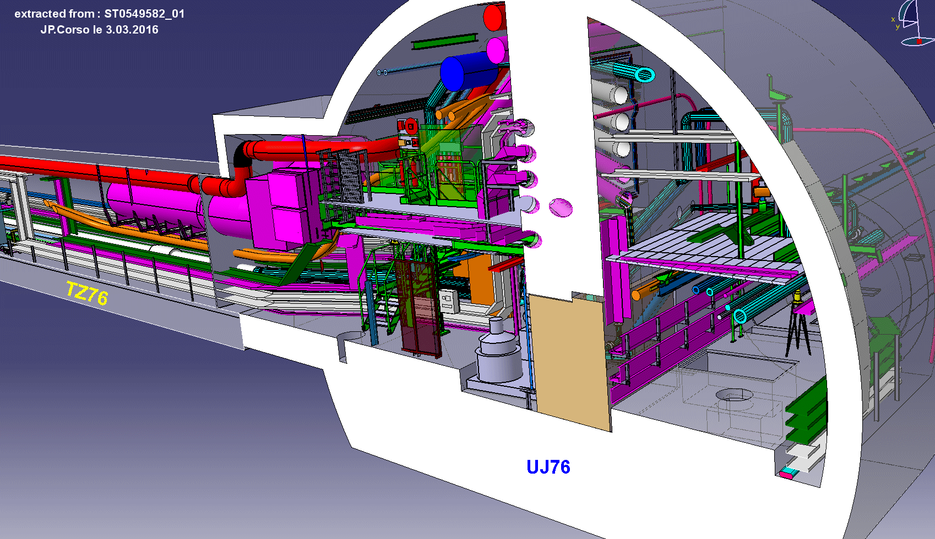
Junction with LHC tunnel

Slide 8
The adopted approach and the related constraints

Slide 9
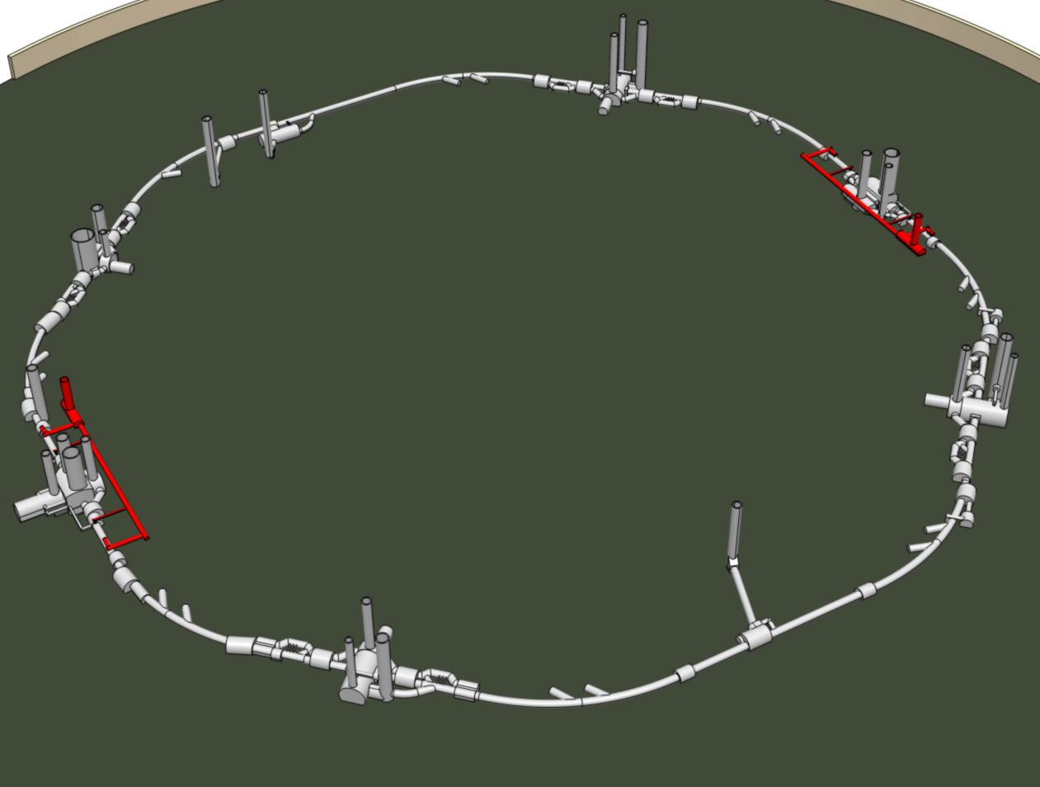
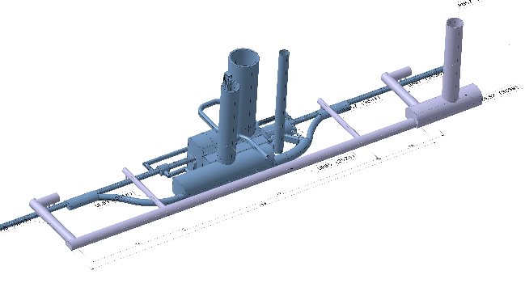
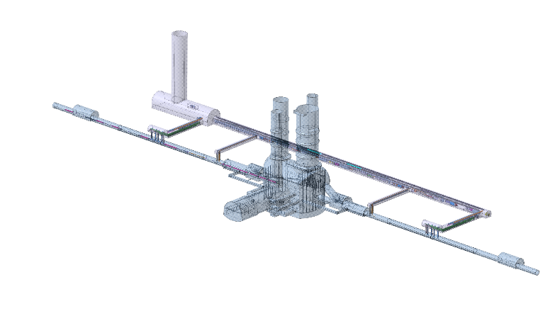
The adopted approach: the double decker solution
POINT 5
POINT 1

Slide 10

The Double Decker

Slide 11
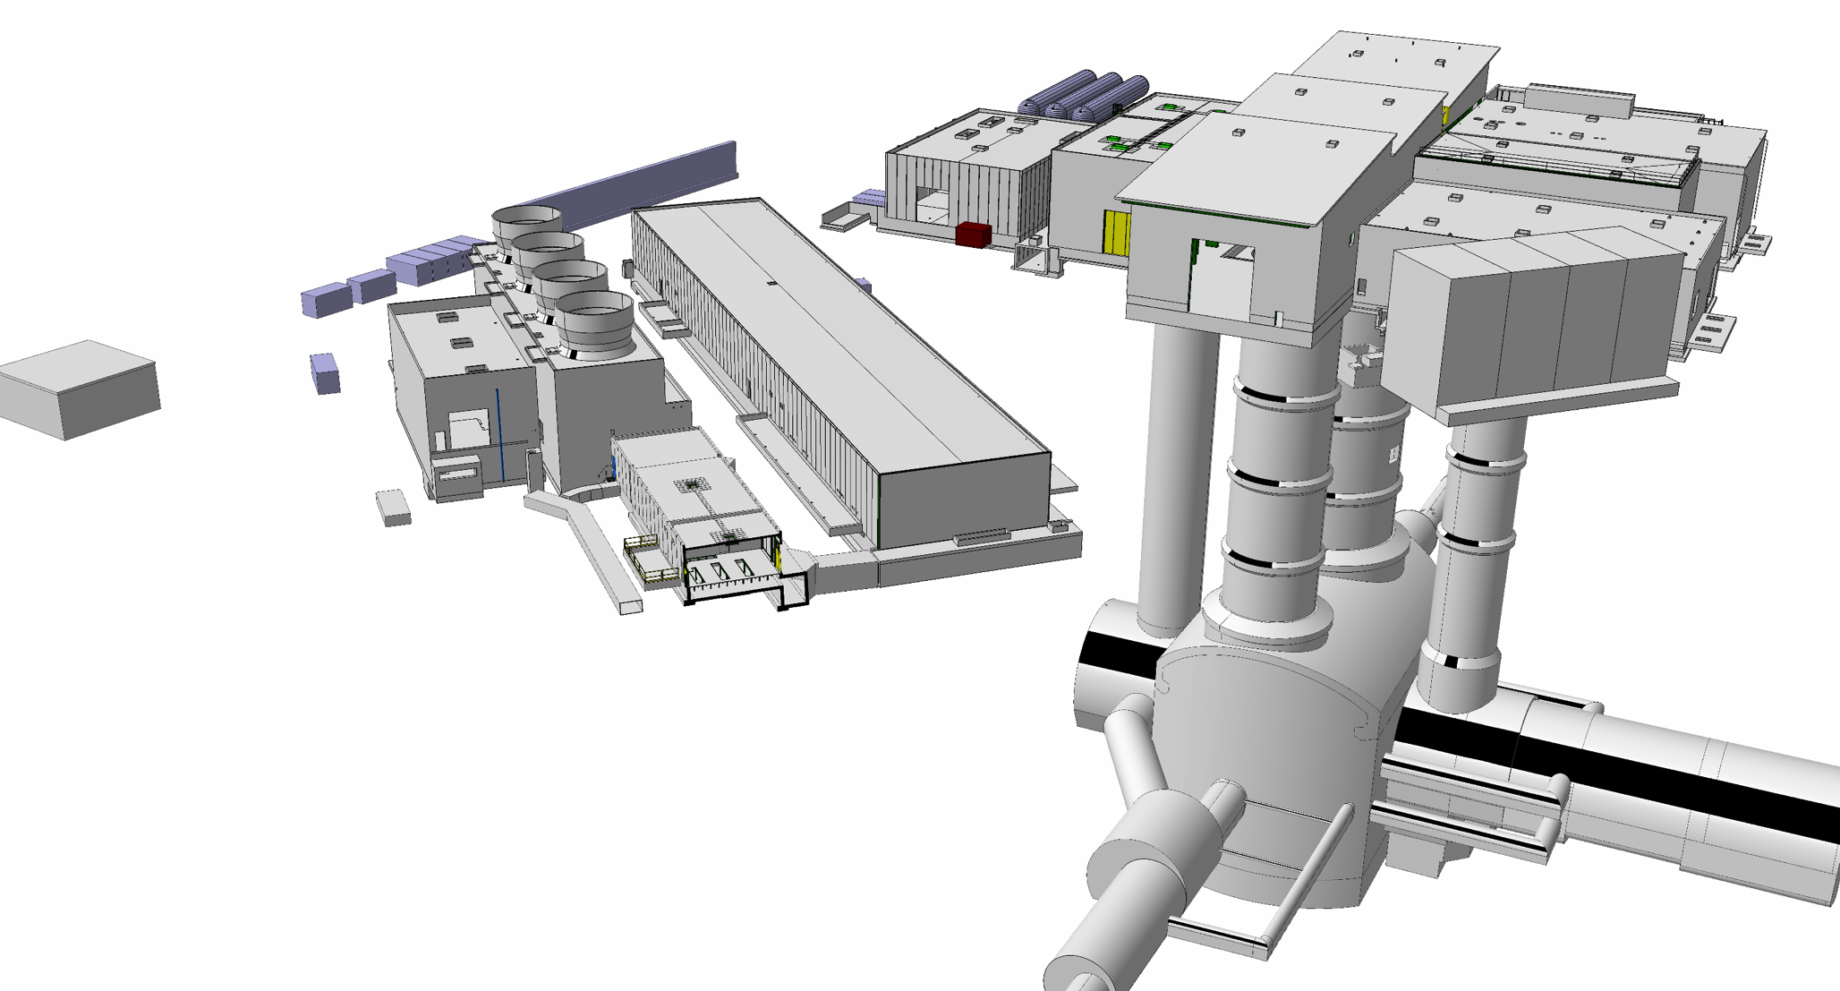
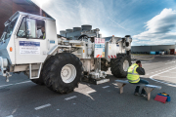
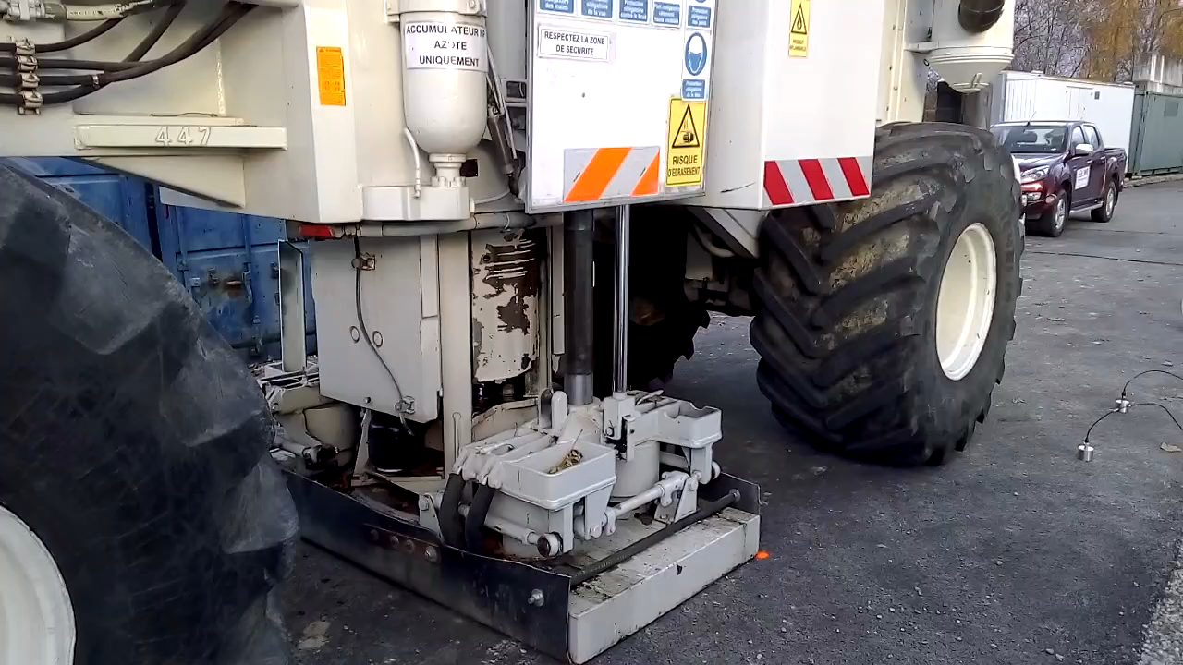
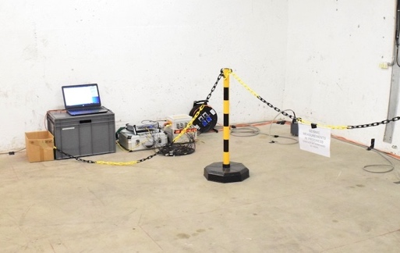
One among many tests on vibrations effect…..
Vertical transfer functions were measured at point 1 with a vibrating truck (frequency range 4-100 Hz). Beam observations were made in parallel (for 89m distance).
89m
141m
Geophones

Slide 12
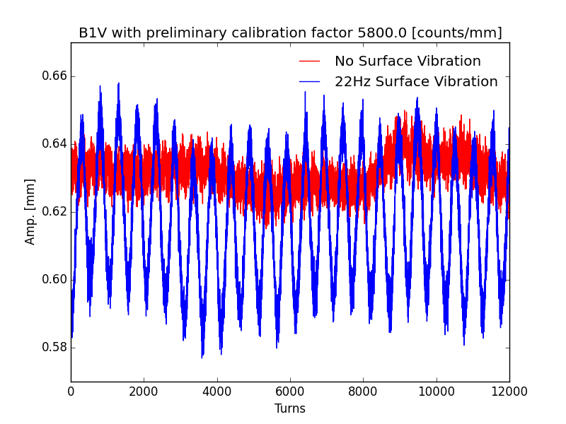
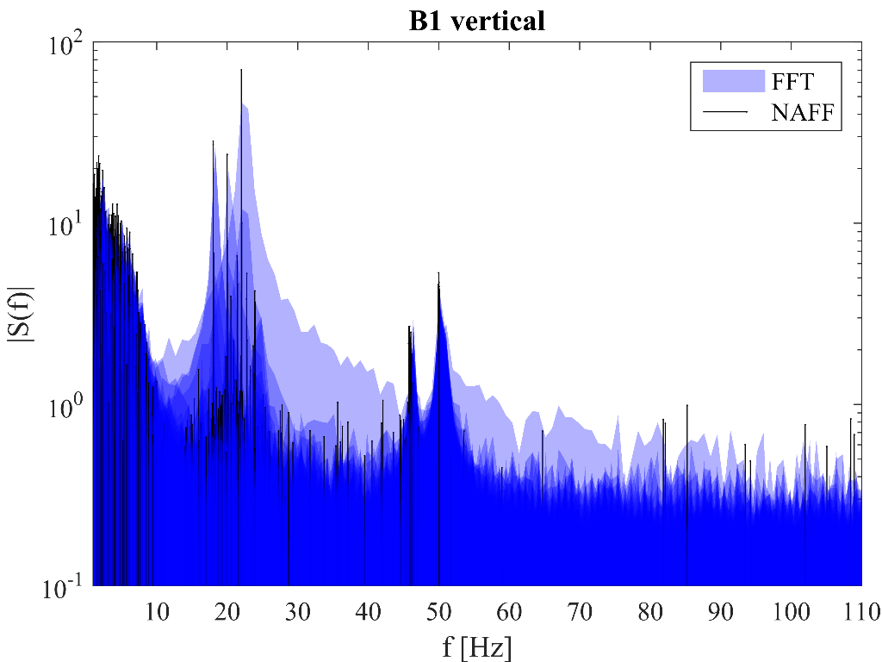
….. and one of the many results
Beam measurements with the vibrating truck were performed for the squeezed optics (80 cm) at 6.5 TeV and at injection.
  Multi-turn data (all BPMs) & ADT data.
Measurements results:
  Beam oscillations were only observed in the vertical plane ⇔ truck location.
  Beam oscillations were only observed for vibration frequencies of 18-22 Hz – consistent with the measured triplet cyostated magnet resonances.
  Observed B1/B2 amplitude ratio of ~2.5 implies that the different triplet quads oscillated with different amplitudes.
  The oscillation amplitudes of the triplet CMs were in the few μm range for a ground motion amplitudes of ~50 nm in the tunnel.
Dark blue = no truck
The observations are consistent with the triplet resonances that enhance the vibrations by a factor >> 10
12

Slide 13
How to cure….
Go Far

Slide 14
How to cure….
…. Do not do vibrate when you cannot
The vertical shaft excavation overlaps with the 2018 LHC run, the distances to the triplet are 90-95m longitudinally + height. The underground design was modified to place the shaft as far as possible from the triplets.
The horizontal galleries and cavern will be excavated during LS2.
Concreting / finishing work overlaps with LHC runs 2021 / 2022.

Slide 15
As result….
Envelope of the underground structure
has been fixed the 26th/02/2016
Drawings will be handled to the contractor for construction design on the end of April 2016
From that moment till 2019 modification could be possible,
but will induce exponentially increasing extra costs
From 2019 no modification will be possible

Slide 16
General view of the underground integration of the powering system

Slide 17
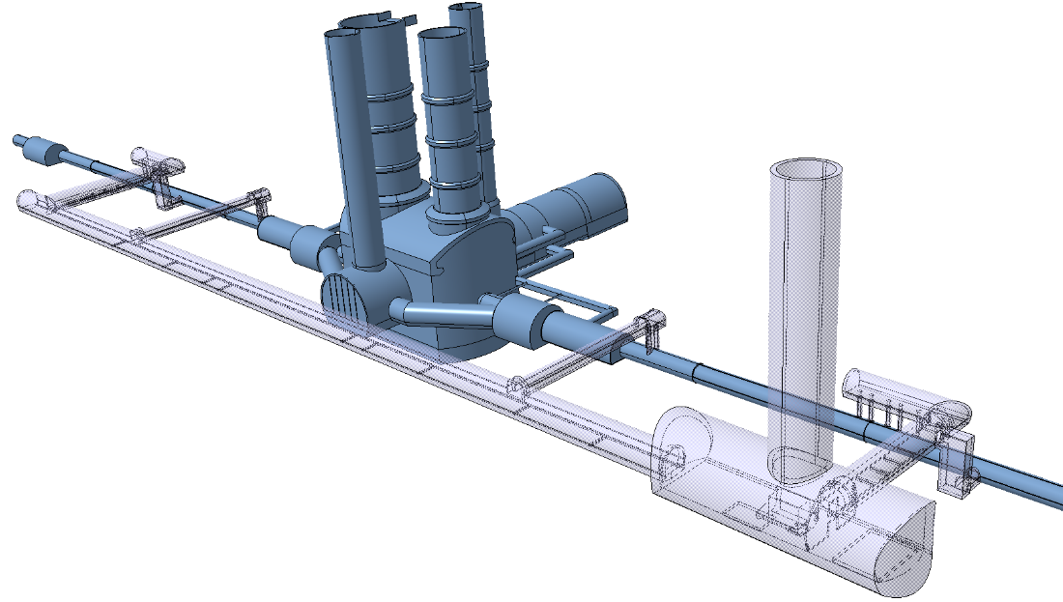
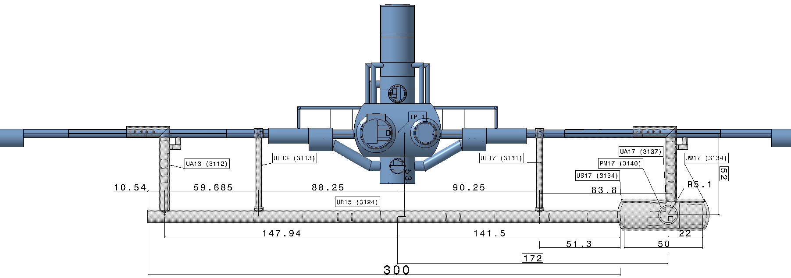
Together with cryogenics

Slide 18
Together with crab RF

Slide 19
Powering system

Slide 20
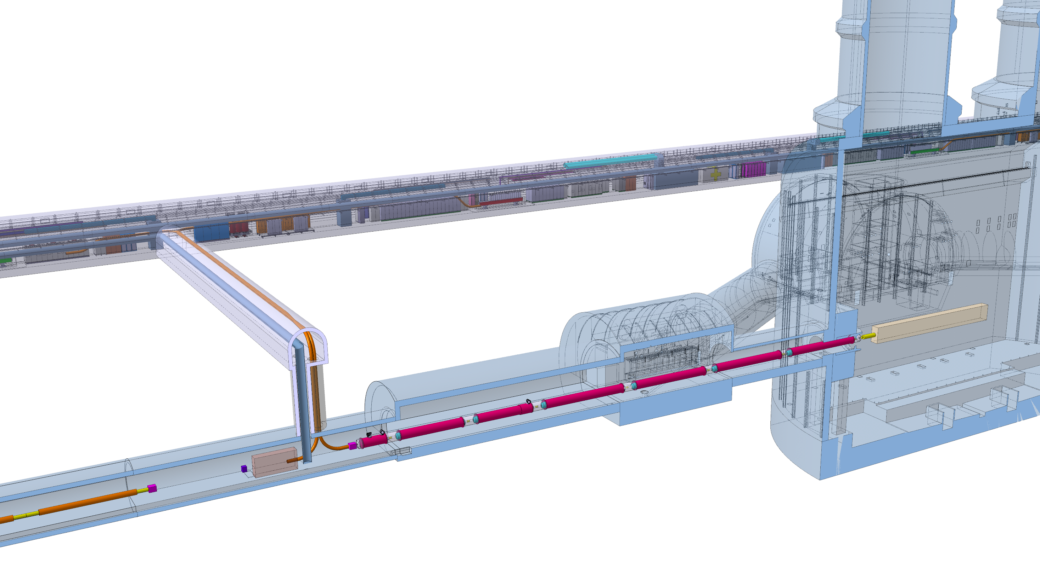
Hl-LHC machine: from Q1 to DFM
Q2a
Q1
Q2b
Q3
D1
CP
DFM
DFX

Slide 21
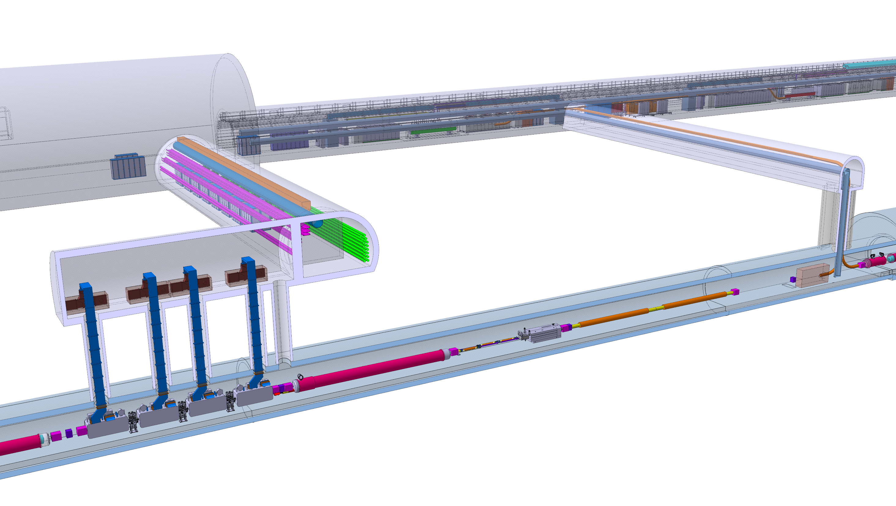
Hl-LHC machine: from DFX to Q4
DFM
DFX
D2
CRAB cavities
Q4

Slide 22
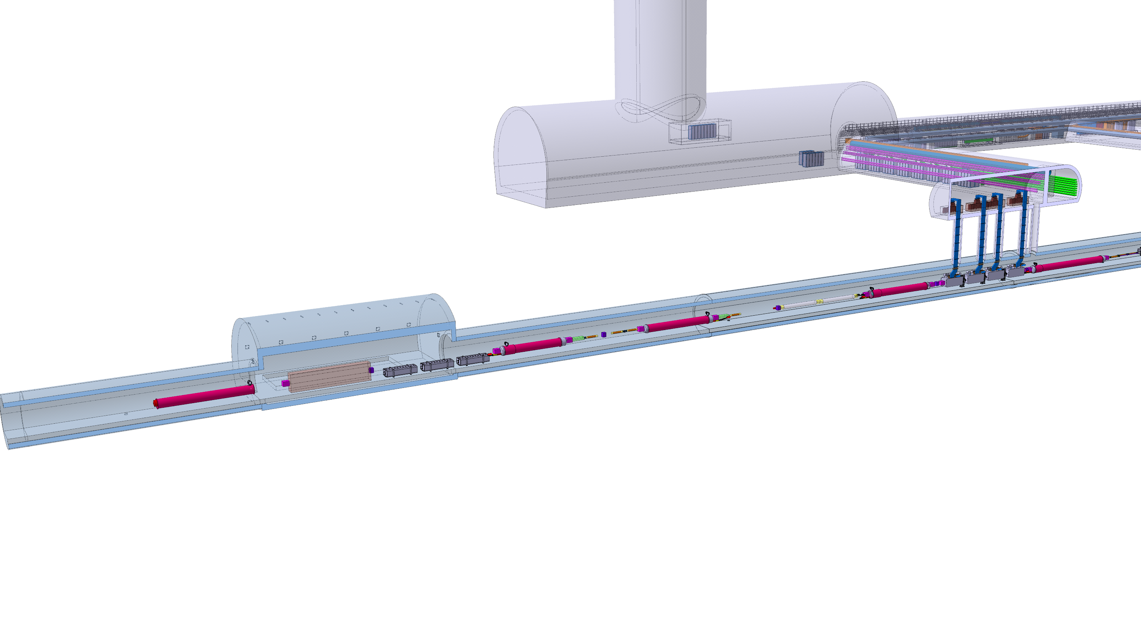
Hl-LHC machine: D2 to Q6
CRAB
cavities
D2
Q4
Q6
Q5
LHC

Slide 23
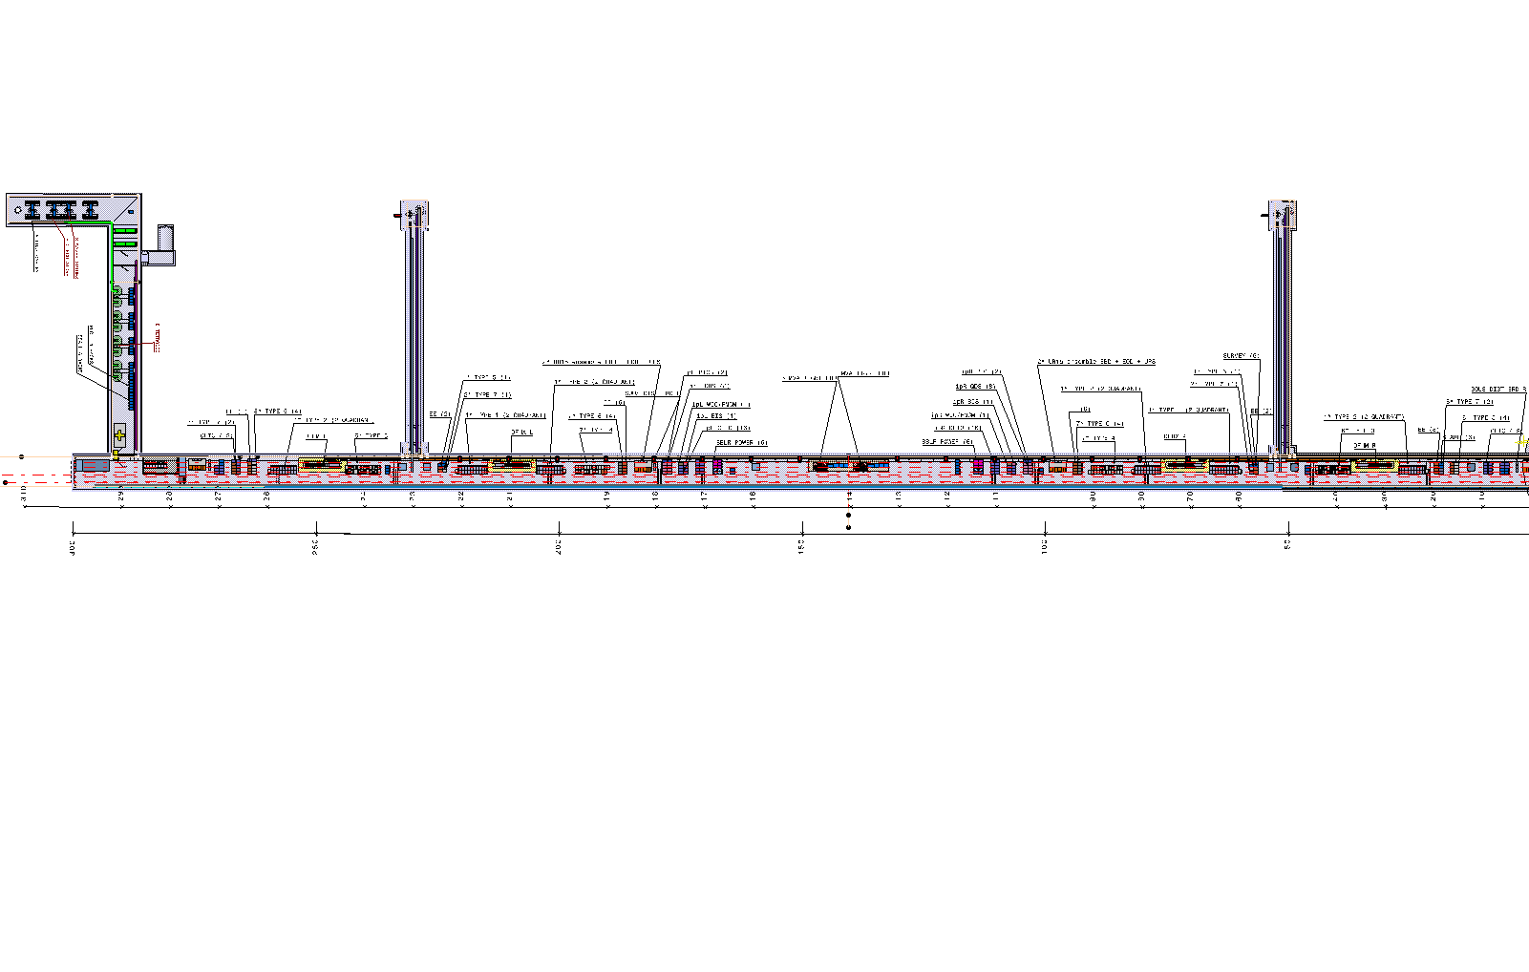
Powering system: the UR

Slide 24
What you find in the integration
As stated integration was in hurry to prepare proper CE engineering volumes, therefore taking risk several changes were introduced vs. the baseline

Slide 25
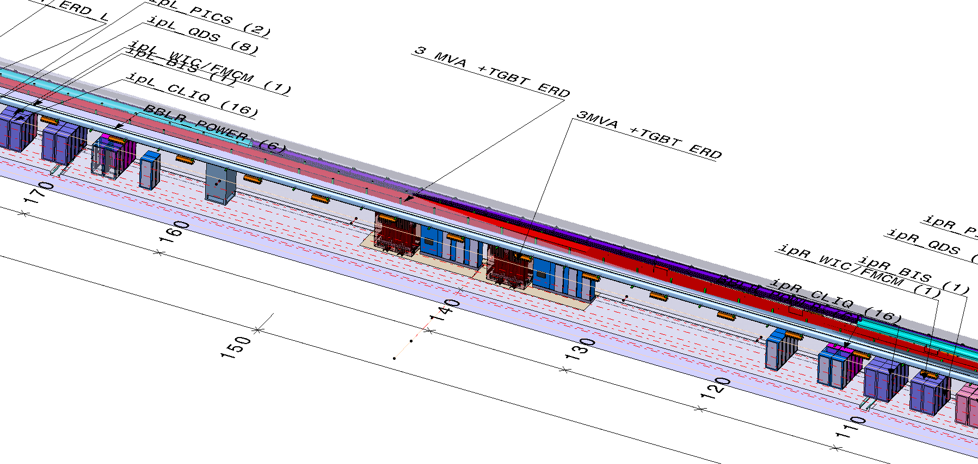
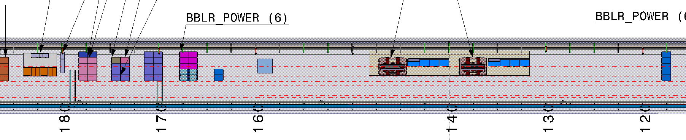
Powering system: the UR transformers
for L and R

Slide 26
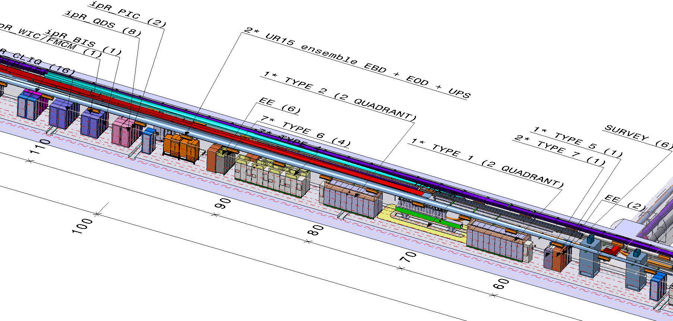
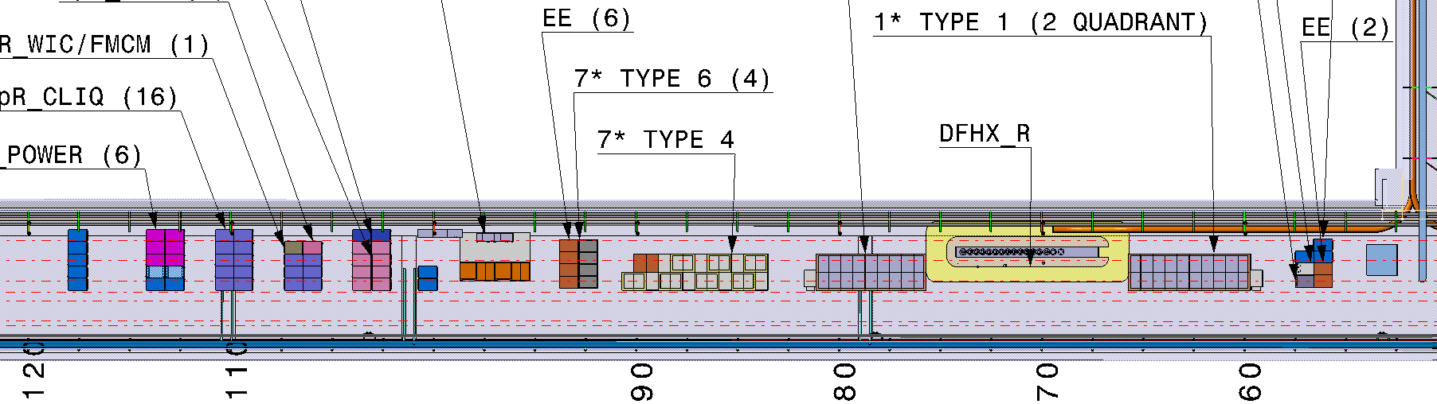
Powering system: the D1 to Q1 supply
(via DFHX)

Slide 27
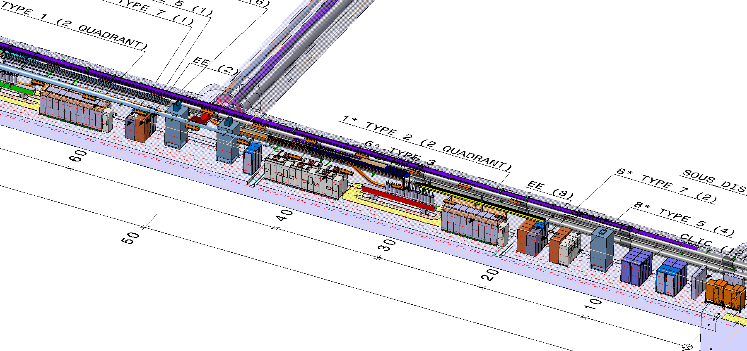
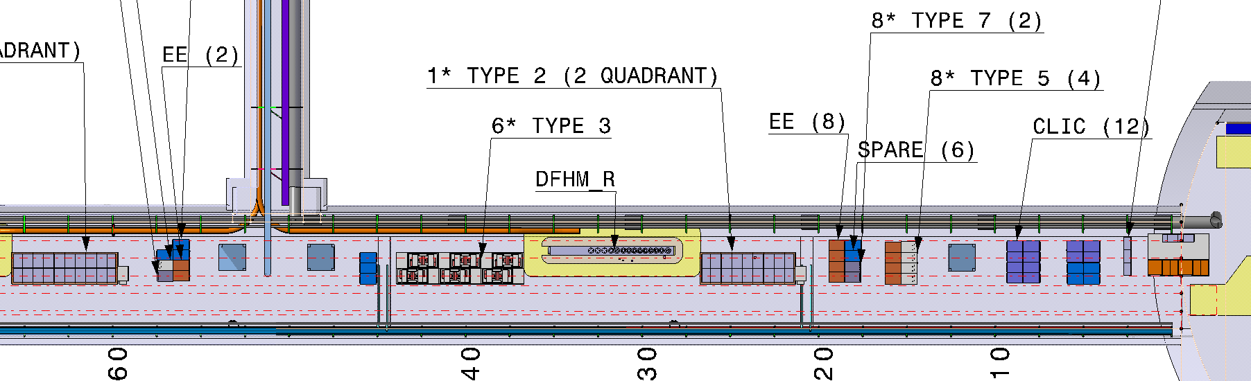
Powering system: the D2 to Q6 supply
(via DFHM)
Latest integration features all SC links of the same length
CLIQ
CLIQ

Slide 28
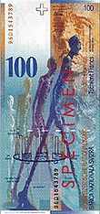
An obvious recall
Integration of the powering system is not only finding place for convertors and services equipment but it is also part of optimising the full performance:
Operational costs
1kW dissipated
Cabling
Air cooling
Water cooling
Air ducts
Air treatment units
Water piping
Water cooling units
Tunnel sections
Cavern dimensions
Installed electrical power

Slide 29
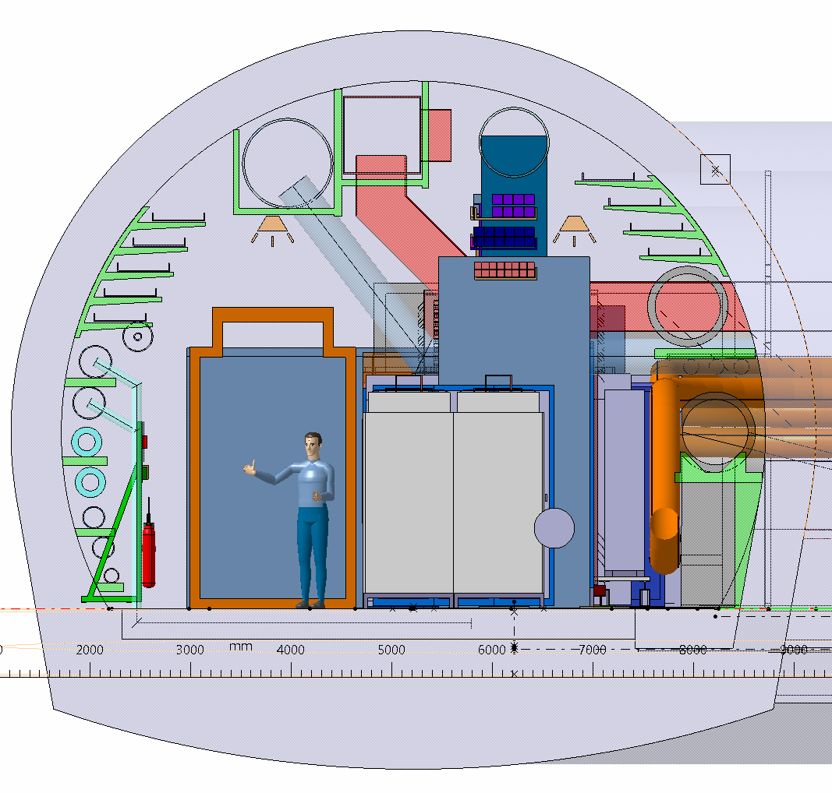
Integration and WP17 have worked hard since last summer to reduce heating loads. The achievements were already partially presented in the integrating talk at the annual review it will be updated and reviewed in the L. Tavian talk

Slide 30
Initial consideration on the protection system

Slide 31
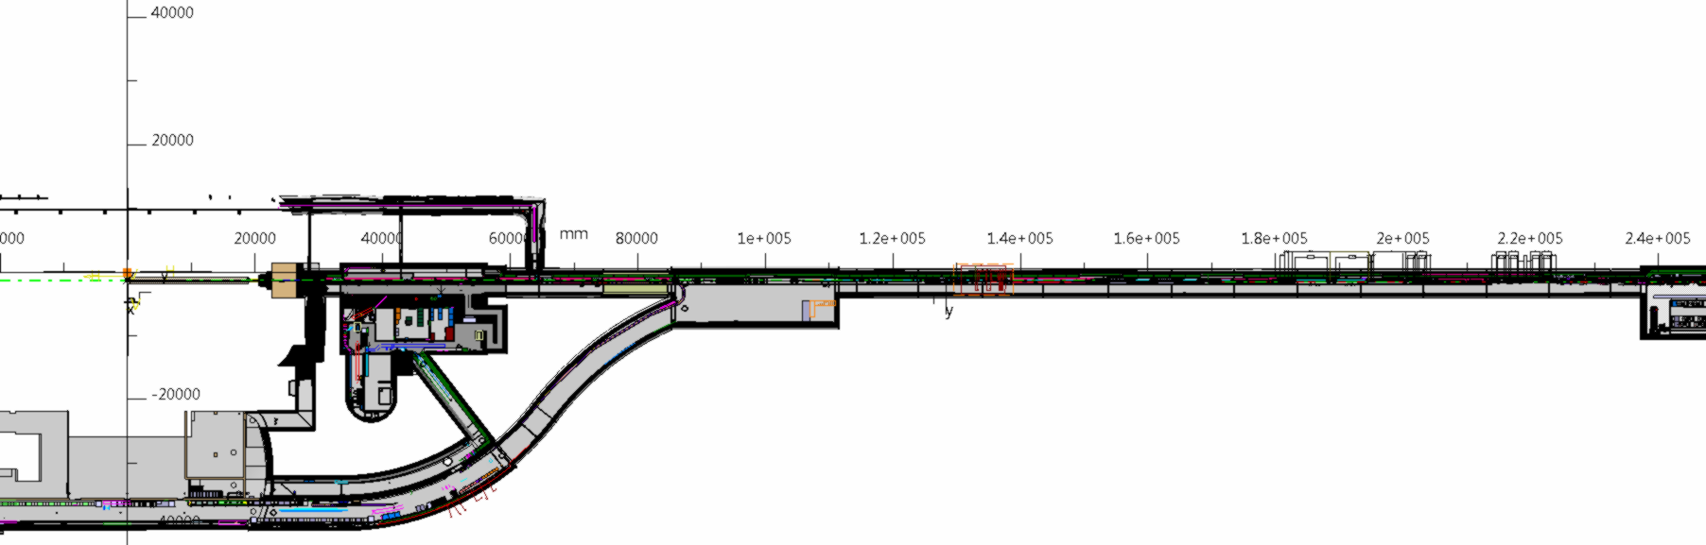
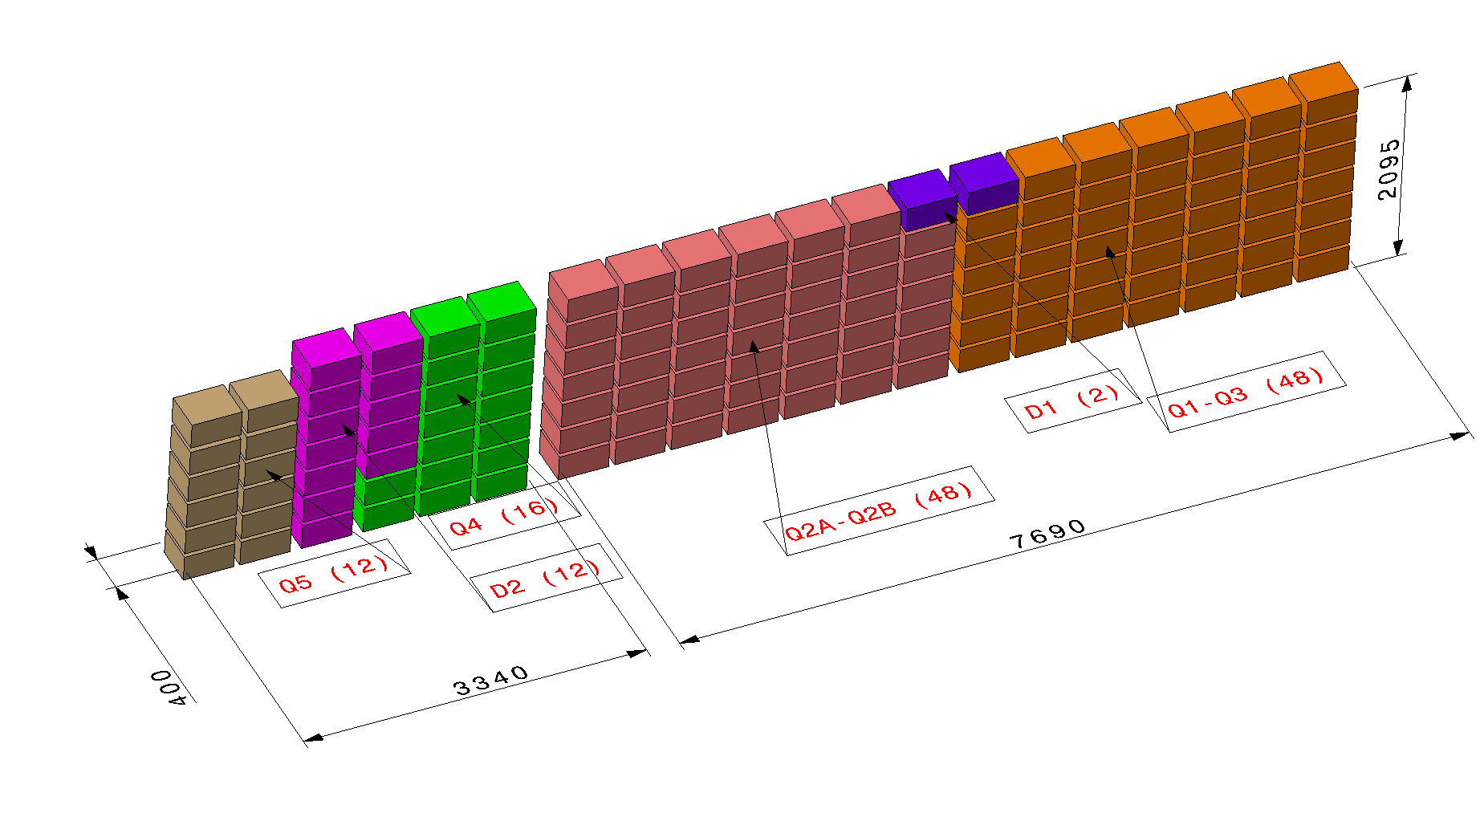
Point 5: protection preliminary integration
RR57
D2
Q6
Q1
D1
UL557

Slide 32
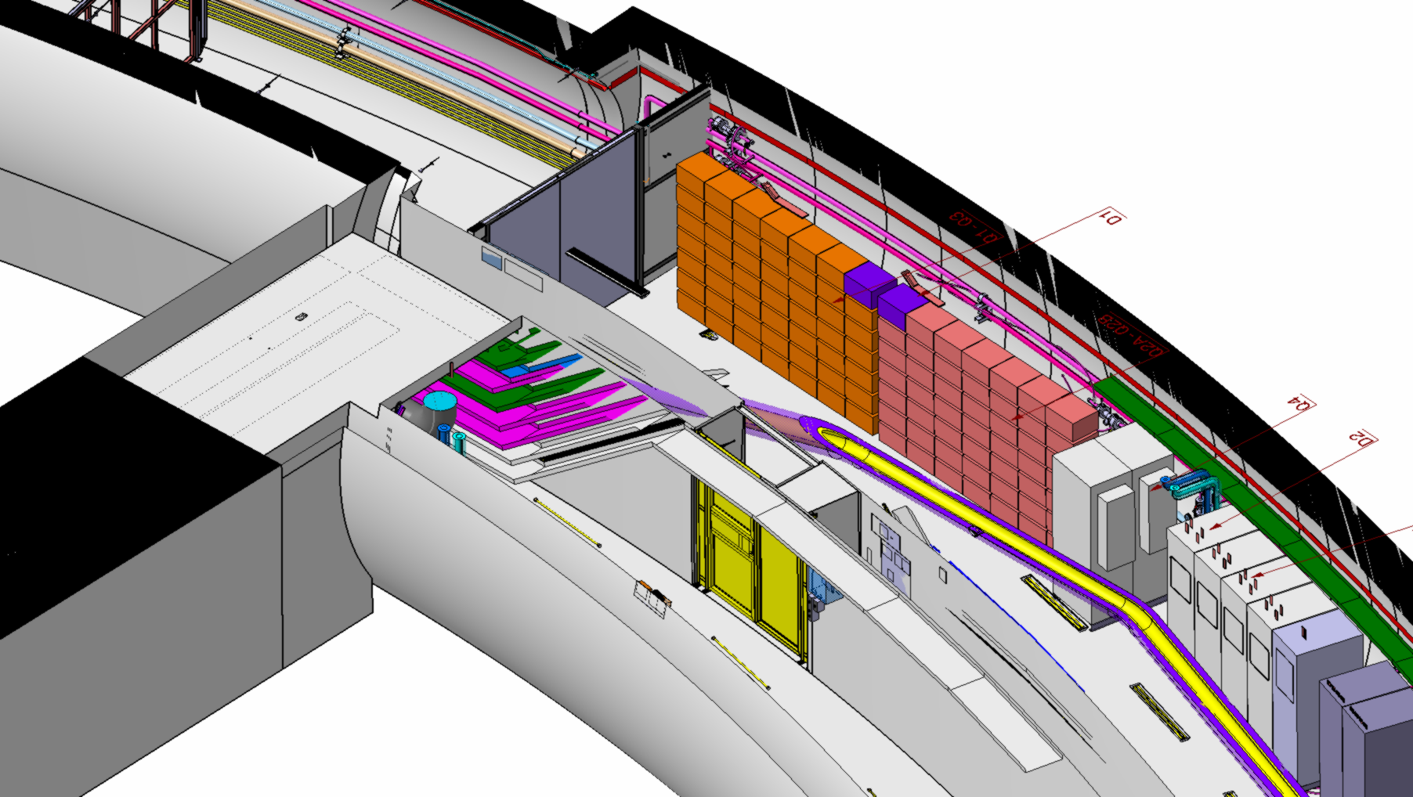
Point 5: protection preliminary integration
Q1-Q3
D1
Q2A-Q2B

Slide 33
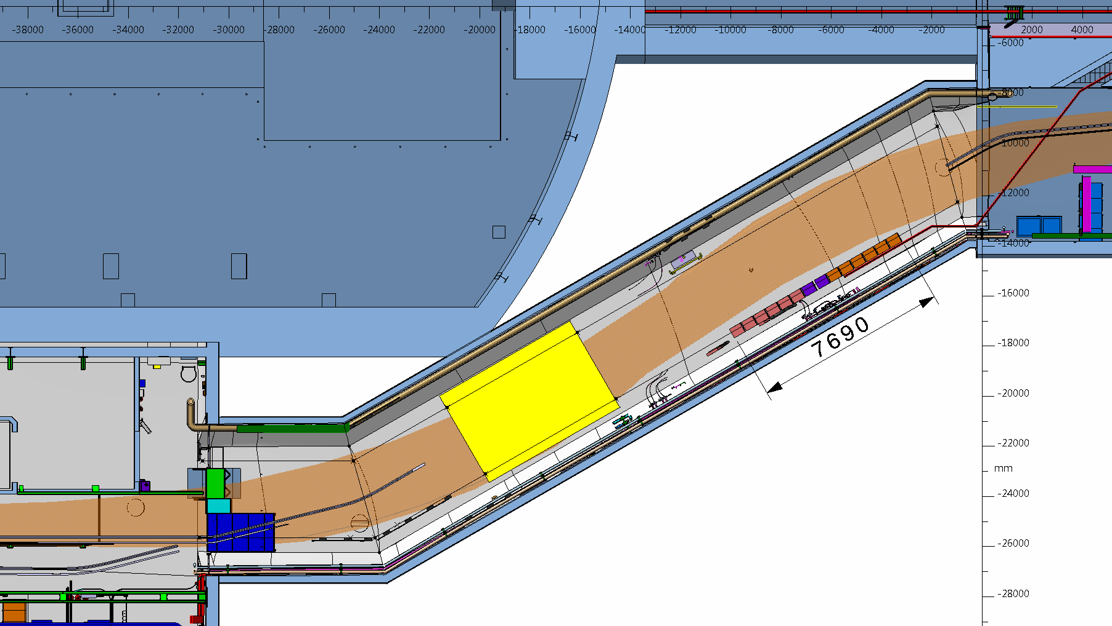
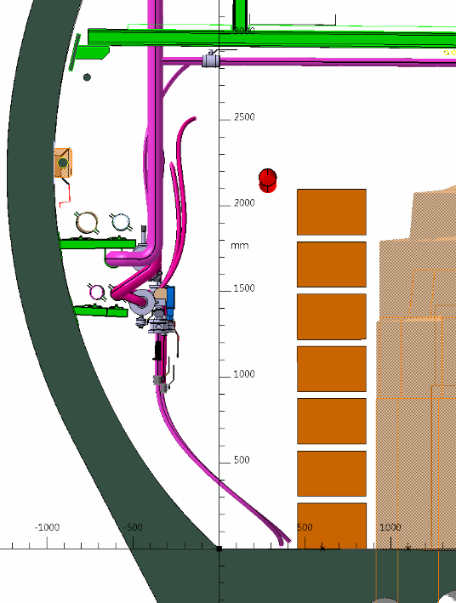
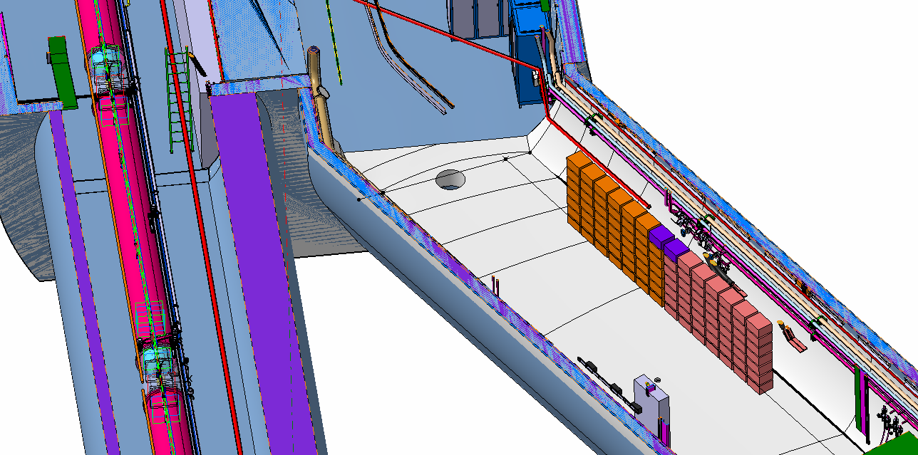
Point 1: protection preliminary integration
A-A
UL16
A
Q1-Q3
D1
Q2A-Q2B
UL16

Slide 34
Example of installation constraints
The installation in the underground technical galleries and cavern should follow the sequence here below:
Safety related elements
Cranes
Metallic structures
General services: electrical, ventilation, communication system, etc
Cryogenic
SC link
Power converters

Slide 35
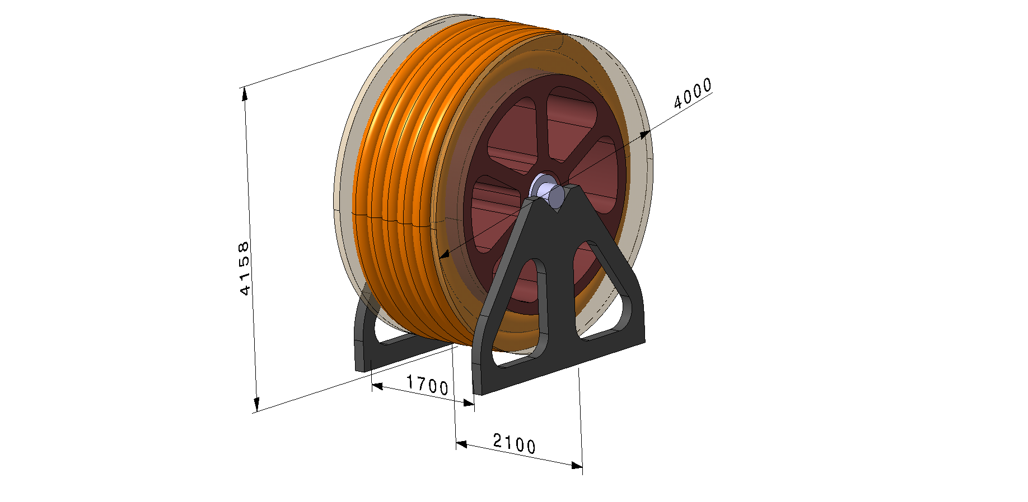
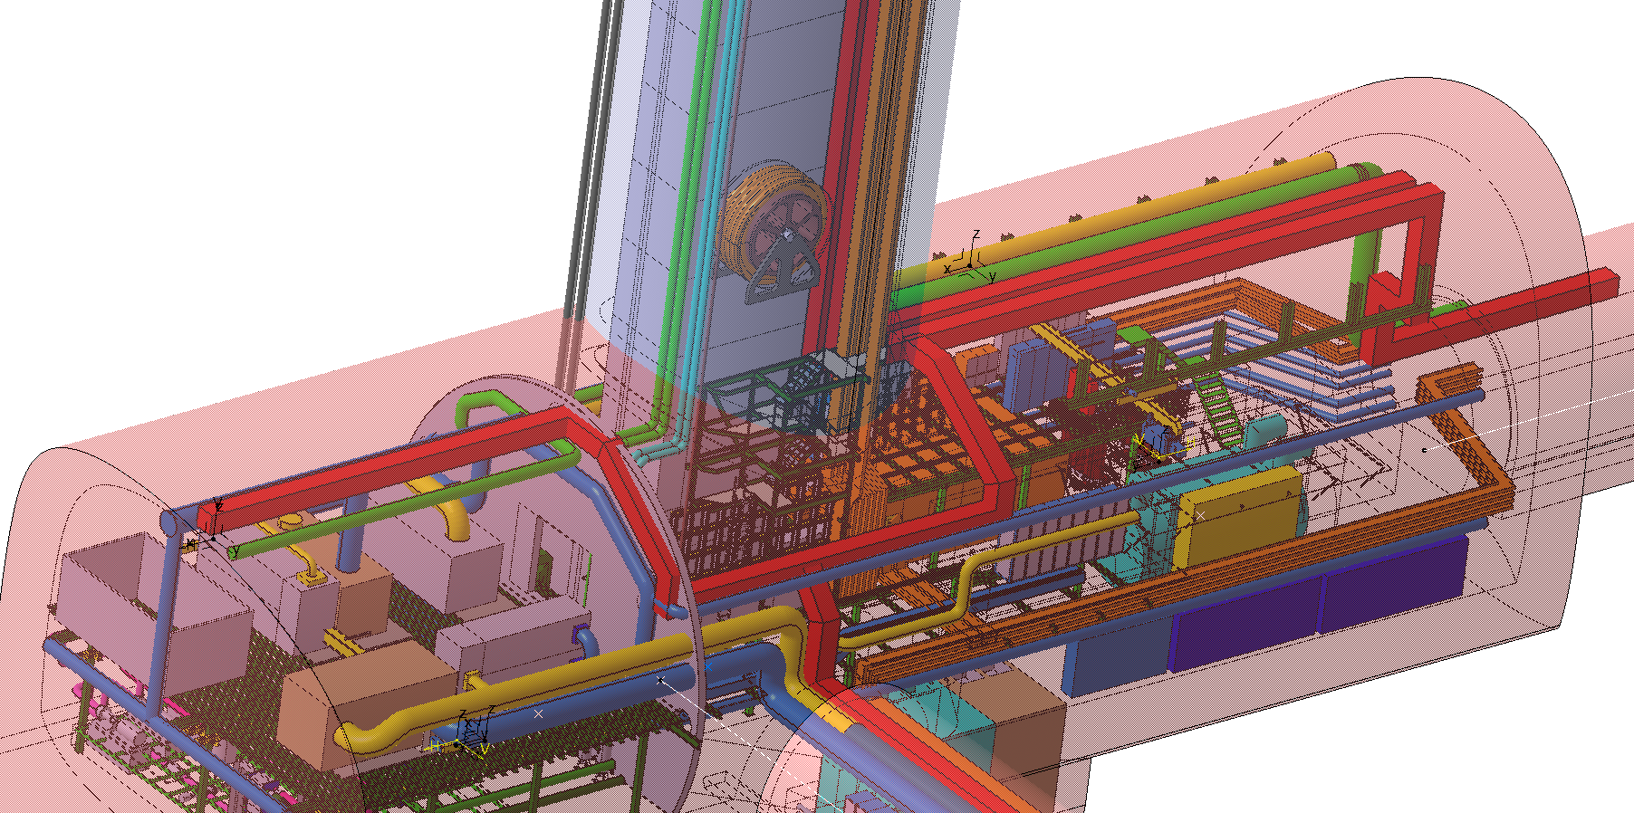
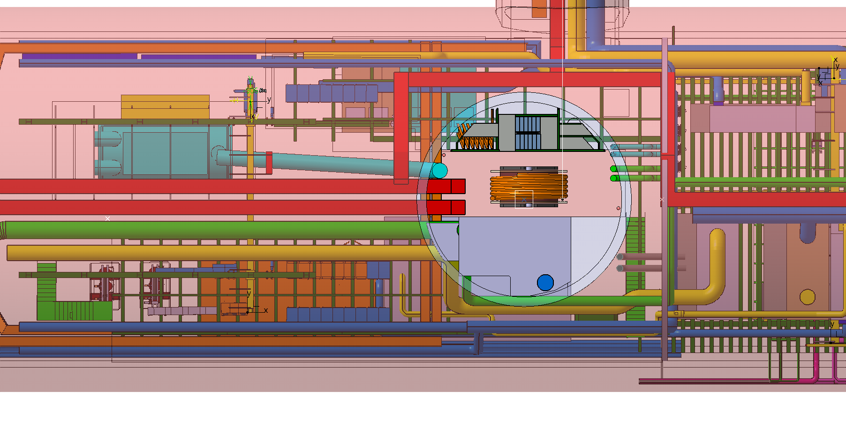
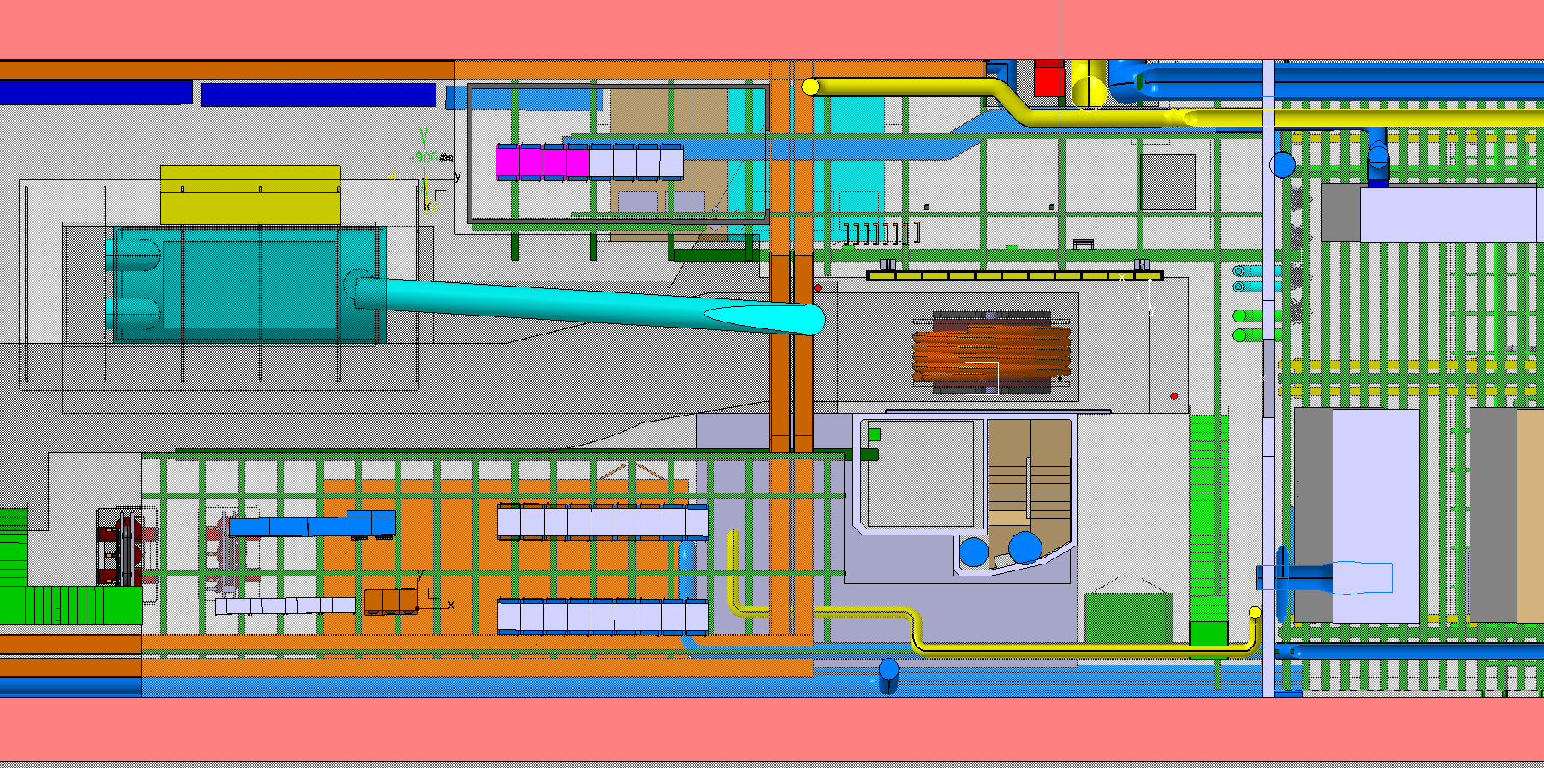
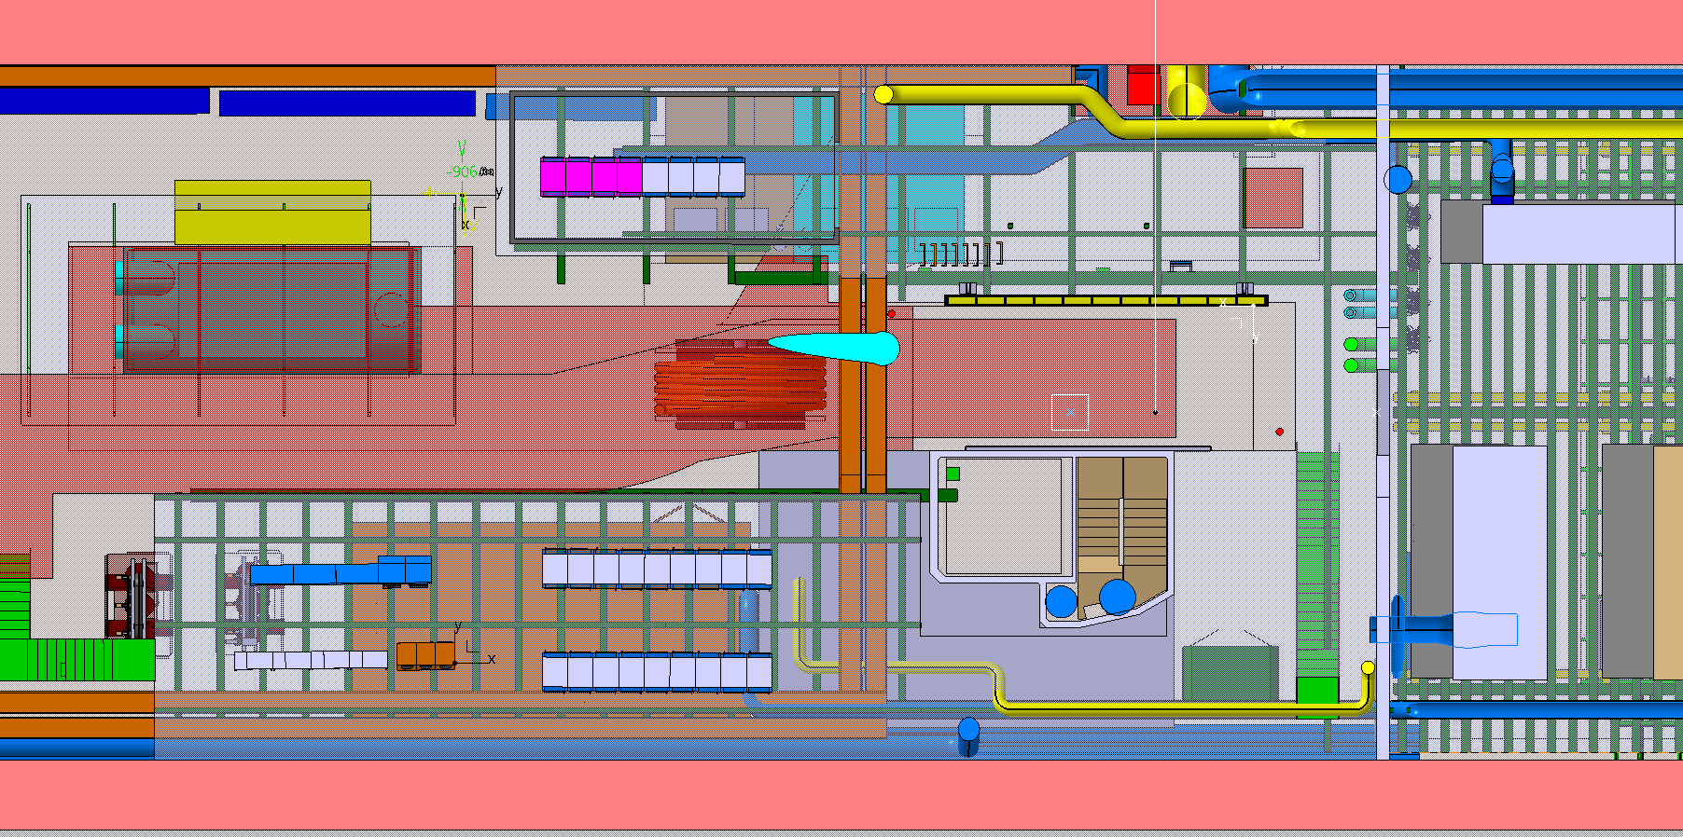
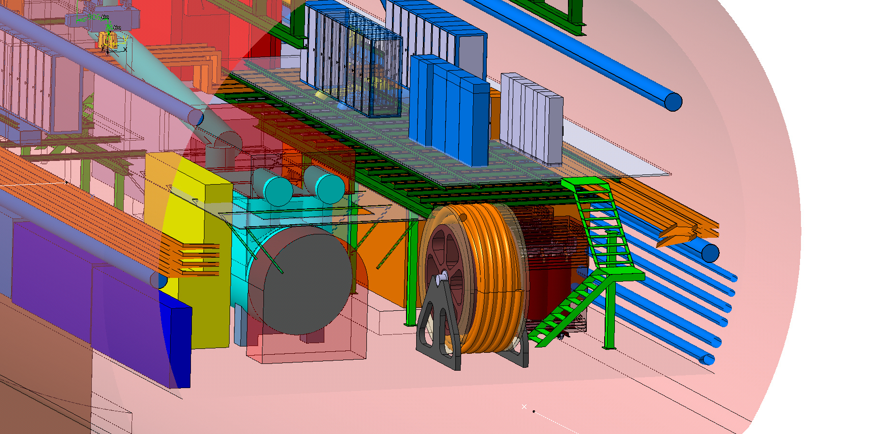
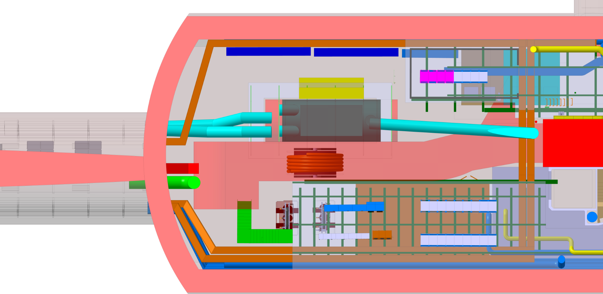
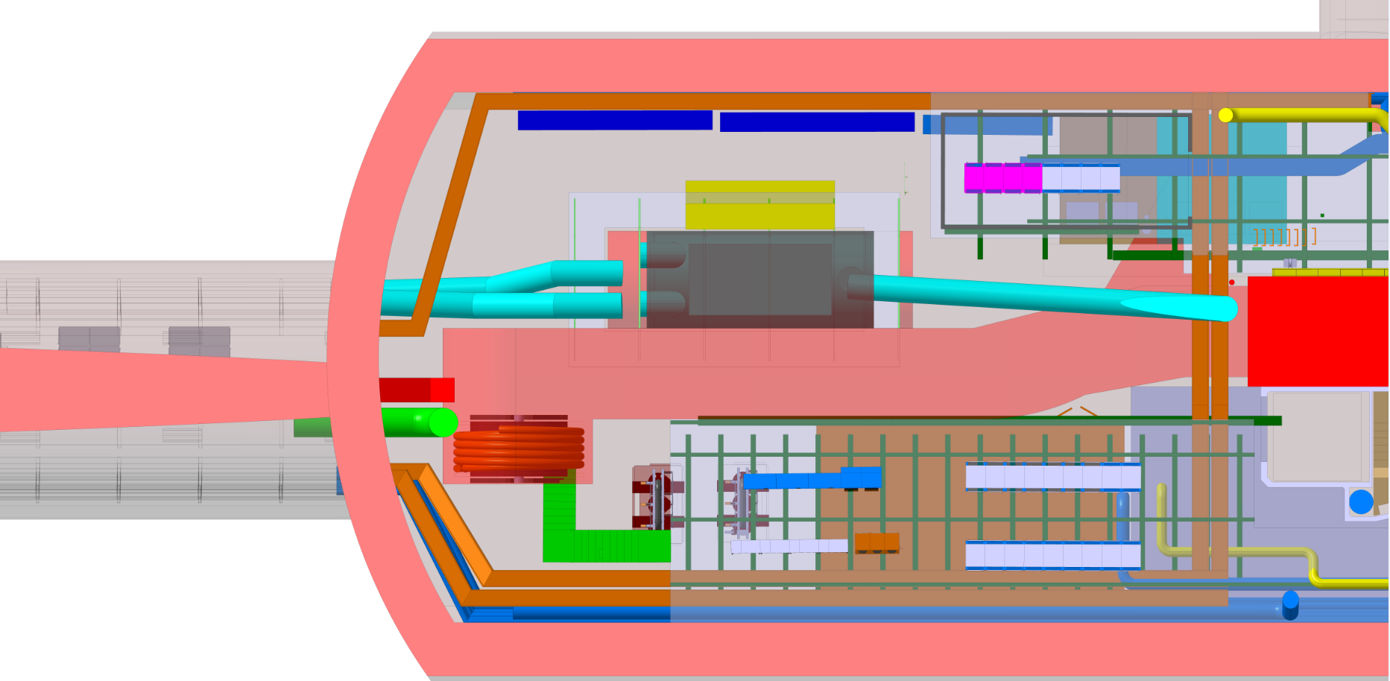

Slide 36
Annexes

Slide 37
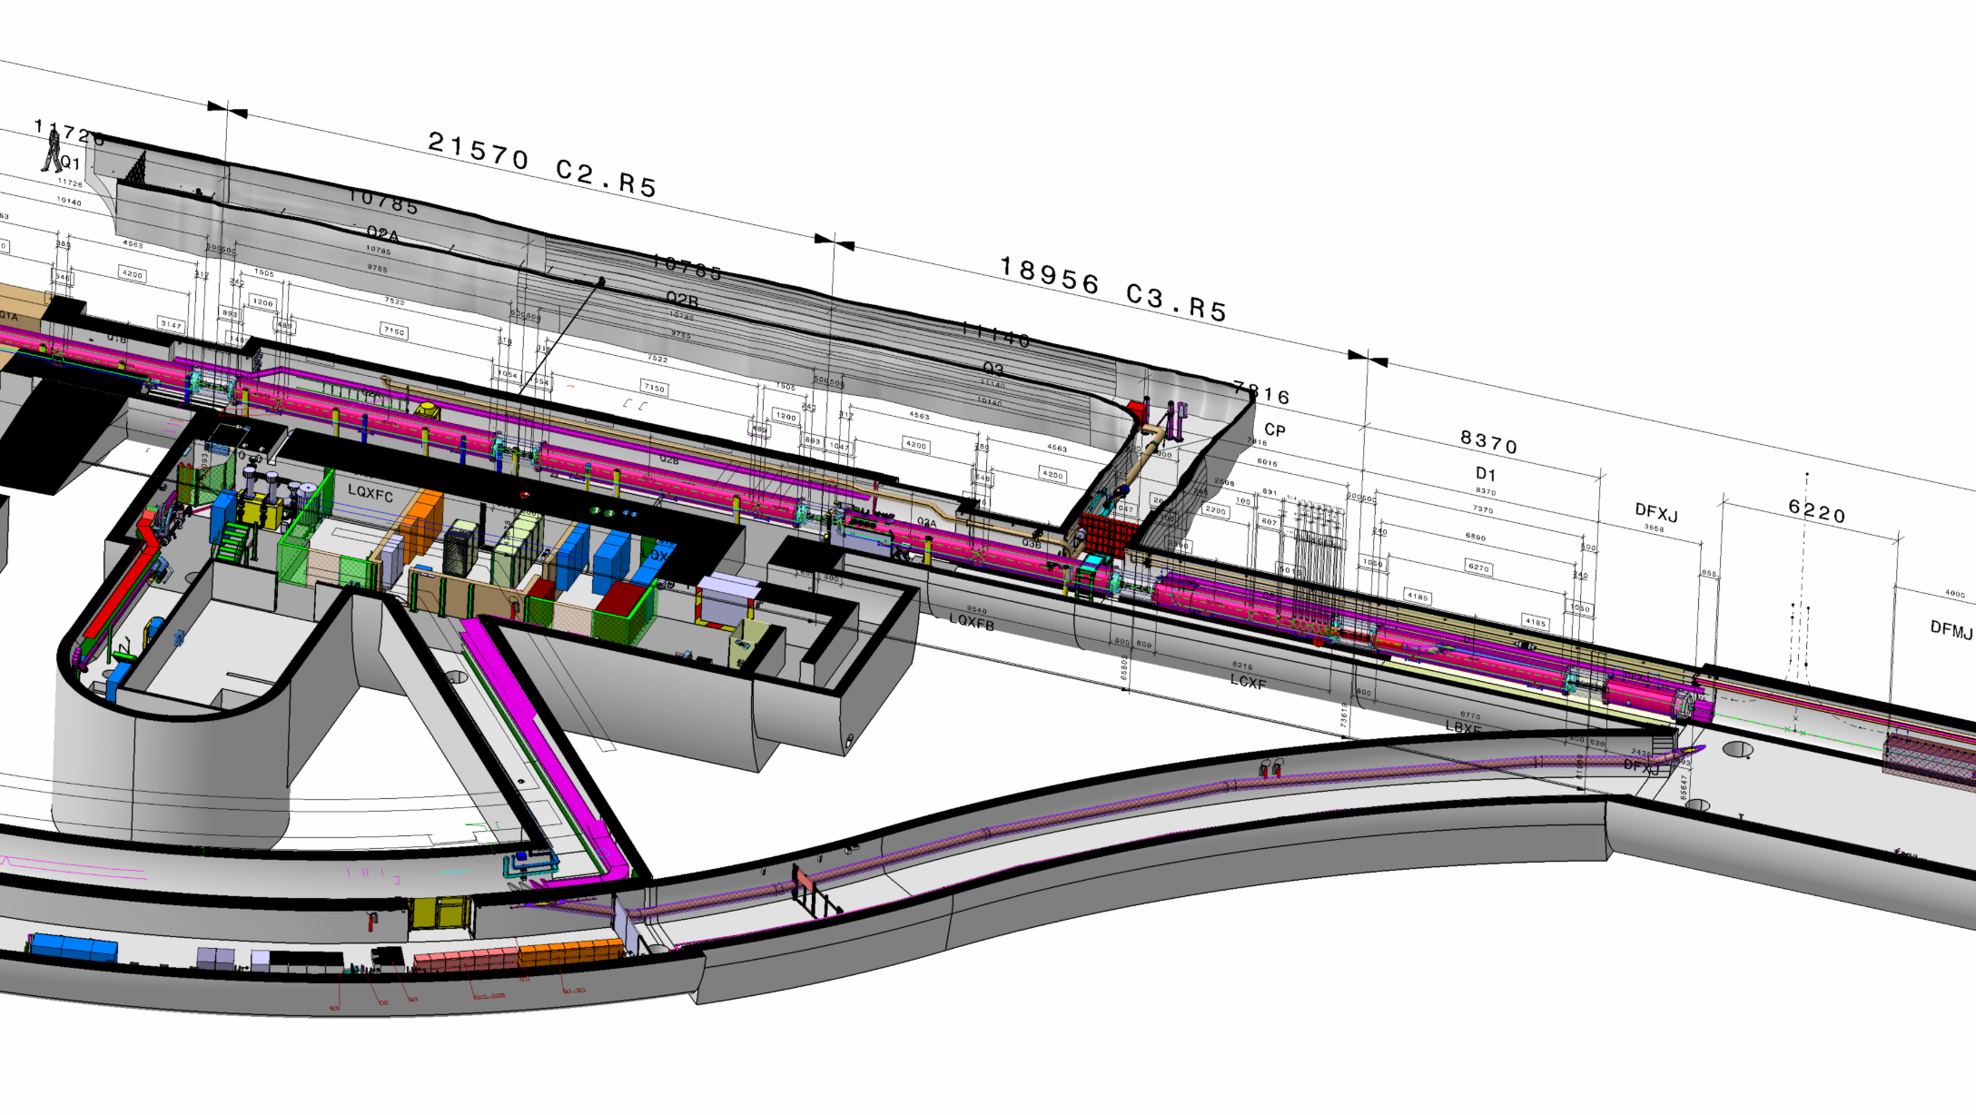
Q1
Q2A
Q2B
Q3
D1
UL557
≈ 120 m

Slide 38
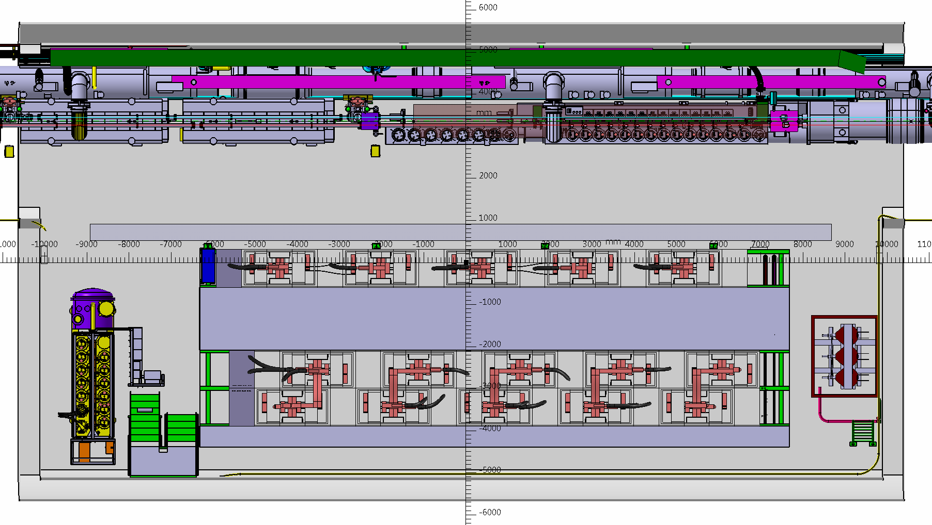
STAY
REMOVE
RQ6
RQ6
RQ5
D2
2X4 m
1X1 m
RQ7
RQ8
RQ9
RQ10
RQ4

Slide 39
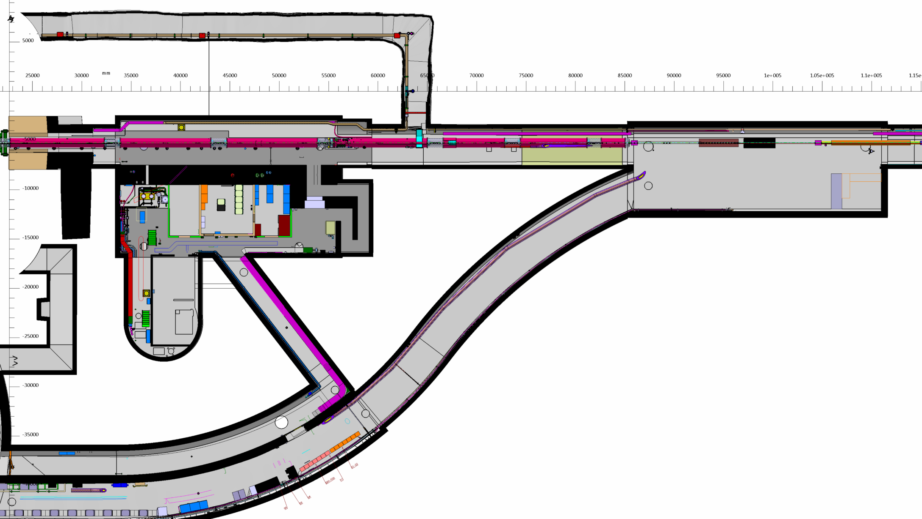
Q1
Q2A
Q2B
Q3
D1
UJ57
≈ 120 m
≈ 40 m
UL557

