Slide 1
The HL-LHC Circuits: Global View and Open Questions
F. Rodriguez-Mateos
with inputs from many colleagues at CERN and Hi-Lumi Collaborating Institutes, in particular B. Auchmann and D. Wollmann

Slide 2
Outline
Why this Review?. What is within scope?. What is not within scope?
Rationale for Baseline of Circuits
Questions to answer
Global View on Circuits

Slide 3
Outline
Why this Review?. What is within scope?. What is not within scope?
Rationale for Baseline of Circuits
Questions to answer
Global View on Circuits

Slide 4
Initial considerations
Many of the HL-LHC magnets are of a new design, with different technology than the present one in LHC, based on Nb₃Sn superconductors. In many cases, the current is much larger than for the LHC correspondent elements. Various options could be adopted and the optimization of the performance and of costs depends on a variety of parameters:
  Magnet design and performance
  Magnet and circuit protection
  Optics and operations constraints and optimization
  Cold and warm powering options and optimization
  Other parameters may also be influential for the optimization process
A global optimization having in mind performance, operation and cost (both construction and operation cost over the 10-15 years of HL-LHC) is not trivial and has to consider the level of operating currents, the number of circuits and the different powering and protection configurations that are possible within the LHC and HL-LHC constraints.

Slide 5
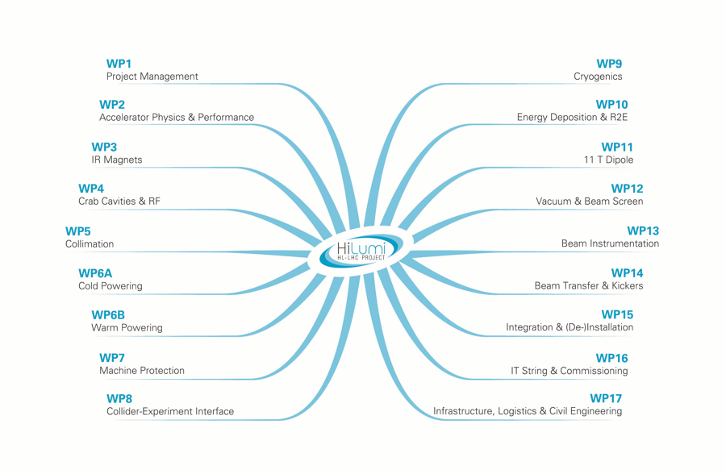
A common effort across WPs

Slide 6
Objectives of the review
The goal of this review is to examine the baseline choices and open variants with respect to the following aspects:
  Circuit Layout
  Circuit Integration
  Magnet and Circuit Protection
  Operation
  Electrical Qualification
  Plan and Schedule
The review should focus on technical aspects and optimization; not on cost and financial issues

Slide 7
Within the scope
The powering schemes to fulfill the requirements with respect to beam operation at a conceptual level (this is a CDR)
The instrumentation and protection means foreseen in the magnets
The protection means foreseen at circuit level
The integration aspects of the foreseen hardware in compatibility with the infrastructure
The appropriateness of the proposed utilities and infrastructure (cabling, cooling & ventilation)
The strategy for the electrical quality assurance of circuit components

Slide 8
Not within scope
The design of the components and systems only powering & protection aspects at conceptual level are to be considered at this stage:
  Magnets
  S.C. Link and Leads
  Bus bars
  Electrical Distribution Boxes
  Power converters
  Electronics

Slide 9
How is the review structured

Slide 10
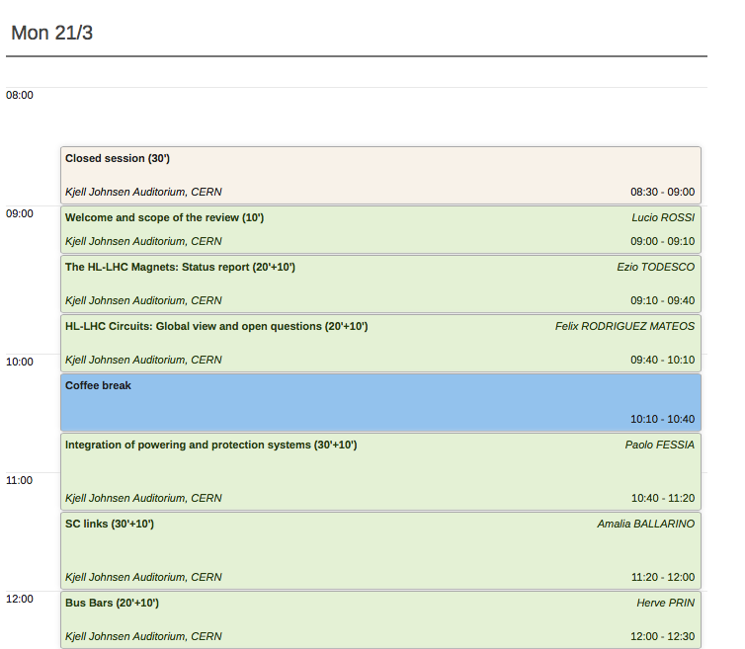
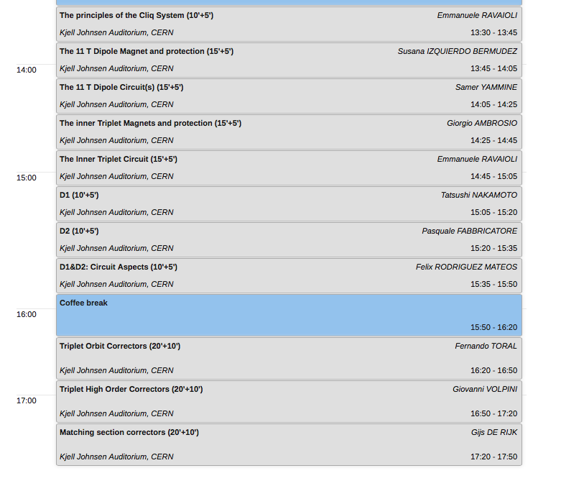
Introductions to Review, HL-LHC Magnets and Circuits
Integration
Concepts for s.c. link, leads and bus bars
Magnets and Circuits
Powering and Protection
Today

Slide 11
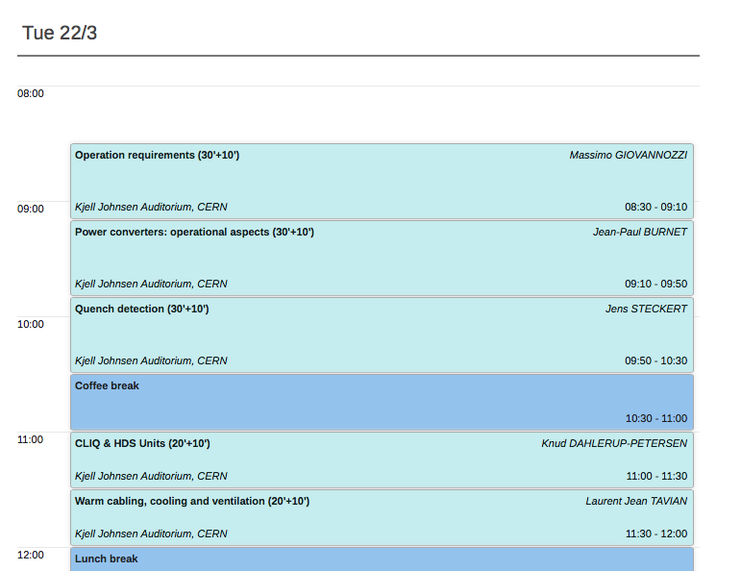
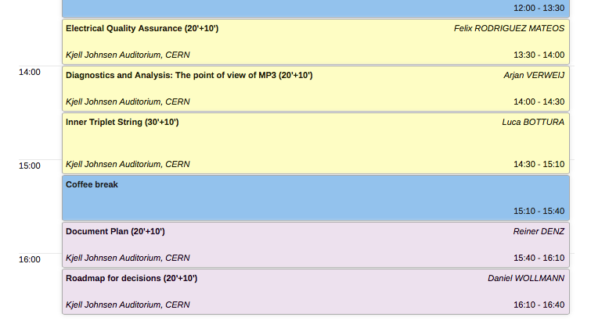
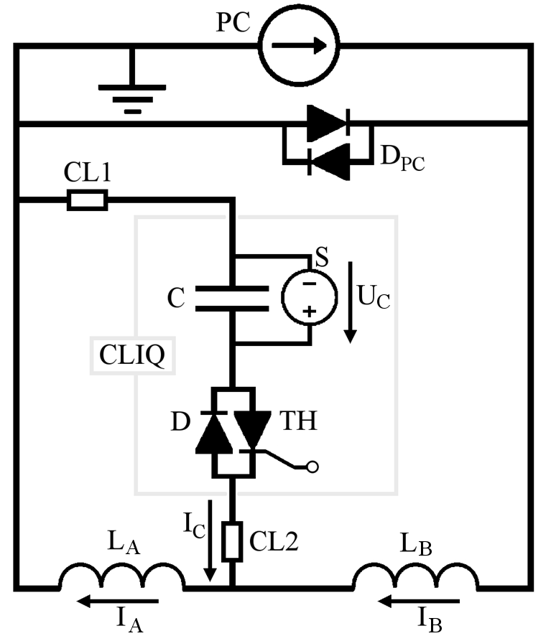
Tomorrow
Operational requirements
Systems:
  Power converters
  Quench detection
  CLIQ and heater discharge supplies
  Cabling, cooling and ventilation
HV qualification
Recommendations in the light of LHC experience
IT String Test validation
Circuit Documentation Plan
Roadmap and future milestones

Slide 12
Outline
Why this Review?. What is within scope?. What is not within scope?
Rationale for Baseline of Circuits
Questions to answer
Global View on Circuits

Slide 13
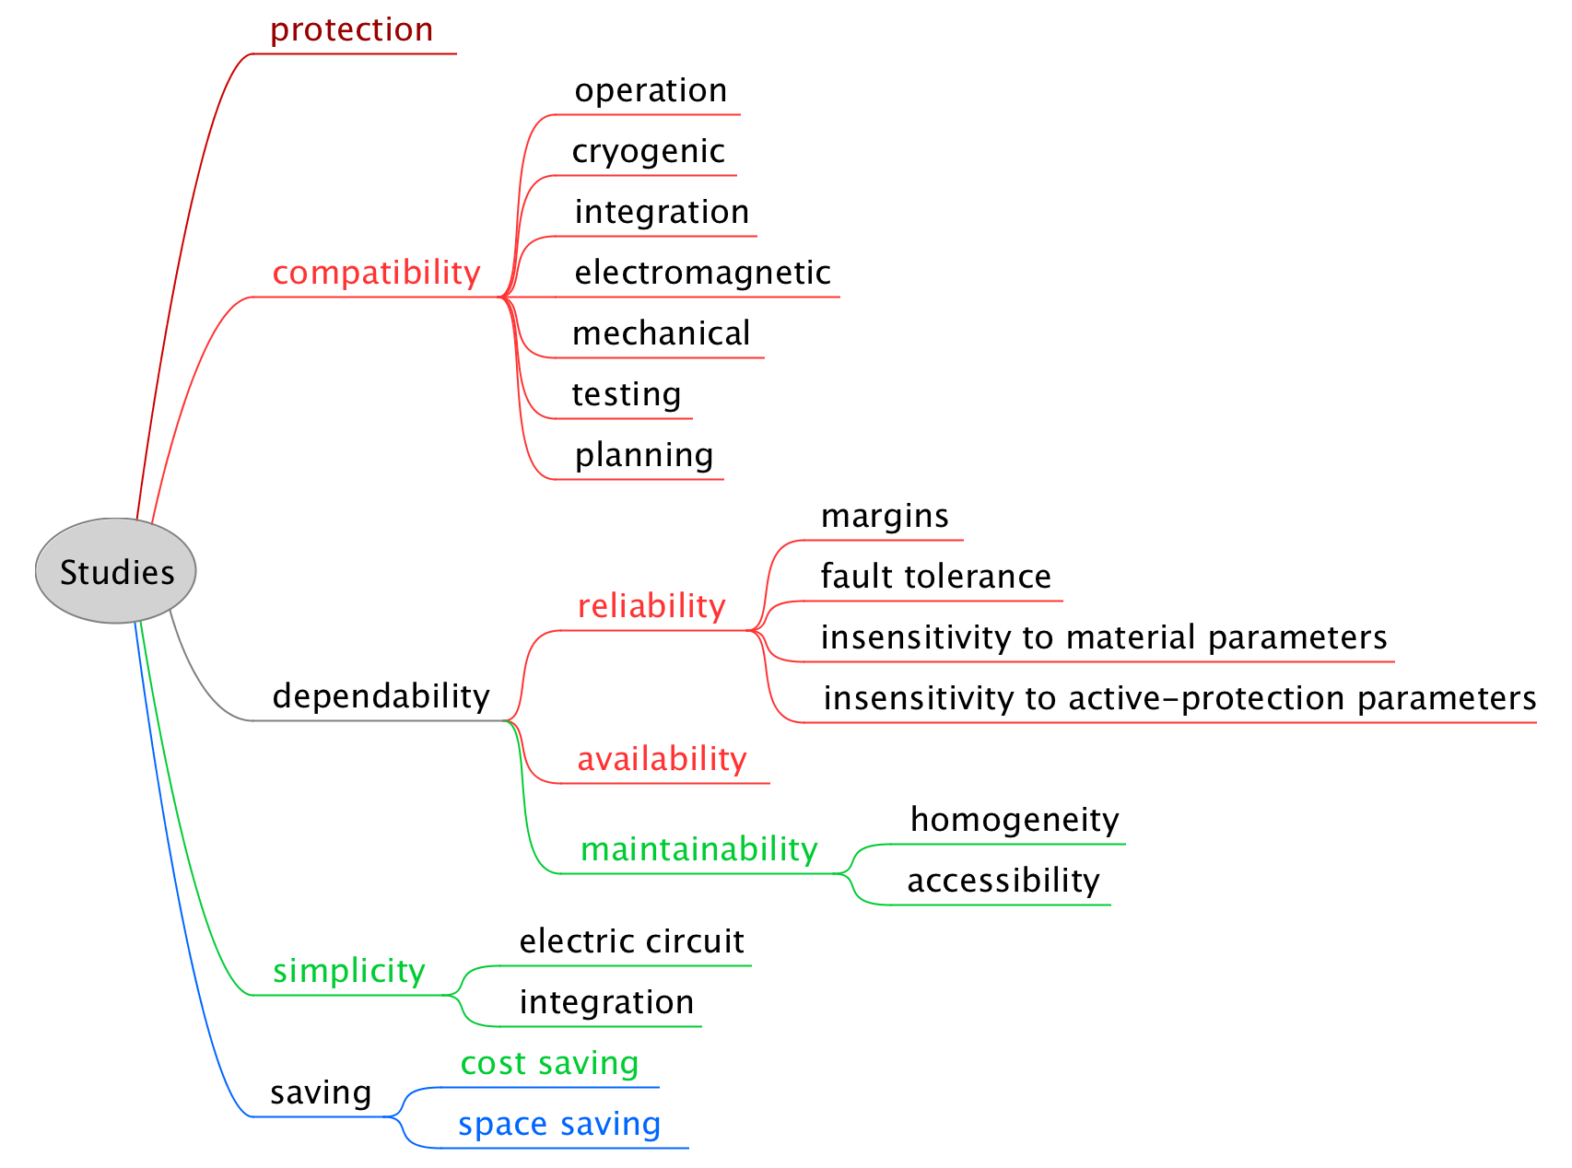
Goals in terms of peak temperature and voltages
includes probability analysis:
protection goals for very rare failures;
contingency goals for expected failures.
Mean-time to failure (MTTF)
Mean-time to repair (MTTR)
B. Auchmann, D. Wollmann

Slide 14
Outline
Why this Review?. What is within scope?. What is not within scope?
Rationale for Baseline of Circuits
Questions to answer
Global View on Circuits

Slide 15
Some of the questions to answer (1/2)
Number of circuits, number of power supplies, number of auxiliary trims, fulfilling the beam dynamics requirements
Ramp-down speed
  Power converter technology issues
  Losses in passive elements
Protection elements
  Number of heater strips in active use, how many as spares
  HDS parameters, redundancy (capacity, triggering)
  Number and connection of CLIQ units
  CLIQ parameters, redundancy (capacity, triggering)
  Parallel elements
  Lead design (CLIQ, bypass and heaters)
  Heater & CLIQ polarity assignment

Slide 16
Some of the questions to answer (2/2)
Detection and related instrumentation
  Taps (incl. symmetric detection)
  Logic (voting, redundancy)
  Variable thresholds
Monitoring
  Online monitoring, interlocking
  Post-mortem data
Test and reception criteria
Documentation

Slide 17
Some of the questions to answer
…later on
Electro-dynamic aspects in s.c. link and bus bars are to be considered at the time of design. Designs of link and bus bars will have an impact on
  the protection hardware at circuit level,
  cross-coupling between circuits which may affect layouts
  strategy for power aborts
Compatibility of CLIQ protection with respect to the design of the s.c. link remain to be studied in detail as return currents will pass through the link
Feedback from s.c. magnet/link/leads tests will be of paramount importance as to confirm protection choices
Feedback from s.c. magnet/link/leads manufacturing and electrical tests will be important as to define the right electrical QA levels
Anything forgotten ???

Slide 18
Outline
Why this Review?. What is within scope?. What is not within scope?
Rationale for Baseline of Circuits
Questions to answer
Global View on Circuits

Slide 19
Circuits Table as in TDR v0 (Ref. Baseline)
D. Wollmann

Slide 20
Circuits Table as in proposal at this Review
D. Wollmann

Slide 21
Summary of principal proposed changes
It is proposed to reduce the number of main inner triplet circuits from 2 to 1 per IP side. This has implications that will be discussed later in several talks (E. Ravaioli, J.P. Burnet)
  This circuit will have no energy extraction system
  2-quadrant converter is required
  Three trim circuits are required
It is proposed to remove energy extraction systems from the closed-orbit dipole correctors of the inner triplet
It is proposed that the super-ferric magnets get low voltage extraction within the crowbars of the converter (compatible with the PC limits)
  Only exception is the quadrupole corrector for which a standard 0.7Ohm/600A extraction system can be envisaged
D2-Q4 orbit correctors would not require quench heaters
Q5 orbit correctors would not require quench heaters

Slide 22
Many thanks for your attention!

