Slide 1
Busbars integration in the cold masses
H. Prin
Conceptual Design Review of the Magnet Circuits for the HL-LHC
21-23 March 2016
CERN

Slide 2
Outline
Global view of the Busbars presently used in the LHC cold masses
Expansion loops
Present integration principles
Conceptual design for the busbars integration in the HL-LHC cold masses
  Inner Triplet String
  D2 Separation Dipole
  Q4
  Q5 and Q6
  Q10 with MS
  MBH 11T Dipole
  New connection cryostats around Point 2
Summary

Slide 3
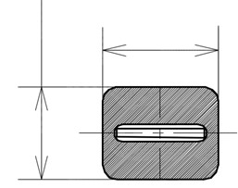
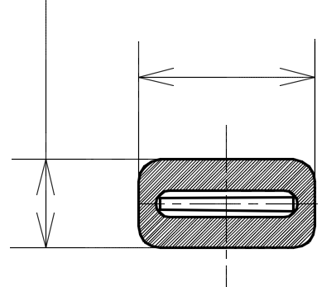
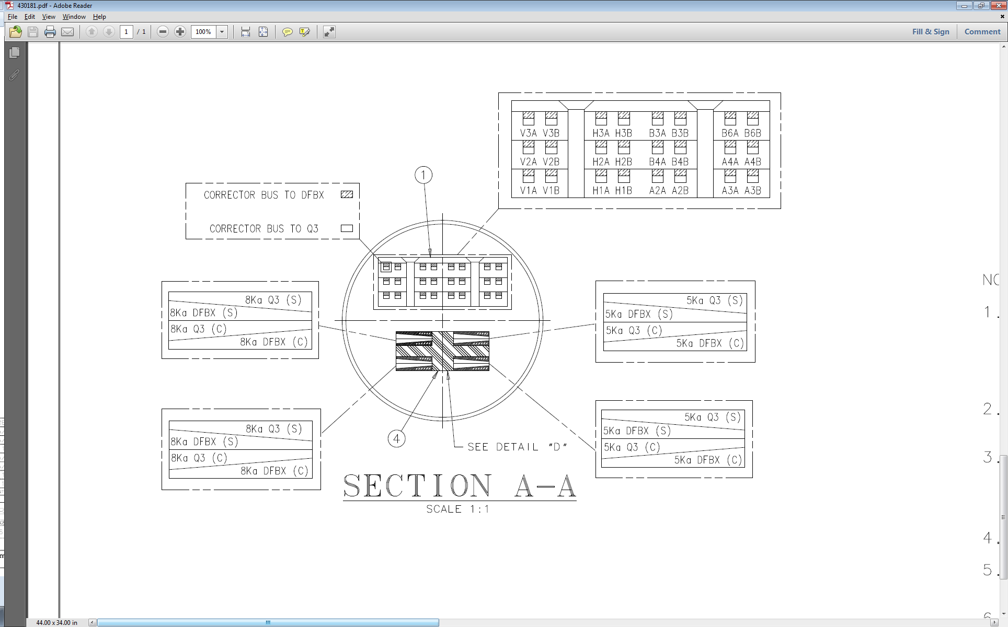
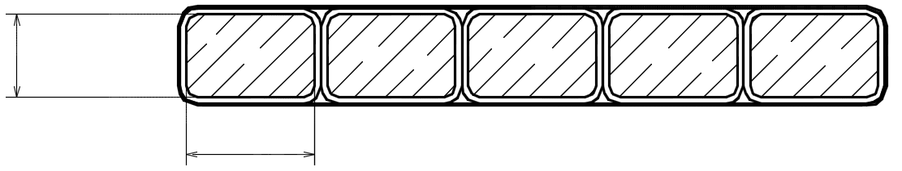
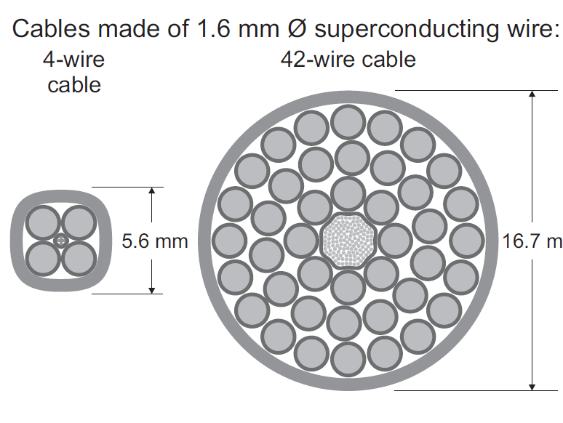
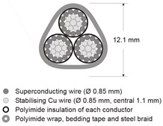
Global view of the Busbars presently used in the LHC cold masses
13kA busbars for RB circuit
13kA busbars for RQF-RQD circuits
5 or 8kA busbars for RQX
and RTQX circuits
16mm
20mm
20mm
10mm
2.3mm
15.4mm
154 Main Dipoles in series
46 to 50 Main Quads in series
4 MQXA/B Quads in series
600A busbars multipole correctors
77 MCD Decapole correctors in series
77 MCO Octupole correctors in series
154 MCS Sextupoles correctors in series
Individually powered correctors in the inner triplet
60 and 120A busbars for RCB circuits
6kA busbars for RQ4 to 10,
RD2, RD3 and RD4 circuits
1.47mm
2.5mm
600A busbars lattice correctors
1 to 8 MQT Trim or Tuning Quads in series
2 to 4 MQS Skew Quads in series
8 to 13 MO Octupoles in series
9 to 11 MS Sextupoles in series
4 MSS Skew Sextupoles in series
1 or 2 MQTL Trim Quads in series
MCB orbit corrector (60A)
MCBC orbit corrector (120A)
MCBY orbit corrector (120A)
Individually powered cold masses in MS and DS
1 to 2 MQM or MQY quads in series (Q4 to Q10)
MBRC separation Dipole (D2 and D4)
MBRS separation Dipole (D3)

Slide 4
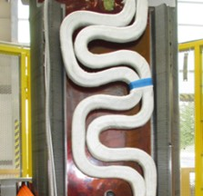
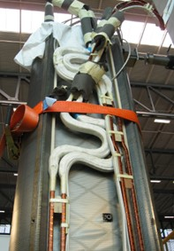
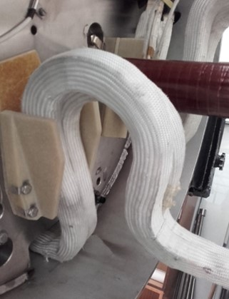
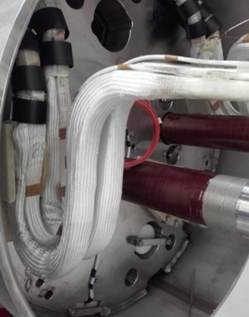
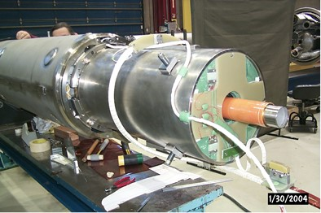
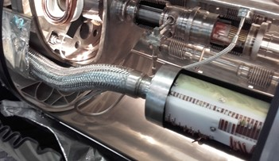
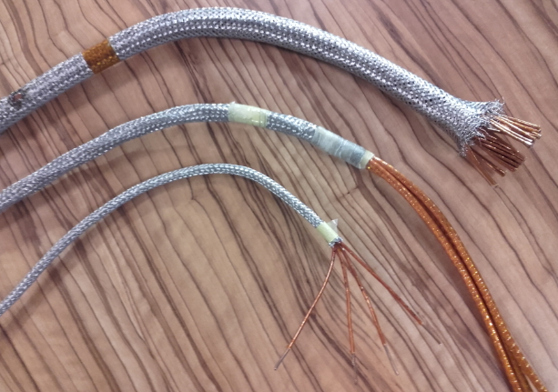
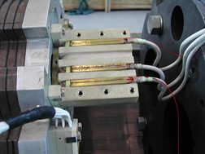
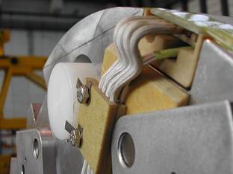
Expansion loops
13kA busbars for RB circuit
13kA busbars for RQF-RQD circuits
5 or 8kA busbars for RQX
and RTQX circuits
600A busbars multipole correctors
600A busbars multipole correctors
16mm
20mm
1.47mm
2.3mm
1.47mm
2.5mm
2.5mm
10mm
20mm
15.4mm
N-Line integration
600A busbars lattice correctors
6kA busbars for RQ4 to 10,
RD2, RD3 and RD4 4 circuits
60 and 120A busbars for RCB circuits

Slide 5
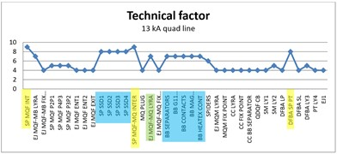
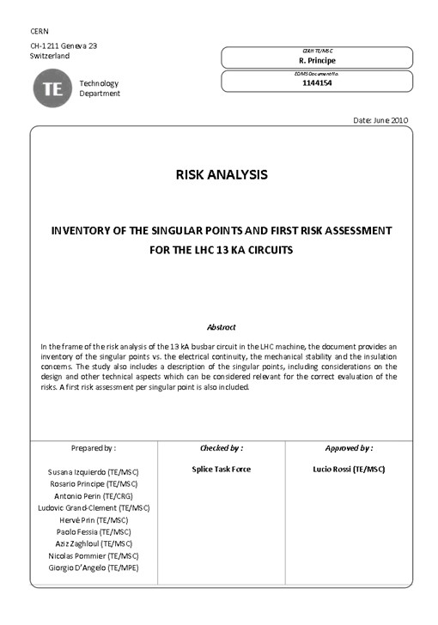
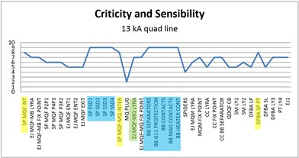

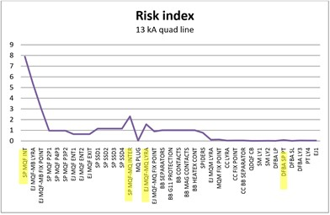
To be taken into account for the next design(s)

Slide 6
Present integration principles
Cross section of the hollow copper stabilisation is determined by the ramp down rate of the circuit.
Busbars are insulated with at least two layer of polyimide tape wounded in opposite direction. Whenever possible they are surrounded by fibber glass spouts.
Busbars routing and connections to magnets are preferably located on the lowest part of the cold mass (heritage of the 4.5K operating temperature for cooling).
The cold mass “connection side” is defined by the main magnet connection side inside. It is located on the service module side (QQS) of the cryostat in order to minimise the lengths between the fixed points.
Orbit correctors connexion side is located in the opposite side to save longitudinal space and to access the connections from the cold mass extremity.
If possible, prefer in line splice connection type to praying hands (Lorentz forces)
Instrumentation (V-taps, QH, cryo-thermometer) is limited by the present cover flange design.

Slide 7
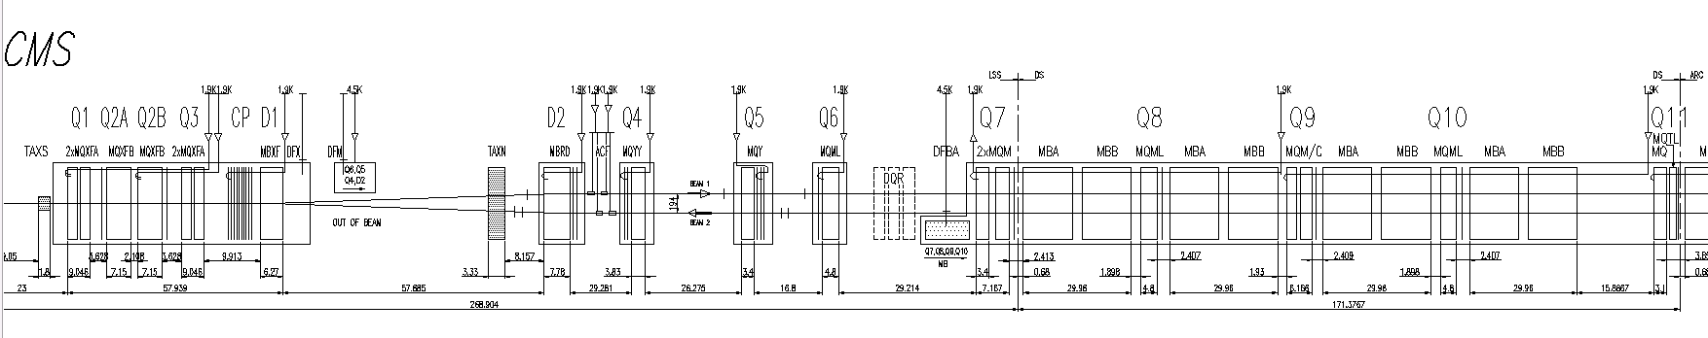
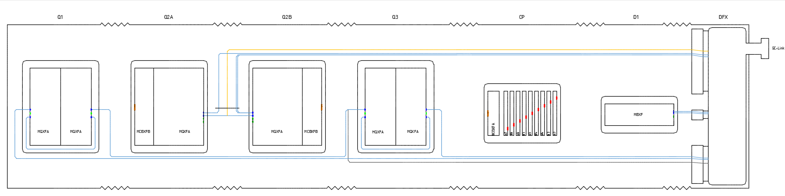
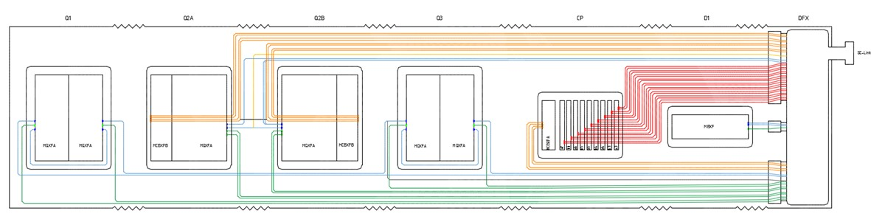
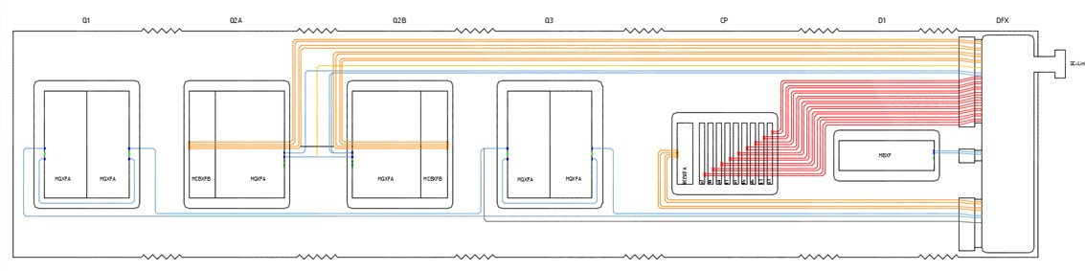
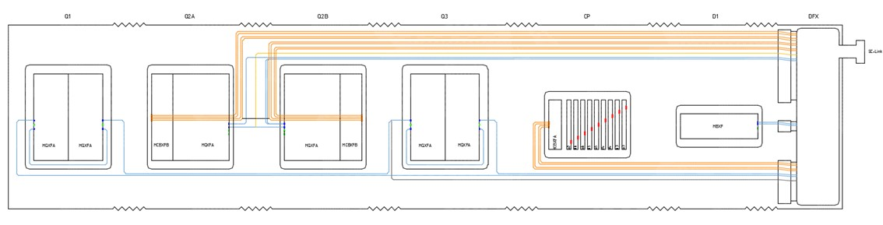
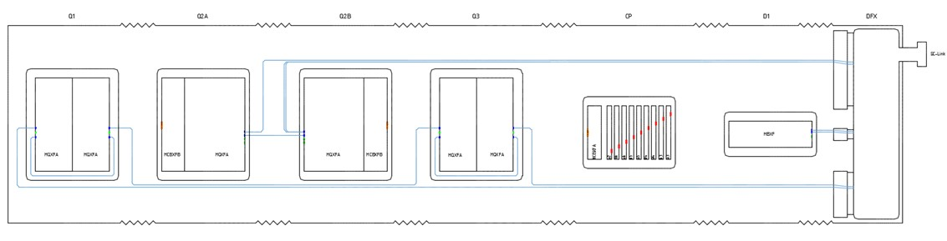
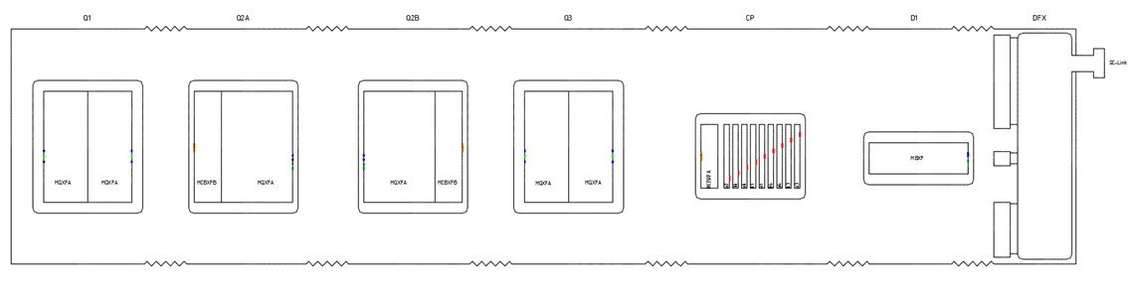








Inner Triplet String
Q1
Q2A
Q2B
Q3
CP
D1
DFX
External busbars
Internal busbars
18kA
 | 7
 | 5
 | 2
 | 2
 | 2
 | 24
 | 36
 | 18
+ | 13
+ | 11
 | 2
+ | 4
+ | 5
+ | 62
 | 36
+ | 43
18kA
12kA
+83%
2kA
Splices
200A
2kA
200A
2.8kA,
12Hz fast decay
96
176

Slide 8
Int./Ext. routing - Pros and Cons
 | External bus bars | Internal bus bars
Splice quantity | ☺ | ☹ > 80%
Short to ground on a circuit or electrical fault | ☺ Cable exchange between the DFX and concerned interconnect | ☹ Cryoassembly exchange
Possibility to alternate the impedances on the main circuit: Q2 and b on the return bus bar | 😐 Not really needed according to Mr Circuit | ☺
Magnet exchange | ☹ 3 to 5 ICs to open ☺ Less splices to be redone Or 😐 only affected buses | ☺ 2 ICs to open ☹ All splices to be de-soldered/re-soldered
Interchangeability Q1⬄Q3 and Q2A⬄Q2B | ☺ | ☹ Q1 and Q2a have to house all circuit present in respectively Q3 and Q2b to allow
Cryogenic Scheme | 😐 restrictions between the external line and the cold mass volume | ☺
Flexibility for cold test (Q1, Q3) on surface | ☺ Possibility to test each MQXA individually | 😐 Additional bus bar needed to power each MQXA individually

Slide 9
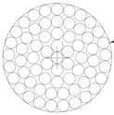
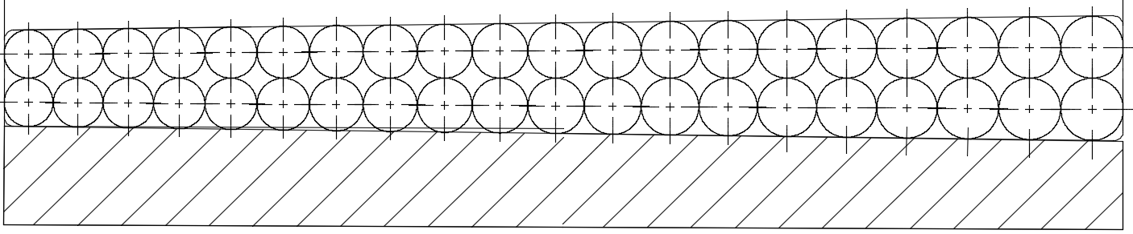
Busbar vs Cable - Pros and Cons
 | Busbar (stabilized Rutherford cable) | Round cable
Development & experience | ☺ Strand and cable availability with low external field | ☹ Cable development and validation
Protection (current distribution) | ☺ Proven technology ☺ Soldered stabilizer | 😐 To be studied and proven
Fabrication place | ☺ Cable availability if LHC cable retained ☺ CERN in the busbar factory | 😐 To be developed with industry
Integration | ☺ stability | ☺ 3D flexibility 😐 Containment of electromagnetic forces to be studied
Installation | Preferably during cold mass assembly 😐 Cartridges could be envisaged | ☺ Opportunity to be installed in the tunnel from one connection point to the other
Expansion loops | ☺ Well known (lyre profiles) but ☹ integration volume (radial and longi) | ☺
Insulation | ☺ | 😐 To be settled according existing developments
Splices | ☺ | 😐 To be developed (existing experience on the 6kA circuits) ☹ Preparation in case of reconnection (ALARA)
QA Process (Splices validation @warm) | ☺ | ☹ To be developed

Slide 10
Bus technology towards Routing
Bus technology
Busbar
Cable
++ Splices types and validation
+ Well known technology
⎯⎯⎯⎯⎯⎯⎯⎯⎯⎯⎯⎯⎯⎯⎯⎯⎯⎯⎯⎯⎯⎯⎯⎯⎯⎯⎯⎯⎯⎯⎯⎯
- Longitudinal space for expansion loops
- Entire cold mass disassembly in case of bus bar problem (may be solved with cartridges?)
- More splices
- Surrounding field
-- Cryoassembly exchange in case of short
-- Ergonomic for splices and ALARA principle
++ Longitudinal space gain for the expansion loops playing with cable flexibility
+ Easier bus exchange in case of problem
⎯⎯⎯⎯⎯⎯⎯⎯⎯⎯⎯⎯⎯⎯⎯⎯⎯⎯⎯⎯⎯⎯⎯⎯⎯⎯⎯⎯⎯⎯⎯⎯
- More splices
- Splices types and validation
++ Splices types and validation
+ self magnetic field
⎯⎯⎯⎯⎯⎯⎯⎯⎯⎯⎯⎯⎯⎯⎯⎯⎯⎯⎯⎯⎯⎯⎯⎯⎯⎯⎯⎯⎯⎯⎯⎯
? Expansion loop integration
⎯⎯⎯⎯⎯⎯⎯⎯⎯⎯⎯⎯⎯⎯⎯⎯⎯⎯⎯⎯⎯⎯⎯⎯⎯⎯⎯⎯⎯⎯⎯⎯
-- Installation
-- Rigidity
++ Less splices
++ Installation in the tunnel
++ Cable exchange in case of a short
⎯⎯⎯⎯⎯⎯⎯⎯⎯⎯⎯⎯⎯⎯⎯⎯⎯⎯⎯⎯⎯⎯⎯⎯⎯⎯⎯⎯⎯⎯⎯⎯
? Magnet exchange
? Plugs or restrictions
⎯⎯⎯⎯⎯⎯⎯⎯⎯⎯⎯⎯⎯⎯⎯⎯⎯⎯⎯⎯⎯⎯⎯⎯⎯⎯⎯⎯⎯⎯⎯⎯
- Splices types and validation
- Cable development
Routing
External
Internal

Slide 11
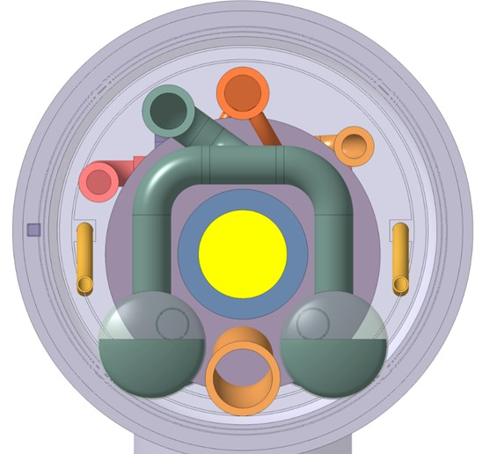
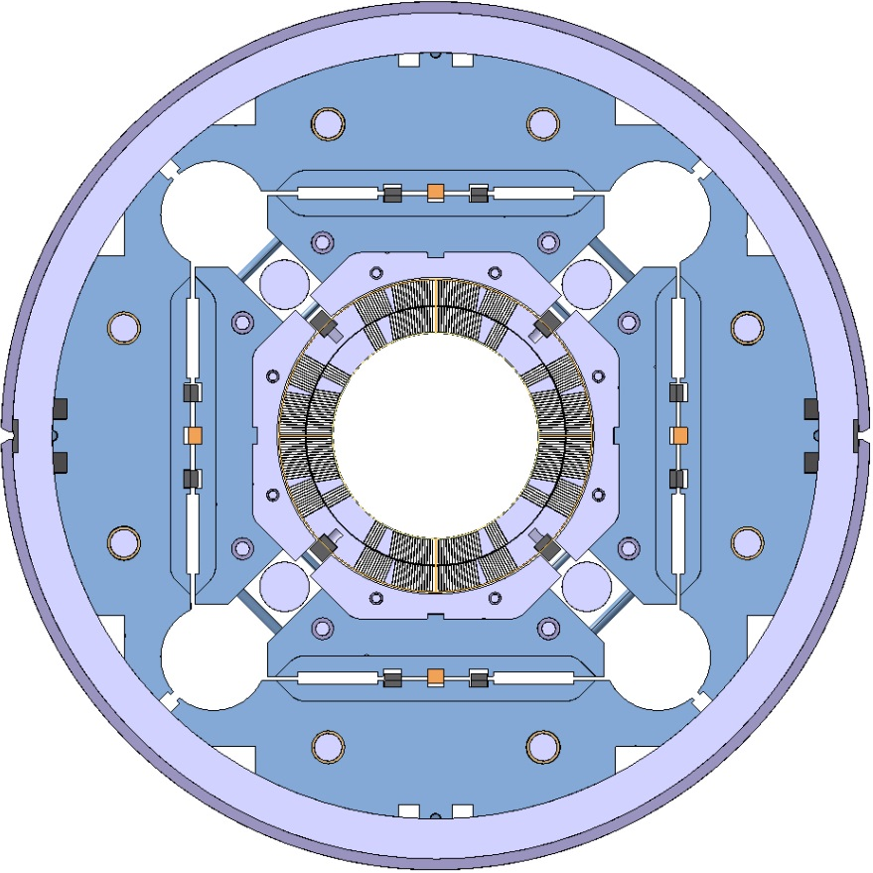
Inner Triplet Busbars Integration Proposal
(until a 18kA cable is developed and proven)
Splices
External busbars
(round cable type)
2kA
+ | 13
+ | 11
 | 2
 | 2
 | 2
 | 24
 | 36
 | 18
200A
2kA
200A
2.8kA,
12Hz fast decay
In Q2 cold masses
Total 108
Internal busbars
(stabilized Rutherford cable)
18kA
Courtesy of Cedric Eymin
18kA

Slide 12
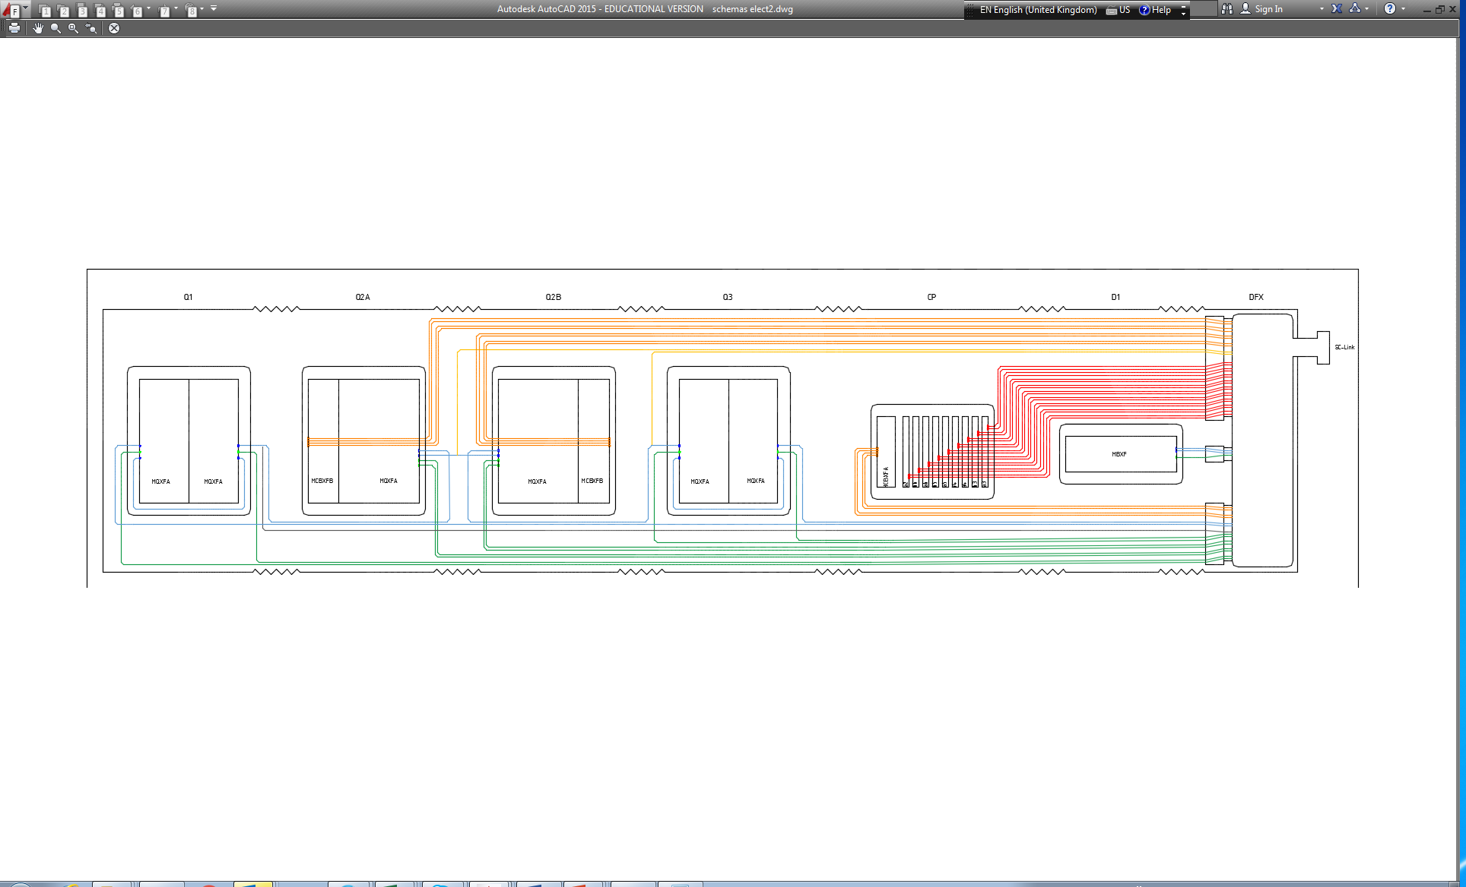


Inner Triplet Alternate Electrical Scheme
Saving set of 2 busbars for Q2A-Q2 with associated current leads ☺ integration
Saving 9 splices on 18kA circuit ☺ installation
Additional one 200A lead with 2 splices for the Q2B and Q3 trim
101 splices in total
18kA bubars integration in D1 and Corrector Package cold masses
Corrector package connection side

Slide 13
Inner Triplet String Busbars Integration Summary
Internal/External integration were compared
Cable/Busbars technologies were compared
Integration solution proposed as “best compromise”:
  For high current : Rutherford cable stabilized busbars routed through the cold masses as long as an appropriate 18kA cable has been developed
  For lower current : external cables routed in a dedicated line on top of the cold masses [2kA cable to be developed]
Alternate circuit design eases the busbars integration
Splices quantity varies from 96 to 176. 101 to 108 could be achieved depending on the retained scheme
Cold masses design including the busbars integration will start in the coming weeks
To be studied: Integration of 18 kA busbars in the D1 and CP

Slide 14

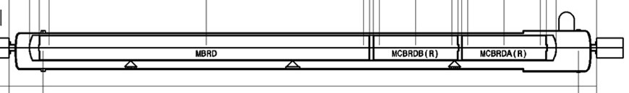
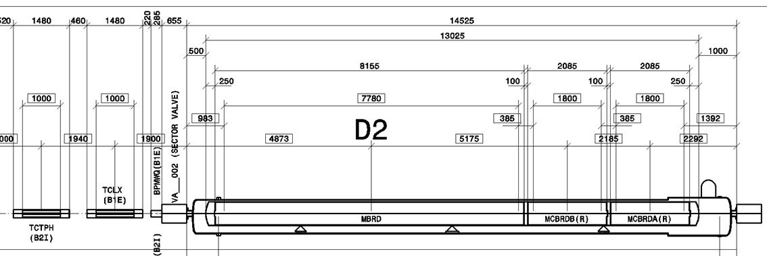
D2 Separation Dipole
12kA
4x430A
S1
to the link
Integration
Exception due
to collimators
S2
to the link
S3
to the link
 | ☺ Pro | ☹ Cons
S1: All connected on the QQS side | Minimise the 12kA busbars routing | MBRD connections not accessible except by dismantling the cold mass Larger longitudinal gap required between MBRD and MCBRDA
S2: Orbit corr. connected from QQS side MBRD connected from opposite side MBRD busbars internal | Connections accessibility for 2 out 3 mag. | Longer 12kA routing inside magnetic field environment Expansion loops capacity
S2: Orbit corr. connected from QQS side MBRD connected from opposite side MBRD busbars external | Connections accessibility for 2 out 3 mag. 12kA routing outside magnetic field environment 12kA splices easier accessibility | 12kA cable to be developed or busbars integration to be studied carefully

Slide 15
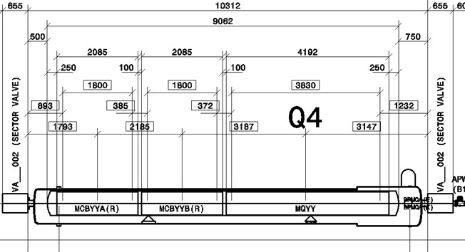
Q4
4x430A
4.59kA
to the link
Similar in all aspects with the configuration for existing standalone (next slide)
Exiting Sc cables and splicing procedures can be used (6kA and 600A)
Orbit correctors bus bars routing and integration in the MCBYY outer yoke?

Slide 16
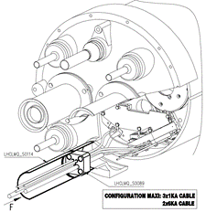
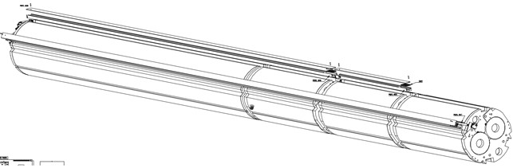
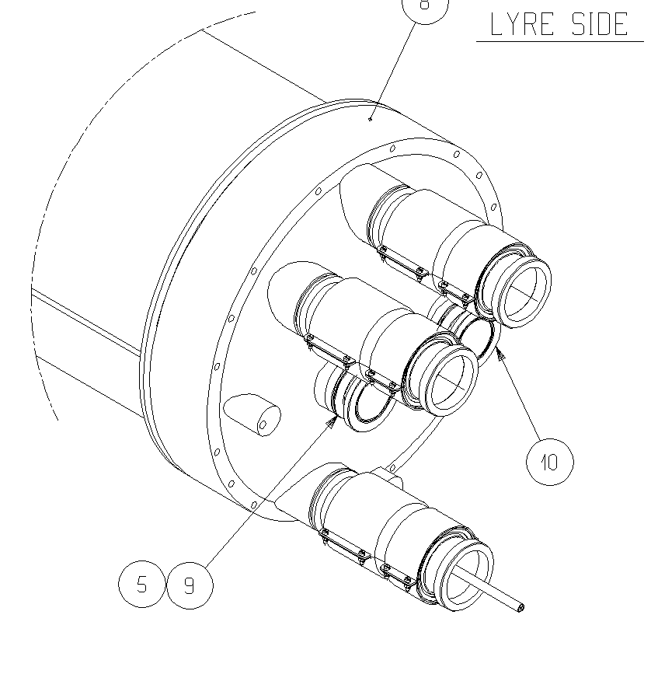
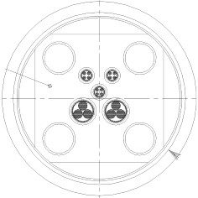
Q5 and Q6
Existing cryo-assemblies to be modified to operate at 1.9K
Operating current increased for the quads but still compatible with the bus bars
Connection to the link: Plugs? Cryogenic distribution for the link through the jumper?
Busbars to feed the D2 installed in the present Q4 (future Q5) floating or grounded?

Slide 17
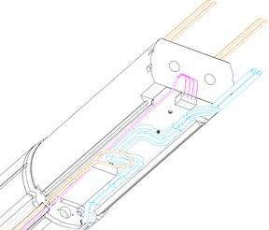
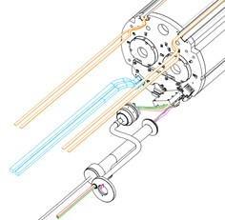
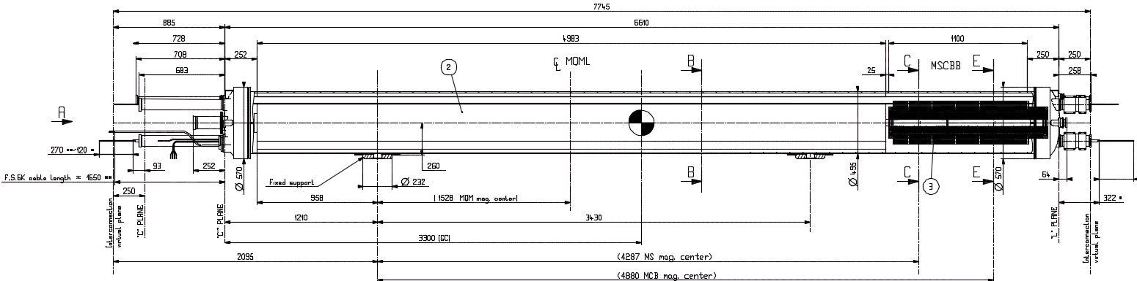
Q10 with MS
Design based on existing Q10 with MSCB integration
Design almost completed
6kA (MQML) and 120A (MCB) feeding bus bars integration identical to the existing ones
600A (MS) compatible with space allocation in the spout and between magnets
No QF-QD buses in IR1&5 (circuits shorten at Q11 level during LS1)
Identical connections to all circuits (elect & hydro) than the present Q10 plus 4x600A to N-Line
RB buses using existing shape upstream and SSS expansions lyres downstream
Plug to be adapted or restriction allowed? Ongoing discussion with cryogenics group
600A spool busbars routing remains the same with supporting pieces along (ongoing design)
MS V-Taps integration in the instrumentation cover flange is not an issue
Connection box in the N-line to be designed for 3x6kA and 4x600A

Slide 18
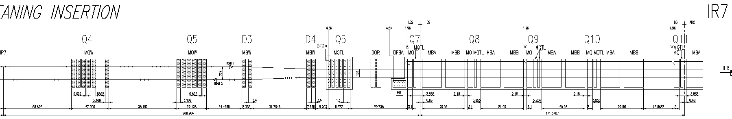
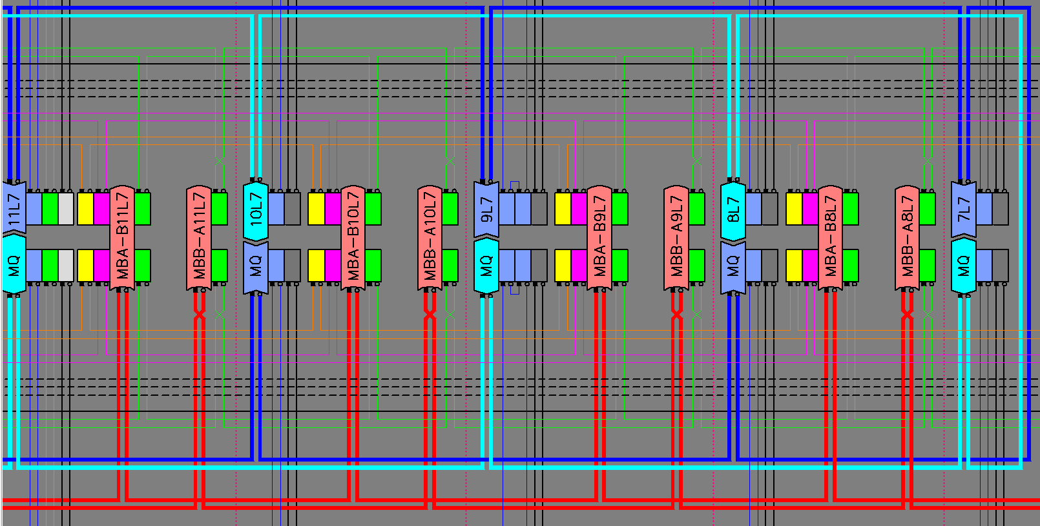
MBH 11T dipole
LS2
LS3
LMBH cold masses will be produced as MBA ones independently of the position in the machine
  RB global electrical scheme in the arc alternating MBA on the direct powering line and MBB on the return one is broken. In L7 the impedance will be unbalanced on the direct and return lines
  Design integrates the most demanding configuration to ease spare policy and minimise the components diversity
  MCDO lattice corr. will equip the upstream cold mass but will be connected to the RCD and RCO circuits or not depending on the final installation slot
  MCS sextupole corr. polarity will be adapt accordingly

Slide 19
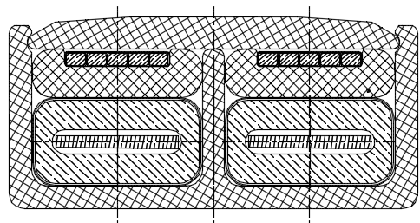
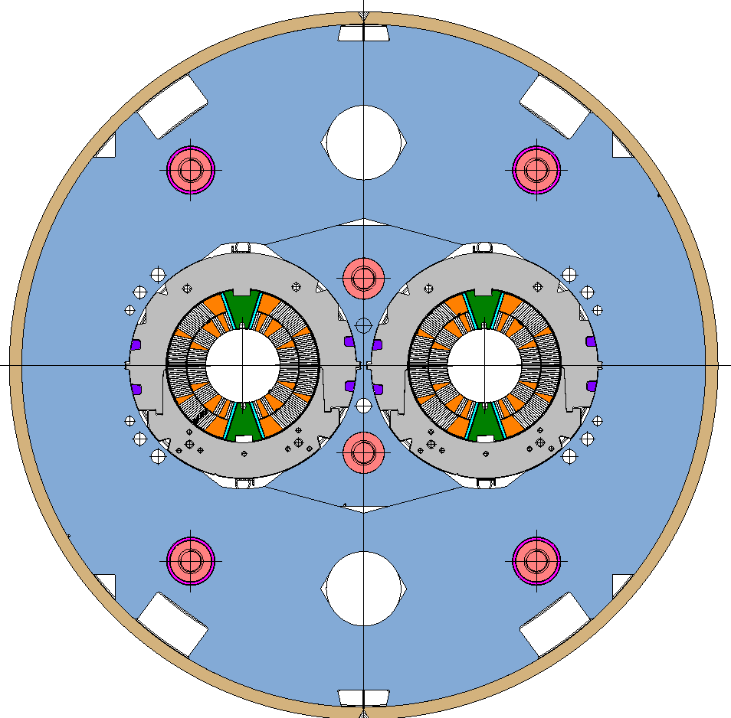
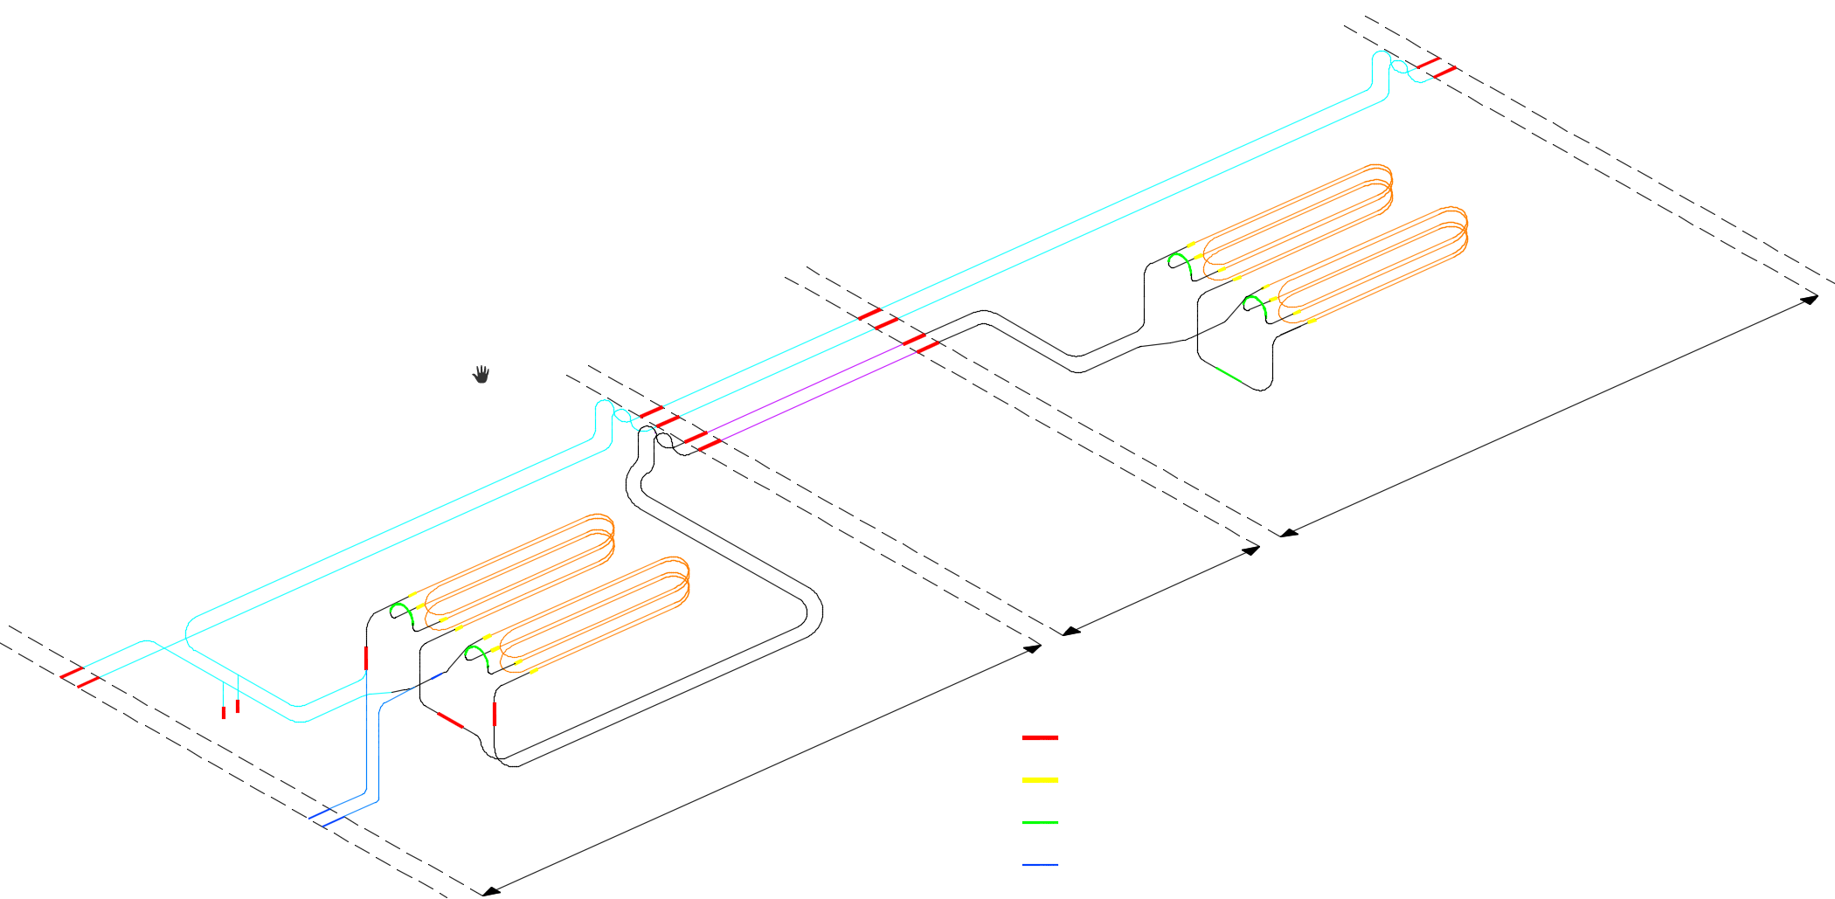
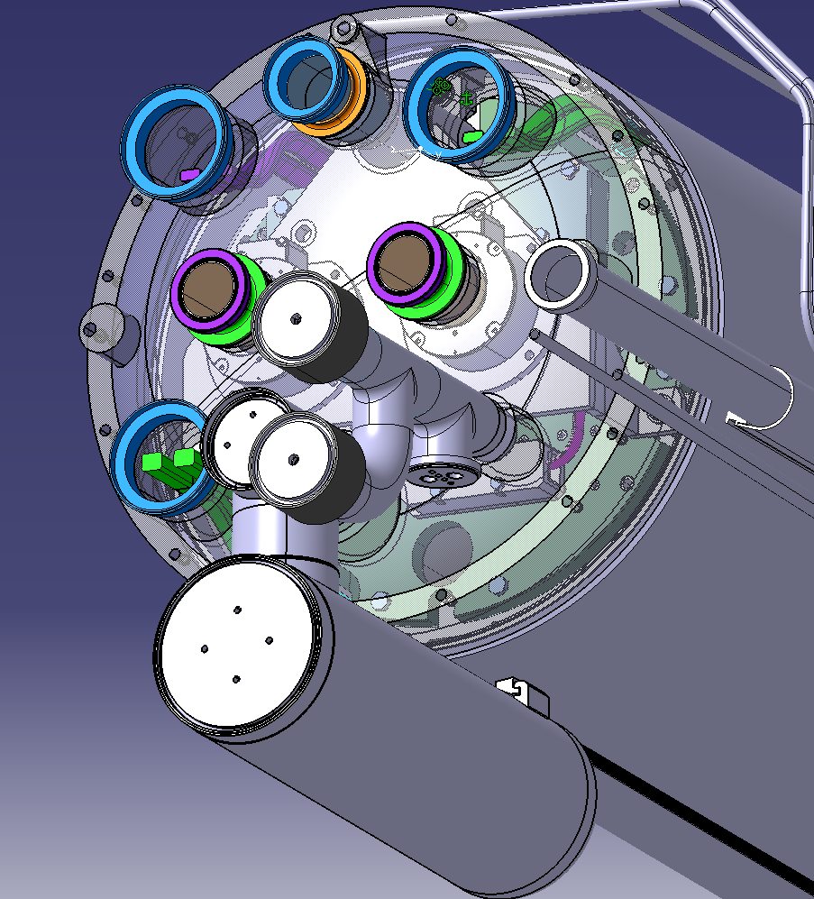
MBH 11T dipole
LS2
LS3
2 instrumentations capillaries (IFS) to route all the required instrumentation
M3
LMBH_002
M3
Trim
LMBH_001
Splice 13kA
Splice Nb3Sn/NbTi
Splice "coil(s)" junction
Diode
Splice "Trim" junction

Slide 20
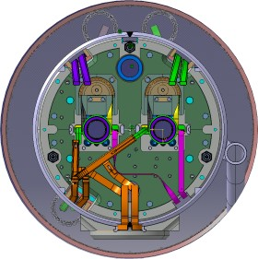
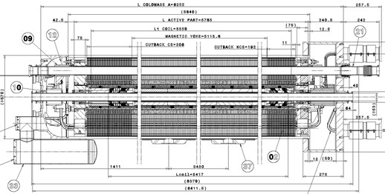
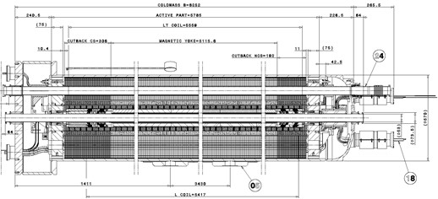
MBH 11T dipole
LS2
LS3
Design completed will be presented in the next review 11 T Dipoles at Collimator Section for HL-LHC (Apr. 2016)
Internal splices based on the main dipole design using same tooling and procedures
Development ongoing to replace screwed connection to the diode by soldered ones
M3
LMBH_002
M3
Trim
LMBH_001
Splice 13kA
Splice Nb3Sn/NbTi
Diode
Splice "coil(s)" junction
Splice "Trim" junction
Standard LHC external splices using typical interfaces, preparation, components, procedures, shunts and insulation. Only the geographical position is different ⇨ might lead to resistive heating instead of induction due to space restrictions.
Standard QA and QC procedures used during LS1 will be applicable (R8-R16 measurements for copper stabilizer junction @RT, geometrical checks for shunt and insulation installation…)

Slide 21


New connection cryostats to integrate collimators for ions physics debris around IP2
LS2
Design based on development for 11T integration
Preliminary design has started
Standard junction cryostat for collimator integration surrounded by two connection cryostats to house the standard bus bars cross sections in M-lines (RB, RQF, RQD, RCD, RCO, RCS) and 600A cables in the N-line
Bus bars could be integrated inside spouts like almost everywhere in the cold masses in order to increase the dielectric insulation and provide mechanical strength to contain Lorentz forces
Centring system inside the M lines may have to be redesign but could be significantly simpler

Slide 22
Summary
Electrical schemes (LHCLSD%_0002, 3 and 4 like) controlled and stored in the CDD are needed; including magnet polarity, connection side, terminals… This has to be the base line agreed and used by every system integrator.
An important part of the integration work is dedicated to the electrical bus integration taking into account the technology and the related constraints (splices quantity and types, ergonomics, ALARA principle…) as well as the bus installation.
Proposals presented are based on available and proven designs and technologies for the busbars and their associated splices.
The IT string layout is a best compromise solution to minimise the splices quantities until a 18kA cable has been developed. Internal routing is considered inside the cooling holes (external solution is not excluded), extensive integration work is ongoing.
Situation has to be studied at the level of the Corrector Package and the D1 for the 18KA integration.
The different intervention scenarios will be considered to determine the intervention time and the shielding possibilities in order to support the different choices.
Global integration work is going on taking into account environment constraints and requirements (cryogenics, vacuum, beam instrumentation…).

Slide 23
Inner Triplet string | 18kA 12kA 2kA 200A CLIQ | 210 4 500 80 330 | 18kA busbars to be developed and integrated in D1 and CP New baseline for the electrical scheme? Busbars integration work is part of global integration study Pig tail expansion loops potentially ease integration
Q5 and Q6 | 6kA 120A | - - | Reuse of existing cryo-assemblies Operating temperature change will not affect the cold masses busbars D2 bus bars to ground?
Q4 | 6kA 600A | 11 156 | Design will be based on the present standalone one and should not bring any issue since the feeding current is compactible with existing busbars
D2 | 12kA 600A | 70 51 | Scheme has to be studied carefully taking into account maintenance, integration and busbars types for the routing
Q10 with MS | 13kA(MB) 6kA 600A(spools) 600A(round) 120A | 16 4 32 8 9 | MB Busbars design is a mix between Standard arc SSS and series 600 Well known integration New N-Line connection box design
11T Dipoles | 13kA(MB) 13kA(MQ) 13kA(MBH) 300A(trim) | 51 102 27 3 | Busbars mechanical integration in the cold mass is well advanced. Standard LHC solution and splices are applied Studies on going to replace bolted connection to the diode with soldered ones trim current leads studies (conduction cooled) and integration is starting
New connection cryostats | 13kA(MB) 13kA(MQ) | 30 60 | Standard junction cryostat for collimator integration Standard busbars cross sections to be routed and integrated with standard splices in the extremities
Exiting design
Under development
To be developed
Approximate quantity in meters for one unit (for ex. x4 for the triplet, x5 considering spare, x6 considering string test….)

Slide 24
Spare slides

Slide 25






Busbars integration in the present LHC Inner Triplet
Each bus wrapped with 50um kapton with 50% overlap. (2), 100 um kapton sheets placed between each bus pair
Entire buss wrapped with 50um kapton with 50% overlap with polyimide coating, then baked at 170C.
Bus Housing (G11)
Each bus pair wrapped with 50um kapton with 66% overlap.
Individual Bus (Cable Pair)
Entire buss wrapped with 50um kapton with 50% overlap
Bus Housing (G11)
Individual Bus Pair
Each cable pair wrapped with 50um kapton with 66% overlap.

Slide 26





Busbars integration along the “arc cryostat” in the Main Dipole MB cold masses

Slide 27








Busbars integration along the “arc cryostat” in the SSS cold masses
4 wire cable (600A)
4 wire cable (60A)
``
``
``

Slide 28


Slide 29

Electrical insulation
Each bus wrapped with 50um kapton with 50% overlap. (2), 100 um kapton sheets placed between each bus pair
Bus Housing (G11)
Entire buss wrapped with 50um kapton with 50% overlap
Individual Bus Pair
Entire buss wrapped with 50um kapton with 50% overlap with polyimide coating, then baked at 170C.
Each bus pair wrapped with 50um kapton with 66% overlap.
Individual Bus (Cable Pair)
Bus Housing (G11)
Each cable pair wrapped with 50um kapton with 66% overlap.

Slide 30


Magnetic Field in the MQXF cooling holes
Courtesy of Susana Izquierdo Bermudez

Slide 31

Triplet flow diagram
31

Slide 32
Steps for 18kA Nb-Ti cable development up to production
Feasibility study
6 Months
Price inquiry and Prototype cable production
10 Months
Validation
Tests
3 Months
Technical specification
1 Month
Procurement process
4 Months
Series production
Splices developments
QA Splices
Decision
Procurement
2016
2017
2018
Today
According to discussions with A. Ballarino
32

Slide 33






Plugs
13kA cable plugs
6kA cable plugs

Slide 34








Splices 1/2
13kA busbars for RB circuit
13kA busbars for RQD-RQF circuits
5 or 8kA busbars for RQX
and RTQX circuits
Resistive soldering
Induction soldering
Resistive soldering
Inner Triplet multipole correctors
Induction soldering
Induction soldering
Resistive soldering
Resistive soldering
Resistive soldering

Slide 35





Splices 2/2
6kA busbars for RQ4 to 10,
RD2, RD3 and RD4 circuits
600A busbars multipole correctors
60 and 120A busbars for RCB circuits
Resistive soldering
US Welding
Resistive soldering
Resistive soldering
600A busbars (N-Line)
US Welding

