Slide 1


Conceptual Design Review of the
Magnet Circuits for HL-LHC
21-23 March 2016 , CERN
SC Links
A. Ballarino
21/03/2016

Slide 2
Contributions from:
WP6 contributors:
S. Giannelli, G. Montenero, A. Jacquemod, J. Hurte, R. Betemps, B. Bordini and V. Parma (CERN)
Y. Yang and the team at the Univ. of Southampton
LHC Cryogenics:
U. Wagner and S. Claudet (CERN)
Integration studies:
P. Fessia and S. Maridor (CERN)

Slide 3
System overview
Cryogenic layout
Electrical components
Integration
Protection
Milestones and schedule
Conclusions
A. Ballarino, 21/03/2016

Slide 4
System overview
Cryogenic layout
Electrical components
Integration
Protection
Milestones and schedule
Conclusions
A. Ballarino, 21/03/2016

Slide 5
Cold Powering System (WP6)
SC Current Leads
Interconnection Cryo-assembly - DFH
Function: transfer the current from the
power converters to the Hi-Luminosity magnet circuits
Integration in LHC: during LS3
SC Link - DSH
SC Link: a component of
the Cold Powering system
Machine Interface Cryo-assembly - DF
Nb-Ti
Bus-Bar
A. Ballarino, 21/03/2016

Slide 6
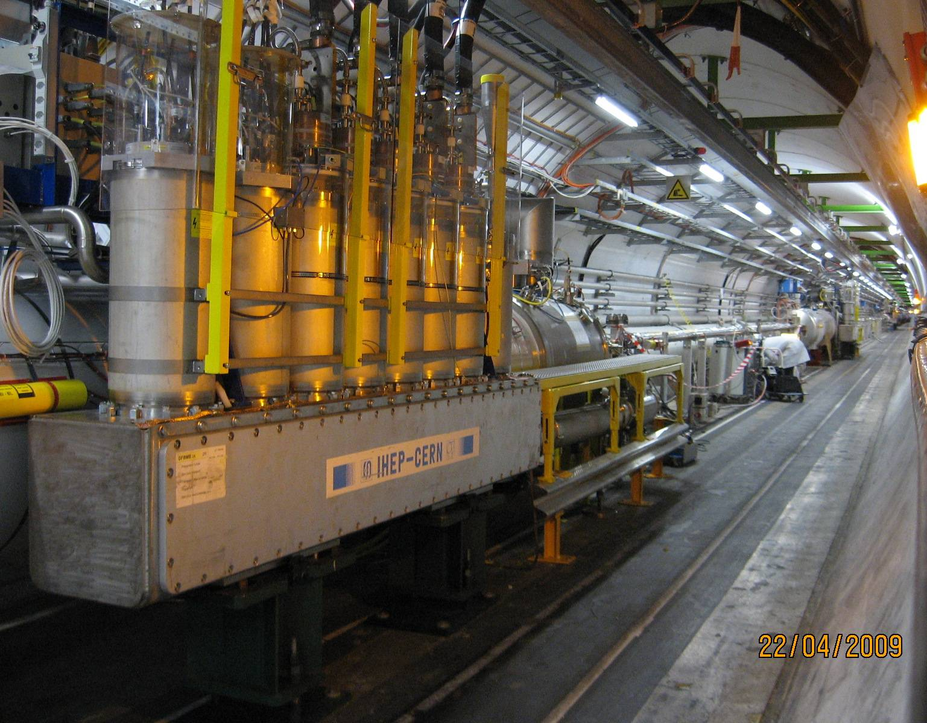
Distribution Feedbox and current leads in LHC Tunnel
A. Ballarino, 21/03/2016

Slide 7
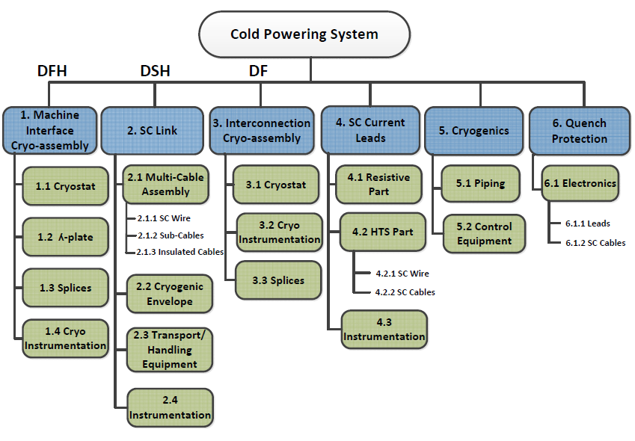
Cold Powering System WP6 - WBS
WP9
WP7
WP6
A. Ballarino, 21/03/2016

Slide 8
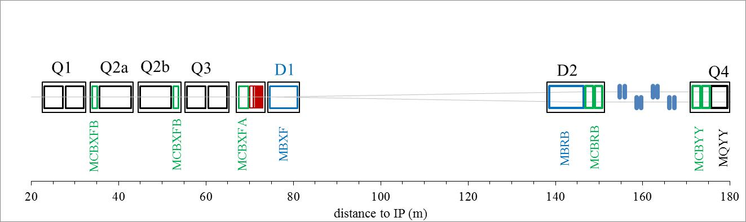
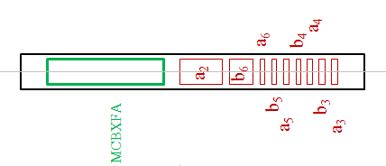
Hi-Lumi Triplets and Matching Section
+ Q5 and Q6
A. Ballarino, 21/03/2016

Slide 9
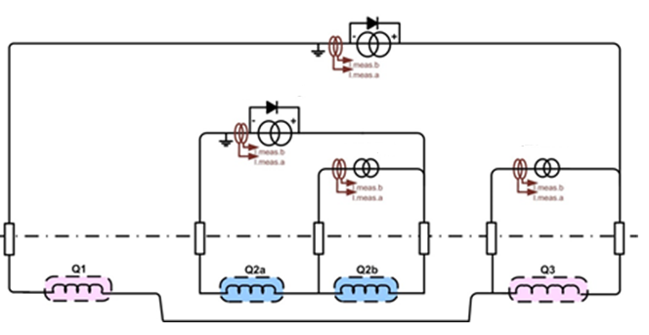
Baseline Powering Layout: MQXF quadrupoles
18 kA/20 V
Trim
Trim
18 kA/20 V
± 0.12 kA/ ± 10 V
± 2 kA/ ± 10 V
All other magnets are individually powered
Proposals for different powering layouts being discussed, i.e. MQXF quadrupole magnets all in series and D1 in series with D2, can/will be taken into account by the Cold Powering System (see next slides)
A. Ballarino, 21/03/2016

Slide 10
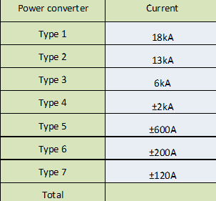
Changes in operating current (2015)
NB 2015 Baseline
Q1/Q3 – Q2a/Q2b
20 kA
D2, D1
Q4, Q5, Q6
Q4 16 kA
Orbit correctors Q3 and Q2, Trim on Q3
Orbit correctors D2 and Q4
2 kA
CP,
Correctors Q5 and Q6, Trim on Q2
DC Current ∼ 70 kA per IP
A. Ballarino, 21/03/2016

Slide 11
Number of Leads and of SC cables, Current Rating
NB 2015 Baseline
Triplets, D1 and CP – per IP Side
Type | N_IPside
18 kA | 6
13 kA | 4
6 kA | 12
2 kA | 13
0.6 kA | 16
0.2 kA | 18
0.12 kA | 19
6 × 18 kA
13 × 2 kA
× 0.2 kA
1 ×0.12 A
38 Units
2×68.5 kA
Matching Sections – per IP Side
2 × 13 kA
12 × 6 kA
16 × 0.6 kA
18 × 0.12 kA
48 Units
2×54.8 kA
Per IP side : 2×123 kA , 86 Leads/SC Cables
Hi-Luminosity Upgrade: 2×492 kA, 344 Leads/SC Cables
A. Ballarino, 21/03/2016

Slide 12
Number of Cold Powering Systems
Two Cold Powering Systems per IP Side at LHC P1 and P5 (one for the Matching Section and one for the Triplets + D1)
⇒ eight Cold Powering Systems in total
Two types of Cold Powering Systems (two powering
layouts, one for MSs and one for Triplets):
2 Types of DF Cryo-assemblies (DFX and DFM)
2 Types of Superconducting Links (DSHX and DSHM)
2 Types of DFH Cryo-assemblies (DFHX and DFHM)
Series of leads at different current ratings
A. Ballarino, 21/03/2016

Slide 13
Inputs for design of Cold Powering System
SC cables and current leads designed for operating in DC mode at the rated (maximum) current of the associated power converters
Insulation voltages to ground and between electrical components of ∼ 1 kV -1.5 kV in nominal operating conditions
Capability of enabling discharge of the magnet circuits with time constants of 3 s (MQXF circuit)
CLIQ, if used for magnets protection, fed by its own system – to avoid EM coupling issues in the SC cables
In case of quench/resistive transition of any component of the Cold Powering System, discharge of the circuit with time constants in the range from 3 s to 6 s
A. Ballarino, 21/03/2016

Slide 14
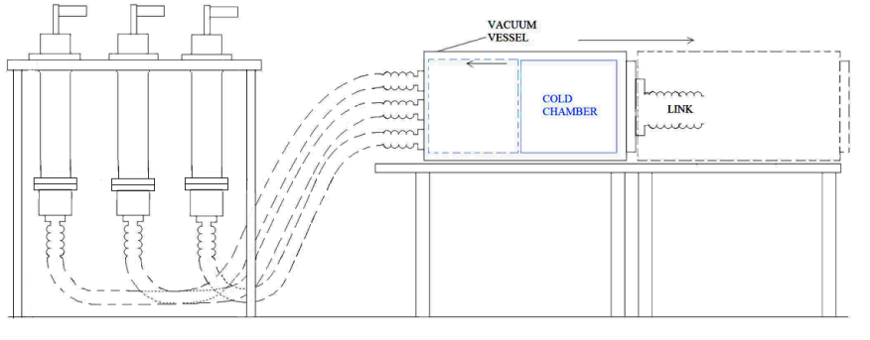
Cold Powering System - Concept
1. Current leads
3. Electrical interconnection box
HTS
MgB₂
2. Superconducting link
Concept initially developed for LHC P7 and
proposed also for LHC P1 and P5
A. Ballarino, 21/03/2016

Slide 15
System overview
Cryogenic layout
Electrical components
Integration
Protection
Milestones and schedule
Conclusions
A. Ballarino, 21/03/2016

Slide 16
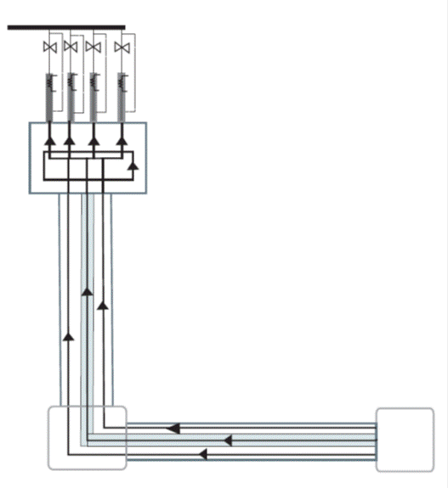
Cryogenic layout : present baseline
Room Temperature
1
TLead = 40 K-50 K
Bi-2223 or YBCO
THe < 35 K (Mixing of He gas)
T < 20 K
Qcold_mass ≤ 0.3 W/m
Qth_shield ∼ 2.5 W/m
2
3
THe = 20 K
MgB₂
LHe
A. Ballarino, 21/03/2016

Slide 17
Under evaluation
Room Temperature
Shorter superconducting Lines (from ∼ 300 m to ∼ 100 m):
Possible elimination of thermal shield cooling (and mixing)
1
TLead = 40 K-50 K
Bi-2223 or YBCO
THe < 35 K (Mixing for LHC P1 and P5)
T < 20 K
Qcold_mass ≤ 0.3 W/m
Qth_shield ∼ 2.5 W/m
2
3
THe = 20 K
MgB₂
LHe
A. Ballarino, 21/03/2016

Slide 18
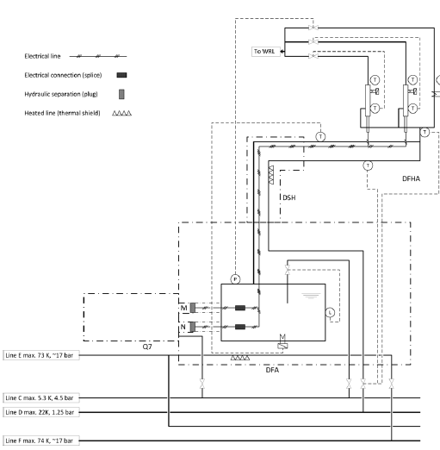
Cryogenic layout : present baseline
LHe from QRL in the tunnel
GHe at 20 K from line D
U. Wagner et al.
CERN-ACC-2014-0065 (2014)
A. Ballarino, 21/03/2016

Slide 19
System overview
Cryogenic layout
Electrical components
Integration
Protection
Milestones and schedule
Conclusions
A. Ballarino, 21/03/2016

Slide 20
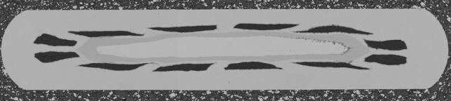
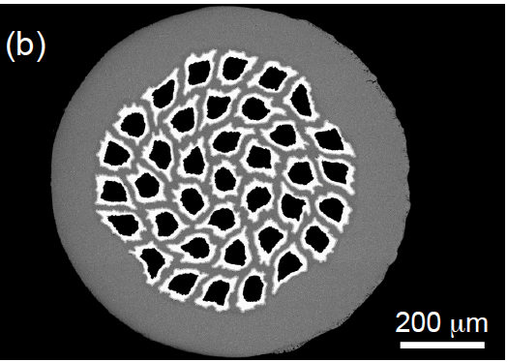
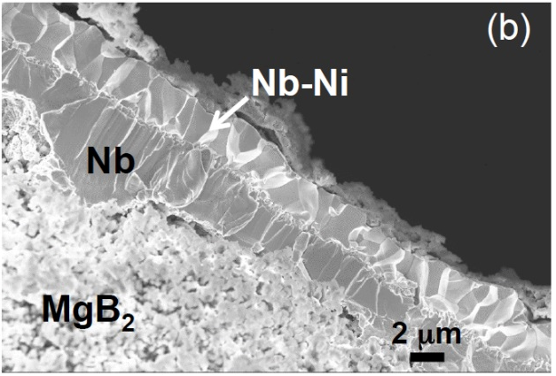
Superconducting Material
3.6×0.67 mm²
Product commercial at Columbus when the
project started: MgB₂ tape
Launched development of MgB₂ round wire
Φwire = 1 mm
37 MgB₂ filaments
Twisted filaments (LT=100 mm)
Φeq_MgB₂ = 56 μm
ACu ∼ 5 % Awire (th=30 μm)
Cu plating
Sn coating of Cu surface
Ic(25 K, 0.9 T) > 186 A
Launched procurement of 80 km of wire
Unit lengths ≥ 500 m
60 km at CERN
20 km to be delivered before end of April 2016
Use of Nb barrier
A. Ballarino, 21/03/2016

Slide 21
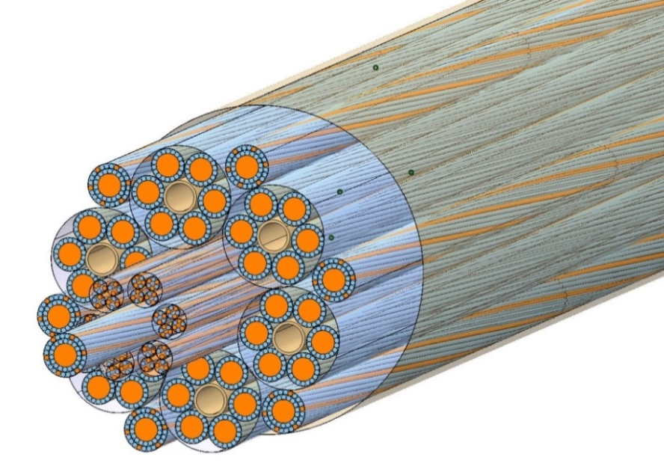
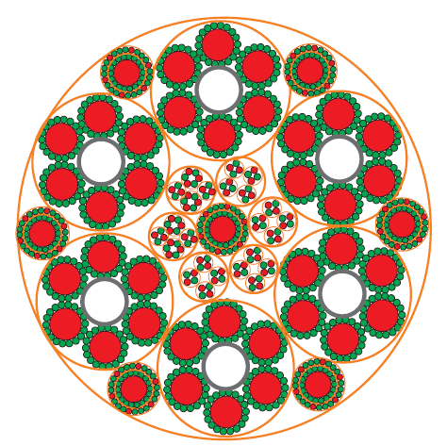
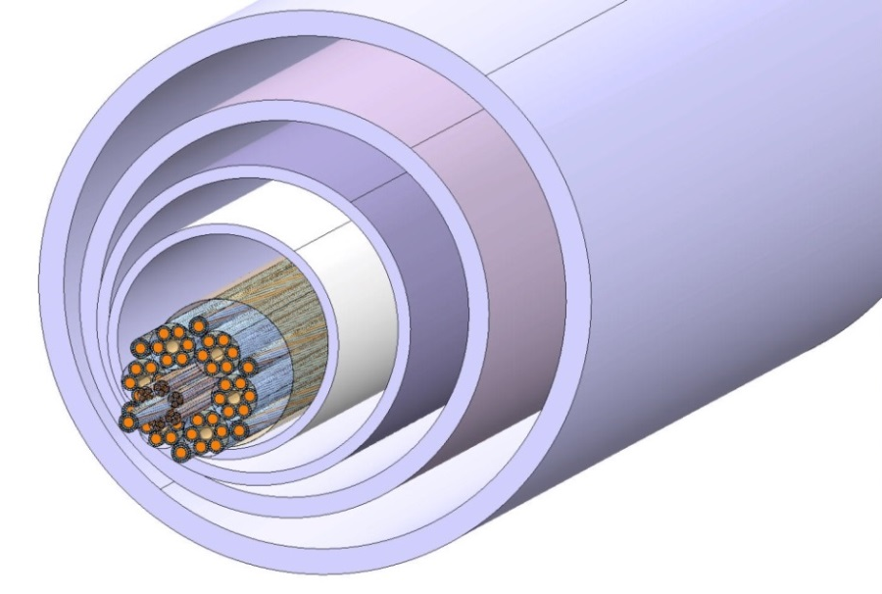
Superconducting Cable Assembly
Hi-Lumi Triplets and D1
Φext ∼ 65 mm
Mass ∼ 11 kg/m
Φext ∼ 220 mm
A. Ballarino, 21/03/2016

Slide 22
Superconducting Cable Assembly
Hi-Lumi Triplets and D1
Six high-current (18 kA) cables:
MQXF and D1
Φext ∼ 65 mm
Mass ∼ 11 kg/m
A. Ballarino, 21/03/2016

Slide 23
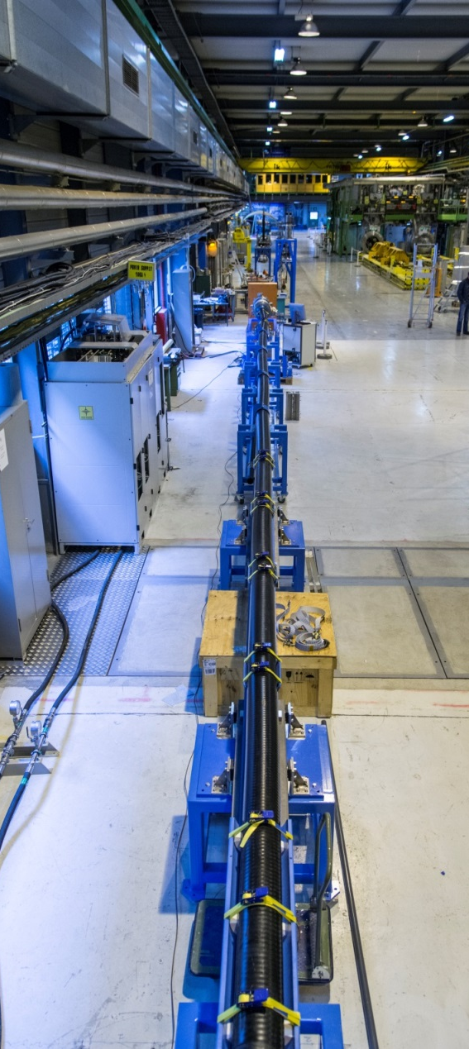
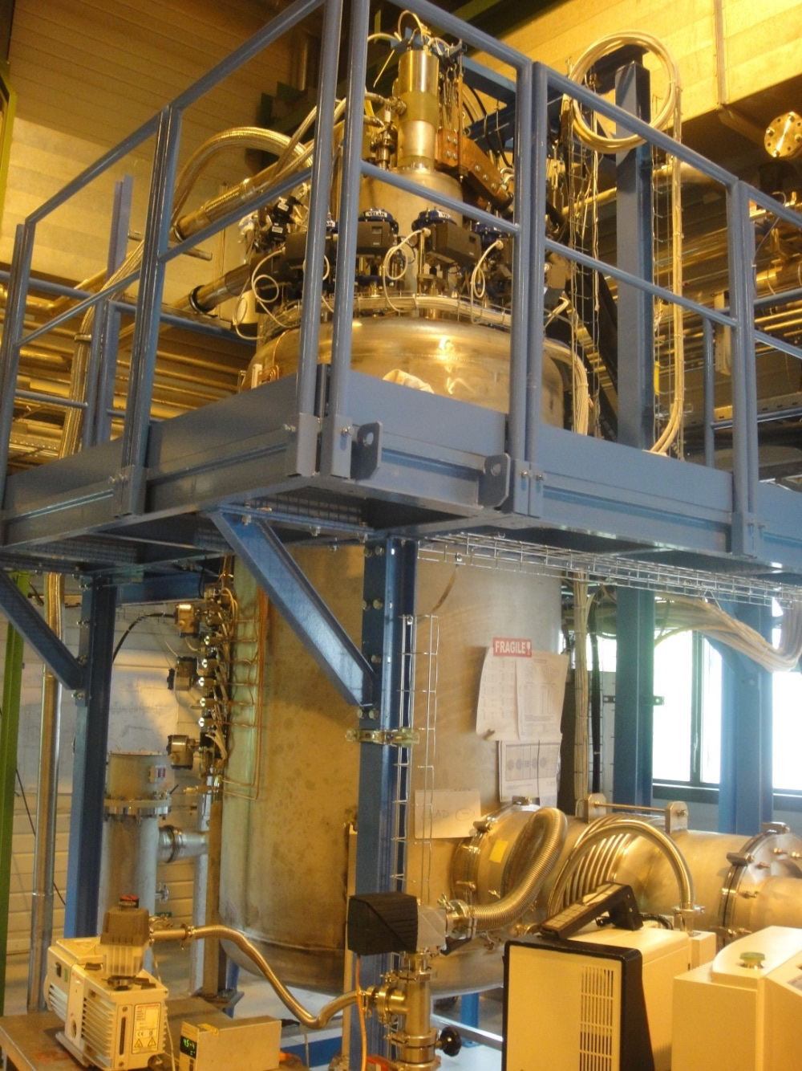
Test station at CERN
L = 20 m
Φext = 163 mm
H ∼ 4 m
A. Ballarino, 21/03/2016

Slide 24
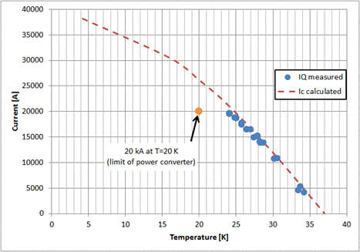
High Current Cable
I = 20 kA
T = 24 K
Bp = 1 T
Φ=19.5 mm
Imax Power Converter
Record in current for MgB₂
Hcable =3.7 μH
A. Ballarino, 21/03/2016

Slide 25
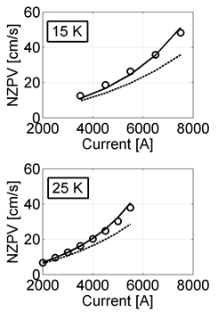
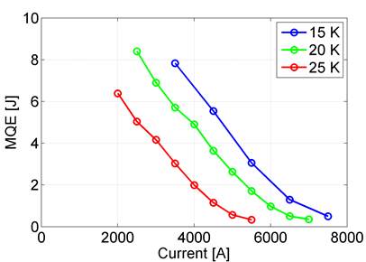
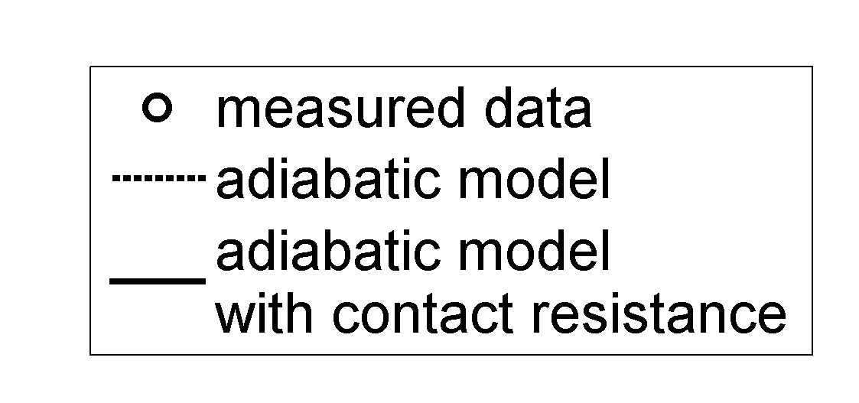
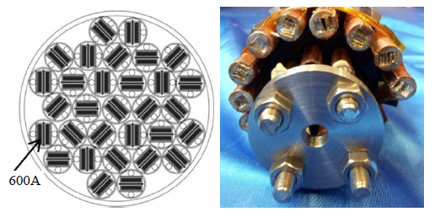
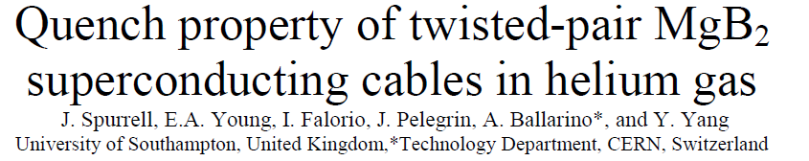
Thermal stability and quench studies
Measurements @ CERN
Thermal stability
4 Joule !
Quench propagation
in He gas
Measurements @ SOTON
At 3 kA NPVZ = 7.3-12.6 cm/s for T = 5K -25 K
Twisted-Pair MgB₂ Cables
Study for LHC P7
J = Normalized Current Density
A. Ballarino, 21/03/2016

Slide 26
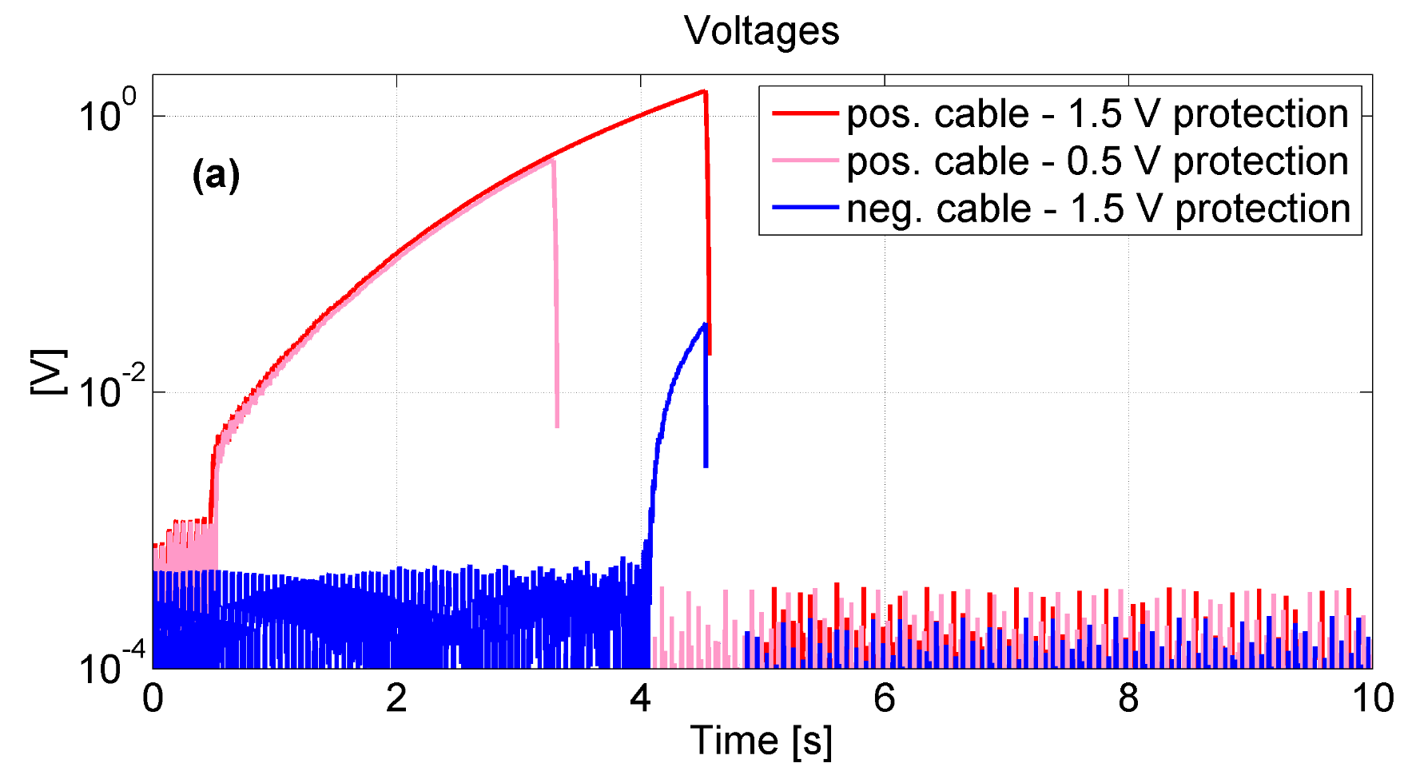
Quench propagation and thermal coupling
Effect of radial quench propagation among cables
Measurement performed at 15 K, 3000 A
Max hot-spot temperature reached T_{hs}~340 K with no degradation of cable performance
25 K, 3 kA, 100 mV detection threshold → 15 MIITS of “quench capital” before detection → final T_{max} ∼ 150 K within 3 s
Quench Propagation in Helium-Gas-Cooled MgB₂ Cables, S. Giannelli , G. Montenero, A. Ballarino , IEEE Febr. 2016

Slide 27
System overview
Cryogenic layout
Electrical components
Integration
Protection
Milestones and schedule
Conclusions
A. Ballarino, 21/03/2016

Slide 28
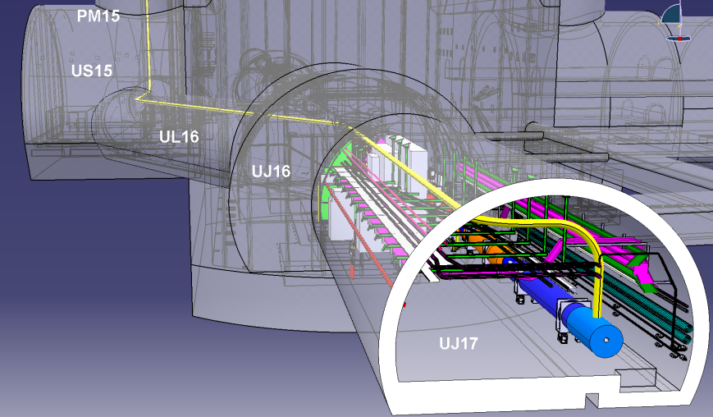

Integration baseline till mid 2015
LHC P1
∼ 80 m

Slide 29
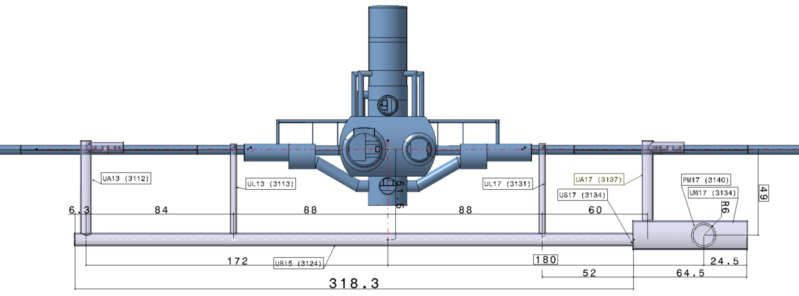
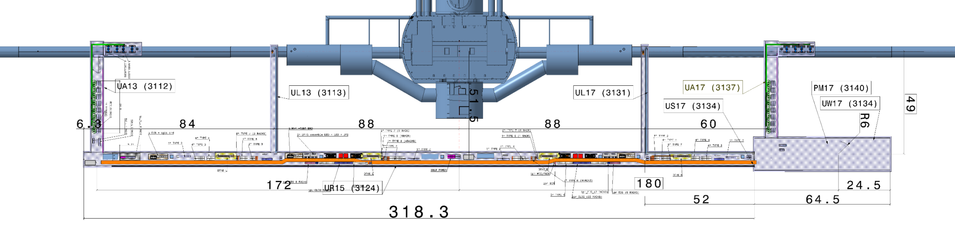
Integration: new baseline
Point 1
Presentation by P. Fessia on Friday, WP6 Session
S. Maridor, CERN
DFH
DFH
DFH
DFH
A. Ballarino, 21/03/2016

Slide 30
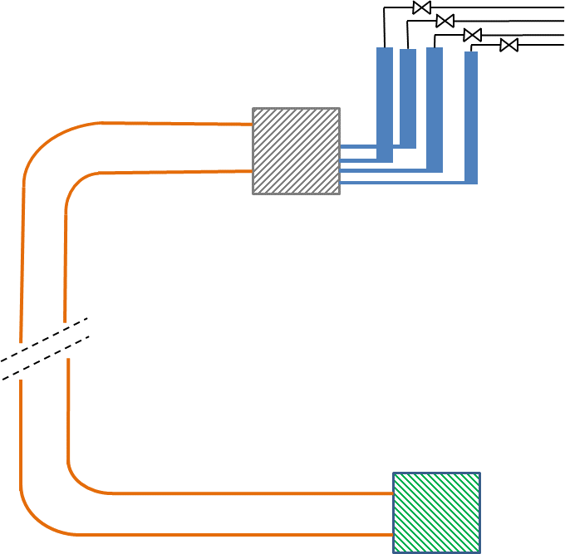
Integration of Cold Powering System
Leads assembled and tested before integration
SC Link assembled and tested before integration
    Bending radius ≥ 1.5 m
    Φ ≤ 300 mm
    DF and DFH cryostats assembled and tested before integration
Splicing in the tunnel
A. Ballarino, 21/03/2016

Slide 31
System overview
Cryogenic layout
Electrical components
Integration
Protection
Milestones and schedule
Conclusions
A. Ballarino, 21/03/2016

Slide 32
Protection
Room Temperature
Resistive part of each lead
1
Superconducting part of each lead
Bi-2223 or YBCO
Joints MgB₂/HTS
Superconducting cables in the
link (each cable)
2
3
MgB₂
Joints MgB₂/Nb-Ti
LHe
A. Ballarino, 21/03/2016

Slide 33
Protection
Resistive part of each lead
As for LHC: voltage detection. Detection threshold ∼ 100 mV
Long integration times permitted
Superconducting part of each lead
As for LHC: voltage detection. Detection threshold ∼ 1-5 mV
Integration times of ∼ 100 ms (depending on final choice of material)
Superconducting cables in the link cryostat
Long (∼ 100 m) cables. Work on-going. Aiming at detection thresholds in the range from 50 mV-100 mV, with τ of the circuits of up to 3 s
A. Ballarino, 21/03/2016

Slide 34
Protection
Electrical joints (MgB₂ to Nb-Ti and HTS to MgB₂)
Required availability of individual signals for post-quench analysis (need to identify location - and circuit – for interventions in case of performance degradation).
The design of the cold powering system takes as boundary condition the need of accessing and repairing individual joints at the level of the electrical interconnection box (MgB₂-HTS) or at the magnets interface (MgB₂ – Nb-Ti)
A. Ballarino, 21/03/2016

Slide 35
Temperature Interlocks
Room Temperature
Joint RT Cables/Lead
As in the LHC
1
Warmer end of HTS in each Lead
As in the LHC (cryo)
Bi-2223 or YBCO
Warmer end of MgB₂ cable (cryo)
Joints MgB₂/HTS
2
3
MgB₂
Joints MgB₂/Nb-Ti
LHe
A. Ballarino, 21/03/2016

Slide 36
System overview
Cryogenic layout
Electrical components
Integration
Protection
Milestones and schedule
Conclusions
A. Ballarino, 21/03/2016

Slide 37
Program and schedule
Till beg. 2018: Construction and test of prototype Cold Powering Systems (Phase 1)
      80 m long SC Link, horizontal test in SM-18 (Triplets)
      80 m long SC Link, horizontal test in SM-18 (MSs)
2018-2021: Series production (Phase 2)
2021-2023: Test of Series production (Phase 3)
From Cost & Schedule Review, March 2015
A. Ballarino, 21/03/2016

Slide 38
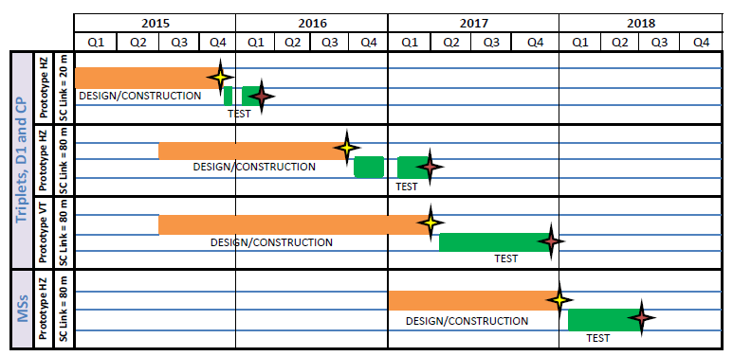
Prototype production
From Cost & Schedule Review, March 2015
A. Ballarino, 21/03/2016

Slide 39
Prototype production - by end 2016
First installation and test: a pair of 18 kA leads, full SC Link
MgB₂ wire procured
MgB₂ cabling: DO being prepared for cabling in industry
HTS cables procured
SC Link cryostat – 60 m long - being procured (DO issued, received offers from four companies)
Leads: internal production at CERN in the Main Workshop (together with production of lead for SM-18 test stations). DO for manufacturing of two 18 kA components launched
DFH cryostat: design completed. Production launched in Main Workshop
A. Ballarino, 21/03/2016

Slide 40
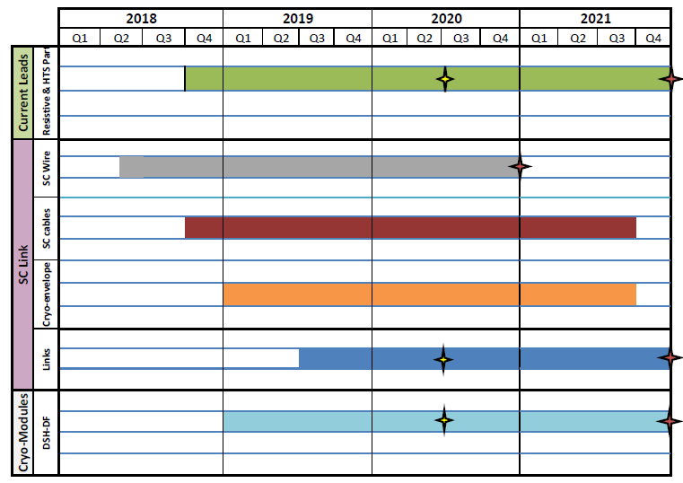
Series Production
Components for String
Delivery of components
End of production
FC Dec 2017
304 units
FC Dec 2017
∼ 3000 km
FC March 2018
304 unit lengths
FC March 2018
8 units
FC June 2018
8 SC Links
8+8 Cryo-Modules
From Cost & Schedule Review, March 2015
A. Ballarino, 21/03/2016

Slide 41
Procurement strategy
Contracts:
  Procurements based on build to print CERN design: Current leads, SC Cables (as for LHC)
  Procurements based on technical specification: MgB₂ and HTS conductor (as for LHC)
  Procurement based on technical specification: Cryostat of SC Link (DSH)
  Integration of SC cables in DSH cryostat: in industry or at CERN
  Procurement of sub-components with in-house cryostating assembly: DFH and DF cryo-assemblies
A. Ballarino, 21/03/2016

Slide 42
Conclusions
Significant activity (design , test, procurement,…) made/being made on the design/test of the Cold Powering system for Hi-Lumi (Triplets and D1)
First prototype system planned to be available at CERN by end 2016
Detailed study of interfaces in tunnel to be launched as well as integration of the system in the tunnel
Needed “final” circuits configuration (voltages, time constants,..) for definition of system and validation of the on-going development/test program
A. Ballarino, 21/03/2016

Slide 43
Thanks for your attention !

