Slide 1
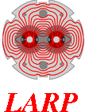

The Inner Triplet Circuit
E. Ravaioli, GL. Sabbi
with inputs from G. Ambrosio, B. Auchmann, J-P. Burnet,
F. Rodriguez-Mateos, H. Prin, E. Todesco, A. Verweij, D. Wollmann,
and many other CERN and LARP colleagues
Conceptual Design Review of the Magnet Circuits for the HL-LHC
21 March 2016

Slide 2
Outline
  Powering scheme and Quench protection system
  CLIQ system
  Coil to QH peak voltages and QH connection scheme
  Failure cases and mitigation strategies

Slide 3
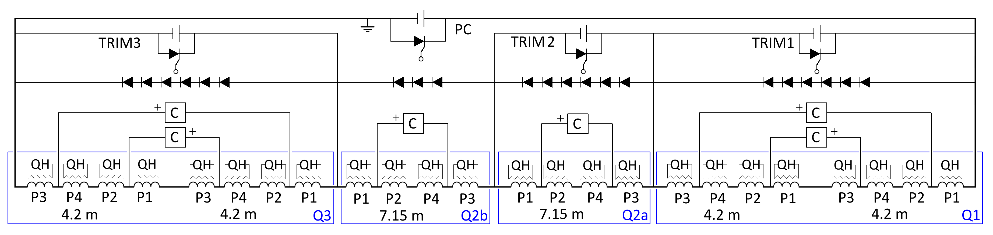
Powering and Quench protection system
POWERING SYSTEM
1 main power supply (2-quadrant)
3 trim power supplies
Parallel Diodes
MAGNETS
4x 4.2 m QXF (LARP)
2x 7.15 m QXF (CERN)
PROTECTION SYSTEM
CLIQ system + Quench Heater system

Slide 4
Outline
  Powering scheme and Quench protection system
  CLIQ system
  Coil to QH peak voltages and QH connection scheme
  Failure cases and mitigation strategies

Slide 5
CLIQ system
6 CLIQ units and 4 warm diode strings per triplet
  The proposed connection scheme of 2 units to Q1/Q3 greatly reduces the peak voltage to ground in the case of misfiring of one CLIQ unit
  Additional current lead between the 2 magnets of Q1/Q3 not needed
  All parallel elements can be installed to the leads already foreseen for the trim power supplies
  Polarities of the CLIQ units is a key ingredient! (QA, testing at 50 V)
  All CLIQ units have the same capacitance (easier to design, manufacture, maintain the units). Units connected to Q1/Q3 can be charged to a lower voltage (600 V)
  Warm diodes are preferred over resistors (no leakage current during ramps, better control of the voltages to ground in failure cases)

Slide 6
CLIQ – Circuit behavior
6 CLIQ units and 4 warm diode strings per triplet
AC currents
Parallel diodes only carry small current differences between magnets during the discharge
Voltages to ground just after triggering
600V
1kV
1kV
600V
600V
600V
~0
+300V
-300V
+300V
-300V
~0
+500V
-500V
~0
+500V
-500V
~0
+300V
-300V
+300V
-300V
~0

Slide 7
Simulated currents in the circuit
Q2a/Q2b
Q1/Q3
CLIQ units for Q2a/Q2b
Charging voltage: 1000 V
Capacitance: 40 mF
CLIQ units for Q1/Q3
Charging voltage: 600 V
Capacitance: 40 mF
Diodes
Hot-spot temperature T_{hot}~230 K
Currents through the SC Link (no fault case)
Main leads: Magnet current ± AC oscillations, 1.5 kA, 12 Hz
Trim leads: Their initial current + AC pulse, 500 A, 12 Hz
CLIQ

Slide 8
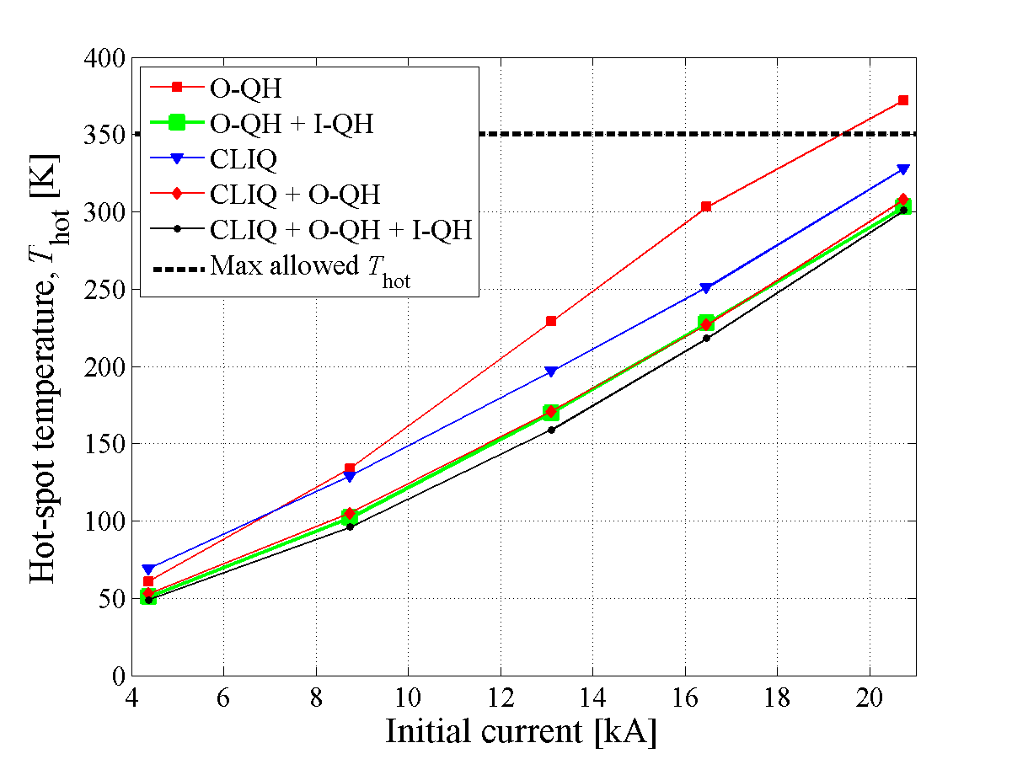
Simulated hot-spot temperature
Nominal I
Protection system | Hot-spot T
CLIQ | 250 K
CLIQ+8 outer QH’s | 230 K
CLIQ+8 outer QH’s+4 inner QH’s | 220 K
CLIQ+4 outer QH in HF region | 240 K
The more QH units are triggered, the higher the probability of degrading the electrical insulation
CLIQ + outer QH’s seems the best compromise for reducing
hot-spot temperature and thermal stress, and increasing redundancy and robustness.

Slide 9
Simulated voltages to ground
Voltages to ground and between coil sections in Q1/Q3 are 40% lower than Q2a/Q2b
Q1
Q2a
Q2b
Q3

Slide 10
Outline
  Powering scheme and Quench protection system
  CLIQ system
  Coil to QH peak voltages and QH connection scheme
  Failure cases and mitigation strategies

Slide 11
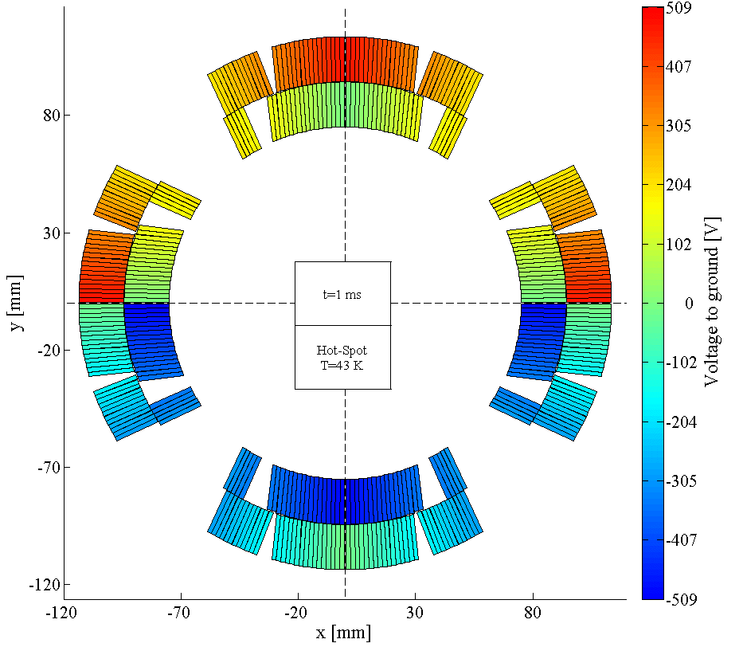
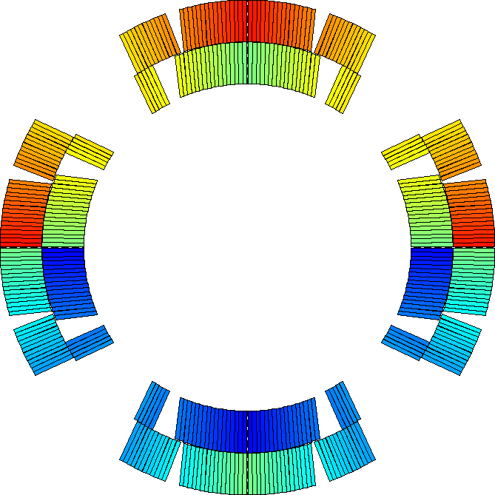
CLIQ-induced voltage distribution
  The voltage distribution in the windings just after triggering CLIQ remains almost constant along the magnet length, but is inhomogeneous in the magnet cross-section

Slide 12
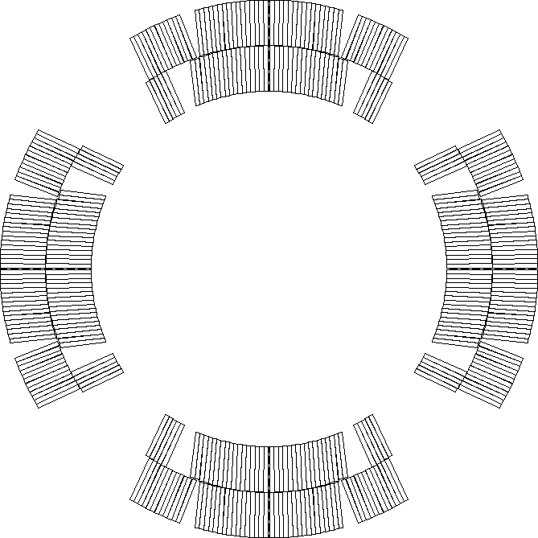
QH-induced voltage distribution
  The voltage distribution in the QH strips just after triggering varies linearly along the conductor length, but is homogeneous in the cross-section
+
-

Slide 13
Coil to heater voltage optimization
  CLIQ and QH are triggered simultaneously. It is important to choose a QH connection scheme that compensates the voltages induced by CLIQ and QH
LF3
LF2
Q2a/Q2b case
HF3
HF2
Peak coil-to-QH voltages ≤500 V
HF4
HF1
IN3
IN2
LF4
IN4
IN1
LF1
LF1
IN1
IN4
LF4
IN2
IN3
HF1
HF4
Peak coil-to-QH voltages ≤500 V
HF2
LF2
LF3
HF3

Slide 14
Proposed QH connection scheme
Each QH supply is connected to 2 strips in series
  Connection scheme that compensates the voltages induced by CLIQ and QH
  Connecting in series 2 strips attached to different poles reduces the effects of failures (hot-spot temperature, voltage distribution)
LF3
LF2
HF3
HF2
HF4
HF1
IN3
IN2
LF4
IN4
IN1
LF1
Standard LHC quench heater power supply
Charging voltage: 900 V
Voltage to ground: ±450 V
Capacitance: 7.05 mF
Note: 2x 450 V, 14.1 mF modules in series
LF1
IN1
IN4
LF4
IN2
IN3
HF1
HF4
  Only a quarter of the circuits shown
HF2
LF2
LF3
HF3

Slide 15
Outline
  Powering scheme and Quench protection system
  CLIQ system
  Coil to QH peak voltages and QH connection scheme
  Failure cases and mitigation strategies

Slide 16
Summary of failure cases -1
Failure | Consequences | Probability | Mitigation
One QH supply (2 strips) not triggered | Hot-spot T = Peak voltage to ground = | Low | Parallel diodes CLIQ
Two QH supplies (4 strips) not triggered | Hot-spot T = Peak voltage to ground = | Very low | Parallel diodes CLIQ
CLIQ capacitor in open circuit | Hot-spot T = Peak voltage to ground = ~500 A through the diodes | Low | Capacitors in parallel Parallel diodes
CLIQ capacitor in short circuit | Hot-spot T = Peak voltage to ground = ~1 kA through the diodes | Very low | Capacitors in series Parallel diodes
One CLIQ unit triggered spuriously | Hot-spot T = Peak voltage to ground = ~2 kA through the diodes | Very low | Units interlocked Parallel diodes
One CLIQ unit not triggered | Hot-spot T +70 K (290-305 K) Peak voltage to ground = ~2.5 kA through the diodes | Very low | Double triggers Voltage monitor Parallel diodes QH
One CLIQ unit and one QH supply not triggered | Hot-spot T +70 K (290-305 K) Peak voltage to ground = ~2.5 kA through the diodes | Very low | QH connection scheme Parallel diodes

Slide 17
Summary of failure cases -2
Failure | Consequences | Probability | Mitigation
One parallel element disconnected | Hot-spot T = Peak voltage to ground = ~500 A through the diodes | Very low
One lead of the parallel elements disconnected | Hot-spot T = Peak voltage to ground = ~500 A through the diodes | Very low
Two leads of the parallel elements disconnected | Hot-spot T = Peak voltage to ground 600 V ~500 A through the diodes | Nihil | Monitoring currents in the circuit during each discharge
Entire CLIQ unit in short circuit | Hot-spot T +70 K (<300 K) Peak voltage to ground = ~2.5 kA through the diodes CLIQ unit to replace | Nihil | Capacitors in series CLIQ chargers protected QH
One CLIQ unit not triggered and one lead of the parallel elements disconnected | Hot-spot T +50 K (<280 K) Peak voltage to ground 1.6 kV ~1.5 kA through the diodes | Nihil | Monitoring currents in the circuit during each discharge
One CLIQ unit and all QH protecting the same magnet not triggered | Hot-spot T >500 K Magnet current through the diodes | Nihil | Redundant triggers for CLIQ and QH

Slide 18
Worst-case analysis
  The probability of particularly dangerous failure cases can be almost nullified by implementing the proposed mitigations.
  In the remaining “realistic” failure cases, the worst-case analysis yields
 | Q2a/Q2b (7.15 m) | Q1/Q3 (4.2 m)
Peak hot-spot temperature | 320 K | 320 K
Peak voltage to ground | 520 V | 430 V
Peak coil-to-QH voltage | 520 V | 430 V
Peak mid-plane voltage | 500 V | 400 V
Peak layer-to-layer voltage | 500 V | 340 V
Peak turn-to-turn voltage | 50 V | 30 V

Slide 19
Conclusion
  Powering scheme
      1 main 2-quadrant power supply + 3 trim supplies
  Protection system
      6 CLIQ units per inner triplet circuit
      8 QH circuits (+ 4 spares) per magnet
      4 strings of parallel Diodes
  QH connection scheme
      Compensating voltages induced by CLIQ and QH
  Failure case analysis
      Mitigation strategies identified
      Worst-case scenarios assessed

Slide 20
Annex
  Here you’ll find:
  Criteria for the powering and protection design choices
  Tables of characteristic voltages in failure cases
  Simulated hot-spot temperature and temperature distribution
  Why do we need parallel elements
  Simulations of failure cases
  Quick way to tell if a CLIQ configuration is optimized for MQXF or not
  Influence of an energy-extraction system
  What is CLIQ

Slide 21
Notes
  When not specified:
  The powering scheme includes one power supply (less expensive, more challenging)
  EE system is not present
  QH attached to the outer layer of the coil (2 circuits per pole) but not to the inner layer
  Current level set to the nominal current (I₀=16.47 kA)
  Each CLIQ unit has a capacitance C=40 mF charged to U₀=1 kV
  Each QH system has 8 circuits, each with a capacitance 9.6 mF charged to ±450 V (Q1/Q3) or ±300 V (Q2a/Q2b)

Slide 22
Powering and Quench protection system
  This is a conceptual diagram. The actual electrical order and connection scheme of the poles of each magnet will depend on several factors:
  Opposite field orientation required for Q1/Q3 versus Q2a/Q2b
  Naming of the poles based on the physical position they occupy (with respect to the lead end? to the interaction point?)
  Pizza box design
  Rotation of the coil around its axis
  Positioning of the lead ends of each magnet

Slide 23
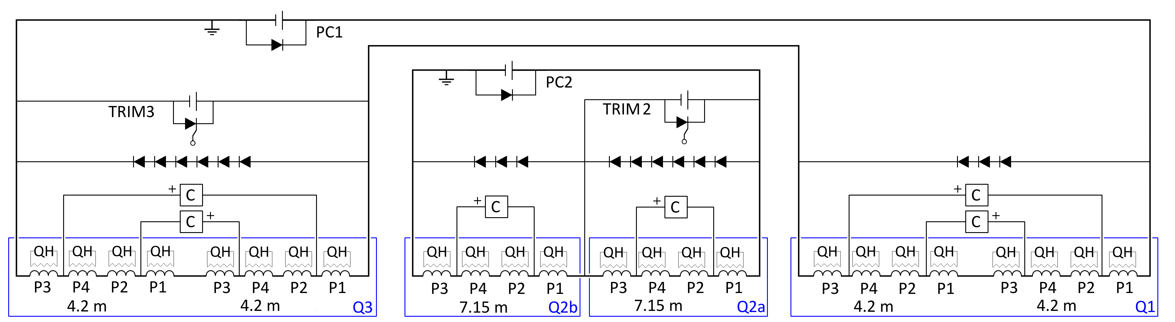

Powering schemes
Baseline: Two main 1-quadrant power supplies + 2 trim power supplies
Slow discharge with free-wheel discharge
One main 2-quadrant power supplies + 3 trim power supplies
Slow discharge achieved with 2-quadrant supply
Little impact on magnet protection!

Slide 24
1 or 2 circuits – Advantages
 | 1 Circuit |  | 2 Circuits
Criterion | Fulfillment | Advantages | Fulfillment | Advantages
Protection | 1 |  | 1 | Lower stored energy per circuit
Compatibility | 0.8 | Less effect of power converter ripples on beams as compensated. Faster ramp down (2 Quadrant PC) | 0.8
Reliability | 0.7 | Less electromagnetic interference. | 0.8 | Reduced # of high current quenches. Better distribution of voltage to ground during quench (without parallel elements).
Availability | 0.8 | Less high current power converters & links → less beam aborts | 0.7 | Quicker quench recovery (firing of heaters in less magnets).
Maintainability | 0.8 | Less high current power converters & links | 0.6
Simplicity | 0.7 | Less high current leads. | 0.6 | Only two trim circuits.
Cost saving | 1 | 1 main power converter (but 3 trims). Less high current leads + less splices. Reduced operational costs | 0.7
Space Saving | 1 | 1 main power converter (but 3 trims). Less high current leads. 2 Quadrant power converters save space (less warm cables needed) | 0.6
Judgment of fulfillment [0…1], subjective and open for discussions

Slide 25
Options for the quench protection
 | CLIQ + Outer QH (+Inner QH?) |  | Outer QH + Inner QH
Criterion | Fulfillment | Features | Features | Fulfillment
Protection | 1 | Hot-spot temperature <300 K and peak voltage to ground <500 V in all realistic failure cases analyzed |  | 0.9
Compatibility | 1 | Less dependence on magnet/cable/strand parameters |  | 0.9
Reliability | 1 | Higher redundancy No expected performance degradation More homogeneous temperature distribution in the coil windings | Lower characteristic voltages (in absence of failures) Some concern on long-term inner QH performance | 0.75
Availability | 0.9 (0.8) | 1 CLIQ and 8(+4) QH supplies per magnet [Option to rely on less QH power supplies increasing availability at the cost of redundancy] | 8+4 QH supplies per magnet | 0.9
Maintainability | 1 | Very easy repair/replacement of damaged CLIQ units (room temperature operation) |  | 0.9
Simplicity | 0.9 | Less dependence on magnet/cable/strand parameters | R&D needed for Inner QH technology Easier modelling | 0.9
Cost saving | 0.9 (0.8) | 1 CLIQ and 8(+4) QH supplies per magnet | 8+4 QH supplies per magnet | 0.9
Space Saving | 0.9 (0.8) | 1 CLIQ and 8(+4) QH supplies per magnet | 8+4 QH supplies per magnet | 0.9

Slide 26
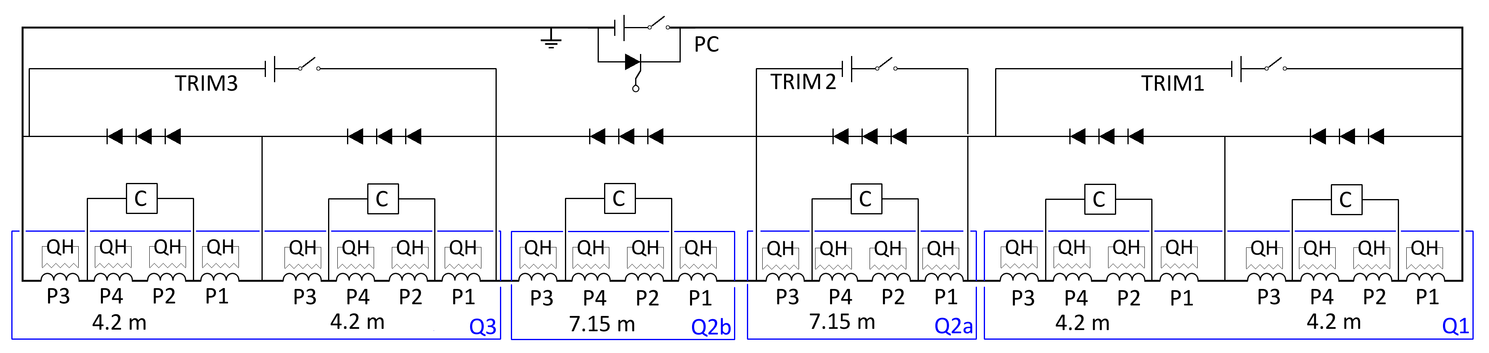
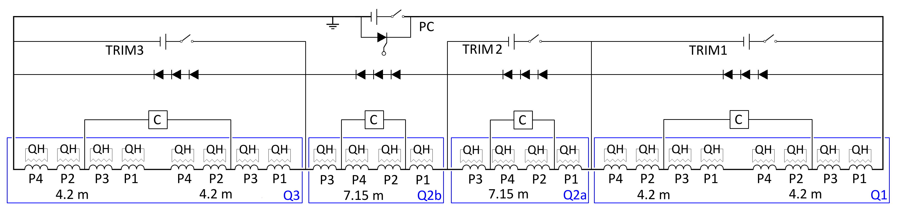
CLIQ configuration -1
6 CLIQ units and 6 warm diode strings per triplet
4 CLIQ units and 4 warm diode strings per triplet
Less CLIQ units, parallel elements, parallel leads. But change of the electrical order of Q1/Q3 required, and peak voltages to ground in Q1/Q3 increased.

Slide 27
What are the expected voltages during a discharge?

Slide 28
Simulated currents in the circuit
4-CLIQ
4 Warm Diodes
6-CLIQ
4 Warm Diodes
Negligible difference in the hot-spot temperature (T_{hot}~230 K)

Slide 29
Simulated voltages to ground
4-CLIQ
4 Warm Diodes
6-CLIQ
4 Warm Diodes
Q1
Q2a
Q2b
Q3
Q1
Q2a
Q2b
Q3
Reduced voltages to ground and between coil sections in Q1/Q3 by 40%

Slide 30
Options for CLIQ configuration
 | 6-CLIQ, 4 Warm Diodes |  | 4-CLIQ, 4 Warm Diodes
Criterion | Fulfillment | Advantages | Advantages | Fulfillment
Protection | 1 | Both options assure hot-spot temperature <300 K and peak voltage to ground <500 V in all realistic failure cases analyzed |  | 1
Compatibility | 1 | Both options use identical CLIQ units for all magnets |  | 1
Reliability | 1 | Reduces voltages to ground and between coil sections in Q1/Q3 by 40% |  | 0.85
Availability | 0.9 |  | 4 CLIQ units per triplet circuit instead of 6 | 1
Maintainability | 0.9 |  | 4 CLIQ units per triplet circuit instead of 6 | 1
Simplicity | 0.9 | Same pole electrical order and similar CLIQ connection scheme for short and long magnets. CLIQ performance can be tested in machine-relevant configuration more easily. | 4 CLIQ units per triplet circuit instead of 6 | 0.7
Cost saving | 0.9 | No need to redesign the pizza box of Q1/Q3 | 4 CLIQ units per triplet circuit instead of 6 | 0.9
Space Saving | 0.9 |  | 4 CLIQ units per triplet circuit instead of 6 | 1

Slide 31
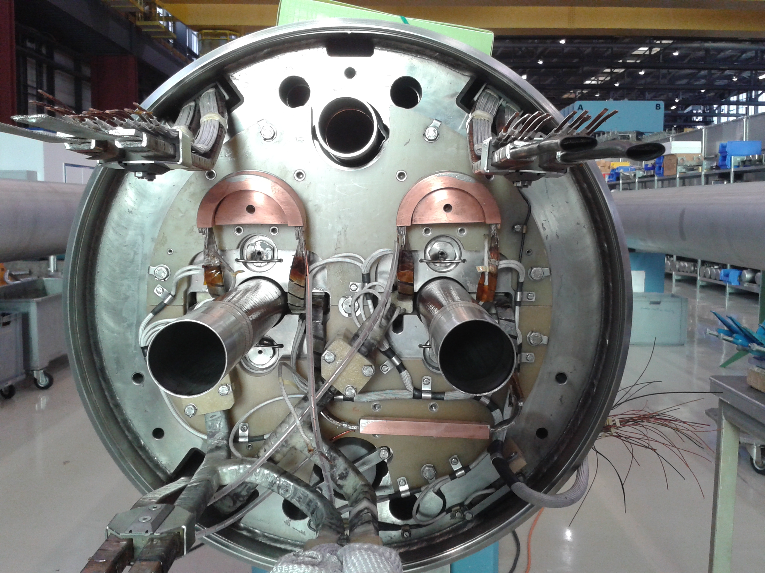
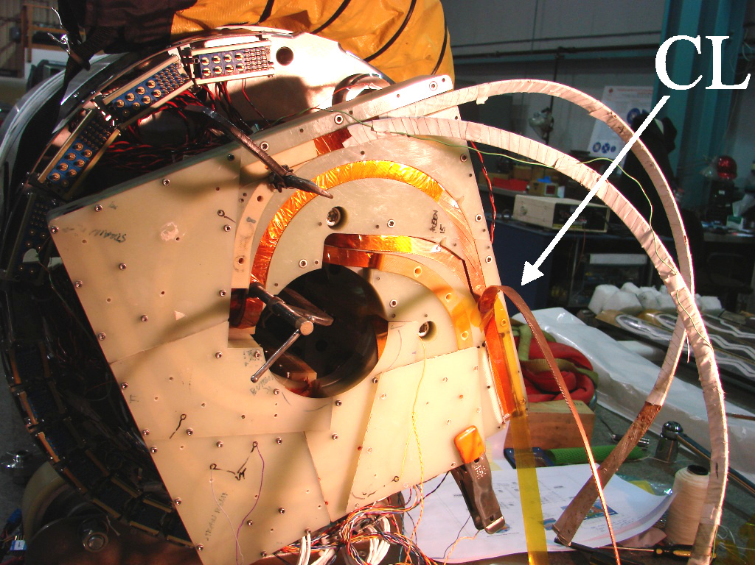
What are the requirements for the CLIQ terminal and leads?
  Leads attached to the coils: Copper cross-section >10 mm2, RRR>100
  Superconducting lead preferred to further reduce its resistance
  Leads outside the cryostat: If the units are located relatively far from the magnet area (80 m?), larger cross-section needed
  Target: Overall resistance of a CLIQ discharge system (external leads + internal resistance of the unit) < 10 mΩ
Aug 2015: full-size 15 m LHC main dipole
2014: H02b
Courtesy of Dan Cheng

Slide 32
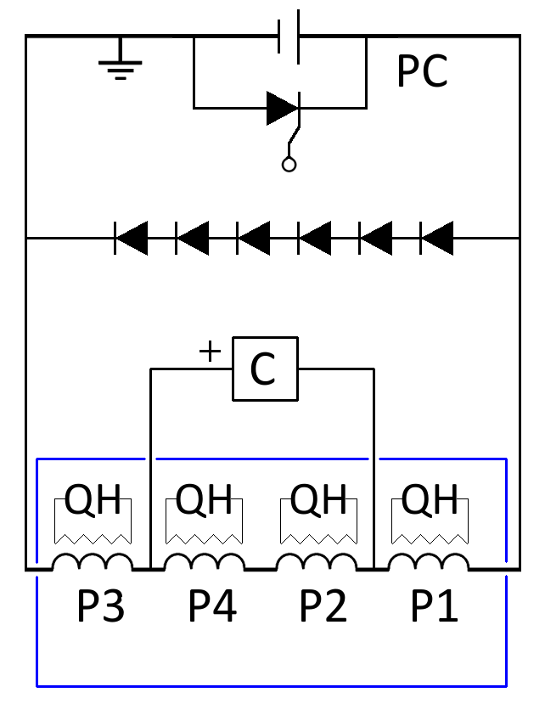
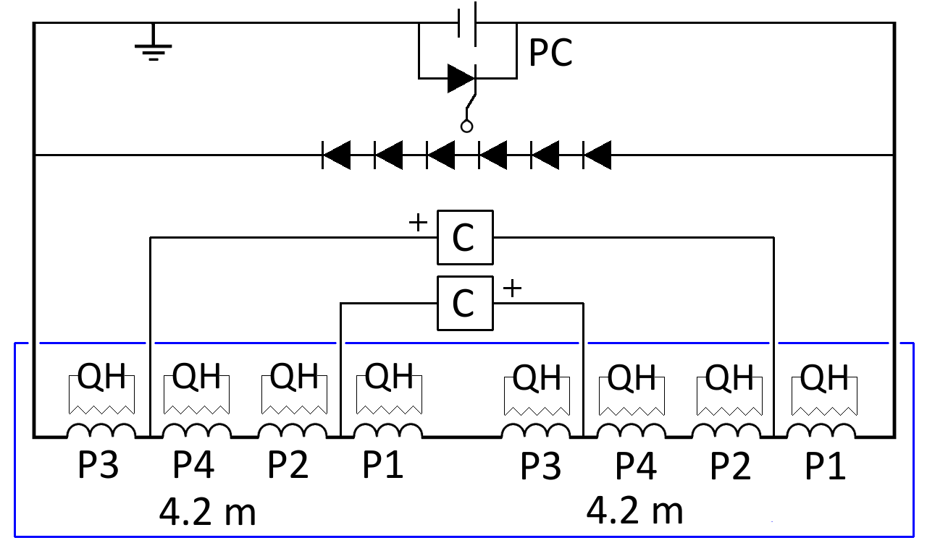
Test of magnets and cold masses
6 CLIQ units and 4 warm diode strings per triplet
Magnet test (7.15 or 4.2 m long)
Cold mass test (2x 4.2 m long)

Slide 33
Sim- 1 QH supply (2 strips) not triggered
D
4-CLIQ 40 mF, 600 V
2-CLIQ 40 mF, 1 kV
Peak voltages to ground unchanged
300 500 V
(Q1/Q3 Q2a/Q2b)
Hot-spot temperature
unchanged
Peak current in the parallel elements
500-750 A
for 50-100 ms

Slide 34
Sim- 2 QH supplies (4 strips) not trig’d
D
4-CLIQ 40 mF, 600 V
2-CLIQ 40 mF, 1 kV
Peak voltages to ground unchanged
300 500 V
(Q1/Q3 Q2a/Q2b)
Hot-spot temperature
unchanged
Peak current in the parallel elements
500-750 A
for 50-100 ms

Slide 35
Sim- One CLIQ unit not triggered
D
4-CLIQ 40 mF, 600 V
2-CLIQ 40 mF, 1 kV
Peak voltages to ground unchanged
300 500 V
(Q1/Q3 Q2a/Q2b)
Hot-spot temperature
305 K
Peak current in the parallel elements
2-2.5 kA
for 100-200 ms

Slide 36
Sim- One CLIQ unit not triggered
D
4-CLIQ 40 mF, 600 V
2-CLIQ 40 mF, 1 kV
Peak voltages to ground unchanged
300 500 V
(Q1/Q3 Q2a/Q2b)
Hot-spot temperature
291 K
Peak current in the parallel elements
1.5-2 kA
for 100-200 ms

Slide 37
Sim- 1 CLIQ and 1 QH supply (2 strips) not trig’d
D
4-CLIQ 40 mF, 600 V
2-CLIQ 40 mF, 1 kV
Peak voltages to ground unchanged
300 500 V
(Q1/Q3 Q2a/Q2b)
Hot-spot temperature
299 K
Peak current in the parallel elements
2-2.5 kA
for 100-300 ms

Slide 38
Sim- Disconnection of one parallel lead
D
4-CLIQ 40 mF, 600 V
2-CLIQ 40 mF, 1 kV
Peak voltages to ground slightly increased
375 500 V
(Q1/Q3 Q2a/Q2b)
Hot-spot temperature
unchanged
Peak current in the parallel elements
500-750 A
for 50-100 ms

Slide 39
Sim- Disconnection of a parallel diode
D
4-CLIQ 40 mF, 600 V
2-CLIQ 40 mF, 1 kV
Peak voltages to ground slightly increased
385 500 V
(Q1/Q3 Q2a/Q2b)
Hot-spot temperature
unchanged
Peak current in the parallel elements
500 A
for <50 ms

Slide 40
Sim- CLIQ not trig’d + lead disconnected
D
4-CLIQ 40 mF, 600 V
2-CLIQ 40 mF, 1 kV
Peak voltages to ground greatly increased!
1619 500 V
(Q1/Q3 Q2a/Q2b)
Hot-spot temperature
268-276 K in Q1 and Q2a
Peak current in the parallel elements
1-1.5 kA
for 100-200 ms

Slide 41
Simulation of a short in a CLIQ unit
D
4-CLIQ 40 mF, 600 V
2-CLIQ 40 mF, 1 kV
Peak voltages to ground unchanged
300 500 V
(Q1/Q3 Q2a/Q2b)
Hot-spot temperature
305 K
Peak current in the parallel elements
2-2.5 kA
for 100-200 ms

Slide 42
Simulation of a short in a CLIQ unit
D
4-CLIQ 40 mF, 600 V
2-CLIQ 40 mF, 1 kV
Peak voltages to ground unchanged
300 500 V
(Q1/Q3 Q2a/Q2b)
Hot-spot temperature
300 K
Peak current in the parallel elements
0.5-1 kA
for 100-200 ms

Slide 43
Simulation of a short in a CLIQ unit
D
4-CLIQ 40 mF, 600 V
2-CLIQ 40 mF, 1 kV
Peak voltages to ground unchanged
300 500 V
(Q1/Q3 Q2a/Q2b)
Hot-spot temperature
269 K
Peak current in the parallel elements
1-1.5 kA
for 100-200 ms

Slide 44
Sim- CLIQ and all QH not triggered
D
4-CLIQ 40 mF, 600 V
2-CLIQ 40 mF, 1 kV
500K→
Peak voltages to ground unchanged
300 500 V
(Q1/Q3 Q2a/Q2b)
Hot-spot temperature
>>500 K
Parallel elements will receive the circuit current

Slide 45
Simulated characteristic voltages
Characteristic voltage | 4-CLIQ 40mF/600V 2-CLIQ 40mF/1kV |  | 4-CLIQ 40mF/1kV |  | 4-CLIQ 40mF/600V Opt 2-CLIQ 40mF/1kV
NO FAILURES | Q1/Q3 | Q2a/Q2b | Q1/Q3 | Q2a/Q2b | Q1/Q3 | Q2a/Q2b
Peak voltage to ground [V] | 316 | 513 | 513 | 509 | 316 | 512
Turn to turn voltage [V] | 16* | 29* | 16* | 28* | 19* | 32*
Mid-plane voltage [V] | 307 | 509 | 500 | 512 | 307 | 509
Layer to layer voltage [V] | 295 | 496 | 247 | 492 | 296 | 495
Layer-layer of adjacent poles [V] | 600 | 1000 | 505 | 1000 | 600 | 1000
CLIQ unit Q1 not triggered | Q1/Q3 | Q2a/Q2b | Q1/Q3 | Q2a/Q2b | Q1/Q3 | Q2a/Q2b
Peak voltage to ground [V] | 312 | 509 | 502 | 509 | 313 | 509
Turn to turn voltage [V] | 28* | 32* | 29* | 32* | 28* | 32*
Mid-plane voltage [V] | 307 | 512 | 497 | 512 | 307 | 512
Layer to layer voltage [V] | 295 | 492 | 246 | 492 | 297 | 492
Layer-layer of adjacent poles [V] | 600 | 1000 | 502 | 1000 | 600 | 1000
CLIQ unit Q2a not triggered | Q1/Q3 | Q2a/Q2b | Q1/Q3 | Q2a/Q2b | Q1/Q3 | Q2a/Q2b
Peak voltage to ground [V] | 318 | 506 | 502 | 516 | 316 | 506
Turn to turn voltage [V] | 16* | 42* | 19* | 47* | 19* | 46*
Mid-plane voltage [V] | 307 | 512 | 497 | 512 | 307 | 512
Layer to layer voltage [V] | 295 | 492 | 246 | 492 | 492 | 492
Layer-layer of adjacent poles [V] | 600 | 1000 | 502 | 1000 | 600 | 1000
Note: When not specified, peaks occur 1 ms after triggering the protection system. Values marked with “*” refer to a peak occurring 100-120 ms after triggering the protection system.

Slide 46
Simulated characteristic voltages
Characteristic voltage | 4-CLIQ 40mF/600V 2-CLIQ 40mF/1kV |  | 4-CLIQ 40mF/1kV |  | 4-CLIQ 40mF/600V Opt 2-CLIQ 40mF/1kV
Disconnection of 1 // lead | Q1/Q3 | Q2a/Q2b | Q1/Q3 | Q2a/Q2b | Q1/Q3 | Q2a/Q2b
Peak voltage to ground [V] | 418* | 522* |  |  | 375 | 521
Turn to turn voltage [V] | 19* | 32* |  |  | 19* | 33*
Mid-plane voltage [V] | 421 | 509 |  |  | 339 | 509
Layer to layer voltage [V] | 295 | 499 |  |  | 296 | 500
Layer-layer of adjacent poles [V] | 600 | 1000 |  |  | 600 | 1000
Disconnection of 2 // leads | Q1/Q3 | Q2a/Q2b | Q1/Q3 | Q2a/Q2b | Q1/Q3 | Q2a/Q2b
Peak voltage to ground [V] | 527* | 642*
Turn to turn voltage [V] | 19* | 32*
Mid-plane voltage [V] | 493 | 509
Layer to layer voltage [V] | 295 | 498
Layer-layer of adjacent poles [V] | 600 | 1000
One // diode in open circuit | Q1/Q3 | Q2a/Q2b | Q1/Q3 | Q2a/Q2b | Q1/Q3 | Q2a/Q2b
Peak voltage to ground [V] |  |  |  |  | 385 | 521
Turn to turn voltage [V] |  |  |  |  | 19* | 32*
Mid-plane voltage [V] |  |  |  |  | 314 | 509
Layer to layer voltage [V] |  |  |  |  | 296 | 498
Layer-layer of adjacent poles [V] |  |  |  |  | 600 | 1000
Note: When not specified, peaks occur 1 ms after triggering the protection system. Values marked with “*” refer to a peak occurring 100-120 ms after triggering the protection system.

Slide 47
Simulated characteristic voltages
Characteristic voltage | 4-CLIQ 40mF/600V 2-CLIQ 40mF/1kV |  | 4-CLIQ 40mF/1kV |  | 4-CLIQ 40mF/600V Opt 2-CLIQ 40mF/1kV
1 OutHF QH not triggered | Q1/Q3 | Q2a/Q2b | Q1/Q3 | Q2a/Q2b | Q1/Q3 | Q2a/Q2b
Peak voltage to ground [V] | 318 | 513 |  |  | 316 | 512
Turn to turn voltage [V] | 20* | 32* |  |  | 19* | 32*
Mid-plane voltage [V] | 307 | 509 |  |  | 307 | 509
Layer to layer voltage [V] | 295 | 496 |  |  | 296 | 495
Layer-layer of adjacent poles [V] | 600 | 1000 |  |  | 600 | 1000
2 OutHF QH not triggered | Q1/Q3 | Q2a/Q2b | Q1/Q3 | Q2a/Q2b | Q1/Q3 | Q2a/Q2b
Peak voltage to ground [V] | 316 | 513 |  |  | 318 | 512
Turn to turn voltage [V] | 21* | 32* |  |  | 20* | 32*
Mid-plane voltage [V] | 307 | 509 |  |  | 307 | 509
Layer to layer voltage [V] | 295 | 496 |  |  | 296 | 495
Layer-layer of adjacent poles [V] | 600 | 1000 |  |  | 600 | 1000
CLIQ unit Q1 not triggered and disconnection of 1 // lead | Q1/Q3 | Q2a/Q2b | Q1/Q3 | Q2a/Q2b | Q1/Q3 | Q2a/Q2b
Peak voltage to ground [V] | 909 | 509 |  |  | 1619 | 509
Turn to turn voltage [V] | 33* | 32* |  |  | 32* | 50*
Mid-plane voltage [V] | 801 | 512 |  |  | 707 | 1494
Layer to layer voltage [V] | 295 | 492 |  |  | 295 | 492
Layer-layer of adjacent poles [V] | 725 | 1000 |  |  | 600 | 1336
Note: When not specified, peaks occur 1 ms after triggering the protection system. Values marked with “*” refer to a peak occurring 100-120 ms after triggering the protection system.

Slide 48
Simulated characteristic voltages
Characteristic voltage | 4-CLIQ 40mF/600V 2-CLIQ 40mF/1kV |  | 4-CLIQ 40mF/1kV |  | 4-CLIQ 40mF/600V Opt 2-CLIQ 40mF/1kV
1CLIQ and 1 OutHF QH not trig’d | Q1/Q3 | Q2a/Q2b | Q1/Q3 | Q2a/Q2b | Q1/Q3 | Q2a/Q2b
Peak voltage to ground [V] | 324 | 509 |  |  | 428 | 509
Turn to turn voltage [V] | 34* | 32* |  |  | 29* | 32*
Mid-plane voltage [V] | 307 | 512 |  |  | 396 | 512
Layer to layer voltage [V] | 295 | 492 |  |  | 339 | 296
Layer-layer of adjacent poles [V] | 600 | 1000 |  |  | 600 | 1000
1CLIQ and 2 OutHF QH not trig’d | Q1/Q3 | Q2a/Q2b | Q1/Q3 | Q2a/Q2b | Q1/Q3 | Q2a/Q2b
Peak voltage to ground [V]
Turn to turn voltage [V]
Mid-plane voltage [V]
Layer to layer voltage [V]
Layer-layer of adjacent poles [V]
CLIQ Unit in short circuit | Q1/Q3 | Q2a/Q2b | Q1/Q3 | Q2a/Q2b | Q1/Q3 | Q2a/Q2b
Peak voltage to ground [V] | 318 | 506 |  |  | 302 | 509
Turn to turn voltage [V] | 19* | 46* |  |  | 29* | 32*
Mid-plane voltage [V] | 307 | 512 |  |  | 307 | 512
Layer to layer voltage [V] | 295 | 492 |  |  | 296 | 492
Layer-layer of adjacent poles [V] | 600 | 1000 |  |  | 600 | 1000
Note: When not specified, peaks occur 1 ms after triggering the protection system. Values marked with “*” refer to a peak occurring 100-120 ms after triggering the protection system.

Slide 49
No CLIQ – Sim characteristic voltages
Characteristic voltage | Q1/Q3 | Q2a/Q2b
No CLIQ, With // diodes, 1 OutHF QH not trig’d | Q1/Q3 | Q2a/Q2b
Peak voltage to ground [V] | 324* | 330*
Turn to turn voltage [V] | 34* | 46*
Mid-plane voltage [V] | 162* | 35*
Layer to layer voltage [V] | 240* | 374*
Layer-layer of adjacent poles [V] | 149* | 24*
No CLIQ, No // diodes, 1 OutHF QH not trig’d | Q1/Q3 | Q2a/Q2b
Peak voltage to ground [V] | 616* | 729*
Turn to turn voltage [V] | 29* | 50*
Mid-plane voltage [V] | 431* | 170*
Layer to layer voltage [V] | 245* | 427*
Layer-layer of adjacent poles [V] | 223* | 111*
No CLIQ, No // diodes, 2 OutHF QH not trig’d | Q1/Q3 | Q2a/Q2b
Peak voltage to ground [V] | 988* | 1020*
Turn to turn voltage [V] | 27* | 47*
Mid-plane voltage [V] | 802* | 229*
Layer to layer voltage [V] | 408* | 406*
Layer-layer of adjacent poles [V] | 417* | 146*
Note: When not specified, peaks occur 1 ms after triggering the protection system. Values marked with “*” refer to a peak occurring 100-120 ms after triggering the protection system.

Slide 50
Simulated characteristic voltages
Characteristic voltage | 4-CLIQ 40mF/600V 2-CLIQ 40mF/1kV |  | 4-CLIQ 40mF/1kV |  | 4-CLIQ 40mF/600V Opt 2-CLIQ 40mF/1kV
With CLIQ, All QH not trig’d | Q1/Q3 | Q2a/Q2b | Q1/Q3 | Q2a/Q2b | Q1/Q3 | Q2a/Q2b
Peak voltage to ground [V] |  |  |  |  | 358 | 593
Turn to turn voltage [V] |  |  |  |  | 29* | 47*
Mid-plane voltage [V] |  |  |  |  | 307 | 509
Layer to layer voltage [V] |  |  |  |  | 296 | 495
Layer-layer of adjacent poles [V] |  |  |  |  | 600 | 1000
No CLIQ, Only Out QH trig’d | Q1/Q3 | Q2a/Q2b | Q1/Q3 | Q2a/Q2b | Q1/Q3 | Q2a/Q2b
Peak voltage to ground [V]
Turn to turn voltage [V]
Mid-plane voltage [V]
Layer to layer voltage [V]
Layer-layer of adjacent poles [V]
No CLIQ, Out and In QH trig’d | Q1/Q3 | Q2a/Q2b | Q1/Q3 | Q2a/Q2b | Q1/Q3 | Q2a/Q2b
Peak voltage to ground [V] |  |  |  |  | 179* | 285*
Turn to turn voltage [V] |  |  |  |  | 18* | 30*
Mid-plane voltage [V] |  |  |  |  | 46* | 34*
Layer to layer voltage [V] |  |  |  |  | 115* | 193*
Layer-layer of adjacent poles [V] |  |  |  |  | 47* | 34*
Note: When not specified, peaks occur 1 ms after triggering the protection system. Values marked with “*” refer to a peak occurring 100-120 ms after triggering the protection system.

Slide 51
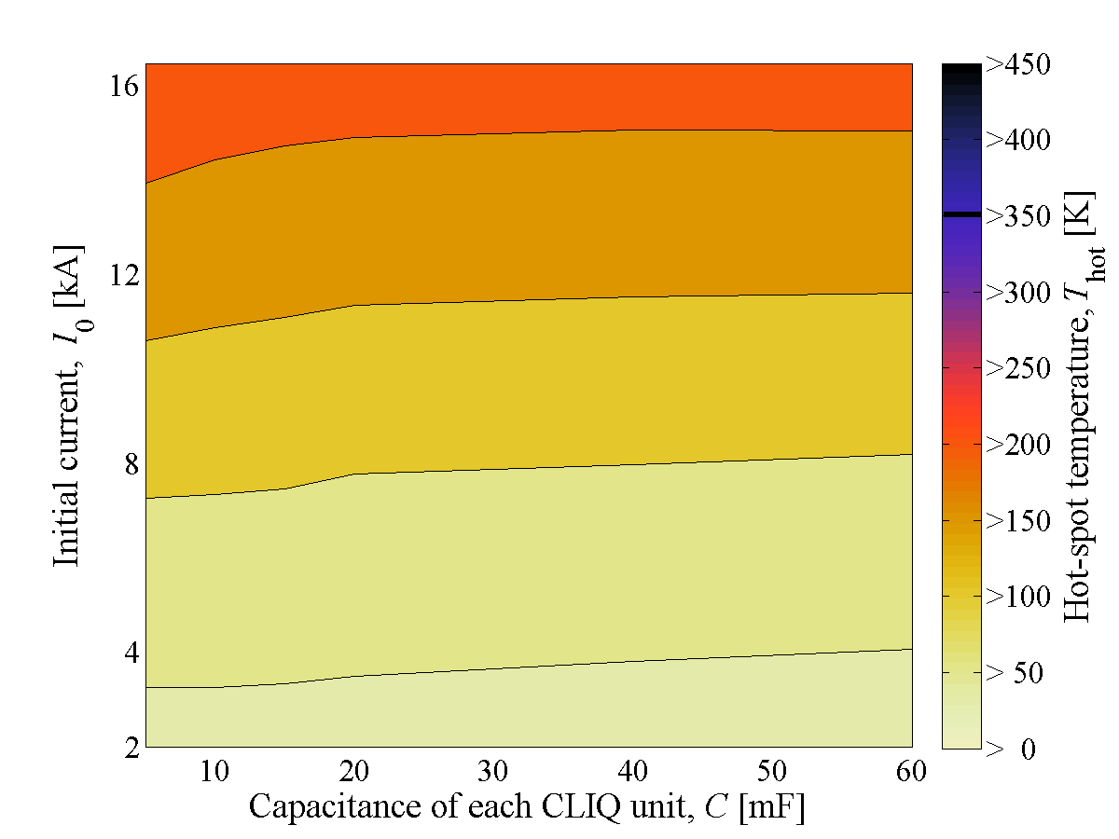
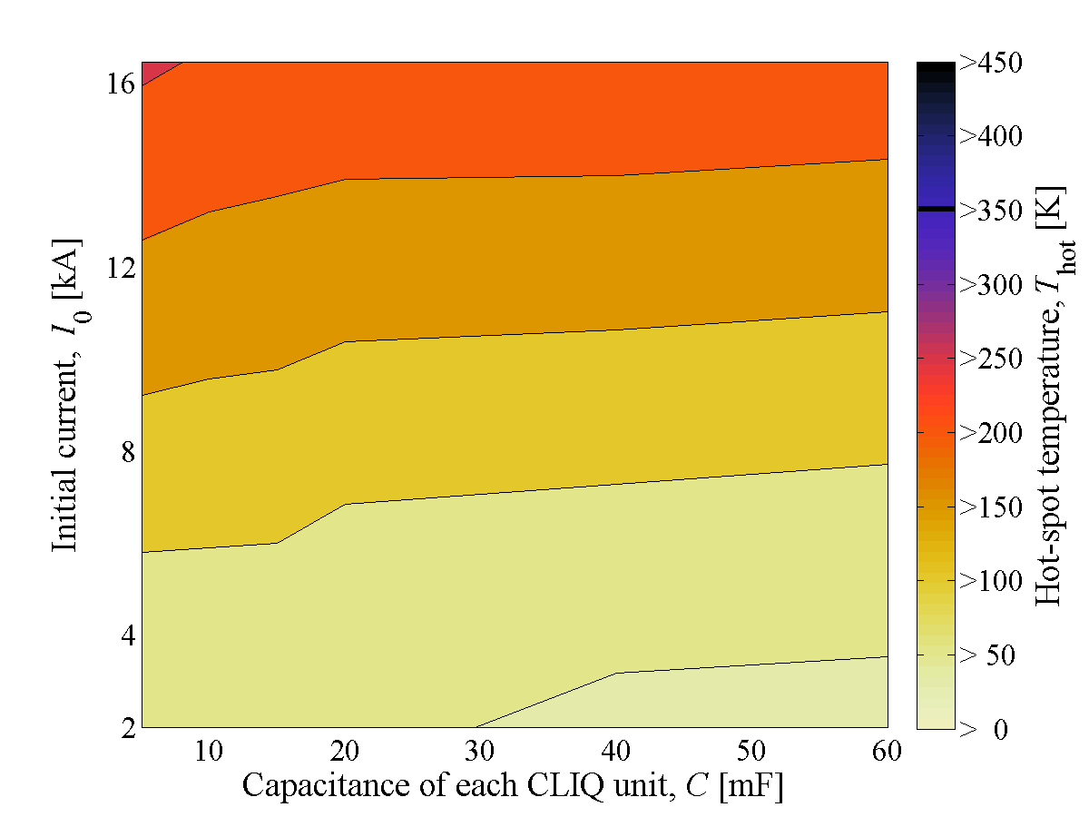
Level of redundancy
  Choose an optimum level of redundancy
      Reduce capacitance of CLIQ units to reduce their size and cost?
      Keep some QH as spares to reduce the risk of degradation?
      Redesign QH to be more effective at low-to-medium current? (Tiina)
  Next step: Once determined the baseline circuit, Failure cases with reduced number of QH units and with reduced capacitance of CLIQ units
Simulated hot-spot temperature
CLIQ + 4 HF QH strips + 4 LF QH strips
CLIQ + 4 HF QH strips

Slide 52
Simulated currents in the circuit
6-CLIQ, 40 mF
6-CLIQ, 10 mF

Slide 53
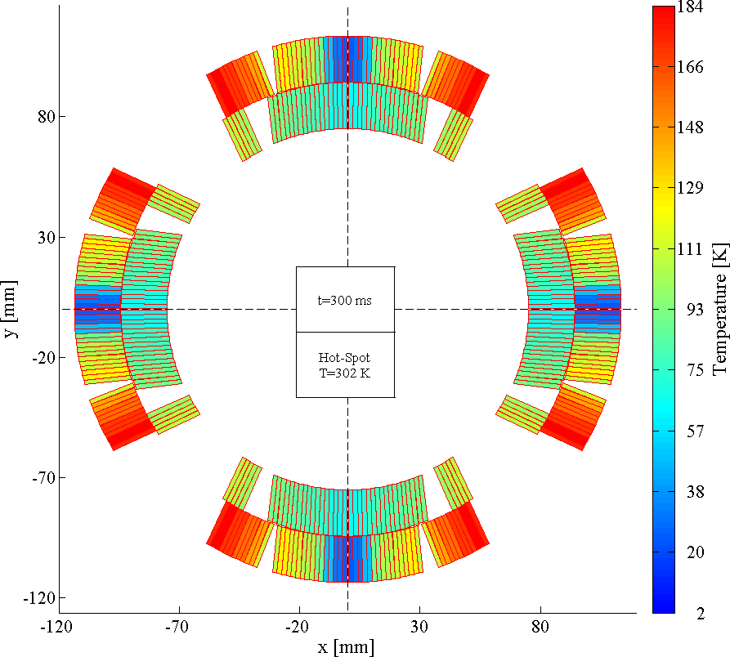
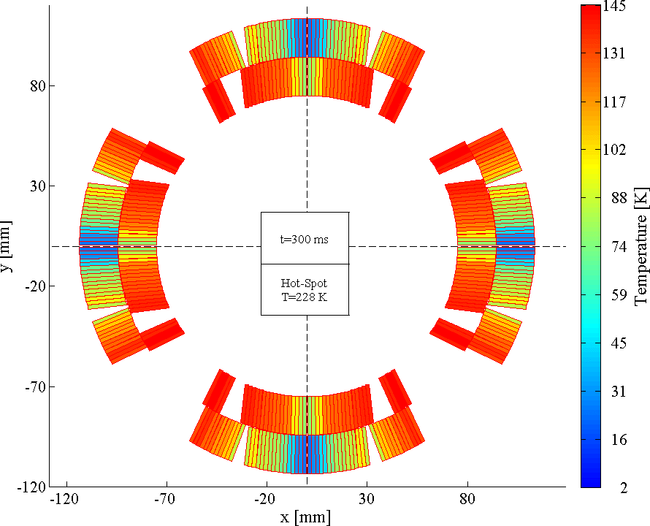
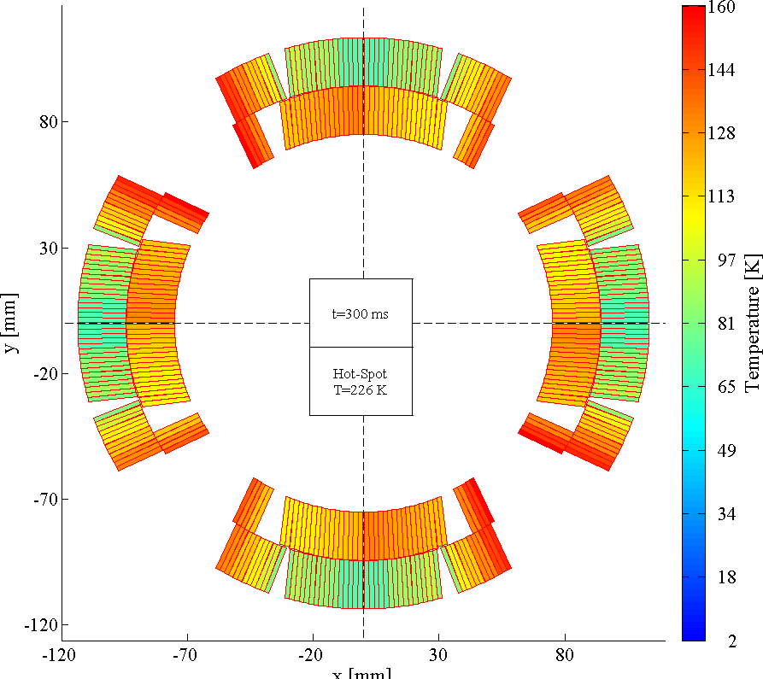
Simulated temperature profiles
  CLIQ + Quench Heaters assure the most homogeneous temperature distribution in the coil windings at the end of a discharge
  Reducing the thermal gradients reduces the thermal stress
Outer QH
Outer+Inner QH
CLIQ + Outer QH
ΔT=140 K
ΔT=100 K
ΔT=85 K

Slide 54
Simulated hot-spot temperature
Nominal I
Protection system | Hot-spot T
CLIQ | 250 K
CLIQ+8 outer QH’s | 230 K
CLIQ+8 outer QH’s+4 inner QH’s | 220 K
CLIQ+4 outer QH in HF region | 240 K
The more QH units are triggered, the higher the probability of degrading the electrical insulation
CLIQ+4 HF outer QH’s seems the best compromise for reducing
hot-spot temperature and thermal stress, and increasing redundancy and robustness.

Slide 55
Why do we need parallel elements?
  Voltages to ground reduced by means of parallel elements across parts of the circuit which equalize the voltage distribution
  Avoid very high voltages to ground in several CLIQ failure cases
  Cold parallel diodes are probably incompatible with the very high expected radiation dose in the interaction regions
  Proposed solution: Warm parallel diodes utilizing existing leads of the trim supplies (but needs different connection schemes for Q1/Q3 and Q2a/Q2b)
  Back-up solution: 1Ω parallel resistors (but leakage currents, cryo loads)
No parallel elements
1 Ω resistors
Warm diodes
Q1
Q2a
Q2b
Q3

Slide 56
Why do we need parallel elements?
Failure: One CLIQ unit not triggered
  Worst-case: CLIQ unit at one end of the circuit is not triggered
  Without parallel elements, the voltage to ground just after triggering the CLIQ units reach 3*U₀=3 kV
4-CLIQ system, no parallel diodes
4-CLIQ system, 4 parallel diodes
Q1
Q2a
Q2b
Q3
Q1
Q2a
Q2b
Q3

Slide 57

Current change
What is CLIQ?
Magnetic field change
Coupling losses (Heat)
Temperature rise
QUENCH
3/21/2016

Slide 58
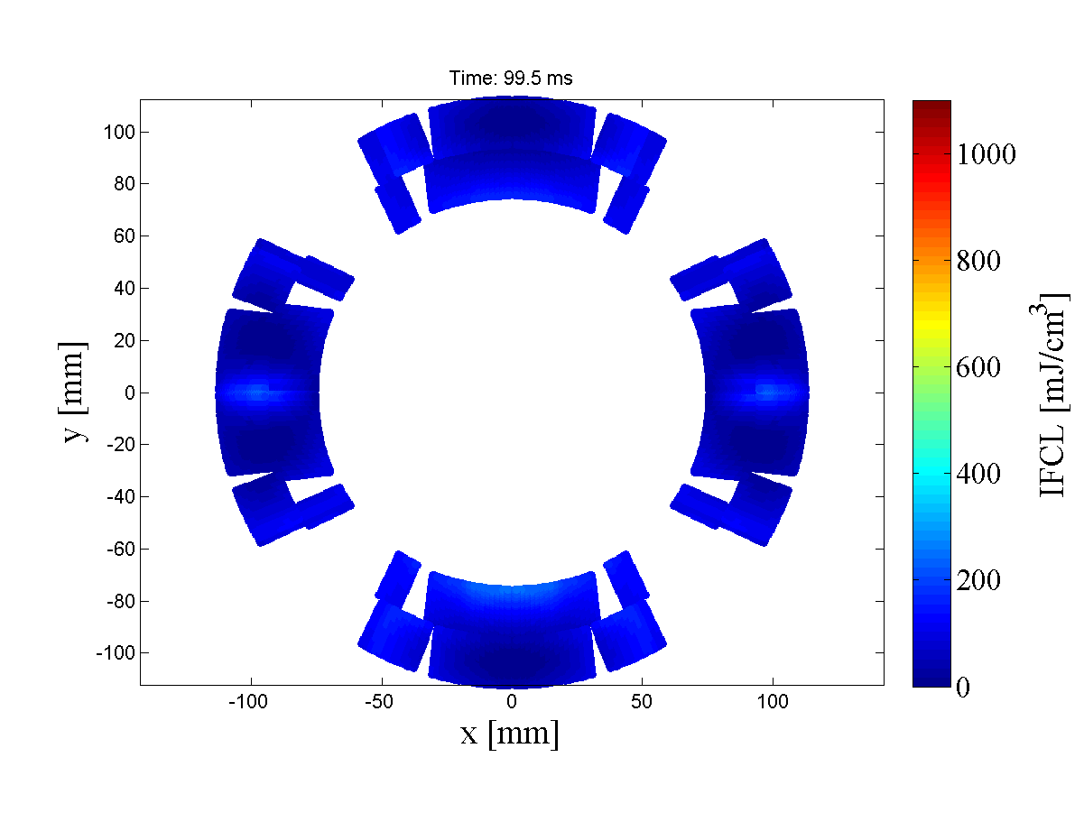
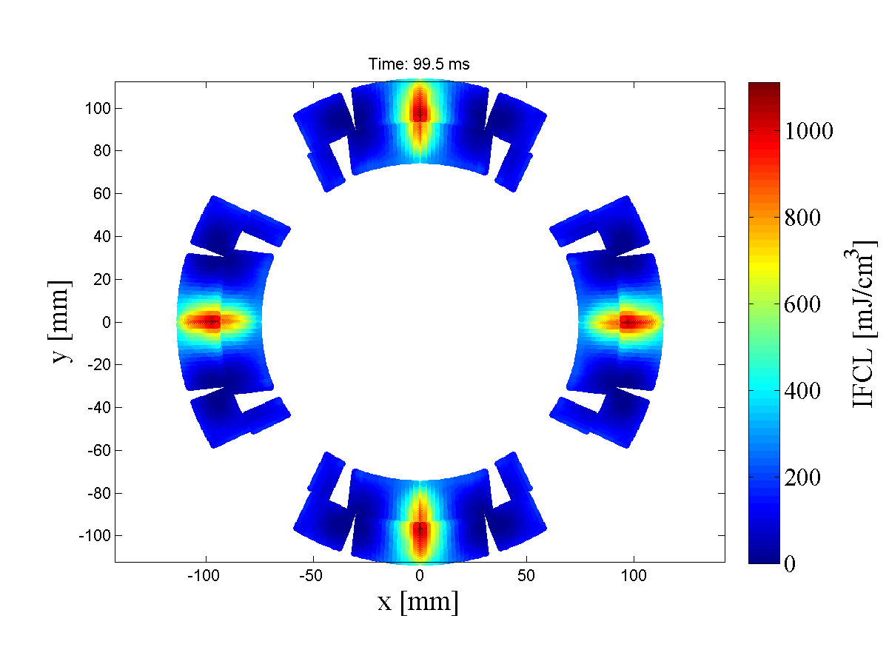
Why does it matter if the pole electrical order is different?
  Depending on the connection of the CLIQ units to the magnets in the circuit, different coil sections will receive different current changes. For MQXF, two options are possible
Not optimized
Optimized
About 10 times faster heat deposition, AND more uniform

Slide 59
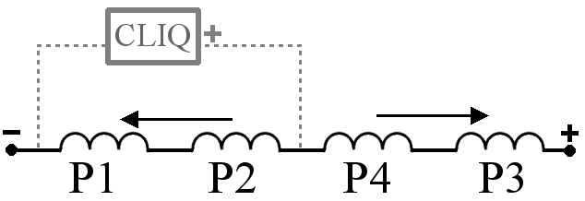

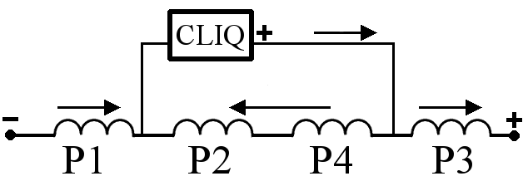

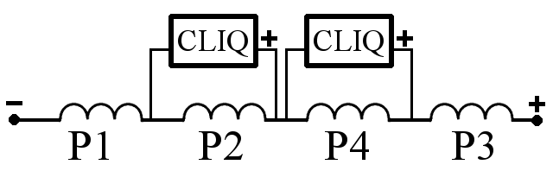
Is there a quick rule to determine whether a configuration is optimized?
  Indeed!
  Poles that are physically adjacent must receive opposite dI/dt.
  Some examples:
2
1
1
2
4
3
3
4
1
2
4
3
1
3
2
4
3
1
2
4
1
2
4
3
2
4
3
1
4
2
1
3

Slide 60
Wouldn’t adding an EE system help?
  The addition of a 50 mΩ EE system decreases the hot-spot temperature only by a few degrees
  On the other hand, the peak voltage to ground is increased
4-CLIQ +OutQH
4-CLIQ +OutQH +EE
OutQH +EE
±500 V
1100 V
-800 V
Q1
Q2a
Q2b
Q3

