Slide 1
Document Plan & Milestones WP7
R. Denz
Acknowledgements: B. Auchmann, F. Rodriguez-Mateos, D. Wollmann, M. Zerlauth
Conceptual Design Review of the Magnet Circuits for the HL-LHC
21-23 March 2016 CERN

Slide 2

Introduction
Proper documentation is a fundamental part of any project and should be regarded as a deliverable of its own.
  This presentation focusses on the documentation for the HiLumi circuit protection.
The timely delivery of the required documentation is essential.
The quality and completeness of the documentation have a direct impact on the system dependability.
Keeping all information up-to-date is self-evident but may require a significant effort.

Slide 3
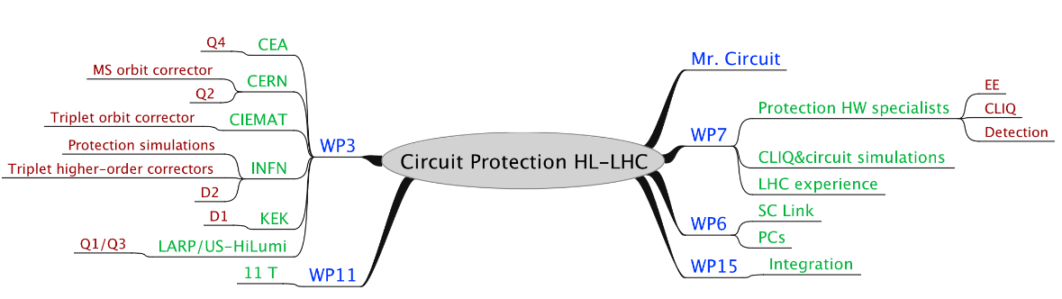
HiLumi Circuit Protection
Many actors involved in the circuit protection for HL-LHC
Documentation supposed to be complete, coherent, up-to-date and approved

Slide 4
Deliverables & Actors
For each circuit type an extensive set of documents is required :
Detection specification (Mr. Circuit, WP 3, 6, 7,11)
Heater design documentation (WP 3, 7, 11)
Active protection specification (Mr. Circuit, WP 3, 6, 7,11)
Specification of ELQA tests voltages (Mr. Circuit and WP 3, 6, 7, 11)
PIC interface documentation (Mr. Circuit, WP 7)
Bus-bar specification (Mr. Circuit, WP 3, 6, 7, 11)
CLIQ, EE: reliability studies (Mr. Circuit, WP 7)
Electric circuit diagram incl. instrumentation (Mr. Circuit, WP 3, 11, 15)
Definition of instrumentation routing (Mr. Circuit and WP 3, 6, 11, 15)

Slide 5


Milestone / Document Plan Overview
Part I: from R&D to Production
16Q1
Circuit & Protection Review
  Conceptual baseline update
16Q3
TDR V1
  Conceptual baseline update
  Electrical drawings
  ECR (if applicable)
16Q3
Cost & Schedule Review
  Conceptual baseline update
17Q2
Protection R&D Documentation
  Mag. & Circuit Protection
  SC Link Protection
  ELQA Test Voltages
Despite the sequential timeline many documents need to be created and processed in parallel.
The functional specification been approved, design changes are still possible but by far more difficult to implement.
17Q4
Functional Specification
  Quench detection
  Heater powering
  CLIQ
  PC protection
17Q3
TDR V2
  Functional spec.
17Q3
Cost & Schedule Review
  Functional spec.
18Q2
Eng. Spec.
  Quench detection
  Heater powering
  CLIQ
  PC protection
  Interfaces

Slide 6

Milestone / Document Plan Overview
Part II: from Production to Operation
Managed by sub-system owners
Timeline still to be finalized
Same sequence for the IT-String
Some documentation (test procedures, manuals) not yet standardized
Production Readiness Reviews
Technical Specifications
Tender & Production
Test Procedures
  Acceptance tests
  Individual system tests etc.
Delivery & Installation
Managed by HC/MP3
Hardware commissioning procedures (WP16)
Hardware commissioning
Review (WP16)
Operational & service manuals
Hardware commissioning (WP16)
Operation

Slide 7
Protection R&D Documentation
New document type proposed and elaborated by Bernhard Auchmann
Essential for understanding the choice of solution selection of components etc.
  Will ease further upgrades and trouble shooting
  To be maintained throughout the LHC lifetime
  Helps to ensure traceability of design project knowledge
Not really existing for LHC
  Private communication, hard-disks etc., folders ...
  The partially lost minutes of the former EEWG is a “famous” example

Slide 8
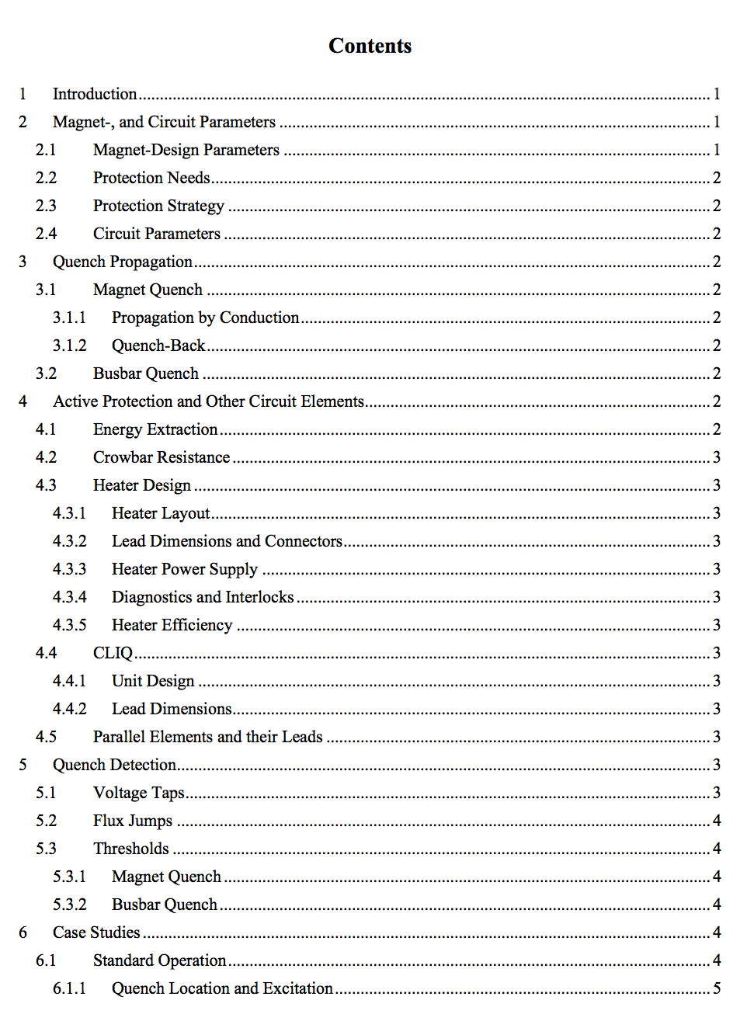
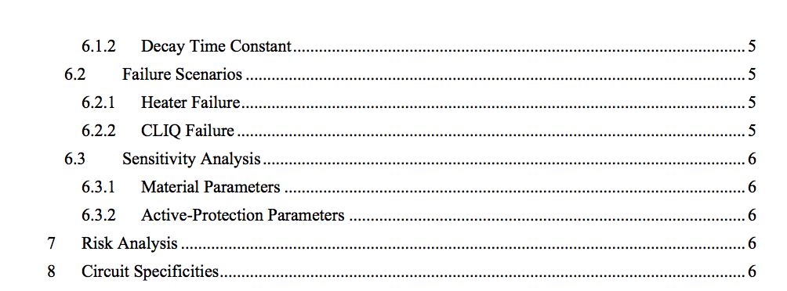
Protection R&D Documentation
The document is to be versioned on EDMS and supplemented by numerical data from measurements and simulations for long-term reference and comparison.

Slide 9
Status and Next Steps
Current review expected to validate baseline choices
Many R&D milestones have been already achieved and a large amount of work has been done.
  All relevant information needs to be harvested and compiled into the “Protection R&D Documentation”
  Developers, test engineers etc. to be contacted soon
  Documents supposed to be completed by the end of the year
Preparation of functional specifications

