Slide 1
Inner Triplet String
Presented by L. Bottura
In lieu of M. Bajko

Slide 2
Outline
Scope of the HiLumi IT-String
  The HiLumi IT-String mandate
  Previous experience with String-1 and String-2
  Reference configuration
  Timeline for the construction and test
Status of work
Relevance of the HiLumi IT-String test
Summary
Note: this does not cover the 11 T circuit, which will be validated only in stand-alone on a horizontal test bench

Slide 3
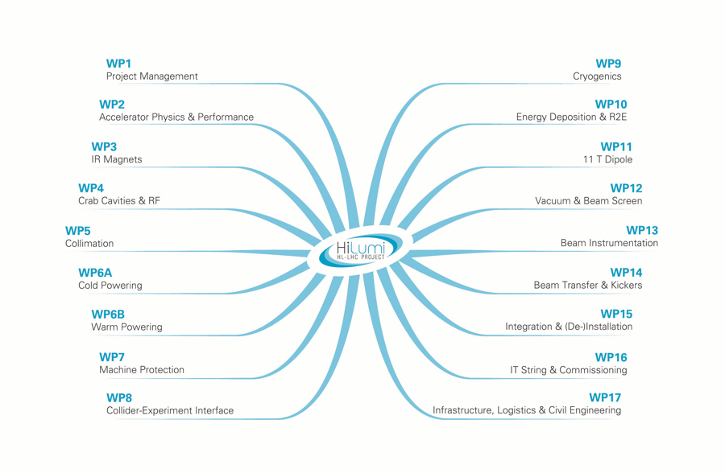
A dedicated WP
WP16
IT String & Commissioning

Slide 4
Scope of the HiLumi IT-String Test – 1/3
Components
[…] a full integral test (called HL LHC IT STRING) of the equipment from Q1 till D1 including the DFX) is foreseen in the HL-LHC project, in CONDITION AS SIMILAR AS POSSIBLE to the operational ones. The IT STRING of the HL LHC will be composed by systems previously tested individually at least in nominal operational conditions.
From: L. Rossi, Scope of the HL LHC Inner Triplet String Test, July 2015

Slide 5
Scope of the HiLumi IT-String Test – 2/3
Main goal
The HL LHC IT STRING will be a test stand to STUDY and VALIDATE the COLLECTIVE BEHAVIOUR of the different systems: magnets, magnet protection, cryogenics for magnets and superconducting link, magnet powering, vacuum, and interconnections between magnets and superconducting link, alignment.
From: L. Rossi, Scope of the HL LHC Inner Triplet String Test, July 2015

Slide 6
Scope of the HiLumi IT-String Test – 3/3
Timeline
The test is necessary to be performed BEFORE the series equipment will be INSTALLED in the future HL LHC machine. The HL LHC installation is planned today to be started in 2024. Therefore the IT STRING tests should be performed previous to this date and for a total duration of maximum 2 years.
Based on the present production planning of the main elements the STRING can be built with series elements only after 2020 […] it may be considered an earlier 1st phase using prototype magnets.
From: L. Rossi, Scope of the HL LHC Inner Triplet String Test, July 2015

Slide 7
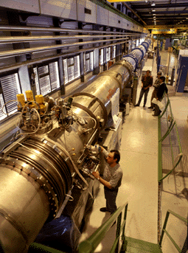
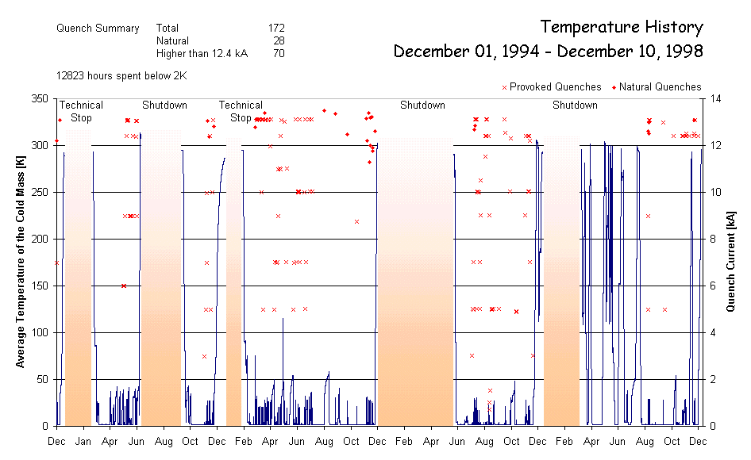
Previous experience – String-1 (1994-1998)
One LHC half-cell:
  3 MB (10 m) + 1 MQ
Validation of:
  Cryogenics (6 CD’s)
  Vacuum
  Quench (172) and protection
  Powering and energy extraction
String-1 in SM-18

Slide 8
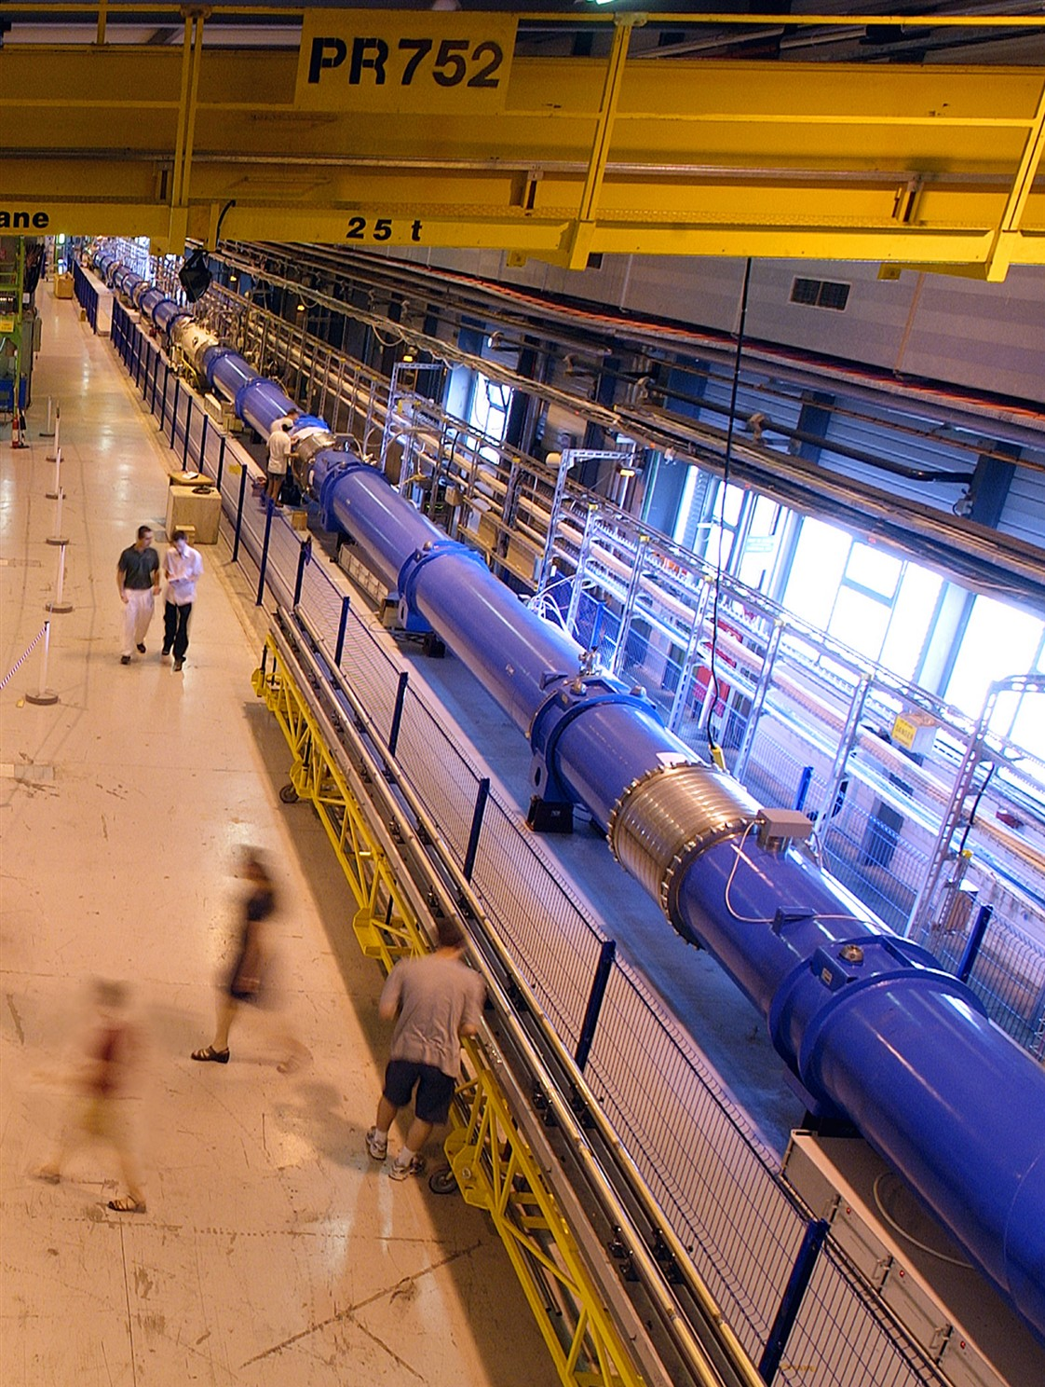
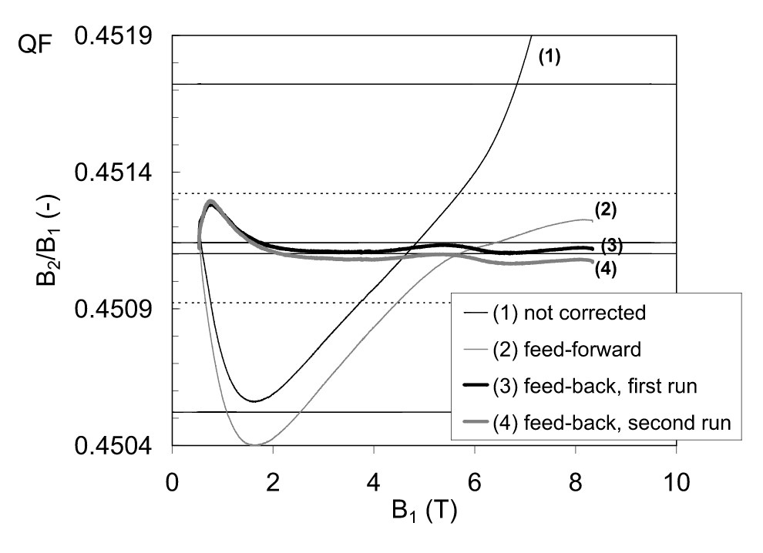
Previous experience – String-2 (2000-2004)
One full LHC cell
  6 MB (15 m) + 2 MQ + correctors
Validation of:
  Cryogenics, powering, quench and protection, vacuum
  Accelerator relevant operation (e.g. tracking of MQ and MB)
Quadrupole/dipole ratio measured in String-2 V. Granata, EPAC-2004
String-2 in SM-18

Slide 9
Reference configuration – schematic
Valve box
gHe recovery
lHe
Busbar
DFX
D1
CP
Q3
Q2b
Q2a
Q1
SC link (DSH)
DFH
Power converters
(depends on final topology)
20 kA
12kA
6x3 kA
9x120 A
Switches and dump resistors
(depends on final requirements)

Slide 10
Reference configuration – comments
The present configuration includes the IT magnets (Q1, Q2a/Q2b, Q3, CP, D1) the cold connection box (DFX) the SC link (DSH) and the warm-end connection box (DFH)
It reproduces exactly the configuration of the LHC tunnel
  Mechanically: supports and interfaces
  Electrically: circuit number, topology, powering and protection (apart for the power converters, if different equipment is used because of schedule reasons)
  Cryogenically: cooling and recovery, operating conditions (but for the valve-box)

Slide 11
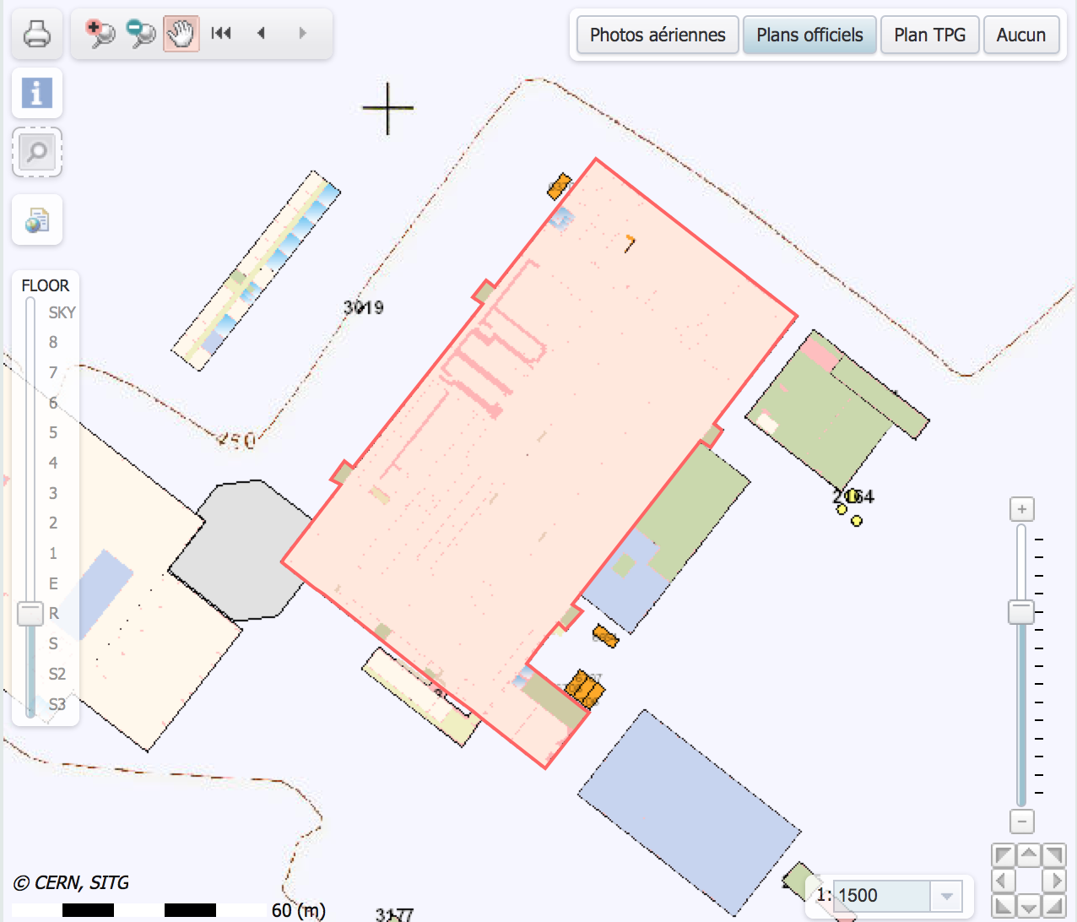
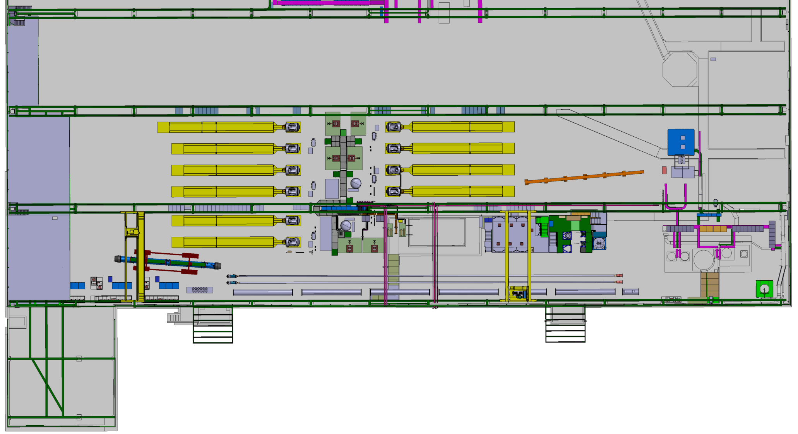
Integration in SM-18
Building 2173 (SM-18)
Horizontal test benches
Vertical test benches
Power
converters
DFH
Q1
Q2a
Q2b
Q3
CP
D1
DFX
60 m

Slide 12
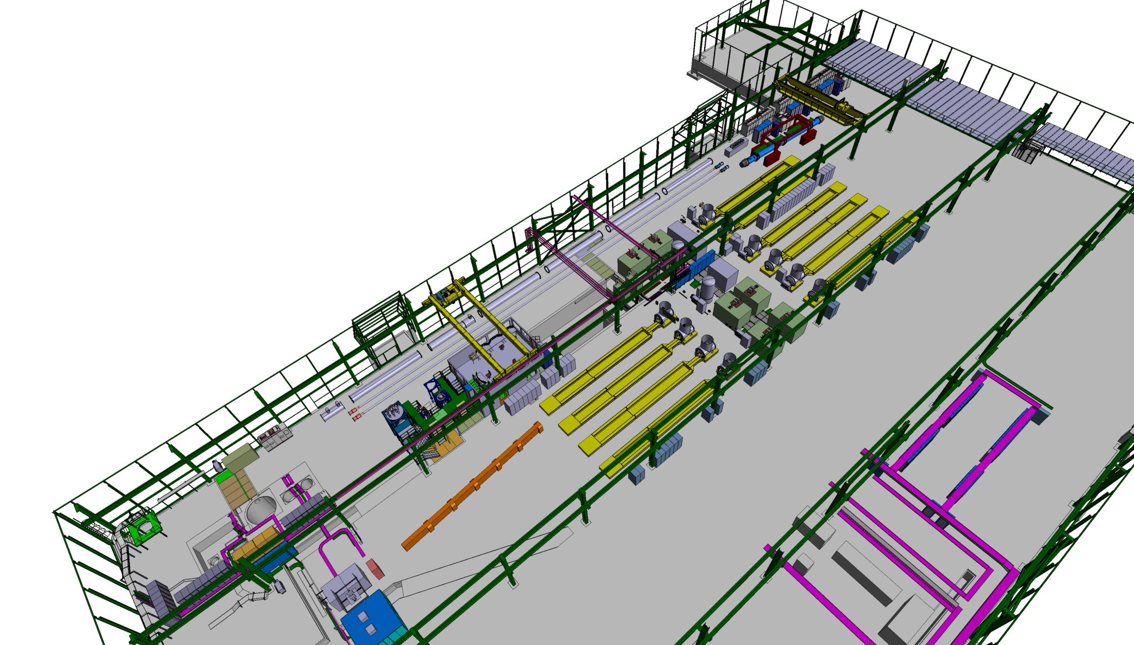
On-going discussion on
Location of control room
Physical separation of String area from the rest of the test hall (safety)
IT-String area, as already used for String-1 and String-2

Slide 13
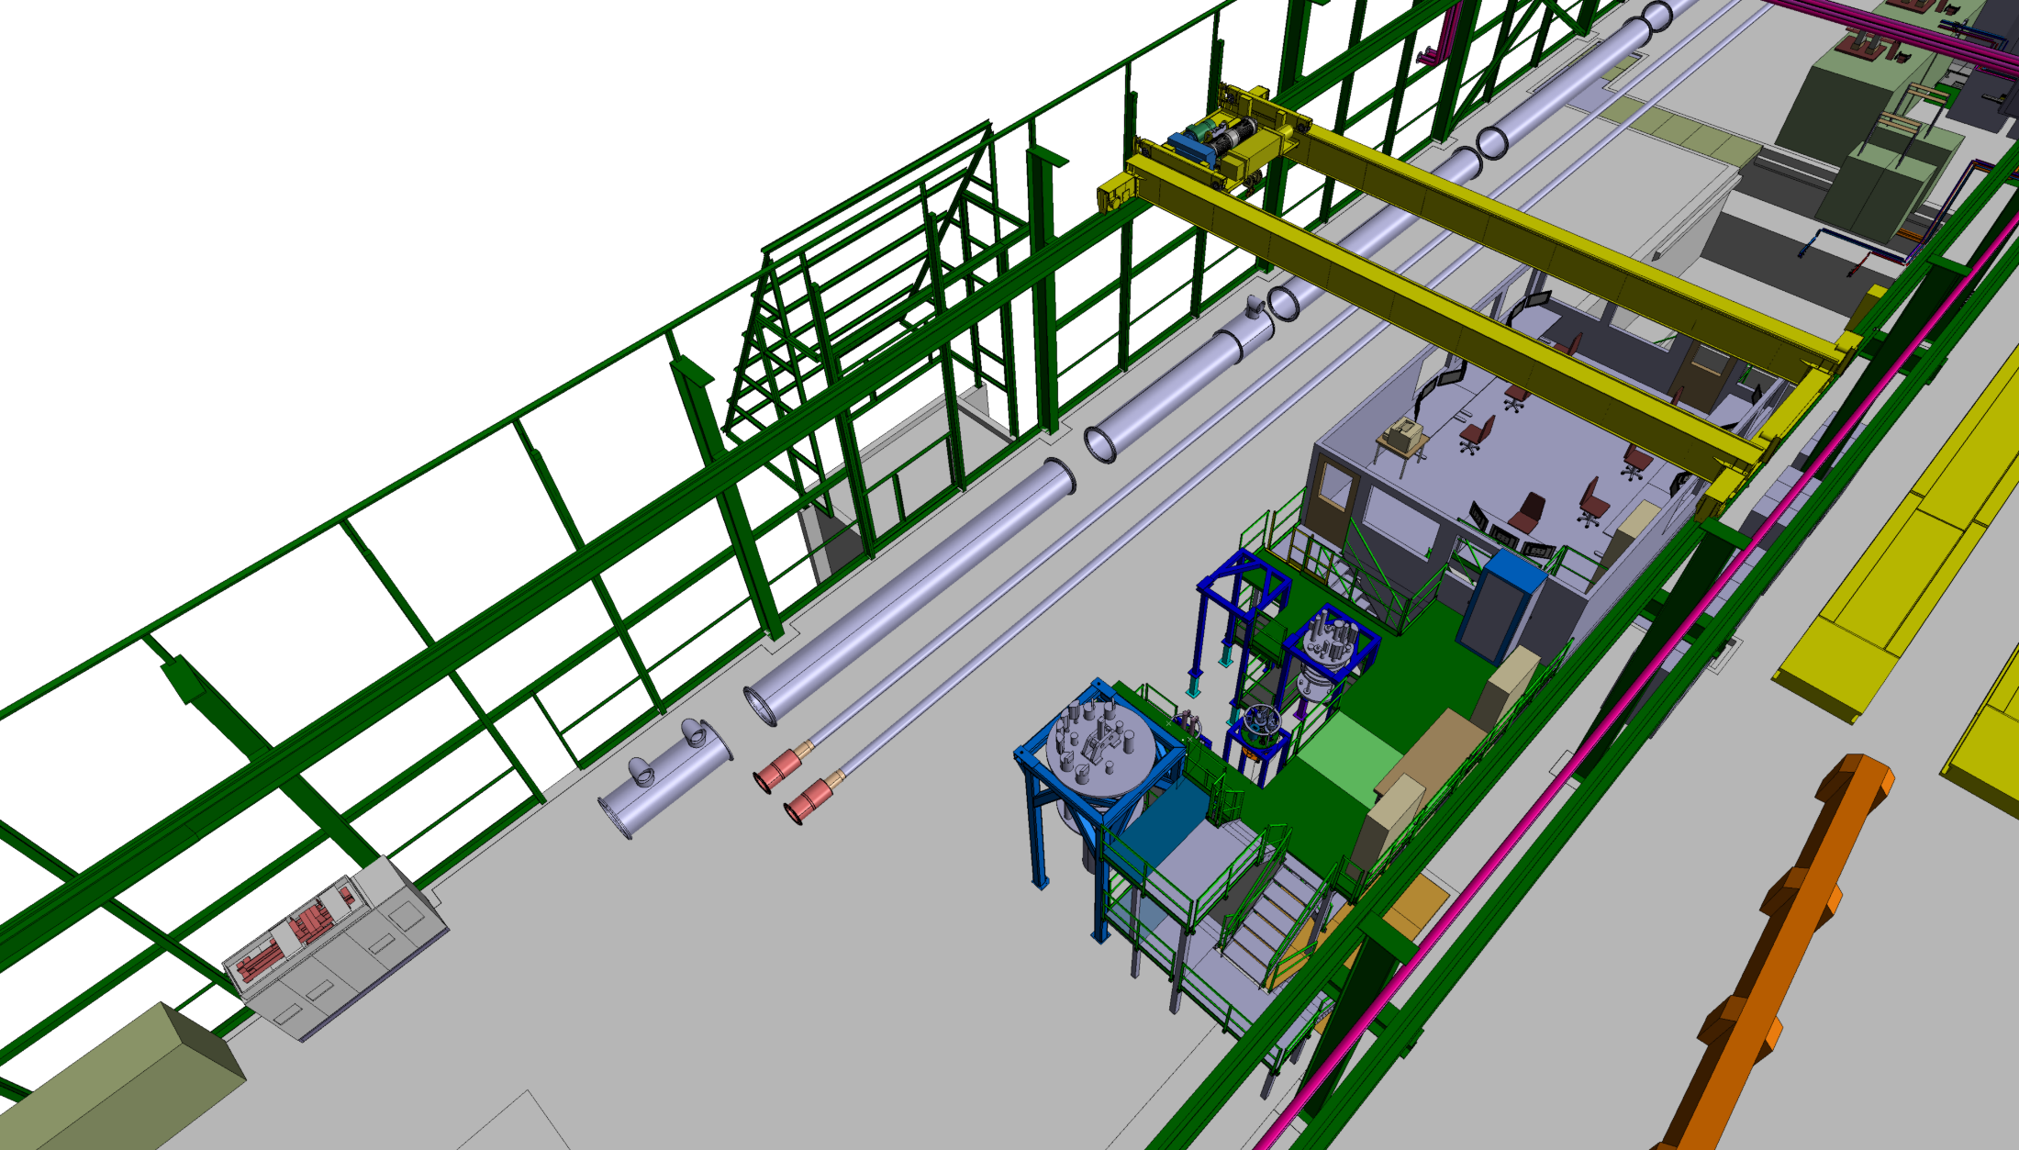
Q2b
Q3
CP
D1
DFX connection module
Cryogenic
SC link connection

Slide 14
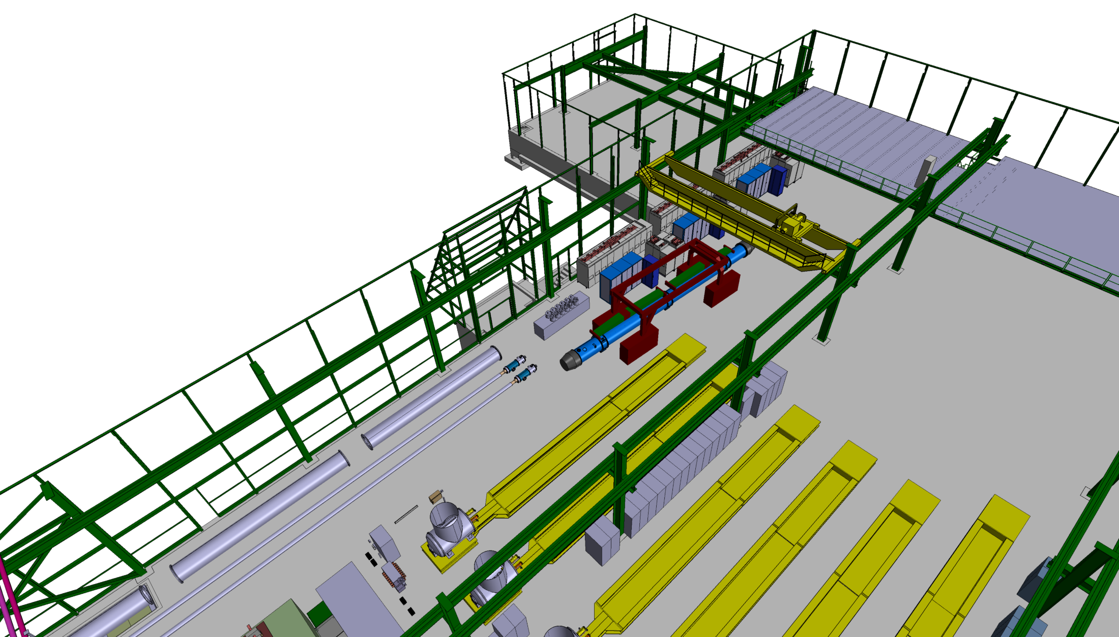
Powering system
Power converters
Energy extraction systems
DFH connection module
Cryogenic
SC link warm connection
Powering
Q1
Q2a

Slide 15
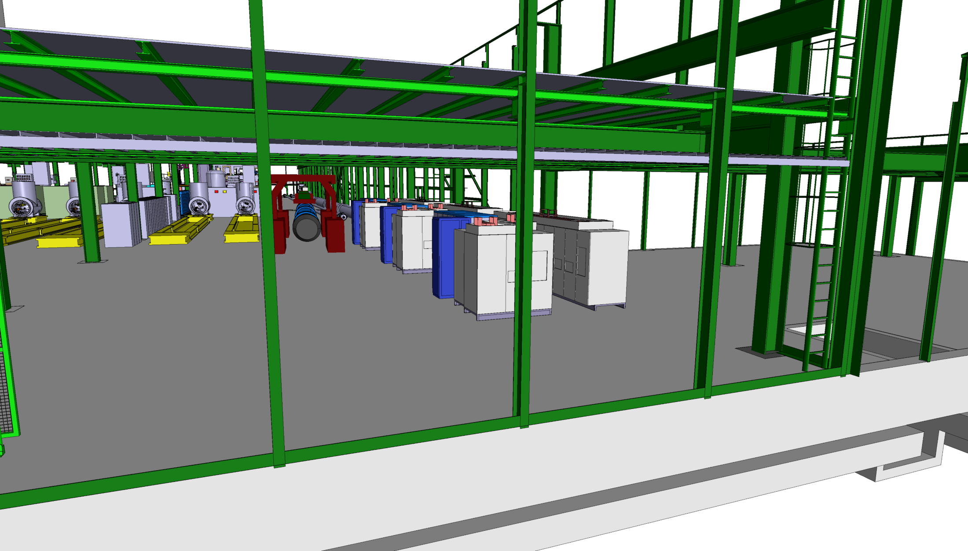
Powering system
Power converters
Energy extraction systems

Slide 16
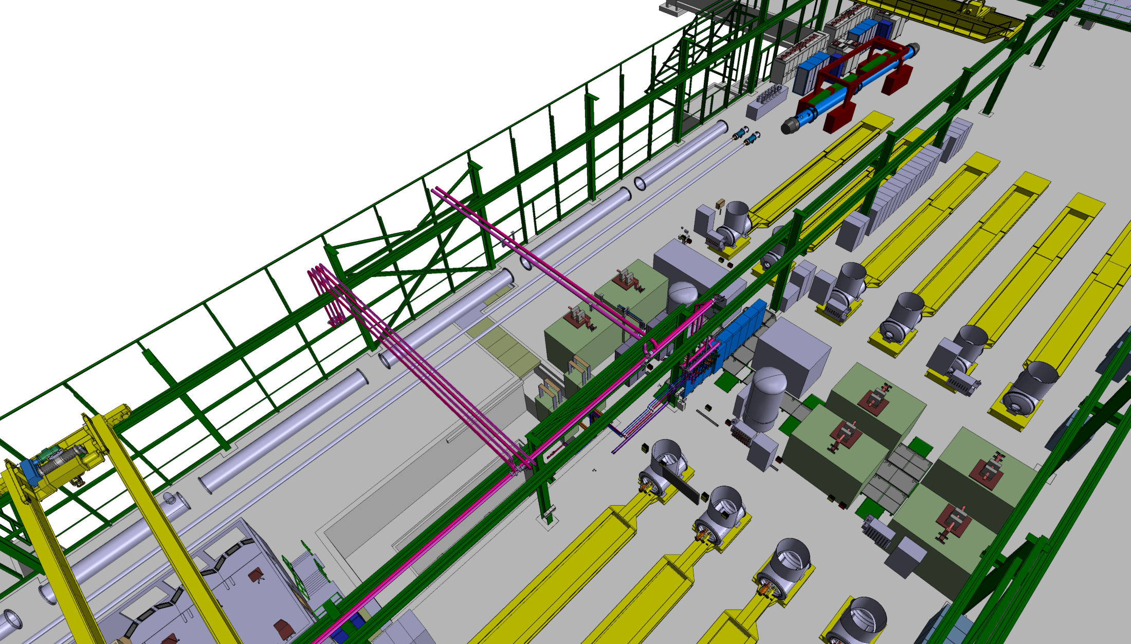
Optional location for
Powering system
Power converters
Energy extraction systems
DFH connection module
Cryogenic
SC link warm connection
Powering
Q1
Q2a
Q2b
Q3
CP

Slide 17
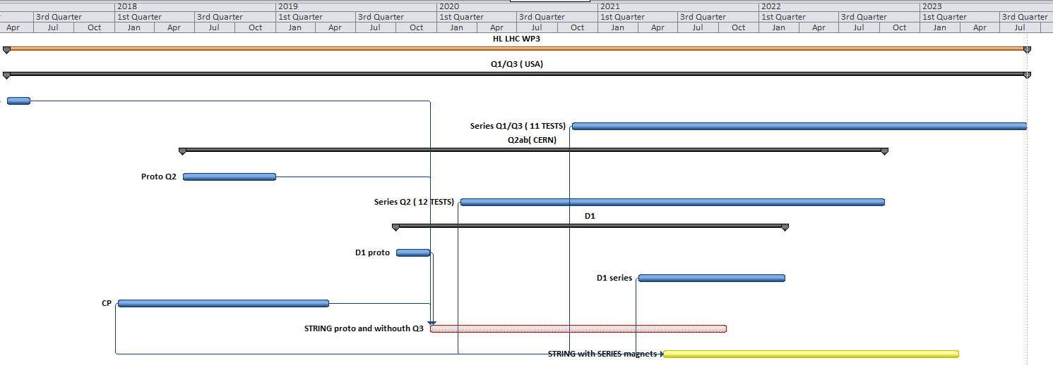
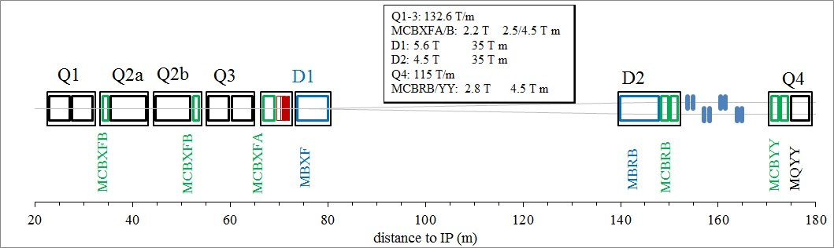
Schedule
2018
2019
2020
2021
2022
2023
Q1 prototype
Q2 prototype
D1 prototype
CP
IT-String phase 1 (prototypes)
Installation
Test
Removal
IT-String phase 2 (series)
Installation
Test

Slide 18
Status
Integration work is on-going to reserve space and prepare the necessary infrastructure
Verification of the required “services”
  Cryogenics
  Electrical infrastructure
  Water cooling
  Handling
First round of discussion on a test plan
Plan to review M+P within the next two months

Slide 19
Status – cryogenics
The IT String will require additional cryogenic equipment (approx 35 g/s liquefaction capacity). Pumping to 1.8 K can be managed with the existing WPUs, but at the limit (needs management)
IT String

Slide 20
Status – electrical distribution
  The present distribution of the electrical power in SM18 seems to be sufficient and redundant. A detailed study on the new connections for the IT-String should be done

Slide 21
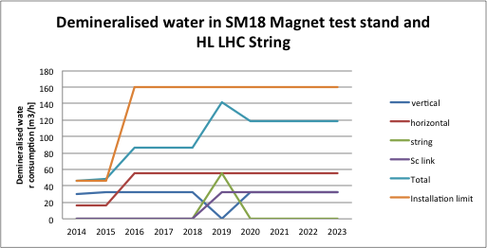
Status – water cooling
Upgrade demineralized water capacity to 160 m³/h
  This upgrade does not include the upgrade of the primary water system, which will be unavoidable in conjunction with the upgrade of the cryogenics capacity

Slide 22
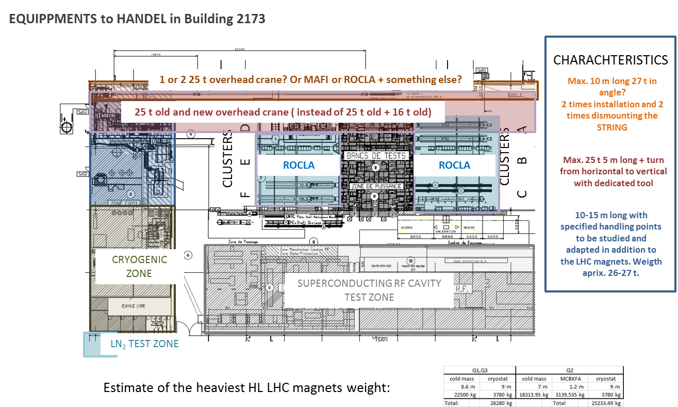
Status – handling
The combination of the two 25 t overhead crane will be used to install the IT String. The installation has not been studied in detail yet, possible to use (and validate) tunnel transport vehicles

Slide 23
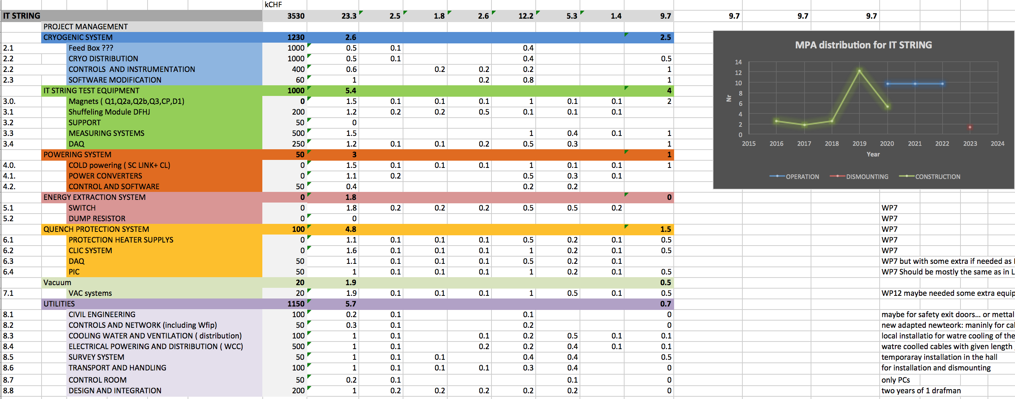
Status – plan
First iteration on-going on a WBS, resource estimate and profile. This will depend on the actual scope, test program, additional instrumentation, operation demands, …

Slide 24
Relevance of the HiLumi IT-String
The HiLumi IT-String can provide relevant experience (same object as in the LHC), validation (“first time” test) and advanced operation information on:
Transport, assembly, alignment, interconnection procedures (do not under-estimate)
Mechanical behavior of the IT continuous cryostat (Q1 to DFX) and other components (DSH, DFH) under pressure, vacuum, cool-down, operation and warm-up
Cryogenic behavior and operation under static (and dynamic) conditions
Insulation and beam vacuum static (and dynamic) behavior
Powering behavior of the system, dynamic response (and associated field quality), interaction of circuits
Quench behavior, detection, propagation and protection of the complete superconducting circuit
Alignment, mechanical (and magnetic)

Slide 25
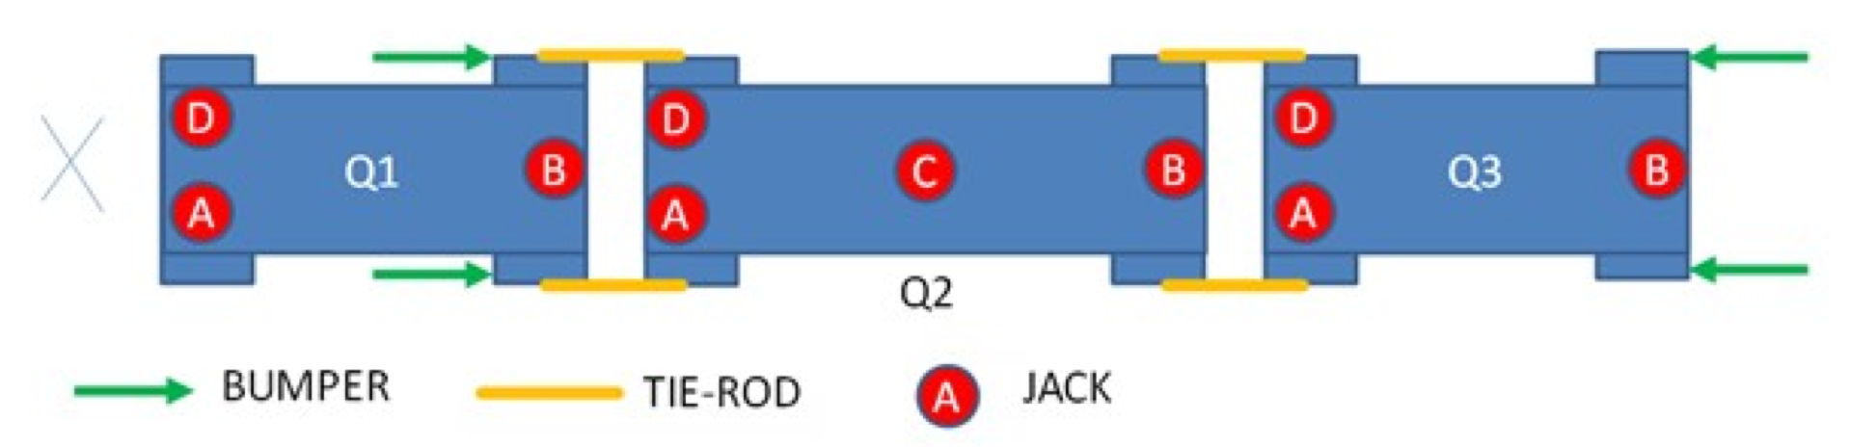
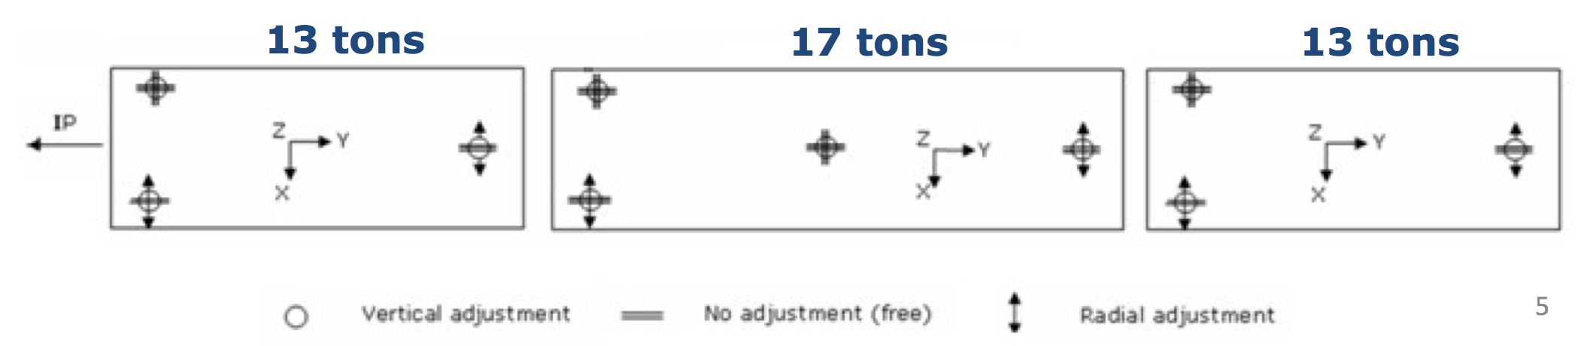
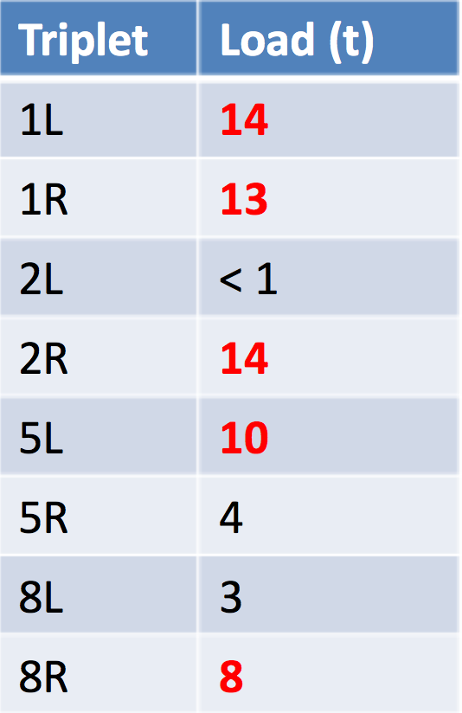
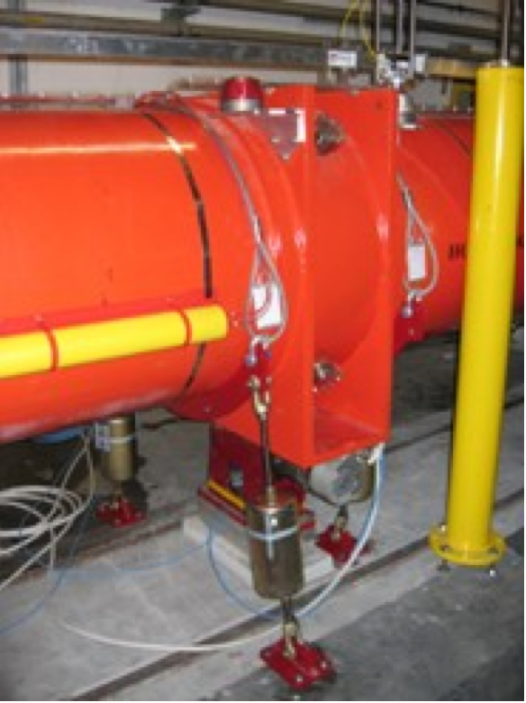
An example of a practical issue – the past
Present supporting system
IP
DFBX
Expected loads
Support and straps
The supporting of the present triplet is largely hyperstatic
The alignment is delicate and laborious
The IT-String must “catch” any similar issue, and provide a benchmark for the alignment
Load on Q2 central jack

Slide 26
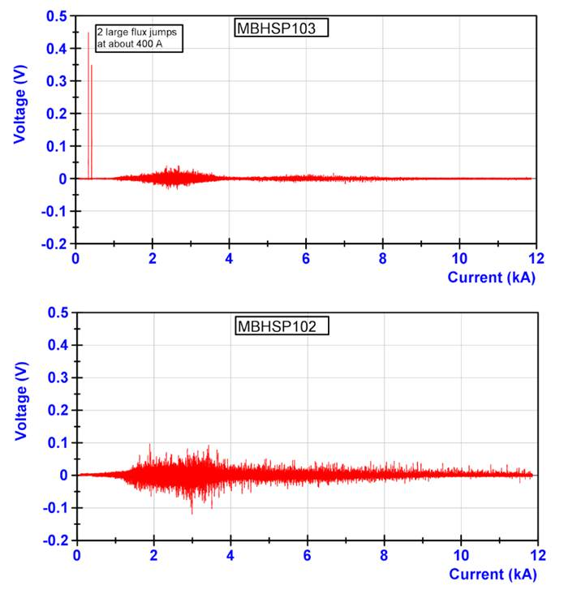
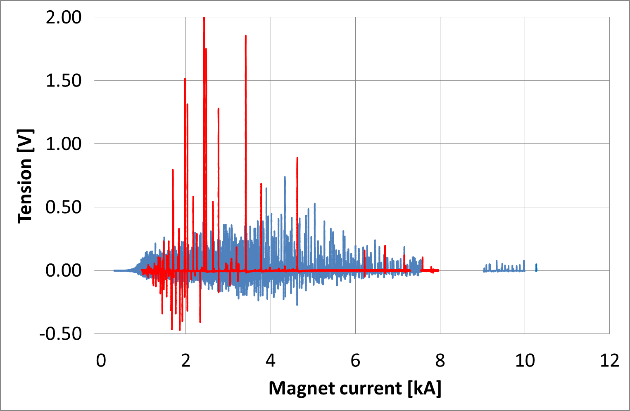
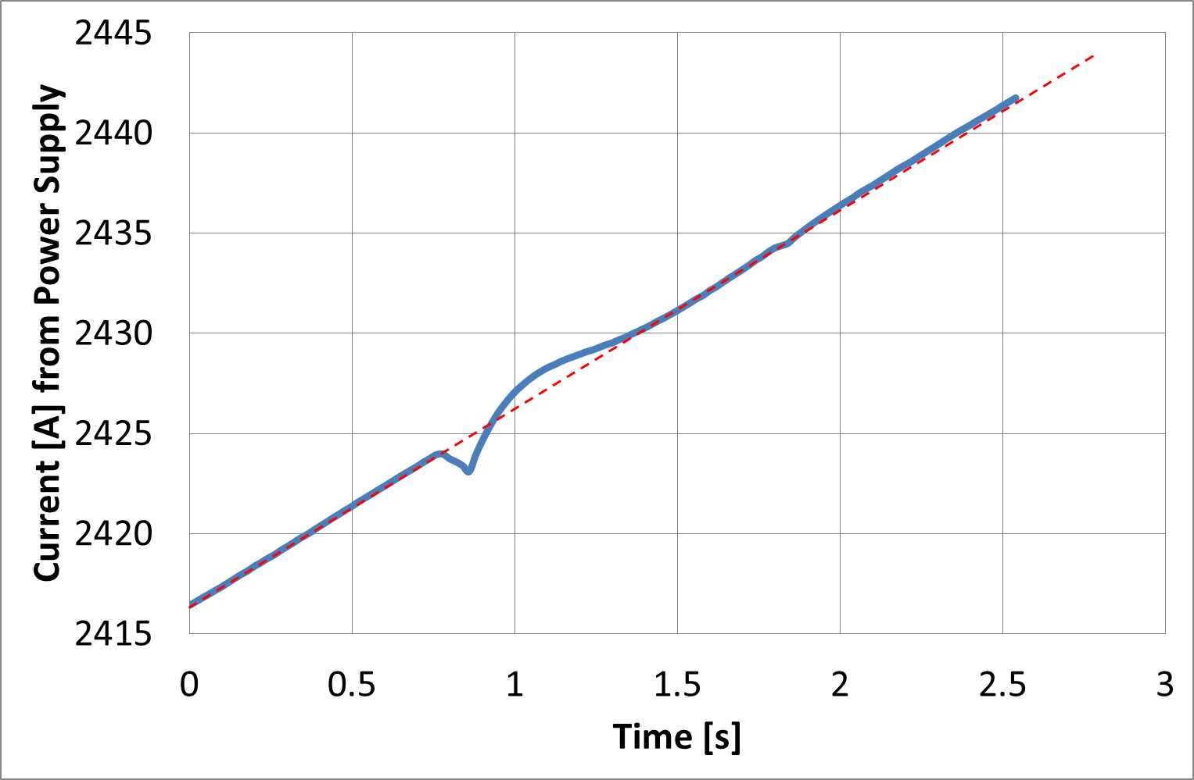
An example of a practical issue – the future
HQ01 flux jumps
HQ01 current control
11 T flux jumps
Flux jumps show up in Nb₃Sn magnets as a “noise”, both in the terminal and compensated voltage
  The effect propagates from one spot along the cable length
  Poles are coupled magnetically, attempting to reduce flux changes
Flux jumps are random in location, amplitude and occurrence
They can influence powering (1 ppm control) as well as the detect-ability of normal transitions
11 T flux jump spectrum

Slide 27
Summary
The present plan is to build a IT-String that reproduces exactly the configuration in the tunnel
This is a system validation test with great value
  Thermo-mechanics (installation, supporting, alignment)
  Cryogenics and vacuum (static and dynamic)
  Electrical aspects (powering, protection, interaction)
  Operation (field references and tracking)
Test results are expected in the final configuration in 2022, with two years to feed-forward to the installation (2024), commissioning (2025-2026) and operation (2026) of HiLumi

Slide 28
To the Committee
Is the IT-String the right test (at the right time) to validate the integrated system powering and protection ?
Are there parts of the IT-String that are missing, or redundant ?
What tests (and what instruments) are mandatory/desirable to achieve the declared objective ?

