Slide 1
Power converters and circuits
Jean-Paul Burnet
WP6b magnet power converters
Circuits review – CERN – 21 March 2016

Slide 2
Outline
List of circuits
Design based on present LHC technology
First baseline of Inner Triplet powering
Impact of SuperAMALU^{2™}
New generation of Power Converters
Ultimate optimization
D1-D2 Story
Conclusions
SuperAMALU2™ = SCLink
PC = Power Converter

Slide 3
Outline
List of circuits
Design based on present LHC technology
First baseline of Inner Triplet powering
Impact of SuperAMALU^{2™}
New generation of Power Converters
Ultimate optimization
D1-D2 Story
Conclusions

Slide 4
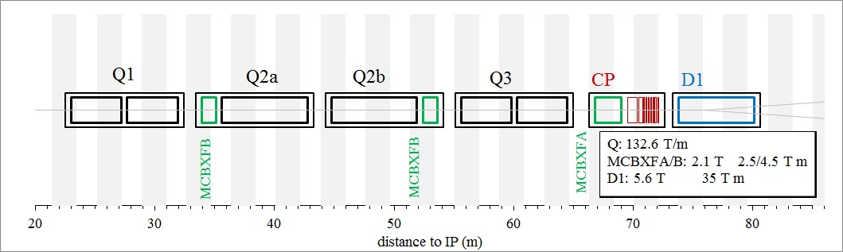
List of circuits, present baseline
Layout of the Inner Triplet
Layout of the Matching section
43 circuits per IP side. In total, 172 power converters

Slide 5
List of power converters, present baseline
The total current to be delivered for the new inner triplet and matching section is 462kA with 172 power converters.
The total current of the present inner triplet and matching section is 232kA with 112 power converters.
The present LHC machine has a total current delivered by the power converters of 1.8MA and it will reach 2.2MA with HL-LHC.
x2

Slide 6
Outline
List of circuits
Design based on present LHC technology
First baseline of Inner Triplet powering
Impact of SuperAMALU^{2™}
New generation of Power Converters
Ultimate optimization
D1-D2 Story
Conclusions

Slide 7
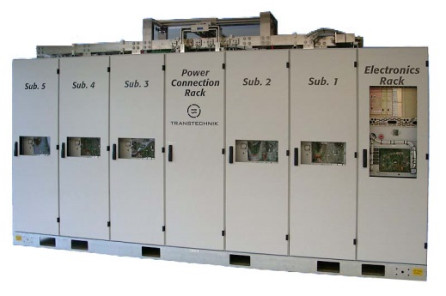
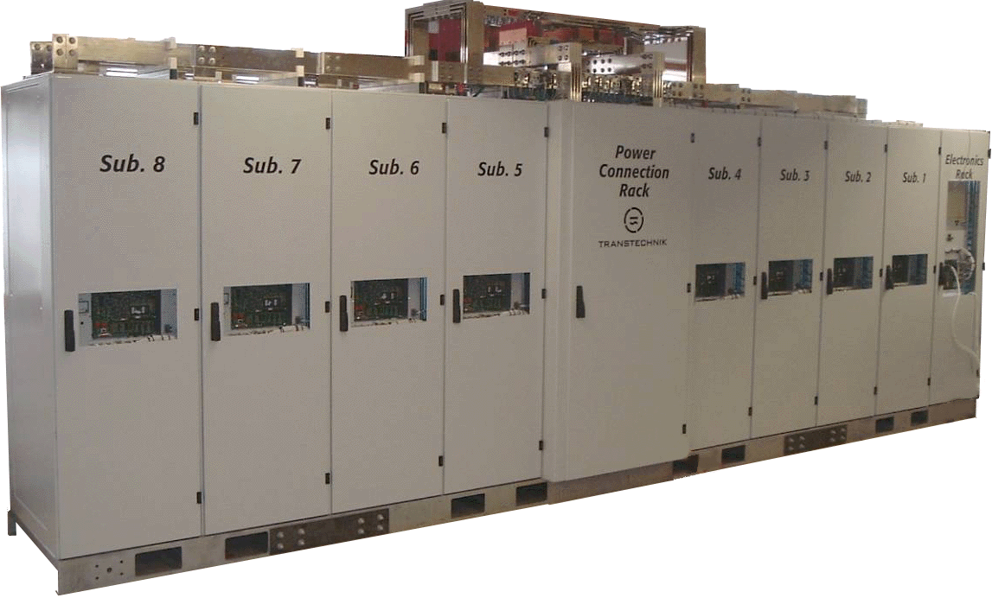
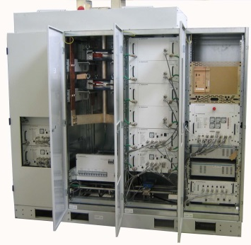
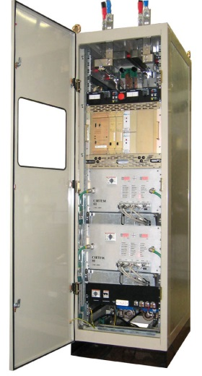
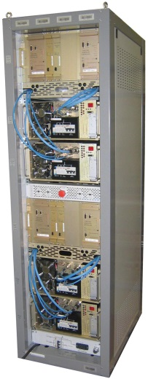
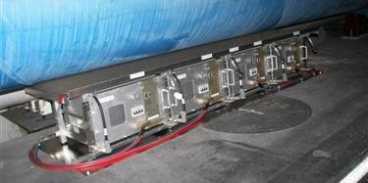
LHC power converters
The LHC was build with 5 families of switch-mode power converters.
1-quadrant
Main Quadrupoles: 13kA/18V
Atlas Toroid: 20.5kA/18V
Individual Quadrupoles: 6kA/8V
Same family
4-quadrant for correctors : ±600A/±10V
4-quadrant for correctors : ±120A/±10V
4-quadrant for correctors : ±60A/±10V
4-quadrant

Slide 8
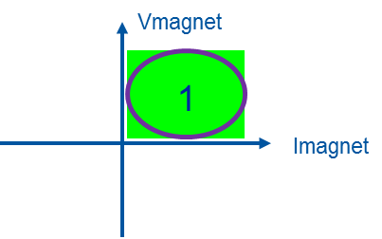
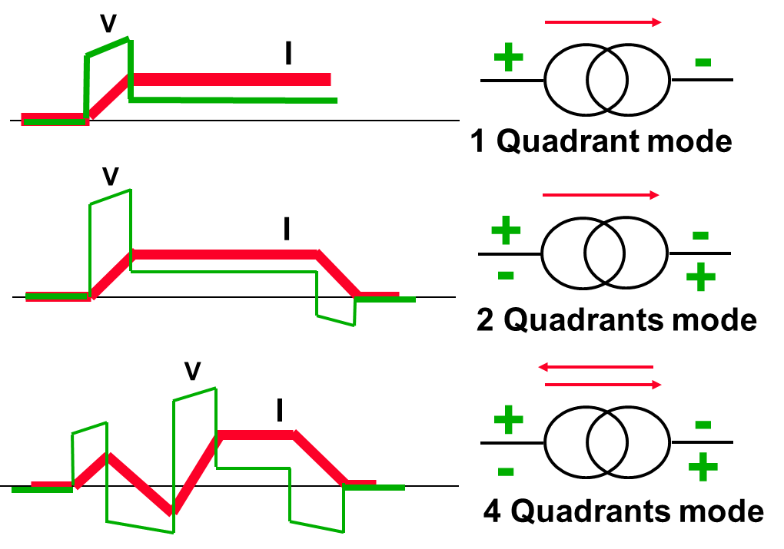
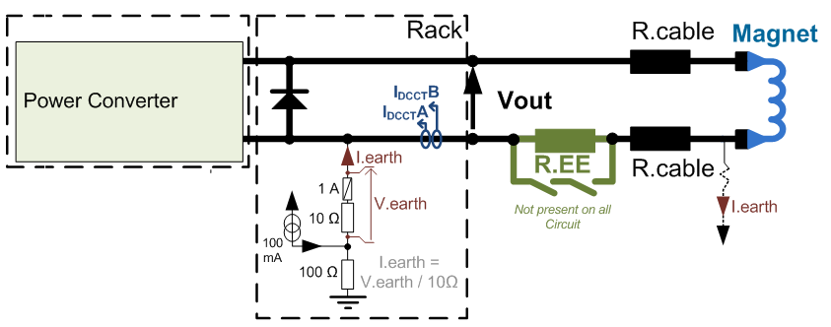
Circuit layout with 1-quadrant converter
Current and voltage applied to the magnets are always positive.
1-quadrant converter has a free-wheeling diode at the output.
The return magnet energy is dissipated in the resistance of the circuit.

Slide 9
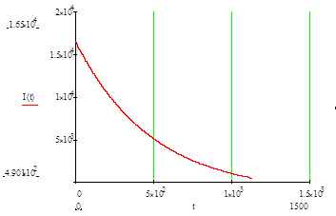
Ramp-down with 1-quadrant converter
The electrical circuit is described by the equation:
Vout = R_{cables} . I_{magnet} + L_{magnet} . dI_{magnet}/dt
During the free-wheeling process, the current is flowing only through the output diode.
Vout = -Vdiode= -0.3V which is the diode voltage when diode is conducting.
I_{magnet}(t) = (I_{7TeV} + V_{diode} / R_{cables} ) * e^{-t/}τ_{circuit} - V_{diode} / R_{cables} Exponential decay
Where
τ _{circuit} = L_{magnet} / R_{cables}

Slide 10
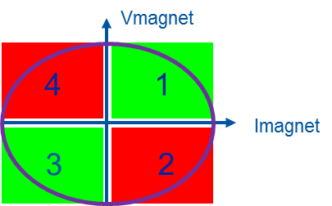
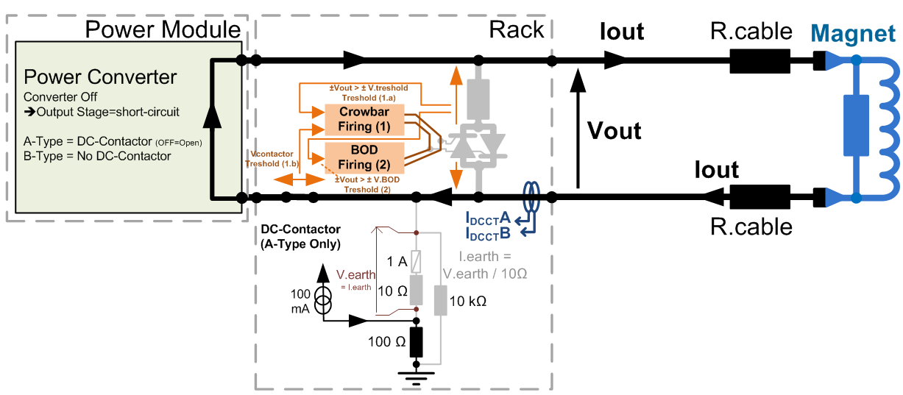
Circuit layout with 4-quadrant converter
Current and voltage applied to the magnets can be positive or negative.
The return magnet energy shall also managed by the PC (dissipated inside the PC).
In case of PC fault, a thyristor crowbar is fired, creating a free-wheeling path.

Slide 11
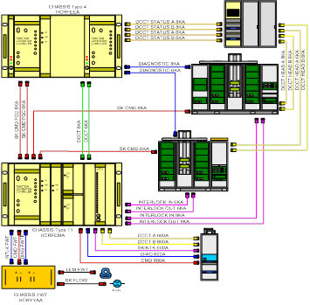
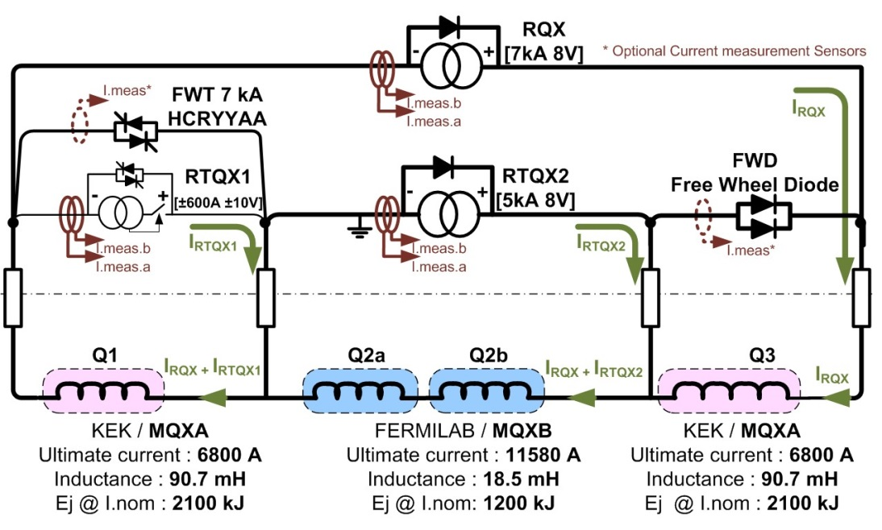
Present Inner Triplet
The present layout is quite complex with nested circuits.
It requires decoupling matrix to get a good control of each circuit.
The operation of such system is complex and need experts especially in case of fault where it is difficult to identify the origin of the fault.
Most complex powering system in LHC

Slide 12
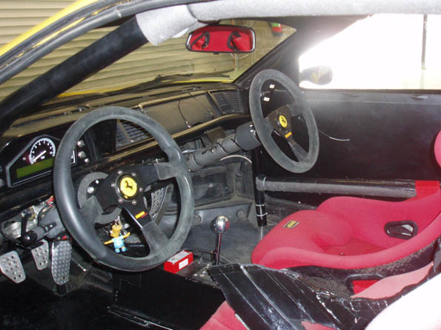
Solution for nested circuits
Nested powering scheme can be a nightmare for power engineers !!
Complex control, it is like a car with many drivers having a steering wheel acting on only one wheel.
Reduce capital cost but decrease availability

Slide 13
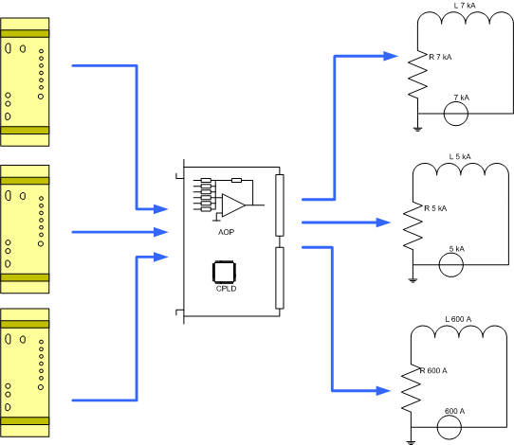
Solution for nested circuits
Difficult to operate and repair, long MTTR (Mid Time To Repair).
All converters have to talk each others.
Need a decoupling matrix to avoid fight between converters !
https://edms.cern.ch/file/1100412//LHC-Inner-Triplet-I_PAC_2010.pdf

Slide 14
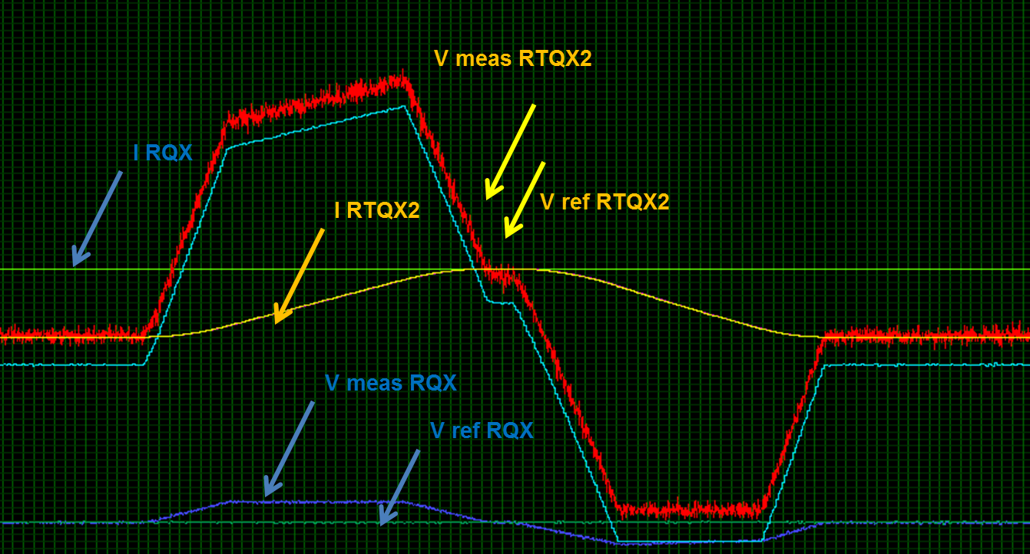
Solution for nested circuits
Look at the current and voltage of RQX while RTQX2 current is changing!
Nested circuits aren’t RECOMMANDED !
LHC inner triplet works perfectly well but MTTR is much higher.
RHIC had many difficulties with nested circuits.

Slide 15
Outline
List of circuits
Design based on present LHC technology
First baseline of Inner Triplet powering
Impact of SuperAMALU^{2™}
New generation of Power Converters
Ultimate optimization
D1-D2 Story
Conclusions

Slide 16
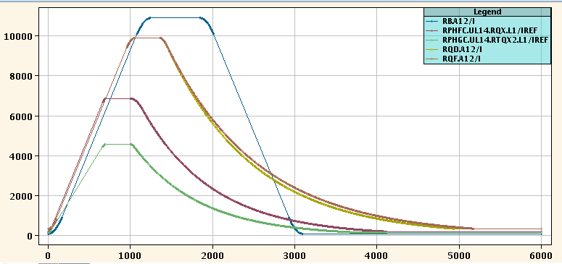
LHC power converters
The circuit layout needs to be chosen based on the impact on 4 parameters:
Beam optics (number of Converters) flexibility
Tune shift (inductance of the circuit) Beam quality
Squeeze time (time constant of the circuit) Production
and ramp down
Magnet protection (Energy management) Safety

Slide 17
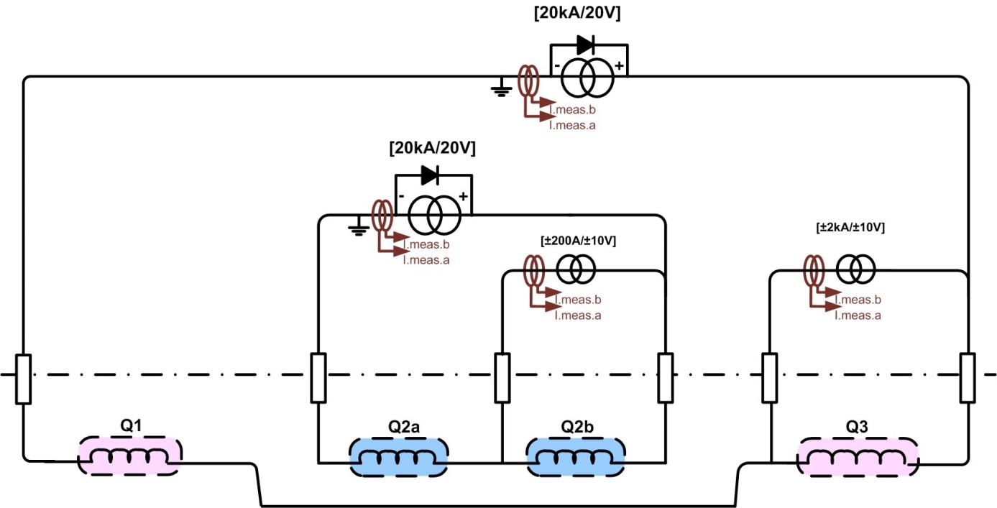
Present baseline for the Inner Triplet magnets
The proposed layout allows full flexibility for beam optics.
Each circuit has a single trim power converter.
The goal is to ease the operation and diagnostic to improve the availability of the machine.
Extra-cost: +1 power converter, +2 current leads, +2 SClink cables.
Optics flexibility, Availability

Slide 18
Alternative powering of the Inner Triplet magnets
This layout allows full flexibility for beam optics and reduce the tune shift.
Control more complex but still feasible.
Cheaper due to less SClink, DC cables, power converters, sockets,….
Tune shift, Cost
Q1-Q2-Q3:
slightly smaller tune shift than Q1-Q2a Q2b-Q3
for current control regime
best compensation voltage control regime
=> best scheme (for beam dynamics)
PC1 17.4 kA
Q1
Q2a
Q2b
Q3
PC2 ±2.0 kA
PC3 ±0.2 kA
PC4 ±2.0 kA

Slide 19
Outline
List of circuits
Design based on present LHC technology
First baseline of Inner Triplet powering
Impact of SuperAMALU^{2™}
New generation of Power Converters
Ultimate optimization
D1-D2 Story
Conclusions

Slide 20
Present limitation during ramp down
From Matteo Solfaroli, Hugues Thiesen
 | Ramp-down | Precycle | Solution
RB | 1257 sec (21 min) | 3110 (52 min)
RQXs | 3323 sec (56 min) | 4368 sec (1h 13 min)
RQSs | 2195 sec (37 min) | 3294 sec (55 min) | Current reduced (250A) + settings optimization
MQYs | 2051 sec (34 min)
RQD/F | ~2000 sec (33 min) | 3500 sec (59 min)
RQ4/5.LR3/7 (MQWBs) | 1935 sec (32 min) |  | To be defined: 1 less cycles? Reduced current?
ROs | 1920 sec (32 min) |  | 1 cycle less
RQD/F can be taken as reference.

Slide 21
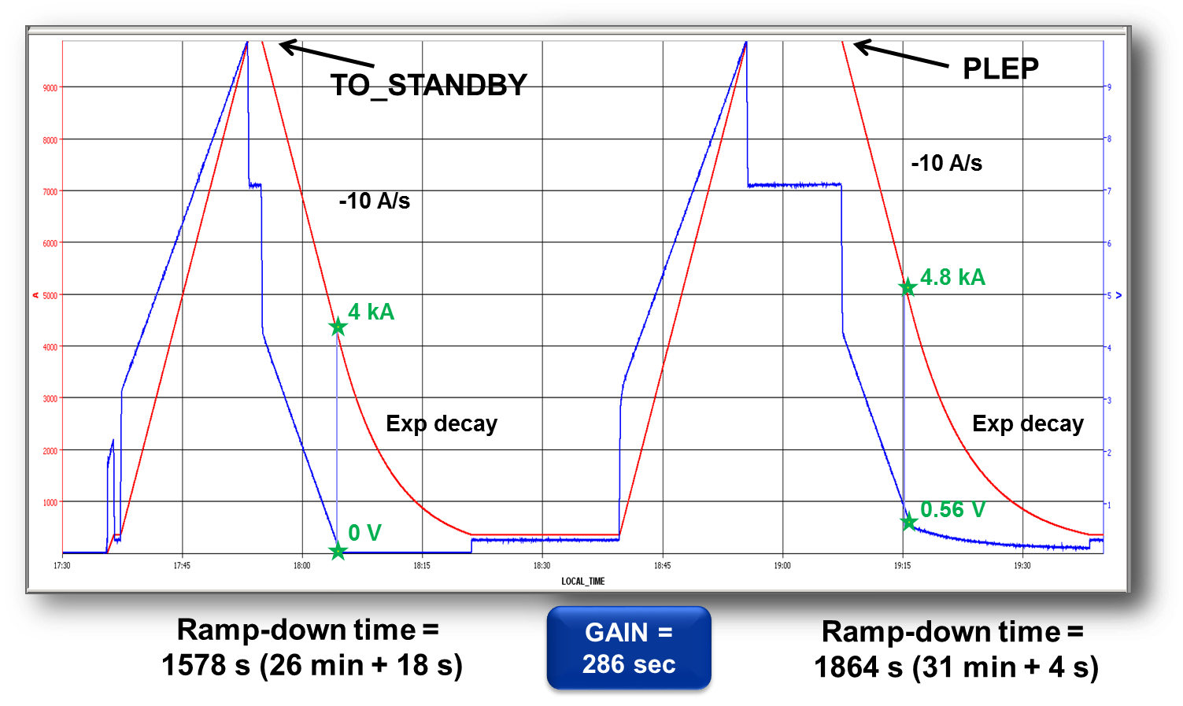
Main Quadrupole as reference
New principle
RQD/F circuits have these characteristics:
I nom = 11870A
L magnet = 263mH
R circuit = 1.1mΩ
Di/dt max = 10A/s
Τcircuit = 240s
Phase1 = 950s
Phase2 = 550s
Ramp-down = 1500s
Current control only
Phase1, current control
Phase2, voltage control
Phase 1
Phase 2

Slide 22
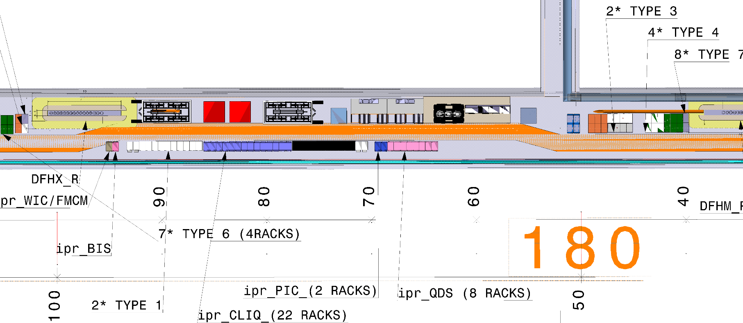
First integration and DC cabling
Thanks to the SuperAMALU², the power converters are very closed to the DFHX ≠ present LHC layout (DFBX inside the accelerator tunnel).
The DC cables will be much shorter !
Resistance of the circuit divided by 5.
Resistance down to 0.2mΩ

Slide 23
DC cables and dump resistor
First integration with extraction switch and dump resistor.
Ramp down still in line with present LHC machine
Alternative with Q1-Q2-Q3 in series and 78m of cable.
Ramp down two time longer !

Slide 24
DC cables without dump resistor
No Dump resistor and with last integration work, the cable lengths are even shorter.
Ramp down two time longer !
With Q1-Q2-Q3 in series and 30m of cable and 1-quadrant power converter,
We need 2 hour to ramp down !
With 1-quadrant converter, the only solution is two circuits and long DC cables !
Q1-Q2-Q3 in series needs a 2-quadrant power converter!

Slide 25
Outline
List of circuits
Design based on present LHC technology
First baseline of Inner Triplet powering
Impact of SuperAMALU^{2™}
New generation of Power Converters
Ultimate optimization
D1-D2 Story
Conclusions

Slide 26
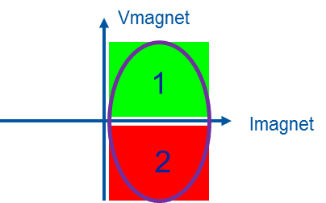
2-quadrant converter
With 2-quadrant converter, the ramp down can be actively control at -14A/s by applying a negative voltage.
The stored energy of the magnets is 35MJ (~10kWh, ~1L of gasoline).
The PC has to manage this return energy. 3 possibilities:
Return the energy to the grid
Dissipate the energy inside the PC
Recuperate it with energy storage
Only present technology : Thyristor rectifier

Slide 27
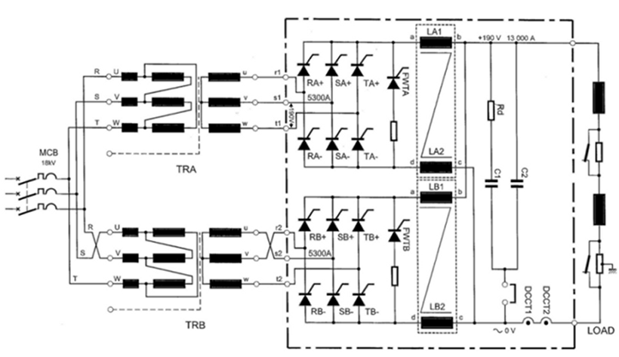
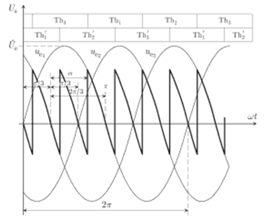
2-quadrant converter, example
Example: LHC dipole converter 13kA / 180V, Circuit: 15H / 1mΩ, T = 15000s, 1,2GJ
Magnets
18kV AC
50Hz transformer
Output filter
Thyristor rectifier
Advantages: return energy to the grid, simple topology
Drawback: 50Hz harmonics, sensitive to grid perturbation, size

Slide 28
2-quadrant converter R&D
Development of 2-quadrant converter in switch-mode technology.
Main topic: energy management
Dissipation: experience with 4-quadrant PC
Return to the grid: topology research for bipolar inverter
Energy storage: Which technology?

Slide 29
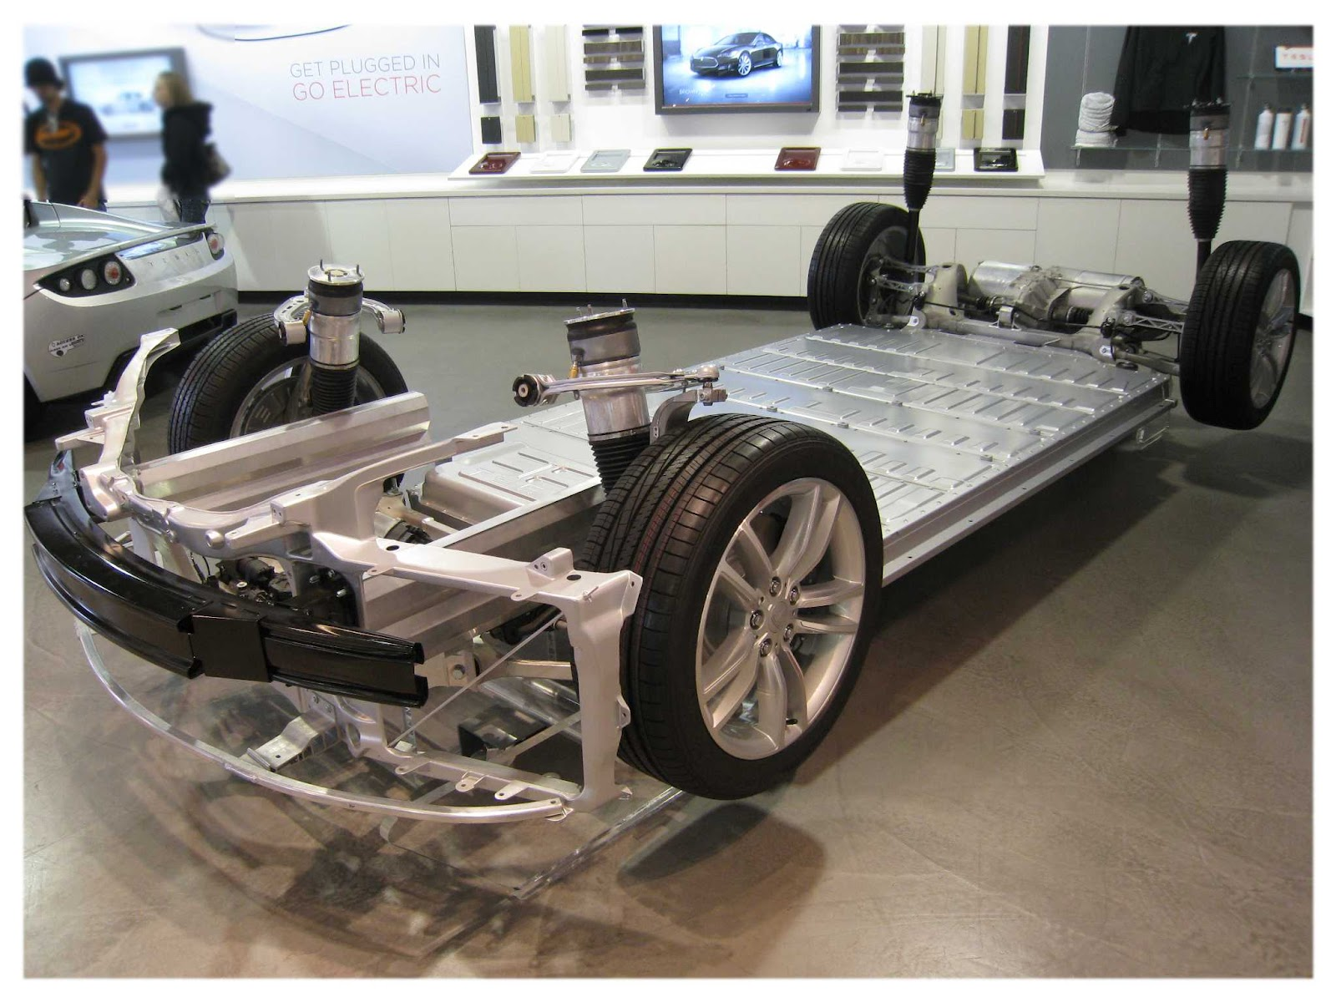
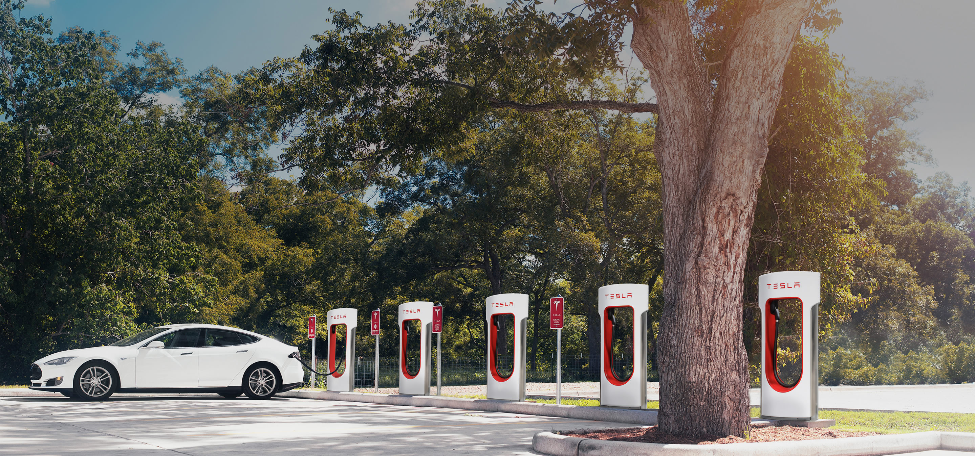
TESLA converter
TESLA S car have a Li-ion Battery of 70 to 90kWh (324MJ)
Present price : 500 $/kWh
2020 target price: 250 $/kWh
250 Wh/kg
2000 cycles
Supercharger has a power of 120kW and it can charge 50% of the battery in 20’
We could imagine to use this kind of battery for our application.

Slide 30
TESLA converter
Power converter topology
Divide by 3 the infrastructure services
Design for the cable losses
40kW
Design for magnet current
120kW
Design for the magnet energy recovery
50kWh
<200kg

Slide 31
Outline
List of circuits
Design based on present LHC technology
First baseline of Inner Triplet powering
Impact of SuperAMALU^{2™}
New generation of Power Converters
Ultimate optimization
D1-D2 Story
Conclusions

Slide 32
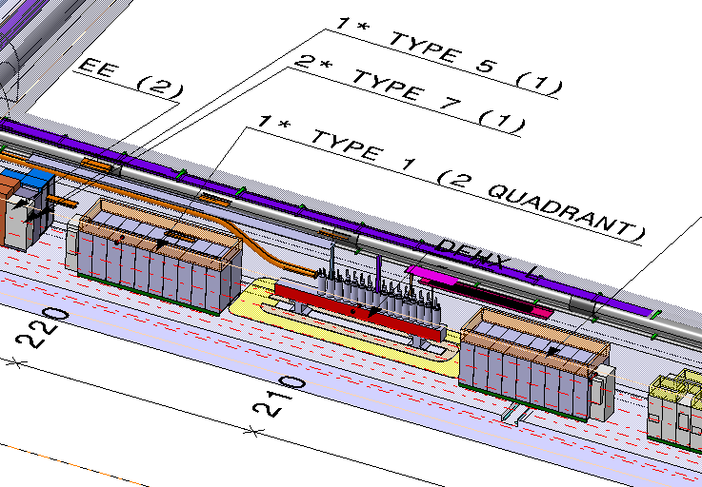
Ultimate optimization with 2-quadrant converter
Energy balance:
No energy is dissipated in the magnet
The energy taken on the grid is only the energy dissipated inside the power converter and in the DC cables.
Ultimate optimization:
Reduce DC cable length as much as possible
Improve power converter efficiency

Slide 33
Ultimate optimization with 2-quadrant converter
By putting the PC close the DFHX, the DC cables can be less than 30m.
The needed voltage will be reduced.
The PC size, the electricity socket, the water flow, the air losses will also be reduced.
The PC efficiency will be limited due to the high current.
Ultimate optimization: DC cables = 10m, Cable losses = 22kW
PC voltage =5V, PC Power = 90kW, PC Losses = 16,5kW
PC grid = 40kW
First design, cable losses was 300kW, then reduced to 57kW, ultimate 22kW !

Slide 34
Outline
List of circuits
Design based on present LHC technology
First baseline of Inner Triplet powering
Impact of SuperAMALU^{2™}
New generation of Power Converters
Ultimate optimization
D1-D2 Story
Conclusions

Slide 35
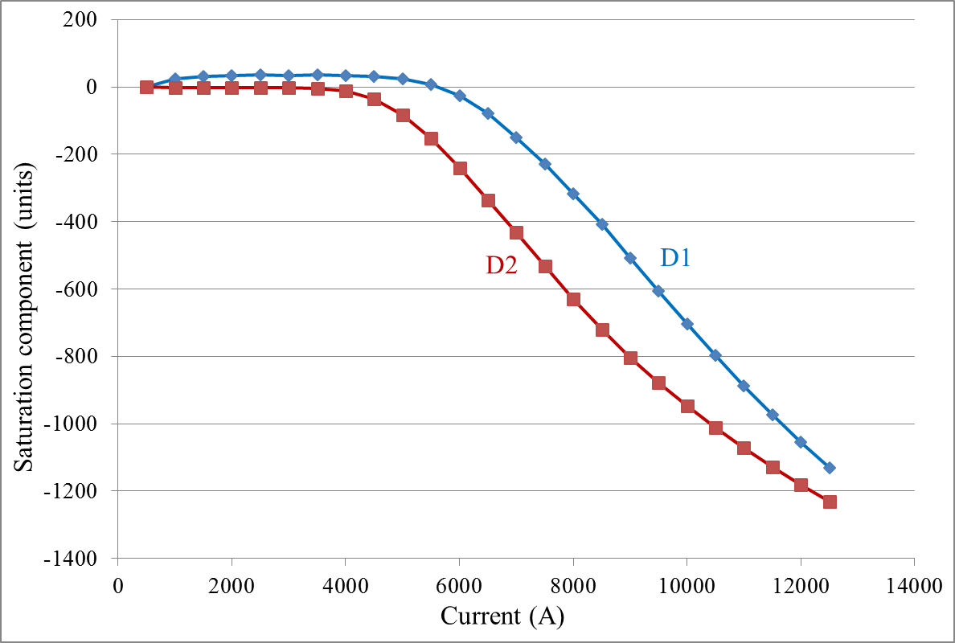
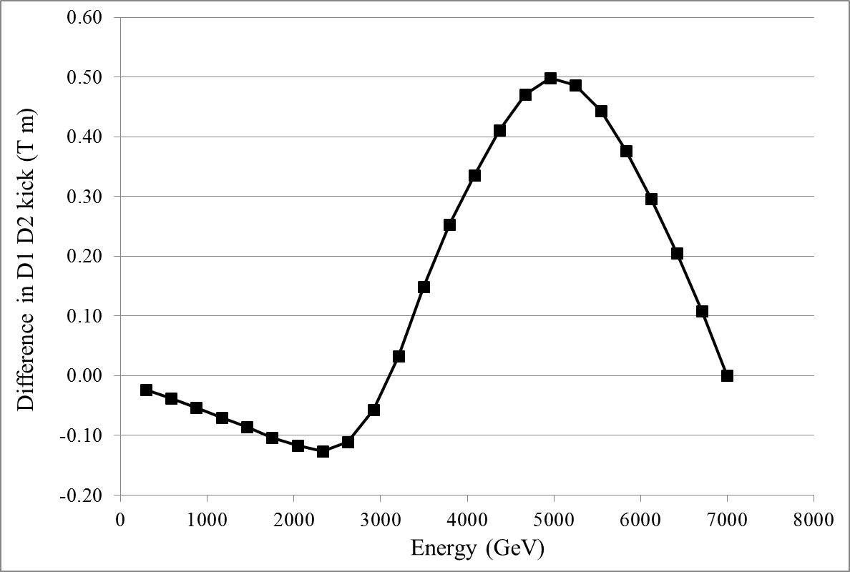
D1 – D2 magnets
Present baseline:
D1 is powered through DFHX with one 13kA PC
D2 is powered through DFHM with one 13kA PC
D1 and D2 are different magnets (single aperture, double aperture) with strong non-linearity due to saturation effect.

Slide 36
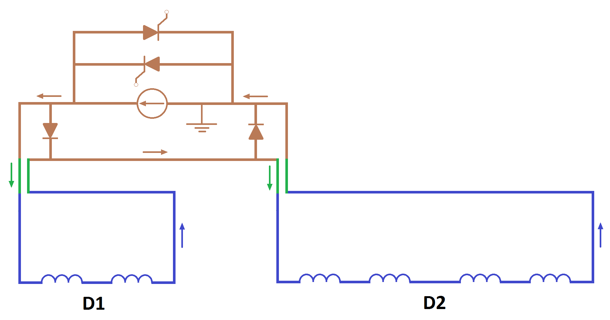
D1 – D2 in series
Alternative circuit layout:
D1 and D2 powered in series with one 13kA PC
One Trim power converter to compensate the difference between magnetic field
Additional protection diode for quench
PC with crowbar
Warm bypass diodes
SC Link D1/Triplet
+ HTS leads
SC Link D2/Q4 + HTS leads

Slide 37
D1 – D2 in series
Circuit layout:
Introduce complexity with magnet protection
Save one 13kA PC but add a TRIM PC
Need more DC cables
Accelerator physics
Natural compensation of current ripple thanks to opposite B field
D1 and D2 shall be controlled independently
Power converter designer:
Current ripple won’t be an issue thanks to low noise PC
Independent circuit is easier to control and to operate
TRIM PC shall be avoided due to control complexity and fault diagnostic
Magnetic model is needed to obtain the right performance

Slide 38
D1 – D2 in series
Potential Savings:
-1.2 MCHF could be saved by suppressing 4 PC
+300 kCHF Extra-cost for Trim PC
+500 kCHF for extra-manpower
+100 kCHF of DC cabling
+100 kCHF for the protection diode ?
+…kCHF for qualification of the protection scheme?
My conclusion:
At the end, we will probably save nothing!
But for sure, we will need more manpower and we will introduce complexity which will decrease the machine availability.

Slide 39
Others circuits
No other problems identified…

Slide 40
Outline
List of circuits
Design based on present LHC technology
First baseline of Inner Triplet powering
Impact of SuperAMALU^{2™}
New generation of Power Converters
Ultimate optimization
D1-D2 Story
Conclusions

Slide 41
New list of power converters
Subjects to come with integration optimization:
2-quadrant 13kA PC
2-quadrant 6kA PC
Upgrade of RQD/F to 2-quadrant to improve the LHC turnaround

Slide 42
Conclusions
SuperAMALU² imposes a new approach for magnet powering.
Time constant of the circuits are too high to use 1-quadrant converter.
Global optimization pushes to have warm DC cables as short as possible and to use energy storage for the return energy.
New generations of 2-quadrant power converters are needed for HL-LHC.
R&D will start this year.

Slide 43

Sure, not the end…
#HL_LHC 2016

Slide 44


Pushing the limits and welcome in terra incognita…
#HL_LHC 2016
The road toward FCC

