Slide 1


Operation and beam dynamics requirements
G. Arduini, J. M. Coello de Portugal, R. De Maria, S. Fartoukh, M. Fitterer, M. Giovannozzi, R. Tomás
Acknowledgements: A. Ballarino, R. Bruce, J.-P. Burnet, B. Holzer, Q. King, E. McIntosh, E. Métral, Y. Sammer, F. Savary, F. Schmidt, H. Thiesen, E. Todesco and the LHC@Home volunteers
Conceptual Design Review of the Magnet Circuits for the HL-LHC – 21-23 March 2016

Slide 2
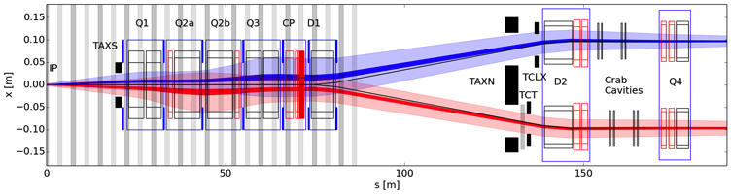
Outline
General requirements
Beam dynamics
  The IT quadrupoles
  The separation dipoles
  The matching quadrupoles
  The 11 T dipoles
Operation
Summary

Slide 3
Outline
General requirements
Beam dynamics
  The IT quadrupoles
  The separation dipoles
  The matching quadrupoles
  The 11 T dipoles
Operation
Summary

Slide 4
General requirements
Requirements from beam dynamics
  Minimise time-dependent effects, such as ripple
    Impact on emittance
    Impact on luminosity
  Maximise magnetic reproducibility on a fill-to-fill basis
  Minimise duration of transients (putting beams in collisions) to avoid instabilities
Requirements from operation
  Availability
  Reliability
  Maximise physics time
    Minimise time of squeeze
    Minimise time to put beams in collision
    Minimise time for ramp down of magnets

Slide 5
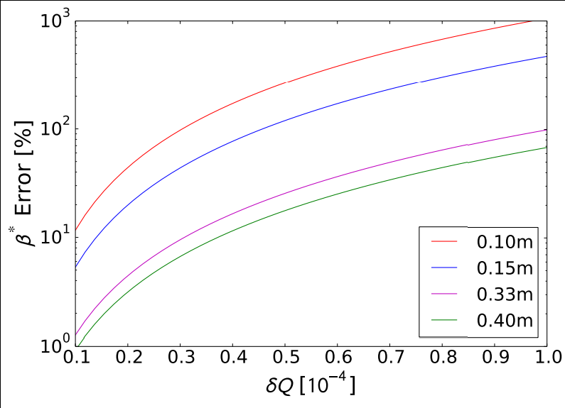
Specification of tune ripple
LHC (4.5 km β_{max}): long efforts for the determination of maximum tolerable tune ripple from power converters.
Tolerance based on:
  Long-term tracking studies
  Experimental studies (SPS) and HERA experience
HL-LHC (21.7 km - round,
43 km - flat - β_{max}): new regime to
be explored.
Tolerance based on analysis of
the performance of
K-modulation method for β* control
LHC -> δQ_{total} < 10⁻⁴
HL-LHC -> δQ_{total} < 10⁻⁵
Courtesy F. Carlier

Slide 6
Outline
General requirements
Beam dynamics
  The IT quadrupoles
  The separation dipoles
  The matching quadrupoles
  The 11 T dipoles
Operation
Summary

Slide 7
IT powering Schemes
Nominal current values
Baseline powering scheme:
proposed by WP3 (HL-LHC preliminary Design report) and presented by A. Ballarino, 4th LHC Parameter and Layout Committee
PC1 16.5 kA
Q1
Q2a
Q2b
Q3
Agreed to move the trim at Q3 to Q1, better for β* measurement with k-modulation
PC4 ±0.12 kA
PC3 ±2.0 kA
PC2 16.5 kA
Q1Q2a Q2bQ3:
proposed by S. Fartoukh
smallest tune shift for current control
regime
PC1 16.5 kA
PC2 16.5 kA
Q1
Q2a
Q2b
Q3
PC3 ±2.0 kA
PC4 ±2.0 kA
Q1Q2Q3:
smaller tune shift than Q1Q3 Q2aQ2b for
current control regime
best compensation voltage control regime
=> best scheme (for beam dynamics)
PC1 16.5 kA
Q1
Q2a
Q2b
Q3
PC2 ±2.0 kA
PC4 ±0.12 kA
PC3 ±2.0 kA

Slide 8
Model of PC output to magnetic field
two regimes:
current control (<0.1 Hz):
voltage control (>0.1 Hz):
with
current ripple (Power converter specifications)
voltage ripple (Power converter specifications)
transfer function of the load (circuit) seen by the power converter
transfer function from the input current of the magnet to the
magnetic field (assumed constant)
transfer function of the cold bore, absorber, beam screen etc.,
T_{Vacuum} ≤1 (not taken into account)

Slide 9
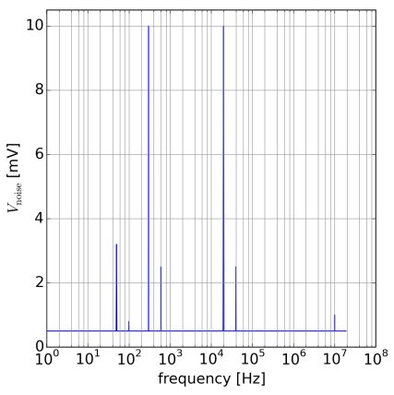
Expected voltage spectrum for HL-LHC
current control:
Class 1 PC: 1ppm
Class 2 PC: 10 ppm
voltage control (Class 1 + Class 2 PC):
50 Hz harmonics (main grid):
50 Hz: 3.2 mV R.M.S.
100Hz: 0.8 mV R.M.S.
300 Hz harmonics (diode rectifier):
300 Hz: 10.0 mV R.M.S.
600 Hz: 2.5 mV R.M.S.
20 kHz harmonics (ITPT converters):
20 kHz: 10.0 mV R.M.S.
40 kHz: 2.5 mV R.M.S.
10 MHz harmonics:
10 MHz: 1.0 mV R.M.S. (0.5 mV)
all other frequencies:
0.5 mV R.M.S
300 Hz
20 kHz
50 Hz
600 Hz
40 kHz
100 Hz
10 MHz
Courtesy EPC group
Notes:
dBmuV = Gain references to 1muV, e.g. 20*log10(3.2 mV/(1muV))=70 and 20*log10(10 mV/(1muV))=80
Nominal LHC (peak to peak): Vpk-pk(PC1 (8kA, 8V)) = 5 mV => Vrms=0.707*Vpk-pk =>V [dBmuV) = 20*log10(0.707 Vpk-pk/(1muV))=70

Slide 10
Tolerances current control regime
current control = random low frequency noise
Class 1 PC: ±1 ppm Class 2 PC: ±10 ppm
tune shift induced by uniformly distributed random error on current and assuming Class 1 power converters
 | Round optics |  | Flat optics
HL-LHC | rms((Q_{z}-Q_{z0})) [10⁻⁴] | ΔQ/ΔQ(IT Baseline) | rms((Q_{z}-Q_{z0})) [10⁻⁴] | ΔQ/ΔQ(IT Baseline)
IT nominal LHC | 0.25 | x0.18
IT Baseline | 1.37 | x1.0 | 1.98 | x1.0
IT Q1-Q2-Q3 | 0.67 | x0.5 | 0.98 | x0.5
IT Q1-Q2a Q2b-Q3 | 0.54 | x0.4 | 0.79 | x0.4

Slide 11
Tolerances voltage control regime
In this case the tolerances on:
  Ripple amplitude of the overall spectrum
  Determination of most dangerous frequencies
Have been determined with long-term simulations to assess the impact on the ripple on the dynamic aperture.
Several configurations have been probed:
  Without beam-beam
  With beam-beam and with/without crab crossing, ε_{N}=3.75 μm, N_{b}=2.2x10¹¹, 4D beam-beam lens
  With beam-beam and crab crossing, ε_{N}=2.5 μm, N_{b}=2.2x10¹¹, 6D beam-beam lens

Slide 12
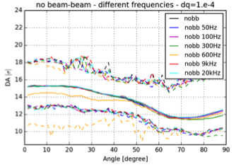
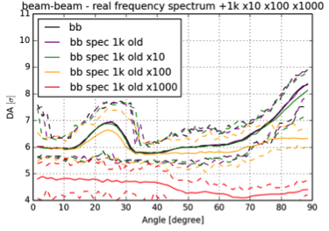
Results of numerical simulations
300 and 600 Hz have a sizeable impact on dynamic aperture if the amplitude of tune modulation is 10⁻⁴.
With beam-beam, the realistic spectrum starts showing an impact on dynamic aperture if its amplitude is multiplied by a factor of 10.
Reminder: sixty realisations of magnetic field errors are used.
Continuous lines: average (over realisations) DA
Dashed lines: minimum or maximum (over realisations) DA

Slide 13
Outline
General requirements
Beam dynamics
  The IT quadrupoles
  The separation dipoles
  The matching quadrupoles
  The 11 T dipoles
Operation
Summary

Slide 14
Tolerances current and voltage control
current control:
Class 1 PC: ±1 ppm
Class 2 PC: ±10 ppm
closed orbit distortion induced by uniformly distributed random error on current
voltage control:
even smaller closed orbit distortions due to attenuation from inductance -> negligible
b2 error (3 units for D2, 0.4 units for D1) -> tune modulation -> -> negligible
 | rms((z-z₀)) at IP [μm] | rms((Q_{z}-Q_{z0})) [10⁻⁴]
D1 + D2 class 1 | 0.040* | 0.027
D1 + D2 class 2 | 0.42 | 0.27
Recommended option
* Nominal rms beam size at IP: 7 μm
Notes:
correctly (as described in script, z'max is given by:
!one power supply for D1, one power supply for D2 and dI/I=1.e-6 current ripple results directly in dk/k=1.e-6
! kick from ripple.ipynb:
! D1: scale = 23348.89927, ld1=6.27 #length (WP3 website, 12/03/2015) for D1 => zpmaxd1=6.6*ld1/scale #[Tm] from (6.6 T peak field, 6.27 m length from WP3 website, 12/03/2015)
! D2: ld2=7.78 #length (WP3 website, 12/03/2015) for D2, zpmaxd2=5.1*ld2/scale #[Tm] from (5.1 T peak field, 7.78 m length from WP3 website, 12/03/2015)
f frev/f theta(D1) [rad] theta(D2) [rad]
0.0 inf 1.80237146702e-03 1.69935205686e-03
-> rescale results by 0.00180/0.00300395244503=0.6

Slide 15
D1/D2 powering schemes
main PC
trim PC
current control:
closed orbit distortion induced by uniformly distributed random error on current – trims not taken into account but expected to be negligible:
D1L-D2L-D1R-D2R
D1LD2L-D1RD2R
D1LD2LD1RD2R
D2L
D1L
D1R
D2R
D2L
D1L
D1R
D2R
D2L
D1L
D1R
D2R
Worse in terms of orbit deviation and tune shift
- Better in terms of orbit deviation and tune shift
- D1LD2L-D1RD2R and D1LD2LD1RD2R are equivalent
Class 1 (±1 ppm) | rms((z-z₀)) at IP [μm] | rms((Q_{z}-Q_{z0})) [10⁻⁴]
D1L-D2L-D1R-D2R | 0.040 | 0.027
D1LD2L-D1RD2R | 0.015 | 0.010
D1LD2LD1RD2R | 0.011 | 0.013

Slide 16
Some considerations on D1/D2 powering schemes
We want to keep separate the function of defining the geometry and the orbit correction. This implies:
  Independent power converters for D1 and D2
  Single power converter with trim on D1 or D2.
The impact of beam dynamics (separation at the IP and in particular tune modulation) favour the option of single power converter with trim, but the absolute effect is nevertheless acceptable provided that the power converter is of Class 1.
The reduction in terms of cost should be evaluated.

Slide 17
Outline
General requirements
Beam dynamics
  The IT quadrupoles
  The separation dipoles
  The matching quadrupoles
  The 11 T dipoles
Operation
Summary

Slide 18
Tolerances
Current control regime = random low frequency noise
Class 1 PC: ±1 ppm Class 2 PC: ±10 ppm
Tune shift induced by uniformly distributed random error on current
Voltage control regime
Due to its small inductance Q4 contributes as much as the IT
Recommended option
HL-LHC | rms((Q_{z}-Q_{z0})) [10⁻⁴] | ΔQ/ΔQ(IT Baseline)
IT Baseline | 1.37 | x 1.00
IT Baseline + Q4 class 1 | 1.42 | x 1.04
IT Baseline + Q4 class 2 | 1.87 | x 1.34
The design of the Q4 has been changed in the meantime (lower current, higher inductance): the situation will be re-assessed

Slide 19
Powering Q4 apertures
Circuit configuration
  Nominal LHC:
    Two power converters are used for the two apertures.
    Only three leads are present, which imposes
    0.5 I_{AP2} < I_{AP1} < 2 I_{AP2}
    The constraint has impact only on high-beta optics
  In HL-LHC:
    No high-beta optics is expected to be used
    The field quality of Q4 might get worse for strongly unbalanced powering of the apertures. Therefore, the present three-lead scheme seems suitable also for HL-LHC.
    The use of a single power converter with a trim could be considered.
    The rating of the trim should be assessed for the baseline optics including all possible variants.
    Previous studies indicated that 2 kA was a reasonable assumption for the rating of the trim power converter.

Slide 20
Other matching quadrupoles
Circuit configuration
  Nominal LHC:
    Two power converters are used for the two apertures of each magnet.
    Only three leads are present: this imposes
    0.5 I_{AP2} < I_{AP1} < 2 I_{AP2}
    The constraint has impact only on high-beta optics
  As no high-beta optics is expected to be used, the present three-lead scheme seems suitable also for HL-LHC.
Impact of current ripple in Q5 and Q6 has to be assessed.

Slide 21
Outline
General requirements
Beam dynamics
  The IT quadrupoles
  The separation dipoles
  The matching quadrupoles
  The 11 T dipoles
Operation
Summary

Slide 22
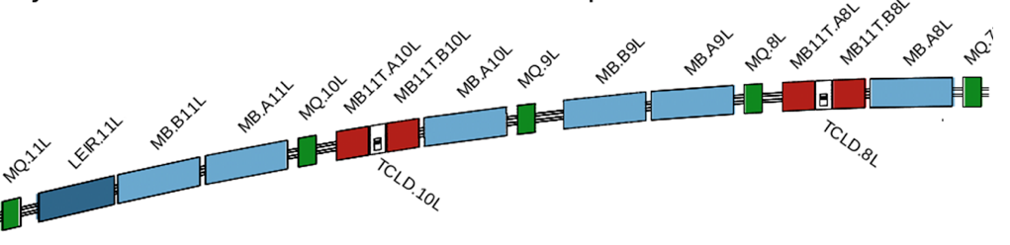
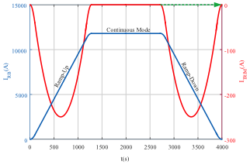
11 T dipoles
Four units are planned to be installed in IR7.
The 11 T dipoles are powered in series with the main dipoles.
The baseline foresees one
trim power converter
(for two magnets/four
apertures)
The difference in TF generates a bump of 2 cm. Two options:
  Apply a local correction (with a trim)
  Apply a global correction with several magnets.
    About 5 σ aperture lost
    About 40-80 % of corrector’s strength used (depending on number of correctors)
    A bump of up to 1.5 mm will develop during the ramp, including also the collimator region
Courtesy Y. Sammer

Slide 23
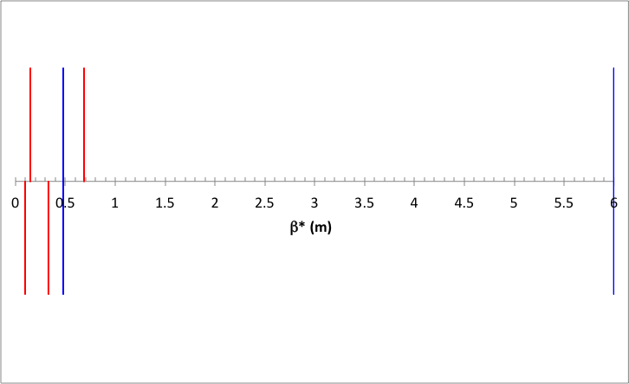
Operation: bringing beams in collision
Collisions
Configuration for L=5×10³⁴ cm⁻² s⁻¹
ATS pre-squeeze: from 6 m to 0.48 m β*
Variation of quadrupoles in IR1/5
β* 0.15 m
β* 0.69 m
Need to speed up this phase
Need to speed up this phase
ATS pre-squeeze: from 6 m to 0.48 m β*
Variation of quadrupoles in IR1/5
Configuration for L=7.5×10³⁴ cm⁻² s⁻¹
β* 0.10 m
β* 0.33 m
Collisions

Slide 24
Operation: bringing beams in collision
Overall, the pre-squeeze duration should be minimised.
Preliminary results:
  Pre-squeeze time: 826 s
  Q5 circuits are the slowest: improvements required.
The process of bringing the beams in collisions should be analysed:
  Specify maximum acceptable time based on beam dynamics arguments
  Specify ramp and acceleration rates for orbit corrector circuits
In progress

Slide 25
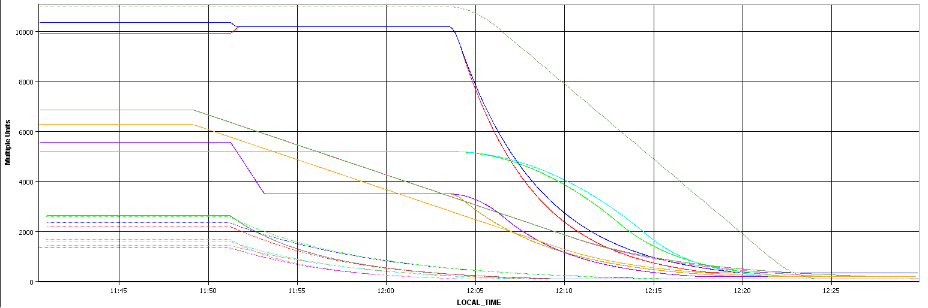
Operation: ramping down
Requirement: the ramp down time of the new magnets should be in the shadow of that of the nominal magnets.
MQs ≈ 16 min
MBs ≈ 21 min
Note: also LHC would benefit from an improvement of the ramp down time of MQXs (IR2/8)
MQXs (IR2/8) ≈ 32-37 min
D1s ≈ 19 min
Q4s (IR2/8) ≈ 17-24 min

Slide 26
Summary
Beam dynamics requirements
  The main challenge is the impact of ripple on tune: the current situation is not completely satisfactory and improvements are needed.
  ITs require better than ±1 ppm accuracy, while for D1s, D2s, and Q4s ±1 ppm accuracy is adequate.
  ITs: move to the configuration with all magnets in series
  D1, D2: can be kept either separate or in series with a trim
  Q4, Q5, Q6: the three-lead powering can be kept (two power converters or one with a trim are equivalent scheme from beam dynamics standpoint)
  Specifications for ramp and acceleration rates for orbit correctors are being worked out.
  The change of design of Q4 implies that new studies should be carried out to determine maximum amplitude of tune ripple and dangerous frequencies.
  Studies to assess the impact of Q5 and Q6 circuit characteristics in tune ripple will be launched.
  For the 11 T, the baseline will be re-assessed taking into account recent data concerning the transfer function reproducibility (magnet to magnet, and correlation between apertures).

Slide 27
Summary
Operation requirements
  Minimise pre-squeeze time is essential for HL-LHC performance. This requires optimising circuit properties of Q5 magnets.
  Minimise ramp down time is also essential for HL-LHC performance. The goal is to remain in the shadow of other LHC magnets.
    The slowest magnets are the ITs of IR2/8 (about 32-37 min).
    The other magnets feature a ramp down time between 16-21 min.
  Reduction of ramp down time for ITs of IR2/8 is useful already for LHC performance.

Slide 28
Thank you for your attention!

Slide 29
Additional slides

Slide 30
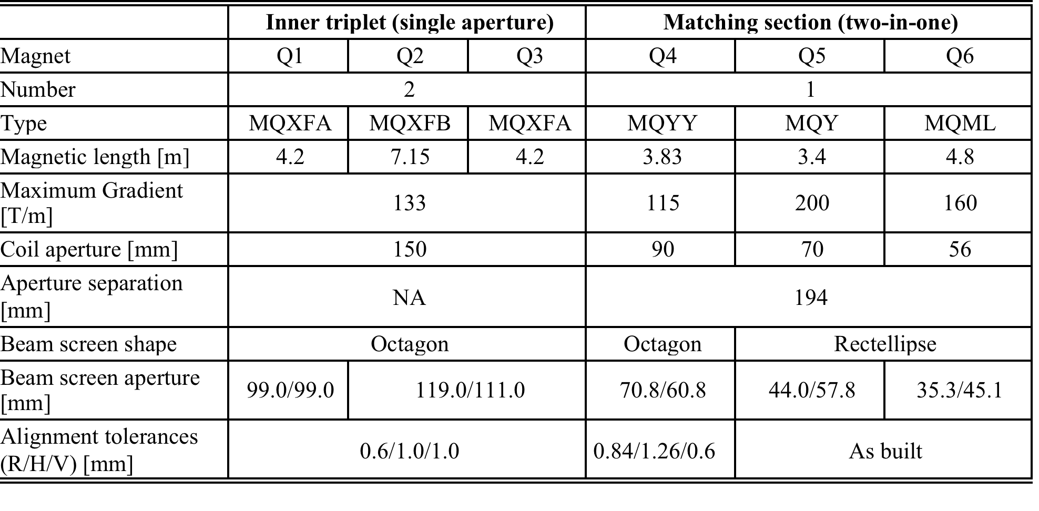
Parameters of IR1/5 quadrupoles

Slide 31
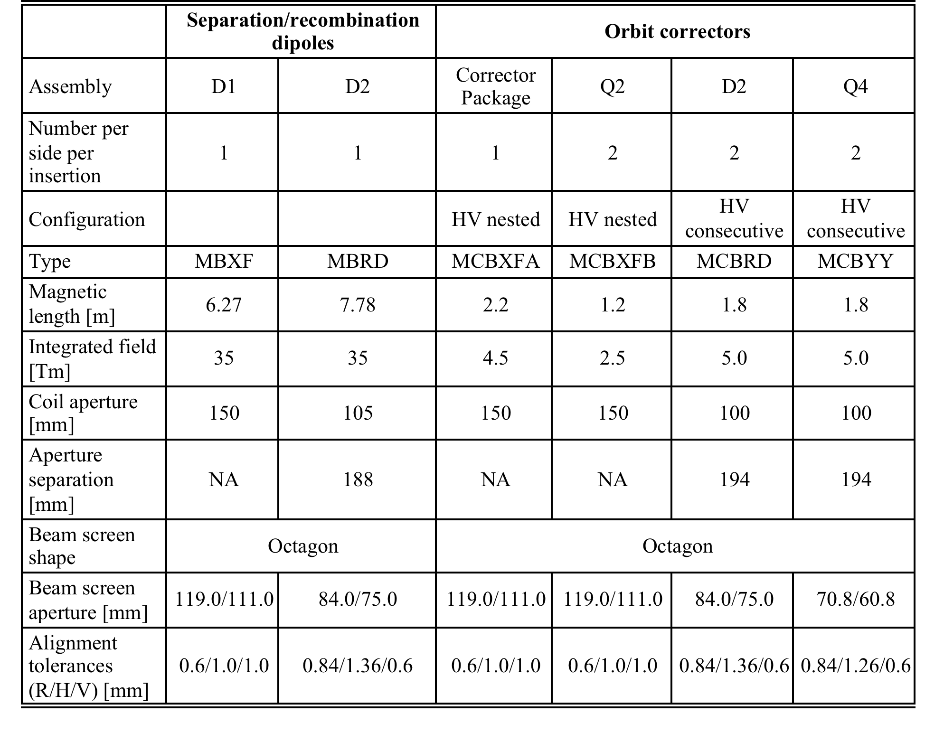
Parameters of IR1/5 dipoles

Slide 32
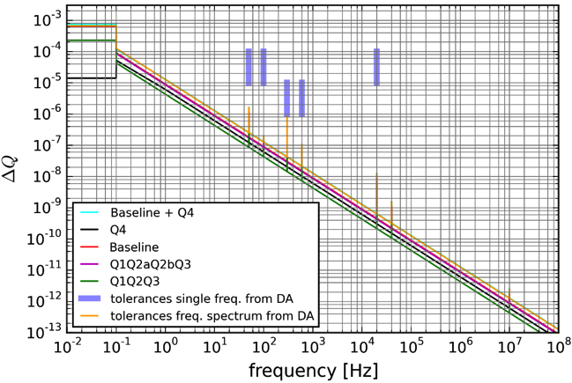
The global picture
Current control regime
Voltage control regime
The tolerance bars represent the most stringent conditions over the various configurations simulated.
The tracking has been performed with an earlier version of the layout (sLHCV3.1b)

Slide 33
The global picture
HLLHCV1.0 optics, class 1 PC, target tune ripple 0.1×10⁻⁴
Work to decrease the current ripple of the triplet power converter is needed also for the proposed solution
 |  | rms((Q_{z}-Q_{z0})) [10⁻⁴] | rms((z-z₀)) at IP [μm]
 | IT nominal LHC | 0.25
Baseline | IT Baseline | 1.37
 | D1L-D2L-D1R-D2R | 0.027 | 0.040
 | Q4 | 0.05
Linear sum |  | 1.447
Proposal | IT Q1-Q2-Q3 | 0.67
 | D1L-D2L-D1R-D2R | 0.027 | 0.040
 | Q4 | 0.05
Linear sum |  | 0.747

