Slide 1
CLIQ Coupling Loss Units &
HDS Quench Heater Discharge Supplies
- a short description of these safety-critical components for LHC machine protection and as candidates for use in the Hi-Lumi Project
K. Dahlerup-Petersen CERN/TE/MPE
with acknowledgements to A. Dinius, M. Favre, J. Mourao, B. Panev,
F. Rodriguez Mateos and E. Ravaioli.

Slide 2
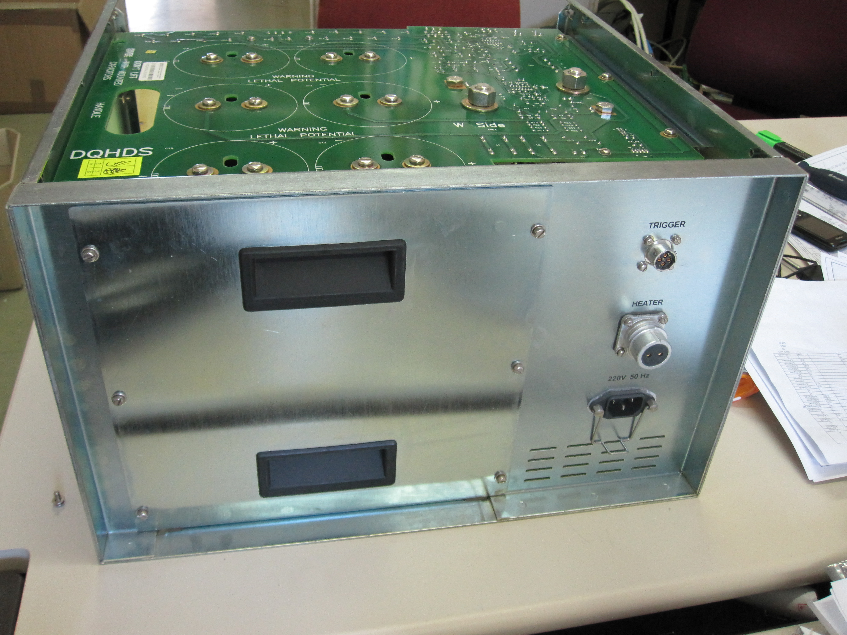
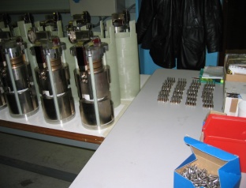
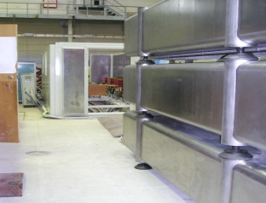
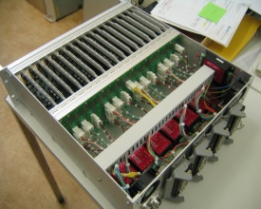
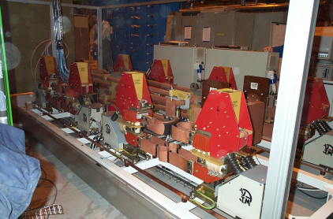
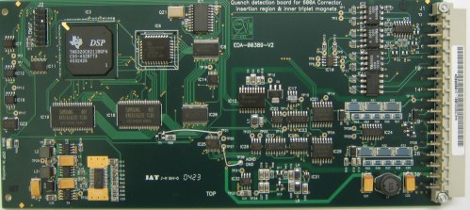
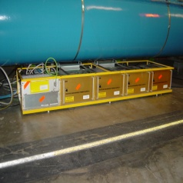
The Four Keystones of Quench Protection in S.C. Circuits
Coil Heating through either Energy Discharge into Strip Heater or Exchange of Energy with the Coil Conductor itself
By-passing of the
Quenching Magnet
through conduction
of a Cold Parallel Diode
Quench Detection by resistive voltage recognition followed by immediate activation of further protection measures
Extraction of the Stored Energy (EE) to resistor elements in the warm
part of the circuit
One of the 1232 ‘Local’ Quench Protection racks (DYPB) under main dipole magnets in the LHC tunnel
Comprising 4 standard Heater Discharge Supplies

Slide 3
Outline
Introduction
Concept and design of the LHC discharge units
    Basic ratings
    Operational aspects
    Limitations
    Typical discharge profile
Concept and design of the CLIQ units
    Basic ratings
    Operational aspects
    Limitations
    Typical coupling loss pattern
Conclusion

Slide 4
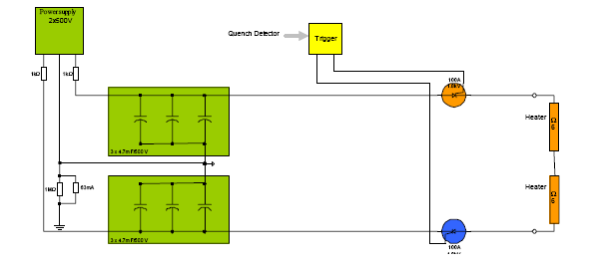
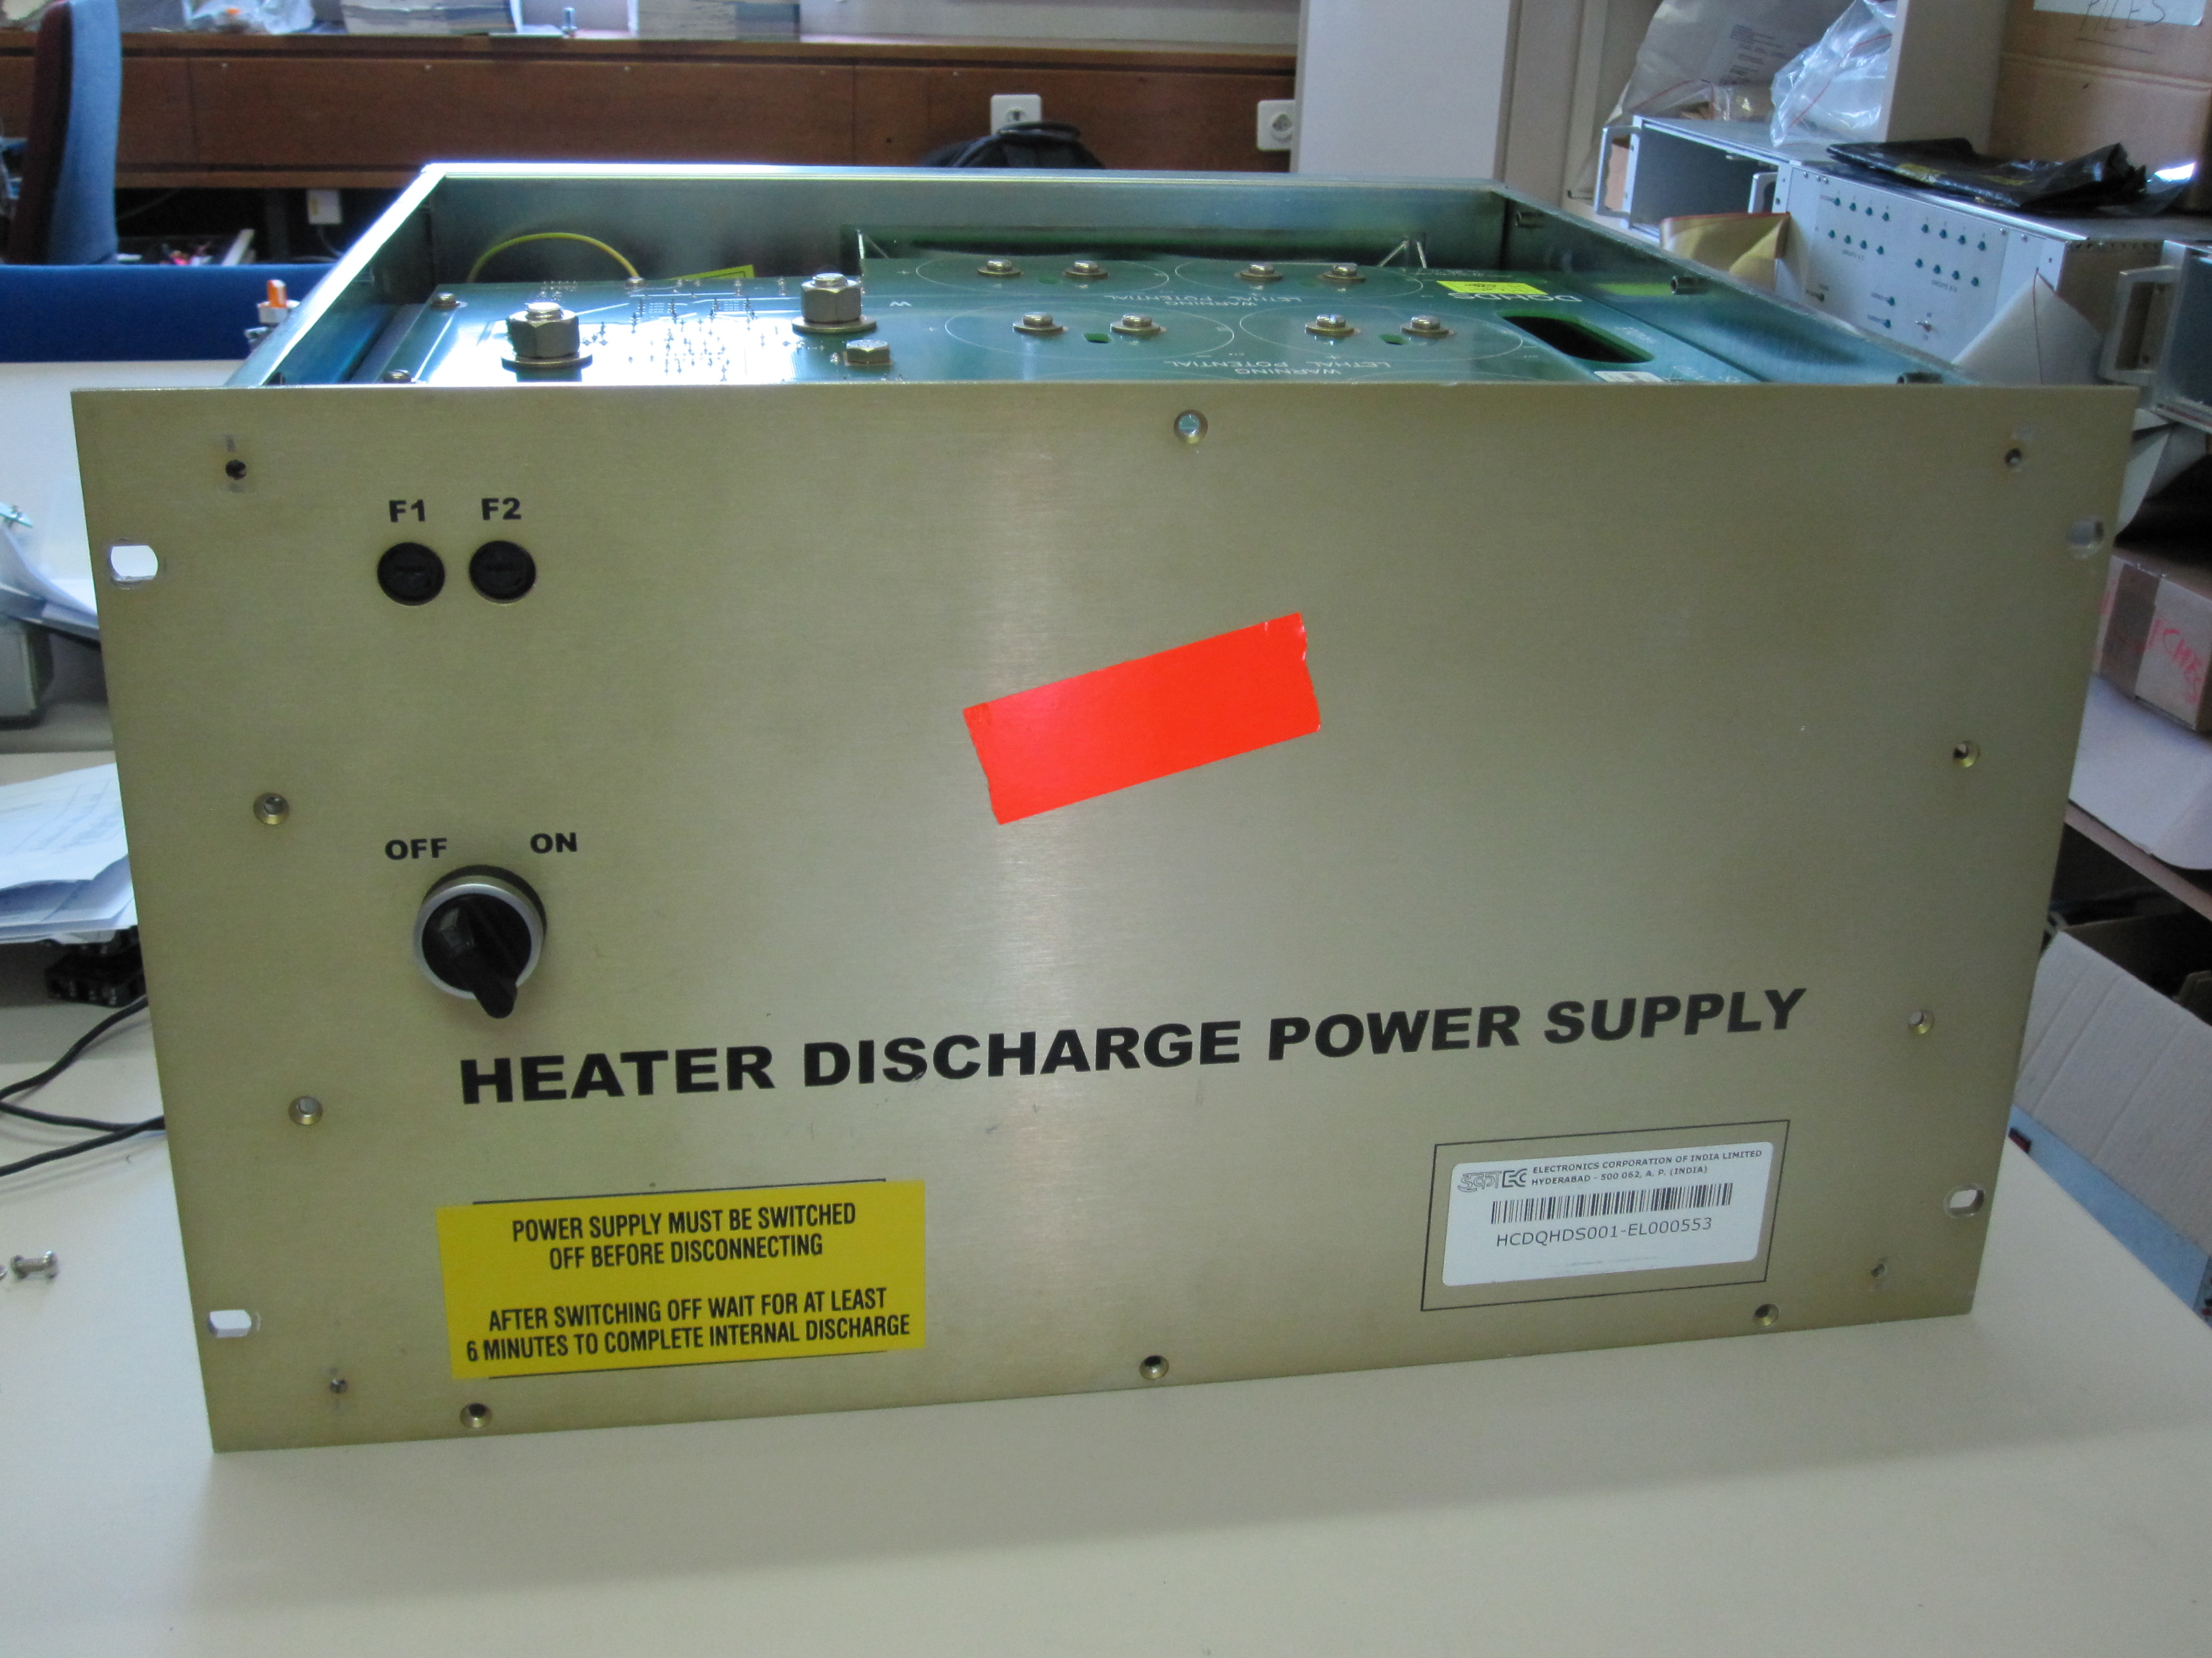
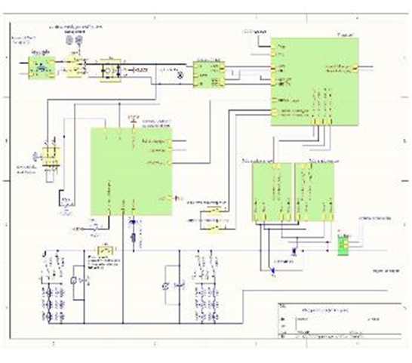
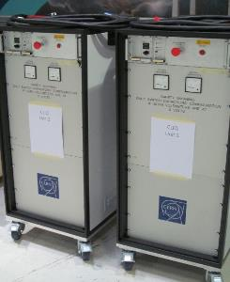
HDS
CLIQ
Power Supply
The TRIGGER board
MCB
The HV Capacitor
CHARGER
The PULSE transformers
Internal’ discharge
resistors

Slide 5
HDS – monopolar heater discharge supply – basic ratings:
Storage Capacitance: 6 Electrolytic Capacitors (with protection diodes) in
series/parallel connection, each rated 500 VDC
Total Capacitance: 7050 µF +/- 20%
Charging Voltage: 900 V_{DC} nominal (+ 450V; - 450 V)
Total Stored Energy: 2.9 kJ / DQHDS unit
Typical LHC Peak Discharge Current: 80 A_{peak}
Typical LHC Discharge Time Constant: 80 ms exponential decay
Robust, but non-redundant design – redundancy obtained by multiplication of the units

Slide 6

Energy storage
Charging resistors
V-divider
3C
Power ground via fuse
Main rectifier
Auto-discharge
resistors

Slide 7
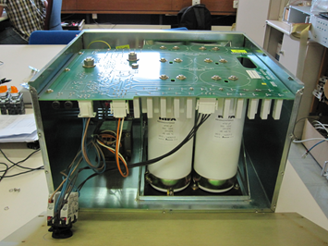




HDS – the power part.
Storage Capacitors
Discharge Thyristor +
Charging Controllers
Discharge resistors
Main rectifier for charging current
Grounding point
Earth fuse 63 mA
Voltage divider
Discharge Thyristor -

Slide 8
1
Discharge Trigger arrives from QDS
RL2 gets activated
The trigger circuit:
The other pulse is used for pulling relay RL1 which blocks the capacitor charging for 5sec while discharging the caps
2
RL2 switching
The two TI NA556 timers / pulse generators will reset and generate a pulse on their outputs
One pulse is used to turn ‘on’ the transistor which then pulls a current pulse through the two pulse transformers herewith creating the thyristor gate current pulses.

Slide 9
Charching Circuit
When switching, RL1 will start the two timers which drives the relays RL3, 6: 200s delay
RL4,7: 400s delay
This will modify the charging time constant for shorter overall charging
Start charge: RL1 activation
At start-up: All 2 x 6 resistors in circuit
After 200 s: 2 x 4 resistors in circuit
After 400s: only 2 x 2 resistors in circuit

Slide 10
The reaming part of the DQS circuit is a power source for producing the +15 V needed for the electronics.
The remaining part of the HDS circuit is a power source for producing the + 15 V needed for powering of the electronics

Slide 11
HDS – other features and characteristics:
Trigger pulse (LHC): Rising signal 0-12 V_{DC} (for operational reasons)
Trigger Time Delay, Appearance to
Peak of Discharge current: 4 ms*
Input Power Control (ON/OFF): On/Off command only locally on each unit
Charging Process: Can be latched at zero / unlocked from remote
Capacitor Voltage Monitoring: Read permanently by logging and by Post Mortem (event)
Current Monitoring during Discharge: Individually, from measurement transformer
At the moment only installed on LHC main dipole magnets
Alarm: If charging voltage drops below 810 V_{DC}
Powering: From one of two independent UPS networks - 50/50
Failure rate (from experience): ≈ 2 per mille / year – 10-12 cases – mainly affecting availability, all cases repaired and returned to spare store
6076 HDS’s are installed and operating in the LHC collider. We have 200 spare units.
* Composed of RL2 opening time (2 ms) + pulse creation time (1 ms) + current rise time (1ms)

Slide 12
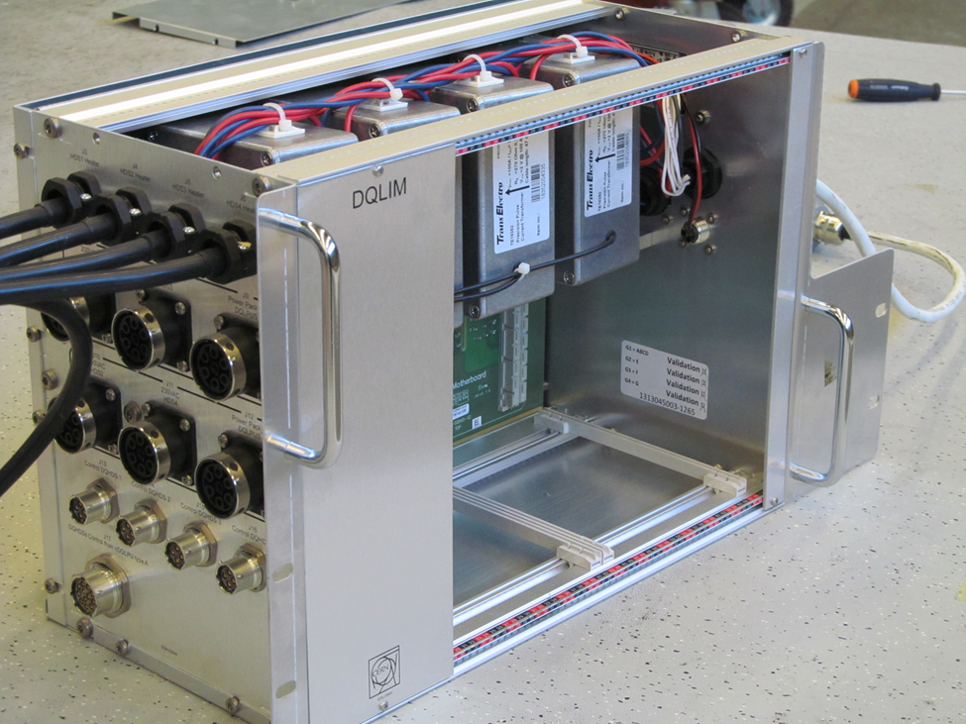
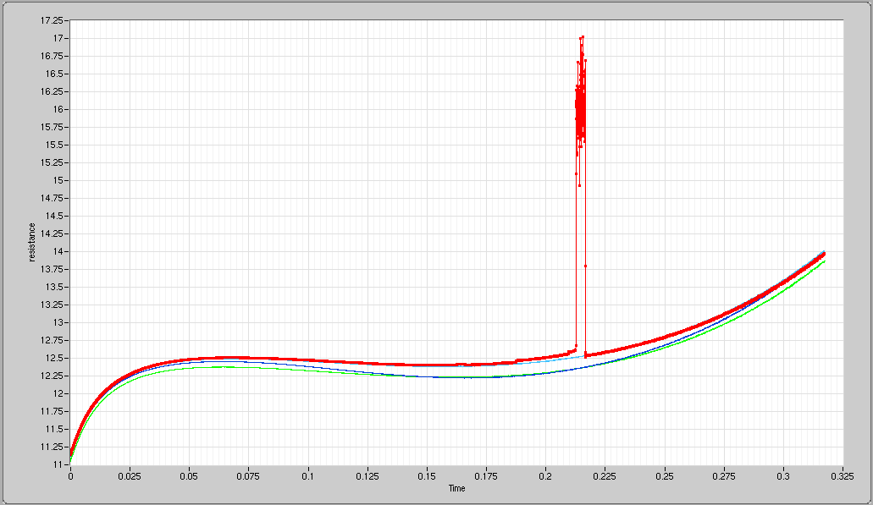
Further relevant info:
Voltage and current profiles of discharges from rated voltage have been recorded and stored for use as reference curves.
At each heater firing the new discharge profile is automatically compared
with the reference.
Strip heater resistances calculated from measured voltage and current profiles, for dipole A26R8
Four current pulse measurement transformers in the shuffling module of each local dipole quench protection rack
Recent example showing the beginning of a strip heater failure – only visible on the current profile. Reconfiguration of the heaters could be performed before further damage and energy deposit occurs at next firing.

Slide 13
CLIQ basics
The quench expansion process does not depend on heat transmission from heaters to the magnet coil from
The power output of the CLIQ unit is connected directly to the superconducting powering circuit, across a part of the coil in which quench expansion is required.
The capacitor bank of the CLIQ unit and the magnet coil will create a
resonance circuit, with losses generated during the exchange of
stored energy between them.
- The voltage and current oscillations will be damped, with increasing
strength as the quenching process progresses. Also the external
resistance counts so the ESR of the capacitors shall be minimized.

Slide 14
CLIQ basics (continued)
Other important differences:
  The peak current from the CLIQ unit is typically one to two orders of magnitude higher than from the HDS supply
  The CLIQ powering system must be bi-polar in both voltage and current. For each current direction both polarities occur as a result of the ringing.
  The CLIQ unit is fully floating w.r.t. ground
  The method requires adequately rated additional current leads
  Important Note: The CLIQ principle is subjected to a Patent, registered by CERN. According to the CERN-DOE Protocol information about this subject shall not be disclosed to any third party but exclusively be used for purposes within the Larp-CERN collaboration for Hi-Lumi LHC.

Slide 15
First CLIQ Unit: Concept, Component Selection and Design
Experimental version – for test purpose at CERN and at FNAL
System Layout: The bi-polar / bi-directional topology is maintained throughout
    the design
- Energy Storage: Capacitor type: Dry, metallized thin-film (polypropylene) type Bi-polar by nature, self-healing type, rating: 2x40 mF, 500 V_{DC}
10kJ stored energy (80 mF). Does not fail in short-circuit!
Features low ESR compared to electrolytic capacitors.
Valves: Fast-switching Thyristors, Bi-directional (two opposite wafers
in one press-pack). Approved by ‘ABB Semiconductors’ for the CLIQ application of 6 kA_{peak}, 500 ms: 2800 V, 3820 A_{rms} version
- Thyristor driver: Train of 12 kHz pulses from dedicated generator – through
pulse transformers.
- Trigger: Normally high (10 V_{DC} , 20 mA min) dropping to low upon Trig
- Charging unit: A dedicated switched-mode converter assures the complete
charging of one or both capacitors to 500 Vdc at 100 mA
constant current in 8 mins (80 mF), 4 mins (40 mF).
Accepts 110 Vac input. Commutator for steps of 50 V.

Slide 16
CLIQ – Safety Measures:
EQUIPMENT STOP activation accessible from outside enclosure will:
    - Cut the input power
    Switch-in a set of discharge resistors for a forced ‘internal’ discharge of the storage capacitors. Discharge time (1 min max) is shorter than the time to open up the cabinet
OTHER PRECAUTIONS:
    No automatic start of capacitor recharge after a input power cut.
    No automatic restart of capacitor charger after a trigger (system latched until manual restart)
    Permanent display of the two capacitor voltages and ‘safe conditions’ indication (<40VDC)
    Special screws and special tools for cabinet opening
    End of charging indication
CLIQ – Redundancy:
- The trigger circuit is redundant up to the pulse release thyristors
CLIQ – Total reaction time:
≈ 500 μs

Slide 17
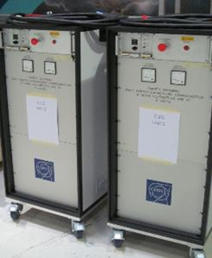

Slide 18
CLIQ - general overall layout
Power Supply
The TRIGGER board
MCB
The HV Capacitor
CHARGER
The two PULSE transformers
Internal discharge resistors

Slide 19
High 10 V
500 ms
low
Trigger
Energy for pulse train
Opto-coupler
15V
Monostable = 1 pulse
0
12kHz
15V
Mosfet
12 kHz Oscillator
Astable
Filter
Redundant channel

Slide 20
Source:: Emmanuele Ravaioli

Slide 21
Current (purple) and voltages (red/green) during an energy exchange between CLIQ and a test inductor (choke) @ RT

Slide 23
Conclusions:
HDS:
After solving a few teething problems, the HDS supplies appear as simple, robust and reliable equipment – used continuously in large numbers for protection of LHC s.c. circuits, e.g. main dip and quad, IPQ/IPD/IT.
Redundancy is obtained by multiplication and selection (crossing) of the heater elements for each powering circuit.
The HDS design features a slow reaction (4 ms) to the incoming trigger (the electronic design is from 2003).
With an upgraded trigger board it should be possible to gain 2-3 ms (opto devices replacing relays, use of modern logic components).
CLIQ:
The first generation of CERN-made, Industrial-quality units have successfully passed the type testing, on dummy and real s.c. load. Two of the three manufactured units are on-loan to Fermi lab.
Also the second generation will remain an experimental unit –with multiple charging levels and five different capacitances. It will be the first version with full redundancy of the trigger application (from input to output incl. doubling of the thyristors). Three such units are planned for September 2016.

