Slide 1
Quench detection for HiLumi
J. Steckert
Acknowledgements: S. Izquierdo Bermudez, TE-MPE colleagues
Conceptual Design Review of the Magnet Circuits for the HL-LHC
21-23 March 2016 CERN

Slide 2

Outline
Introduction
QD basics
General architecture
Example 11T unit
SC links
Controls
Development strategy
Conclusion
Concepts only !

Slide 3
Introduction
Quench detection is a key component in magnet protection
QD is mostly the challenge of finding a small resistive in a large inductive signal
To determine resistive voltage one has to compensate the inductive voltage
As better the inductive compensation and suppression of all other non-quench related signals as better is
“signal-to-noise”
As better “signal-to-noise” as faster and more reliable detection gets.
Signal quality is important (coupling, shielding etc...)

Slide 4
Inductive compensation
The classical bridge:
Ures = U1 – U2
Simple
Good compensation
Poor symmetric quench detection
Example: LHC iQPS
U1
U2
“Numeric compensation”:
Ures = Udiff - L * di/dt
Some calculation power required
High resolution current measurement required
VERY sensitive to glitches in current
To be avoided if possible
Example: LHC 600A correctors
Icirc
Udiff
“Multi coil compare”:
U1-U2, U1-U3, U1-U4, U2-U3, U2-U4, U3-U4
Some calculation power required
Good symmetric quench detection if enough signals
Compensation depends on equal transient responses
Example: LHC nQPS
U1
U2
U3
U4

Slide 5
Basic architecture
Fully digital, FPGA based system
  Logic can be changed easily during development and even after first operational experience...
Fully isolated measurement channels
  Potential differences between channels are irrelevant
Hard-wired current loops as interlocks
  Simple, proven, reliable
Solid state relays for sub-millisecond triggering
Contemporary controls infrastructure
All-in-one-box design, in case of service whole unit is going to be exchanged
  → To be seen what is most practical...
Two-fold redundancy.
➔ Whole chain down to protective elements

Slide 6
Basic architecture
bus
bus
bus
di/dt
DCCT
Isolated analogue input
Isolated analogue input
Isolated analogue input
Isolated analogue input
Isolated analogue input
Isolated analogue input
Isolated analogue input
Isolated analogue input
Isolated analogue input
FPGA
Controls interface
Interlocks

Slide 7
Basic architecture (continued)
High quality connectors, mechanical coding to avoid mix-up
Well shielded and laid out cabling/instrumentation
  → Most detection settings will not allow 50Hz filtering !
Current-awareness
  Current dependent quench detection settings
High resolution, low latency sampling of signals
All parameters necessary for quench decision measured on the same card
(no transmission of signals between boards)
Mixed magnet/bus-bar protection boards possible

Slide 8
Example: 11T quench detection
Nb₃Sn magnet in series with main dipoles
Powered with main dipoles: 12kA + trim
Ramp rates up to 10A/s, EE with 104s time constant
Threshold: 100mV, Evaluation time: 10ms
Flux jumps observed in short model testing
Current-dependent threshold/eval. time required
Nb₃Sn/NbTi Splices could be monitored together with coil voltages
Universal
QD constant

Slide 9
Example: 11T quench detection unit
Ic
U1
U2
U3
U4
U8
U7
U6
U5
NbTi/NbTi splice
Nb₃Sn/NbTi splice
Measurement of 8 coil voltages (U1..U8)
Use voltage taps which include the splices within aperture
Measurement of circuit current (I_{c}) and didt (optional)
Dedicated bus-bar monitoring ?
  All splices to be monitored by dedicated units ?
  Only long bus-bars to be monitored separately ?
  Details have to be worked out...

Slide 10
Example: 11T quench detection
Traditional logic for asymmetric quenches:
  (U1-U2 > Td) OR (U3-U4 > Td) OR
  (U5-U6 > Td) OR (U7-U8 > Td)
Traditional logic for aperture symmetric quenches:
  (U1+U2)–(U3+U4), (U1+U2)–(U5+U6), (U1+U2)–(U7+U8)
  (U3+U4)–(U1+U2), (U3+U4)–(U5+U6), (U3+U4)–(U7+U8)
  (U5+U6)–(U1+U2), (U5+U6)–(U3+U4), (U5+U6)–(U7+U8)
“Flat” logic, covering all cases:
U1-U2, U1-U3, U1-U4, U1-U5, U1-U6, U1-U7, U1-U8
U2-U1, U2-U3, ...
..
U8-U1, U8-U2, U8-U3, U8-U4, U8-U5, U8-U6, U8-U7
AND
OR

Slide 11
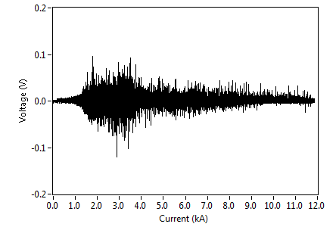
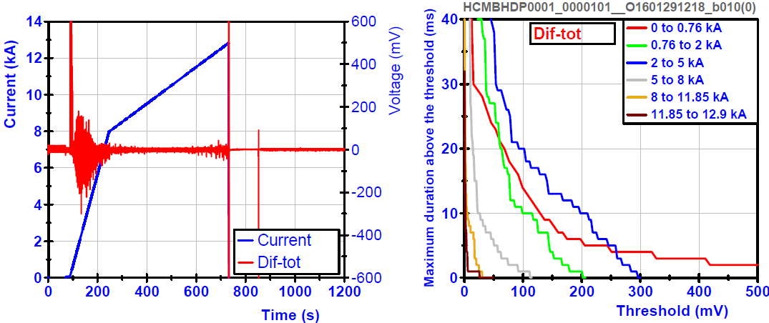
Flux jumps in Nb₃Sn
Flux jumps are visible as voltage signals
At lower currents they’re directly interfering with our QD boundaries (100mV/10ms)
Within the same aperture flux-jumps are less present in the difference signal
Current dependent detection settings should provide enough “room” to not trigger on spikes
SM18 test benches will serve as test bed for flux jump “survival” strategies

Slide 12
SC link protection
Long super-conducing links require quench detection
Threshold 100mV with 3s evaluation time
  Probably no inductive compensation required
  3s allow plenty of filtering
Current leads at the PC side need protection
  Resistive part 100mV / ~s
  HTS part 1..5mV / 100ms
Splice monitoring for HTS/MgB₂ and MgB₂/NbTi
  Interlocking ?
  Dedicated or “parasitic” ?
  To be discussed

Slide 13
Controls / Supervision
Contemporary controls system
  Industrial Ethernet based e.g. ETHERCAT
  Enough bandwidth for proper configuration management and full resolution signals
  Logging always on
  (PM transmission should not fully block logging)
  Remote firmware update capability
Higher logging rates could be useful
One communications controller per circuit
Timing-aware quench detectors should allow good absolute time-stamping
Sufficient amount of memory for high-resolution PM files

Slide 14
Development strategy
Closely follow the testing of the magnets
  1st early prototype implementation autumn 2016 for SM18
  11T protection mid 2017 for SM18 testing
  Pre production units for String 2
Experience collected in these prototypes should enhance final system
Ideally a common hardware platform for all magnets equipped with specific firmware

Slide 15
Conclusion
Sufficient amount of instrumentation allows direct comparison schemes
Un-committed analog channels connected to FPGA allow maximal flexibility during development
SM18 and String-2 will act as test-bed for final units
New caverns remove the rad-tol difficulties
(11T QD needs some rad tolerance 2Gy/a...)
Contemporary controls system allows for enhanced supervision/monitoring

