Slide 1
Warm cabling, cooling and ventilation
L. Tavian, ATS-DO
On behalf and under the controls of SWP17.2 and SWP17.3
Conceptual Design Review of the Magnet Circuits for the HL-LHC,
21-23 March 2016

Slide 2
Content
Integration layout in URs
Integration constraints of warm DC cables
Basic conception of warm DC cables
Inventory and main characteristics
Cooling and ventilation requirements and margins
Conclusion

Slide 3
Integration layout for DFHX and related power converters and warm DC cables
DC-cable
trays
DC-cable
trays
WCC: Water-Cooled Cable
ACC: Air-Cooled Cable

Slide 4
Integration layout for DFHM and related power converters and warm DC cables
DC-cable
trays
DC-cable
trays
WCC: Water-Cooled Cable
ACC: Air-Cooled Cable

Slide 5
Principle for cable-length calculation
Currently, no attribution of the electrical circuit to the current leads,
Position of the cable trays/convertors not exactly defined.
d2= 4 m
L. Cable = d1 + 2xd2
L. Circuit= 2L. câble

Slide 6
Integration constraints of DC cables
Area reserved for cable support system
I [kA] | Section [mm2] | h [mm] | r [mm] | Ext. D [mm]
18 | 2 x 1300 | 500 | 800 | 2 x 95
13 | 2000 | 500 | 800 | 115
6 | 1000 | 500 | 700 | 95
2 | 500 | 500 | 500 | 70
0.6 | 400 | 300 | 300 | 36
0.2 | 95 | 200 | 200 | 25
0.12 | 70 | 150 | 150 | 22
A minimum elevation of the cable trays is required with respect to the current lead head to respect the minimum bending radius and the maximum interface forces and torques.

Slide 7
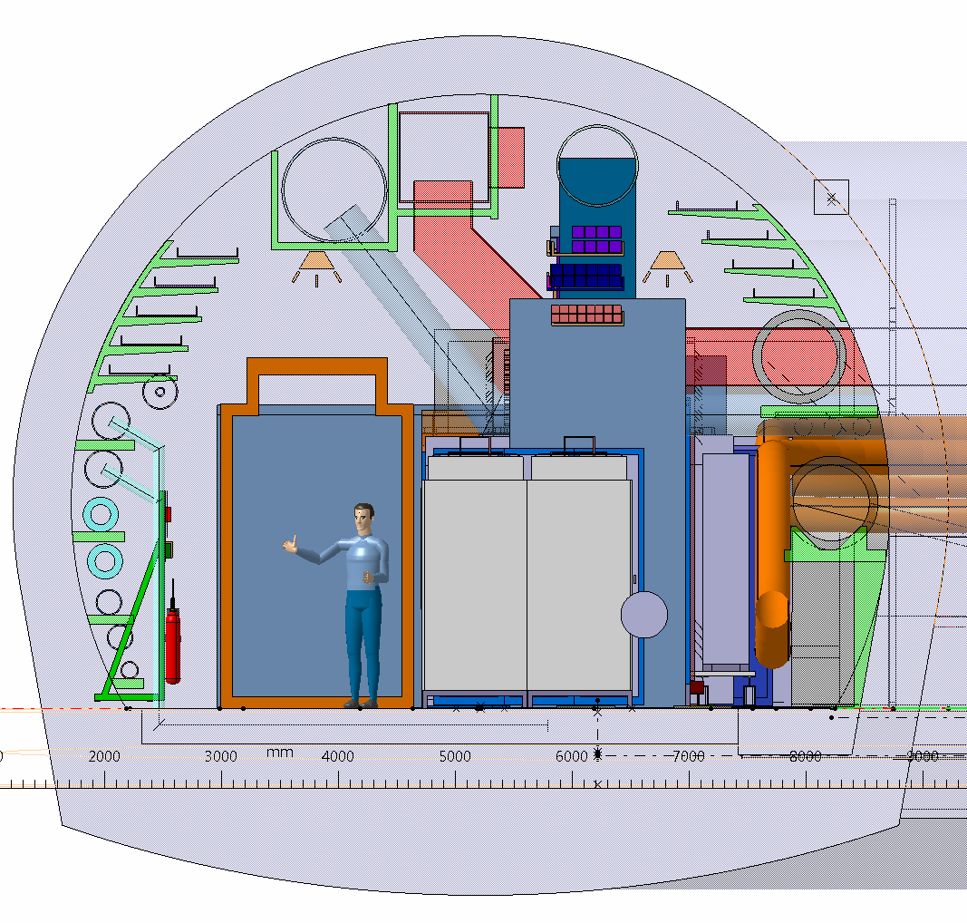
Integration of warm DC cable trays
Warm DC-cable trays

Slide 8
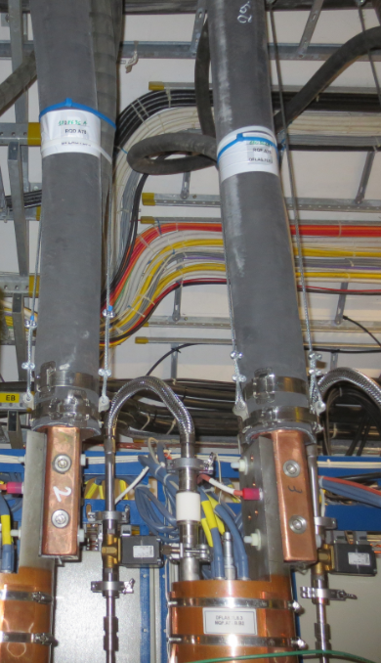
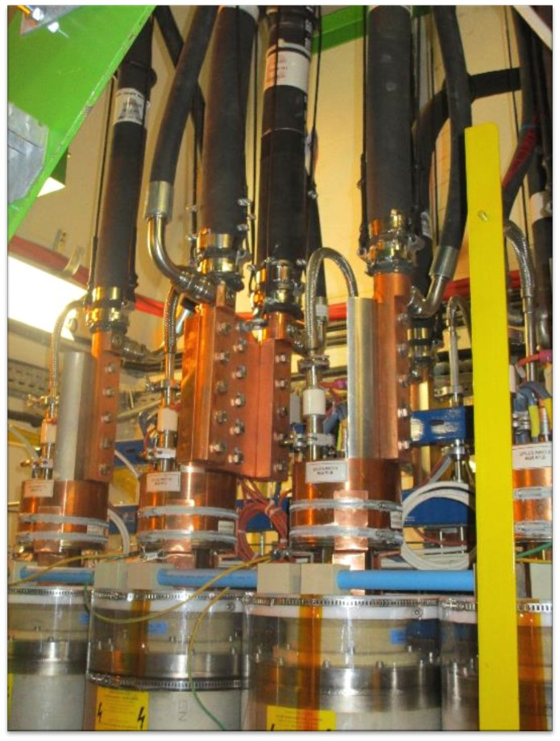
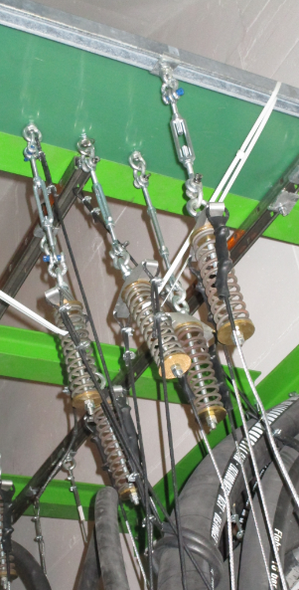
LHC example
13 kA (2000 mm2) warm DC cable
Double warm cable configuration
Cable supporting system for double cable configuration

Slide 9
Conception of HL-LHC warm DC cables
Based on LHC consolidated design, i.e.:
  Fully halogen-free hoses
  As maximum unit lengths of WCC below 50 m, no need of rigid Cu tubes and conical connections
  Use of EPDM hoses (15-20-year life time (SM18 experience return))
Current-lead interface forces:
  Accosting of the current lead must be performed by hand.

Slide 10
Cable inventory
Based on the new baseline proposal of D. Wollmann

Slide 11
Warm DC cable inventory & main characteristics

Slide 12
Losses to air of DC cables
Air cooled cables ACC: 100 % of the total losses
Water cooled cables WCC:
$$Qair=h∙π∙D∙L∙\left(T_{ave}−T_{air}\right)$$
27 kW per UR
10 W.m⁻².K⁻¹
290 m² per UR
9.5 K

Slide 13
Warm DC cable losses to water and to ventilation air

Slide 14
Cooling water flow requirement

Slide 15
Cooling and ventilation margin
If CV systems designed for rated currents without contingency:
 | Water cooling | Air cooling
Installed cooling capacity [kW] | 694 | 43
Ultimate operation margin [%] | 22 | 8
Nominal operation margin [%] | 33 | 12
→ No need of additional margin!

Slide 16
Evolution of DC-cable loss estimate vs time
Large loss reduction (factor ~3 on water, ~5 on ventilation) !
Thanks to the global optimization of the powering scheme and of the UR integration.
But…

Slide 17
… not true for all systems
Tetrodes
IOTs
Change of technology (Tetrodes to IOTs)

Slide 18
Conclusion
The conception of warm DC cables for HL-LHC is based on the LHC consolidated design
The integration of warm DC cables in the UR has started
→ refinement of the cable lengths will be needed when the current feed boxes (DFHX_M) will be designed and integrated.
At P1 and P5, the present powering scheme requires:
→ 176 warm DC cables (72 WCC and 104 ACC)
→ Rated currents from 120 A to 13 kA
→ Unit cable lengths from 15 to 30 m
Thanks to the global optimization of the powering scheme and of the UR integration, the water cooling and ventilation requirements have been reduced.
→ Water cooling capacity: from 460 to 700 kW depending on the operating conditions.
→ Air cooling capacity: from 38 to 43 kW depending on the operating conditions.

Slide 19
Thank you for your attention!

