Slide 1
The D2 magnet
P.Fabbricatore
INFN Genova
Magnet lay-out and characteristics
Peak magnetic field
Protection principle (Quench Heaters)
Quench analysis

Slide 2
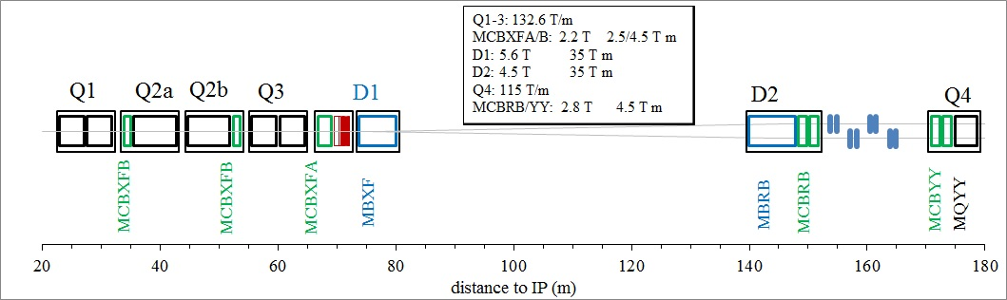
The requirements of D2 dipoles in HL-LHC
Scheme from E.Todesco
Characteristics | Unit | Value
Integrated magnetic field strength | Tm | 35
Magnetic length | m | <10
Aperture | mm | 105
Beam separation (cold) | mm | 188
Operating temperature | K | 1.9
Margin on the load line | % | 35
Multipoles variation due to iron saturation |  | <10 unit

Slide 3
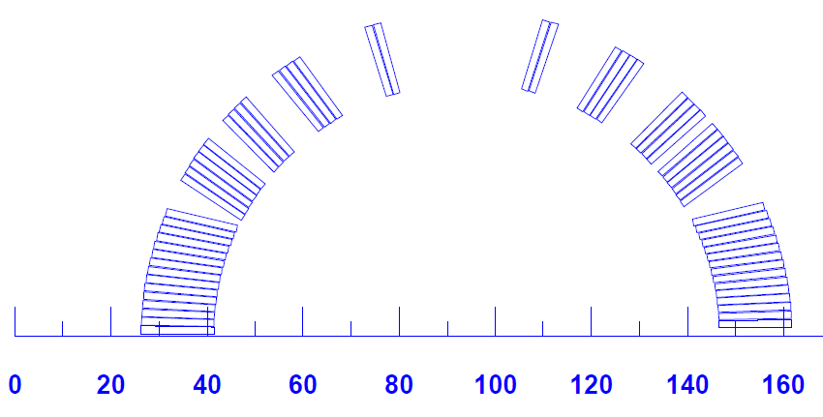
Cross talk problem and its solution
Asymmetric coils
Yoke with window
Yoke elliptical shape
Characteristics | Units | Value
Aperture | mm | 105
Distance between apertures | mm | 188
Magnetic length | m | 7.78
Bore field | T | 4.5
Peak field | T | 5.22
Current | kA | 12.050
Temperature | K | 1.9
Load line margin | (%) | 35
Overall current density | A/mm² | 443
Stored energy per meter | MJ/m | 0.2807

Slide 4
Field quality
b2 and b3 optimised at a B field slightly lower than 4.5 T (4.3 T)

Slide 5
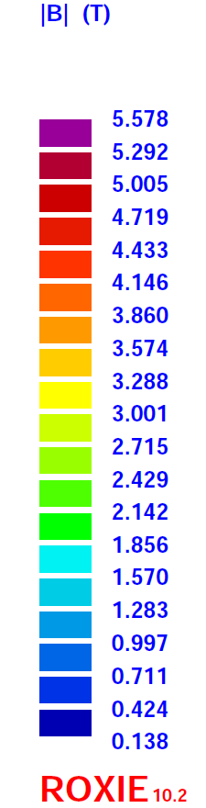
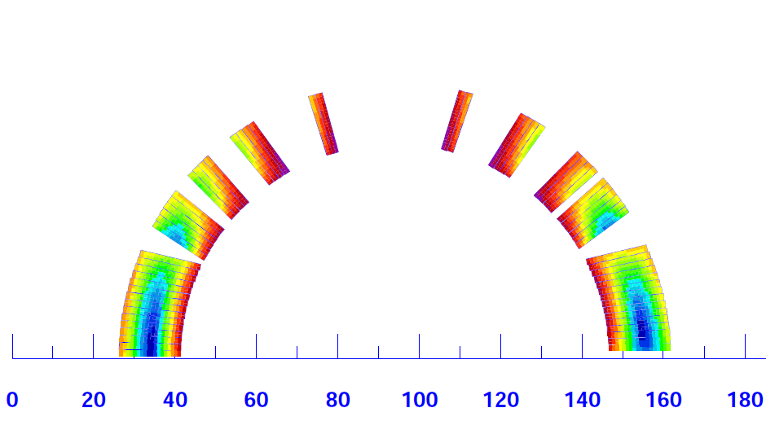
Parameters relevant for protection (Current 108% of nominal)
Peak Magnetic Field - 5.58 T
Current - 13 kA
Stored Energy - 2.51 MJ
The conductor is one involved in the external layer of LHC main dipoles

Slide 6
Circuit lay-out and quench protection
In the envisaged circuit lay-out, D2 is presently considered as a stand alone magnet.
It is assumed that in case of quench the magnetic energy is totally dissipated in the magnet→ D2 is a heater protected magnet.
Preliminarly the QHs of LHC main dipoles have been considered.
Two 0.025 mm thick stainless steel strips bonded in between two layers of poly-imide
Part of the strips are covered with copper (0.005 mm thick).
A single strip has a width of 15 mm
The pattern is 120 mm ss and 400 mm copper
The covered surface is 0.028 m² (per strip)
For the 8 m long D2 magnets the resistance of a single strip is 2.91 Ω
The two strips are connected in series (R _{circuit total}= 7.32 Ω)
With 900 V (± 450 V) the peak current is 122 A → 150 W/cm²

Slide 7
PRELIMINARY QUENCH HEATERS LAY-OUT
8 circuits formed by 2 heaters each. One heater in the HF zone and the second in the LF.
Only 4 circuits are used (1,6,3,8). The voltage is 900 V per each circuit
H7+
H3+
H5+
H1+
H7-
H3-
H5-
H1-
H8-
H4-
H6-
H2-
H8+
H4+
H6+
H2+

Slide 8
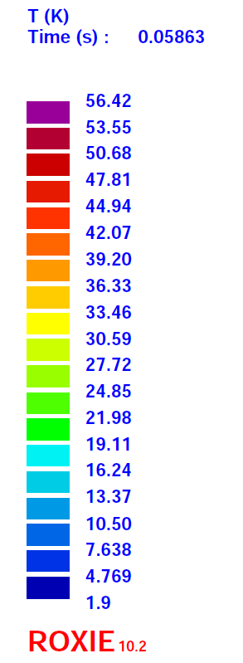
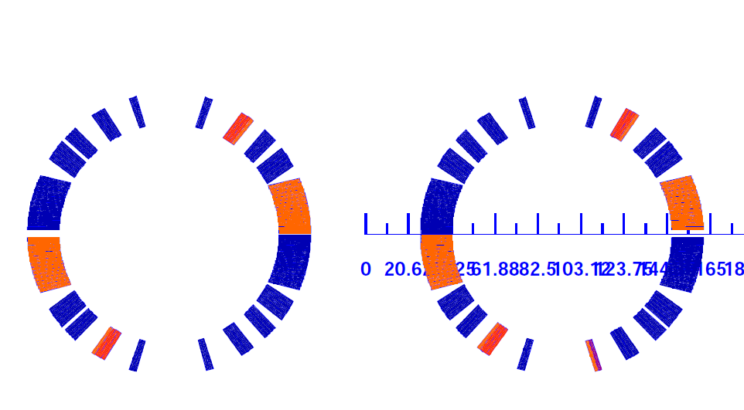
Quench Analysis with Roxie
Quench threshold voltage 100 mV
Delay 15 ms
Heater time constant 52 ms
Quench of a turn in the lower
pole of the rigth coil
At 58 ms after quench start , the QHs have quenched the 8 blocks

Slide 9
Roxie results
The peak temperature at the quenched turn is 220 K.
The Current decays at 2kA in 320 ms.
The peak voltage to ground is 2 kV

Slide 10
Playing with Roxie – Worsening parameters
With
Quench threshold voltage 200 mV
Delay 30 ms
With
Quench threshold voltage 200 mV
Delay 30 ms
Two QH circuits off

Slide 11
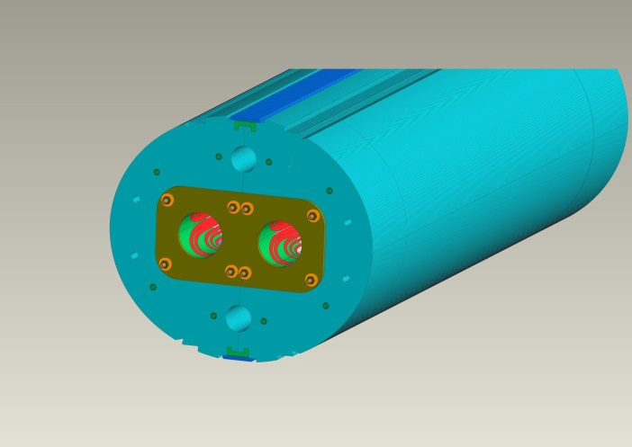
Conclusions
D2 is considered a stand alone unit. In case of quench the energy is dissipated in the coil.
The protection is based on Quench Heaters. Eight QH circuits (Four used)
Preliminary quench analysis with Roxie shows no protection problems
Thank you for your attention

