Slide 1



The 11 T Magnet and Protection
Susana Izquierdo Bermudez
with many contributions from WP11, WP7, FNAL collaboration and CERN-TF, in particular from Gerard Willering.

Slide 2
Contributors
TE-MSC
Luca Bottura.
TE-MSC-SCD
Bernardo Bordini, Jerome Fleiter.
TE-MSC-TF
Gerard Willering, Hugo Bajas, Marta Bajko, Jerome Feuvier.
TE-MSC-MDT
Juan Carlos Perez, Antonios Giannopoulos, Juho Rysti.
TE-MSC-LMF
Ludovic Grand-Clement, Herve Prin, Frederic Savary, David Smekens.
TE-MPE-PE
Bernhard Auchmann, Daniel Wollmann, Jonas Blomberg Ghini, Lorenzo Bortot, Alejandro Manuel Fernandez Navarro.
TE-MPE-EE
Felix Rodriguez Mateos.
FNAL
G. Chlachidze, A. V. Zlobin.
And many other people involved in the design, construction and test of the magnet.

Slide 3
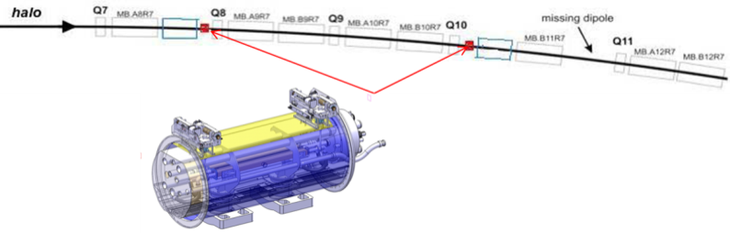
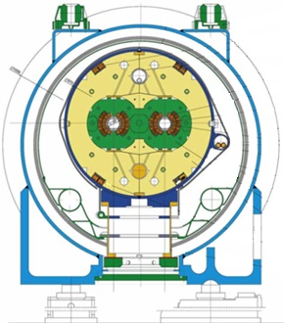

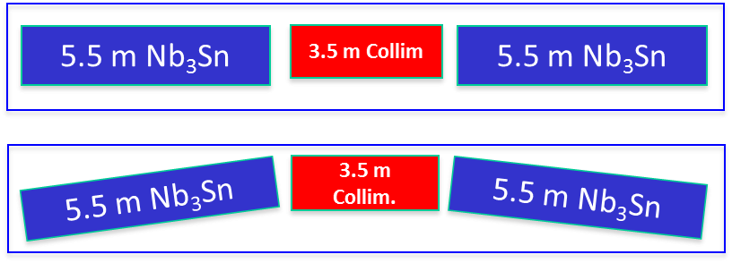
Introduction
DS-11 T magnet must be 100 % compatible with the LHC lattice and main systems
  This has important consequences, as it is setting (many) important constrains in the design:
  Integrated field (pair of DS-11T dipoles): 118.8 Tm
  Operational point
  Yoke dimension/geometry
  Aperture
  Length
  …
Challenges: high field, forces, stored energy!

Slide 4
Contents
Magnet Parameters
Results and analysis on short magnet models
  Overview of the magnets tested
  Initial quench propagation and detection
  Quench heater performance
  Quench propagation within the coil
Baseline protection scheme
Analysis of failure case scenarios
Summary

Slide 5
Contents
Magnet Parameters
Results and analysis on short magnet models
  Overview of the magnet tested
  Initial quench propagation and detection
  Quench heater performance
  Quench propagation within the coil
Baseline protection scheme
Analysis of failure case scenarios
Summary

Slide 6
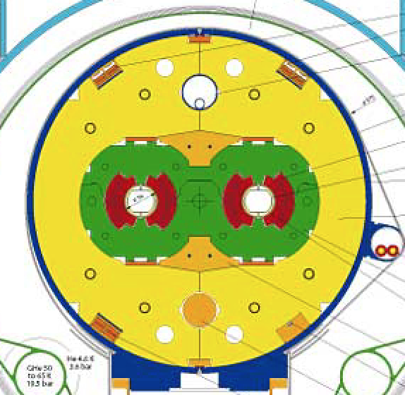
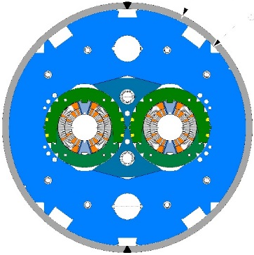
1. Magnet Parameters
Comparing to the Main Bending LHC dipoles:
High stored energy density
(compact winding for cost reduction)
Low stabilizer fraction
(to achieve the desired margins)
Magnet parameters at nominal current I_{nom} = 11.85 kA | LHC MB dipole | DS-11T dipole
Field in the aperture at I_{nom} (B₀), (T) | 8.3 | 11.2
Peak field in the conductor at I_{nom} (B_{p}), T | 8.6 | 11.6
Engineering current density (J_{eng}), A/mm² | 500 | 790
Stored energy in the conductor volume at I_{nom,} MJ/m³ | 60 | 130
Differential inductance at I_{nom}, mH/m | 6.9 | 11.9
Magnetic length, m | 14.3 | 2 x 5.3
Temperature margin, K | 1.8-6.5 | 4.5-14.5
Copper area in the cable (A_{Cu}), mm² | 15.53 (IL)/13.43 (OL) | 8.23

Slide 7
Contents
Magnet Parameters
Results and analysis on short magnet models
  Overview of the magnets tested
  Initial quench propagation and detection
  Quench heater performance
  Quench propagation within the coil
Baseline protection scheme
Analysis of failure case scenarios
Summary

Slide 8
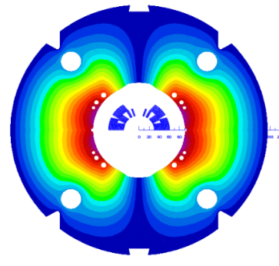
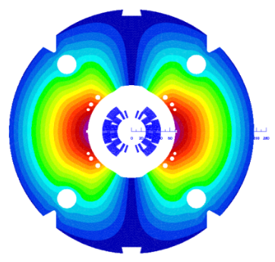
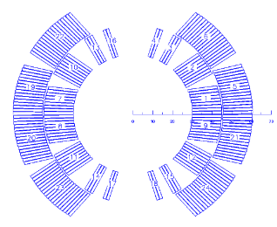
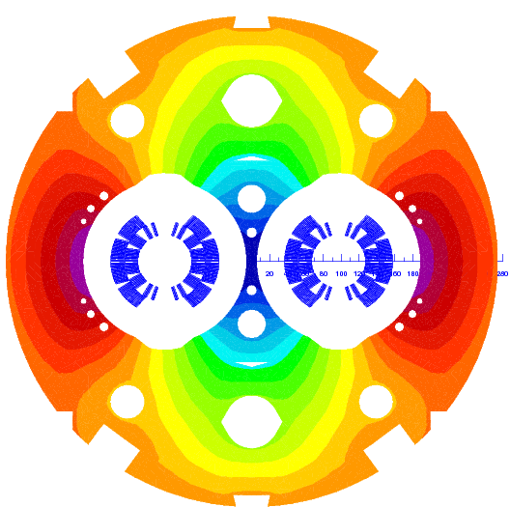
2.1 Overview of the magnets tested
MBHSM101
MBHSP101
MBHSP102
MBHSP103
Coil 105
(RRP 108/127)
Coil 106
(RRP 108/127)
Coil 106
(RRP 108/127)
Coil 109
(RRP 132/169)
Copper coil
Coil 107 (limiting coil)
(RRP 108/127)
Coil 108
(RRP 132/169)
Coil 111
(RRP 132/169)
Collared
Coil 106-108
Collared
Coil 109-111
MBHDP101

Slide 9
2.2 Initial quench propagation and detection
A good characterization of the initial quench propagation is important because it determines the time needed to detect a normal zone:
  Cable level: measurements on FRESCA [1]
  Magnet level:
    R&D Magnets: measurements on the Short Model Racetrack Coil (SMC) [2]
    Magnet models: measurements on FNAL and CERN 11T magnets [3]
Foreseen detection settings:
Threshold voltage = 100 mV
Validation time = 10 ms
Experimental data
[G. Chlachidze]
Experimental data
[G. Willering]
[1] J. Fleiter, et al., Quench Propagation in Nb3Sn Rutherford Cables for the Hi-Lumi Quadrupole Magnets. IEE Trans. Appl. Superconductivity
[2] S. Izquierdo Bermudez, et al., Quench modeling in high-field Nb3Sn accelerator magnets, in Proc. 25th ICEC 25 ICMC 2014
[3] S. Izquierdo Bermudez, et al., Quench Protection Studies of the 11 T Nb3Sn Dipole for the LHC Upgrade, Submitted for publication

Slide 10
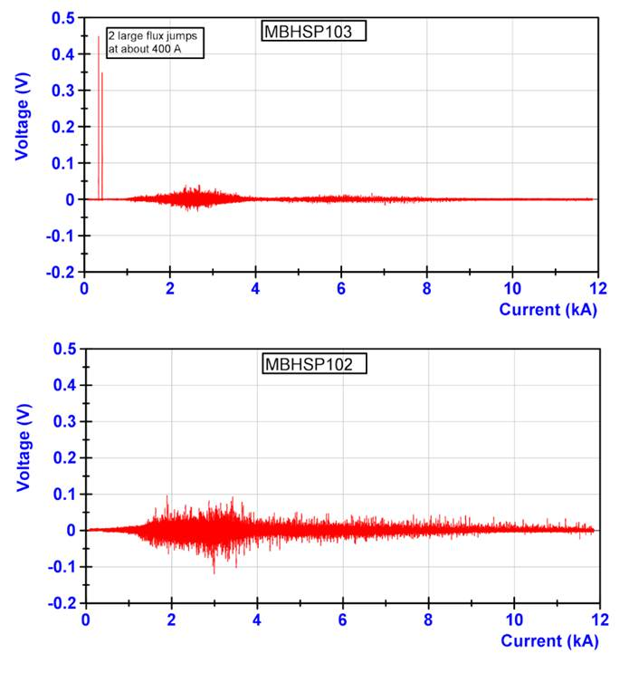
2.2 Initial quench propagation and detection
In Nb₃Sn, voltage spikes at low field are typically observed due to the flux jumps on the superconductor.
This requires the use of a threshold voltage/validation delay which is a function of the magnet current.
The duration and amplitude of the voltage spikes is ~ 5 times larger for the voltage difference in between apertures than for the voltage difference in between coils in the same aperture for MBHDP101.
Flux jumps characterization for all magnet current levels
Flux jumps characterization for magnet current above 1 kA
Baseline protection settings
Baseline protection settings
[G. Willering]

Slide 11
2.2 Initial quench propagation and detection
The evaluation of the maximum amplitude and duration of the voltage spikes as a function of the magnet current is important to determine what is the optimal approach to protect the magnet.
MBHDP101
MBHDP101
[G. Willering]
The situation might be different for full length double aperture magnet.

Slide 12
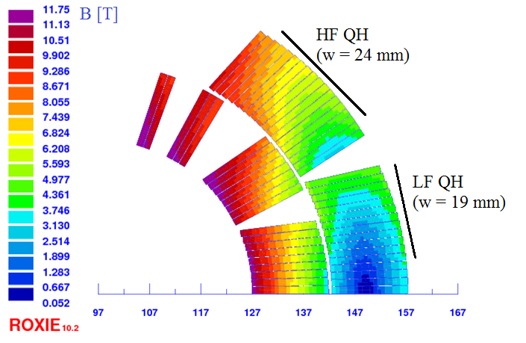
2.3 Quench heater performance
Each coil is protected with 2 quench heater circuits placed on the outer coil radius
Heater geometry optimized to have a uniform quench in the magnet cross section and a propagation in between stations faster than 5 ms.
Extensive tests performed on the single coil model assembly to validate the quench heater performance
I [A] | PLF [W/cm²] | PHF [W/cm²] | Pave [W/cm²]
80 | 41 | 26 | 34
100 | 65 | 40 | 52
150 | 145 | 91 | 118
MBHSM101
Baseline quench heater current = 150 A

Slide 13
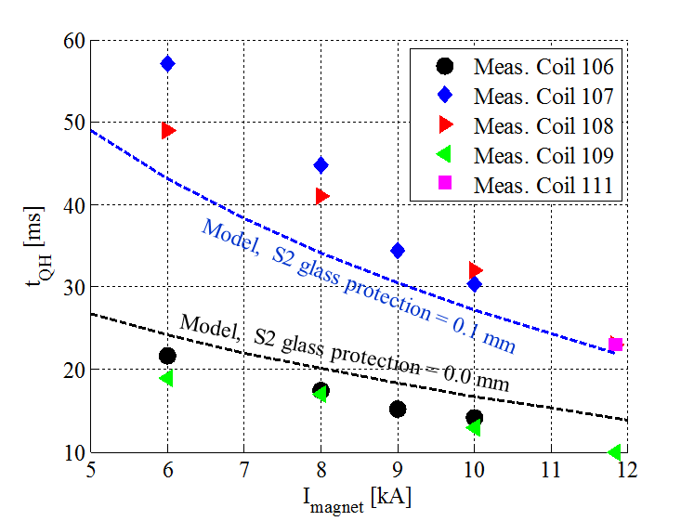
2.3 Quench heater performance
Different insulation schemes tested in the first short magnets, and as expected, significant decrease of the quench heater delay → Baseline: quench heaters impregnated with the coil (S2 glass protection = 0.0 mm)
I_{QH} = 150 A
 | Strand lay out | Coil R at 300 K mΩ | Average coil RRR_{293K/4K} | S2 glass mm
Coil 105 | RRP 108/127 | 426 | 81 | 0.1
Coil 106 | RRP 108/127 | 423 | 66 | 0
Coil 107 | RRP 108/127 | 426 | 97 | 0.1
Coil 108 | RRP 132/169 | 407 | 185 | 0.1
Coil 109 | RRP 132/169 | 400 | 131 | 0
Coil 111 | RRP 132/169 | 401 | 124 | 0.1
MBHSM101 (coil 105); MBHSP101 (coil 106 &107);
MBHSP102 (coil 106&108); MBHSP103 (coil 109 &111)

Slide 14
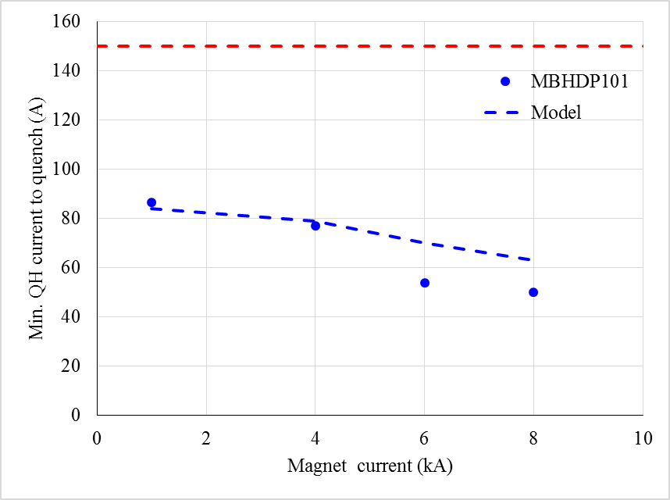
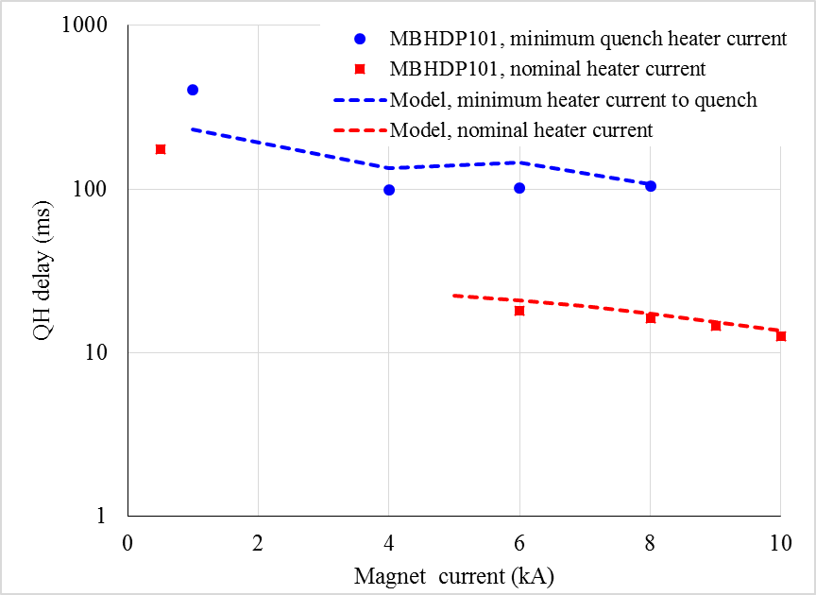
2.3 Quench heater performance
Quench heaters are effective at all magnet current level.
  In MBHDP101, quench heaters were able to start a quench down to a magnet current level of 500 A.
  The magnet is self protected for I < 1.5 kA.
  The model is not accurate in the prediction of the heater delay for the minimum quench energy experiments.
Nominal quench heater current = 150 A

Slide 15
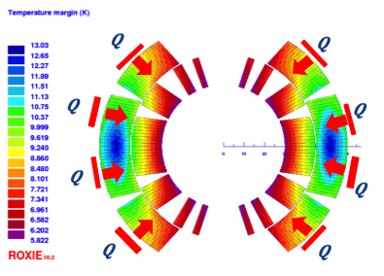
2.4 Quench propagation within the coil
MBHDP101
  Once the quench heaters introduced a distributed quench in the magnet cross section, it is important to study the quench propagation within the magnet cross section:
Manual trip at different currents
Dump delay 1000 ms
Study the quench heater delay, layer to layer propagation, resistance growth and current decay.
Good agreement between Cryosoft model and measurements

Slide 16
2.4 Quench propagation within the coil
  Layer to layer propagation delays in the different magnets tested are comparable
  Work on-going to further refine the model including AC loss and reduce the level of uncertainty on the thermal material properties of the insulation.
Outer layer to inner layer propagation delay
Experimental data
[G. Chlachidze and G. Willering]

Slide 17
Contents
Magnet Parameters
Results and analysis on short magnet models
  Overview of the magnet tested
  Initial quench propagation and detection
  Quench heater performance
  Quench propagation within the coil
Baseline protection scheme
Analysis of failure case scenarios
Summary

Slide 18
3. Baseline protection scheme
Each 11 T cryo-assembly is made out of 2 x 5.3 m magnets connected in series and protected by one standard LHC cold diode.
Unit 1, Ap. 1
Unit 2, Ap. 1
Unit 1, Ap. 2
Unit 2, Ap. 2
Instrumentation:
  For the short models, the coils are heavily instrumented (every coil block is independently monitored, 31 voltage taps/coil)
  For the prototype, the plan is to have full monitoring of the Nb₃Sn-NbTi and an additional voltage tap in between inner and outer layer (quench localization and quench protection efficiency evaluation). (total = 5 voltage taps/coil)
  For the series magnet, each coil will be instrumented with four voltage taps, to have full monitoring of the Nb₃Sn-NbTi internal splices and allow 8 channels comparison for symmetric quench protection .

Slide 19
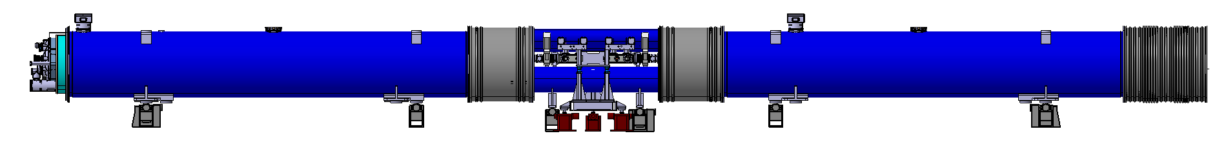
3. Baseline protection scheme
TOTAL = 32 Voltage Taps for the Cryo-Assembly
[L.Grand-Clement]

Slide 20
3. Baseline protection scheme - Detection
A quench fast detection at high current is a must for the 11 T dipole.
  Nominal: U_{thr}=100 mV, t_{val}=10 ms
  Δt_{det}= 10 ms → ΔT = 40 K
Variable detection parameters as a function of the magnet current are needed in order cope with the voltage spikes at low field due to the flux jumps on the superconductor. Two possible approaches:
Baseline: Variable threshold voltage and fixed validation delay (10 ms)
  Alternative option: Variable detection delay and fixed threshold voltage (100 mV)
Case study detection parameters
Case study detection parameters
MBHDP101
MBHDP101

Slide 21
3. Baseline protection scheme - Detection
Based on a simplified adiabatic model, and scaling the measured flux jumps in MBHDP101 with the magnet length to define the detection parameters:
  The magnet is protected for all the current levels using both approaches.
  Variable validation delay for a fixed threshold voltage of 100 mV is more conservative.
  Measurement on the prototype needed to have a better understanding on the impact of flux jumps on the quench detection system.
Baseline
Alternative Option
Simulated detection parameters
Simulated detection parameters
MBHDP101
MBHDP101
Remarks: assumptions on the simplified adiabatic model.
Inputs:
  Quench propagation velocity
  Heater delay.
Assumptions
  All the conductors on the outer layer quenched at the heater delay.
  No outer to inner layer quench propagation

Slide 22
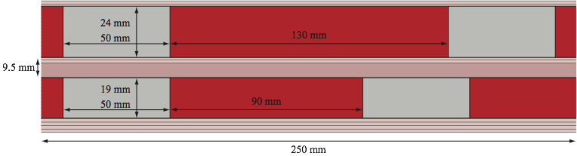
3. Baseline protection scheme – Quench Heaters
Each aperture is protected with 4 quench heater circuits
(2 heater circuits per coil, only in the outer layer)
  Heater geometry optimized to have a uniform quench in the magnet cross section and a propagation in between stations faster than 5 ms.
  High field and low field quench heater in series (better for redundancy)
“Standard” LHC quench heater power supply:
  Charging voltage: 900 V (± 450 V)
  Maximum current through the heaters: 150 A (instead of 80 A)
  Capacitance: 7.05 mF
  Improvement of the heater firing unit expected to reduce the heater firing delay from 5 ms to 1 ms.
  Integration study needed to fit 16 heater power supplies for each cryo-assembly

Slide 23
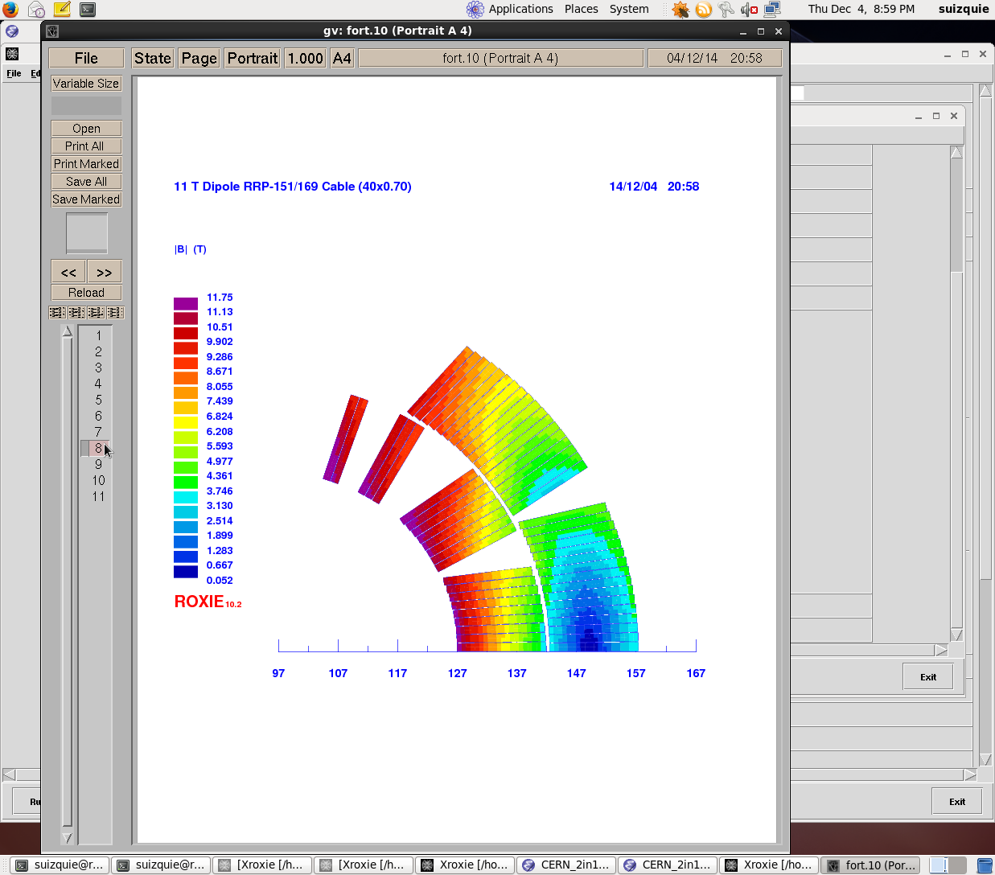
3. Baseline protection scheme - T_{max}
Expected hot spot temperature under accelerator conditions:
100 mV threshold, 10 ms validation
1 ms heater firing delay
Assumed heaters impregnated with the coil. (heater delay ̴ 14 ms). Total insulation from heater to coil :
  50 µm of kapton
  100 µm conductor insulation
Nominal conductor parameters, RRR=100
All quench heaters fired
280 ± 20 K
230 ± 20 K
High field
Low field
What we have today:
Heater firing delay = 5 ms
Heaters delay = 20 ms
T_{max} = 320 ± 20 K

Slide 24
Contents
Magnet Parameters
Results and analysis on short magnet models
  Overview of the magnet tested
  Initial quench propagation and detection
  Quench heater performance
  Quench propagation within the coil
Baseline protection scheme
Analysis of failure case scenarios
Summary

Slide 25
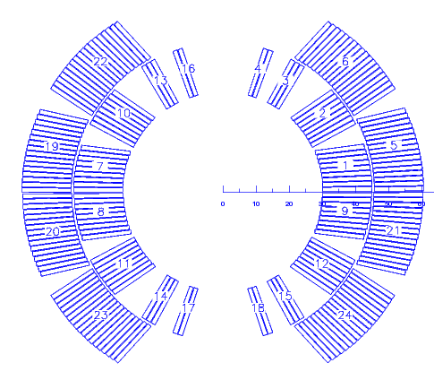
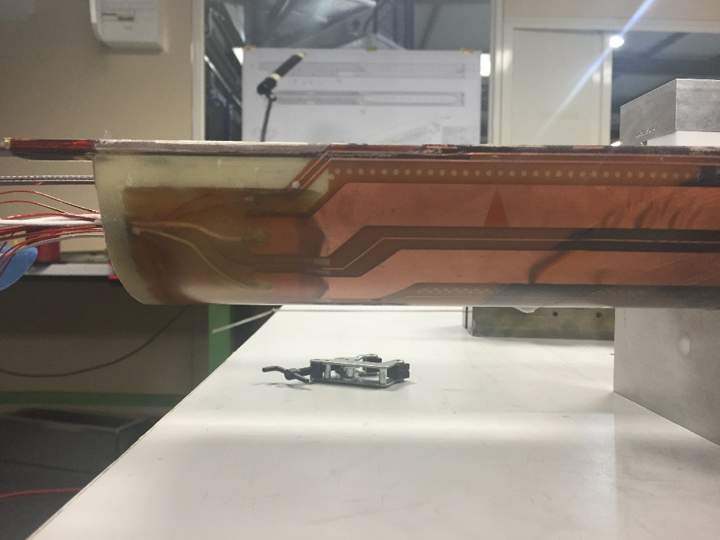
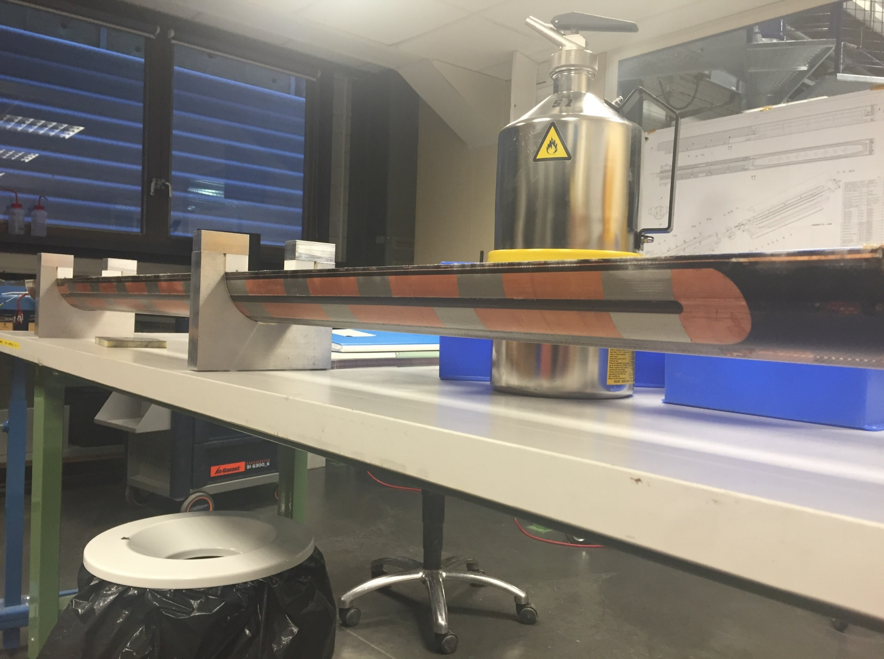
4.1 Definition of the worst case scenario
The baseline protection scheme considers 2 heater circuits per coil (i.e. 4 circuits per aperture, 16 circuits per cryo-assembly).
  Compatible with U-shape heater → 2 connections/heater circuit (only in the magnet connection end)→ lower risk of heater damage ☺;
  For one heater failure we lose only one high field heater, which are much more efficient than the low field heaters ☺;
  It is not the optimal configuration for internal coil voltage distribution in case of heater failure ☹.
The worst case scenario assumes the failure of two heater circuits:
  For the case of the LHC-MB dipoles this means that one full aperture out of two is not quenching, but in case of failure there is a reserve circuit (low field heaters).
  For the case of the 11 T it means that one coil out of 16 is not quenching, but in case of failure there is no a reserve circuit.
Circuit 2
Circuit 1
Circuit 2
Circuit 1
Circuit 4
Circuit 3
Circuit 4
Circuit 3
zoom

Slide 26

4.1 Studied heater wiring options
Option 1
(baseline)
Option 2
Circuit 3
Circuit 1
Circuit 2
Circuit 1
Circuit 4
Circuit 2
Circuit 2
Circuit 1
Circuit 1
Circuit 3
Circuit 3
Circuit 4
Circuit 4
Circuit 2
Circuit 4
Circuit 3
2 connections/heater circuit;
For one heater failure we lose only one high field heater.
Worse coil internal voltage distribution in case of failure.
4 connections/heater circuit;
For one heater failure we lose only one high field heater
Better coil internal voltage distribution in case of failure.
Option 3
Option 4
Circuit 3
Circuit 1
Circuit 3
Circuit 1
Circuit 2
Circuit 4
Circuit 4
Circuit 2
Circuit 4
Circuit 2
Circuit 2
Circuit 4
Circuit 3
Circuit 1
Circuit 1
Circuit 3
4 connections/heater circuit;
For one heater failure we can lose two high field heater
Inductive coupling between heaters and magnet field → showstopper
4 connections/heater circuit;
For one heater failure we can lose two high field heater
Better coil internal voltage distribution in case of failure.

Slide 27
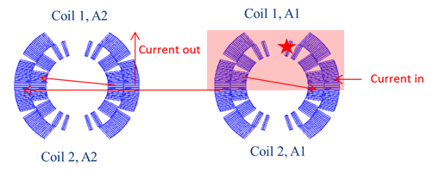
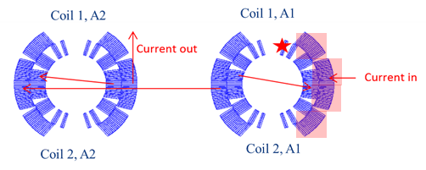
4.2 Failure case analysis
 |  | Peak voltage to ground(V) | Peak turn to turn voltage(V) | T_{max}(K)
Nominal | ROXIE (1x11 T magnet) | 352(without quench back) | 78 | 318
 | TALES (1x11 T magnet) | 260(with quench back) | 75 | 325
 | TALES (2x11 T magnet) | 260(with quench back) | 75 | 325
Worst case scenario heater wiring option 1 | ROXIE (1x11 T magnet) | 1480 (without quench back) | 85 | 355
 | TALES (1x11 T magnet) | 860 (with quench back) 1500 (without quench back) | 90 | 355
 | TALES (2x11 T magnet) | 950(with quench back) 1570 (without quench back) | 90 | 339
Worst case scenario heater wiring option 2 | ROXIE (1x11 T magnet) | 1060 (without quench back) | 85 | 355
 | TALES (1x11 T magnet) | 750 (with quench back) 1100 (without quench back) | 85 | 356
 | TALES (2x11 T magnet) | 950(with quench back) 1500 (without quench back) | 95 | 339
[A. Giannopulos and A. M. Fernandez Navarro]
Remark: Hot spot temperature expected to be 40 K lower in the final configuration by reducing the heater firing delay from 5 ms to 1 ms and the quench heater delay from 20 ms to 14 ms.

Slide 28
Contents
Magnet Parameters
Results and analysis on short magnet models
  Initial quench propagation and detection
  Quench heater performance
  Quench propagation within the coil
Baseline protection scheme
Analysis of failure case scenarios
Summary

Slide 29
Summary
The expected hot spot temperature for the current configuration of the 11 T is 320 K ± 20 K.
The baseline configuration considers a reduction of the quench heater delay (reducing the insulation from heater to coil) and the heater firing delay (through a hardware improvement) → T_{max} = 280 K ± 20 K.
System redundancy:
  The 11 T cryo-assembly can safely operate in case two quench heater circuits are failing: ΔT_{max}=20 K, Peak voltage to ground = 950 V (including quench back effect).
  In case four heater circuits are not operational, the hot spot temperature stays below the stablished limit of 350 K, but the peak voltage to ground increases to 1.9 kV.
  R&D work on-going to reduce the hot spot temperature and improve the system redundancy introducing inter-layer heaters and/or CLIQ (see additional slides).
Variable detection thresholds and/or delays as a function of the magnet current are needed in order cope with the voltage spikes at low field due to the flux jumps on the superconductor.
We have a good set of data for the first magnets tested
  Everyone is very welcome to study it!
  If additional studies are needed, now is a good moment to ask for them.

Slide 30
Thank you for your attention
References and previous studies
A.V. Zlobin, et al., 11 T Twin-Aperture Nb3Sn Dipole Development for LHC Upgrades
A.V. Zlobin et al., “Quench Protection Studies of 11T Nb3Sn Dipole Coils”, IPAC’2014, Dresden, June 2014.
A.V. Zlobin, I. Novitski, R. Yamada, “Quench Protection Analysis of a Single-Aperture 11T Nb3Sn Demonstrator Dipole for LHC Upgrades”, Proc. of IPAC’2012, New Orleans, Louisiana, USA, p.3599.
G. Chlachidze, et al., “Experimental results and analysis from 11T Nb3Sn DS dipole”, FERMILAB-CONF-13-084-TD, and WAMSDO’2013 at CERN, January 2013, CERN-2013-006.
G. Chlachidze et al., “Quench protection study of a single-aperture 11T Nb3Sn demonstrator dipole for LHC upgrades”, IEEE Trans. on Appl. Supercond., Vol. 23, Issue 3, June 2013, p. 4001205.
S. Izquierdo Bermudez, et al., Quench modeling in high-field Nb₃Sn accelerator magnets, in Proc. 25th ICEC 25 ICMC 2014
G. Willering et al., Cold powering tests of 11T Nb3Sn dipole models for LHC upgrades at CERN
S. Izquierdo Bermudez, et al., Quench Protection Studies of the 11 T Nb₃Sn Dipole for the LHC Upgrade, Submitted for publication
J. Fleiter, et al., Quench Propagation in Nb₃Sn Rutherford Cables for the Hi-Lumi Quadrupole Magnets. IEEE Trans. Appl. Superconductivity
G. Willering. https://edms.cern.ch/document/1578493/1
S. Izquierdo Bermudez, et al., 5th Joint HiLumi LHC-LARP Annual Meeting 2015 (CERN, 26-30 October 2015) https://indico.cern.ch/event/400665/overview
http://indico.cern.ch/event/365072/
http://indico.cern.ch/event/407058/
https://indico.cern.ch/event/434223/

Slide 31
Additional slides

Slide 32
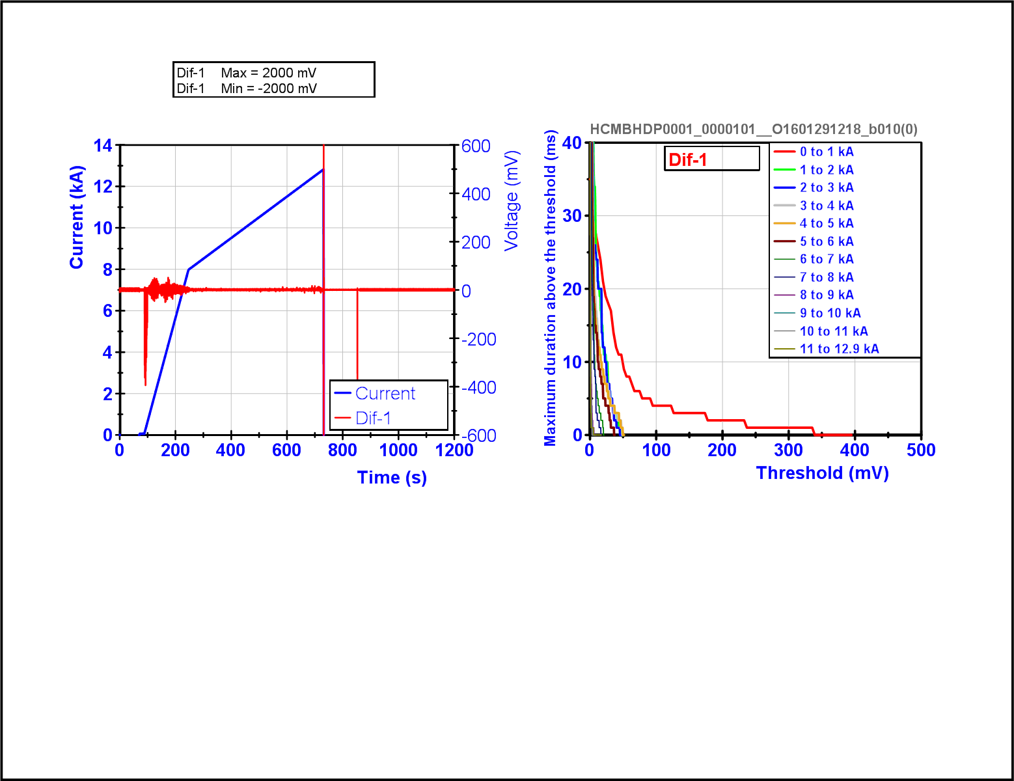
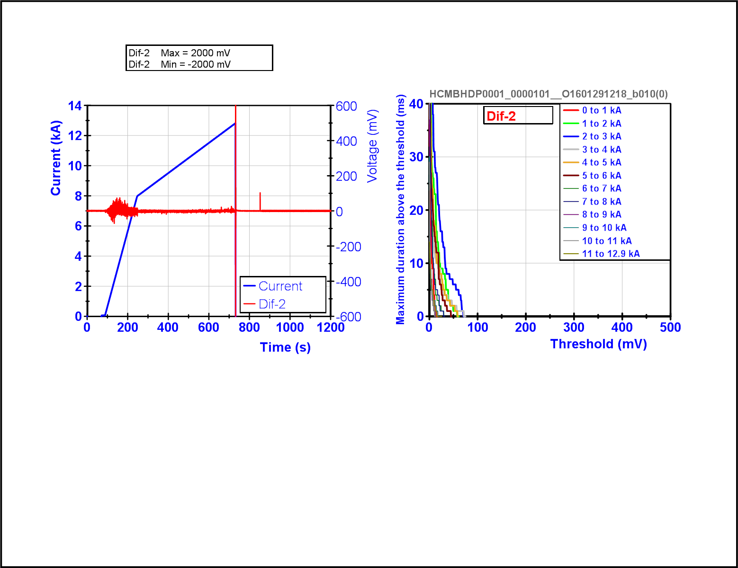
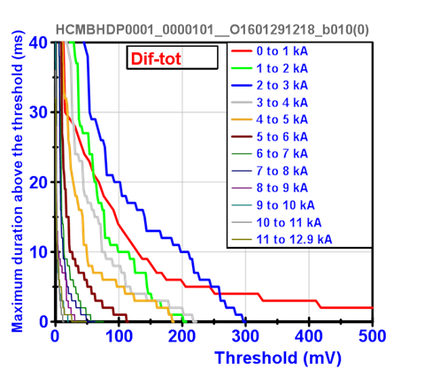
Difference between coils 109-111
Difference between coils 106-108
Difference between apertures

Slide 33
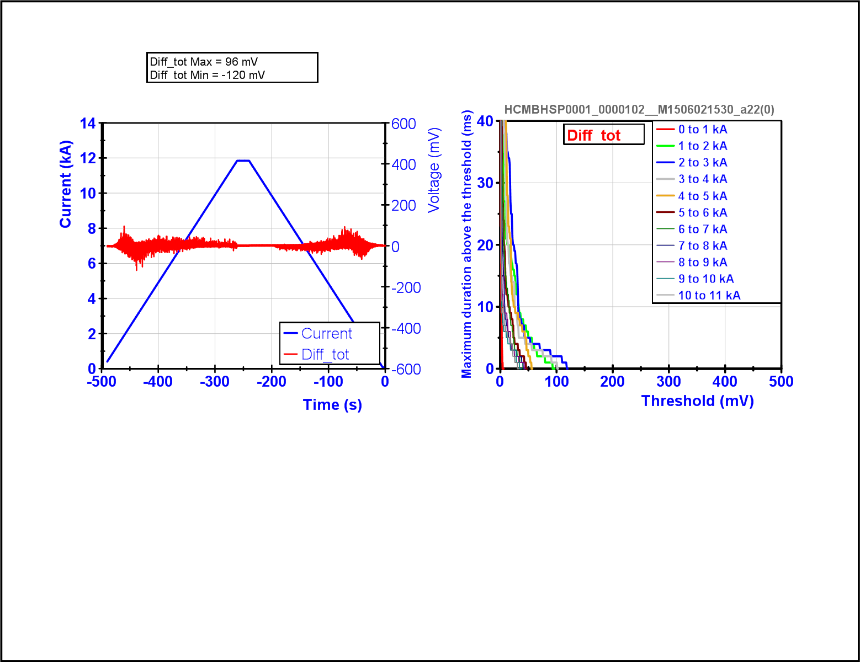
MBHSP102 – Differential between coil 106-108

Slide 34
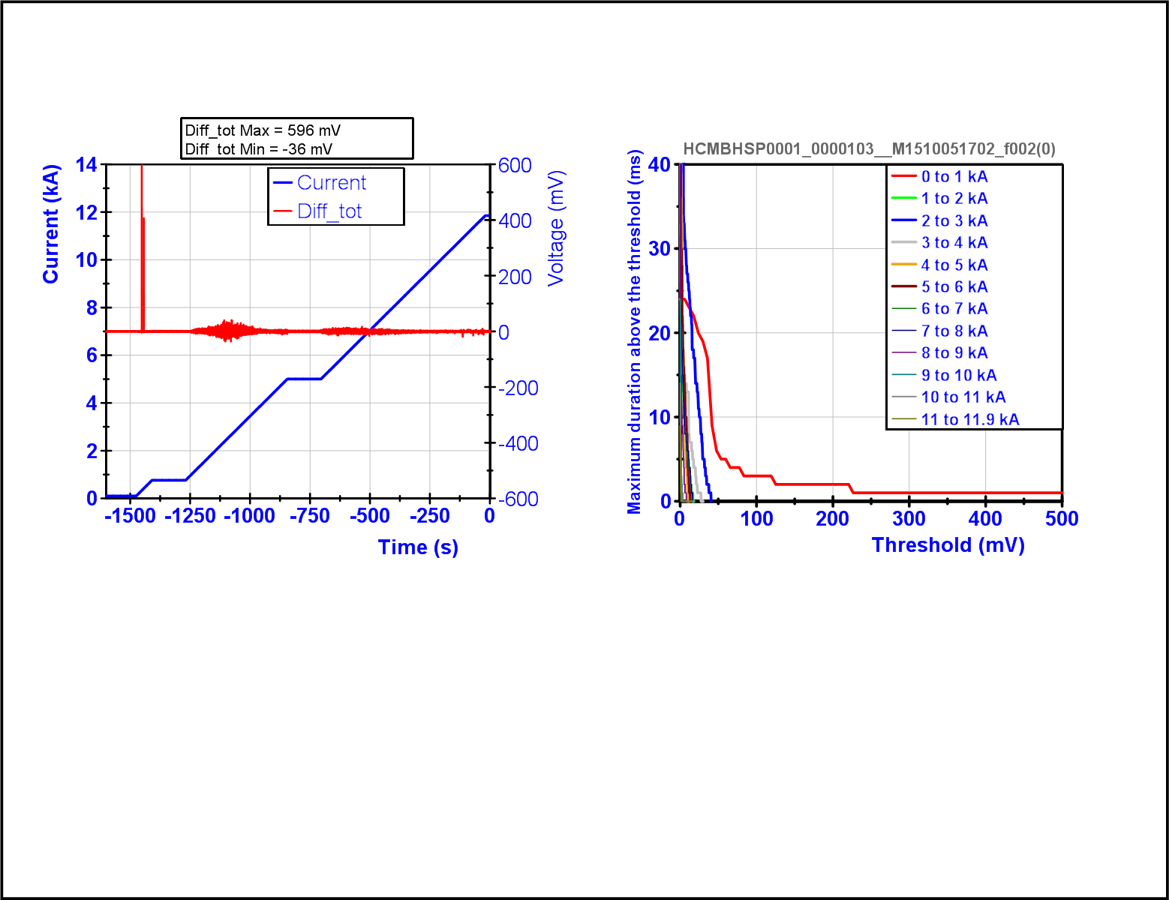
MBHSP103 – Differential between coil 109-111

Slide 35
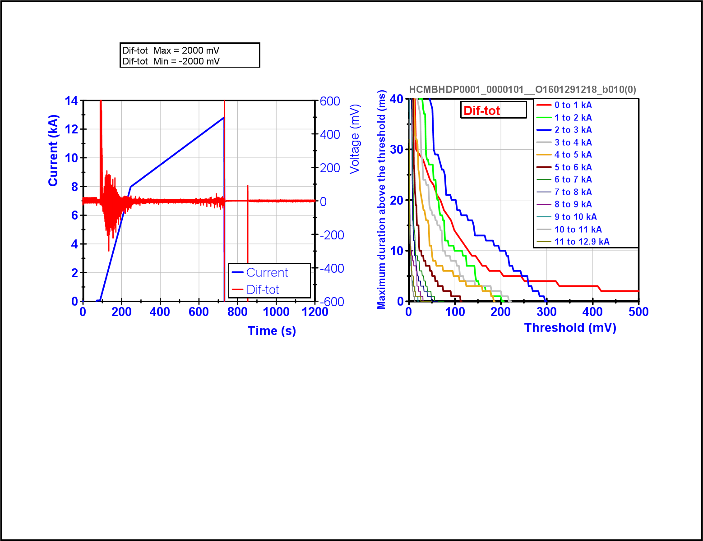
MBHDP101 – Differential between coil (106+108)-(109+111)

Slide 36
MBHDP101 – Differential between coil 109-111

Slide 37
MBHDP101 – Differential between coil 106-108

Slide 38
2.3 Quench propagation within the coil
The large differences on the QI are explained by the low RRR and higher resistivity of coil 106.

Slide 39
Efficiency Low Field/High Field Heaters

Slide 40
Inter-Layer Quench Heaters

Slide 41

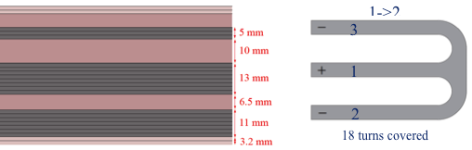
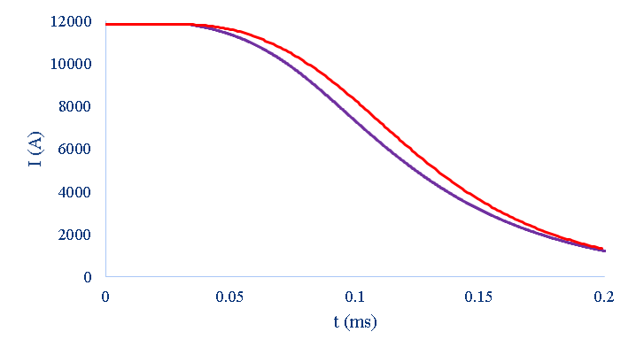
R&D activities: Inter layer quench heaters
Design approach: Maximize the number of turns covered
Heater power density → P_{d} = 50-100 W/cm²
Design constraints:
  Voltage < 450 V
  Current < 150 A
Inter layer QH
60 mm
120 mm
Expected maximum tempearture with outer layer + inter layer heaters:
T_{max} = 240 ± 20 K
OL
IL+OL
[J. Rysti]

Slide 42
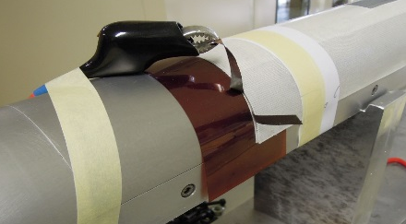
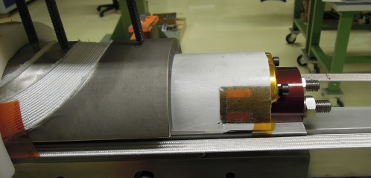
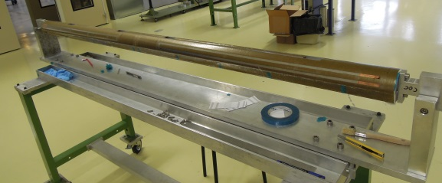
R&D activities: Inter layer quench heaters
Technical challenges:
Electrical Robustness
Inter layer heaters installed in coil 110
(heaters follow the full coil manufacturing process)
Embedded in a S2-glass – Mica sandwich
Total thickness = 0.5 mm
Breakdown voltage heaters2coil = 9 kV ☺
Challenge: find mica full length (max. length available of the preferred product is about 1 m, alternative options under procurement)
Copper plating
Copper plating (needed to reduce the overall strip resistance) requires a thin layer of nickel
During heat treatment, the nickel diffuses in to the copper, increasing significantly the electrical resistivity
Solutions under study:
    a) Increase the thickness of the copper plating
    b) Find a method to deposit non-resistive material on a resistive material without the nickel interface
More details EDMS 1541876
[J. Rysti and Ana Teresa Perez Fontela]

Slide 43
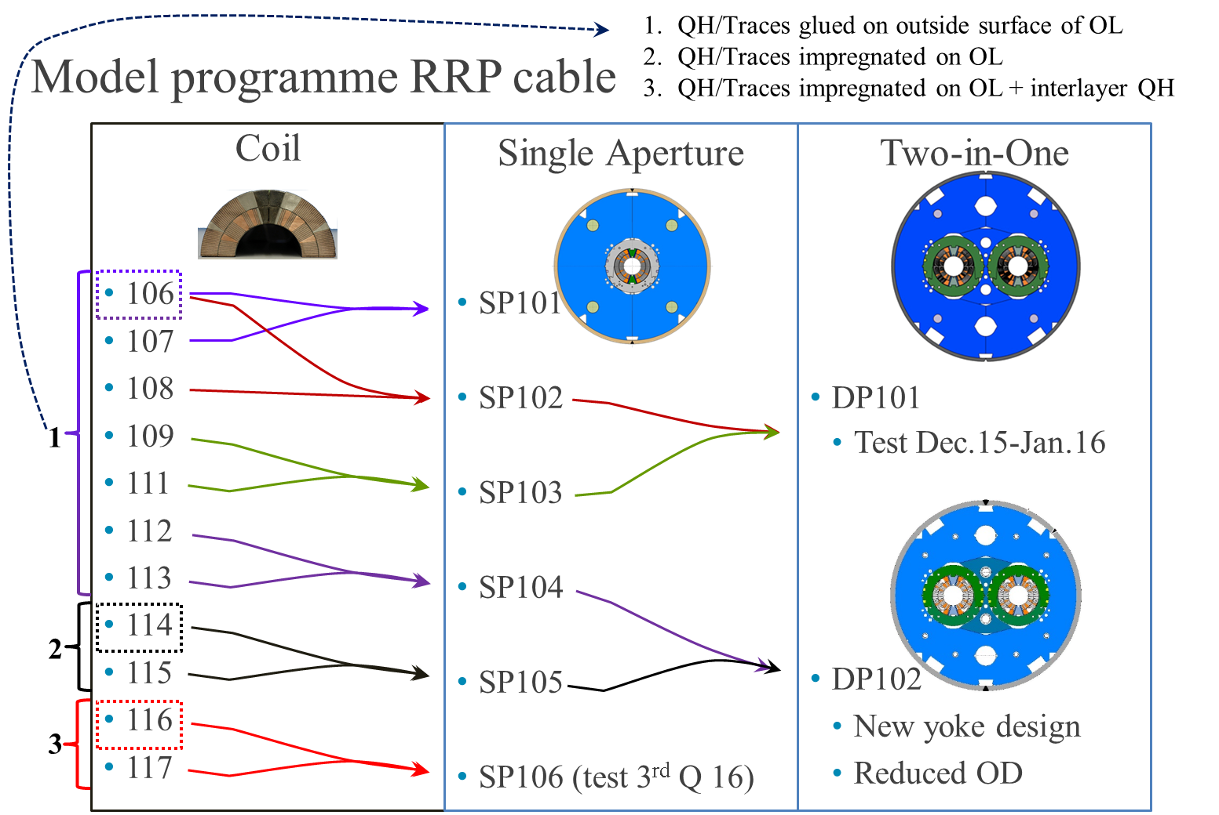
R&D activities: Inter layer quench heaters

Slide 44
CLIQ

Slide 45
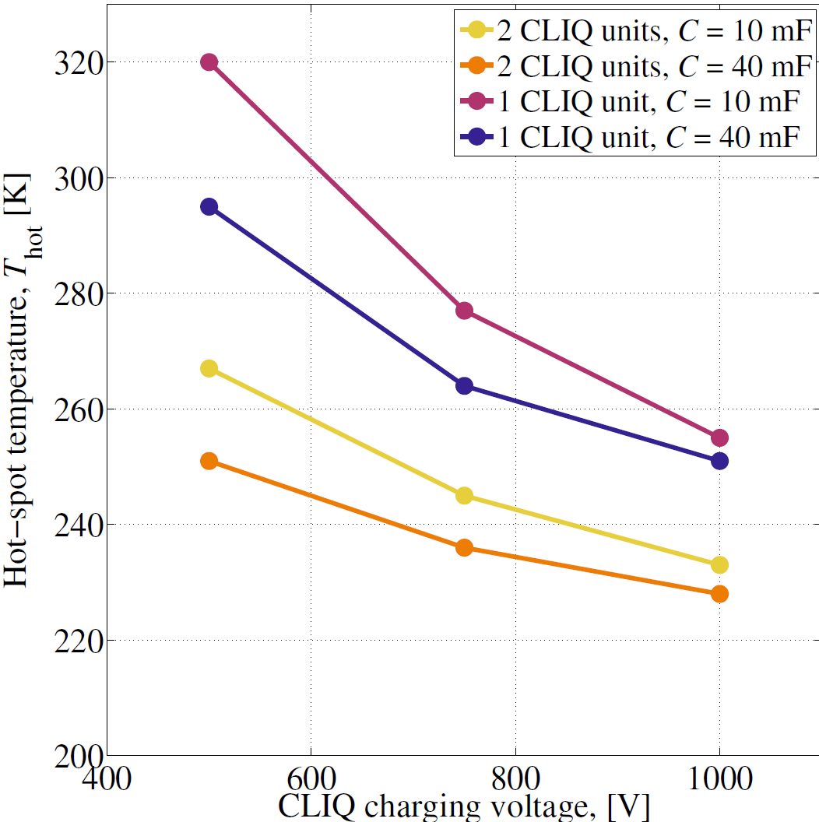

Slide 46
1 CLIQ unit per magnet 400 V/40 mF
CLIQ + QH (#104):
  T_hotspot= 249 K
  U_maxground=400 V
Only CLIQ (#105):
  T_hotspot=280 K
  U_maxground=600 V
Only QH (#85):
  T_hotspot=325 K
  U_maxground=260 V

Slide 47
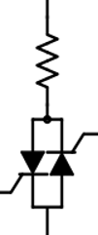


Conclusions
Simulations show no dangerous over-voltages / over-currents detected nor in the main circuit neither in the TrimPC.
More simulation work needed to asses if CLIQ induced voltage oscillations are fully compatible with the iQPS.
Reference design (Rcrow = 16 mΩ)
  No Quench: Not suitable FPA @ 11.85kA 0A/s, crowbar current -500 A
  Quench + QH: Suitable
  Quench + CLIQ: Not suitable crowbar current -600 A
Variant 01 design (Rcrow = 0.5 Ω)
  No Quench: Suitable (!) Effects of MIITS in the bypass diode to be discussed
  Quench + QH: Suitable
  Quench + CLIQ: Not suitable crowbar current -600 A
Variant 02 design (Rcrow = 0.5 Ω + reverse bypass diode 20 V)
  No Quench: Suitable (!) Effects of MIITS in the bypass diode to be discussed
  Quench + QH: Suitable
  Quench + CLIQ: Suitable
0.5 Ω
0.5 Ω
20 V

Slide 48
Heater failure case analysis.
Wiring option 1

Slide 49
Peak temperature
Cryosoft
For this analysis, we consider that all the heaters in a coil fail (very pessimistic scenario as the baseline configuration considers 2 quench heater circuits per coil, and the possibility to have 4 quench heater circuits per coil is being explored)

Slide 50
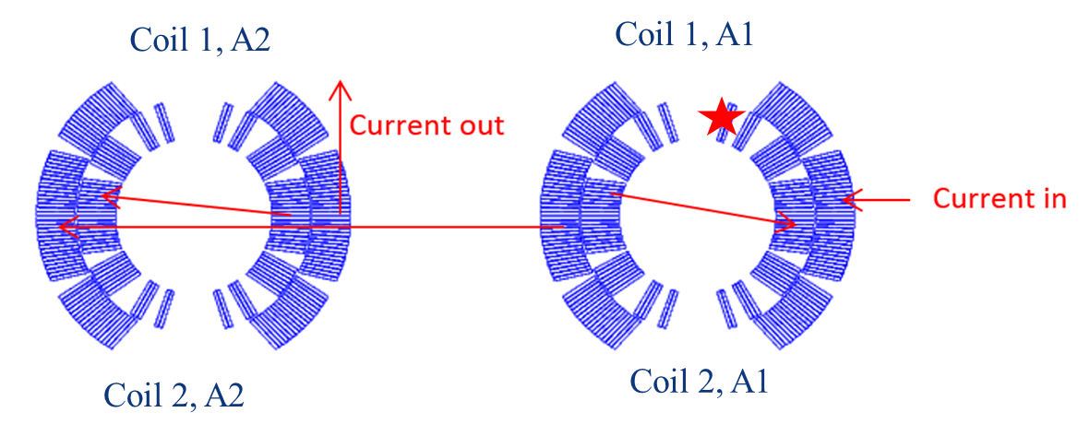
Peak voltage to ground. ROXIE no quench back
No failure: Peak voltage to ground = 352 V
H1C1A1 fails
V_{max} = 702 V
H2C1A1 fails
V_{max} = 712 V
H2C2A1 fails
V_{max} = 527 V
H1C2A1 fails
V_{max} = 530 V
H1C1A1 + H2C1A1 fails
V_{max} = 1481 V
H1C2A1 + H1C2A1 fails
V_{max} = 1009 V

Slide 51
Peak voltage to ground. ROXIE no quench back
C1A1OL
C2A1IL
C1A2OL
C2A2IL
C1A1IL
C2A1OL
C1A2IL
C2A2OL

Slide 52
Peak voltage to ground. ROXIE no quench back
No failure: Peak voltage to ground = 352 V
H1C1A1 + H1C2A1 fails
V_{max} = 1009 V
H2C1A1 + H2C2A1 fails
V_{max} = 1010 V
H1C1A1 + H1C2A1 + H2C1A1 + H2C2A1 fails
V_{max} = 2876 V

Slide 53
Heater failure case analysis.
Wiring option 2

Slide 54
Peak voltage to ground. ROXIE no quench back
No failure: Peak voltage to ground = 352 V
fails
V_{max} = 511 V
fails
V_{max} = 511 V
fails
V_{max} = 518 V
fails
V_{max} = 517 V
fails
V_{max} = 1080 V
fails
V_{max} = 1062 V

Slide 55
Peak voltage to ground – Heater failure scenarios
No failure: Peak voltage to ground = 352 V
fails
V_{max} = 1753 V
fails
V_{max} = 1753 V
fails
V_{max} = 807 V
fails
V_{max} = 631 V
fails
V_{max} = 798 V
fails
V_{max} = 630V

Slide 56
Peak voltage to ground. ROXIE no quench back
No failure: Peak voltage to ground = 352 V
fails
V_{max} = 1010 V
fails
V_{max} = 1011 V
fails
V_{max} = 1018 V
fails
V_{max} = 1010 V

Slide 57
ROXIE – TALES comparison

Slide 58
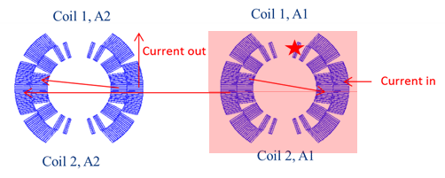
Summary
 |  | Peak voltage to ground(V) | Peak turn to turn voltage(V) | T_{max}(K)
Nominal | ROXIE (1x11 T magnet) | 352 | 78 | 318
 | TALES (1x11 T magnet) | 260 | 75 | 325
 | TALES (2x11 T magnet) | 260 | 75 | 325
Failure Case (no quench-back) | ROXIE (1x11 T magnet) | 2879 | 85 | 396
 | TALES (1x11 T magnet) | 1700 | 155 | 471
 | TALES (2x11 T magnet) | 3050 | 160 | 394
Failure Case (with quench-back) | ROXIE (1x11 T magnet)
 | TALES (1x11 T magnet) | 2800 | 190 | 408
 | TALES (2x11 T magnet) | 1900 | 125 | 356

Slide 59
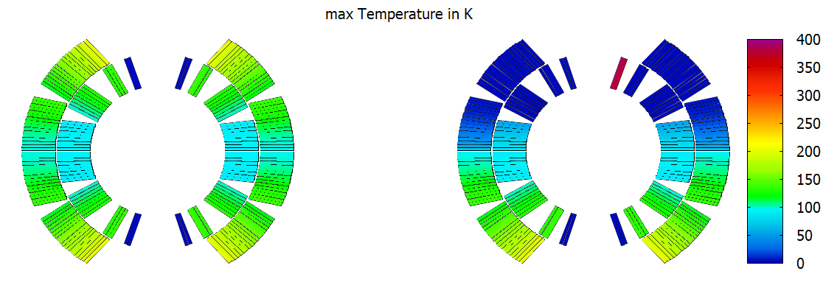
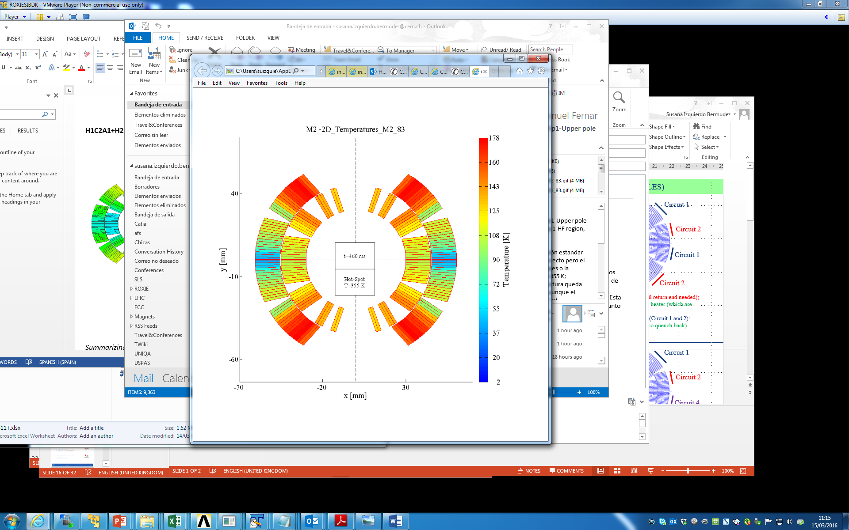
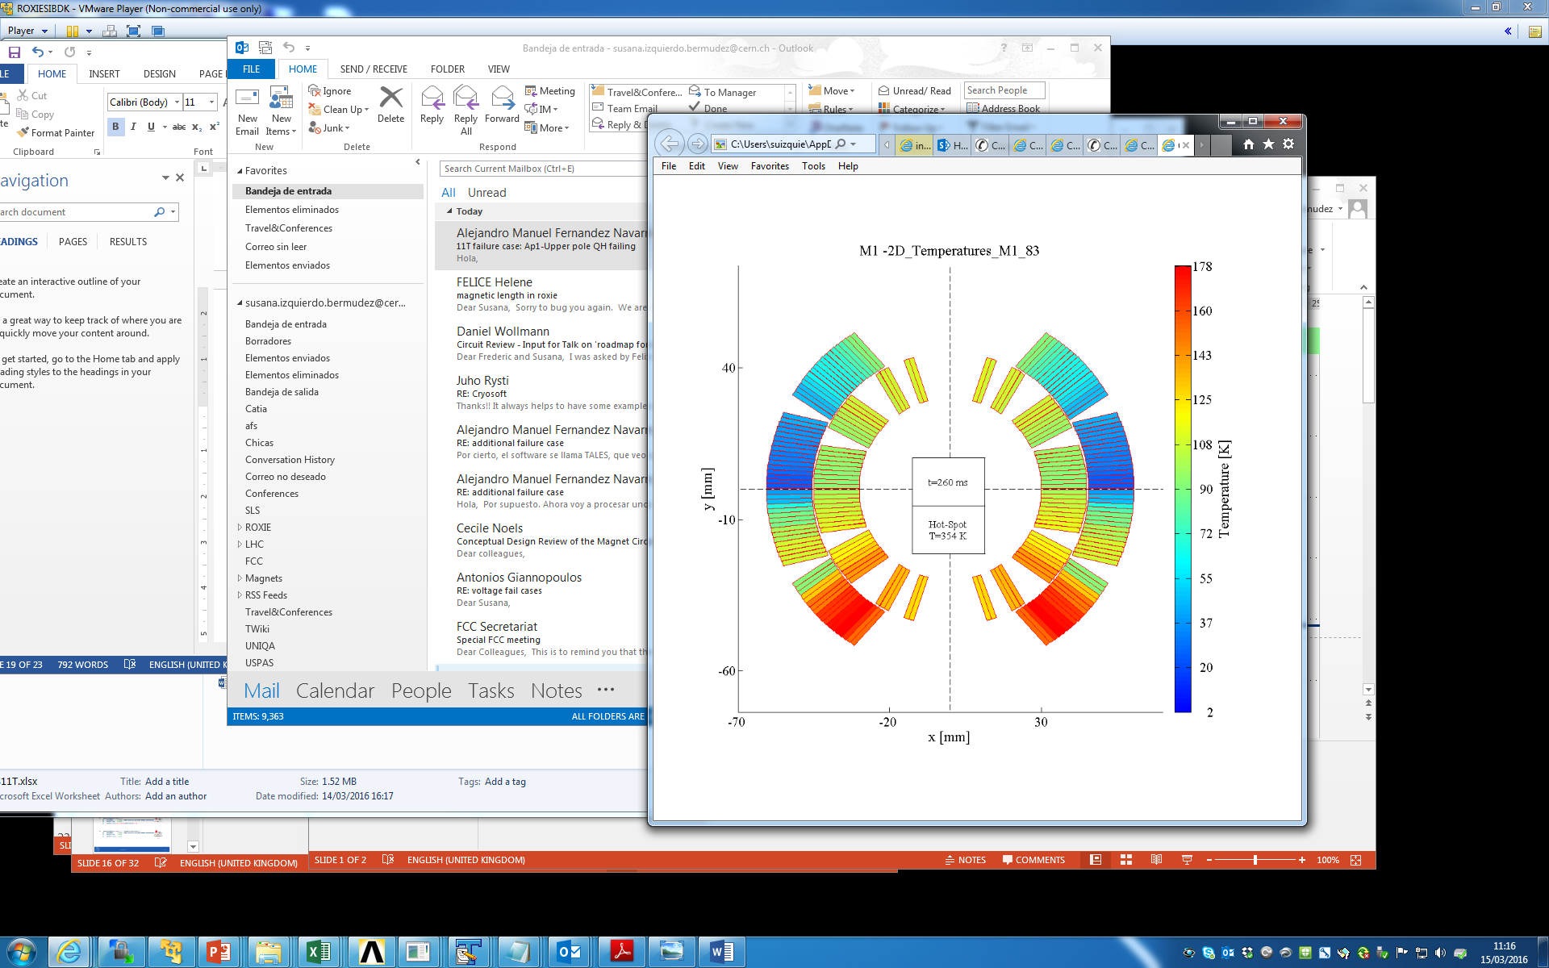
ROXIE vs. TALES
ROXIE
(without quench back)
TALES
(with quench back)

Slide 60
ROXIE vs. TALES
ROXIE
(without quench back)
TALES
(without quench back)

