Slide 1
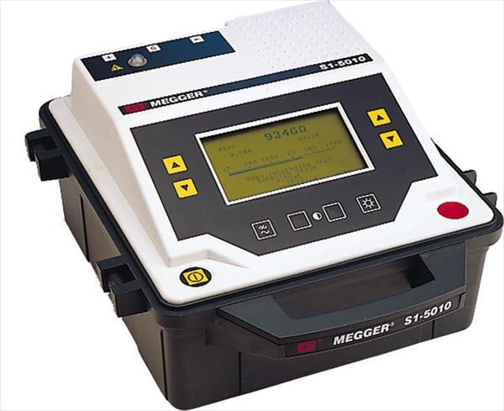
Electrical Quality Assurance and Voltage Withstand Levels
F. Rodriguez-Mateos
on behalf of the
High Voltage Withstand Levels Working Group

Slide 2
Outline
Introduction
HL-LHC HVWL Working Group
What strategy to apply to define test levels?
MQXF case study
11 T Dipole case study
Conclusions

Slide 3
Introduction
One of the main aspects for design of superconducting circuits is also the monitoring of the electrical quality of the components during manufacturing, tests and hardware commissioning
All circuit components (magnets, bus bars, link, current leads, instrumentation), including also the warm DC distribution elements, have to be harmonised in this respect
To this aim, one has to define as soon as possible the tests and the voltage levels, in agreement with the equipment owner

Slide 4
The HVWL WG
Regular meetings, bi-weekly in average
Membership
Based on experience from LHC, the aim is to engineer a common strategy for HL-LHC circuit components
  On design of insulation and voltage withstand levels for main components and ancillaries
  On electrical measurements : dielectric, transfer functions, instrumentation, etc
  Common understanding and application of ElQA programme from manufacturing to operation through testing and commissioning
  Adequacy of test infrastructure in agreement with respect to the defined strategies
Hugo Bajas TE-MSC, Secretary
Marta Bajko TE-MSC
Amalia Ballarino TE-MSC
Mateusz Jakub Bednarek TE-MPE
Jean-Paul Burnet TE-EPC
Giorgio D'Angelo TE-MPE
Paolo Ferracin TE-MSC
Christian Giloux TE-MSC
Juan Carlos Pérez TE-MSC
Jose Vicente Lorenzo Gomez TE-MSC
Félix Rodríguez Mateos TE-MPE, Chair
Frédéric Savary TE-MSC
Ezio Todesco TE-MSC

Slide 5
General strategy
Vq – quench voltage
Vee – extraction voltage
Vpa – power abort voltages
Vmaxr =Vq+Vee+Vpa
Definition of worst case voltages from quench modeling/model tests
Conditions
E.g. 75 K, 1 bar , He (gas)
Definition of conditions under which worst case voltages will show up:
ambient conditions (gas, liquid), pressure and temperature
Scaling factor
ƒ
Definition of test conditions
Definition of strategy:
i) Validation that the worst case voltages will be endured with no degradation and certain margin
ii) Looking for insulation faults

Slide 6
Defining rated and test voltages (1/3)
“If V is the maximum voltage that a component is expected to withstand during normal machine operation, Vtest= a•V+b will be the test voltage at the same conditions (e.g. IEEE Standard 95-177 suggests a=2, and b from 1000 to 2000 V. This standard has been frequently applied to superconducting systems, although it was defined for electrical devices in general)”. This is what was applied at CERN, for LHC but with b=500 V. See [1].
Rated level
Vrated= a * Vmaxr + b
a and b give safety margins
(for LHC : a= 2 and b= 500 V)
E. g. 75 K, 1 bar , He (gas)
It is assumed that the maximum voltage is reached at temperatures between 60K and 90K [2]
We take as reference 75K and 1 bar in He gas
[1]. “Voltage withstand levels for electrical insulation tests …” EDMS 90327
[2]. “Guidelines for the insulation design and electrical tests …” EDMS 1264529

Slide 7
Defining rated and test voltages (2/3)
Manufacturing steps
1st test at arrival to test bench
1st test at cold in the test bench
1st test after cold test in air but possibly with He gas
VmaxrAir = f2 * Vmaxr
Vtest_Air=
a*VmaxrAir + b
f2 is an equivalence between 75 K He and 300 K air
VmaxrLHe = f3 *
Vmaxr
Vtest_LHe= a*VmaxrLHe + b
f3 is an equivalence between 75 K and
4.2 K in LHe
VmaxrAir2 = f4 *
Vmaxr
Vtest_Air2= a*VmaxrAir2 (+ b)
f4 is an equivalence between 75 K and
300 K in He
300K, 1b, AIR
300 K, 1 bar , AIR
4.2 K, 1 bar, He (liquid)
300 K, 1 bar , He (gas)
Factors f are defined as ratios of dielectric strengths at the two conditions considered

Slide 8
Dielectric strength for 0.5 mm gap
Values in [V]
V_{Air, 275 K, 1 b} | 2500
V_{LHe, 4.2 K, 1 b} | 7000
V_{GHe, 275 K, 5 b} | 700
V_{GHe, 75K, 1 b} | 600
V_{GHe, 275 K, 1 b} | 280
C.R. Huffer
f2= 2500/600 = 4.2
f3= 7000/600 = 11.7
f4= 280/600 = 0.47
V_{LHe, 4.2 K, 1 b} = 140 kV/cm

Slide 9
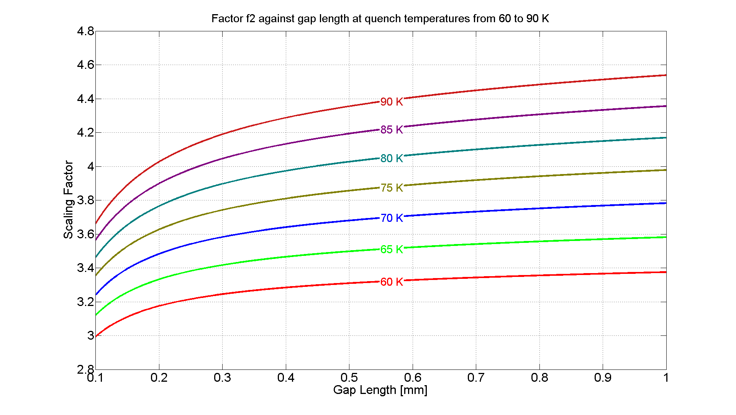
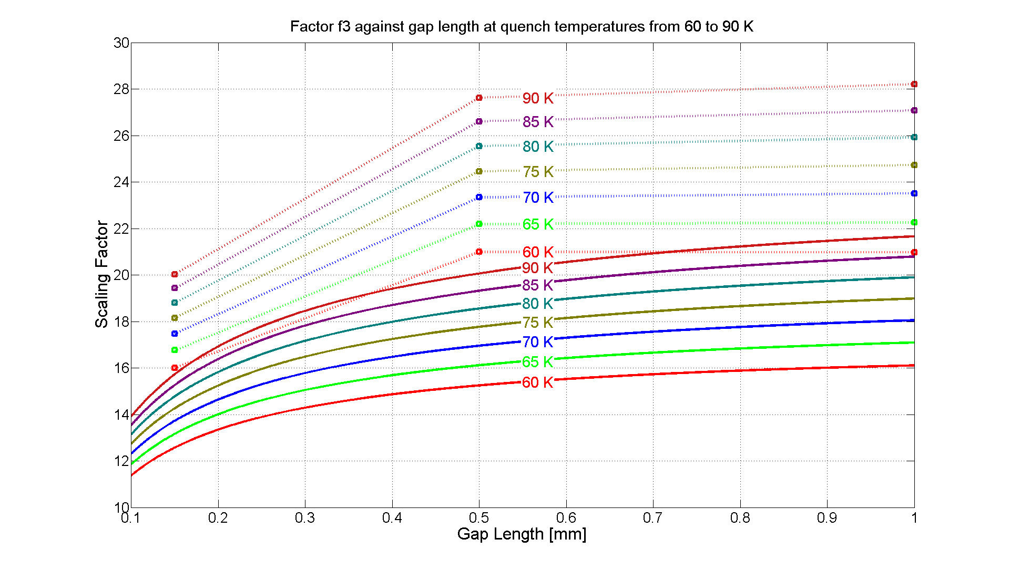
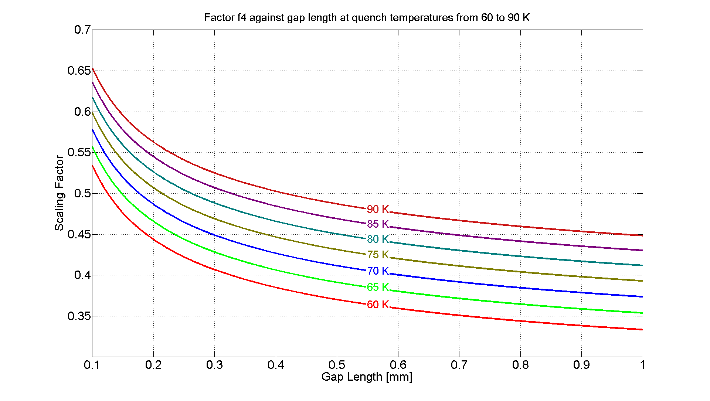
Sensitivity analysis
It is assumed that the maximum voltage is reached at temperatures between 60K and 90K (Ref. 2)
11 ≤ f3 ≤ 22 boiling LHe
16 ≤ f3 ≤ 29 non-saturated LHe
3 ≤ f2 ≤ 4.6
Distance between two active parts (e.g. turns of the same layer, turns to heater) or between active parts and ground span from 0.1 to 1 mm in QXF magnet (P. Ferracin)
0.33 ≤ f4 ≤ 0.66
Courtesy Jose Vicente Lorenzo Gomez TE-MSC

Slide 10
Case 1: worst case voltages QXF (1/2)
  “The probability of particularly dangerous failure cases can be almost nullified by implementing the proposed mitigations”.
  In the remaining “realistic” failure cases, the worst-case analysis yields to
  Peak voltage to ground: 520 V
  Peak turn-to-turn voltage: 50 V
Worst case voltages as presented by Emmanuele Ravaioli

Slide 11
Case 1: worst case voltages QXF (2/2)
We assume the worst case appears at 75 K and 1 bar – we need further analysis on this
Applying the previous rules to these numbers:
  Worst case voltage to ground is Vmaxr=520V
  Test at 75K, 1 b:
    Vrated=(2*520+500)V=1540V
  Test in dry air:
    VmaxrAir=(520*4.2)V= 2184V
    Vtest_Air =(2*2184+500)V=4868V
  Test in liquid helium
    VmaxrLHe=(520*11.7)V=6084V
    Applying any scaling factor at this level seems impractical and unnecessary
    Limits will be given by test station hardware anyway
    Level of the hi-pot tests at LHe would remain to be discussed
  Test after warm up:
    VmaxrAir2=(520*0.47)V=244V
    Vtest_Air2= (244*2+500)V=988V

Slide 12
Defining rated and test voltages (3/3)
Manufacturing
steps
1st test at arrival to test bench
1st test at cold in the test bench
1st test after cold test in air but possibly with He gas
VmaxrAir = f2 * Vmaxr
Vtest_Air=
a*VmaxrAir + b
f2 is an equivalence between 75 K He and 300 K air
VmaxrGHe = 1 *
Vmaxr
Vtest_GHe= a*VmaxrLHe + b
VmaxrAir2 = f4 *
Vmaxr
Vtest_Air2= a*VmaxrAir2 (+ b)
f4 is an equivalence between 75 K and
300 K in He
300K, 1b, AIR
300 K, 1 bar , AIR
75 K, 1 bar, He (gas)
300 K, 1 bar , He (gas)
This proposal has been discussed in the frame of WP3/WP11 with the main Inner Triplet magnets Team and the 11T Dipole Team
Still further discussions with the other magnet teams are required

Slide 13
Case 2: worst case voltages 11 T Dipole (1/2)
  The worst case voltage is 950V calculated using TALES with quench back
  Two heater circuits are failing and this is considered as a “realistic” failure case
  Assuming that this is a magnet in series connection to the LHC dipoles in the arcs, the same strategy should apply. This is in particular true for the energy extraction voltage that is added to the voltage developed by the magnet itself. It is considered to be 500V
  Peak turn-to-turn voltage is around 75 V
Worst case voltages as presented by Susana Izquierdo

Slide 14
Case 2: worst case voltages 11T Dipole (2/2)
We assume the worst case appears at 75 K and 1 bar – we need further analysis on this
Applying the previous rules to these numbers:
  Worst case voltage to ground is Vmaxr=(950+500)V= 1450V
  Test at 75K, 1 b:
    Vrated=(2*1450+500)V=3400V
  Test in dry air:
    VmaxrAir=(1450*4.2)V= 6090V
    Vtest_Air = (2*6090+500)V=12680V
    LHC dipoles were tested at 5kV in dry air
  Test in liquid helium
    VmaxrLHe=(1450*11.7)V=16965V
    Applying any scaling factor at this level seems impractical and unnecessary
    Limits will be given by test station hardware anyway
    Level of the hi-pot tests at LHe would remain to be discussed
  Test after warm up:
    VmaxrAir2=1450*0.47=681V
    Vtest_Air2= (2*681+500)V=1862V

Slide 15

ElQA in the LHC machine
11T is however a particular case
The series connection to the RB circuits in S67 and S78 would advise for application of the standard ElQA as performed nowadays with the dipole circuits in LHC [3]:
Worst case voltages are not very far one to the other:
This would encourage for application of the same levels in the machine as for the RB circuits
Maximum voltage to ground RB | Maximum voltage to ground 11T Dipole
1300 V | 1450 V
[3]. “ELQA Qualification of the superconducting circuits during hardware commissioning” EDMS 788197

Slide 16
Turn-to-turn insulation tests
  For LHC, the turn-to-turn insulation at warm was tested with a factor of 2 with respect to the simulated worst case, i.e. 50V*2=100 V/turn, implying an impulse test of 4kV/pole during assembly of the LHC dipoles
  Both the QXF coils and the 11T dipole have problems in applying a safety factor of 2 due to:
      High number of turns and/or relatively higher voltage expected between turns
        Almost 10 kV peak between layers for MBH (ref. A. Foussat)
        10 kV for the full magnet at cold for QXF (ref. M. Marchevsky)
      The physics of the impulse test where the voltage distribution is not uniform*
  This problem has not been treated in detail at the HVWL-WG yet
  Follow-up needed as to find a good compromise
* See talk by M. Marchevsky & E. Ravaioli at the QXF workshop
https://indico.cern.ch/event/478951/

Slide 17
Conclusions - 1
Acceptance tests can be defined at (say) 75 K, 1 b
  The tests at liquid helium are only validating the cryogenic installation down to that temperature, but from magnet point of view, all contractions/movements have taken already place therefore it seems sound
  This gives a more reasonable picture with respect to scaling factors and levels
Scaling factors are only applied to the bulk voltage values, not to safety factors (2*U+500). Safety factors are applied further on
A more detailed study per magnet is required in order to assess the (p,T) conditions at which the maximum voltages will occur
  This should include worst (p,T,U) as a function of time

Slide 18
Conclusions - 2
The same principles will be applied to all cold components of the electrical circuits
The same type of analysis is required for the warm parts of the circuits (converters, warm cables, energy extraction if required)
Implications to test stations at the different labs have to be analyzed and further discussed
  SM18 test benches are designed for a maximum of 3kV from active parts to ground at nominal operating conditions
Convergence is needed for a strategy on turn-to-turn voltage test levels and procedures

Slide 19
Many thanks for your attention!
Many thanks for the fruitful discussions to colleagues at CERN (B. Auchmann, P. Fessia, A. Foussat, S. Izquierdo, F. Savary) and at Collaborating Institutes (G. Ambrosio, T. Holik, M. Marchevsky, E.Ravaioli)

