Slide 1
HO Corrector Magnets Powering & Protection Issues
Giovanni Volpini
on behalf of the LASA Team

Slide 2
LHC vs. HL-LHC corrector magnet
comparison chart
 |  | LHC |  |  |  |  |  | HL-LHC
Order | Type |  |  | Aperture | Stored energy | Operating Current | Inductance | Aperture | Stored energy | Operating Current | Integrated field at r=50 mm | Magnetic Length | Differential Inductance @ Iop
 |  |  |  | mm | [J] | [A] | [mH] | [mm] | [kJ] | [A] | [T.m] | [m] | [H]
2 | S | MQSX |  | 70 | 2,116 | 550 | 14 | 150 | 24.57 | 182 | 1.00 | 0.807 | 1.247
3 | N | MCSX | MCSTX | 70 | 39 | 100 | 4.7 | 150 | 1.28 | 132 | 0.06 | 0.111 | 0.118
3 | S | MCSSX | MCSOX | 70 | 6 | 50 | 7.8 | 150 | 1.28 | 132 | 0.06 | 0.111 | 0.118
4 | N | MCOX |  | 70 | 16 | 100 | 4.4 | 150 | 1.41 | 120 | 0.04 | 0.087 | 0.152
4 | S | MCOSX |  | 70 | 22 | 100 | 3.2 | 150 | 1.41 | 120 | 0.04 | 0.087 | 0.152
5 | N |  |  |  |  |  |  | 150 | 1.39 | 139 | 0.03 | 0.095 | 0.107
5 | S |  |  |  |  |  |  | 150 | 1.39 | 139 | 0.03 | 0.095 | 0.107
6 | N | MCTX | MCSTX | 70 | 94 | 80 | 29.2 | 150 | 4.35 | 167 | 0.086 | 0.430 | 0.229
6 | S |  |  |  |  |  |  | 150 | 0.92 | 163 | 0.017 | 0.089 | 0.052
187/II
Rev 9 July 2014

Slide 3
Corrector magnet inventory
Iron yoke
Iron yoke
SC Coils
150
SC Coils
SC Coils
Mechanical
Mechanical
Mechanical
support
support
support
OD460
From 6-pole to 12-pole magnets exist in both normal and skew form (the latter is shown)
150
OD320
The superferric design was chosen for ease of construction, compact shape, modularity, following the good performance of earlier corrector prototype magnets developed by CIEMAT (Spain).

Slide 4
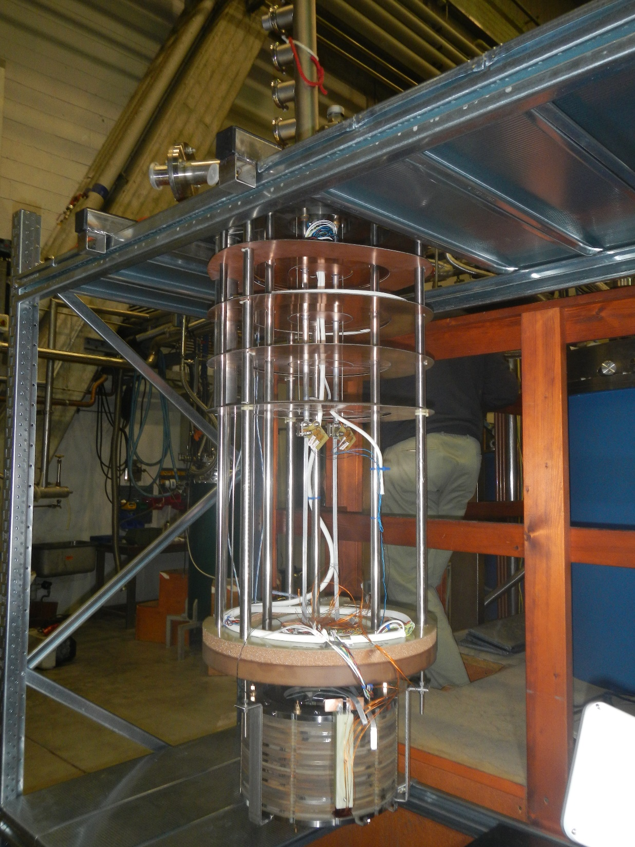
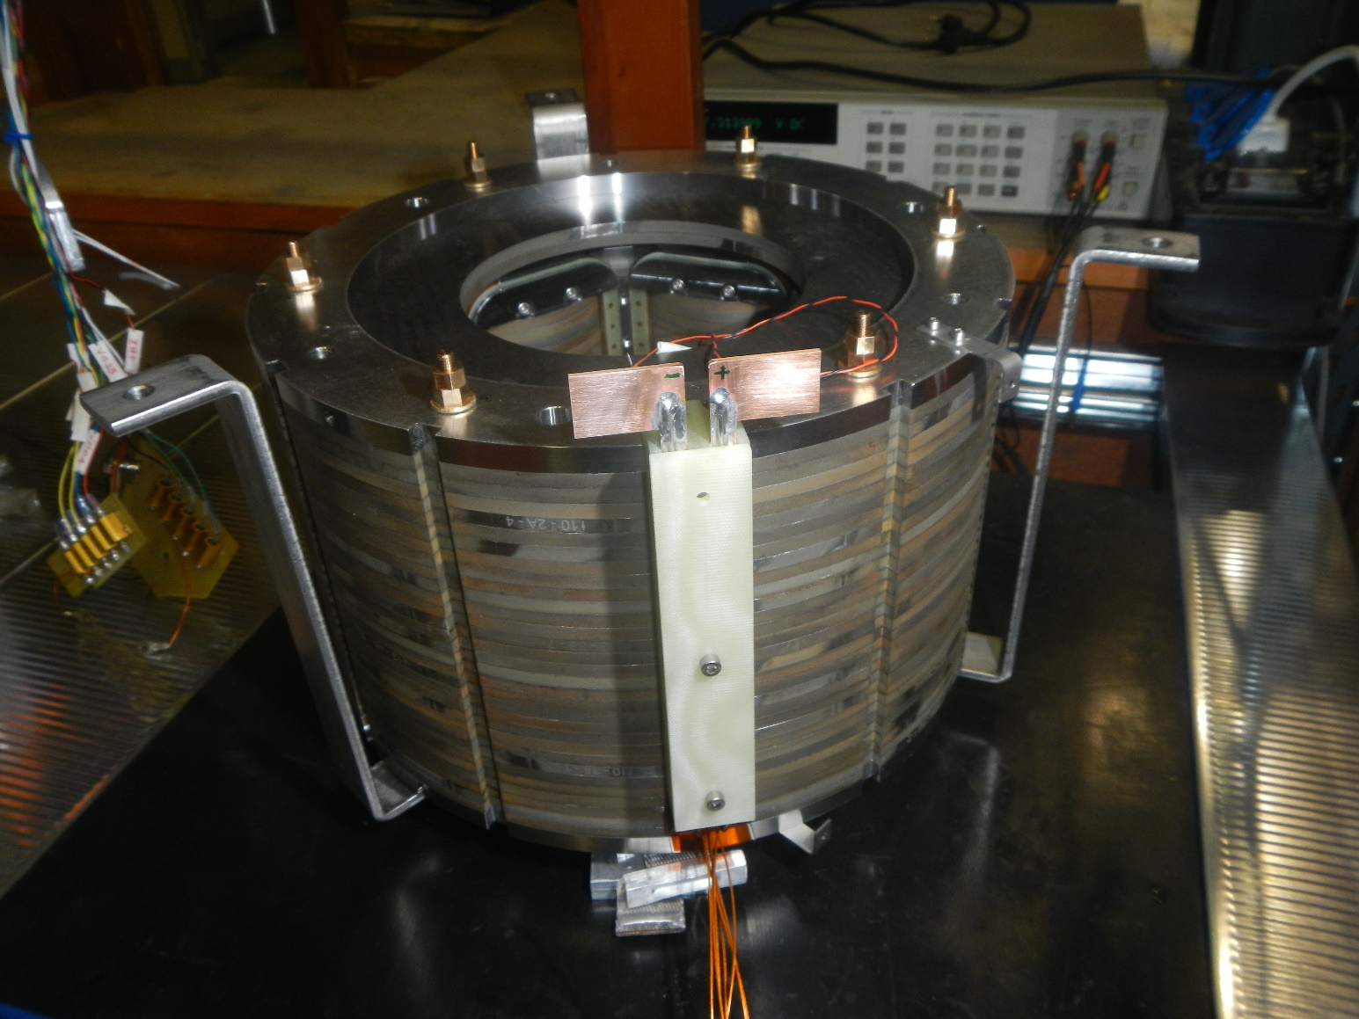
The Magnet on the Test Station

Slide 5
Sextupole test @ LASA lab. Feb 2016
Quench w/ 0Ω dump
Day #1
4.22 K
Day #2
2.17 K
Day #4
4.22 K
Magnet qualification
Training quenches
s.s.l. @ 4.22 K
Day #3
4.22 K
Fast discharges
Ramp tests
ultimate
nominal

Slide 6
Operating Current
The operating current was chosen on the basis of the wire available and of the set operating point (40% on the load line), giving operating currents, I_{op} , in the range 120 A - 180 A. These are the values presently found in the Conceptual Specifications.
To be compliant with existing power converters, that can supply up to 120 A, we are reconsidering the design lowering the operating current to 105 A, in such a way that the ultimate current (I_{op} x 108% = 113 A) is still well within their capability.

Slide 7
Quench Studies
Baseline design of the magnet protection:
The PC output voltage compliance fixed to 12 V;
The PC is switched off and a crowbar activated 100 ms after the PC has reached its voltage compliance; from this moment on the total voltage drop across the magnet is assumed to be zero (no energy extraction).
So the protection is essentially passive.
We consider, as a further protection, that crow-bar activation time may be reduced to 20 ms.
Quench studies performed with QLASA
Computed L(I) included in the model

Slide 8
Quench
A very large number; poses problem for design
QLASA simulations performed by V. Marinozzi

Slide 9
Experimental vs. Computations
Example: 134 A provoked quench in self-dump mode
Results depend weakly on quench propagation speed, but markedly on coil filling factor

Slide 10
Coil filling factor
Report by M. Crouvizier EN/MME
EDMS 1554721
Nominal (insulated wire) 0.640 mm
Vertical (layer to layer) 0.715±0.010 mm
Horizontal 0.765±0.016 mm
Noticeable difference between nominal and real values, they may also depend on the location across the cross section and lengthwise. In general -> More insulation than expected

Slide 11
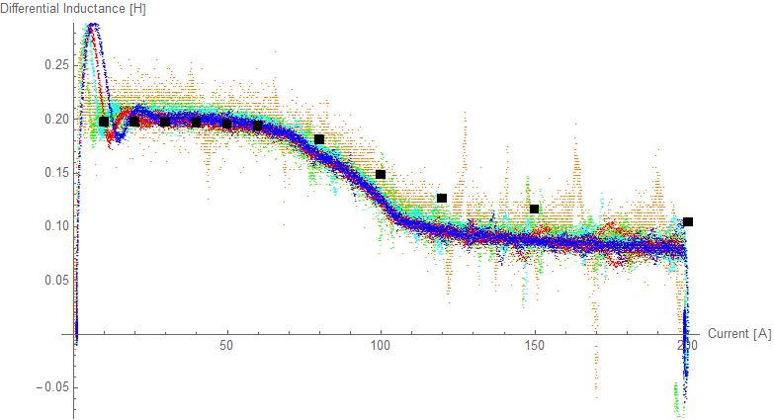
Differential Inductance
The inductance at operating current may become 60%-50% of its low-current value. Comparison with computed values is an important and delicate, issue of the magnet test.
Any more specific request for this issue?
Low-frequency (0.01-1 Hz) impedance measurements

Slide 12
Signals, wiring and the kind
The CS state that …the magnet could be equipped with about 5-8 split Vtaps to be routed to a warm flange on the cold mass…
Prototypes will have 1 voltage tap at any coil-to-coil junction.
Number of voltage taps to be specified. I presume that 3 is the minimum (the two ends and the magnet electric center) + possibly some spares.
In our tests these wires go to a plate with current-limiting protection resistors. Is this connection box required also for the series magnet? Its features?

Slide 13
Prototype Status
 | Nominal operating current | Status
Quadrupole | 182 A considered for final design | Conceptual design
Sextupole | 134 A | Tested | A «2.0» design will be prepared on the base of the octupole and decapole results, no new prototype likely to be built
Octupole | 105 A | Executive design
Decapole | 105 A | Executive design
Dodecapole | 105 A will be considered for executive design | Conceptual design

Slide 14
Conclusions
105 A nominal operating looks feasible for the protection of sextupole, octupole, decapole and dodecapole
For the quadrupole, a large number of turns is required which definitely poses problem for the coils construction and their integration inside the magnet would definitely prefer to stay at present value of 182 A, or so.

Slide 15
Thank you for your attention

