Slide 1
Discussion on D1 & D2 circuit(s) configuration
F. Rodriguez-Mateos
with inputs from many colleagues at CERN (G. Arduini, B. Auchmann, J.P. Burnet, S. Claudet, M. Giovannozzi, E. Todesco, M. Zerlauth, A. Verweij, D. Wollmann)

Slide 2
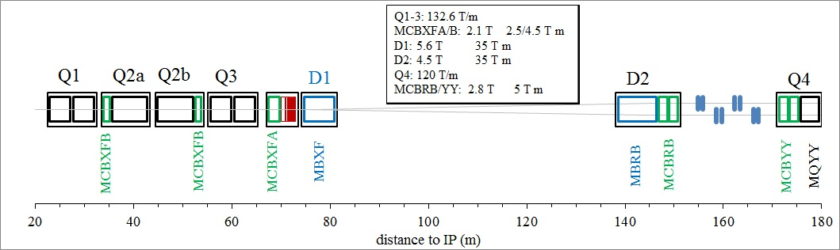
Outline
Source WP3
This talk provides an alternative for the powering of D1 and D2 in series using a single power converter per side and IP (hence there would be 4 converters in total)
Many discussions have been held on the subject, with the final decision as not to present at this review any proposal for changes
We present –as a piece of information to the Panel– what the advantages and disadvantages would be from considering such a series-connected circuit for D1 and D2.

Slide 3
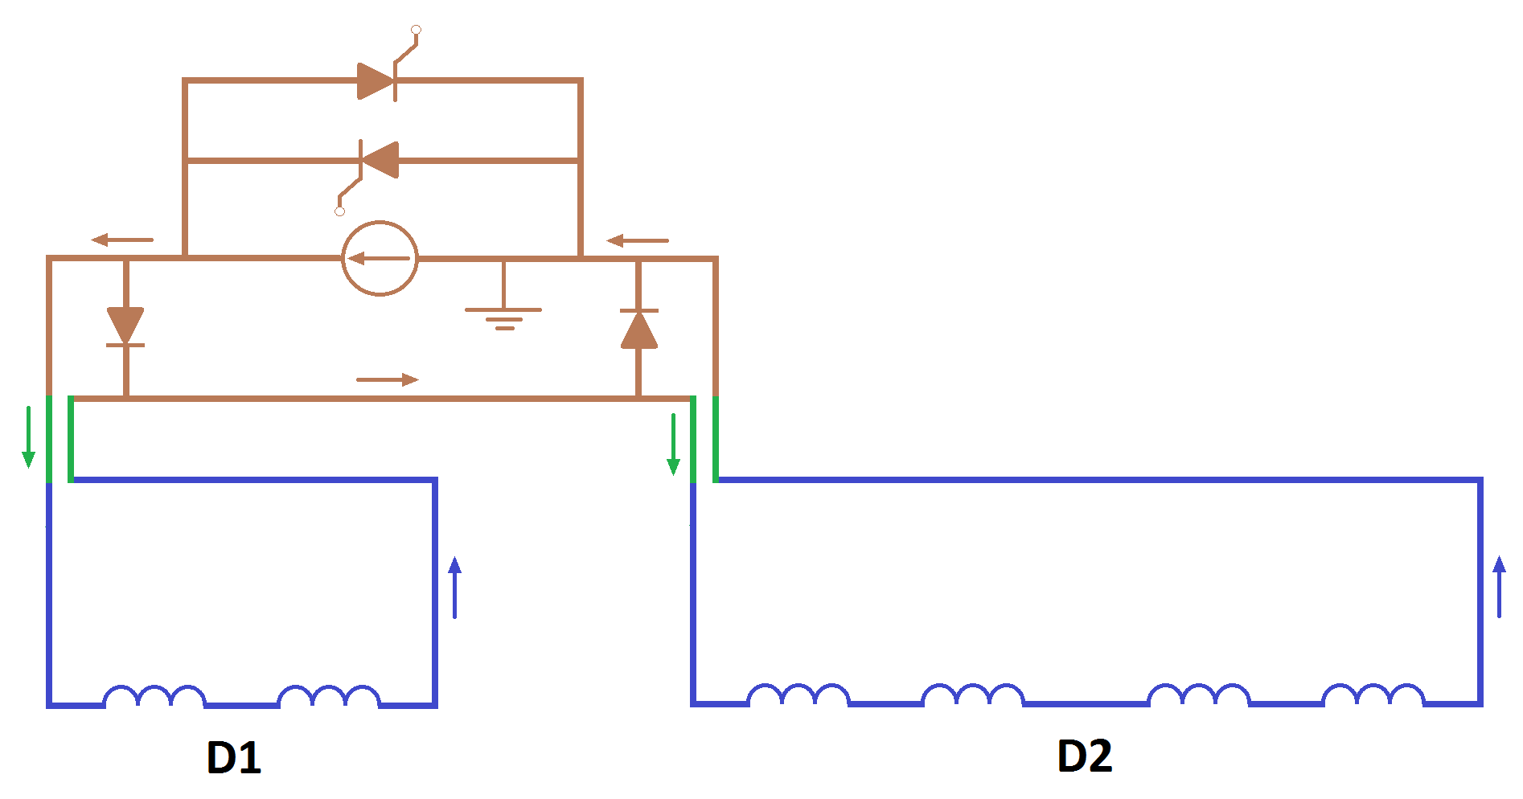
One circuit configuration
The single-circuit configuration differs from a two-circuit solution only on the warm side. All the elements at cold remain the same (in particular current leads and bus bars).
A change between configurations would still be possible later.
Warm bypass diodes decouple the protection of D1 and D2. There are no unprotected cold bus bar segments/splices.
Savings corresponding to the cost of one power converter
PC with crowbar
Warm bypass diodes
SC Link D1/Triplet
+ HTS leads
Warm bridge
SC Link D2/Q4 + HTS leads

Slide 4


Warm By-pass Diodes
Warm bypass diodes decouple the protection of D1 and D2.
  Without bypass diodes, small differences in protection efficiency make one magnet absorb stored energy of the other magnet.
In failure scenarios, diodes reduce voltages to ground.
The warm bypass diode represents a new critical protection element that needs to be developed and tested with its heat sink and leads.
Diode stack composed of several diodes if needed (at 0.75V turn-on, 0.027 H and 20 A/s, enough margin should be guaranteed)

Slide 5
Constraints when having 1 circuit
The jumper should be done close to the PC, not close to the DFB, in order to avoid creating a large inductive loop, i.e., the circuit should look as closely as possible as the two-circuit solution with only a short bridge on the PC side;
The warm diode must be connected as close as possible to the DFB, otherwise the diode would see the voltage across the warm bus bars, i.e., several volts in opening direction;
A trim is needed as the magnets are different in terms of transfer functions (about 2%, ref. Ezio’s talk);
This trim complicates the operation and protection from the converter point of view;
The trim could be avoided by changing the strength of either D1 or D2 correctors (E. Todesco);
There is a loss of flexibility during commissioning as each magnet belongs to different cryogenic sub-sector.

Slide 6
The point of view of Accelerator Physics
(M. Giovannozzi)
It is preferred to keep separate the function of defining the geometry and the orbit correction. This implies:
  Independent power converters for D1 and D2 or single power converter with trim on D1 or D2.
  This might also imply that we need a trim for correcting differences in the integrated field in the two apertures of D2 (see talk from Ezio this morning).
The impact of beam dynamics (separation at the IP and tune modulation) favors the option of single power converter with trim, but the effect is nevertheless small provided that the power converter is of Class 1.
The reduction in terms of cost should be evaluated.

Slide 7
Conclusions for D1/D2 series connection
It seems that the level of complication is increased when connecting the two magnets in series (diodes, trim or change of correctors’ strength, etc)
Only advantage is saving of a PC, but according to EPC experts only this argument does not justify the change of baseline as other developments are required (controls, by-pass diodes)
The two solutions (1 or 2 circuits) are equivalent from beam optics viewpoint
Flexibility for commissioning would be lost with one single circuit
At this moment no proposal is hence presented for a change of baseline

Slide 8
Many thanks for your attention!

