Slide 2
BT.KFAs kicker rise time measurements
(December 2015)
L. Sermeus TE/ABT/FPS
LIU-PSB meeting, 19th January 2016

Slide 3
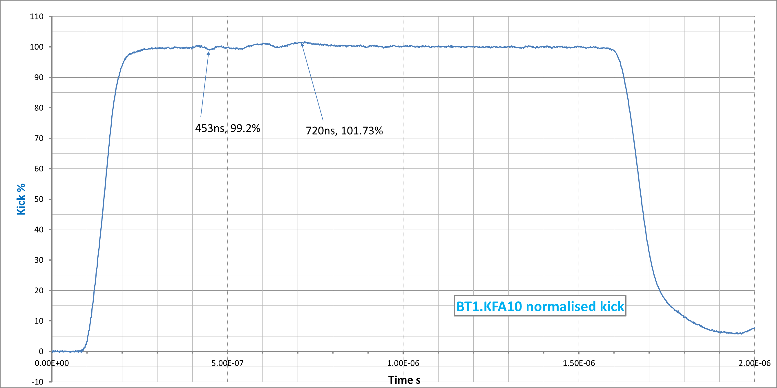
BT1.KFA10 kick (measured waveform at 50 kV)
Kick rise time: |  |  | (5-95)% | 102ns
 |  |  | (2-98)% | 134ns
 |  |  | (1-99)% | 164ns
Scope: 200MHz BW, 13 bits vertical resolution

Slide 4
BT1.KFA10 kick (Pspice calculated waveform)
From revised PSPICE model
Calculated
8C11 (green)
116ns
109ns
95ns
Calculated
4L1( orange)
133 122
103
Measured (red)
164
134
102
LIU (2GeV)
105ns
LIU (1.4GeV)
104ns
Rise (1-99)%
Rise (2-98)%
Rise (5-95)%
The actual ferrite grade is assumed to be 4L1. (must be replaced by 8C11)
Cable impedances are not exactly 25Ω. (variations from 24.8 to 25.5 for PFLs and Transmissions explain reflections)

Slide 5
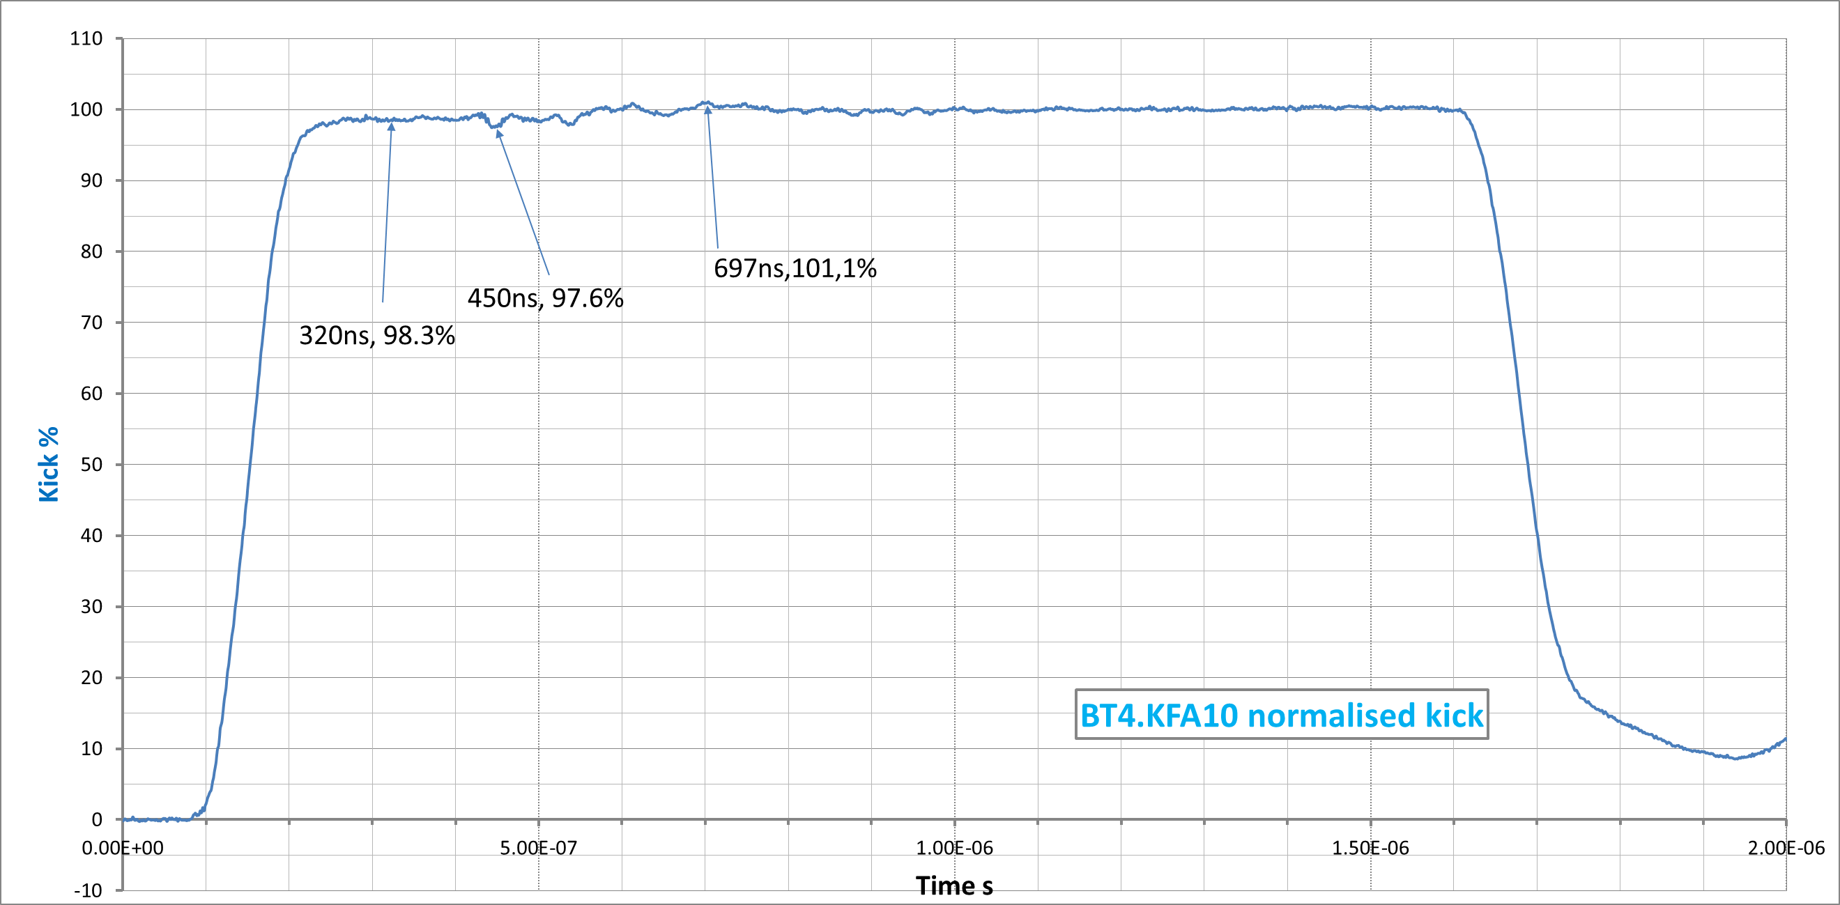
BT4.KFA10 kick (measured waveform at 50 kV)
Kick rise time: |  |  | (5-95)% | 116ns
 |  |  | (2-98)% | 138ns
 |  |  | (1-99)% | 186ns
Scope: 200MHz BW, 13 bits vertical resolution

Slide 6
BT4.KFA10 kick (Pspice calculated waveform)
Kick sum of 2 magnets (From revised PSPICE model)
Calculated
8C11 (green)
110ns
104ns
92ns
Calculated
4L1( orange)
113 107
96
Measured (red)
186
138
116
LIU (2GeV)
105ns
LIU (1.4GeV)
104ns
Rise (1-99)%
Rise (2-98)%
Rise (5-95)%
The actual ferrite grade is assumed to be 4L1. (must be replaced by 8C11)
Cable impedances are not exactly 25Ω. (variations from 24.8 to 25.5 for PFLs and Transmissions explain reflections)

Slide 7
BT1.KFA10 present system layout
One generator supplying two magnets in parallel.
Magnets equipped with their original glued ferrite blocks of assumed 4L1 type.

Slide 8
BT.KFA10 improvements for LIU
New vacuum tank with magnets equipped with “good” 8C11 or CMD5005 ferrite. (ready end 2017)
Tests in the laboratory on KFA20 spare (already equipped with CMD5005) in the same configuration as KFA10 to refine the Pspice equivalent circuit and simulate improvements to reach the specification.
Implementation in the lab to validate the model.(in 2016)
If proven to be efficient, rearrange present Tx-PFL pairs to reduce mismatches during the EYETS.
As a last resort, cut new transmission cables from the PFLs which are longer than necessary (or install new transmissions if we manage to obtain them) for a better matching.
If rise time can ultimately not be met, split magnets in two and build two new generators to supply them. (assuming we can buy SF6 cables)
This option is not presently funded nor staffed.

Slide 9
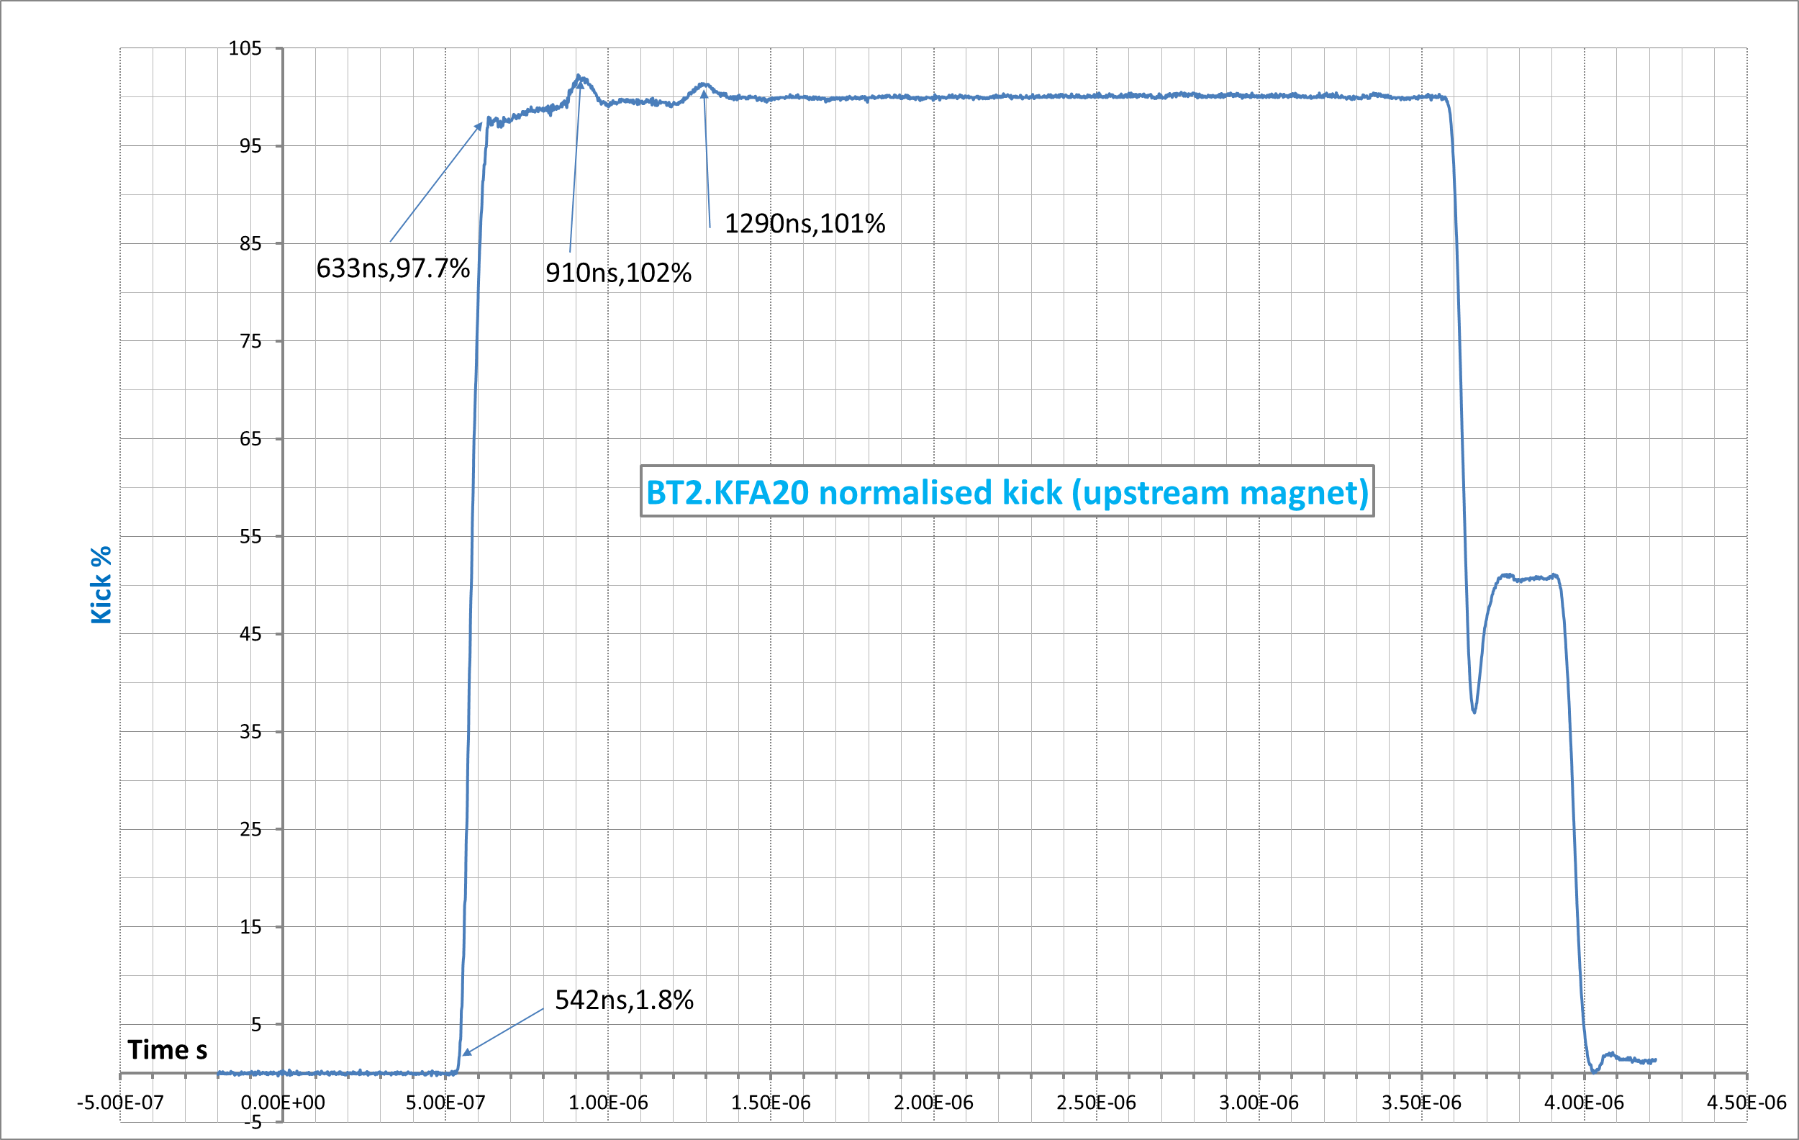
BT2.KFA20 kick (measured waveform at 27 kV)
Kick rise time: |  |  | (5-95)% | 78ns
 |  |  | (2-98)% | 94ns (LIU 104ns)
 |  |  | (1-99)% | 270ns
Scope: 200MHz BW, 13 bits vertical resolution

Slide 10
BT2.KFA20 present system layout
One generator supplying two magnets in parallel.
Magnets equipped with CMD5005 ferrite blocks.
Magnets are charged with the PFLs.

Slide 11
BT2.KFA20 kick (Pspice calculated waveform)
From revised PSPICE model
Calculated
8C11 (green)
91ns
83ns
70ns
Measured (red)
270
94
78
LIU (2GeV)
105ns
LIU (1.4GeV)
104ns
Rise (1-99)%
Rise (2-98)%
Rise (5-95)%
The present kick waveform complies with LIU specification without margin.
The overshoot is not present in the measured waveforms.
Cable impedances are not exactly 25Ω. (variations from 24.8 to 25.5 for PFLs and Transmissions explain the reflection bumps)

Slide 12
BT2.KFA20 improvements for LIU
Improve matching of cables to reduce the amplitude of the two bumps.
Improve filters (mainly on the main switch) to reach 100% earlier.
Reduce kick strength by a few % to reduce the magnet breakdown risk.
(studied by W. Bartmann)
If the new KFA10 is within specification, the KFA20 could then be reconfigured the same way to avoid magnet breakdowns.
No LIU work unit exists for this.

