Slide 1


Update on PSB – PS optics studies
19 January 2016
J.L. Abelleira
LIU-PSB Meeting

Slide 2
Contents
PSB ejection lines review (24/09/2015)
BTP rematched
Other things :
  Specifications for beam stopper (EDMS 1557914)
  Beam Envelopes for integration
  Matchability to ISOLDE
  LIU MAD-X model in repository
Conclusions

Slide 3
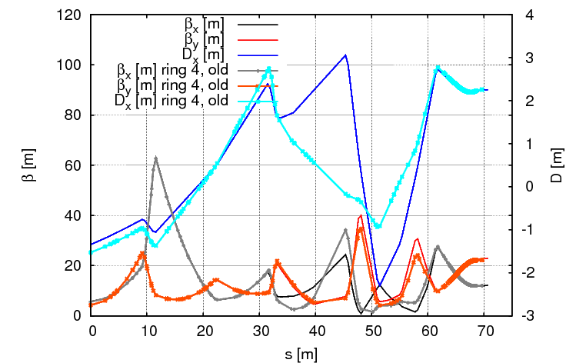
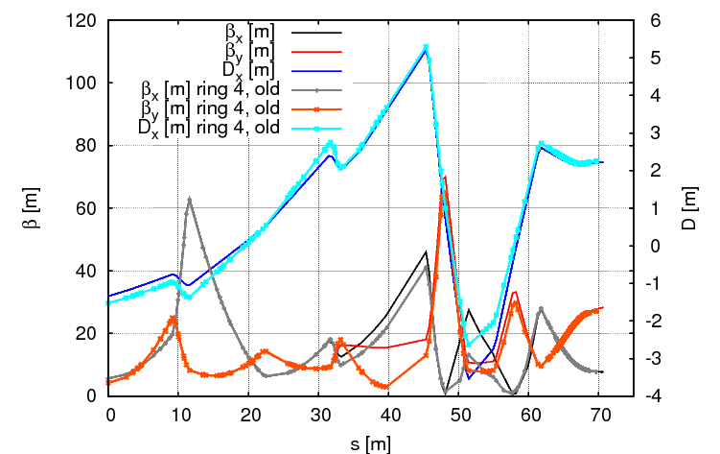
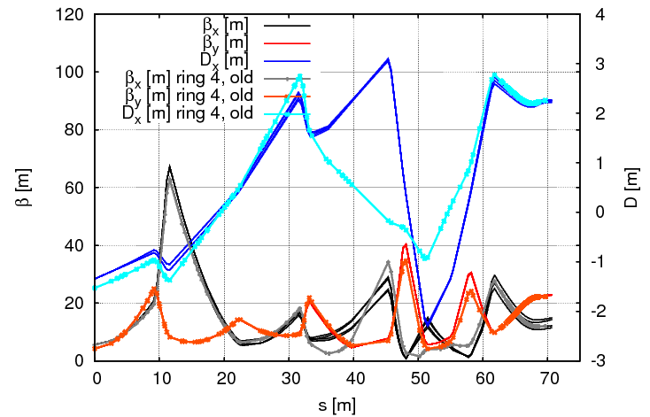
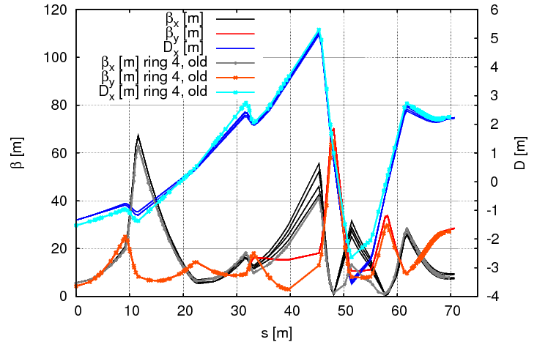
PSB ejection lines review (24/09/2015)
In the PSB ejection lines review (24/09/2015) we found a significant optics disagreement for the different lines (coming from the different weak focusing of the vertical dipoles). It is not possible to fully match the four BT_BTP lines to the PS.
LHC optics
Fixed target (FT) optics

Slide 4
PSB ejection lines review (24/09/2015)
In the PSB ejection lines review (24/09/2015) we found a significant optics disagreement for the different lines (coming from the different weak focusing of the vertical dipoles). It is not possible to fully match the four BT_BTP lines to the PS.
Therefore, an emittance increase associated with it was found.
action: optics rematch to reduce overall emittance increase
Rematched the two optics: HI and LHC beams due to
-new magnetic length
-reduce emittance growth
And keeping:
-maximum GFR / gradients for the quadrupoles already specified

Slide 5
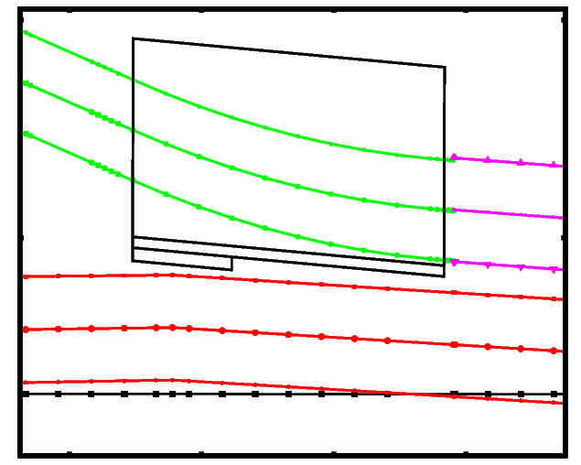
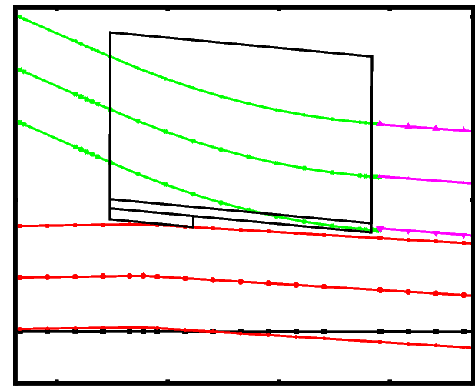
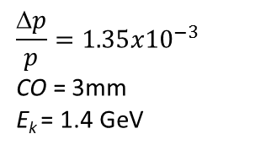
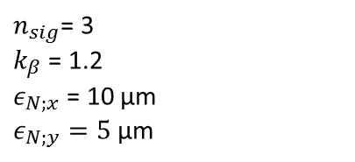

BTP: reason for two optics
HI beam: dedicated optics with reduced betax to reduce losses at injection.
From PSB
PS circulating beam (with bump)
SMH42
SMH42
FT beam with FT optics FT beam with FT optics
$A_{x,y}= n_{sig}∙\sqrt{{k_{β}∙β}_{x,y}∙\frac{ε_{N;x,y}}{γ_{r}β_{r}}} +$ 2|$D_{x,y}$⋅$\frac{Δp}{p}$|$+ CO∙\sqrt{\frac{β_{x,y}}{β_{MAX;x,y}}}$
$n_{sig}$= 3
$k_{β}$ = 1.2
$ε_{N;x}$ = 10 μm
$ε_{N;y}=5$ μm
$$\frac{Δp}{p}=1.35{x10}^{−3}$$
CO = 3mm
E_{k} = 1.4 GeV
EDMS: 1557577. Study and Optimization of the PS Injection Septum Position and of the Injection Bump at 2.0 GeV.

Slide 6
BTP rematched (LHC beams)
Optics at injection:
 | betx [m] | alfx | bety [m] | alfy | Dx [m] | Dpx | Dy [m] | Dpy
PS ring | 12.18 | -0.13 | 22.16 | -0.03 | 2.22 | 0.00 | 0.00 | 0.00
BT1_BTP | 13.50 | -0.11 | 22.2 | -0.03 | 2.28 | -0.01 | -0.19 | -0.03
BT2_BTP | 12.89 | -0.18 | 22.22 | -0.02 | 2.26 | 0.00 | 0.29 | -0.02
BT3_BTP | 10.35 | -0.13 | 22.17 | -0.02 | 2.23 | 0.00 | 0.05 | 0.00
BT4_BTP | 11.04 | -0.06 | 22.15 | -0.03 | 2.26 | -0.01 | 0.53 | 0.01
Rel. Emittance growth:
 | (Δє/є) due to betatron mismatch [%] |  | (Δє/є) due to dispersion mismatch [%]
 | Hor. | Ver. | Hor. | Ver.
Ring1 | 0.58 | 0.00 | 0.17 | 2.38
Ring2 | 0.28 | 0.01 | 0.02 | 1.21
Ring3 | 1.34 | 0.00 | 0.00 | 0.01
Ring4 | 0.61 | 0.00 | 0.11 | 1.37
Max | 1.34 | 0.01 | 0.17 | 2.38

Slide 7
BTP rematched (FT beams)
Optics at injection:
 | betx [m] | alfx | bety [m] | alfy | Dx [m] | Dpx | Dy [m] | Dpy
PS ring | 7.52 | 0.12 | 28.04 | -0.27 | 2.83 | 0.11 | 0.00 | 0.00
BT1_BTP | 8.04 | 0.07 | 28.29 | -0.41 | 1.99 | -0.05 | 0.05 | -0.03
BT2_BTP | 7.86 | -0.03 | 28.50 | -0.40 | 1.98 | -0.04 | 0.47 | -0.01
BT3_BTP | 6.34 | -0.06 | 28.33 | -0.41 | 1.97 | -0.03 | 0.06 | 0.00
BT4_BTP | 6.58 | 0.02 | 28.12 | -0.41 | 1.98 | -0.04 | 0.47 | 0.02
Rel. Emittance growth
 | (Δє/є) due to betatron mismatch [%] |  | (Δє/є) due to dispersion mismatch [%]
 | Hor. | Ver. | Hor. | Ver.
Ring1 | 0.35 | 0.88 | 8.36 | 1.48
Ring2 | 1.15 | 0.78 | 7.61 | 0.68
Ring3 | 3.18 | 0.83 | 7.49 | 0.01
Ring4 | 1.37 | 0.94 | 8.26 | 0.99
Max | 3.18 | 0.94 | 8.36 | 1.48

Slide 8
BTP rematched
Comparative Rel. Emittance growth (Δє/є) before/after rematching
 | (Δє/є) for LHC beams [%] |  | (Δє/є) for HI beams [%]
 | hor. | ver. | hor. | ver.
betatron mismatch | 2.3/1.3 | 0.0/0.0 | 2.0/3.2 | 0.0/0.9
dispersion mismatch | 0.1/0.2 | 5.4/2.4 | 0.0/8.4 | 5.2/1.5
total mismatch | 2.3/1.4 | 5.4/2.4 | 2/8.9 | 5.2/1.75
For the LHC beams, the emittance increase has been reduced in both planes.
For the HI beams:
      Reduced vertical emittance increase
      horizontal emittance increase larger
Figure of merit for HI beams is not emittance increase but losses
Relative increase in beam envelope: 3.4 % (hor.) and 0.8 % (ver.)

Slide 9
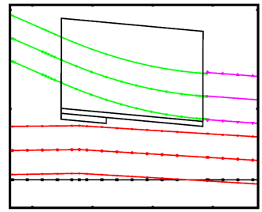
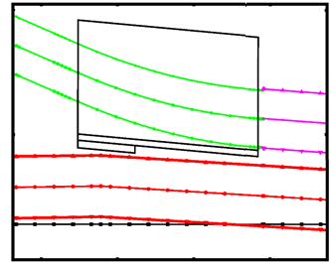
BTP rematched
FT optics better in terms of acceptance, even with the emittance increase
Effect of hor. emittance increase for the HI optics:
No effect on beam losses
HI beam with HI optics
HI beam with LHC optics

Slide 10
Other things
  Beam specifications for beam stopper (EDMS 1557914). Limit cases for the beams to the STP studied and specified for simulations (document sent for approval).
  Element positions and maximum beam envelopes provided for integration (BT, BTM, BTP)
  Impact of new optics to BTY
  LIU MAD-X model in repository

Slide 11
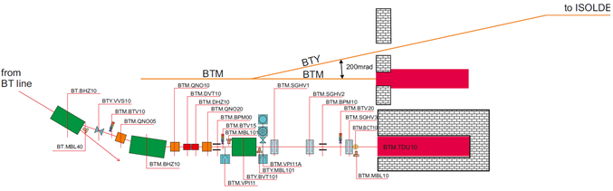
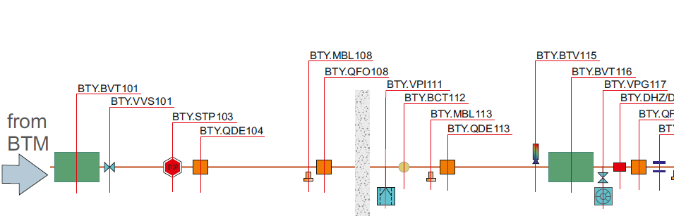
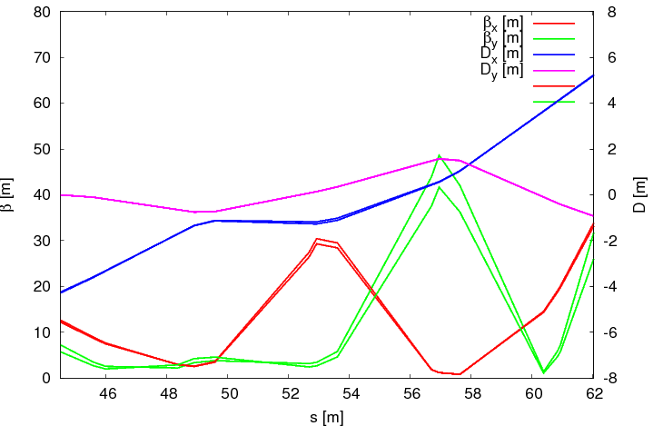
Other things: impact of new optics in BTY
BTM dump optics shared with BTY.
Model of BTY in the AFS repository (B. Mikulec, GP di Giovanni, O. Berrig)
Impact of the new optics analysed. No major effect, but may need rematching at the end of the line

Slide 12
Other things: LIU MAD-X model in repository
BT-BTP model updated
/afs/cern.ch/eng/ps/cps/TransLines/PSB-PS/2015/cmd/PSB-PS-LIU-proj/LIU_PSB-PS_transfer_lines
BT part
  Introduced new septa (vertical dipole strengths adjusted)
  Updated BT.QNO40, BT.QNO50 (position and Lm)
BT-BTP part
  Updated BT.BHZ10 (Lm=1.53 m->2.2 m)
  Updated BT.QNO40, BT.QNO50 (position, Lm, strengths)
  Updated BTPQNO20,BTPQNO30,BTPQNO35, BTPQNO40,
  BTPQNO50, BTPQNO55, BTP.QNO60 (position, Lm, strengths)
BT-BTM part
  Updated BT.BHZ10 (Lm=1.53 m->2.2 m)
  BT.QNO40, BT.QNO50, BTM.QNO05, BTMQNO10, BTMQNO20 (with present Lm).
Lm=640 mm (EDMS 1549299)
Strengths from LIU-PSB WG meeting (08/05/2014)
Not fixed by hardware yet. New optics (5 quadrupole strengths) to be adjusted once Lm is fixed.

Slide 13
Conclusions
The emittance increase for LHC beams at PS injection due to optics mismatch has been reduced.
A new optics has been produced for FT beams, keeping the constraints from gradients and GFR in the new quadrupoles.
The new FT optics shows a small increase in terms of beam size (no impact in beam losses).
The benefit of using a dedicated optics (in BTP and PS) for FT beams has been shown.
The impact of the new BTM optics in the BTY is minimal.

