Slide 1
Using TORCH for photon timing
First results from simulation and plans
LHCb “Theatre of Dreams” meeting
April 6, 2016
M. van Dijk
S. Malde

Slide 2
Introduction
TORCH detector concept has been introduced
TORCH for photon timing to discriminate between primary vertices
Geant simulation to assess feasibility
  Lead plate standalone:
  study high-energy photon shower
  Lead plate in front of TORCH module:
  simulate photon pattern on detectors

Slide 3
TORCH photon timing basics
TORCH placed in front of calorimeter
Lead plate in front of TORCH to convert high energy photon into e⁺e⁻ pairs
Combine Cherenkov photons from electron pair to time tag incoming photon
Main questions
  Conversion efficiency?
  Opening angle of electron pair? Correlation with photon?
  Shape of pattern in TORCH? Compare with regular patterns?

Slide 4
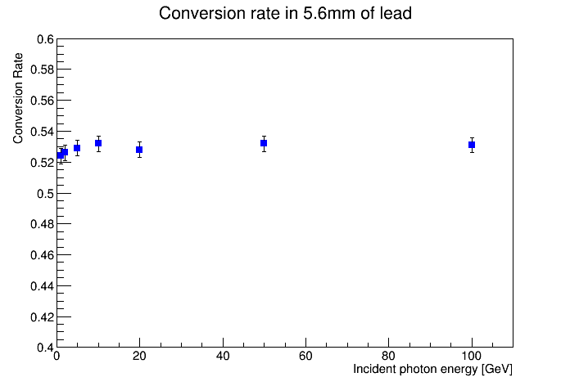
Lead plate simulation
Conversion efficiency: about 53% for 1 X₀ of lead
Scales exponentially (7.5% @ 0.1X₀, 32% @ 0.5X₀, 79% @ 2X₀)
Essentially independent of energy for region >1GeV
Interaction cross section of photons in lead
(PDG, “Passage of particles through matter”)
Observed conversion rate for 1X₀ of lead (5.6 mm)
Pair conversion

Slide 5
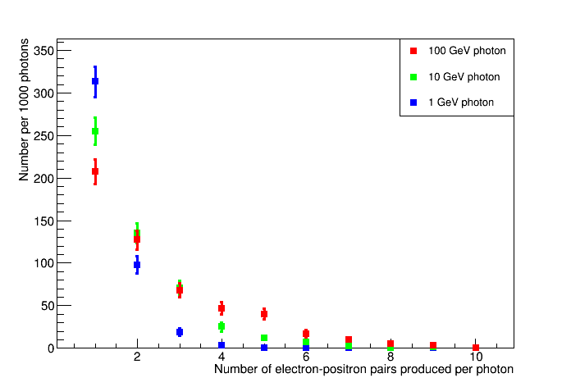
Secondaries from interactions
Particles created from initial pair conversion generate shower of secondaries
Delta electrons (add ~20%)
(not included in plot)
Radiated gammas
  Further pair conversions

Slide 6
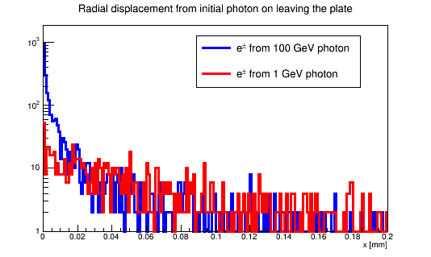
Radial displacement
Radial displacement at plate exit is measure for multiple Coulomb scatter
  Only e^{+/-} pairs considered
Worse for lower energy parent photons
Fewer electrons actually emerge from plate at lower photon energy– secondaries are mostly low energy
e^{-/+}
e^{+/-}
Lead
γ

Slide 7
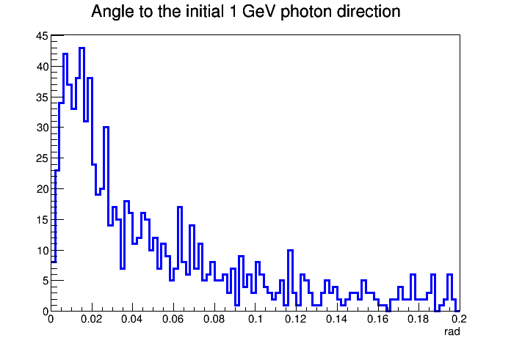
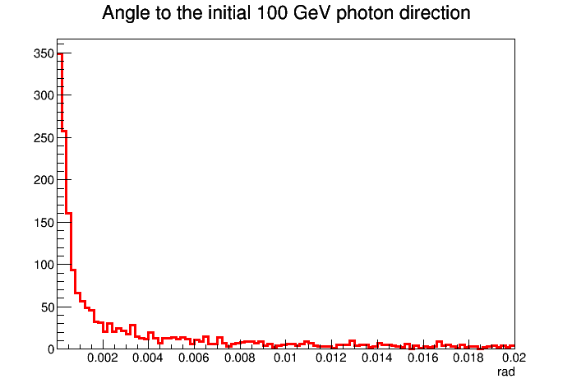
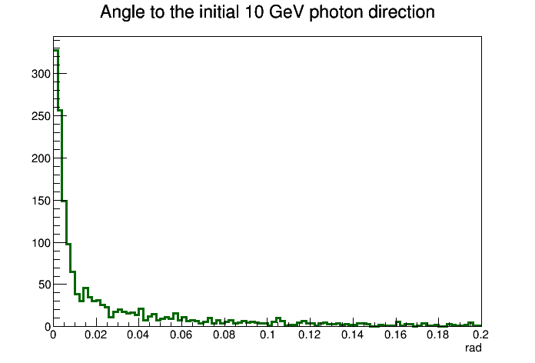
Opening angle of products
Radial displacement is negligible – angular displacement more relevant
Peak values
  1GeV ~15 mrad
  10 GeV ~0.15 mrad
  100 GeV ~0.02 mrad
Note scale change

Slide 8
Patterns in single-plate TORCH
TORCH single plate layout
Cherenkov rings are propagated towards detectors by total internal reflection
Cylindrical mirror in focusing block projects ring onto detector, resulting in a hyperbola-like shape
Thickness of ring set by chromatic dispersion (vertical height in display)
  Highly dependent on energy range
Dimensions of detector plane compressed:
  6 meters wide
  54mm high
Detector display for single plate

Slide 9
TORCH modular layout
TORCH module
Modular layout
  Modules of 66x250cm
  More realistic
Elongated shape of module causes part of Cherenkov ring to reflect on side of radiator
Distorts hyperbola-like pattern on detector
  Pattern folds over itself
Reflections in TORCH
TORCH modular layout

Slide 10
Pattern folding
Considering a single photon energy gives “thin” Cherenkov ring
Ring is projected into hyperbola-like shape
Hyperbola-like shape is folded over on top of itself
Reflected parts arrive later in time
Monochromatic folded pattern
Full-spectrum folded pattern

Slide 11
TORCH with lead – photon patterns
Lead plate (1X₀) placed in front of regular TORCH module
Tracks angled upwards (5º) and about 80cm up to simulate tracks coming from IP
Time projection of detector pattern will be shown
  Reflections off side arrive later
  Within reflection, higher energy photons (higher refractive index) also arrive slightly later
Photon patterns will be shown for four cases
  100 GeV/c pions – benchmarking what the pattern should look like
  2, 5, 10 GeV photons
  Higher energy photons create patterns very similar to 10 GeV

Slide 12
Pions (100 GeV/c)

Slide 13
Photons (2 GeV)

Slide 14
Photons (5 GeV)

Slide 15
Photons (10 GeV)

Slide 16
Future work
Run TORCH reconstruction on photons
  Trade-off of quantity (number of photons) versus quality (time resolution per photon)
  Assess whether outcome is beneficial – and quantify
TORCH for assumes high quality tracking – not available for photons
  Info from calorimeter enough?

Slide 17
Conclusions
Photoconversion occurs for about 53% of photons using 1X₀ of lead in front of TORCH
Results in shower of electrons passing through TORCH
  Distribution governed by multiple coulomb scattering
  High light yield due to many particles
Initial results look very encouraging
  As photon energy increases, already beyond 10 GeV the patterns highly resemble that of “regular” charged particles
  Future work will assess more exactly how good this resemblance is

