Slide 1
and medium
Large Computer Centres
Tony Cass
Leader, Fabric Infrastructure & Operations Group
Information Technology Department
14th January 2009

Slide 2
Characteristics
Power and Power
Compute Power
  Single large system
    Boring
  Multiple small systems
    CERN, Google, Microsoft…
    Multiple issues: Exciting
Electrical Power
  Cooling & €€€

Slide 3
Challenges
Box Management
What’s Going On?
Power & Cooling

Slide 4
Challenges
Box Management
What’s Going On?
Power & Cooling

Slide 5
Challenges
Box Management
  Installation & Configuration
  Monitoring
  Workflow
What’s Going On?
Power & Cooling

Slide 6


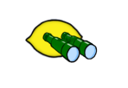
ELFms Vision
Leaf
Logistical
Management
Lemon
Performance
& Exception
Monitoring
Node
Configuration
Management
Node
Management
Toolkit developed by CERN in collaboration with many HEP sites and as part of the European DataGrid Project.
See http://cern.ch/ELFms

Slide 7

Quattor
Configuration server
SQL
Used by 18 organisations besides CERN; including two distributed implementations with 5 and 18 sites.
SQL backend
CLI
GUI
SOAP
CDB
scripts
XML backend
HTTP
XML configuration profiles
SW server(s)
Install server
Node Configuration Manager NCM
Install Manager
SW
Repository
HTTP
CompA
CompB
CompC
HTTP / PXE
RPMs
ServiceA
ServiceB
ServiceC
base OS
RPMs / PKGs
System installer
SW Package Manager
SPMA
Managed Nodes

Slide 8
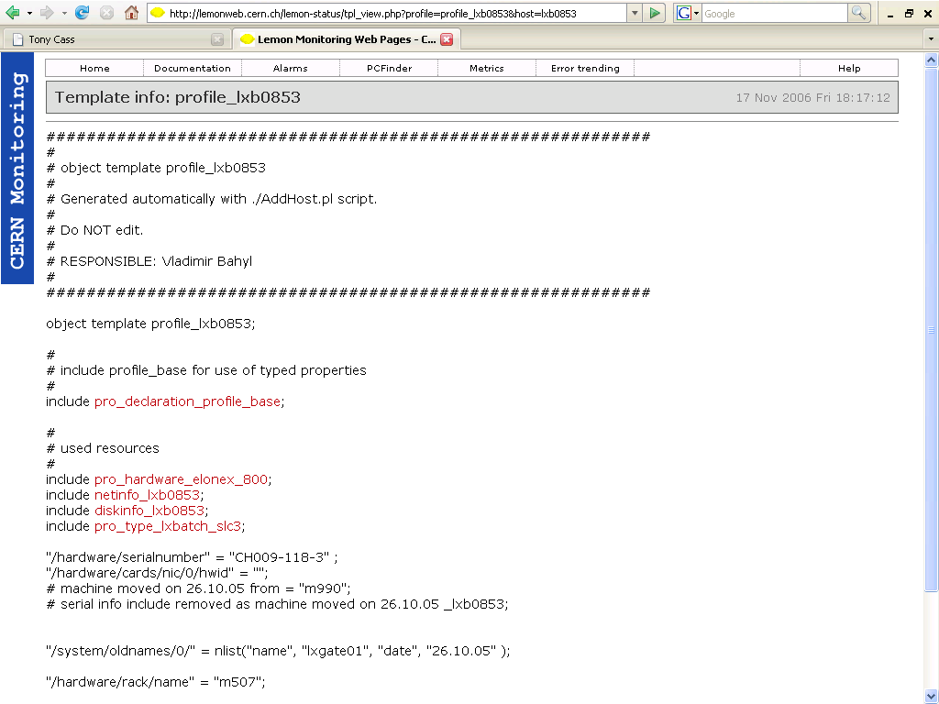
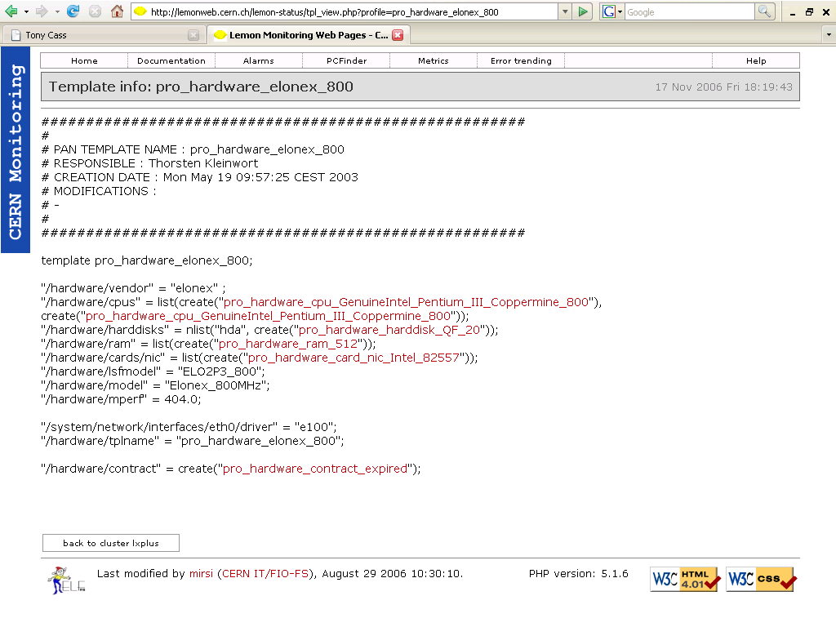
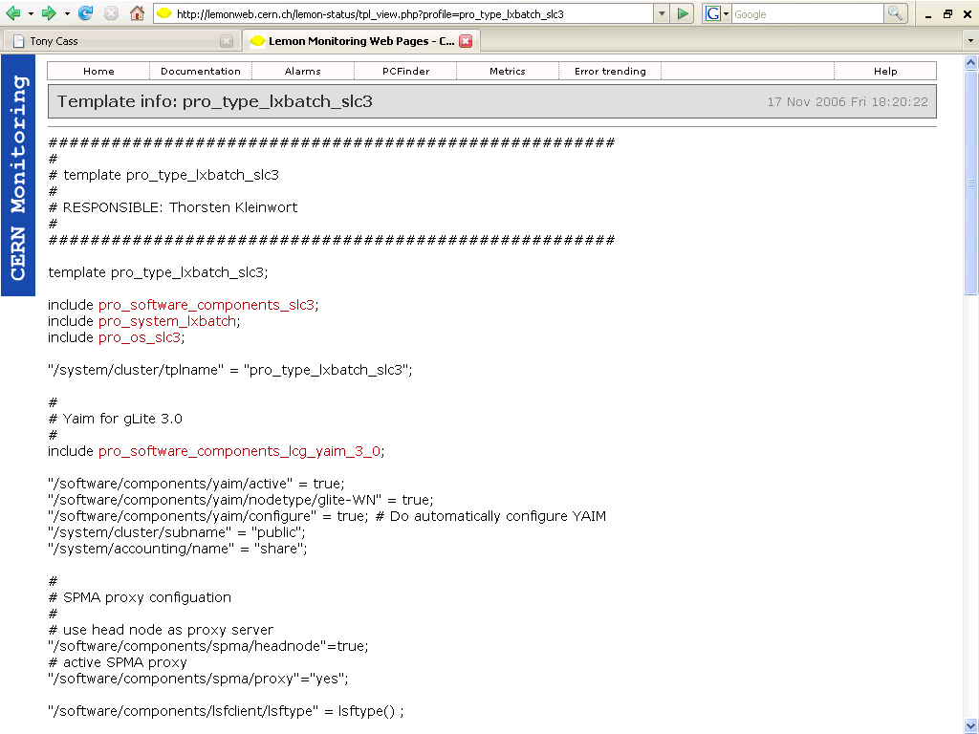
Configuration Hierarchy
CERN
CC
name_srv1: 192.168.5.55
time_srv1: ip-time-1
lxbatch
cluster_name: lxbatch
master: lxmaster01
pkg_add (lsf5.1)
lxplus
cluster_name: lxplus
pkg_add (lsf5.1)
disk_srv
lxplus001
eth0/ip: 192.168.0.246
pkg_add (lsf5.1_debug)
lxplus020
eth0/ip: 192.168.0.225
lxplus029

Slide 9
Scalable s/w distribution…
Server cluster
Backend
(“Master”)
M
M’
Installation images,
RPMs,
configuration profiles
Frontend
L1 proxies
L2 proxies
(“Head”
nodes)
DNS-load balanced HTTP
H
H
H
…
Rack 1
Rack 2…
… Rack N

Slide 10
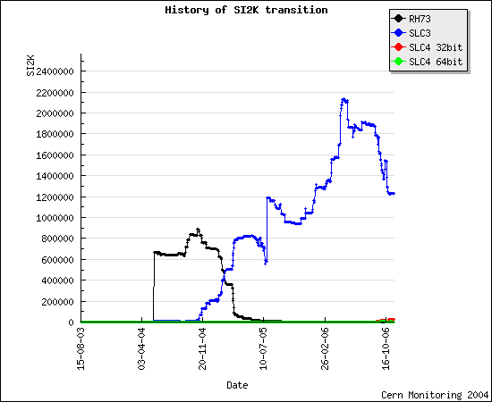
… in practice!

Slide 11
Challenges
Box Management
  Installation & Configuration
  Monitoring
  Workflow
What’s Going On?
Power & Cooling

Slide 12

Lemon
Repository
backend
SQL
RRDTool / PHP
Correlation
Engines
Monitoring
Repository
SOAP
SOAP
apache
TCP/UDP
HTTP
Nodes
Lemon
CLI
Web browser
Monitoring Agent
Sensor
Sensor
Sensor
User
User Workstations

Slide 13
What is monitored
All the usual system parameters and more
  system load, file system usage, network traffic, daemon count, software version…
  SMART monitoring for disks
  Oracle monitoring
    number of logons, cursors, logical and physical I/O, user commits, index usage, parse statistics, …
  AFS client monitoring
  …
“non-node” sensors allowing integration of
  high level mass-storage and batch system details
    Queue lengths, file lifetime on disk, …
  hardware reliability data
  information from the building management system
    Power demand, UPS status, temperature, …
      and full feedback is possible (although not implemented): e.g. system shutdown on power failure
See power discussion later

Slide 14
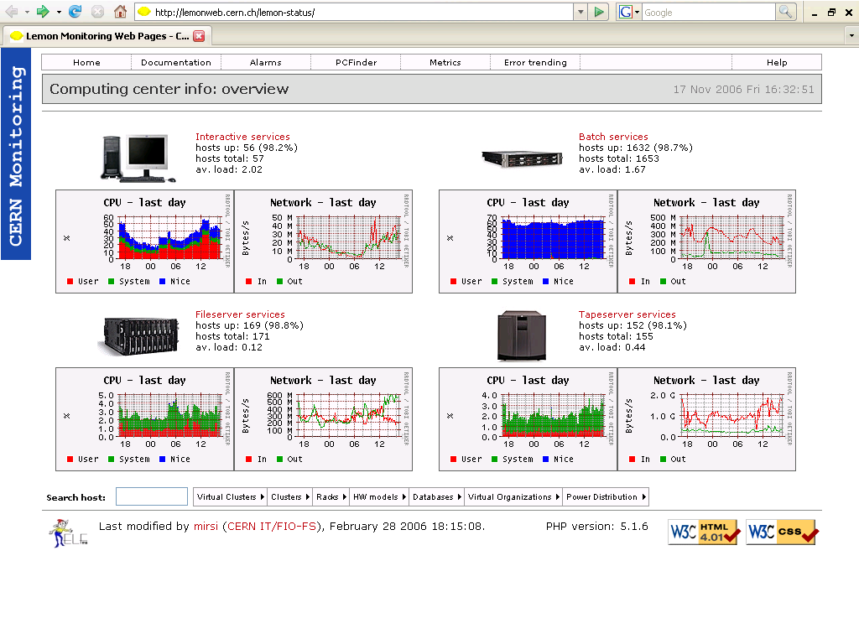
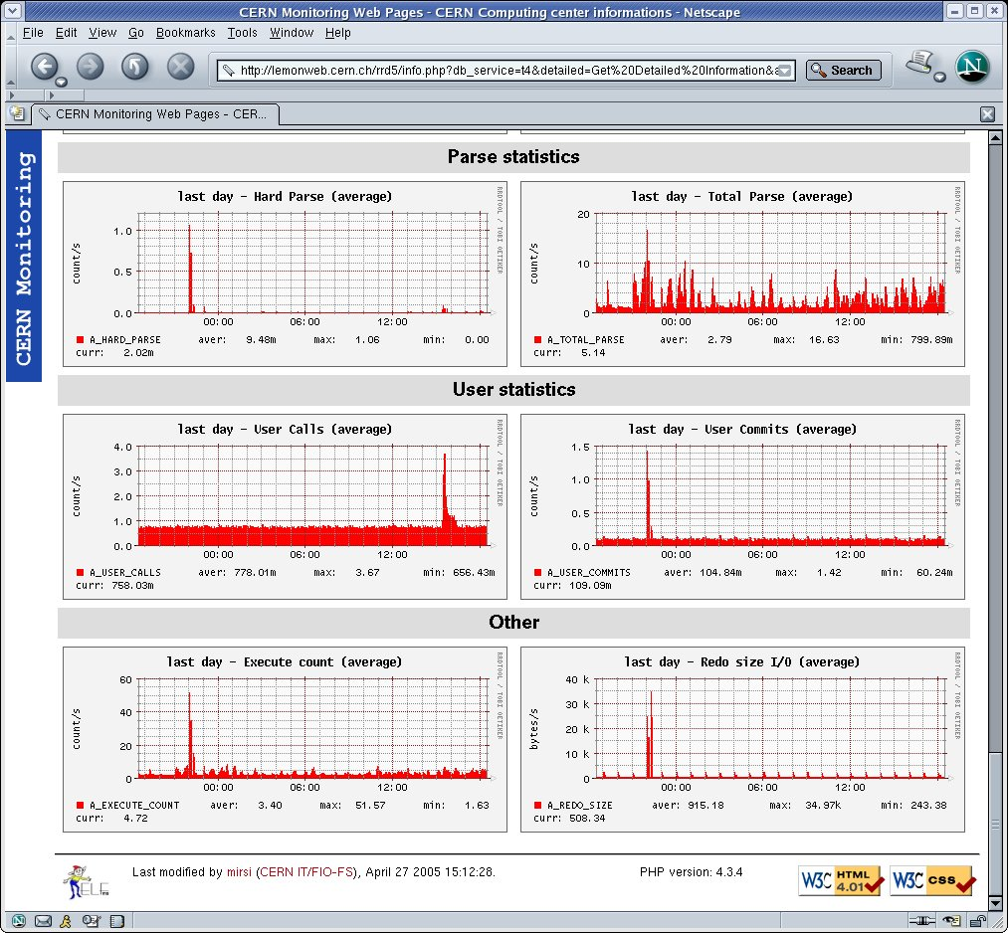
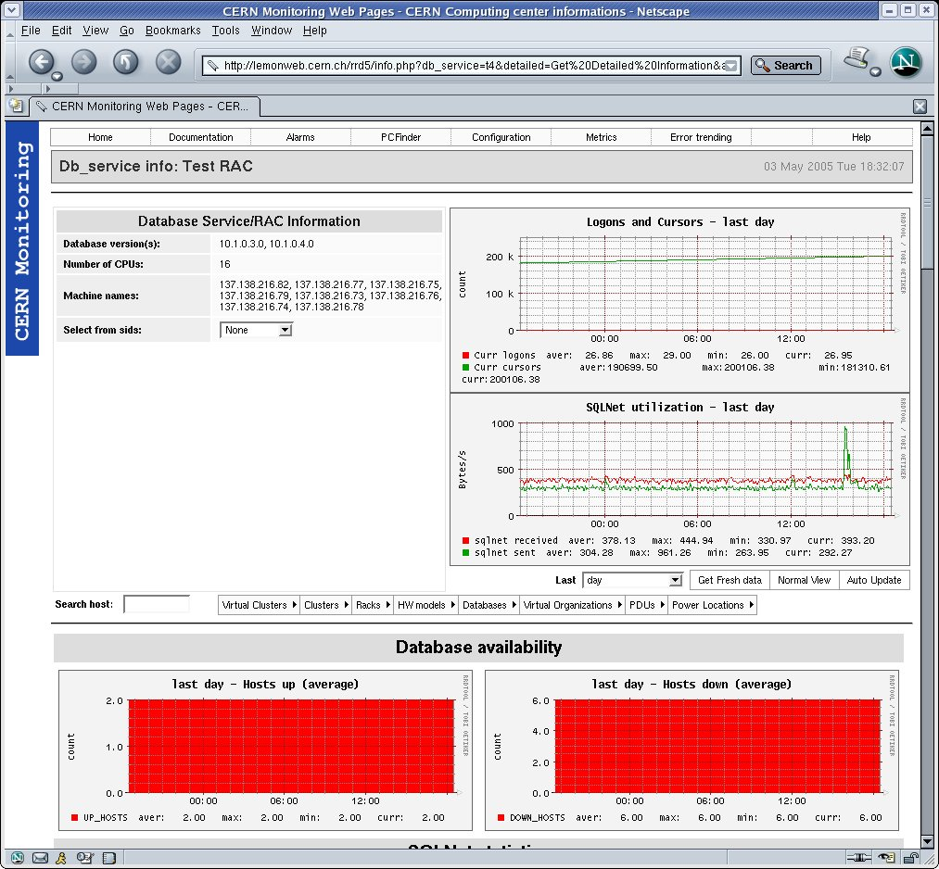
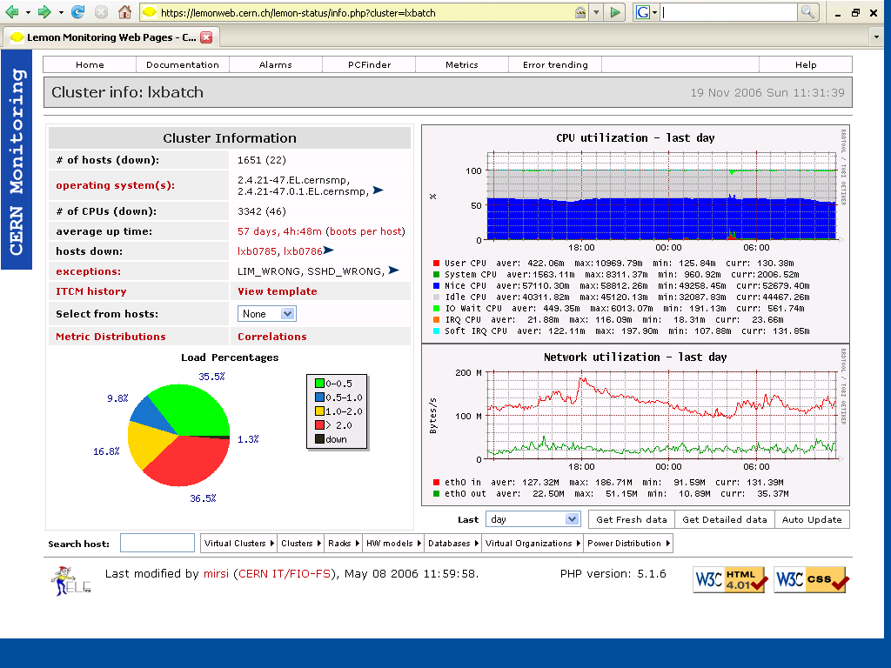
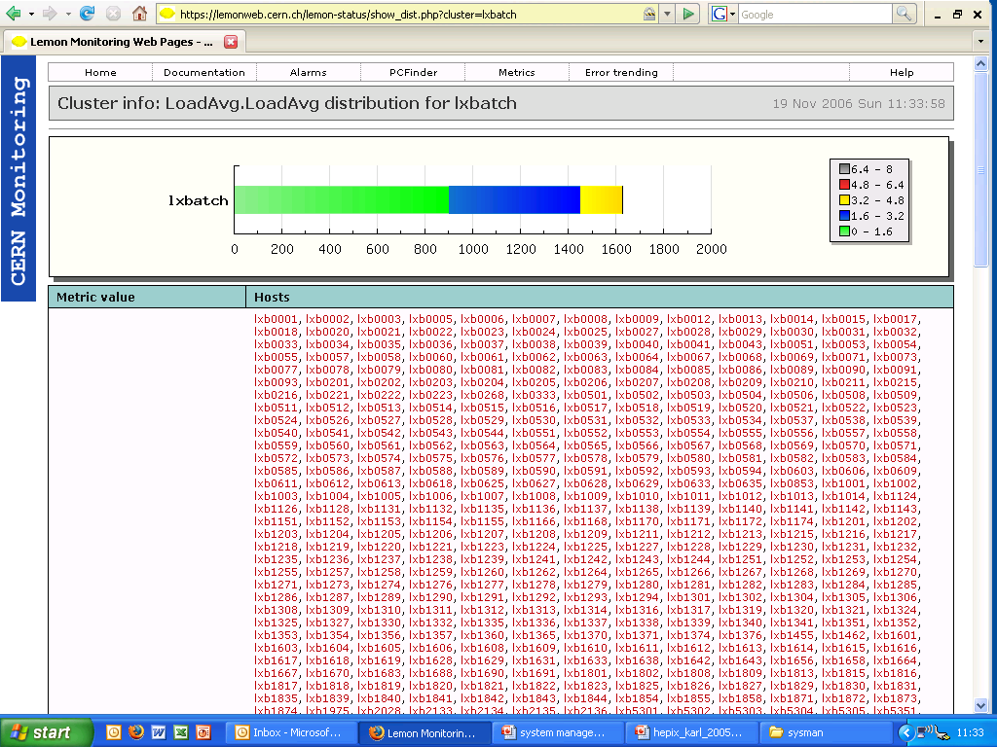
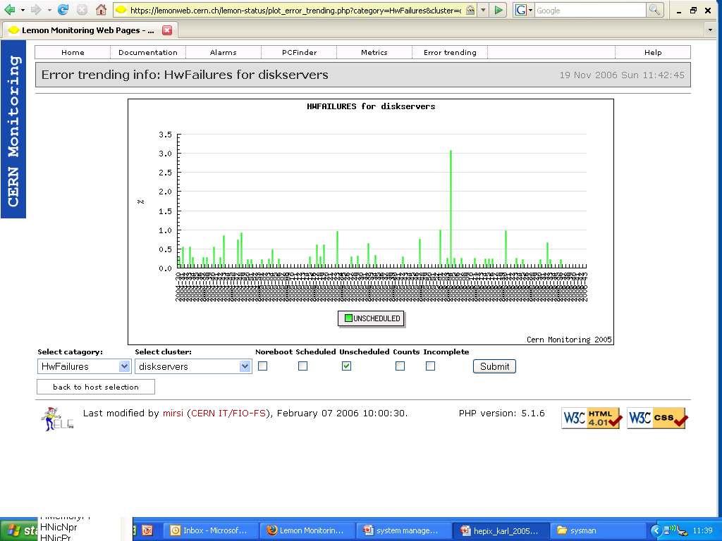
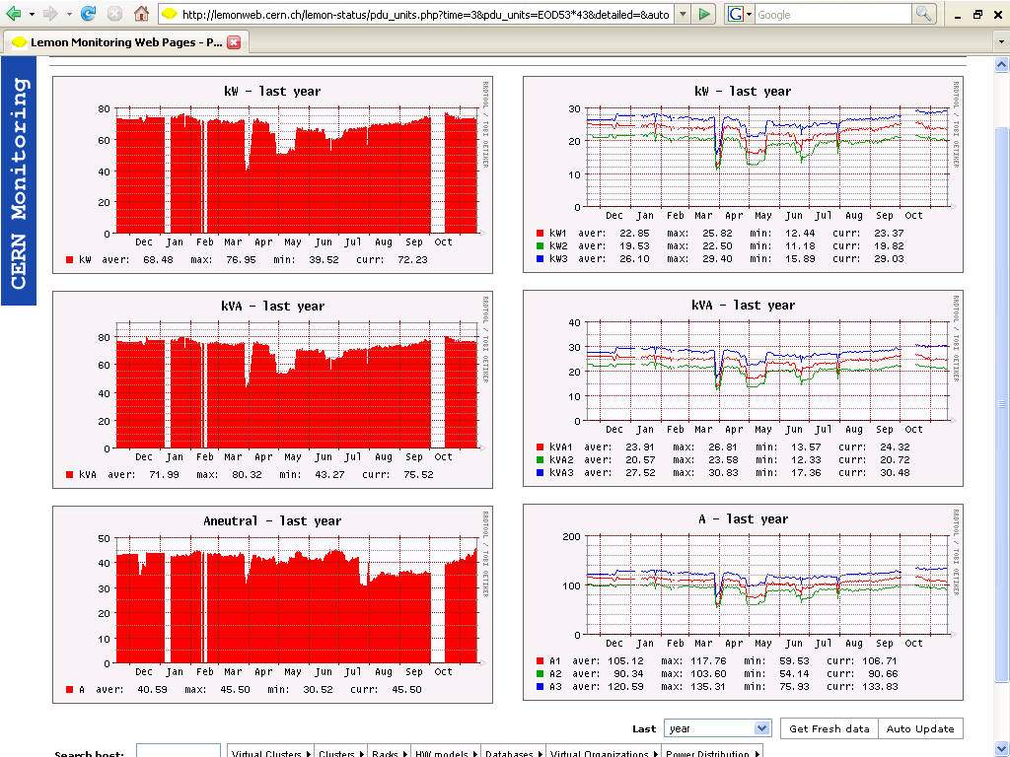
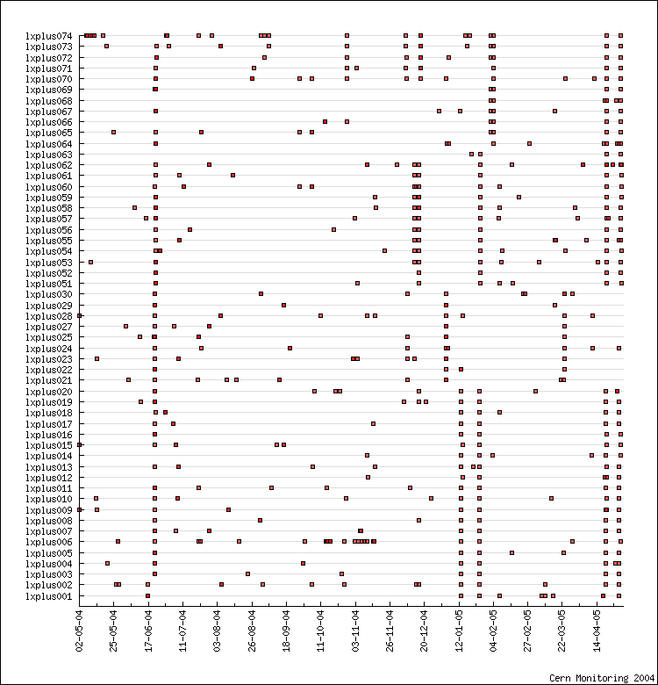
Monitoring displays

Slide 15
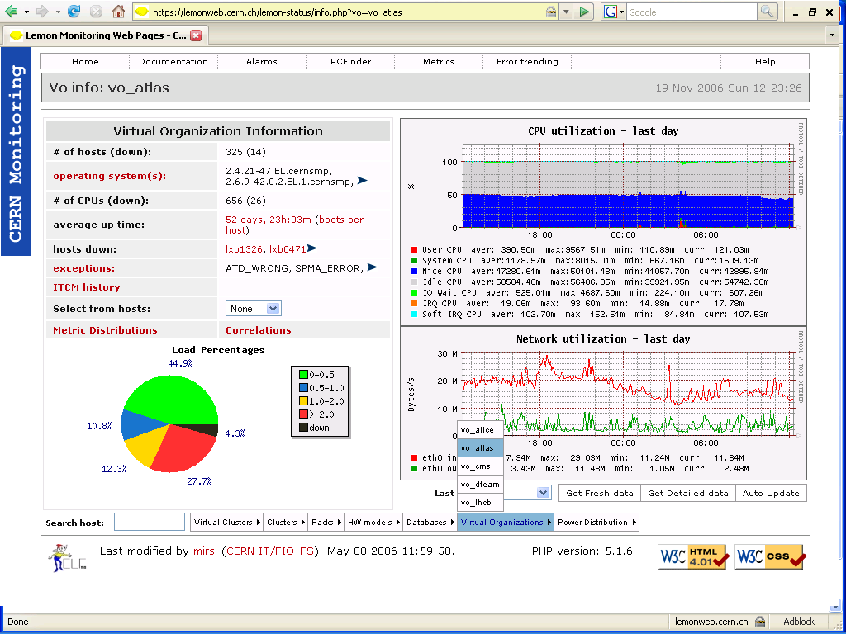
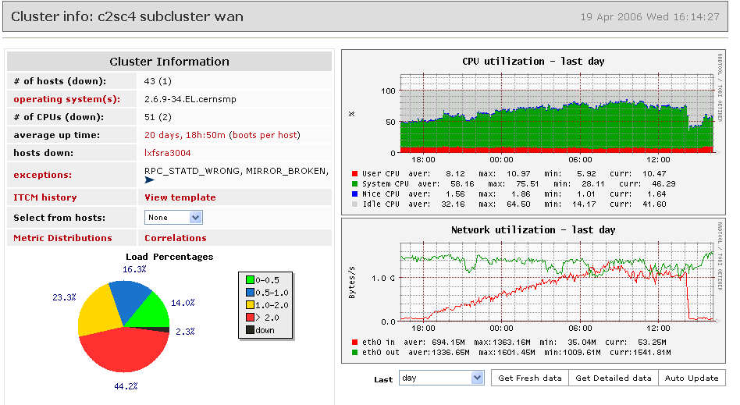
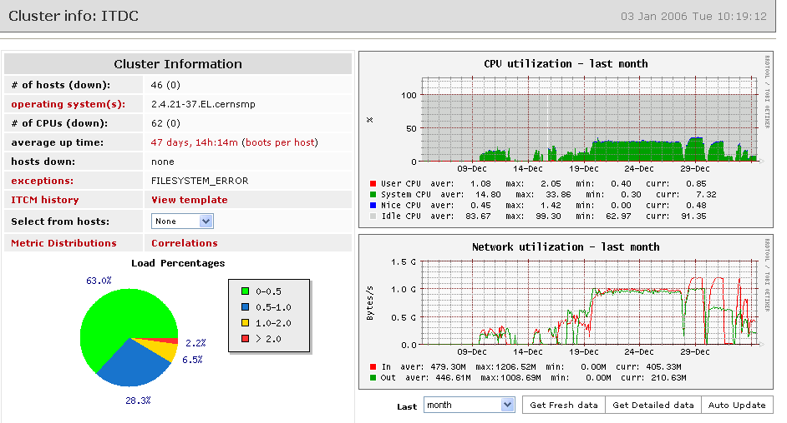
Dynamic cluster definition
As Lemon monitoring is integrated with quattor, monitoring of clusters set up for special uses happens almost automatically.
  This has been invaluable over the past year as we have been stress testing our infrastructure in preparation for LHC operations.
Lemon clusters can also be defined “on the fly”
  e.g. a cluster of “nodes running jobs for the ATLAS experiment”
    note that the set of nodes in this cluster changes over time.

Slide 16
Challenges
Box Management
  Installation & Configuration
  Monitoring
  Workflow
What’s Going On?
Power & Cooling

Slide 17
LHC Era Automated Fabric
LEAF is a collection of workflows for high level node hardware and state management, on top of Quattor and LEMON:
HMS (Hardware Management System):
  Track systems through all physical steps in lifecycle eg. installation, moves, vendor calls, retirement
  Automatically requests installs, retires etc. to technicians
  GUI to locate equipment physically
  HMS implementation is CERN specific, but concepts and design should be generic
SMS (State Management System):
  Automated handling (and tracking of) high-level configuration steps
    Reconfigure and reboot all LXPLUS nodes for new kernel and/or physical move
    Drain and reconfig nodes for diagnosis / repair operations
  Issues all necessary (re)configuration commands via Quattor
  extensible framework – plug-ins for site-specific operations possible

Slide 18
LEAF workflow example
1. Import
Operations
6. Shutdown work order
technicians
7. Request move
10. Install work order
HMS
2. Set to standby
8. Update
NW DB
11. Set to production
SMS
9. Update
5. Take out of production
  Close queues and drain jobs
  Disable alarms
3. Update
4. Refresh
Node
12. Update
Quattor
CDB
14. Put into production
13. Refresh

Slide 19
Integration in Action
Simple
  Operator alarms masked according to system state
Complex
  Disk and RAID failures detected on disk storage nodes lead automatically to a reconfiguration of the mass storage system:
Mass Storage System
SMS
set Standby
set Draining
Alarm Analysis
Alarm
Monitor
Disk Server
LEMON
Lemon Agent
Alarm
RAID degraded
Draining: no new connections allowed; existing data transfers continue.

Slide 20
Challenges
Box Management
  Installation & Configuration
  Monitoring
  Workflow
What’s Going On?
Power & Cooling

Slide 21
A Complex Overall Service
System managers understand systems (we hope!).
  But do they understand the service?
  Do the users?

Slide 22
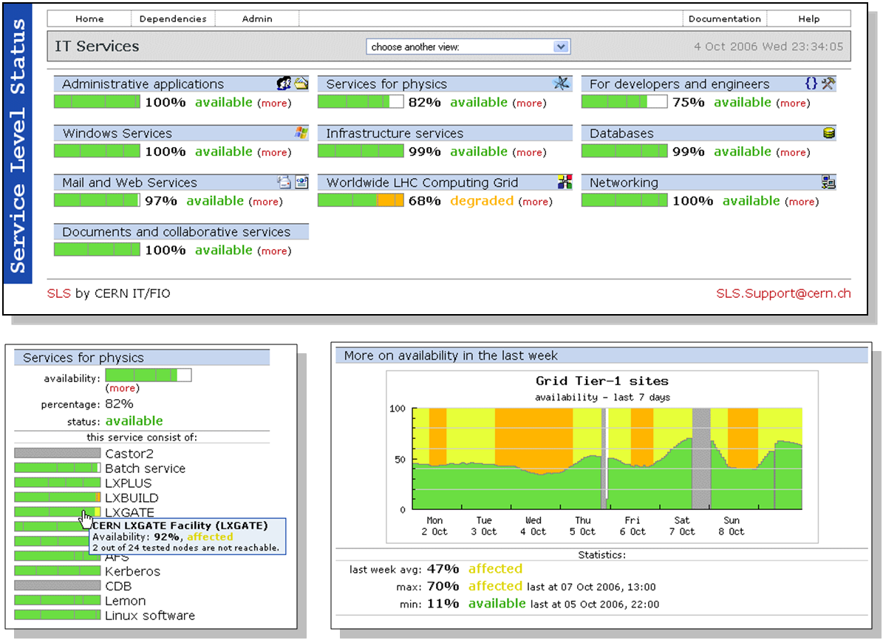
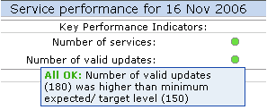
User Status Views @ CERN

Slide 23
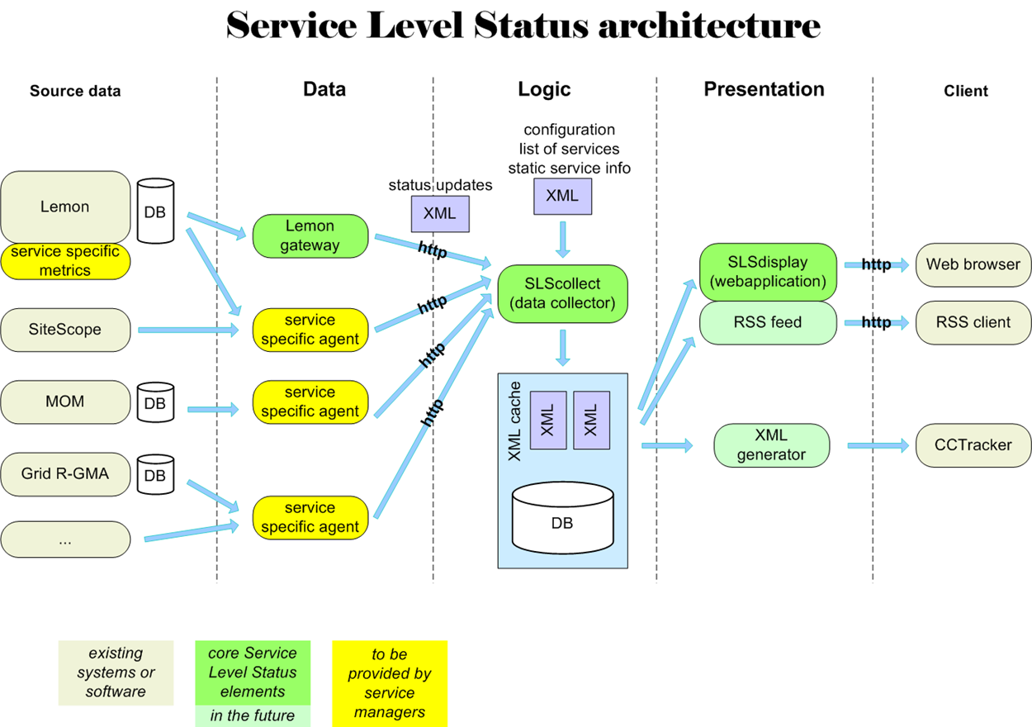
SLS Architecture

Slide 24
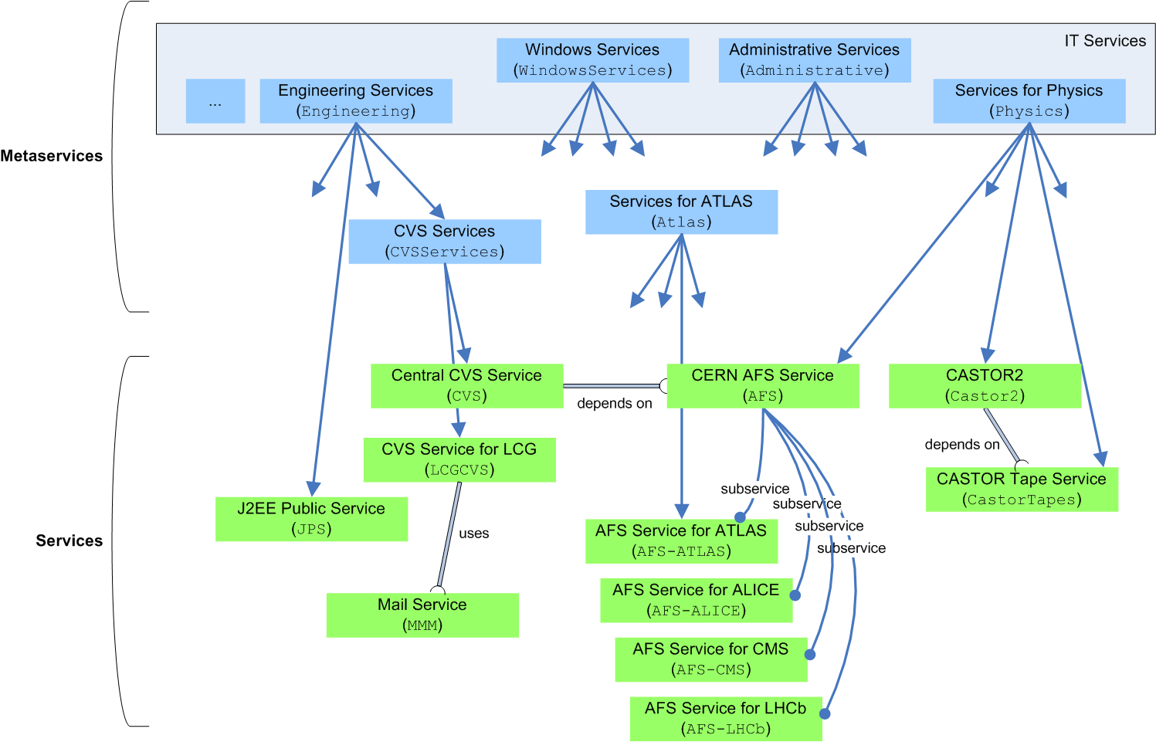
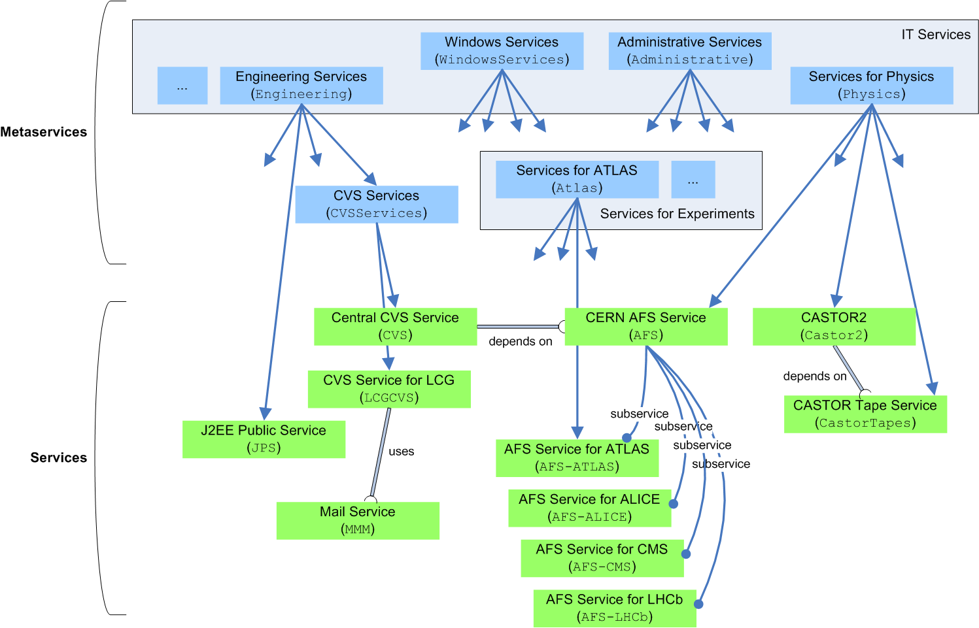
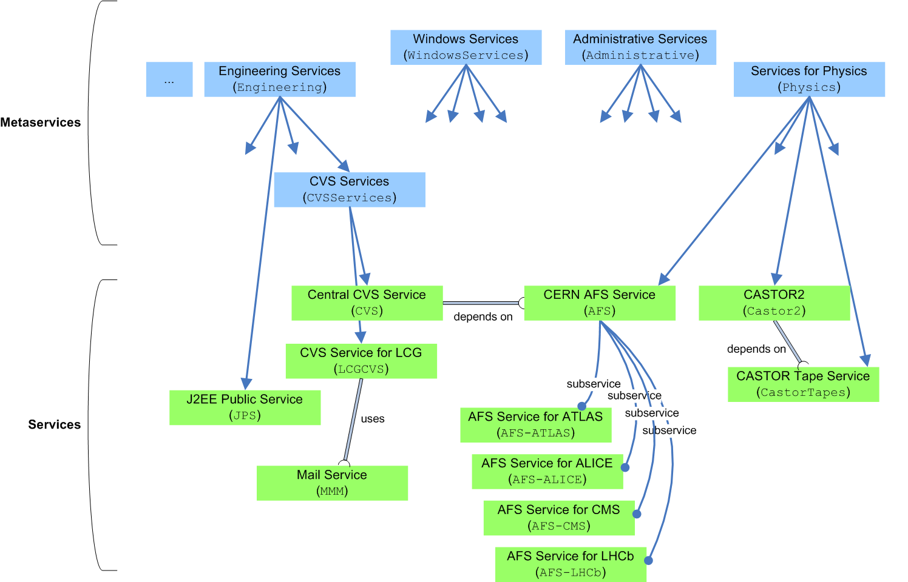
SLS Service Hierarchy

Slide 25
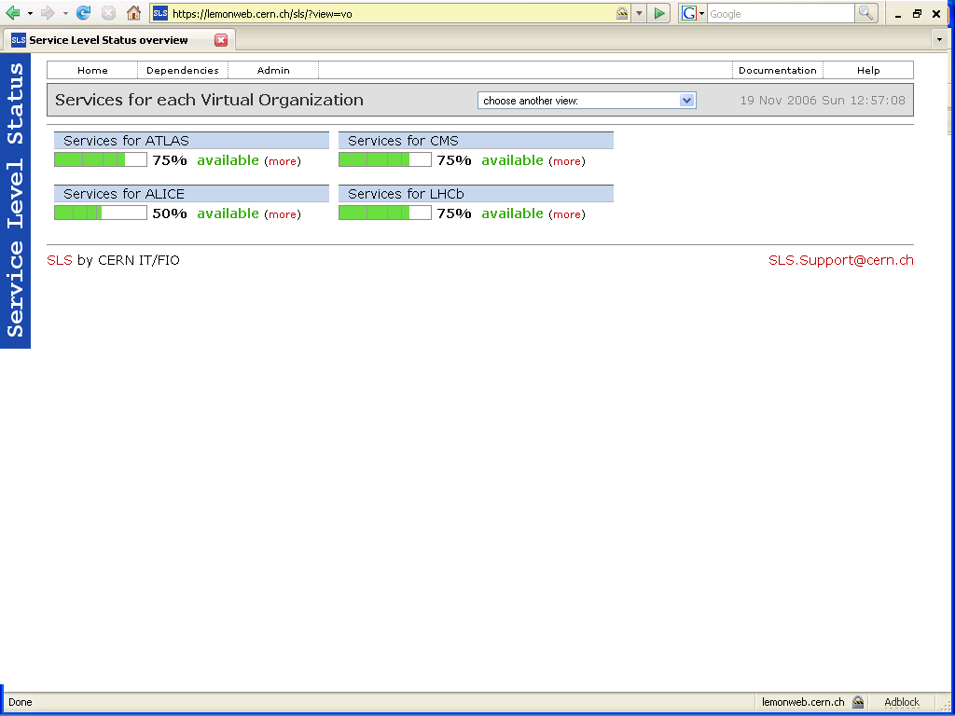
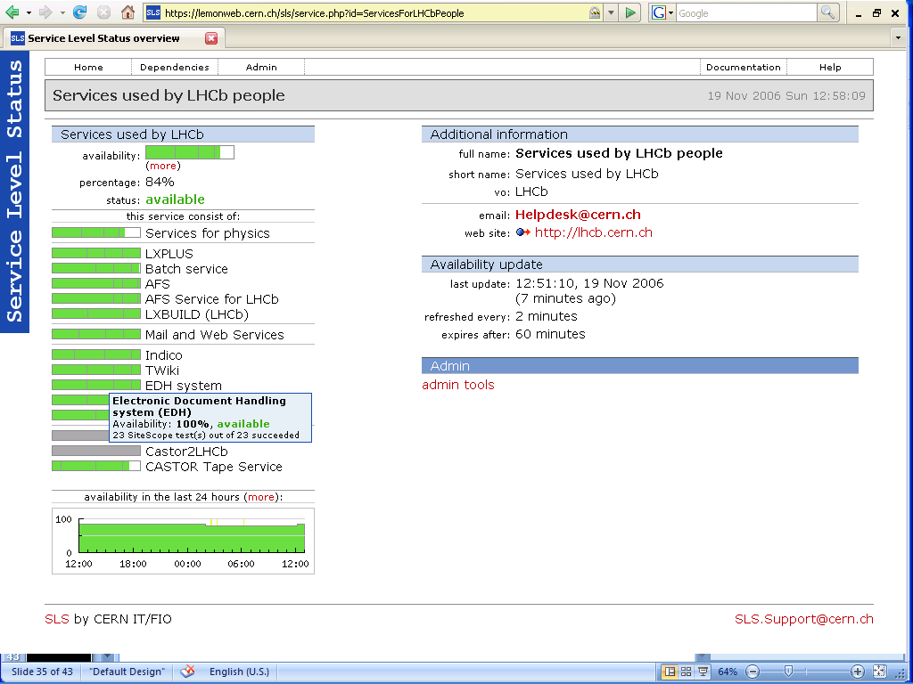
SLS Service Hierarchy

Slide 26
Challenges
Box Management
  Installation & Configuration
  Monitoring
  Workflow
What’s Going On?
Power & Cooling

Slide 27
Power & Cooling
Megawatts in need
  Continuity
    Redundancy where?
  Megawatts out
    Air vs Water
  Green Computing
    Run high…
    … but not too high
Containers and Clouds
You can’t control what you don’t measure

Slide 28
Thank You!
Thanks also to
Olof Bärring, Chuck Boeheim, German Cancio Melia, James Casey, James Gillies, Giuseppe Lo Presti, Gavin McCance, Sebastien Ponce, Les Robertson and Wolfgang von Rüden

