Slide 1
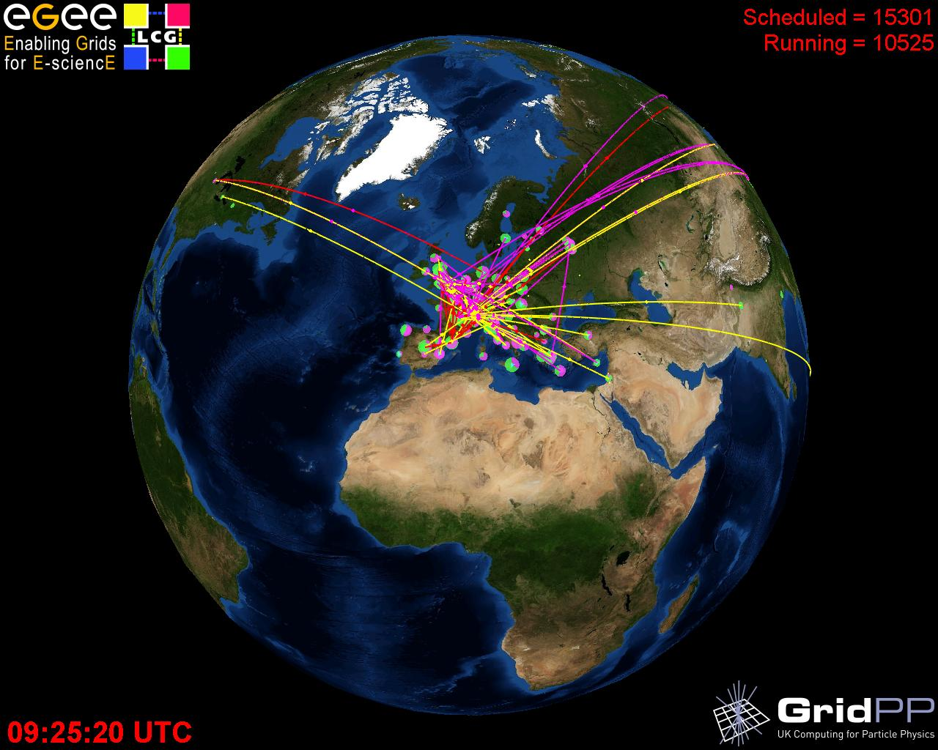


World wide LHC Computing Grid
WLCG
Markus Schulz
LCG Deployment
14 January 2009

Slide 2
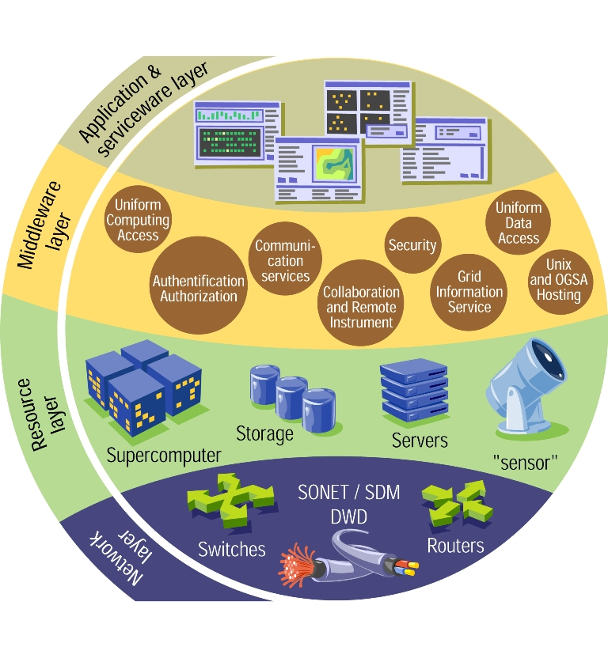
Outline
LHC, the computing challenge
  Data rate, computing , community
Grid Projects @ CERN
  WLCG, EGEE
gLite Middleware
  Code Base
  Software life cycle
EGEE operations
Outlook and summary

Slide 3
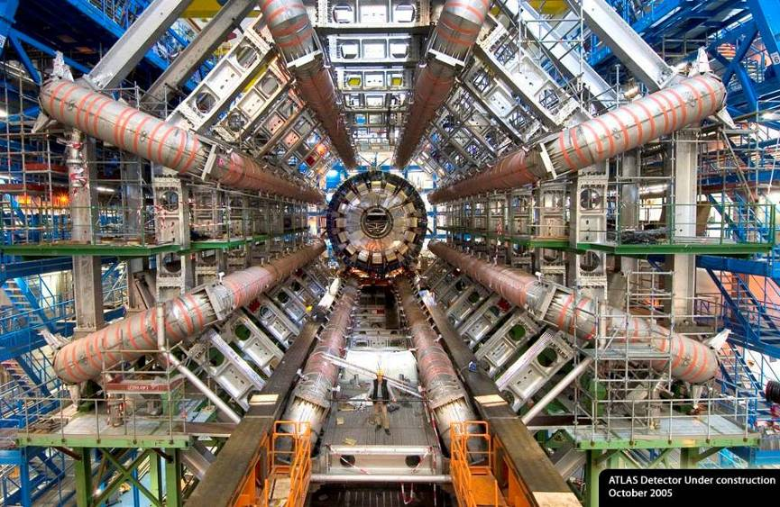
View of the ATLAS detector (under construction)
150 million sensors deliver data …
… 40 million times per second

Slide 4

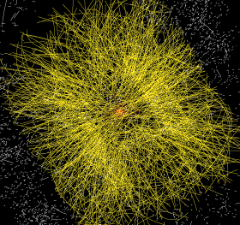

The LHC Computing Challenge
Signal/Noise 10⁻⁹
Data volume
  High rate * large number of channels * 4 experiments
  ➔ 15 PetaBytes of data each year
Compute power
  Event complexity * Nb. events * thousands users
  ➔ 200 k of (today's) fastest CPUs
Worldwide analysis & funding
  Computing funding locally in major regions & countries
  Efficient analysis everywhere
  ➔ GRID technology

Slide 5
Timeline: LHC Computing
ATLAS (or CMS) requirements
for first year at design luminosity
LHC approved
10⁷ MIPS
100 TB disk
7x10⁷ MIPS
1,900 TB disk
55x10⁷ MIPS
70,000 TB disk
(140 MSi2K)
ATLAS&CMS
CTP
“Hoffmann”
Review
Computing
TDRs
1994 | 1995 | 1996 | 1997 | 1998 | 1999 | 2000 | 2001 | 2002 | 2003 | 2004 | 2005 | 2006 | 2007 | 2008
LHCb
approved
ATLAS & CMS
approved
ALICE
approved
LHC start
Ever increasing requirements

Slide 6
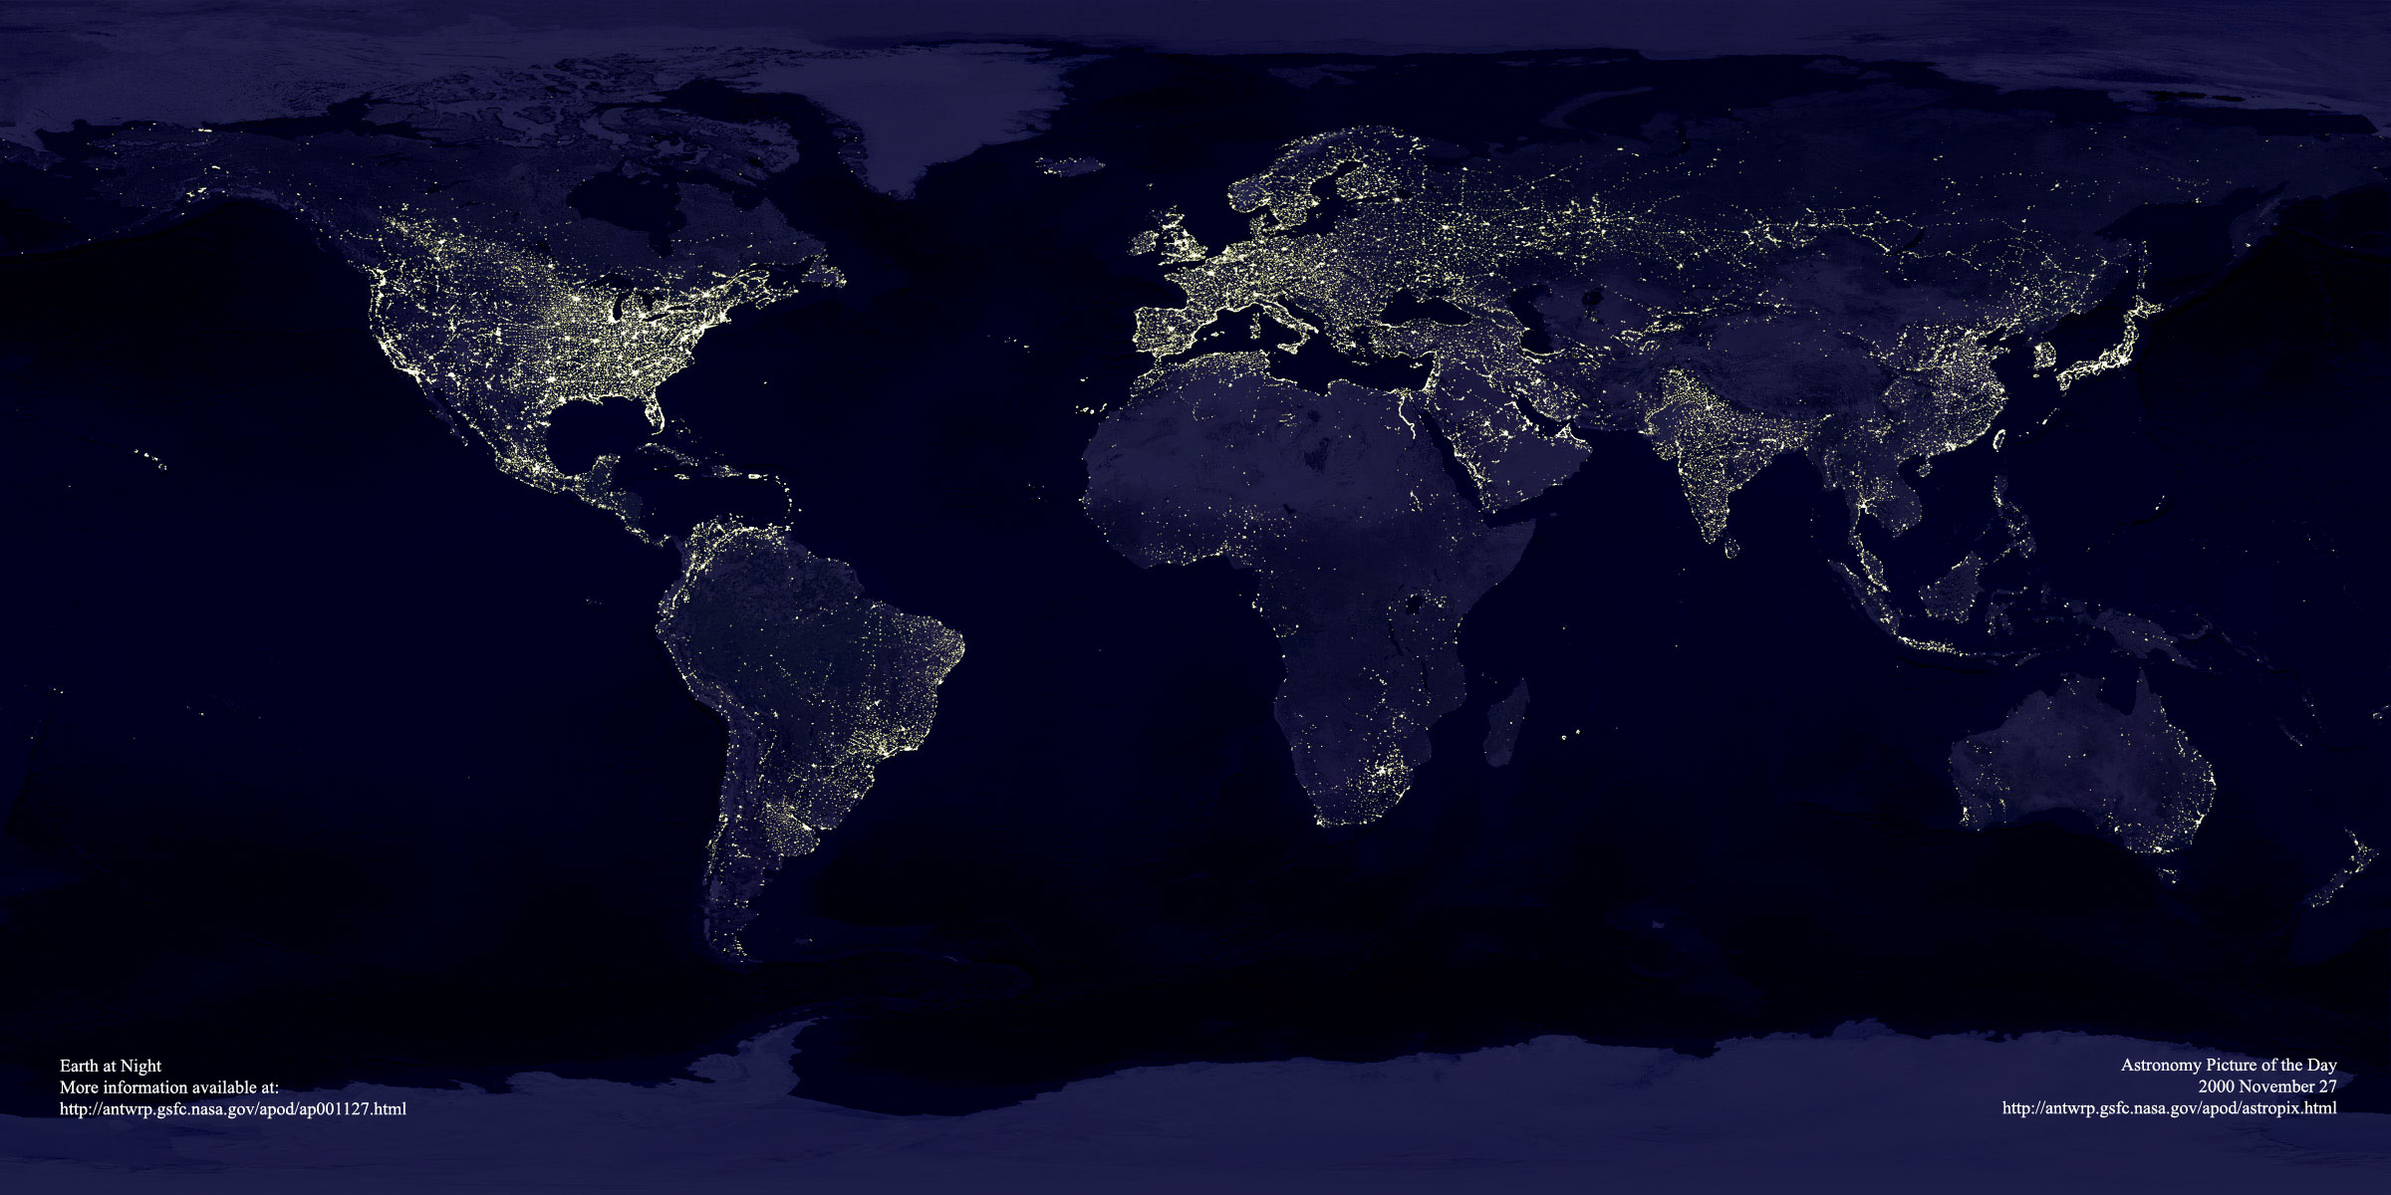
LHC
Over 6000 LHC Scientists world wide
70
637
4603
Outdated!!!
> 9500 CERN “Users”
22
87
538
55
27
10
Europe: 267 Institutes, 4603 Users
Other: 208 Institutes, 1632 Users

Slide 7
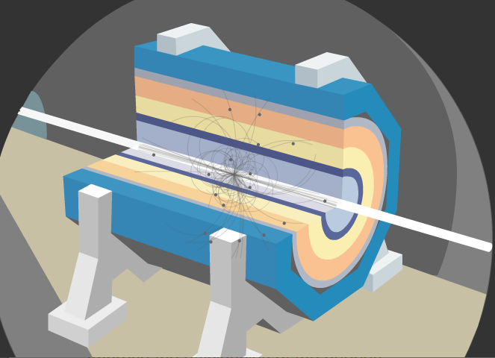
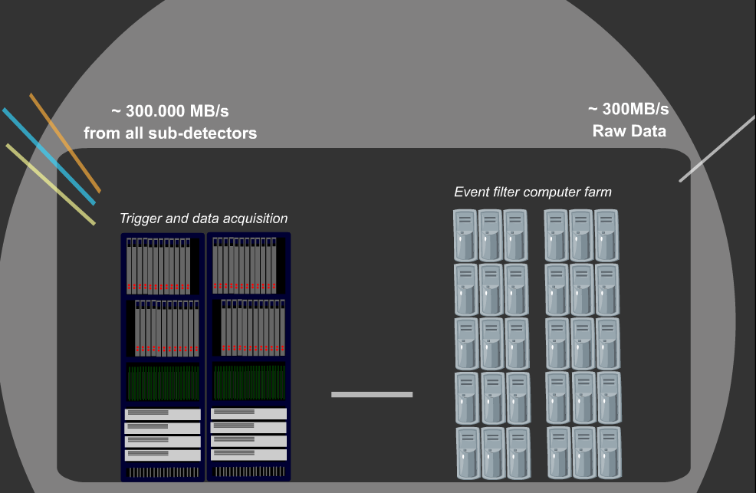
Data Flow

Slide 8
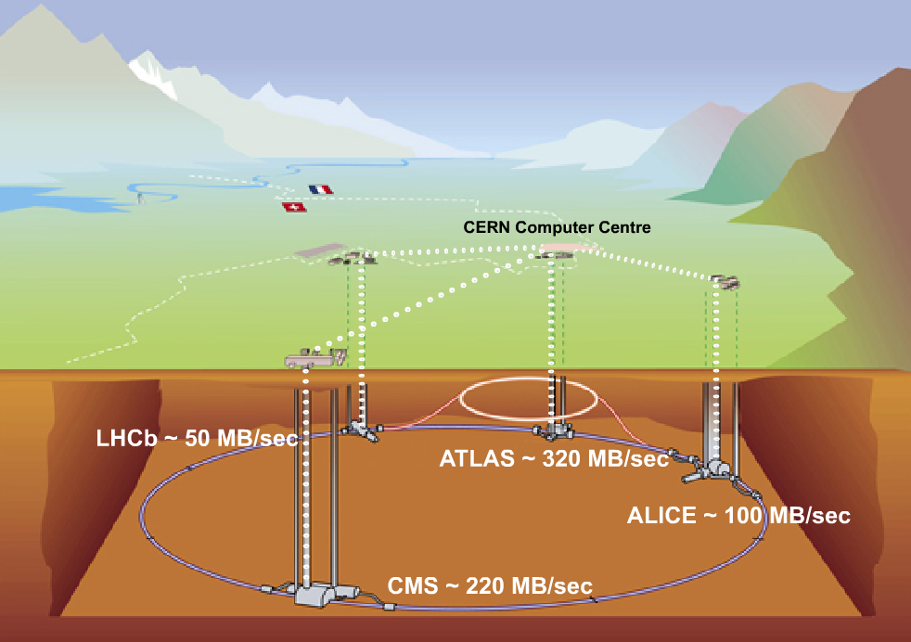
Flow to the CERN Computer Center
10Gbit
10Gbit
10Gbit
10Gbit

Slide 9
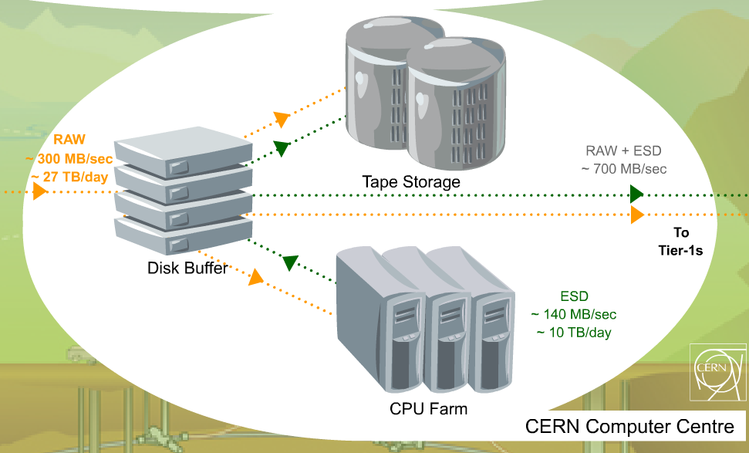
Flow out of the center
Total of 1.5 Gbyte/sec required

Slide 10
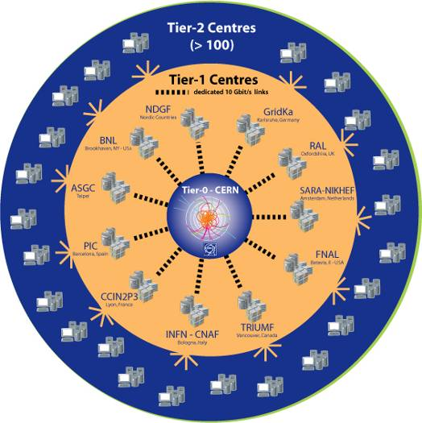

LHC Computing Grid project (LCG)
Dedicated 10Gbit links between T0 & T1s
Tier-0:
Data acquisition & initial processing
Long-term data curation
Distribution of data → Tier-1 centres
Tier-1 (11):
Managed Grid Mass Storage
Data-heavy analysis
National, regional support
Tier-2: ~200 in ~35 countries
Simulation
End-user analysis – batch and interactive
Nordic Data GRID Facility

Slide 11
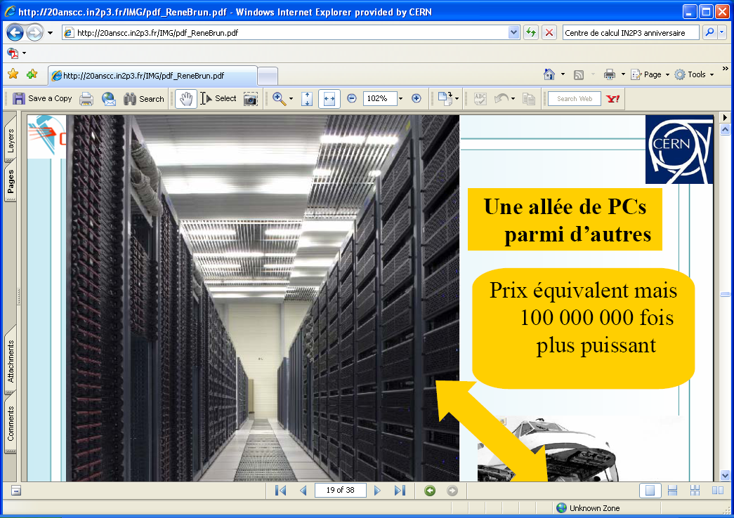
LHC DATA ANALYSIS
HEP code key characteristics
modest memory requirements
  2GB/job
performs well on PCs
independent events
→ trivial parallelism
large data collections (TB → PB)
shared by very large user
collaborations
For all four experiments
~15 PetaBytes per year
~200K processor cores
> 6,000 scientists & engineers

Slide 12



LHC Computing → Multi-science
1999 - MONARC project
  First LHC computing architecture – hierarchical
  distributed model
2000 – growing interest in grid technology
  HEP community main driver in launching the DataGrid project
2001-2004 - EU DataGrid project
  middleware & testbed for an operational grid
2002-2005 – LHC Computing Grid – LCG
  deploying the results of DataGrid to provide a production facility for LHC experiments
2004-2006 – EU EGEE project phase 1
  starts from the LCG grid
  shared production infrastructure
  expanding to other communities and sciences
2006-2008 – EU EGEE project phase 2
  expanding to other communities and sciences
  Scale and stability
  Interoperations/Interoperability
2008-2010 – EU EGEE project phase 3
  More communities
  Efficient operations
  Less central coordination
CERN

Slide 13
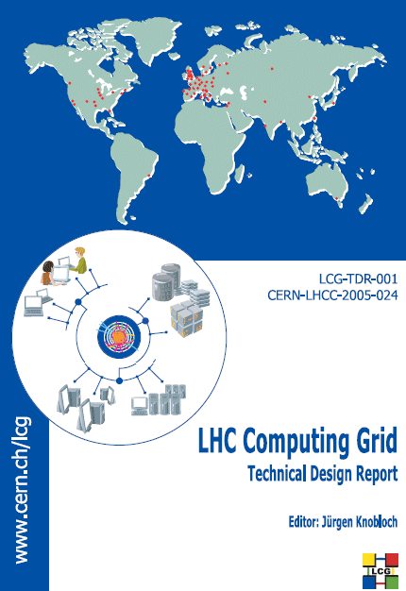


WLCG Collaboration
The Collaboration
  4 LHC experiments
  ~250 computing centres
  12 large centres
  (Tier-0, Tier-1)
  38 federations of smaller
  “Tier-2” centres
  Growing to ~40 countries
  Grids: EGEE, OSG, Nordugrid (NDGF)
Technical Design Reports
  WLCG, 4 Experiments: June 2005
Memorandum of Understanding
  Agreed in October 2005
Resources
  5-year forward look
Relies on EGEE and OSG
  and other regional efforts like NDGF

Slide 14

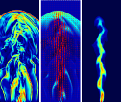

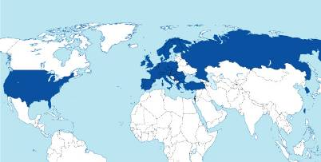
The EGEE project
EGEE
  Started in April 2004, now in second phase with 91 partners in 35 countries
  Now in it’s 3rd phrase (2008-2010)
Objectives
  Large-scale, production-quality
  grid infrastructure for e-Science
  Attracting new resources and
  users from industry as well as
  science
  Maintain and further improve
  “gLite” Grid middleware
Notes:
University of Chicago, USA Chicago
University of Southern California, USA USC
The Board of Regents of the University of Wisconsin System, Madison, WI USA UWisc-Madison
Renaissance Computing Institute, Chapel Hill, NC, US RENCI (University of North Carolina-Chapel Hill, Duke University and North Carolina State University.)

Slide 15


























Registered Collaborating Projects
25 projects have registered as of September 2007: web page
Infrastructures
geographical or thematic coverage
Applications
improved services for academia, industry and the public
Support Actions
key complementary functions
Notes:
15

Slide 16

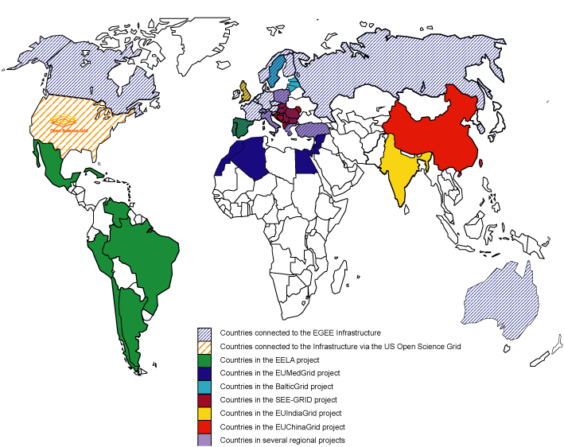





Collaborating infrastructures

Slide 17
Virtual Organizations
Total VOs: 204
Registered VOs: 116
Median sites per VO: 3
Total Users: 5034
Affected People: 10200
Median members per VO: 18
Notes:
Estimates are low – not all VOs are registered

Slide 18
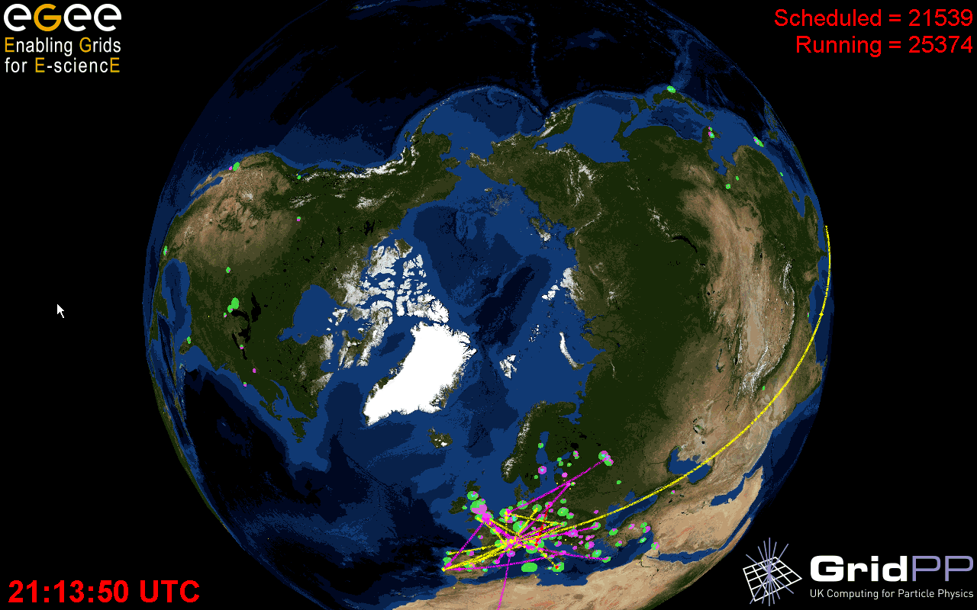
  Archeology
  Astronomy
  Astrophysics
  Civil Protection
  Comp. Chemistry
  Earth Sciences
  Finance
  Fusion
  Geophysics
  High Energy Physics
  Life Sciences
  Multimedia
  Material Sciences
  …
>250 sites
48 countries
>50,000 CPUs
>20 PetaBytes
>10,000 users
>200VOs
>550,000 jobs/day
Notes:
18

Slide 19

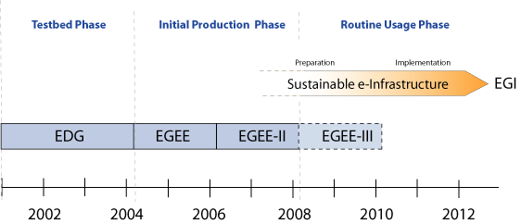
Sustainability
Need to prepare for permanent Grid infrastructure in Europe and the world
Ensure a high quality of service for all user communities
Independent of short project funding cycles
Infrastructure managed in collaboration
with National Grid Initiatives (NGIs)
European Grid Initiative (EGI)
Future of projects like OSG, NorduGrid, ... ?

Slide 20



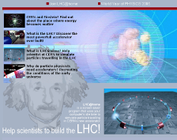
For more information:
www.eu-egee.org
www.opensciencegrid.org
www.cern.ch/lcg
www.eu-egi.org/
www.gridcafe.org
Notes:
20

Slide 21
WLCG Usage

Slide 22
LHC Computing Requirements

Slide 23

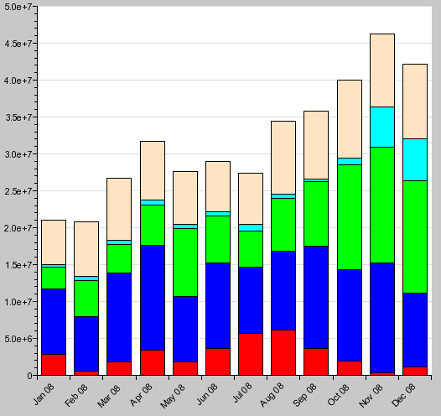
Grid Activity CPU Hours
380 Million kSpecInt2000 hours in 2008
26% non LHC

Slide 24
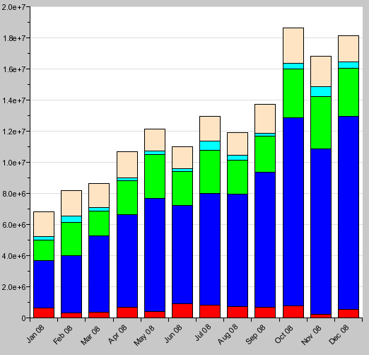
Grid Activity Jobs
150 Million Jobs in 2008
13% non LHC
600K Jobs/day

Slide 25
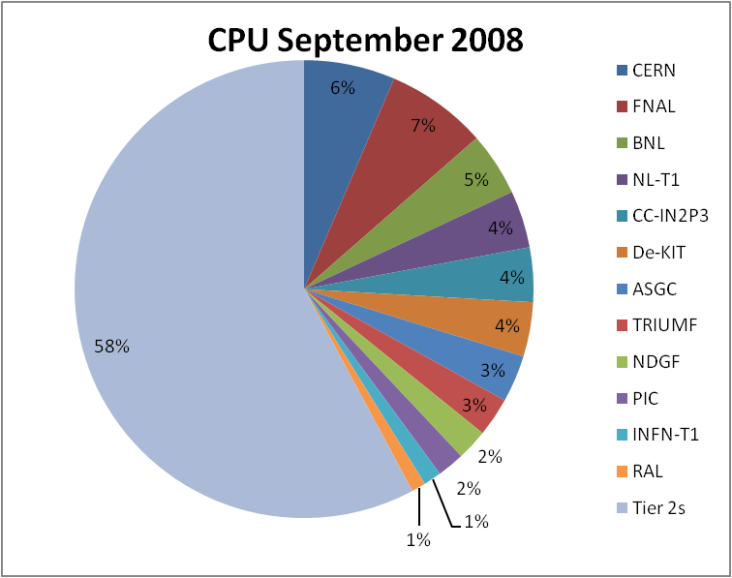
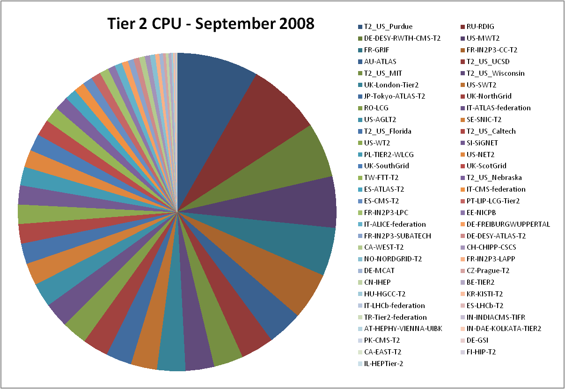
CPU Contributions
NDGF
Tier 2s
> 85% of CPU Usage is external to CERN
Distribution between T1s and T2s is t ask depending

Slide 26
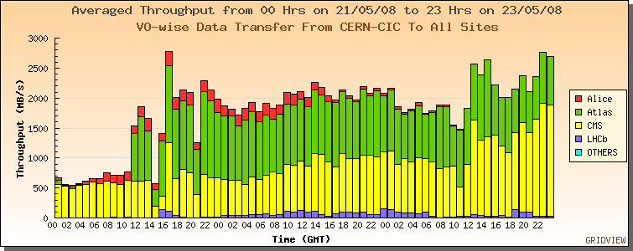
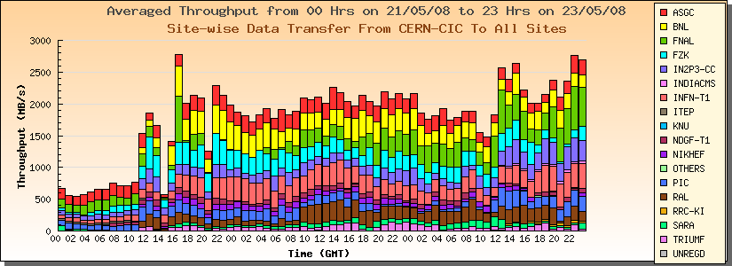
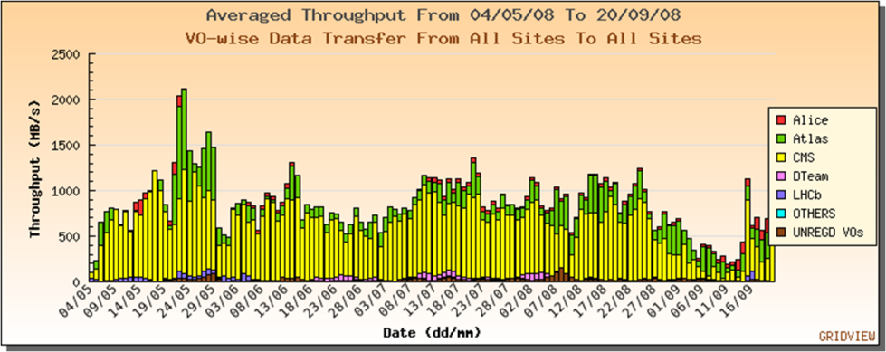

Data Transfers
2.8 Gbyte/sec
CERN → Sites
Sites → Sites

Slide 27
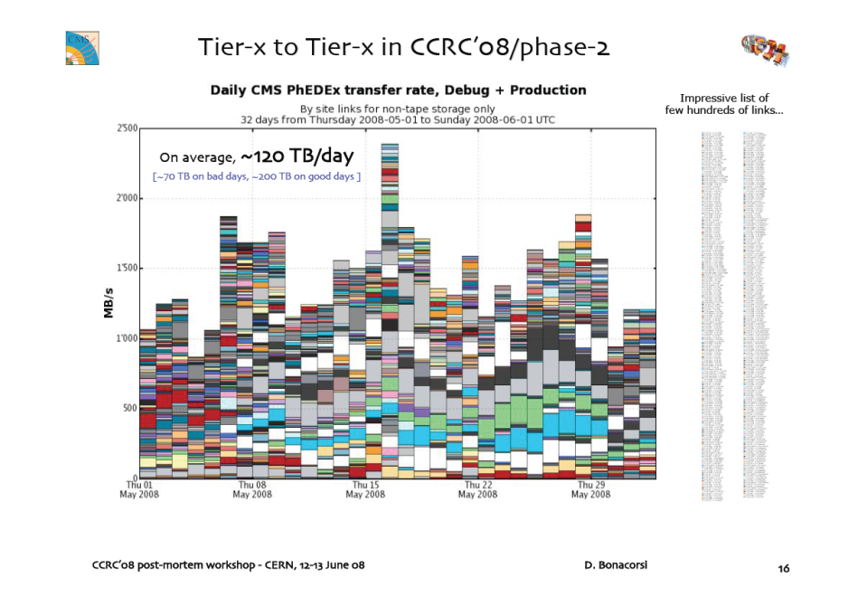
Site → Site Data Transfers (CMS)
Many, many sites

Slide 28
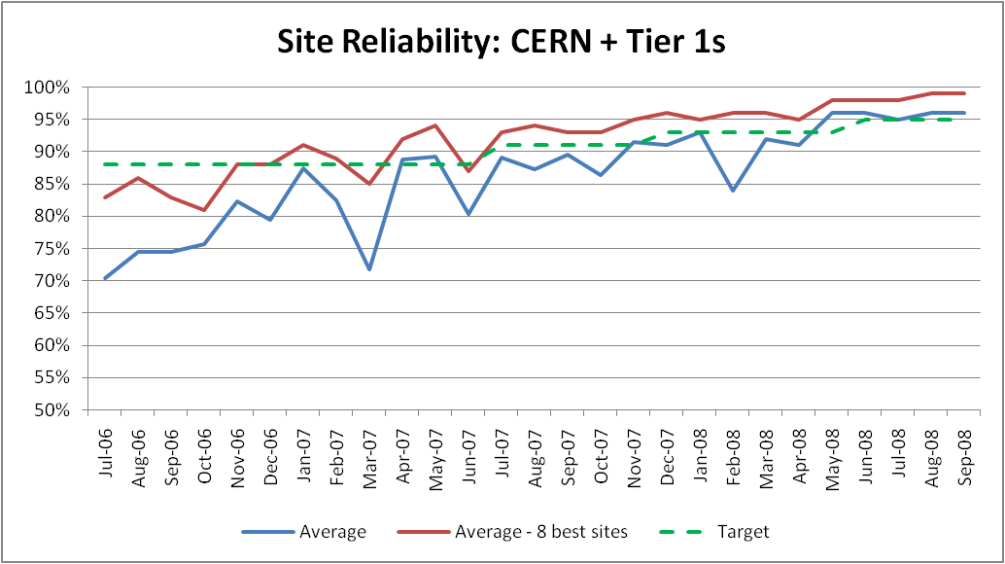
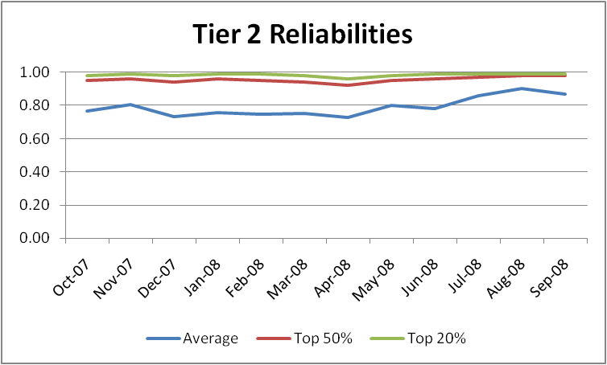
Site Reliability

Slide 29
Grid Computing at CERN
Core grid infrastructure services (~300 nodes)
  CA, VOMS servers, monitoring hosts, information system, testbeds
Grid Catalogues
  Using ORACLE clusters as backend DB
  20+ instances
Workload management nodes
  20+ WMS (different flavours, not all fully loaded)
  15+ CEs (for headroom)
Worker Nodes
  LSF managed cluster
  16000 cores, currently adding 12000 cores (2GB/core)
  We use node disks only as scratch space and for OS installation
Extensive use of fabric management
  Quattor for install and config, Lemon+Leaf for fabric monitoring

Slide 30
Grid Computing at CERN
Storage (CASTOR-2)
  Disk caches : 5 Pbyte (20k disks) mid 2008 additional 12k disks (16 PB)
  Linux boxes with RAID disks
  Tape storage: 18 PB (~30k cartidges)
  We have to add 10 PB this year ( the robots can be extended)
    700GB/cartridge
  Why tapes?
    still 3 times lower system costs
    long time stability is well understood
    The gap is closing
Networking
  T0 -> T1 dedicated 10Gbit links
  CIXP Internet exchange point for links to T2
  Internal: 10Gbit infrastructure

Slide 31

www.glite.org

Slide 32
gLite Middleware Distribution
Combines components from different providers
  Condor and Globus (via VDT)
  LCG
  EDG/EGEE
  Others
After prototyping phases in 2004 and 2005 convergence with LCG-2 distribution reached in May 2006
  gLite 3.0
  gLite 3.1 ( 2007)
Focus on providing a deployable MW
distribution for EGEE production service
LCG-2
gLite
2004
prototyping
prototyping
product
2005
product
2006
gLite 3.0

Slide 33
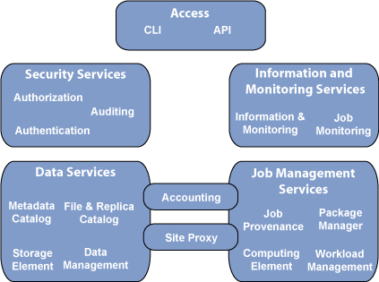

gLite Services
gLite offers a range of services

Slide 34

Middleware structure
Applications
Applications have access both to Higher-level Grid Services and to Foundation Grid Middleware
Higher-Level Grid Services are supposed to help the users building their computing infrastructure but should not be mandatory
Foundation Grid Middleware will be deployed on the EGEE infrastructure
  Must be complete and robust
  Should allow interoperation with other major grid infrastructures
  Should not assume the use of Higher-Level Grid Services
Higher-Level Grid Services
Workload Management
Replica Management
Visualization
Workflow
Grid Economies
...
Foundation Grid Middleware
Security model and infrastructure
Computing (CE) and Storage Elements (SE)
Accounting
Information and Monitoring
Overview paper http://doc.cern.ch//archive/electronic/egee/tr/egee-tr-2006-001.pdf

Slide 35









Standards
EGEE needs to interoperate with other infrastructures:
  To provide users with the ability to access resources available on collaborating infrastructures
The best solution is to have common interfaces through the development and adoption of standards.
The gLite reference forum for standardization activities is the Open Grid Forum
  Many contributions (e.g. OGSA-AUTH, BES, JSDL, new GLUE-WG, UR, RUS, SAGA, INFOD, NM, …)
Problems:
  Infrastructures are already in production
  Standards are still in evolution and often underspecified
OGF-GIN follows a pragmatic approach
  balance between application needs vs. technology push
GIN
35

Slide 36

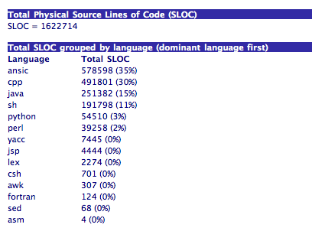
gLite code base

Slide 37
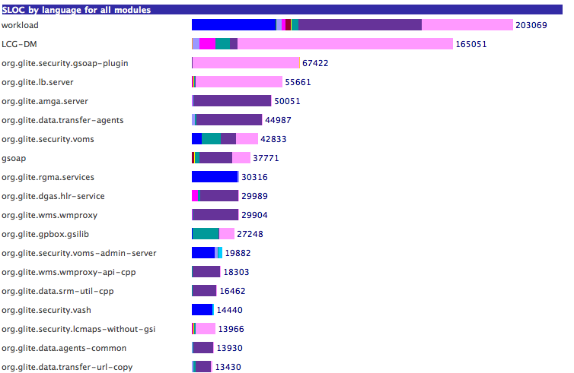
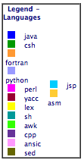
gLite code details

Slide 38
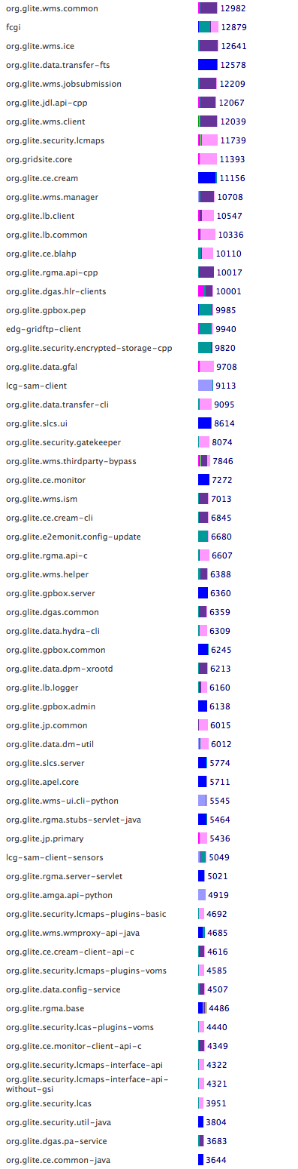
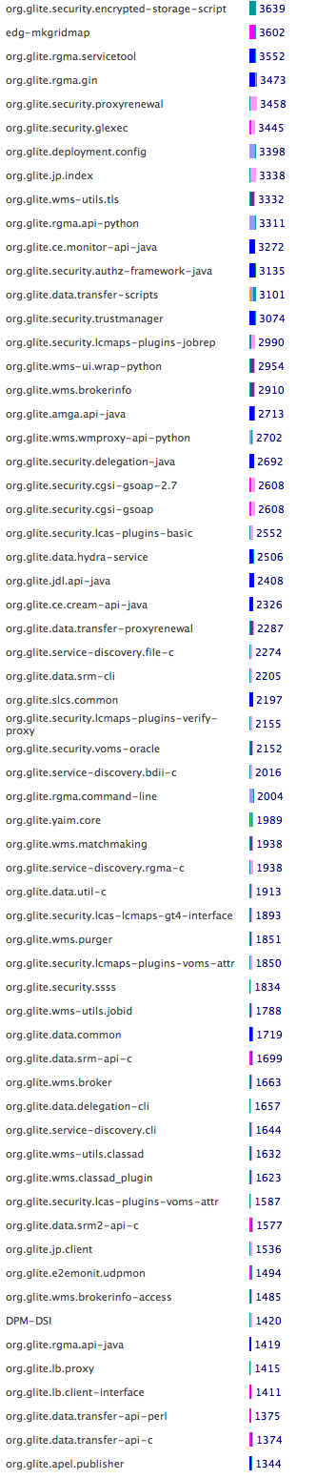
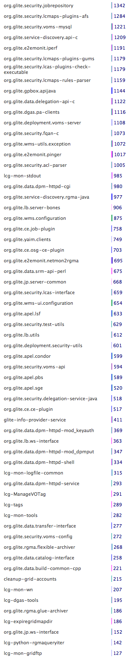
gLite code details
10K
5K
2K
1K

Slide 39
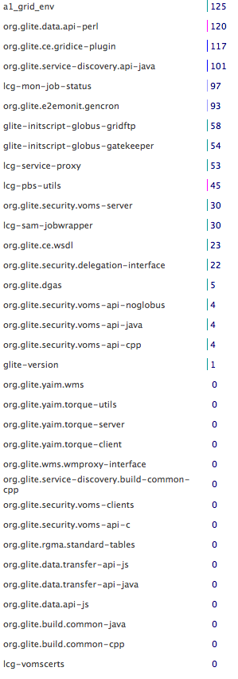
gLite code details
2K
The list is not complete. Some components are provided as binaries and are only packaged by the ETICS system

Slide 40
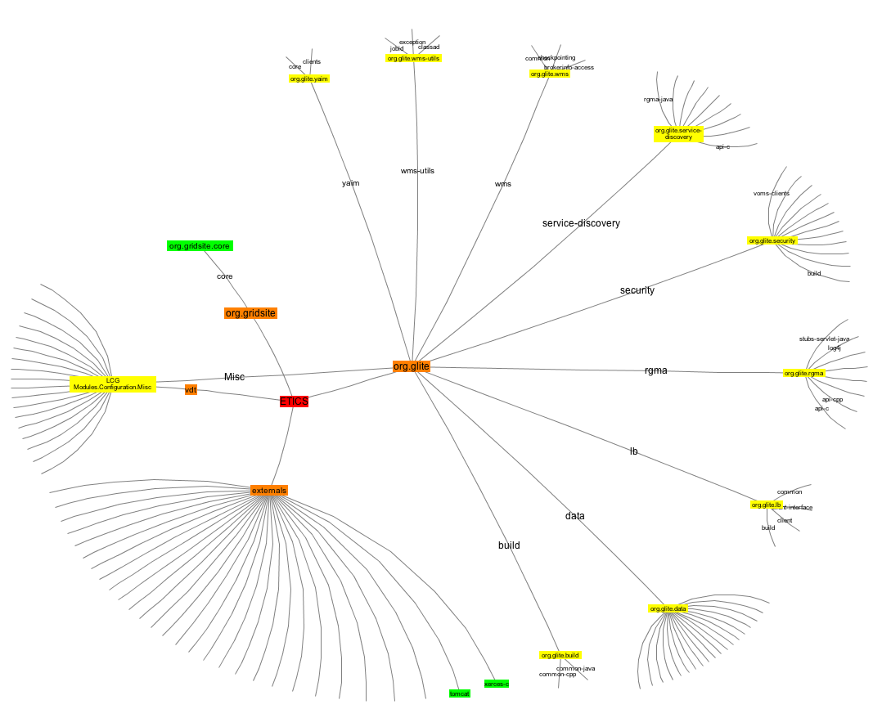
Complex Dependencies
Notes:
40

Slide 41
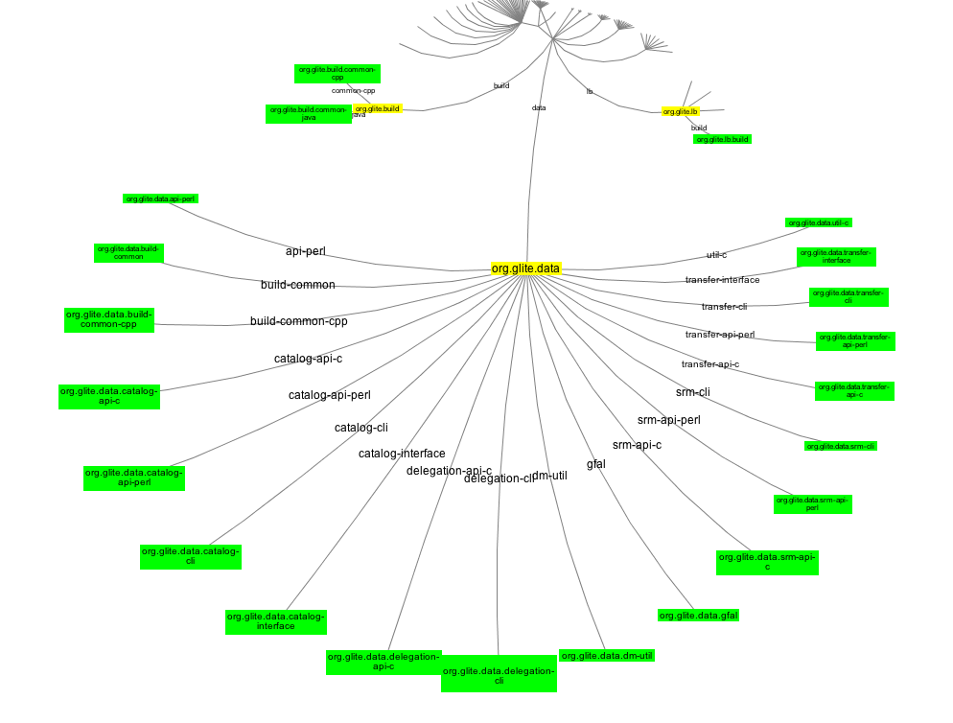
Data Management
Notes:
41

Slide 42
Component based software life cycle process
Weekly Releases

Slide 43
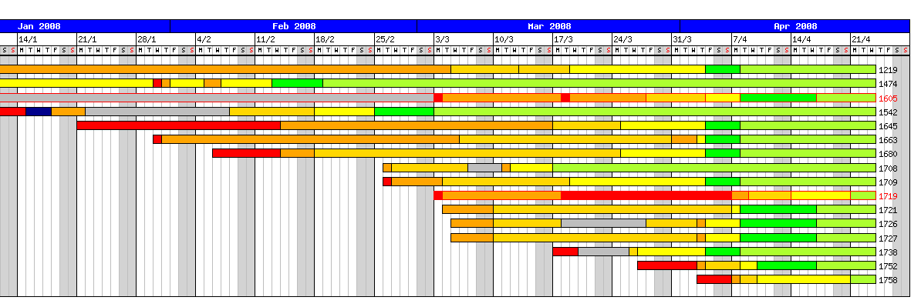
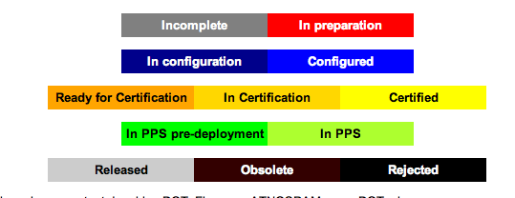
The Process is monitored
To spot problems and manage resources
Notes:
43

Slide 44
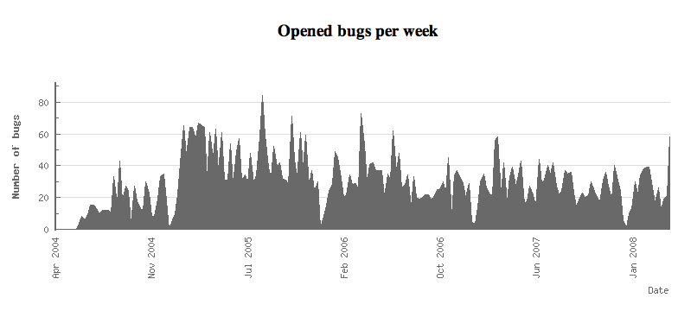
Change Management
This is a challenge
About 50 bugs/week
40 patches/ months
Almost constant rate
Notes:
44

Slide 45
Some Middleware components
www.glite.org

Slide 46
Authentication
gLite authentication is based on X.509 PKI
  Certificate Authorities (CA) issue (long lived) certificates identifying individuals (much like a passport)
    Commonly used in web browsers to authenticate to sites
  Trust between CAs and sites is established (offline)
  In order to reduce vulnerability, on the Grid user identification is done by using (short lived) proxies of their certificates
Support for Short-Lived Credential Services (SLCS)
  issue short lived certificates or proxies to its local users
    e.g. from Kerberos or from Shibboleth credentials (new in EGEE II)
Proxies can
  Be delegated to a service such that it can act on the user’s behalf
  Be stored in an external proxy store (MyProxy)
  Be renewed (in case they are about to expire)
  Include additional attributes

Slide 47
Authorization
VOMS is now a de-facto standard
  Attribute Certificates provide users with additional capabilities defined by the VO.
  Basis for the authorization process
Authorization: currently via mapping to a local user on the resource
  glexec changes the local identity (based on suexec from Apache)
Designing an authorization service with a common interface agreed with multiple partners
  Uniform implementation of authorization in gLite services
  Easier interoperability with other infrastructures
  Prototype being prepared now

Slide 48
Common AuthZ interface
OSG
Pilot job on Worker Node
(both EGEE and OSG)
CREAM
EGEE
pre-WS GT4 gk, gridftp, opensshd
GT4 gatekeeper,gridftp, (opensshd)
gt4-interface
edg-gk
dCache
glexec
edg-gridftp
Prima + gPlazma:
SAML-XACML
LCAS + LCMAPS
L&L plug-in: SAML-XACML
Common SAML XACML library
SAML-XACML Query
Q:
map.user.to.some.pool
R:
Oblg: user001, somegrp
<other obligations>
SAML-XACML interface
Common SAML XACML library
GPBox
Site Central: GUMS (+ SAZ)
Site Central: LCAS + LCMAPS
LCMAPS
plug-in
L&L plug-ins

Slide 49
Information System
The information system is used for:
  Service discovery ( what kind of services are around)
  Service state monitoring ( up/down, resource utilization)
  It is the nervous system of LCG
  Availability and scalability are the key issues
gLite uses the GLUE schema (version 1.3)
  abstract modeling for Grid resources and mapping to concrete schemas that can be used in Grid Information Services
  The definition of this schema started in April 2002 as a collaboration effort between EU-DataTAG and US-iVDGL projects
The GLUE Schema is now an official activity of OGF
  Starting points are the Glue Schema 1.3 the Nordugrid Schema and CIM (used by NAREGI)
  GLUE 2.0 has been standardized and will be introduced during the next year(s)

Slide 50
Information System Architecture
FCR
DNS Round
Robin Alias
Top
BDII
Top
BDII
DNS Round
Robin Alias
One
Many (80)
Query
Query
Site
BDII
Site
BDII
>260
Resource
BDII
Resource
BDII
Resource
BDII
Resource
BDII
>260 * 5
Provider
Provider
Provider
Provider

Slide 51
Performance Improvements
Log Scale!

Slide 52
EGEE/LCG Data Management
VO
Frameworks
User Tools
lcg_utils
FTS
Data Management
GFAL
Cataloging
Storage
Data transfer
Information System/Environment Variables
Vendor
Specific
APIs
(RLS)
LFC
SRM
(Classic
SE)
gridftp
RFIO

Slide 53
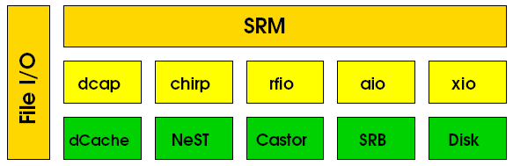
Storage Element
Storage Resource Manager (SRM)
  Standard that hides the storage system implementation (disk or active tape)
  handles authorization
  Web service based on gsoap
  translates SURLs (Storage URL) to TURLs (Transfer URLs)
  disk-based: DPM, dCache,Storm, BeSTman; tape-based: Castor, dCache
  SRM-2.2
    Space tokens (manage space by VO/USER), advanced authorization,
    Better handling of directories, lifetime, +++++++
File I/O: posix-like access from local nodes or the grid
  GFAL (Grid File Access Layer)

Slide 54






Storage Element - DPM
/dpm
/domain
/home
Disk Pool Manager (DPM)
  Manages storage on disk servers
Uses LFC as local catalog
  Same features for role based ACLs, etc...
DPM
head
node
/vo
file
(uid, gid)
Client
data transfer
DPM disk servers
Direct data transfer from/to disk server (no bottleneck)
External transfers via gridFTP (de-facto standard)
Target: small to medium sites
  One or more disk servers
54
Notes:
54

Slide 55



LCG File Catalog
LFC maps LFNs to SURLs
  Logical File Name (LFN): user file name
    in VO namespace, aliases supported
  Glbally Unique IDentifier (GUID)
    unique string assigned by the system to the file
  Site URL (SURL): identifies a replica
LFC
LFN 1
SURL 1
GUID
LFN 2
SURL 2
ACL
  A Storage Element and the logical name of the file inside it
GSI security: ACLs (based on VOMS)
  To each VOMS group/role corresponds a virtual group identifier
  Support for secondary groups
Web Service query interface: Data Location Interface (DLI)
Hierarchical Namespace
Supports sessions and bulk operations
/grid
/vo
/data
lfc-ls –l /grid/vo/
LFC
DLI
file
lfc-getacl /grid/vo/data

Slide 56
Encrypted Data Storage
Intended for VO’s with very strong security requirements
  e.g. medical community
    anonymity (patient data is separate)
    fine grained access control (only selected individuals)
    privacy (even storage administrator cannot read)
Interface to DICOM (Digital Image and COmmunication in Medicine)
Hydra keystore
  store keys for data encryption
N instances
  Decryption works with subset of stores
2. retrieve
keys
1. patient look-up
3. get
TURL
4. read
Hydra
gridftp
SRM
I/O
AMGA
Metadata
DPM
0. store
encrypted
image
&ACL
0. store
patient
data
&ACL
0. store
keys
&ACL
Trigger
0. retrieve
image
DICOM

Slide 57
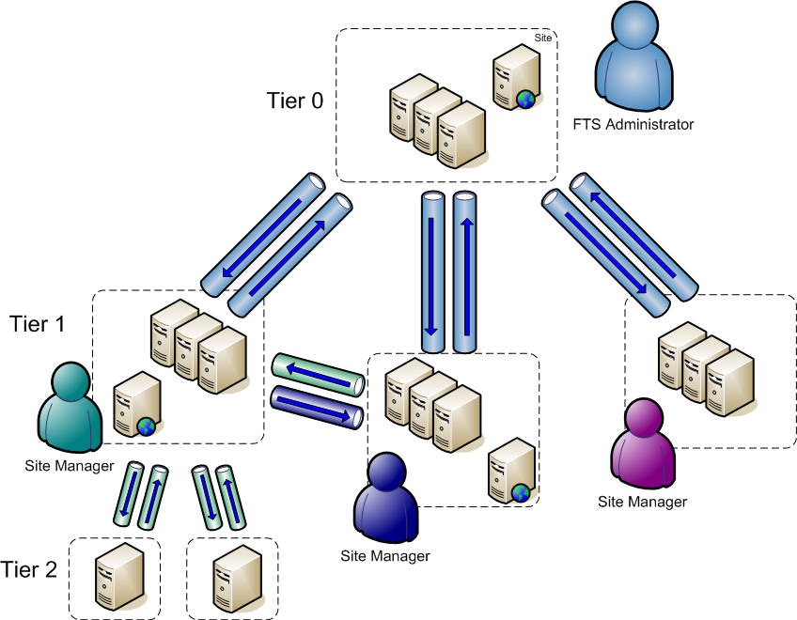

File Transfer Service
FTS: Reliable, scalable and customizable file transfer
  Multi-VO service, used to balance usage of site resources according to the SLAs agreed between a site and the VOs it supports
  WS interface, support for different user and administrative roles (VOMS)
  Manages transfers through channels
    mono-directional network pipes between two sites
  File transfers handled as jobs
    Prioritization
    Retries in case of failures
  Automatic discovery of services
Designed to scale up to the transfer needs of very data intensive applications
  Demonstrated about 1 GB/s sustained
  Over 9 petabytes transferred in the last 6 months (> 10 million files)
57

Slide 58
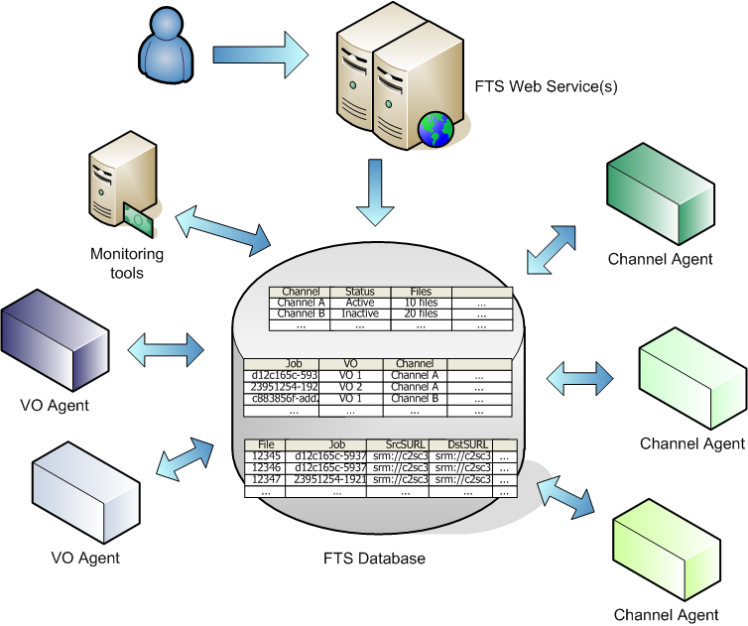
FTS server architecture
Experiments interact via a
web-service
VO agents do VO-specific operations (1 per VO)
Channel agents do channel specific operation (e.g. the transfers)
Monitoring and statistics can be collected via the DB
All components are decoupled from each other
  Each interacts only with the (Oracle) database

Slide 59
High Level Services: Catalogues
File Catalogs
  LFC from LCG
    Fully VOMS aware
    Readonly replicas
    MySQL and ORACLE
  Hydra: distributed key stores for data encryption
  AMGA Metadata Catalog: generic metadata catalogue
    Joint JRA1-NA4 (ARDA) development. Used mainly by Biomed
    Released for Postgres and ORACLE

Slide 60
Job Management Services
User Interface
Information System
Workload Management
Logging & Bookkeeping
submit
query
retrieve
discover
services
update
credential
publish
state
query
submit
publish
state
retrieve
File and Replica
Catalogs
Site X
Computing Element
Storage Element
Authorization
Service

Slide 61
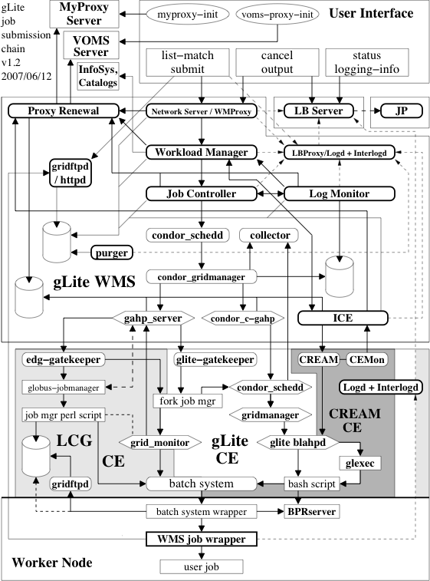
Workload Management (compact)
Desktops
A few
~50 nodes
Legacy Service
1-20 per site
BES standard Compliant
1-24000
per site
Notes:
61

Slide 62
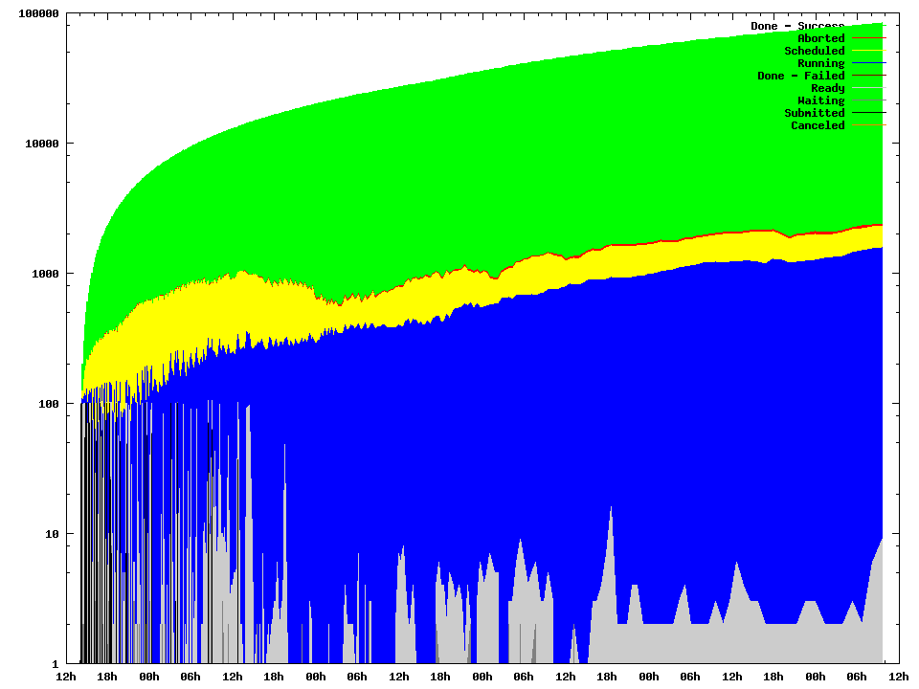
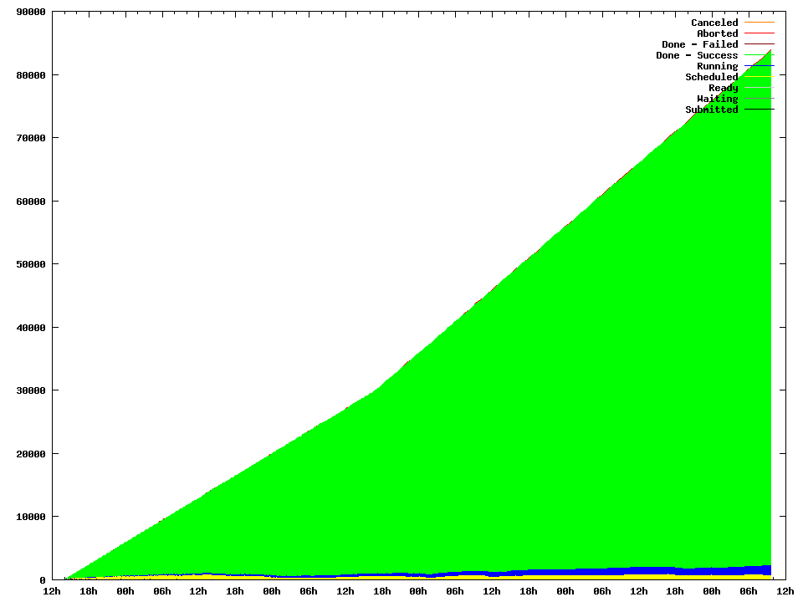
Workload Management System
Workload Management System
  Assigns jobs to resources according to user requirements
    possibly including data location and user defined ranking of resources
  Handles I/O data (input and output sandboxes)
  Supports compound jobs and workflows (Direct Acyclic Graphs)
    One shot submission of a group of jobs, shared input sandbox
  Has a Web Service interface: WMProxy
    UI→WMS decoupled form WMS→CE
  Supports automatic re-submissions
Logging&Bookkeeping
  Tracks jobs while they are running
Job Provenance
  Store and retain data on finished jobs
  Provides data mining capabilities
  Allows job re-execution
  Prototype!
20000 jobs/day
Scalability!!!
15000 jobs/day

Slide 63
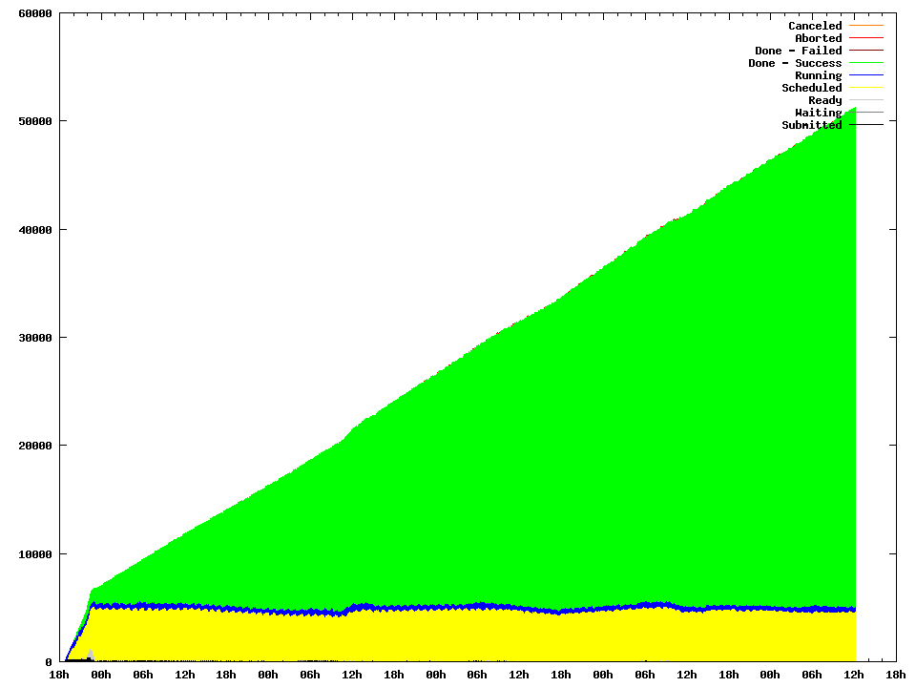
CREAM status
CREAM passed the EGEE accepatance tests
  > 90000 jobs in 8 days by 50 simultaneous users
  111 failures (all LSF errors)
CREAM
~ 6 K jobs on the CE at any time
Run phase:
~10 K jobs/day
Scalability!!!
Load phase:
~ 1 K jobs/hour
}
Introduction to production started in summer 2008

Slide 64
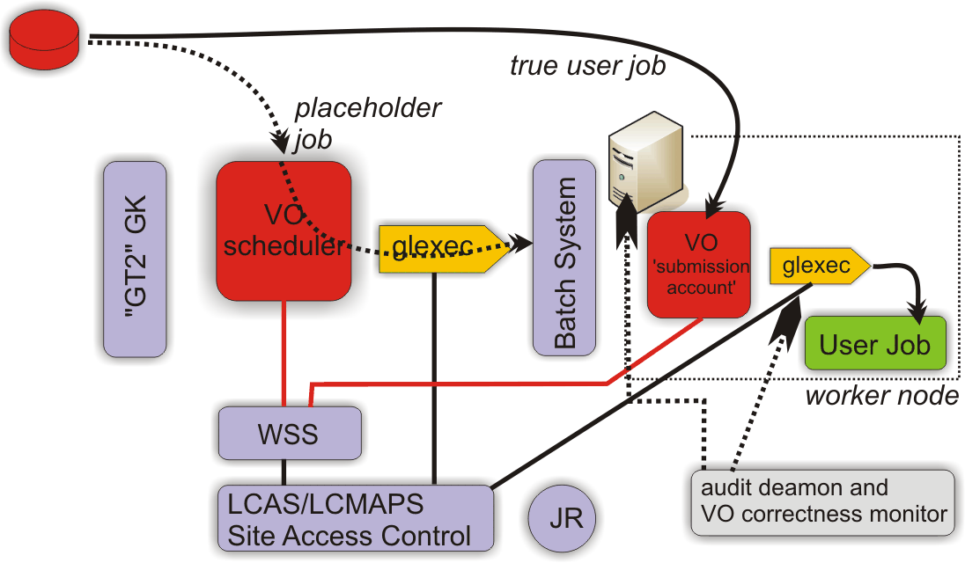
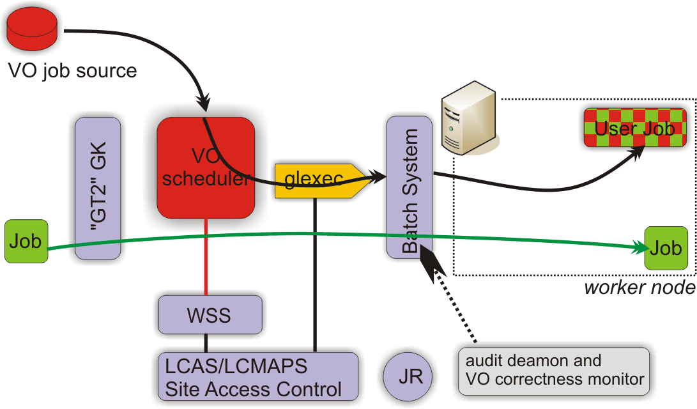
Coming: support for pilot jobs
Several VOs submit pilot jobs with a single identity for all of the VO
  The pilot job gets the user job when it arrives on the WN and executes it
    Just-in-time scheduling. VO policies implemented at the central queue
Use the same mechanism for changing the identity on the Computing Element also on the Worker Nodes (glexec)
  The site may know the identity of the real user

Slide 65
Why Interoperability Matters
CREAM
Nordugrid
ARC
EGEE
LSF
PBS/Torque
GRAM
v2
Sun Grid Engine
Unicore
OSG
Load Leveler
DEISA
GRAM
v4
Condor
NAREGI
Teragrid
Naregi
Large number of batch systems and CEs

Slide 66




Interoperability models
Gateways
User driven
parallel infr.
Gateway
Long term Solution: Common Standards
Site driven
parallel infr.
Adaptors and
Translators
Plugin
API
Plugin

Slide 67



Google Earth Demo
EGEE
OSG
Naregi
Teragrid
Pragma
Nordugrid

Slide 68

The distributed EGEE/LCG Operations Infrastructure
Support Structures & Processes
Operations Coordination Centre
Regional Operations Centres
Test-beds & Services
Global Grid User Support
Production Service
EGEE Network Operations Centre (SA2)
Pre-production service
Operational Security Coordination Team
Certification test-beds (SA3)
Training infrastructure (NA4)
Training activities (NA3)
Security & Policy Groups
Joint Security Policy Group
EuGridPMA (& IGTF)
Grid Security Vulnerability Group
Operations Advisory Group (+NA4)

Slide 69
User Support
GGUS – now well established
  Grid wide distributed user support
  Interfaced to regional support structures
No. Tickets Processed
Operations Network User All
Up to 1300 Tickets/Month

Slide 70
Security & Policy
Incident
Response
Collaborative policy development
  Many policy aspects are collaborative works; e.g.:
Joint Security Policy Group
Certification Authorities
  EUGridPMA → IGTF, etc.
Grid Acceptable Use Policy (AUP)
  common, general and simple AUP
  for all VO members using many Grid infrastructures
    EGEE, OSG, SEE-GRID, DEISA, national Grids…
Incident Handling and Response
  defines basic communications paths
  defines requirements (MUSTs) for IR
  not to replace or interfere with local response plans
Certification
Authorities
Audit
Requirements
Usage
Rules
Security & Availability
Policy
VO
Security
User Registration
& VO Management
Application Development
& Network Admin Guide
Grid Security Vulnerability Group
  Manages vulnerabilities
  Risk analysis
Operational Security Coordination
  day-to-day security work
  Incident response and follow up
  Grid Security Officer

Slide 71
Grid Monitoring
The critical activity to achieve reliability and stability
System Management
Fabric management
Best Practices
Security
…….
Grid Services
Grid sensors
Transport
Repositories
Views
…….
System Analysis
Application monitoring
……
“ … improving system management practices,
Provide site manager input to requirements on grid monitoring and management tools
Propose existing tools to the grid monitoring working group
Produce a Grid Site Fabric Management cook-book
Identify training needs
“… To help improve the reliability of the grid infrastructure …”
“ … provide stakeholders with views of the infrastructure allowing them to understand the current and historical status of the service …”
“ … to gain understanding of application failures in the grid environment and to provide an application view of the state of the infrastructure …”

Slide 72

Prototype site implementation

Slide 73


GridMap Prototype Visualization
Enabling Grids for E-sciencE
Link: http://gridmap.cern.ch
Drilldown into region by clicking on the title
Grid topology view (grouping)
Metric selection for size of rectangles
Metric selection for colour of rectangles
VO selection
Overall Site or Site Service selection
Show SAM status
Show GridView availability data
Context sensitive information
Description of current view
Colour Key
EGEE-II INFSO-RI-031688
LHCC Comprehensive Review; 19-20 November 2007

Slide 74

Availability metrics - GridView

Slide 75
Experience Gained
Middleware flavor is almost irrelevant
  As long as some minimal functionality is provided
    Authentication, Authorization, Accounting, robustness, scalability
    Leave complex services to user communities
Distributed Operations is the challenge
  Policies, Security, Monitoring, User Support…….
  Upgrades take months…
1300 tickets/month
No. Tickets Processed
Operations Network User All

Slide 76
Experience Gained
We have been victims of our own success
  Moved prototypes into production very early
    Complex software stack
      Didn’t understood the right split ( lightweight WNs)
    Hard to port to other platforms
  Since we have users we can only slowly migrate to new approaches (standards)
Interoperability/Interoperation
  Is absolutely a key area
    All middleware that is sufficiently fit will survive
  OSG 100%
  Prototypes: ARC, Unicore, Naregi
Standards have to follow practice
  OGF only recently agrees to this concept

Slide 77
Summary
The grid production infrastructure for LHC computing is available
In the next years the focus will be on:
  Scaling (jobs and data management)
    Handle chaotic use cases (analysis)
    Data management for analysis
  Monitoring to improve:
    Availability and Reliability
    Automate more (reduce operations cost)
  Interoperation
Lessons Learned:
  Operations is the hardest part in grid computing
  A strict, monitored software lifecycle is essential
  Keep the software as simple as possible
  You can’t monitor too much

