Slide 1



ATLAS Forward Calorimeter’s Analysis : Electrons-Position Resolution
University
Mohammed I
Physics of Matter and Radiation Laboratory
Faculty of Sciences
Oujda
KTH/ FSO meeting
13/ 01/ 2016
Malika TOUIL – Yahya TAYALATI

Slide 2

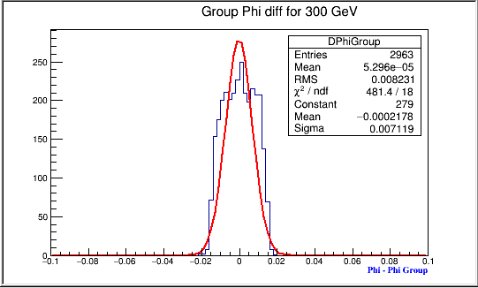
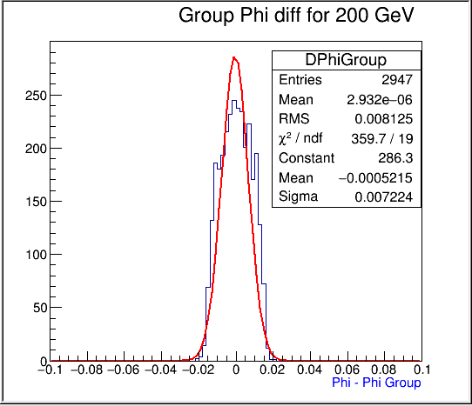
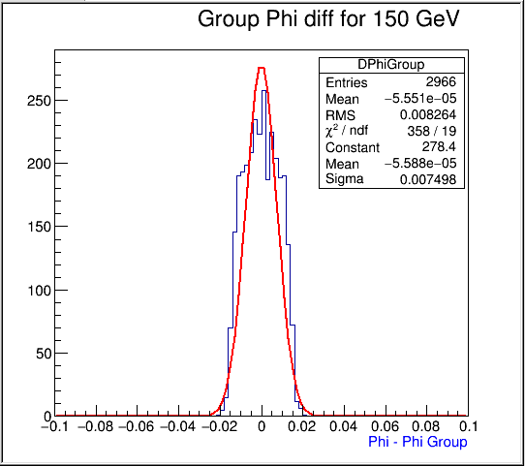
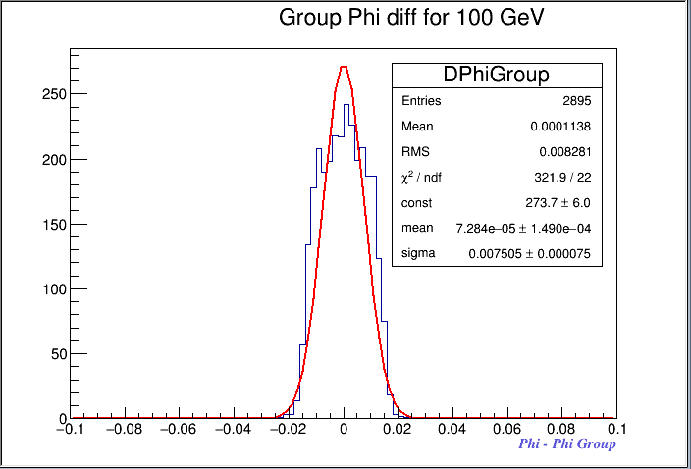

φ group
$\text{3.1 }\text{< }{\text{η}}_{ truth}$ < 3.2
2

Slide 3
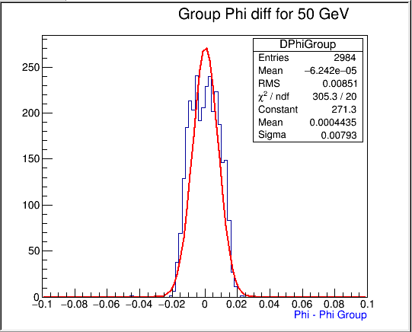
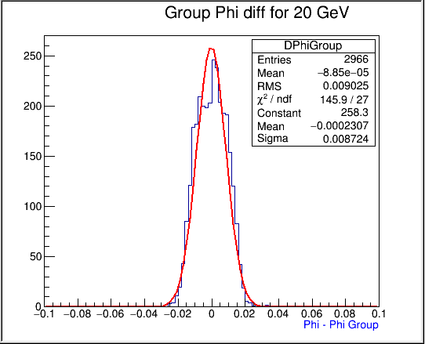
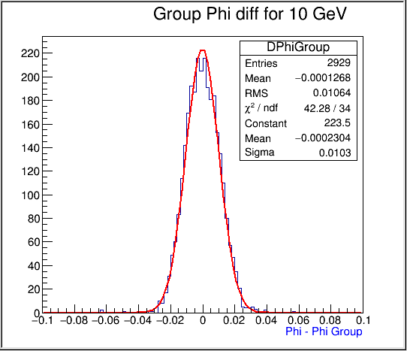
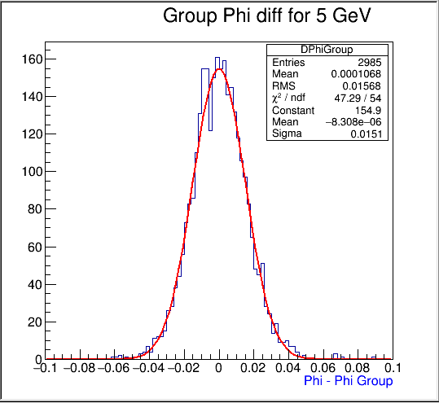
φ group
$\text{3.1 }\text{< }{\text{η}}_{ truth}$ < 3.2
3

Slide 4
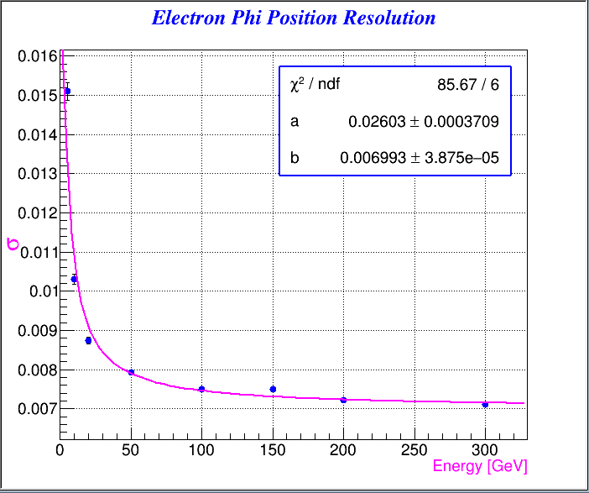


φ group Position Resolution
$$a=26.03 mrad\sqrt{GeV}$$
b$=7$mrad
4

Slide 5
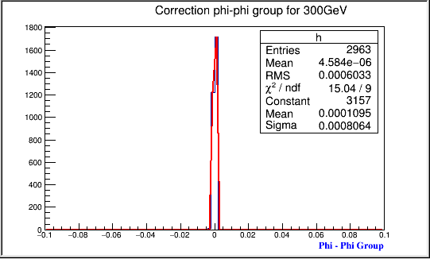
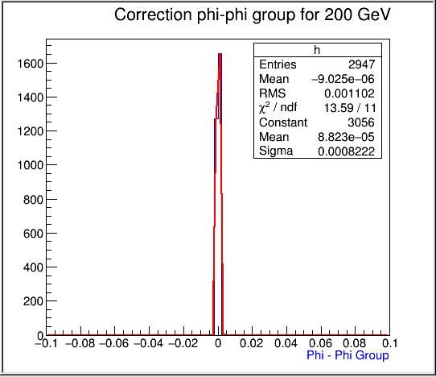
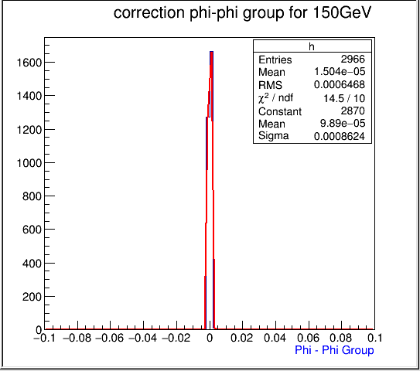
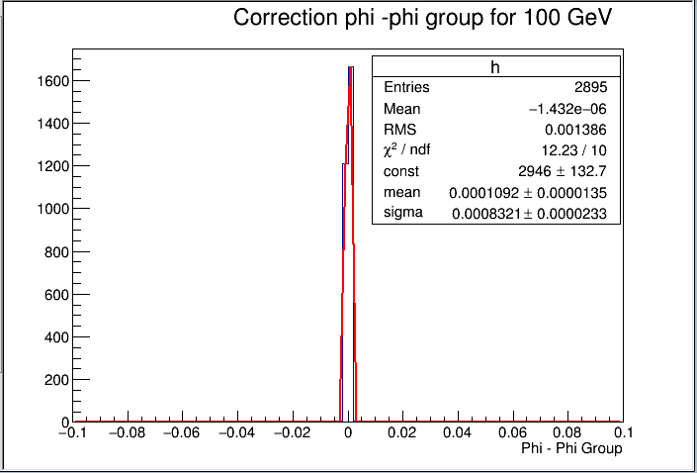
φ group corrected
$\text{3.1 }\text{< }{\text{η}}_{ truth}$ < 3.2
5

Slide 6
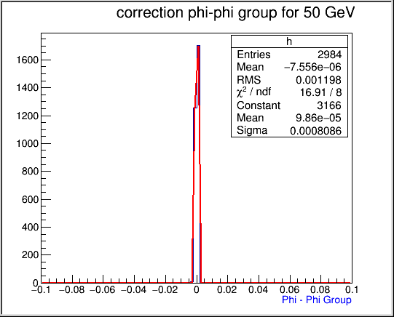
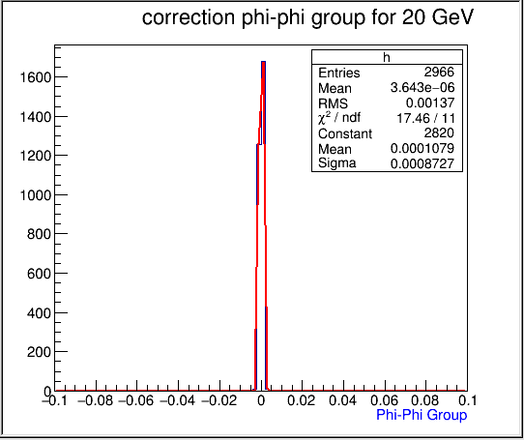
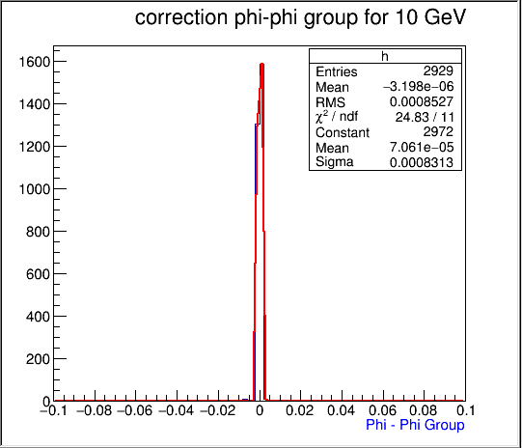
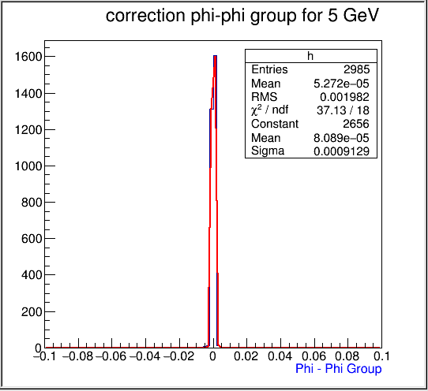
φ group corrected
$\text{3.1 }\text{< }{\text{η}}_{ truth}$ < 3.2
6

Slide 7
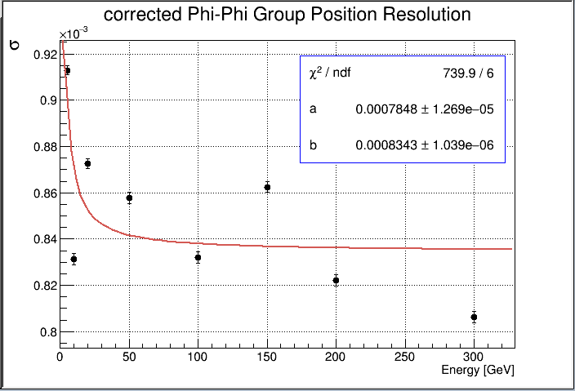
Corrected φ group Position Resolution
7

Slide 8
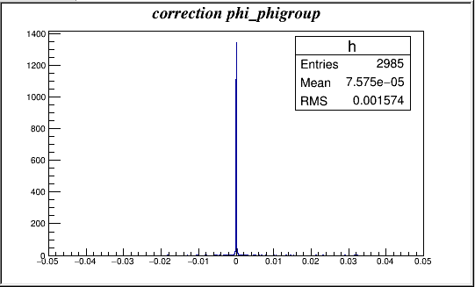
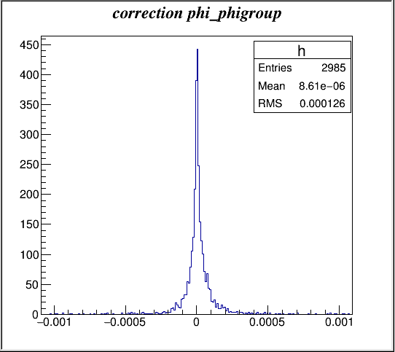
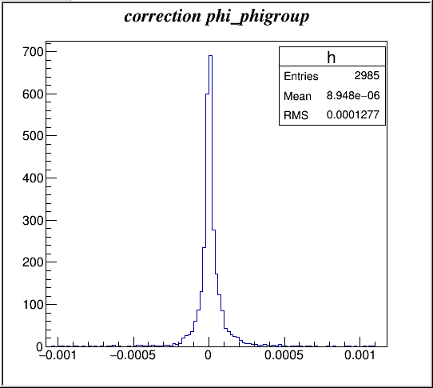
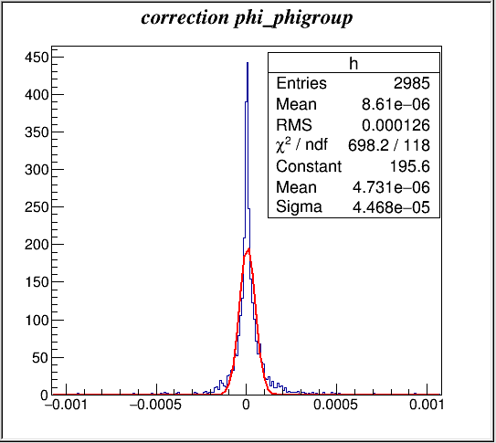
Example of 5 GeV
nbr of bins = 1000
nbr of bins = 500
8

Slide 9
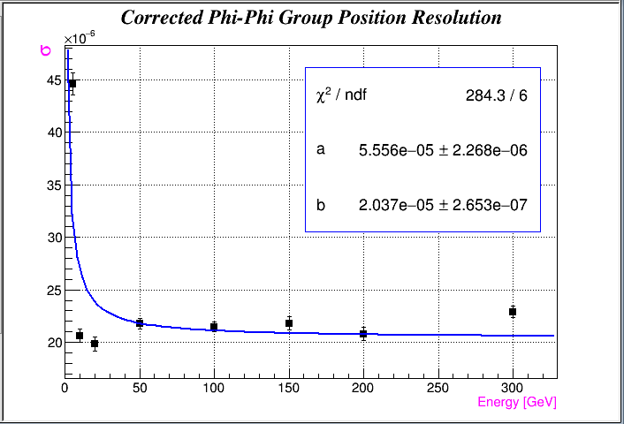
Corrected φ group Position Resolution
9

Slide 10
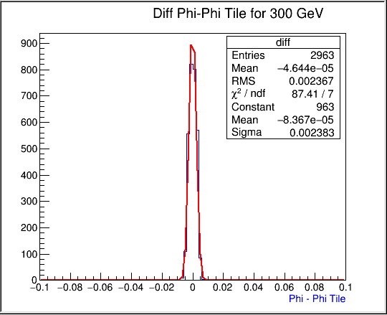
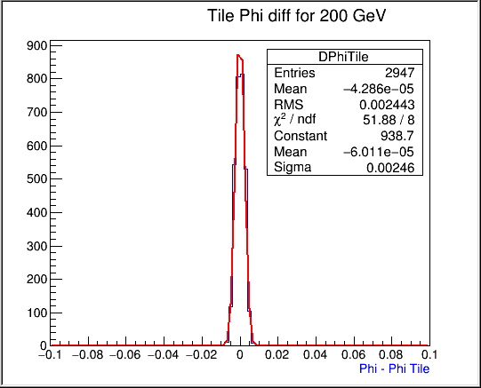
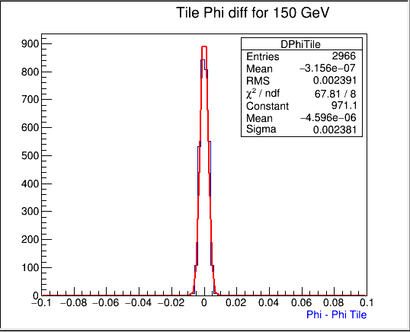
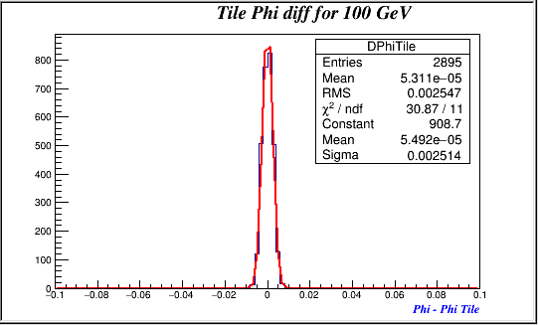
φ Tile
$\text{3.1 }\text{< }{\text{η}}_{ truth}$ < 3.2
10

Slide 11
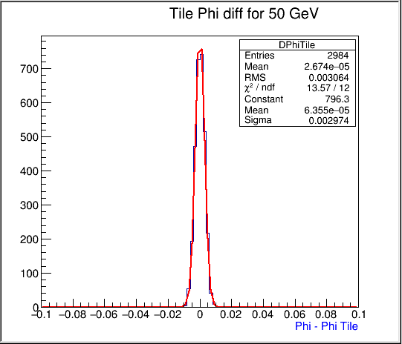
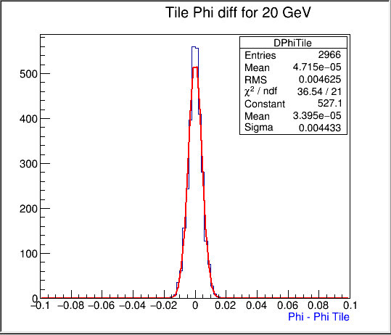
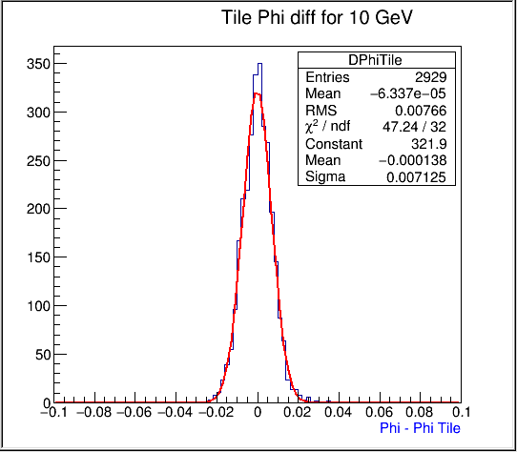
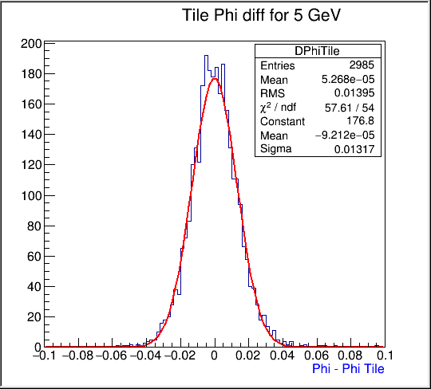

φ Tile
$\text{3.1 }\text{< }{\text{η}}_{ truth}$ < 3.2
11

Slide 12
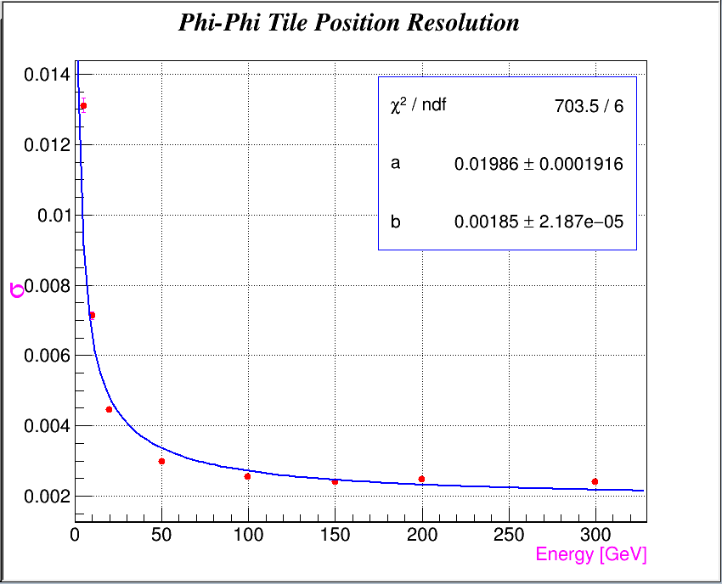


φ tile Position Resolution
$$a=19.86 mrad\sqrt{GeV}$$
b$=1.8$mrad
12

Slide 13
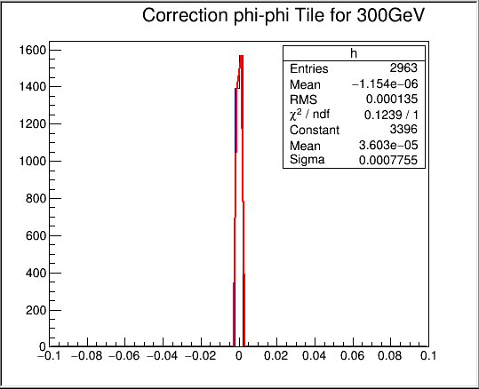
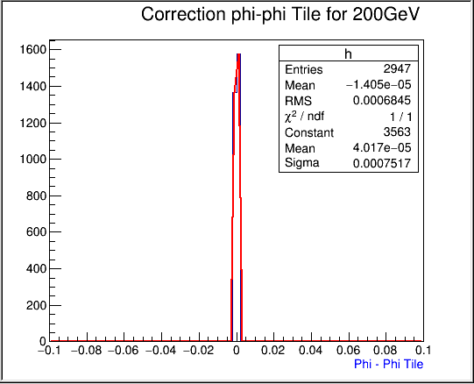
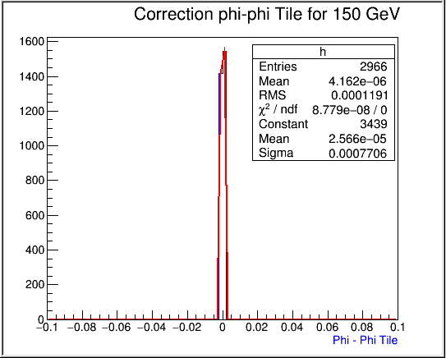
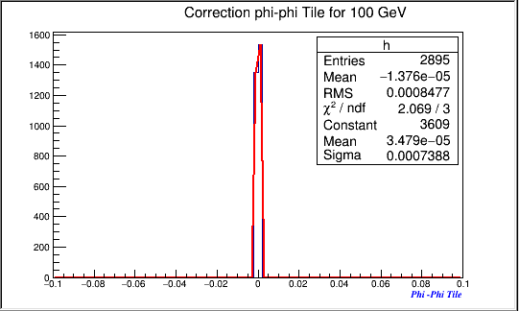
φ Tile corrected
$\text{3.1 }\text{< }{\text{η}}_{ truth}$ < 3.2
13

Slide 14

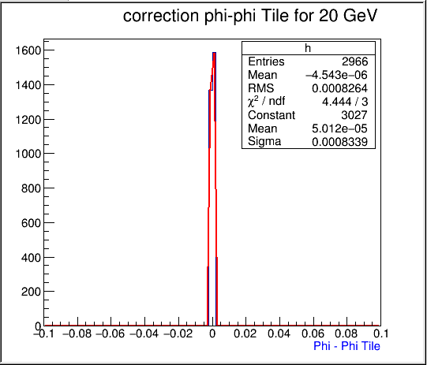
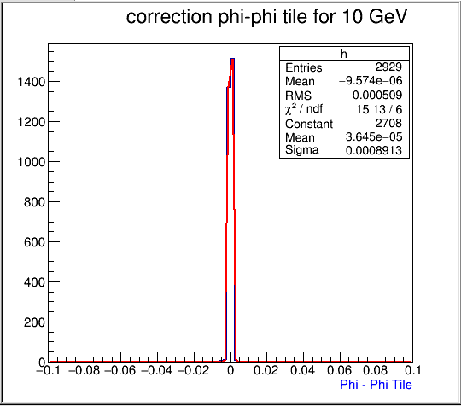
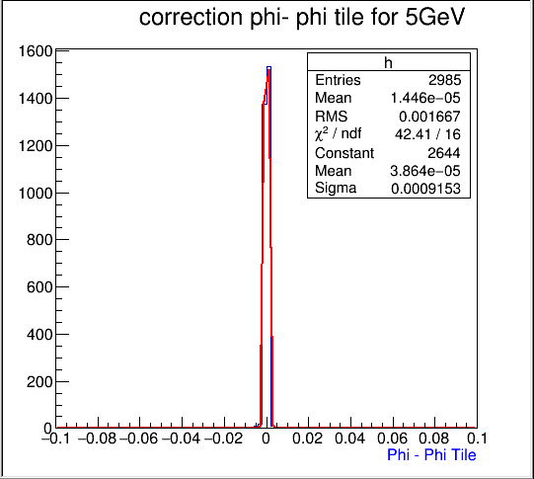
φ Tile corrected
$\text{3.1 }\text{< }{\text{η}}_{ truth}$ < 3.2
14

Slide 15
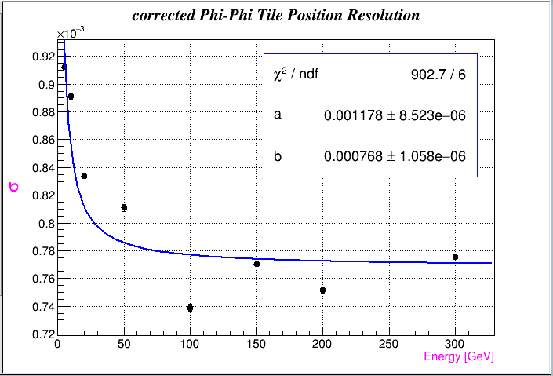
Corrected φ Tile Position Resolution
15

Slide 16
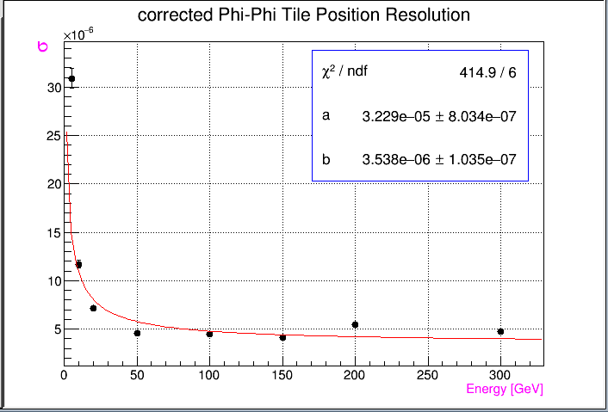
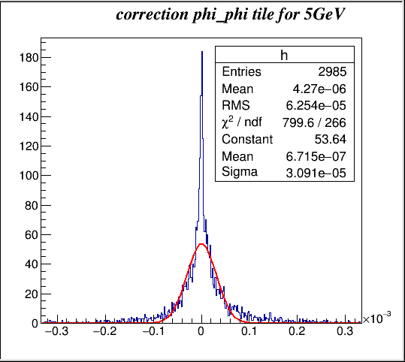
Corrected φ Tile Position Resolution
16

Slide 17


Thank you
KTH/FSO meeting 13/01/ 2016
17

