Slide 1

Emulsion Test Beam first results
Annarita Buonaura, Valeri Tioukov
On behalf of Napoli emulsion group
This activity was supported by AIDA2020

Slide 2
New elements in respect to OPERA were tested
New emulsions produced in Nagoya lab
  Different emulsion base material (unexpected effects found)
  Different layers thickness
  Different emulsion handling
Emulsion spectrometer in a magnetic field
  Different geometry (15 mm instead of 1 mm gap)
  Different accuracy requirements: 1 micron resolution over cm scale (1/10000) instead of 1 micron over mm scale (1/1000) in OPERA
Emulsion to electronic detector matching
  Different coordinate resolution in the detectors, no angular information in TT, no time information in emulsion
Higher signal tracks density expected in SHiP
Fast scanning with a new scanning system
  Speed of 80 cm/h instead of 20/h

Slide 3
Exposures Summary
At PS (Sep 2015)
  ECC (OPERA-like brick) exposure with high density in magnetic field @ different angles
  CES (Compact Emulsion Spectrometer) exposure with different density and angles
  Matching between emulsions and Micromegas chambers
  In collaboration with Napoli Atlas group
At the SPS (Oct 2015):
  Matching between emulsions and GEM
  CS (emulsion doublets), ECC and CES was exposure together with GEM at different angles and magnetic field
  In collaboration with Frascati GEM group

Slide 4
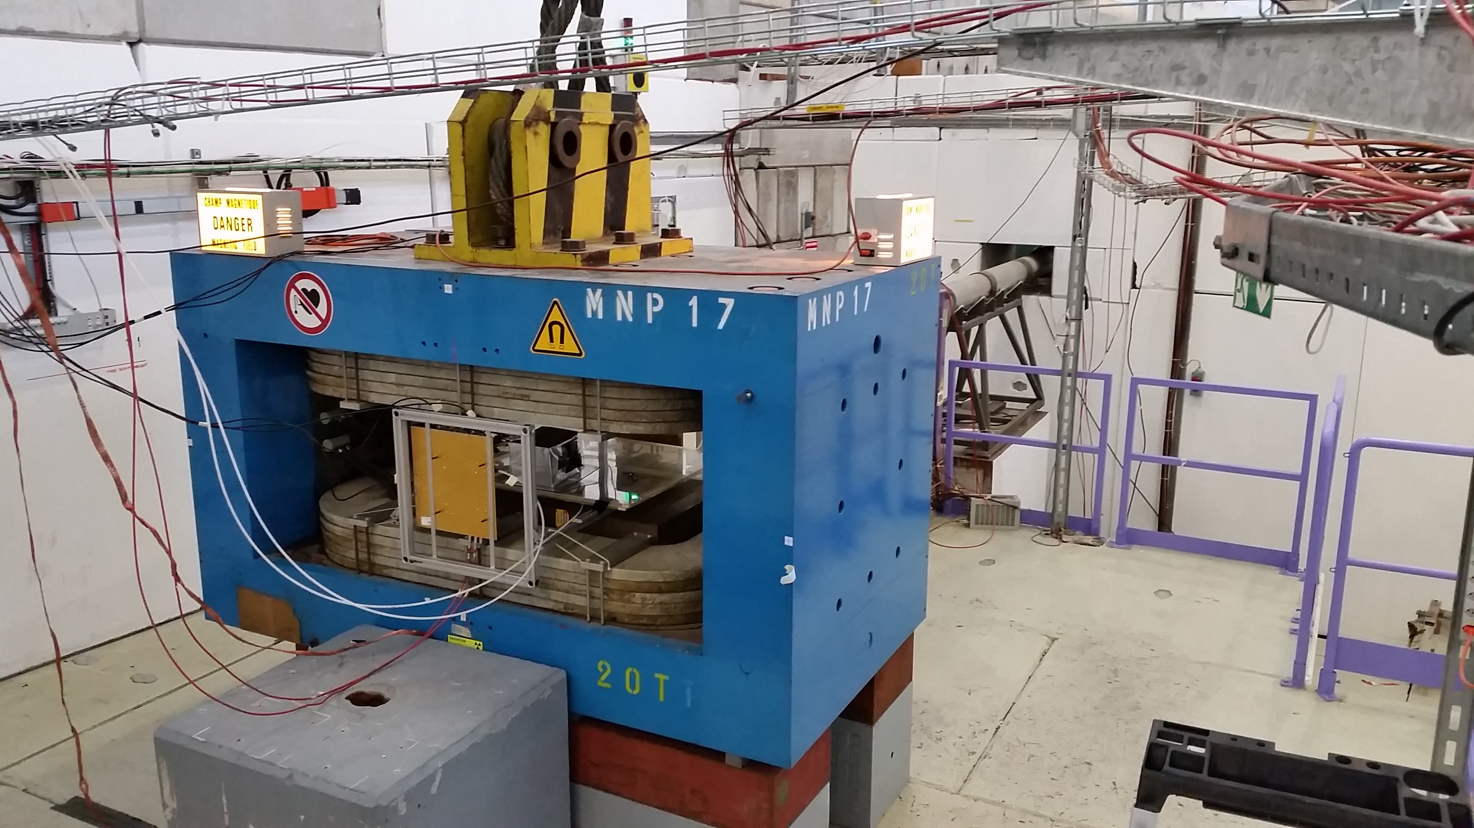
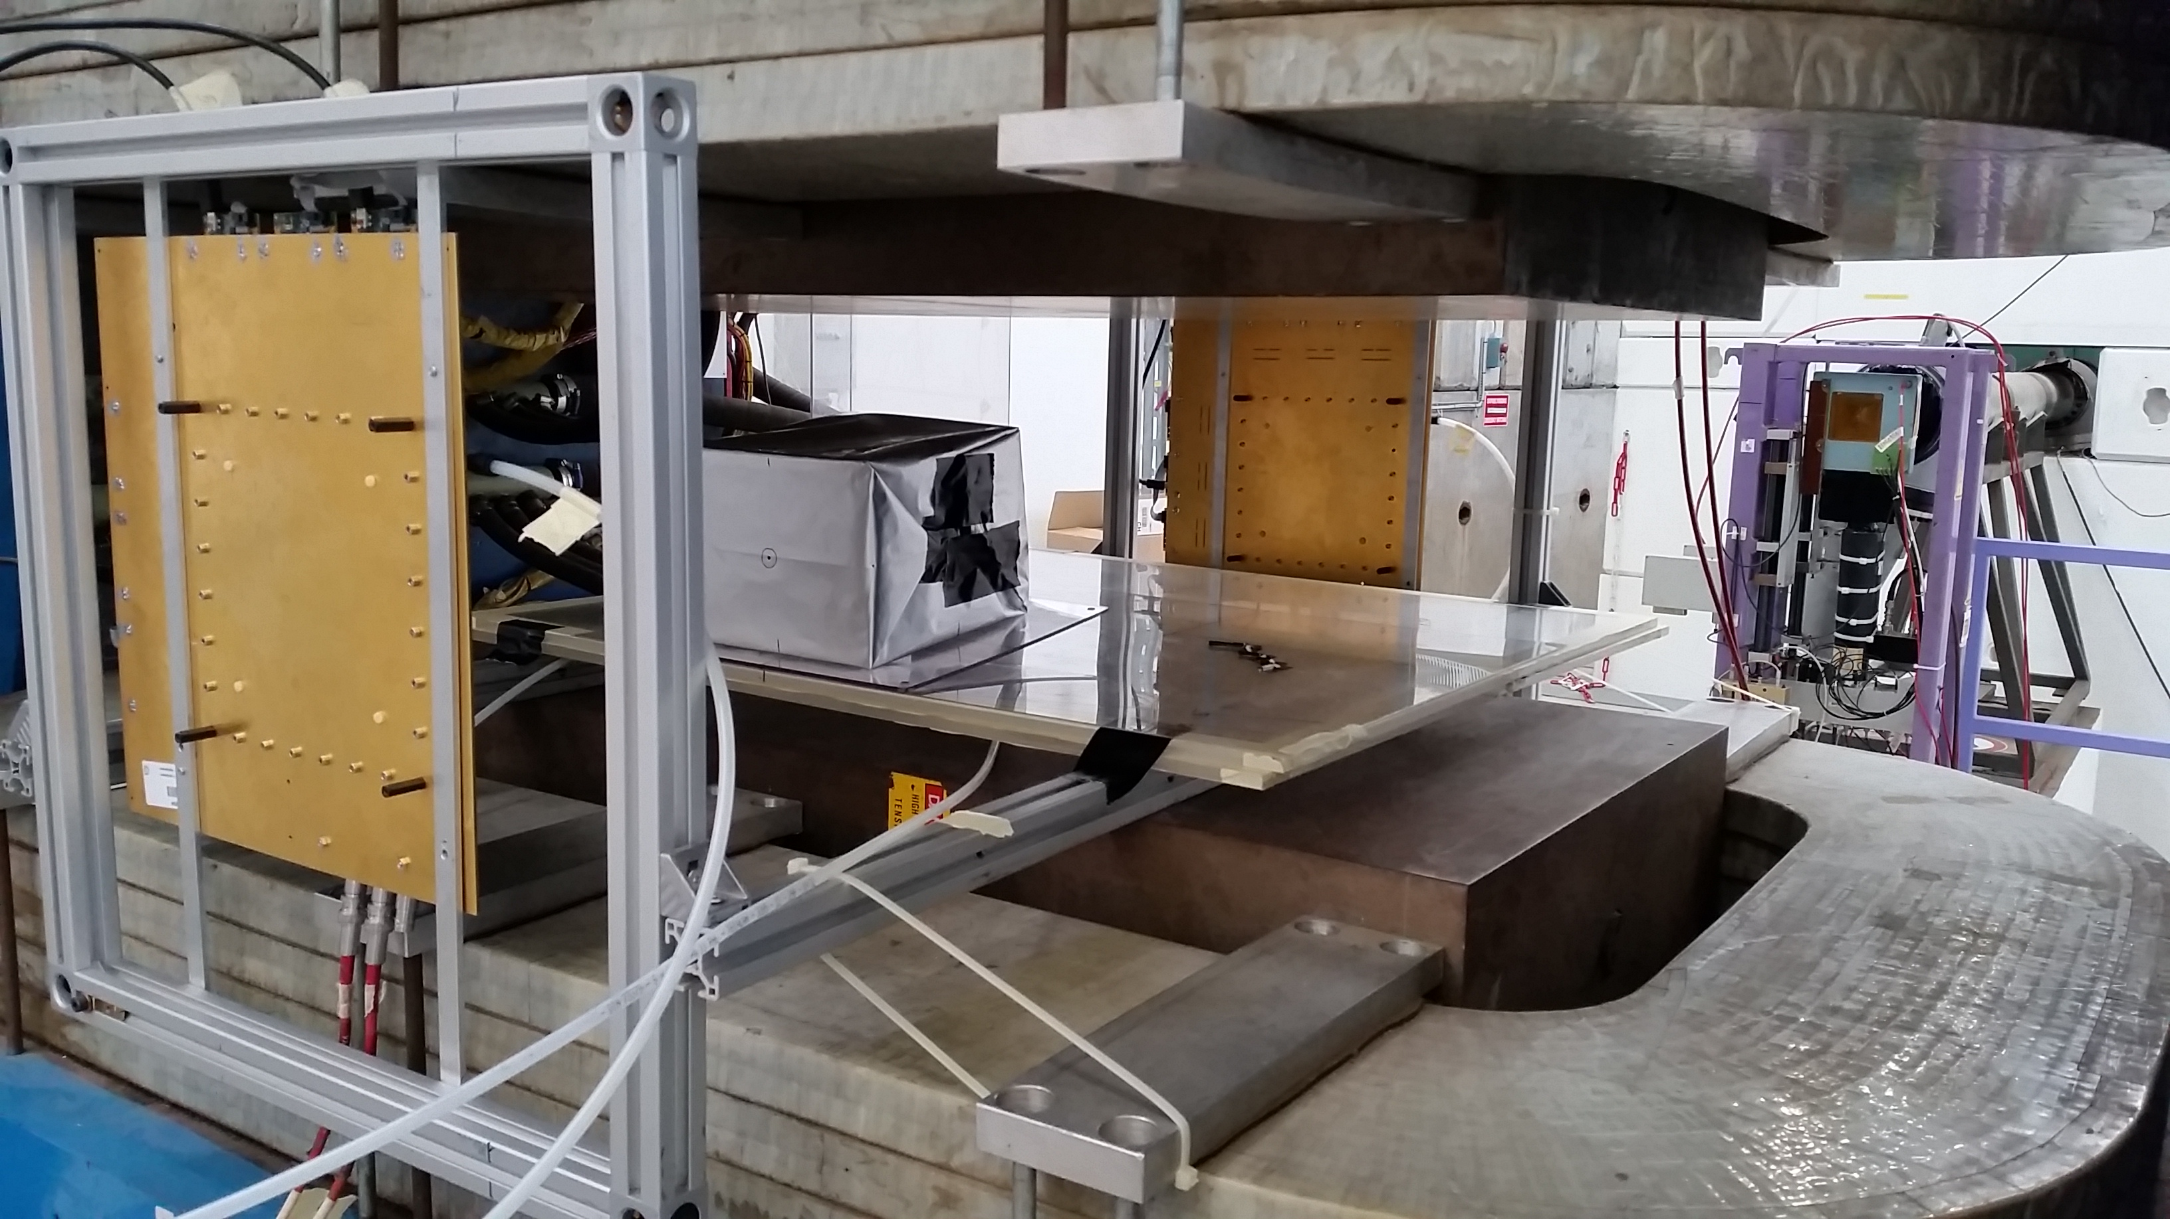
MNP17 at T9 (PS)
CES inside the magnet

Slide 5
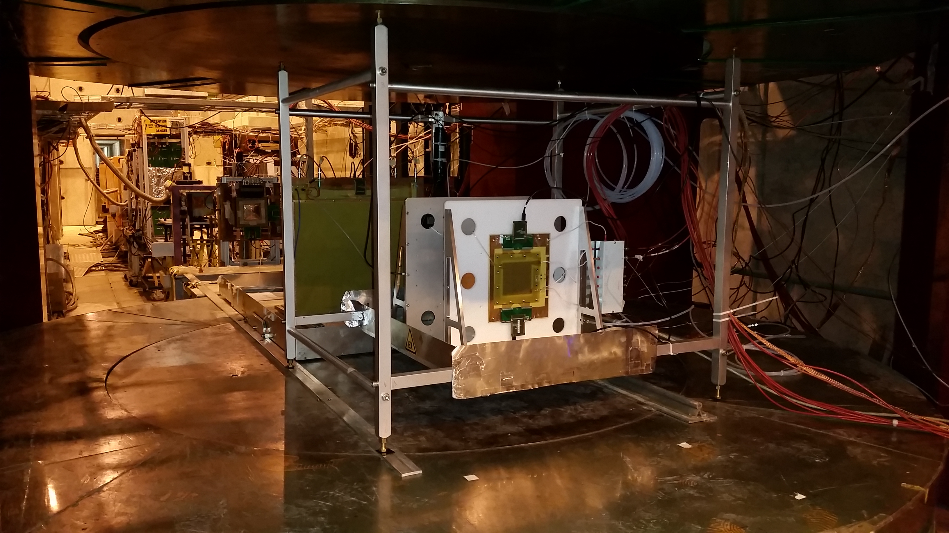
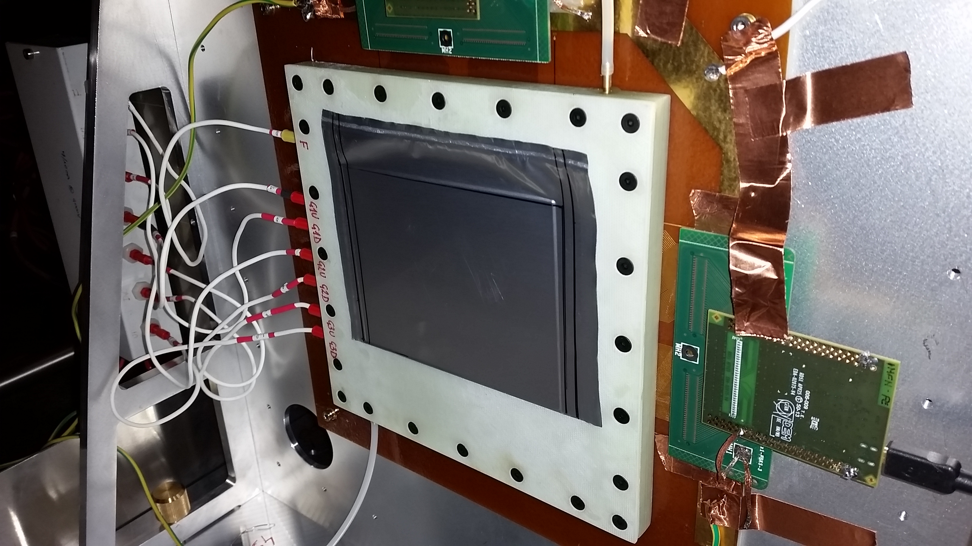
TT installed Inside
Goliath magnet at
East Area (SPS)
CS attached to GEM

Slide 6
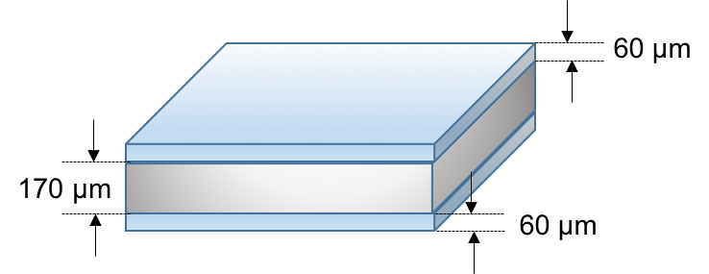
Emulsion Films
Emulsion films produced in Nagoya University
Film dimensions
  Surface: 125 mm x 100 mm
  Total thickness: 290 μm
    Emulsion Layer: 60 μm
    Plastic Base: polystyrene : 170 μm
New emulsion gel developed in Nagoya University
    Grain density: 50 grains/100 μm (higher than OPERA films)
Emulsion production
  Emulsion poured in middle August 2015 and cut by hand
  Shipped to CERN by plane
  Total amount of emulsion films produced: 120
  Emulsion films used in the test beam: 91

Slide 7
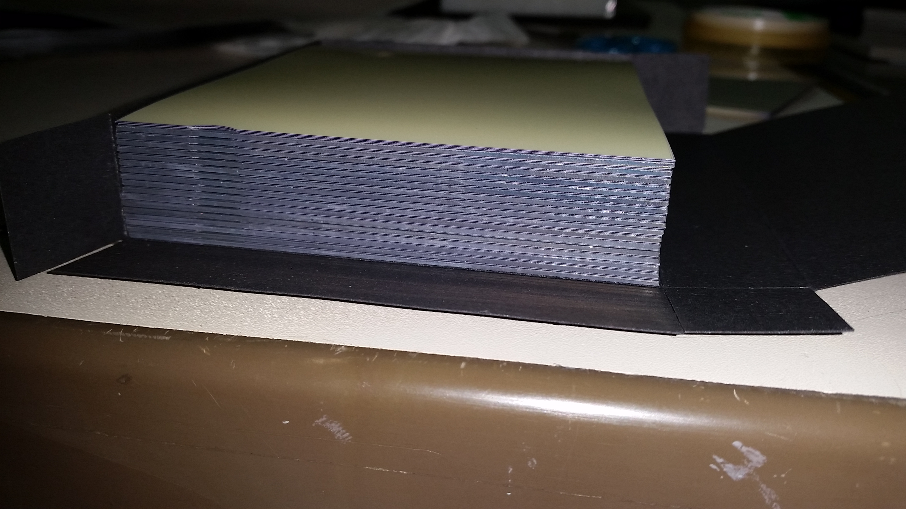
Types of emulsion assembling
CS (Changeable Sheet) – emulsions films doublet without spacer enclosed inside an envelope sealed under vacuum
ECC (Emulsion Cloud Chamber) – emulsions interleaved with dense spacers (1 mm lead) tightly assembled together
CES (Compact Emulsion Spectrometer) – emulsions interleaved with low density spacer (15 mm Rohacell in this test)

Slide 8
Measurement of momenta and charge in magnetic field
Exposure at CERN
First time with Passive Material !
290 μm
Target: CES (10 emulsion films interleaved with Rohacell plates)
Beam exposure:
High density: 104 tracks/cm²/angle
Magnetic field: 1T, -1T
15 angles, 5 momenta

Slide 9
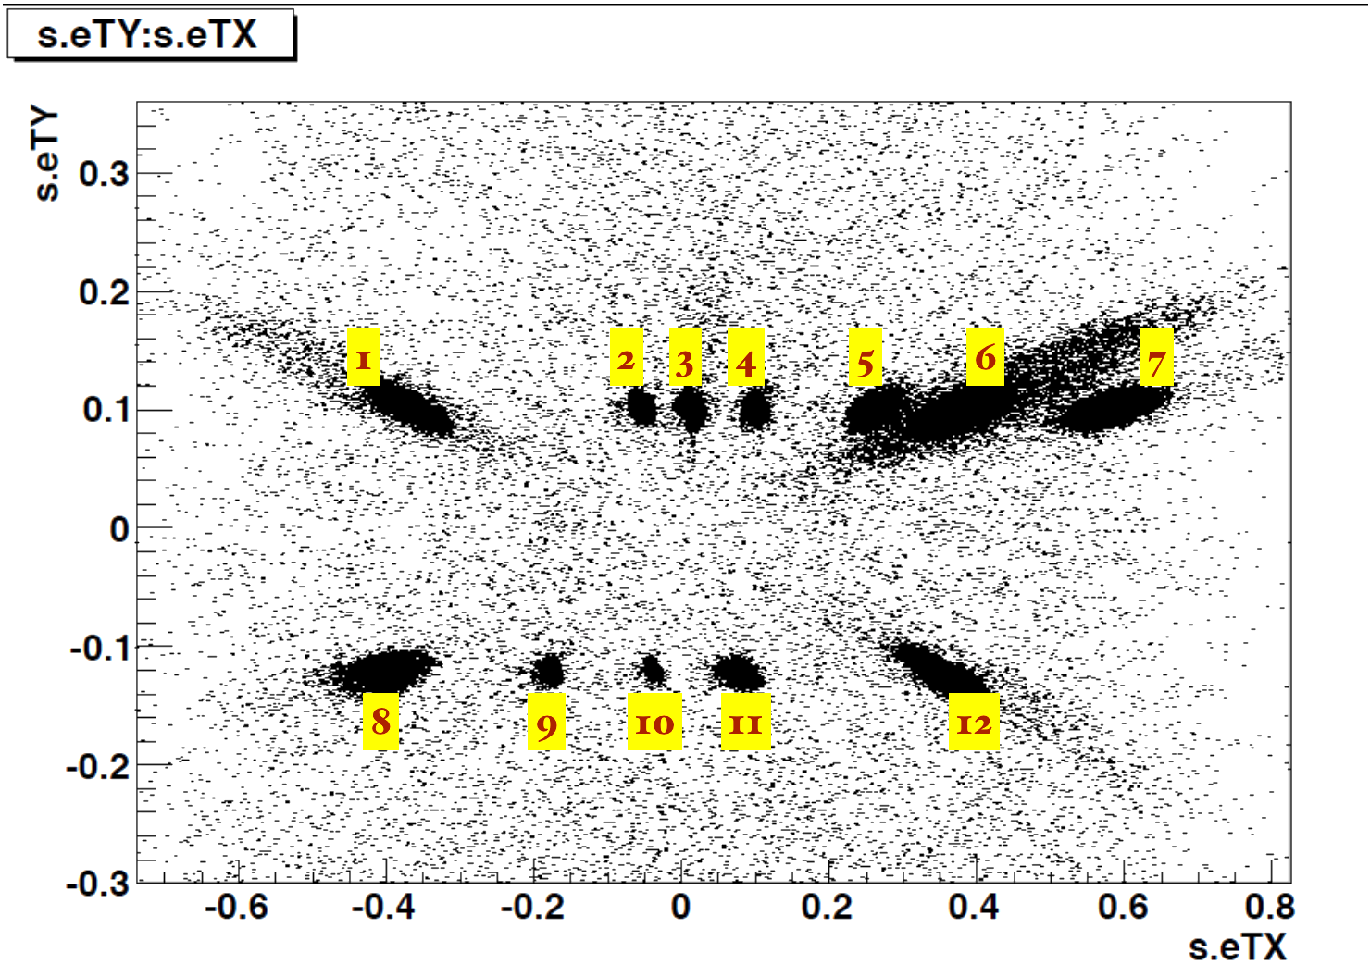
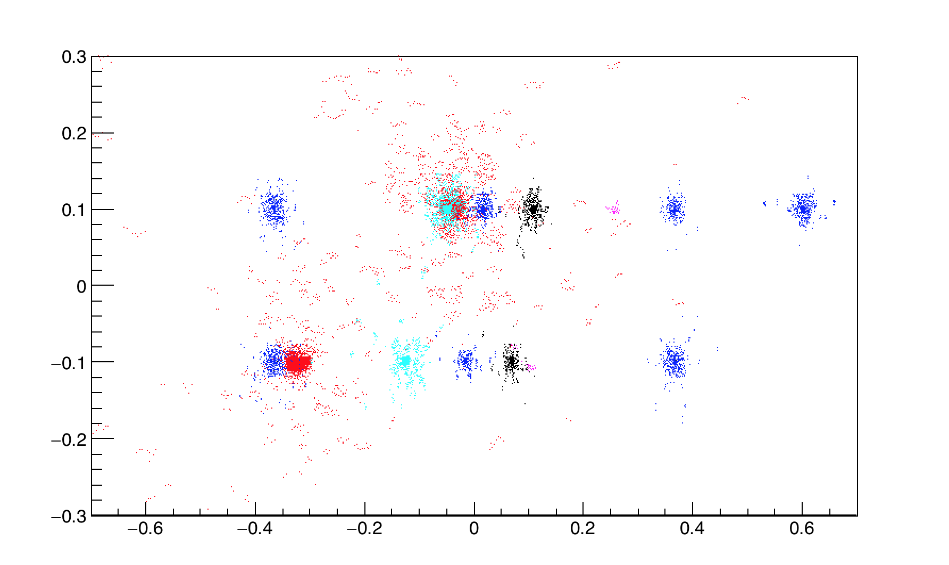
Measurement of momenta and charge in magnetic field
Scanning of the CES emulsions in the Napoli Emulsion Laboratory
The fragment of data 2x3 cm was scanned on 10 plates, tracks reconstructed
Angular distribution of reconstructed tracks
Angular distribution of MC tracks
s.eTY
1
2
3
4
5
6
7
8
9
10
11
12
s.eTX

Slide 10
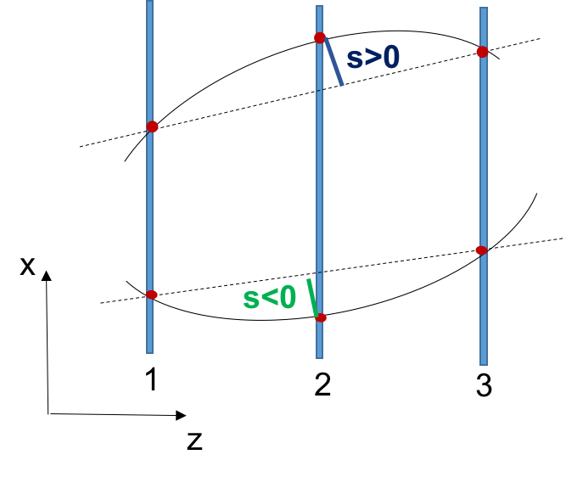
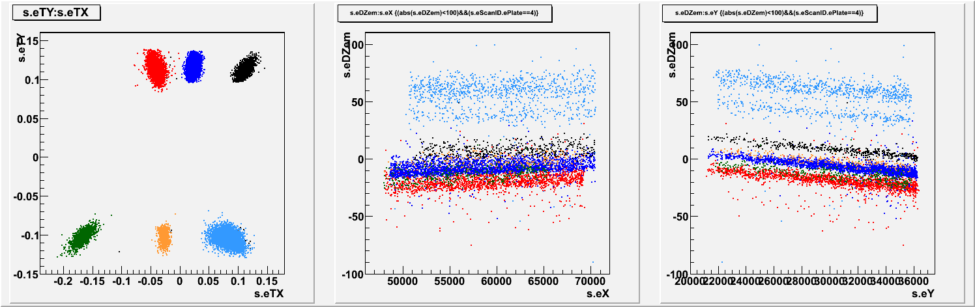
P (GeV/c) | <sgt> (μm)
1 | 35
2 | 17
4 | 8.8
8 | 4.4
10 | 4.2
We can separate different beams
but the absolute values of sagitta appeared to be
not correct and some position-dependent
effects are present when all peaks reconstructed together

Slide 11
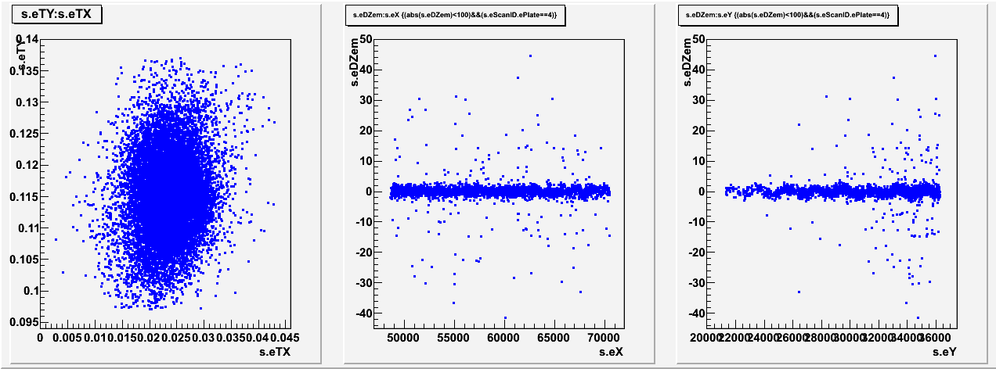
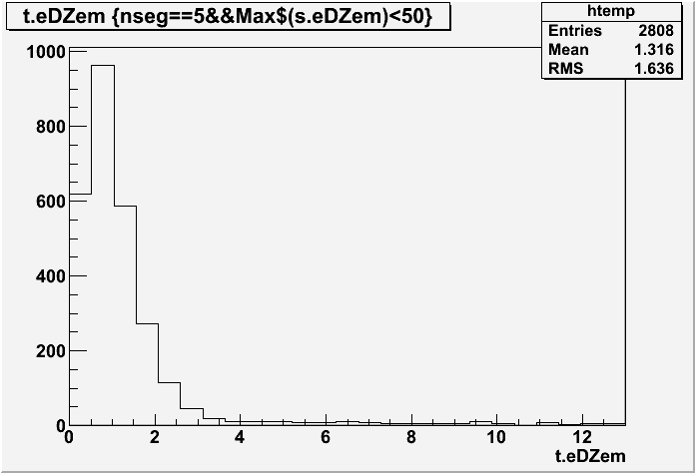
1 micron coordinate resolution over cm scale is confirmed
10 GeV beam
The position (“sagitta”) resolution is measured with the accuracy of about 1 micron on the area of 2x3 cm²

Slide 12
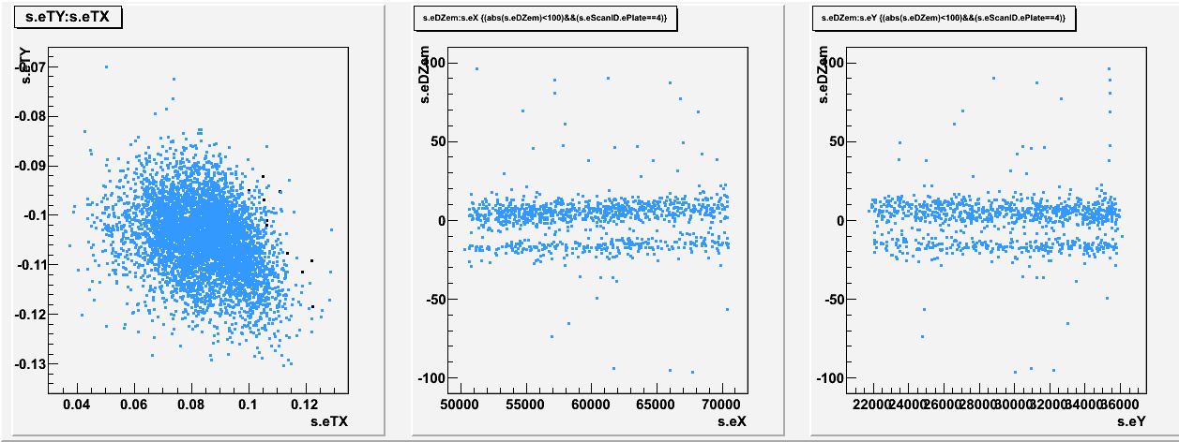
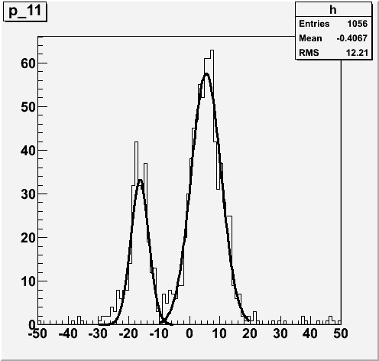
Two momentum (8 and 2 GeV) with the same angle clearly separated
8 Gev
2 Gev

Slide 13
Tracks reconstruction without magnetic field (OPERA like)
Started from 3D segments reconstructed in each plate with the accuracy of about 1 micron in position, and of 3 mrad in angle
Plate to plate alignment procedure is performed using passing-through tracks
  Assumed that the tracks in medium are straight
  Assumed that the emulsions are flat and parallel
Alignment procedure optimize
  gap between emulsions (deltaZ)
  Calculate the affine transformation between segments patterns that can be decomposed as shift(XY), rotation, scaling(XY)
After the alignment tracking is performed by segments extrapolation and track following using Kalman Filter

Slide 14
In case of CES this procedure appeared not sufficient
We found that the global corrections does not converge well
If we work peak by peak we reach the 1 micron accuracy on the sagitta measurement as it expected
If we reconstruct globally different angles (even that without magnetic field) together the position-dependent effects appears
Explanation we found is that the spacer was not sufficiently flat so one of our basic assumptions does not work
Rohacell plates thickness as specified by producer is 15+-0.2 mm, this does not guarantee the gap uniformity over the scanned area
Two possible solutions:
  Software – we add tilt correction algorithm (under development)
  Hardware – make spectrometer layers precisely flat (the preferred one)

Slide 15
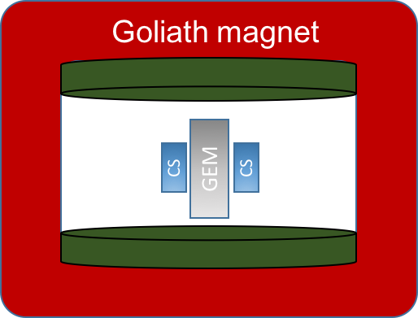
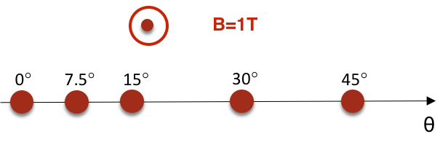
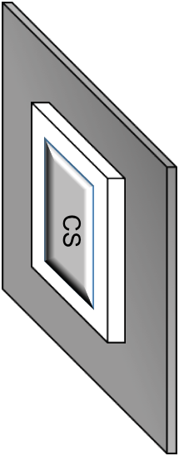
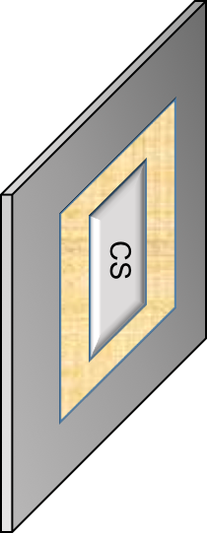
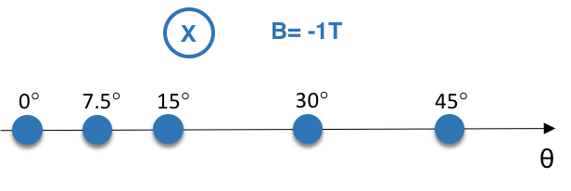
Emulsions and GEM exposure
Setups:
2 CS doublets attached on GEM upstream and downstream surfaces in magnetic field
      Low density: 50 tracks/cm²/angle
Beam
Exposure 1
Target: 2 x CS
Magnetic Field: + 1T
Exposure 2
Beam
Beam
Target: 2 x CS
Magnetic Field: -1T
Front view
Back view

Slide 16
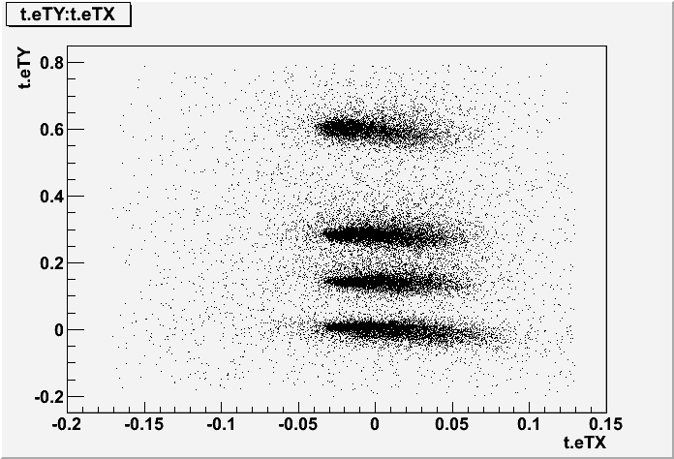
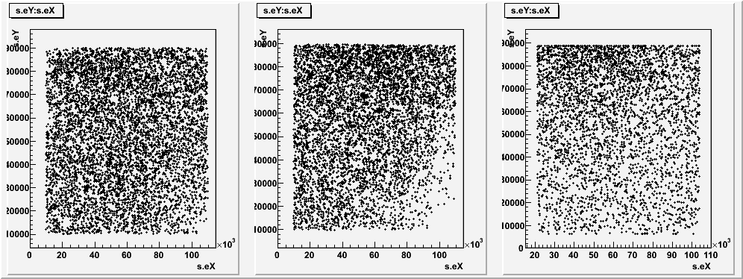
Each CS consists of 2 emulsion plates
Each plate has 2 sensitive layers
The surface of each layer is 10x12 cm²
The full surface was scanned and track matching done in all 4 layers of each CS
The first matching with GEM was attempted for the peak at 0 angle
GEM data provided by Frascati group
CS3
CS4
GEM

Slide 17
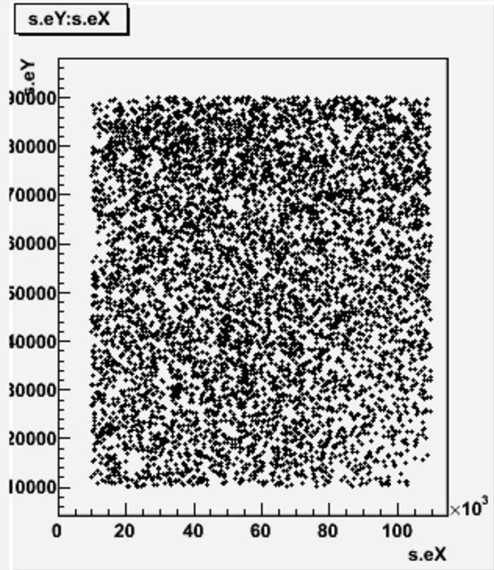
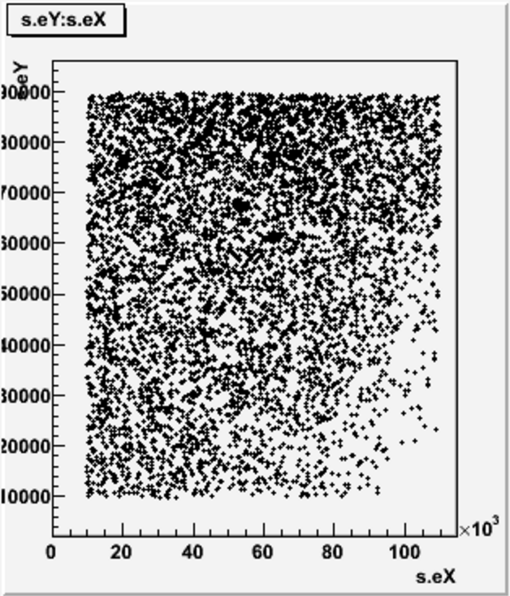
Pattern matching between 2 patterns – “alignment” procedure

Slide 18
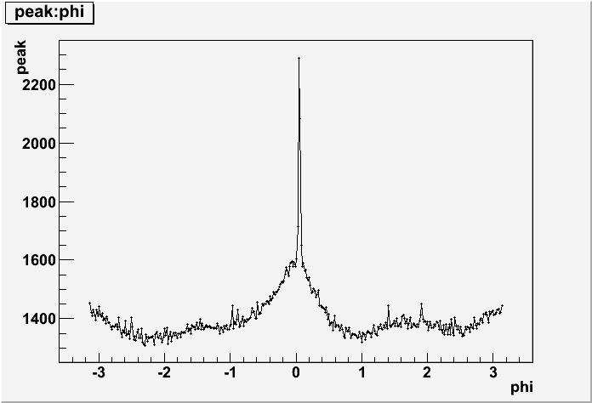
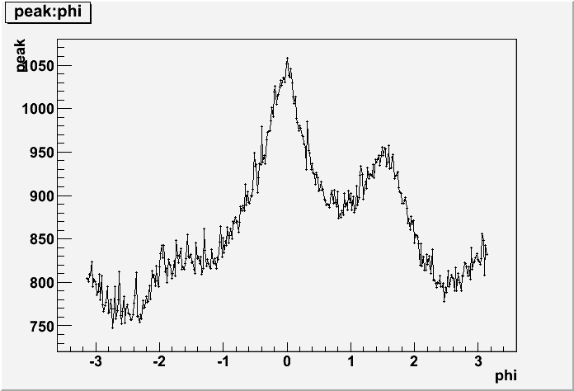
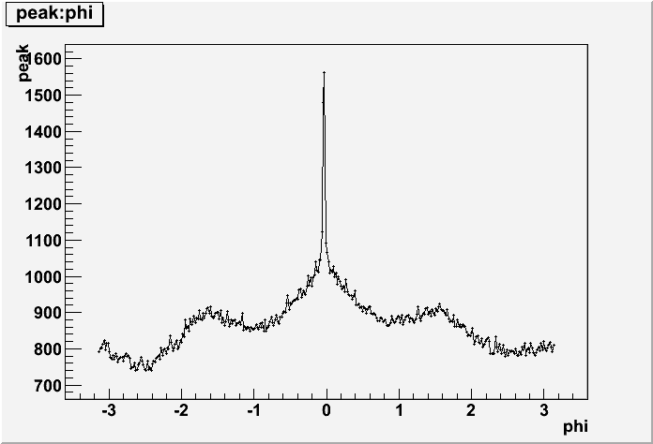
Matching between Emulsions and GEM
“Total alignment” was developed for this case
Offset range in XY: +-10 mm
Angular range +- Pi
Position acceptance 500 microns
CS3 <->CS4
GEM <->CS4

Slide 19
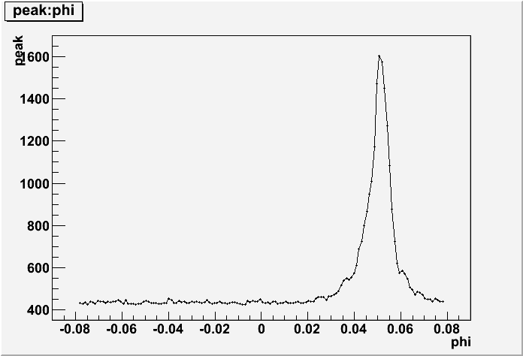
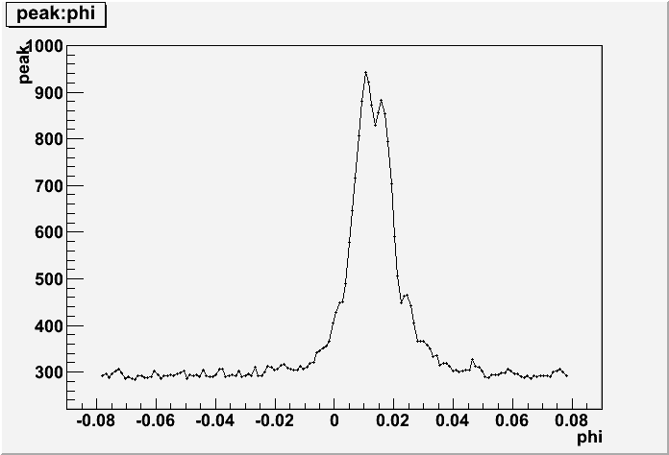
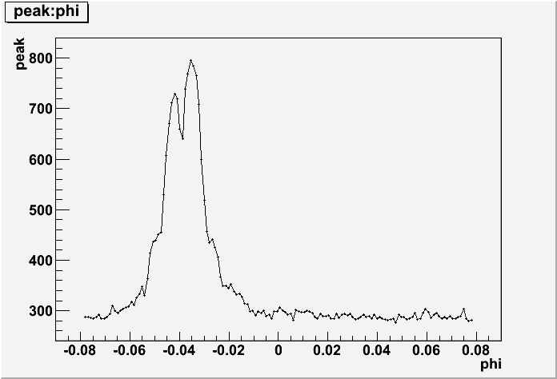
“Total alignment”
Offset range in XY: +-10 mm
Angular range +- 0.08
Position acceptance 250 microns
CS3 <->CS4
GEM <->CS4
GEM <->CS3

Slide 20
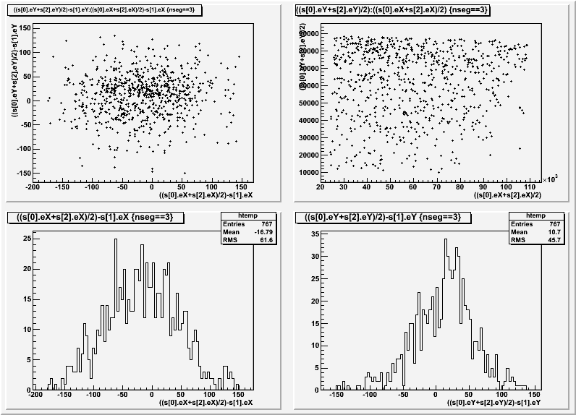
Common tracks are reconstructed in CS3-GEM-CS4
(preliminary data with hard cuts)

Slide 21
Conclusion
CES: emulsion position resolution is sufficient for resolving > 10 GeV momentum at 3 cm base, but the mechanical construction should be improved to obtain reliable absolute values
  Software compensation of mechanical inaccuracy is possible in case of sufficient calibration sample (straight high momentum tracks) – under development
  We plan also to test the different and more precise mechanical solution
Emulsion – GEM matching is verified to be good at 0 angle and B=0
To do for GEM-emulsion data:
  matching resolution and efficiency study
  Analyze all data sets with different angles and B
  Matching with CES and ECC assemblings
Micromegas data set has to be analyzed yet

