Slide 1



Charmed Hadron Production Measurement
Giovanni De Lellis
7th SHiP Collaboration Meeting
CERN, 10-12 February 2016

Slide 2
Motivation
Measurement of angular and momentum distributions of charmed hadrons in p-Mo collisions
Reduction of the uncertainty on the flux of particles originated from charmed hadrons:
tau neutrinos
HNL
a significant fraction of high-energy (electron and muon) neutrinos

Slide 3
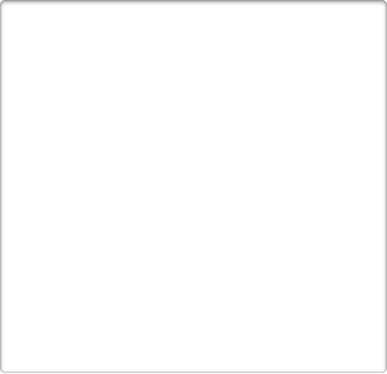
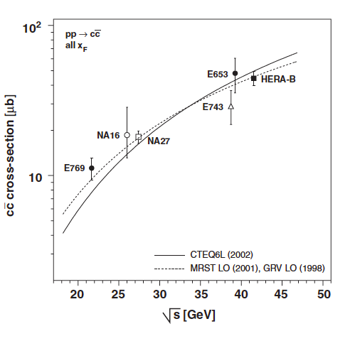


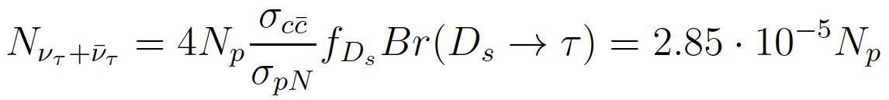
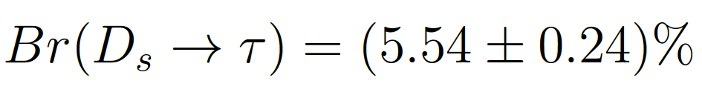
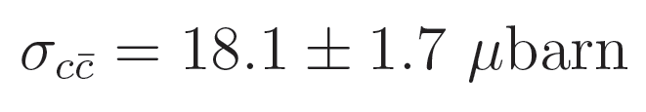
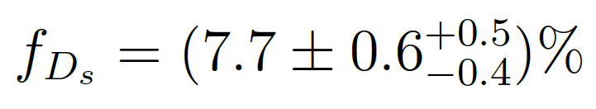
Charm Production Cross-Section
NA27 with 400 GeV protons
Impact on ντ yield
PDG 2014
Physics Reports 433 (2006) 127
JHEP 1309 (2013) 058

Slide 4
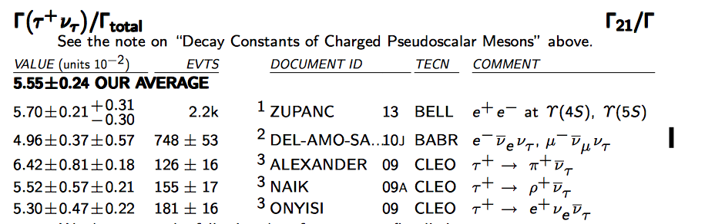
Branching ratio Ds → tau
BES III measurement during this winter, a dedicated run at the Ds+ Ds- mass
Compared to CLEO, gather ~5 times larger statistics → reduce the statistical uncertainty by a factor of 2. First results available by the end of 2016
BELL2: systematic uncertainties related to the tagging procedure. Data driven methods for background estimates will improve with the statistics. Although no dedicated study has been done, they expect 1-2% at the end dominated by systematics
No need to measure Ds → tau decays only

Slide 5




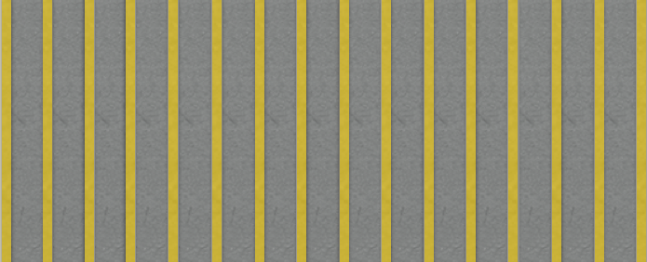

Detector Layout
Mo Plate
SciFi
SciFi
Emulsion Film
Fe
Magnetized
Volume
34 cm
p
(400 GeV)
1 mm
290 um
Instrumented Target
not to scale
Spectrometer
Muon Filter

Slide 6

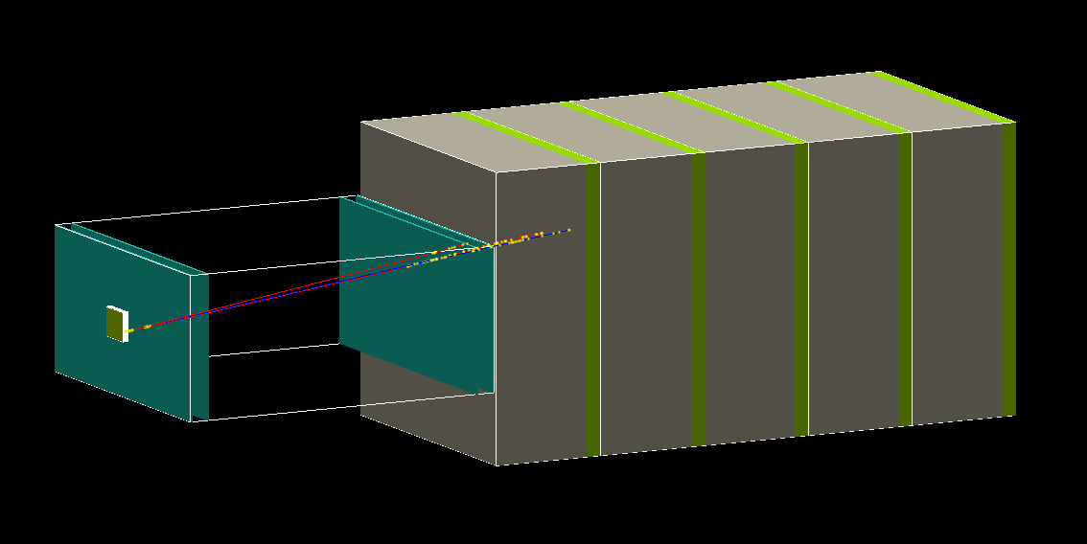
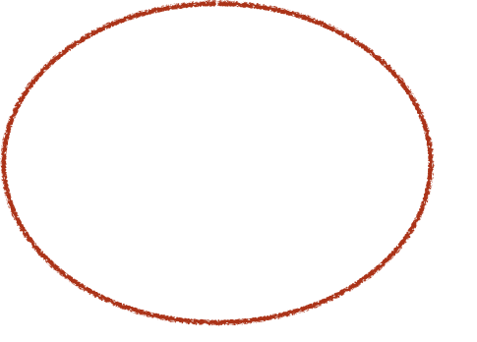
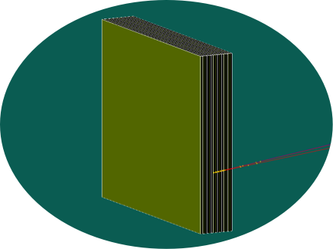
Geant4 Implementation (A. Di Crescenzo)
Muon filter
Spectrometer
0.5 m
1m
1m
Target
1.7 m
Target

Slide 7




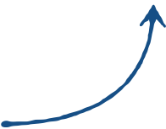
Analysis Chain
Particle propagation & detector response
GEANT4
A. Di Crescenzo
Charmed hadron production in p-Mo collisions
+ Cascade production
PYTHIA 6
Thomas
Charmed hadron decay
PYTHIA 8
(standard libraries)
A. Di Crescenzo

Slide 8
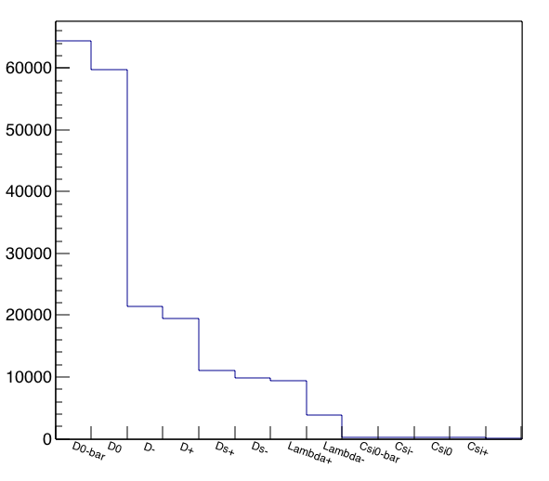

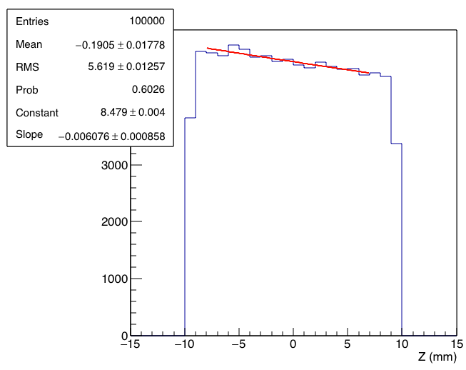
Charmed Hadron Production
Charm production vertex uniformly distributed in (x,y) plane
Charmed hadrons
p
(400 GeV)
Charm production along the beam axis exponential, λ=1/0.006076 ~ 160 mm

Slide 9
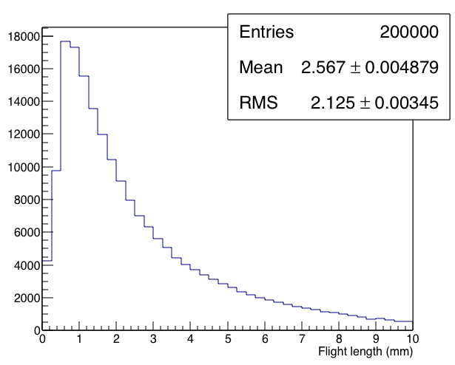
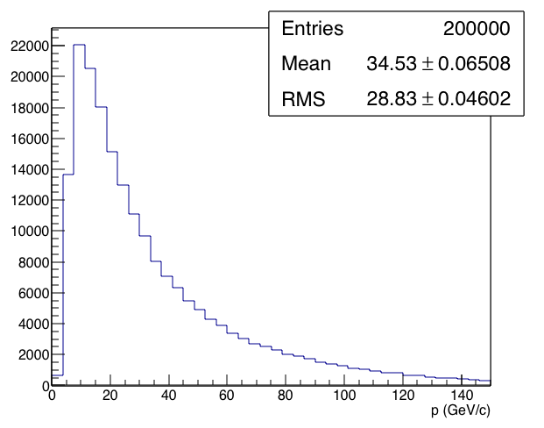
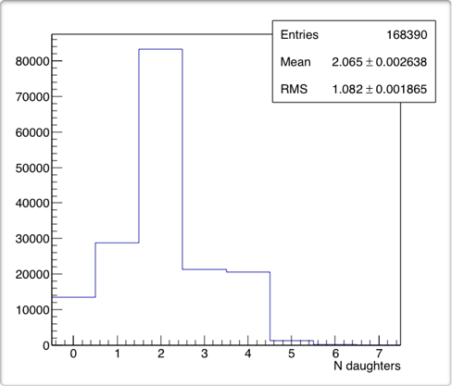
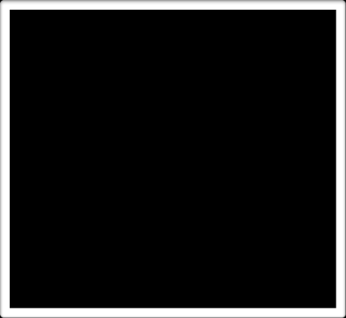
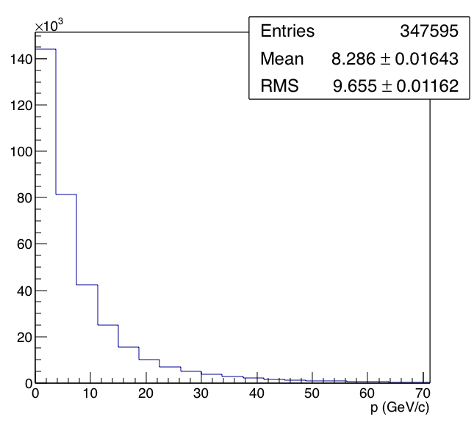
Charm Production And Decay
Flight length
momentum
<p> ~ 35 GeV/c
~85% of charmed hadrons decaying within the target
Daughters momentum
<p> ~ 9 GeV/c
Number of charged decay daughters

Slide 10
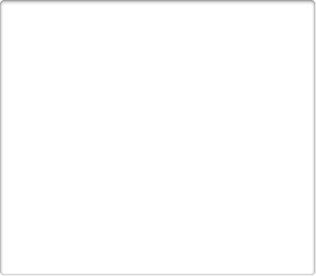

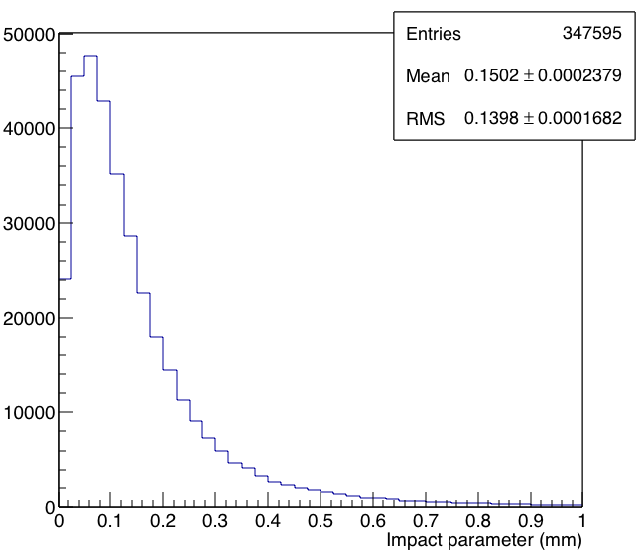
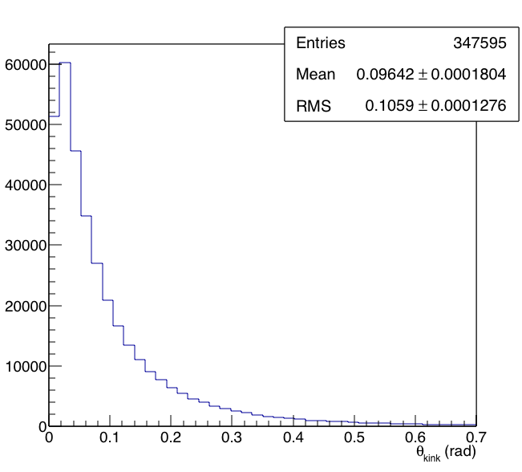
Decay Search
Charm decay vertex identification:
      Impact parameter of daughter track w.r.t. primary vertex >10 μm
      1-prong topology: kink angle>20 mrad
      at least one track with >1 GeV/c
      Fight length <6 mm
Decay search efficiency
90%
<IP> ~ 150 μm
<θkink> ~ 96 mrad

Slide 11


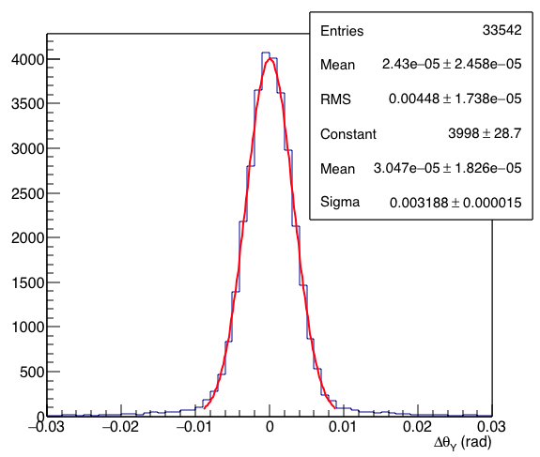

Charge Measurement
Assume 2 mrad angular resolution at each station
SPECTROMETER
SciFi
1 m
SciFi
Positive Charge
Δθ>0
Resolution on Δθ
σΔθ~3 mrad
Unbended projection
B=1T
Negative Charge
Δθ<0
X
Magnetized
Volume
STATION 1
STATION 2
Z

Slide 12


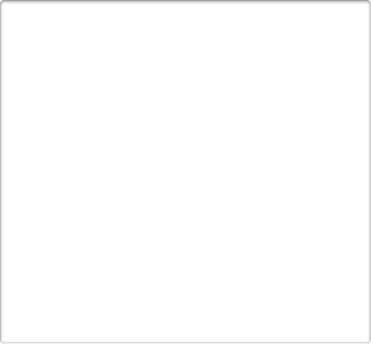
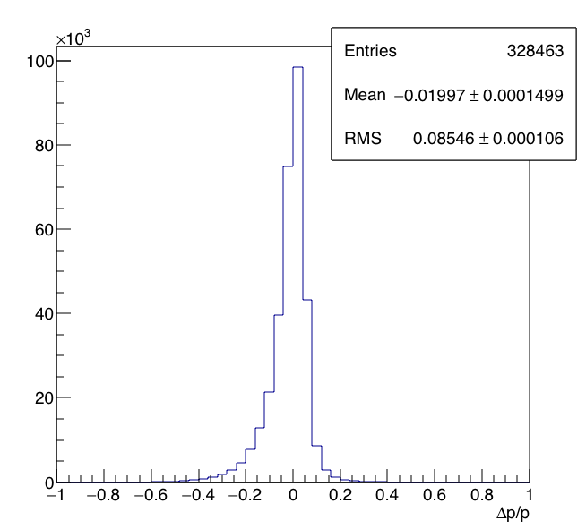
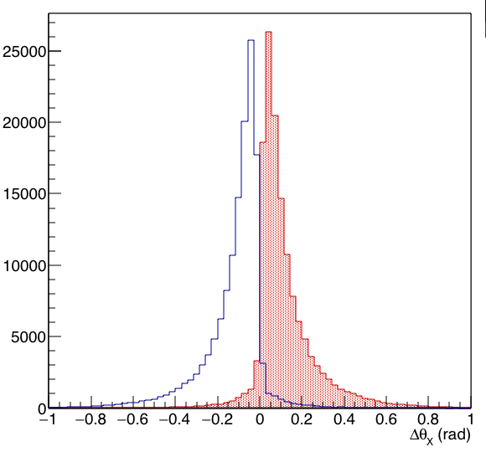
Charge and Momentum Measurement
Charge efficiency 94% (single track)
Charge mis-identification 4%
Charge not measurable 2%
Charge measurement criteria
ΔθX > 3*σΔθ
Momentum resolution
Negative Charge
Positive Charge

Slide 13



Spectrometer: Requirements
Requirement: 2 mrad angular resolution at each station
Angle measured from the track position in two layers (PA and PB)
STATION 1
If the distance between the two layers is 2.5 cm
PB
θ1
PA
Required position resolution at each layer = 50 μm
1 cm
+
+
X coordinate
Y coordinate
Stereo view

Slide 14


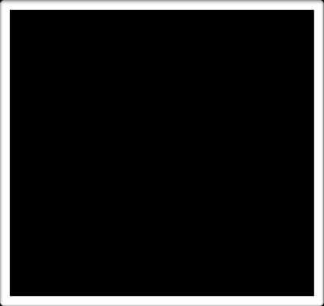
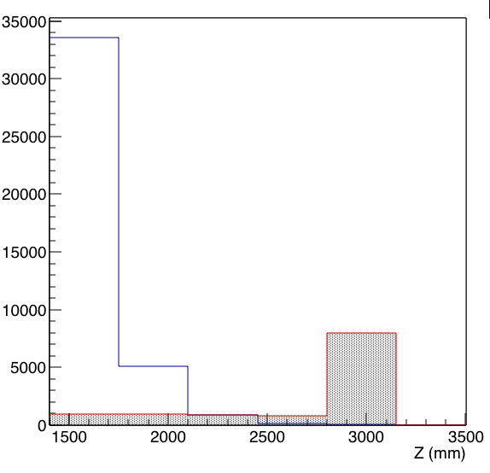
Muon Identification
MUON FILTER
MuonID criterium
number of crossed layers > 3
S0
S1
S2
S3
S4
S5
muon
hadrons
S1
Muons
X
Fe
Hadrons
3.4 cm
~2 λ
muonID =1
Z
Sensitive planes
S5
S2
S3
S4

Slide 15





Charm Detection Efficiency
Single-Charm
Double-Charm
Charmed hadrons decaying in the target 85% 80%
Visible decay vertex 79% 72%
Charmed hadrons detected in emulsion 71% 59%
DETECTION EFFICIENCY (ε^{DET}) 71% 59%
All daughters enter in the spectrometer 60% 42%
All daughters cross the spectrometer 43% 22%
Charge & momentum measurement 37% 16%
Particle ID 36% 16%
OVERALL EFFICIENCY (ε^{KIN}) 36% 16%
TOPOLOGICAL SELECTION
KINEMATICAL
SELECTION

Slide 16
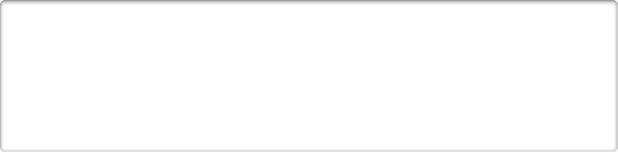
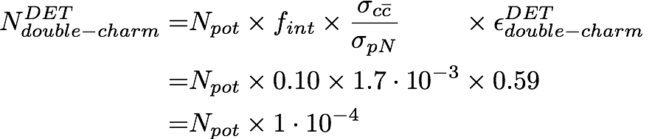

Double-Charm Detection
fraction of protons interacting in the target
Number of detected charm pairs
double-charm yield
double-charm detection efficiency
Number of pot
Number of detected charm pairs fully kinematically reconstructed
Assuming 10⁹ pot from SPS 100 000 detected charm pairs
27 000 fully kinematically reconstructed pairs
Notes:
\begin{equation}
\begin{split}
N^{DET}_{double-charm} = & N_{pot} \times f_{int} \times \frac{\sigma_{c\overline{c}}}{\sigma_{pN}} \mbox{\phantom{iaaaa}}\times \epsilon^{DET}_{double-charm}\\
= & N_{pot} \times 0.10 \times 1.7\cdot10^{-3} \times 0.59 \\
= & N_{pot} \times 1\cdot 10^{-4} \\
\end{split}
\end{equation}
\begin{equation}
\begin{split}
N^{KIN}_{double-charm} = N_{pot} \times 8.5\cdot 10^{-6} \\
\end{split}
\end{equation}

Slide 17
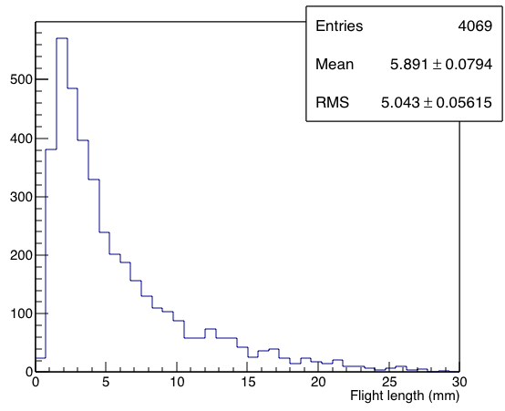
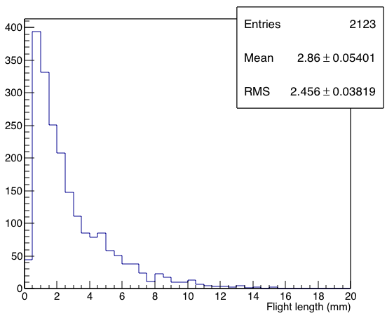
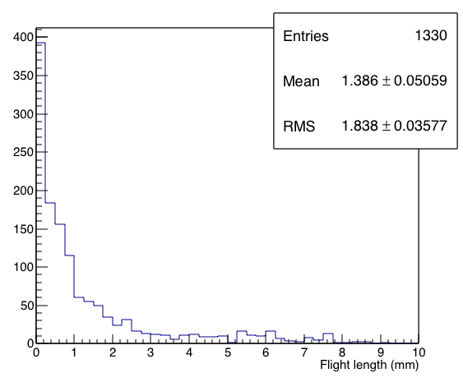
Charmed Hadron Separation
D⁺
<L> ~ 5.9 mm
Ds⁺
<L> ~ 2.8 mm
Λc⁺
<L> ~ 1.3 mm

Slide 18
Conclusions & Outlook
Preliminary considerations for charm production measurement in p-Mo interactions
10⁹ protons from SPS
Assume 10⁴/cm² in emulsions → 10⁵ cm² x 15 films = 1.5 x 10⁶ cm² (1000 bricks)
Current speed per system ~ 100 cm²/h → analysis time = 1.5 x 10⁴ hours ~ 2 months for 10 systems
NEXT STEPS
Charmed hadron separation with a likelihood approach
Optimize the detector layout
Background evaluation
Detector performances
Include primary vertex tracks
Implementation in FairShip

