Slide 1
HL-LHC IT String Test
1st MPE brainstorming
D. Wollmann
Cern, MPE

Slide 2
Outline
Scope of HL-LHC string test
Components
Schedule
Discussion on MPE requirements and test wish list.

Slide 3
THE SCOPE of the HL LHC STRING
Courtesy M. Bajko
MAIN GOAL
The HL LHC IT STRING will be a test stand to STUDY and VALIDATE the COLLECTIVE BEHAVIOURE of the different systems of the HL LHC: magnets, magnet protection, cryogenics for magnets and superconducting link, magnet powering, vacuum, and interconnections between magnets and superconducting link, alignment, interlocks.
TIMELINE
The test is necessary to be performed BEFORE the series equipment will be INSTALLED in the future HL LHC machine. The HL LHC STRING test is planned for a total duration of max. 2 years while it will be operated in alternate with the HL LHC SC LINK test station using the same cryogenic installations and electrical powering systems.

Slide 4
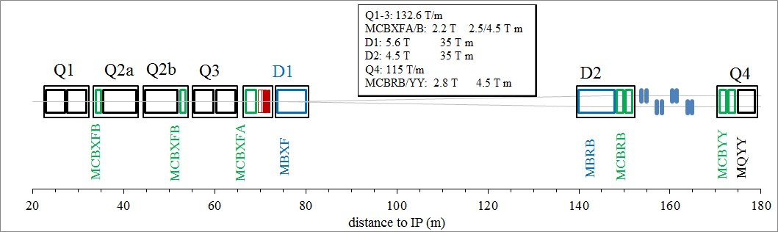
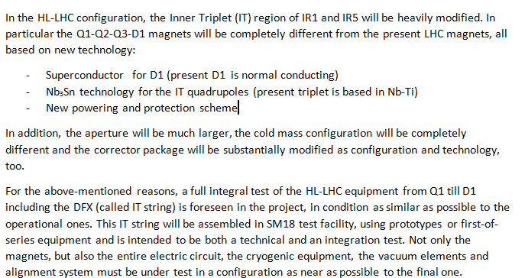
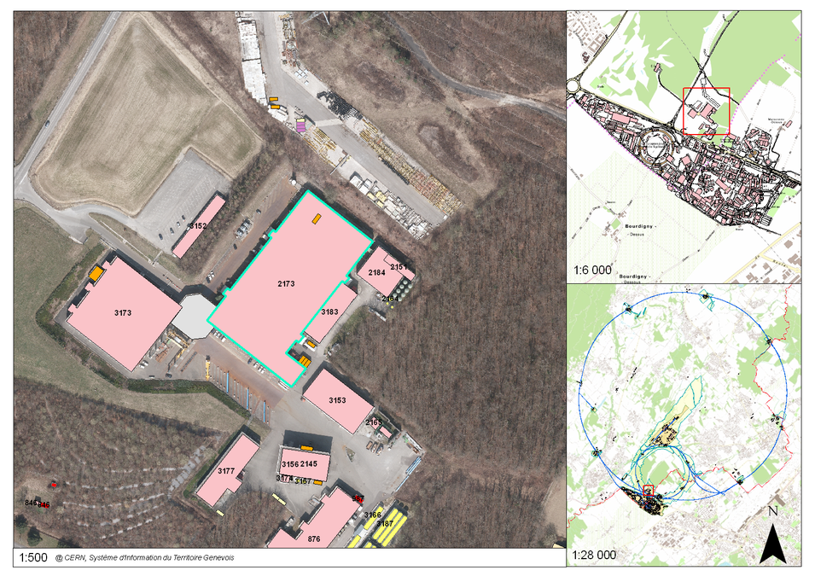
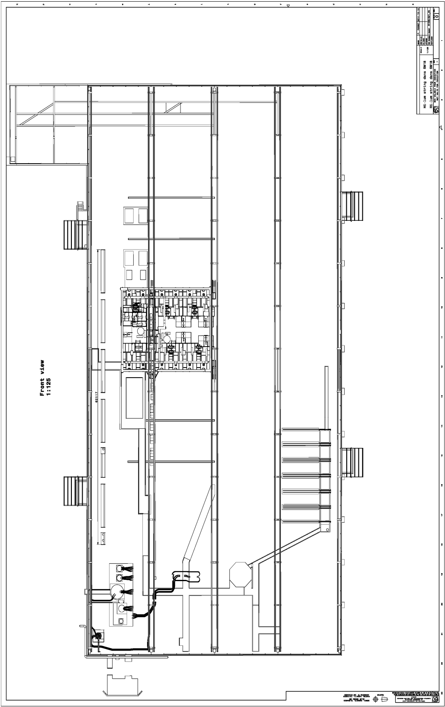

IT STRING COMPONENTS
Courtesy M. Bajko
IR STRING DSH
DFH + CL IR PC
Cluster D
Cluster A
Cluster E
Cluster B
Cluster F
Cluster C

Slide 5
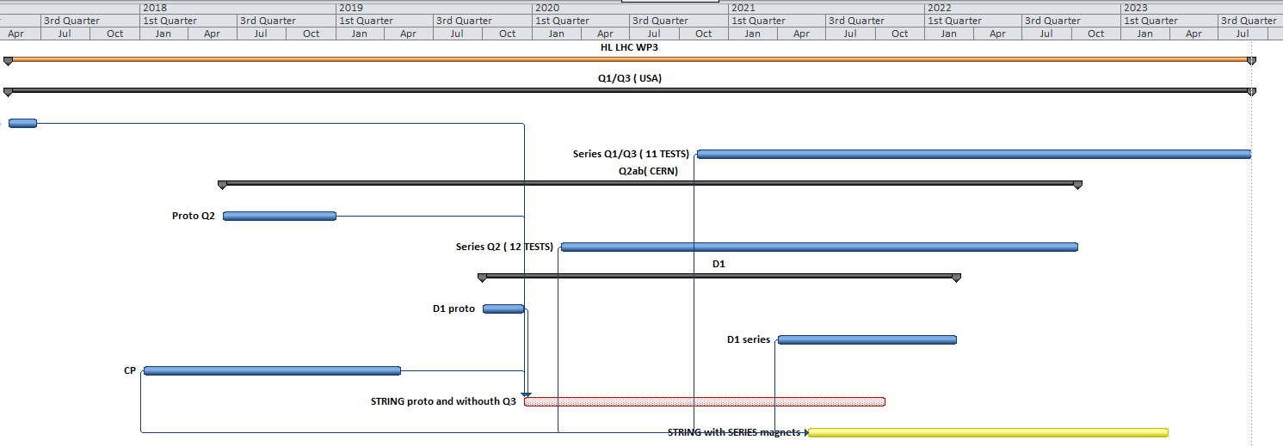
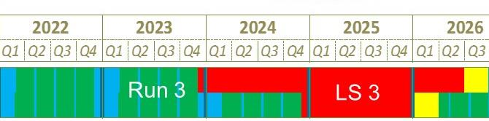
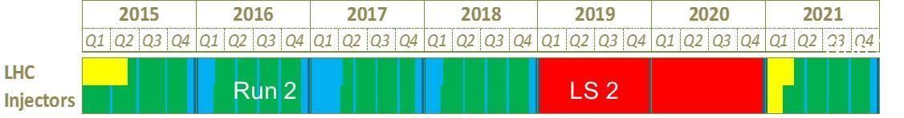
TIMLINE : HL LHC STRING
Courtesy M. Bajko
2018
2019
2020
2021
2022
2023
STRING Phase1
STRING Phase2

Slide 6
Some notes from meeting IT string meeting 17.11.2015
String goals to use full HL-LHC topology i.e. magnets, magnet protection, cryogenics, sc link, powering, vacuum, interconnections between sc link and magnets, alignment, interlocks + control systems
Two phased approach
Magnets: D1, Q3, Q2b, Q2a, Q1 + corrector packages + D2, ifD1 and D2 will be powered together.
SM18 sc link test station + visitor area
Testing up to ultimate current
Alignment of beam screen after quench —> to be discussed with alignment experts how and what could be done.
Test electro magnetic coupling between different circuits.
Use of quench antennas?

Slide 7
MPE wish list - brainstorming
Test electro magnetic coupling between different circuits.

