Slide 1
Comment to FNAL slides: https://indico.cern.ch/event/482835/contribution/1/attachments/1210550/1765498/G4Validation_Jan13.pdf
D Konstantinov
CERN

Slide 2
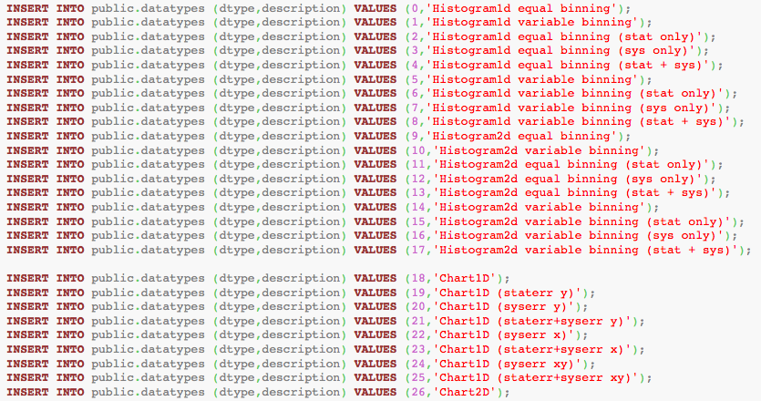
data types proposal
The proposal suggests too many different types of data.
The way of putting data into “content” row suggests that “reading in” algorithm depends on data type (if we have statistical errors we put then if not we do not put them, etc)
Proposal: reduce of different classes, i.e. to use more common cases Hitsogram1D, Histogram2D, Chart1D, Chart2D etc
-

Slide 3
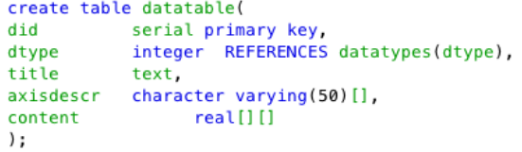
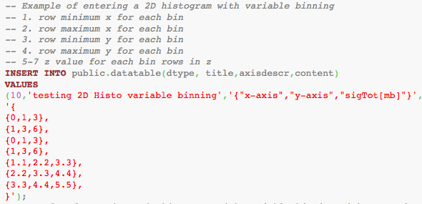
“content” row for data table
Any type of data(1D, 2D) is supposed to be streamed to double dimensional array of reals (“content” row).
The presented example of insertion of 2D histogram works in particular case only when numbers of bins of 2D histogram in X and Y are equal (ie one can not insert histogram where m!=n)

Slide 4
Summary
too many data types which are implicating different "read in" algorithms
the data table is not able to keep 2D histogram with arbitrary dimensions

