Slide 1
TDI and TDIS impedance
Benoit for the impedance team

Slide 2
TDI/TDIS impedance simulations
Many difficulties :
Very long and large device with many small features (gaps)
→ very high number of mesh cells needed
→ very high number of excited modes
Modelling of Ti coating
→ only with analytical models
→ EM properties for all frequencies not easily measurable
Modelling of hBN losses
→ only through conductivity so far
Challenge and uncertainty
on 3D simulations
uncertainty
on resistive wall analytical computations
Large uncertainty on TDI impedance assessment
Needs bench and beam measurements for crosscheck

Slide 3
Main issues linked to TDI8 during 2015 run
Larger power loss (factor 2)
→ beam induced heating
→ could be directly or indirectly linked to vaccum spikes, jaw deformation, higher losses at warm
Larger transverse impedance (factor 4.5)
→ reduced stability threshold at injection for B2

Slide 4
Possible origins of TDI8 issues
Power loss
→ Larger longitudinal real resistive wall impedance of the TDI jaws (lower conductivity, thinner or no coating)
larger resonant modes
Tune shift
→ Larger transverse imaginary resistive wall impedance of the TDI jaws (lower conductivity, thinner or no coating)
larger resonant modes → much less likely (especially in the absence of huge change of geometry)
→ The issues seem most likely due to the resistive wall, as the current results from the bench measurements also seem to indicate

Slide 5
Possible origins of TDI2 impedance
Power loss
→ longitudinal real resistive wall impedance of the TDI jaws
resonant modes
Tune shift
transverse imaginary resistive wall impedance of the TDI jaws
geometric impedance
→ Can resistive wall impedance explain most of the observed impedance effects?

Slide 6
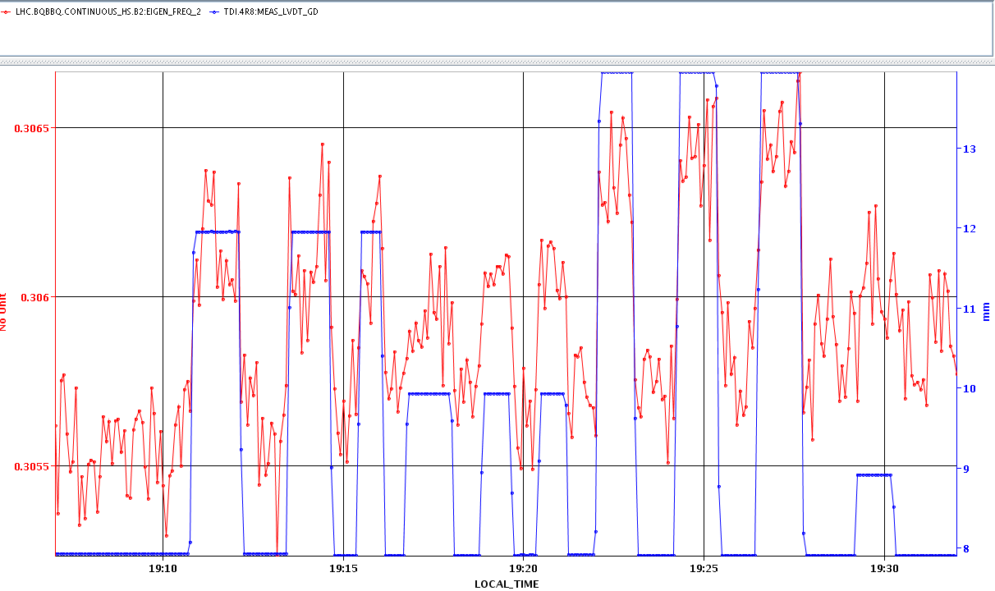
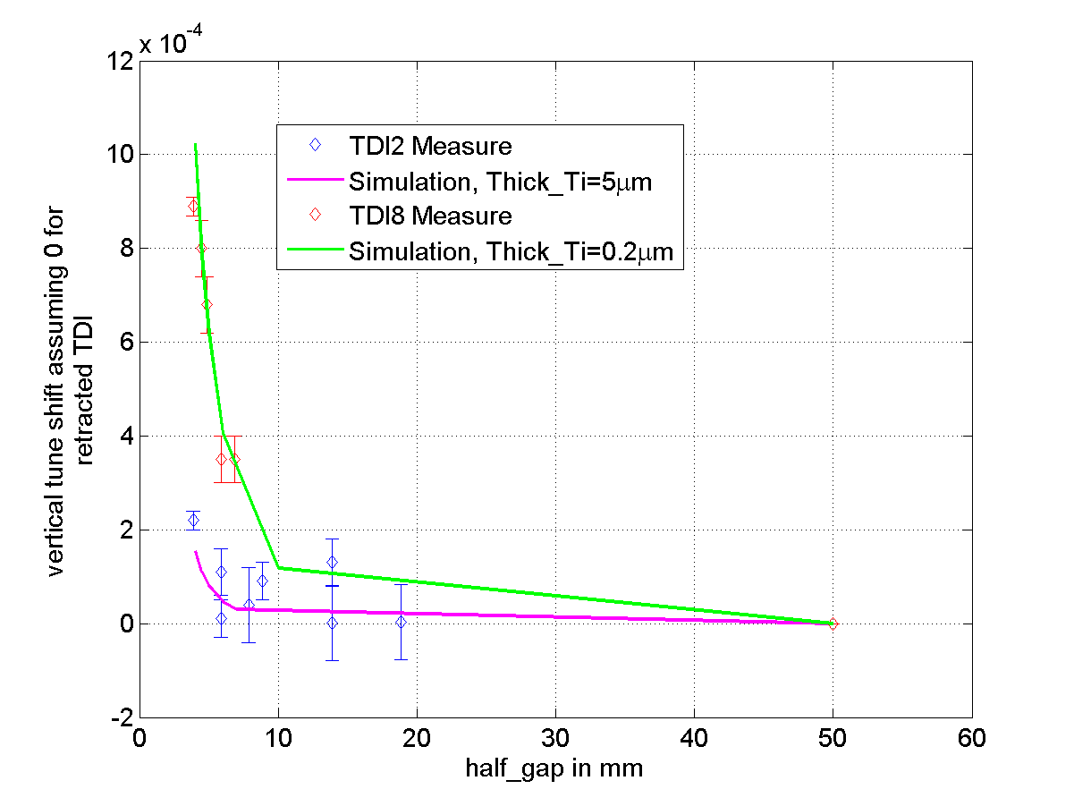
Further TDI impedance tests at injection with smaller gaps (September 15th 2015)
Presented at LMC in September 2015
TDI tune shift vs gap
Tune B2
5e-4
TDI8 full GAP
1 mm
Assuming everything else is the same and no other contribution
the measured transverse tune shifts could be explained (including the 1/b^2 dependence)
- by a coating thickness of 5 micron for TDI2 (design value)
- by a coating thickness of 0.2 micron for TDI8
the measured synchronous phase shifts could be explained
- by a coating thickness of 1 micron for TDI2
- by a coating thickness of 0.2 micron for TDI8
Reduced coating thickness on TDI8 could explain some aspects, but it is not the full picture
It would be useful for the synchronous phase shift to do more steps at intermediate gaps

Slide 7
Further TDI impedance tests at injection with smaller gaps (September 15th 2015)
Presented at LMC in September 2015
TDI tune shift vs gap
Tune B2
5e-4
TDI8 full GAP
1 mm
Assuming everything else is the same and no other contribution
the measured transverse tune shifts could be explained (including the 1/b^2 dependence)
- by a coating thickness of 5 micron for TDI2 (design value)
- by a coating thickness of 0.2 micron for TDI8
the measured synchronous phase shifts could be explained
- by a coating thickness of 1 micron for TDI2
- by a coating thickness of 0.2 micron for TDI8
Resistive wall seems to explain quite well the tune shift but not the energy loss
What is missing? Is our estimate wrong or is there another contribution

Slide 8
What could explain this large discrepancy for the power loss of TDI2?
1) Large resonant modes which would contribute to the power loss
In that case:
→ the currently installed TDI will probably need a quick replacement with TDIS optimized from impedance and cooling point of view → absolute need to optimise the geometry of the TDIS, maybe to the expense of relaxing other constraints (i.e. aperture for ZDC, 3 jaw option)
fill all gaps (between jaws and beam screen and between the jaws) and damp all modes
2) Issues with assessing the real longitudinal resistive wall impedance of the conforming hBN blocks (we only benchmarked the transverse impedance at low frequencies - up to 2 MHz)
The replacement of the jaws in the currently installed TDIs should solve most of the issues
Geometry of the TDIS could be reasonably optimised accordingly
No clear need to exchange TDIS from impedance point of view in LS2, could be done later if needed to get a better design.
3) Additional non conformities?
The answer to this question drives the design and the planning of the TDIS This answer can be obtained:
Provided the new TDIs are conforming
With checking the stable phase of the new TDI jaws (can be done as soon as there is 1 INDIV in the machine at injection) → this test should be requested with high priority.

Slide 9
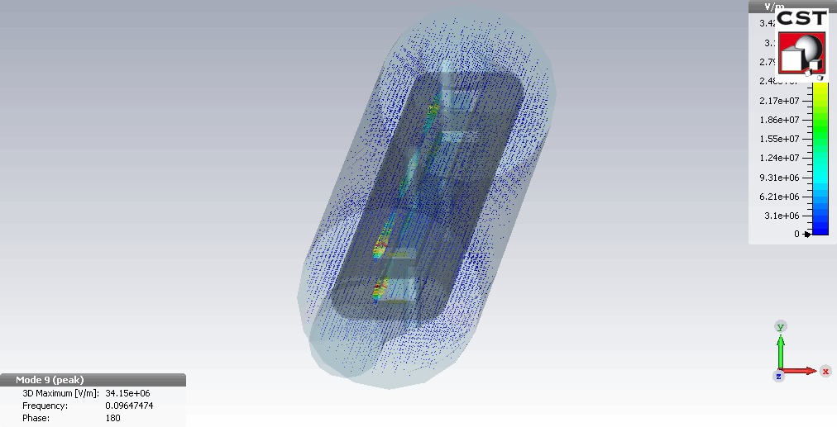
Current TDIS design from Luca (Xth iteration, design from Nov 27th 2015)
Idea: reduce impedance with high priority (WP14)
2 fields of action:
Resistive wall contribution: efficiently addressed by the copper coated graphite
Modes: gave the guidelines to fill all gaps around the jaws, which are responsible for the low frequency modes (~1 kOhm at ~100 MHz → could lead to up to several hundreds of W at injection)
Example of mode at 96 MHz
Rsh=1 kOhm
Q= 600
if overlap
Ploss for Run 2 ~ 350 W (1.3e11, 2748 bunches, 1.2 ns)
Ploss for HiLumi ~ 1 kW (2.2e11, 2748 bunches, 1.2 ns)

Slide 10
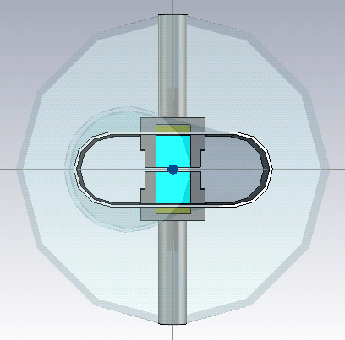
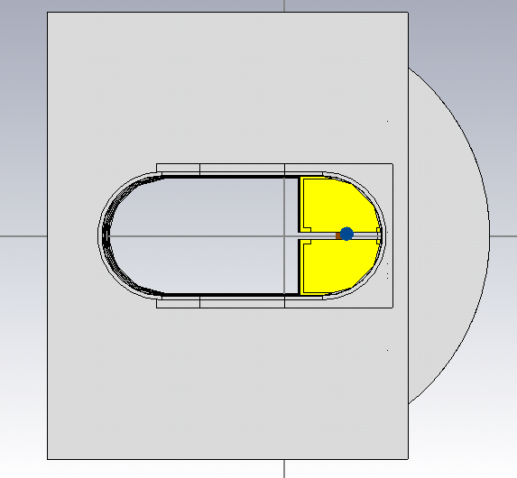
Current TDIS design from Luca (Xth iteration, design from Nov 27th 2015)
Current TDI
New TDIS

Slide 11
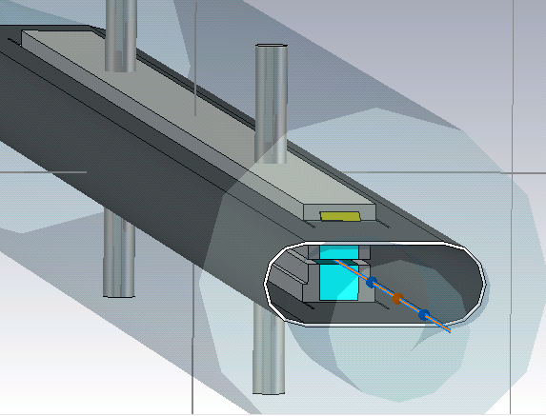
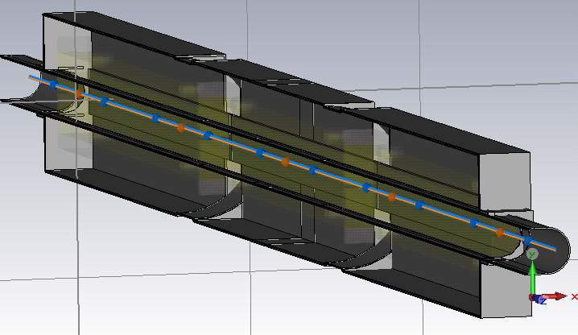
Current TDIS design from Luca (Xth iteration, design from Nov 27th 2015)
RF fingers between jaw and side plate
Reduced volume on the side opposite to the beam screen
Continuous side plate at the interconnection

Slide 12
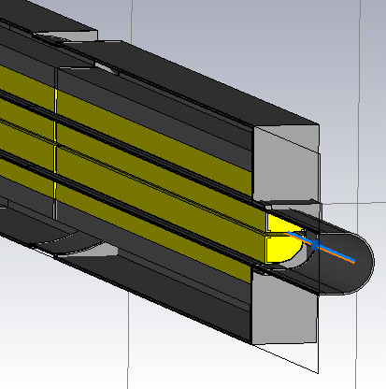
Current TDIS design from Luca (Xth iteration, design from Nov 27th 2015)
RF fingers between jaw and beam screen
Reduce gap width and volume as much as possible, avoid if possible, and install RF fingers if not

Slide 13
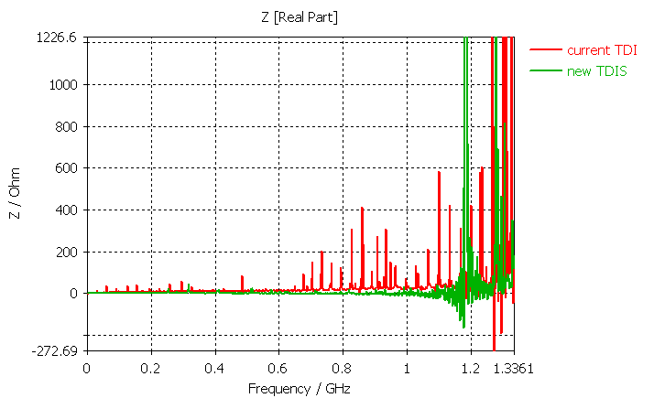
New TDI vs old TDI (longitudinal plane)
→ Much cleaner from mode point of view thanks to closing the gaps

Slide 14
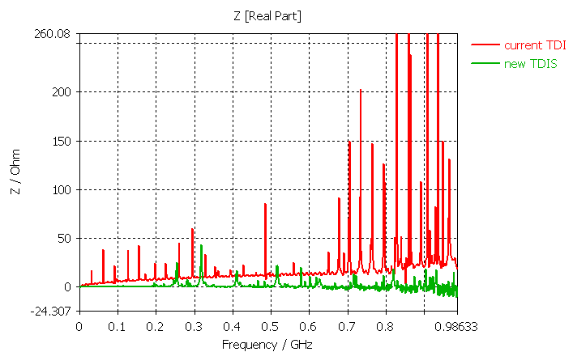
New TDI vs old TDI (longitudinal plane)
→ Much cleaner from mode point of view thanks to closing the gaps

Slide 15
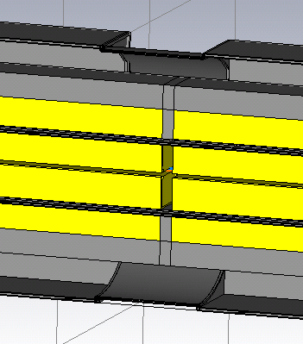
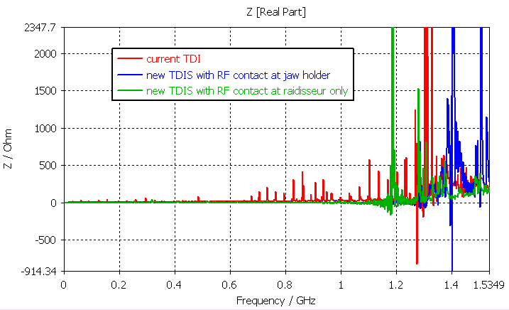
New TDI
RF contact at the level of the raidisseur
RF contact at the level of the jaw holder
Shift of 200 MHz

Slide 16
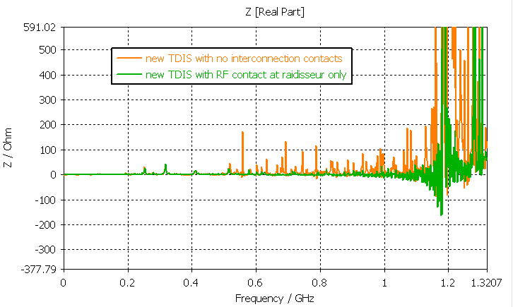
New TDI
Removing the interconnection contact

Slide 17
Summary
Still significant uncertainty on origin of conforming TDI power loss
Strong need for measurements with beam
need to know in order to focus better the effort on reducing the TDI impedance
Also need to check the performance and reliability of the proposed solution to mitigate resistive wall contribution, as strategy may have to be revised in case it cannot be used.
Proposed TDIS design is well optimised and RF fingers are critical to suppress the low frequency modes.

