Slide 1
Task 13.2.2 Radiation HArd BLM Electronics 10'

Slide 2
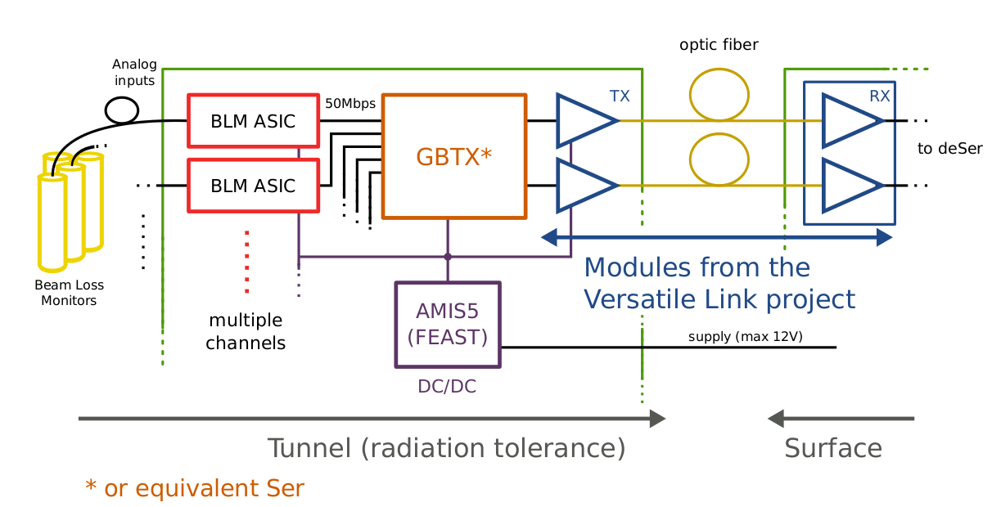
System Overview
VFC

Slide 3
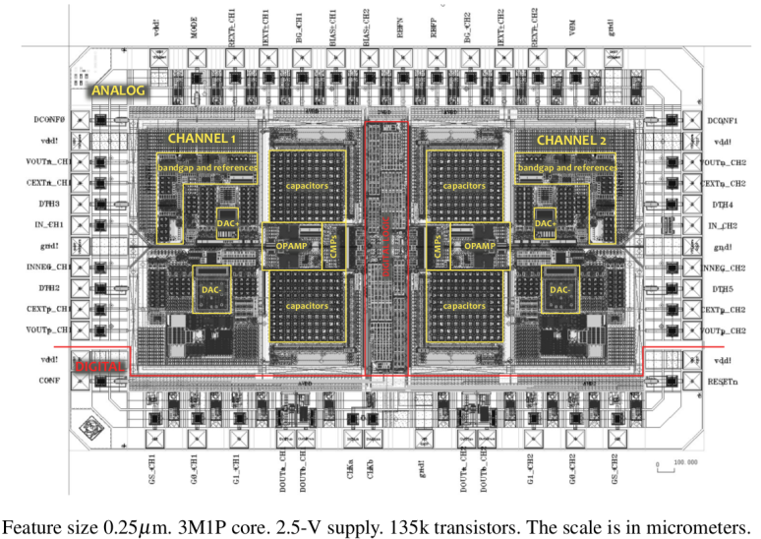
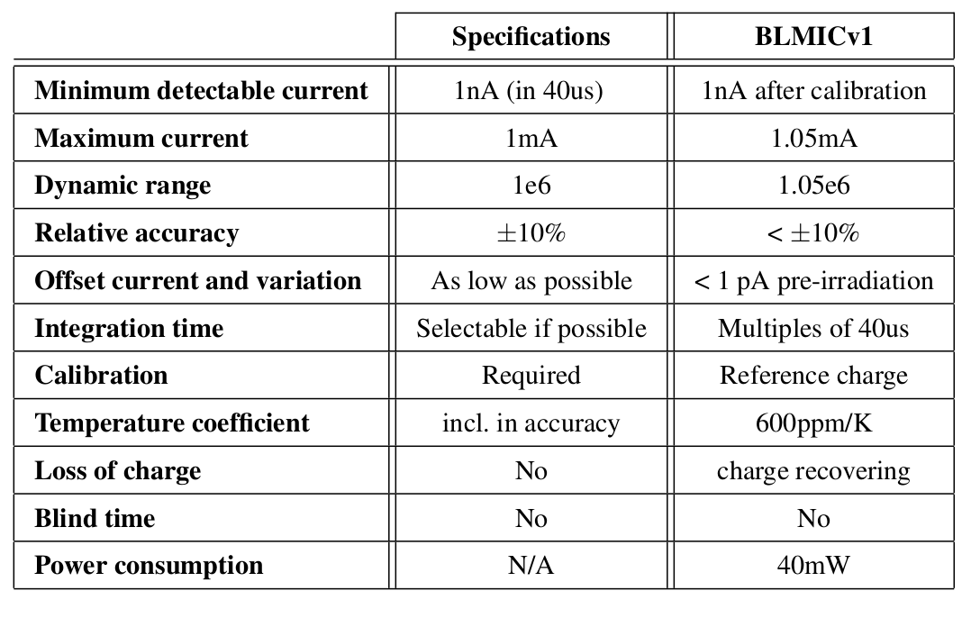
Requirements and test result of version 1
Higher radiation tolerance:
The A/D conversion can be performed close to the detector:
  Before noise and interference add to the signal
  Allowing transmitting digital signals, significantly more resistant to disturbances
Allow positive and negative input signals:
  Supply-polarity independent solution
  Allow positive and negative
• •
Irradiation up to 100 kGy (Xray 20keV)
  Two chips tested
  Increase of offset current to 36 pA
  Full scale change by 3 %
Climatic test
  In range 13 - 43 °C full-scale charge is within +/- 1%
  No offset change
Analogue part of version 1 satisfies the specification

Slide 4
Summary and Future
Development efforts have been resumed by Francesco Zappon
Development steps
  Test of existing ASIC version 2.1 (new: logic implemented)
    modification of test set up
    Functional test
    Climatic test
    Irradiation test
    Envisaged end of test June 2016
  Field test
    PCB design
    Acquisition design
  Design of ASIC version 3.0
    Correction of nonconformities
    Adaption of logic to GBTx
    Envisaged submission of version 3.0 December 2016
Investigation of the ASIC development and production options ongoing
(250 nm process has limited support)

