Slide 1
New LSS BPMs
Drasko Draskovic, Thibaut Lefevre, Christian Boccard
BE-BI-QP
1st BI HL-LHC WP13 Project Meeting
Task 13.4
29.01.2016

Slide 2
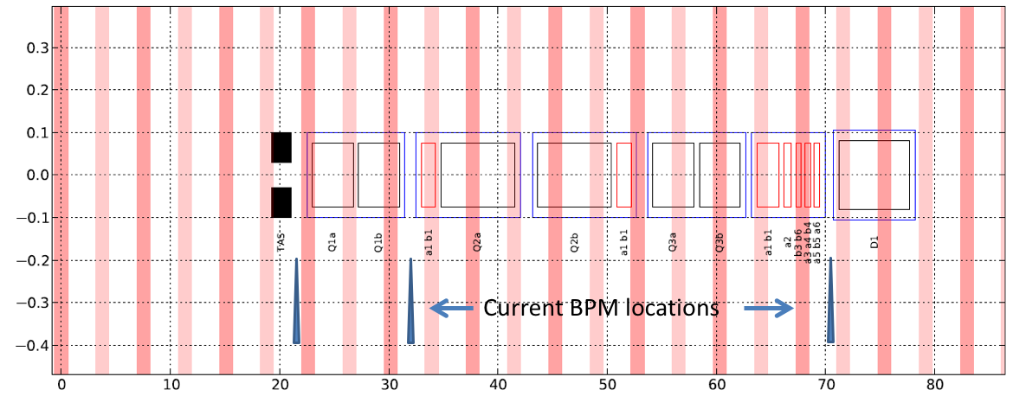
LHC Triplet BPMs

Slide 3
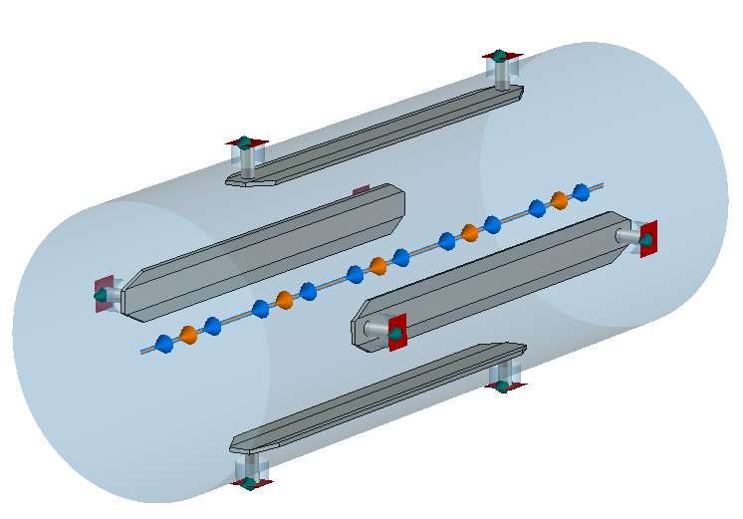
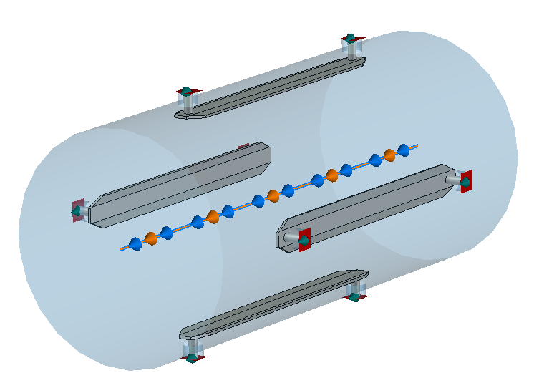
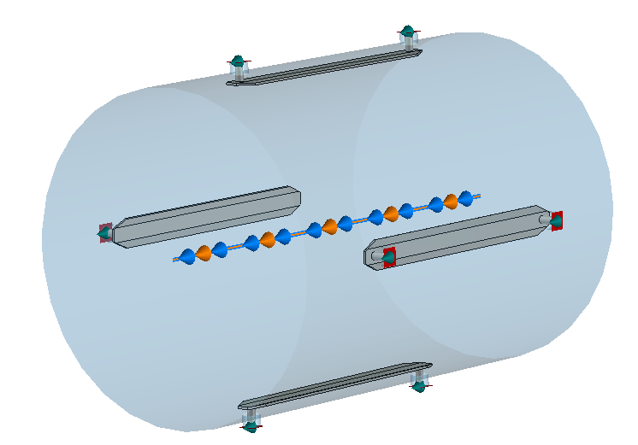
LHC Triplet BPMs
BPMSW/S BPMSX BPMD/BPMSE
Beam pipe diameter (mm) 68.8 88.8 138.8
Aperture (mm) 61 81 131
Electrode length (mm) 120 120 120
Notes:
BPMSW Warm Directional Stripline Coupler (Q1) 8, BPMS Cryogenic Directional Stripline Coupler (Q2) 8, BPMSX Warm Directional Stripline Coupler behind D1 4,
BPMD BPM after MKB Diluter for the Dump lines 2, BPMSE BPM upstream of TCDS in IR6 2

Slide 4
LHC Triplet BPMs
Limited number of BPMs : no redundancy
Limited Accuracy: BPMSW @Q1 very difficult to align properly: large uncertainty of the alignment procedure : not better than 1mm
Stability issue due to temperature dependence in the acquisition system
Limited directivity of the present strip-line design: worse than 20 dB full bandwidth
Cross-talk between the two beams. Error depends of the bunch intensity and position
Resolution of the order of 100um in bunch-by-bunch and better than 10um in Orbit mode
Linked to the current electronics design
Improved using new high resolution electronics (<100nm), DOROS, being installed in parallel with WBTN on Q1: option for gating on specific bunch

Slide 5
Some HL-LHC BPM Constraints
Tungsten-Inermet shielding for absorbing collision debris
Need to rotate BPM by 45 degrees & insert shielding on mid-planes
Adding weight, design complexity (transition from beam screen to BPM) and probably quite costly
Adding up to heat deposition that needs to be estimated
Cryo BPM : Cold to warm implies using sliding contact for strip-line
Larger aperture: less signal & lower final resolution

Slide 6
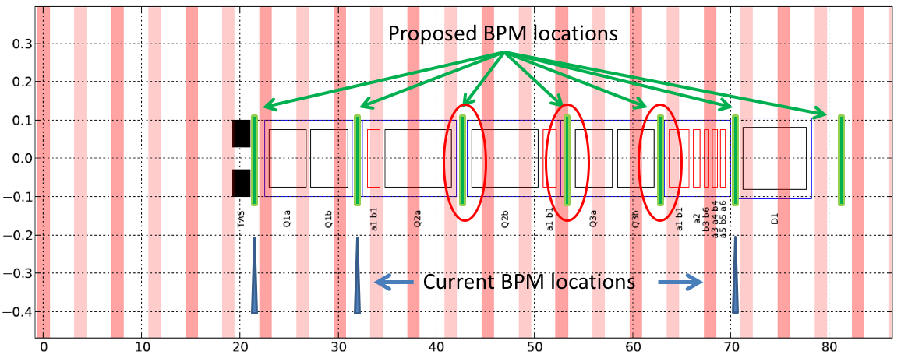
HL-LHC BPMs
7 BPMs for better tuning and redundancy
Rotated 45deg with Inermet
BPMs in the interconnects

Slide 7
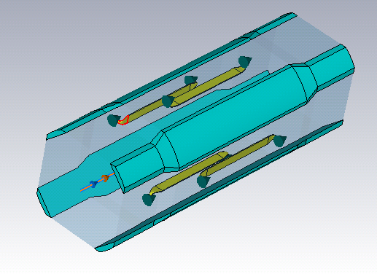
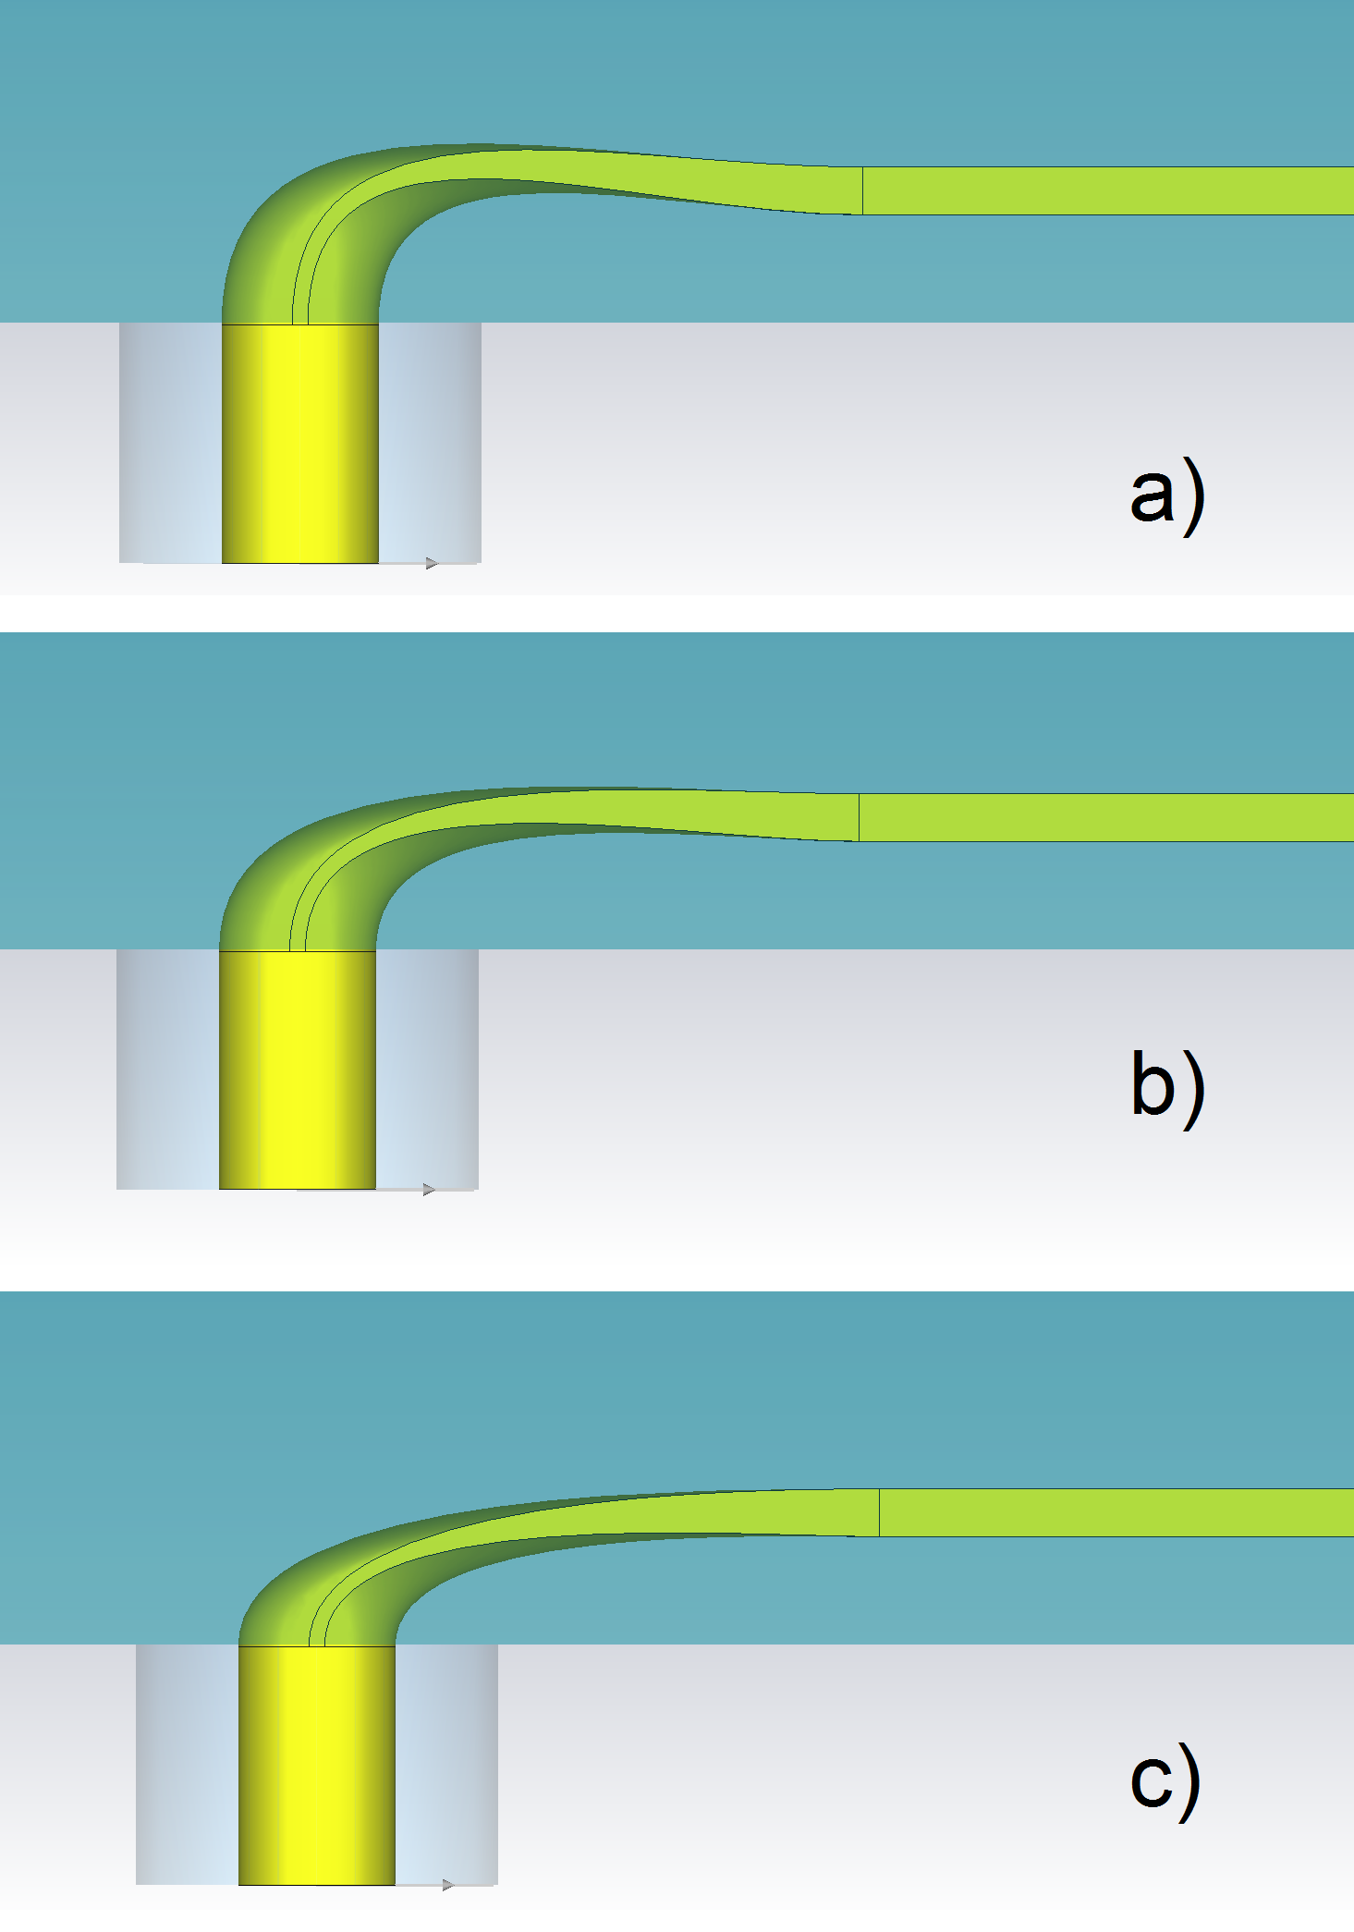
Design of Stripline BPMs for the
High Luminosity LHC
Optimizing the stripline directivity to provide best possible accuracy
Design with Tungsten-Inermet absorbers
RF simulations showed 7 to 10dB improvement compared to current LHC design (IPAC’15 paper MOPTY053)

Slide 8
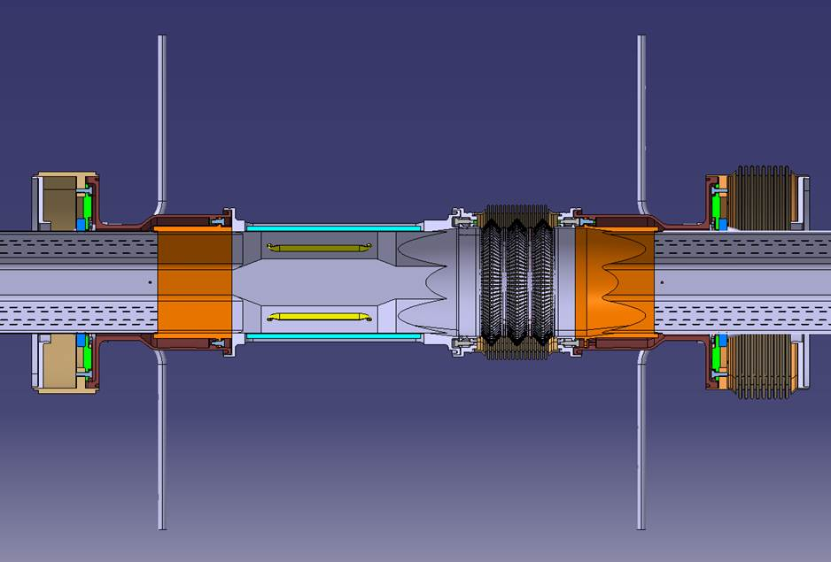
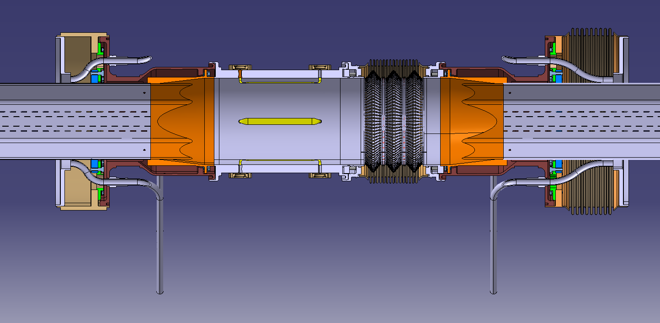
Design of Stripline BPMs for the
High Luminosity LHC
Mechanical designs
Integration of pick-up in the triplet interconnection: two designs being considered (circular and octogonal shape)
Additional FLUKA simulations are being performed to confirm the need of Inermet absorbers and their dimensions. Further extend the shielding? https://indico.cern.ch/event/400665/session/11/contribution/83/attachments/1178005/1704056/Edep_studies_V12_Tsinganis.pdf

Slide 9
MD369 LHC BPM
Goal
Check the sensitivity of the BPM electronics with two acquisition chain electronics systems, WBTN (Wide Band Time Normalizer) and DOROS (Diode ORbit and Oscillation System) to the position of the BPM with respect to beam encounters.

Slide 10
MD369 LHC BPM
Unperturbed beam position
Perfect overlap of the two beams in time: >100um offset
P1 Scenario 1, vertical position drift

Slide 11
MD369 LHC BPM
MD Conclusion / Blind area specification
Answer to WP2 about the blind area, so that the decision can be made on the positions of the BPMs
The central position of the BPM should be outside an area defined by ±57.0 cm from the position of the long range interactions.
Currently HLLHCv1.2 BPM positions TAXS-Q1, Q1b-Q2a in the blind area.

Slide 12
BPM position: Integration Decision Pending
Option 1: BPM in the experiment with difficult alignment, BPM inside Q1 in blind area but with good alignment. Not yet feasible due to cryogenics and ATLAS openings.
Option 2: no BPM in the experiment, BPM outside Q1 with bad alignment and not in blind area. No solution for alignment and leaks.
Option 3: BPM in the TAXS with bad alignment and access, BPM inside Q1 good alignment.
Option 4: Ls=24 m, degradation of pre-squeeze and squeezed beta*.
Option 5: Ls=22.8 m no BPM in experimental area, BPM in Q1 in the good area, well aligned and more reliable, difficult to move Q1 towards the IP.
Option 6: Attach TAXS to Q1, mechanically difficult.
Courtesy: Riccardo De Maria https://indico.cern.ch/event/402184/

Slide 13
Next Steps

Slide 14
Next Steps
Launch the fabrication of the optimised stripline in 2016 with the main goal to validate simulations
3D Printing of the electrode (Christian Boccard coordinating with EN-MME)
Finalize the simulations as soon as we get more info from TE-VSC, TE-MSC, EN-STI, BE-ABP

