Slide 1
RPC activity
Shereen Aly
Helwan University,Egypt

Slide 2
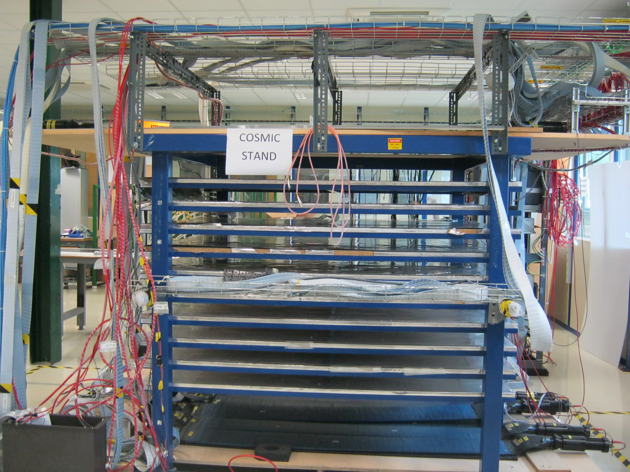
introduction
I was involved in preparing the cosmic telescope in 904 to test new prototypes of the RPC for the CMS upgrade.the telescope consists of 20 scintillator (10 up and down side) in coincidence with the rpc chambers that are sandwiched between them.

Slide 3
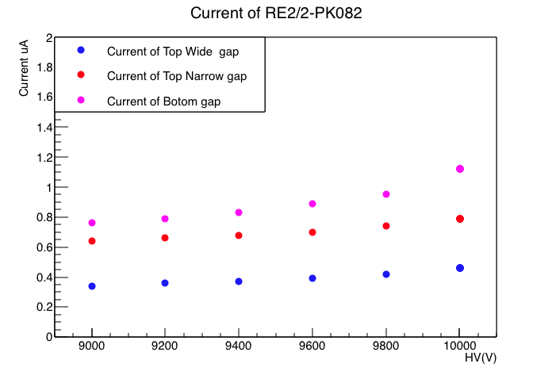
Hv scan for RE2/2-PK082
An HV scan has been performed for RE2/2-PK082 for the three gaps up to 10KV.

Slide 4
Daq system
For each HV point the data from the rpc are read from the daq .the signal from the scintillators (10 up and 10 down) used as a trigger for the daq system and the number of triggers are set to be 10K events.
Scint. as a trigger
PC
TDC
RE2/2-PK082

Slide 5
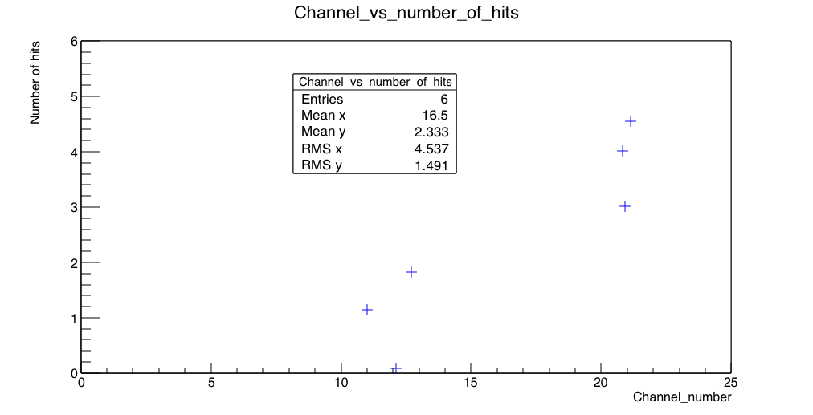
Strip profile
The following plot shows the number of hits versus TDC channel number that corresponds to each strip.

Slide 6
Components prepared for Helwan
Three scintillators
LV cables
Connectors and flat cables to fit the connector of the TDC .

Slide 7
Thank you

