Slide 1
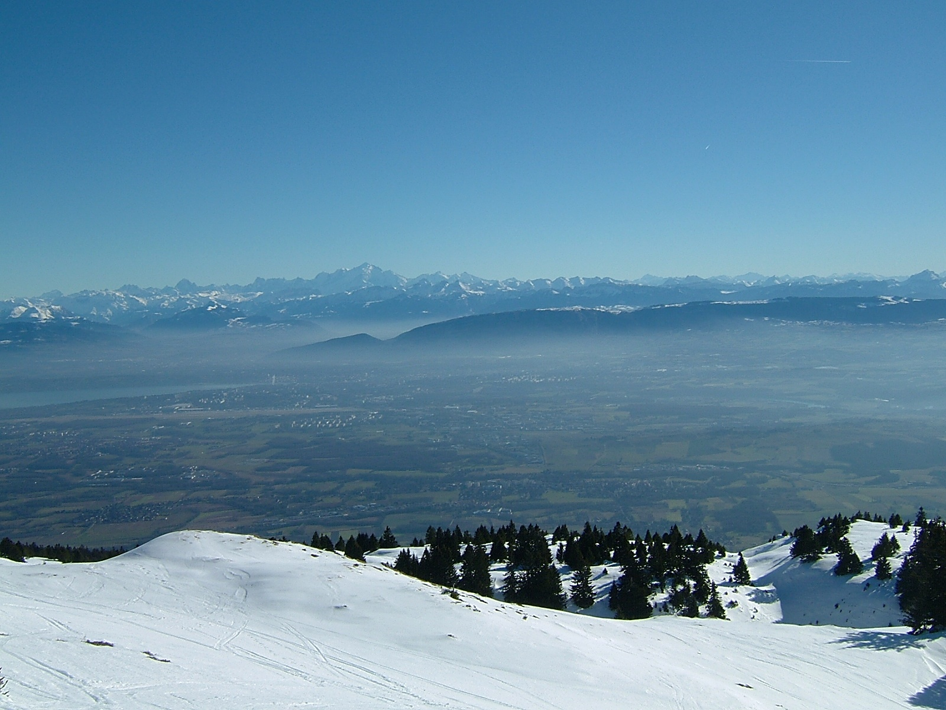
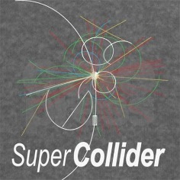


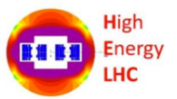
Very High Energy Hadron Colliders
Jörg Wenninger
CERN Beams Department
Operation group - LHC
Acknowledgments to many colleagues, in particular M. Benedikt,
D. Schulte, F. Zimmermann, G. de Rijk, L. Bottura, R. Schmidt, M. Zerlauth

Slide 2
Outline
Introduction
Luminosity
Magnets
High intensity beams
Machine protection
Infrastructure and injectors

Slide 3

High energy colliders
(Very) high energy hadron colliders (VHEC) are generally considered to be discovery machines, for example the heaviest particles of the standard model like b, t, Z, W and H were discovered by HCs. And the search is still ongoing…
N. Arkani-Hamed, FCC kickoff meeting, 2014
With modern detector technology, (very high energy) hadron colliders can also turn into precision machines for some measurements.

Slide 4
High energy colliders
In this talk I will consider as ‘very high energy’ everything that is higher than the LHC 7 TeV per beam.
  There are currently two VHECs – FCC-hh and SPPC – that are studied actively.
  Some past studies also meet my criteria – SSC and VLHC – and I will also mentioned them when appropriate.
The challenges of such machine span a very wide range of topics. The following subset of aspects will be touched today:
  Magnets,
  Synchrotron radiation,
  High intensity beam dynamics,
  Injector chain,
  Machine protection,
  Civil engineering and infrastructure,
  Availability and operation.

Slide 5
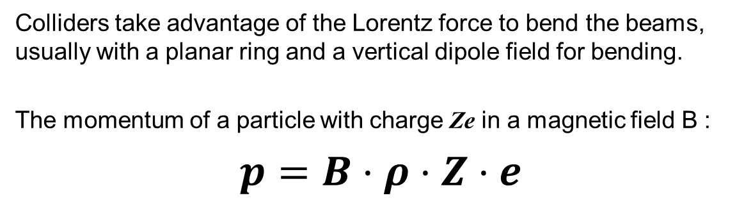
Energy
Colliders take advantage of the Lorentz force to bend the beams, usually with a planar ring and a vertical dipole field for bending.
The momentum of a particle with charge Ze in a magnetic field B :
$p=B⋅ρ⋅Z⋅e$
z
s
B
v
F
radius of curvature
x
The LHC holds the record of magnetic field with 7.7 T (6.5 TeV) operational field (design 8.33 T and 7 TeV).
VHECs are usually aiming at a B-field increase of a factor ~2 wrt LHC.
Since a factor 2 in energy (from B) is not generally considered ‘insufficient’, the size (ρ) is also increased.
  Notable exception of HE-LHC, the energy doubled version of LHC, to be installed in the same tunnel.

Slide 6
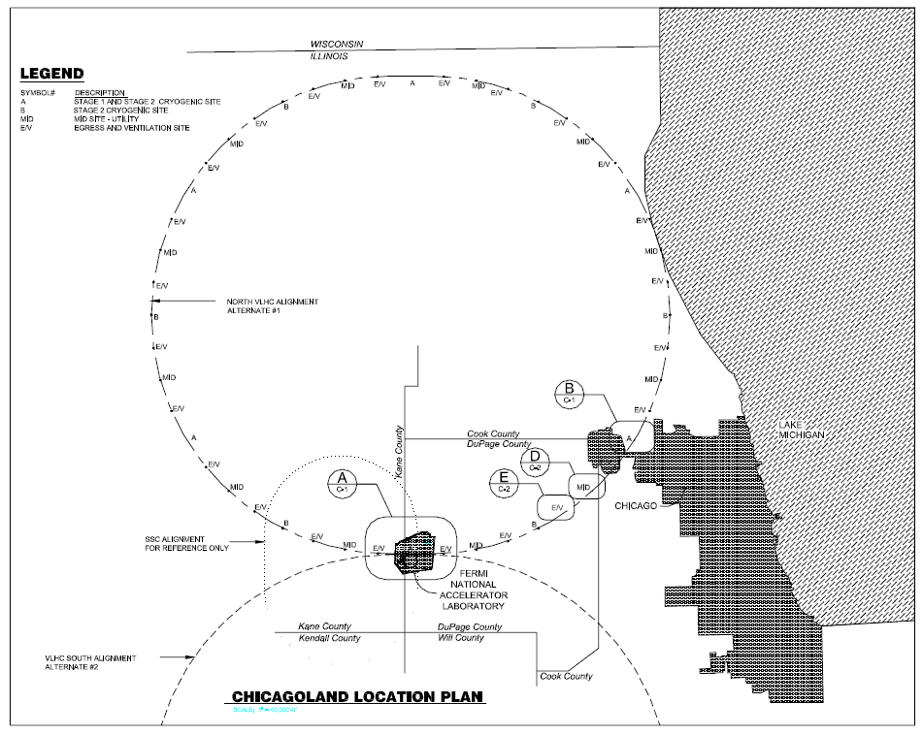
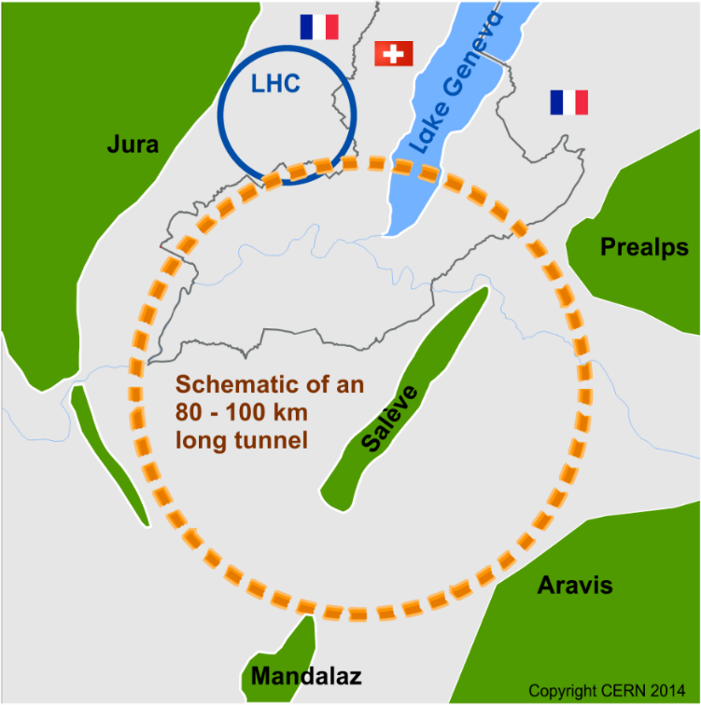

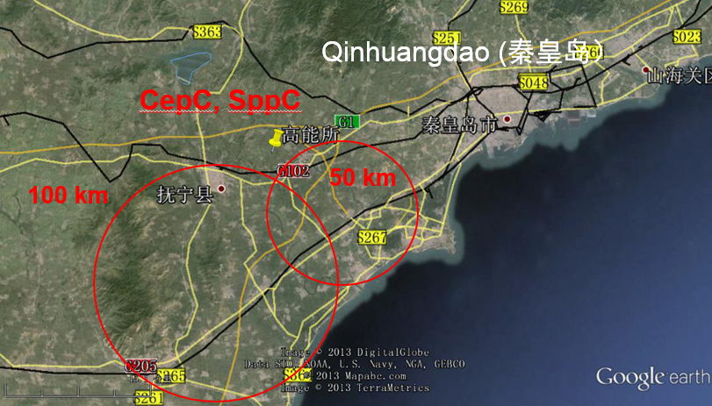
Very large colliders
27 km
HE-LHC
VLHC
230 km
FCC
100 km
87 km
54 km
SSC
SPPC

Slide 7
Luminosity
Another key parameter for the experiments is the event rate dN/dt. For a physics process with cross-section σ it is proprotional to the collider Luminosity L:
unit of L :
1/(surface × time)
Population N₁
Population N₂
area A
N1 × N2
Collision rate ∝
σ ×
× encounters/second
A
L
To maximize L we have to squeeze as many particles as possible into the smallest possible volume !

Slide 8
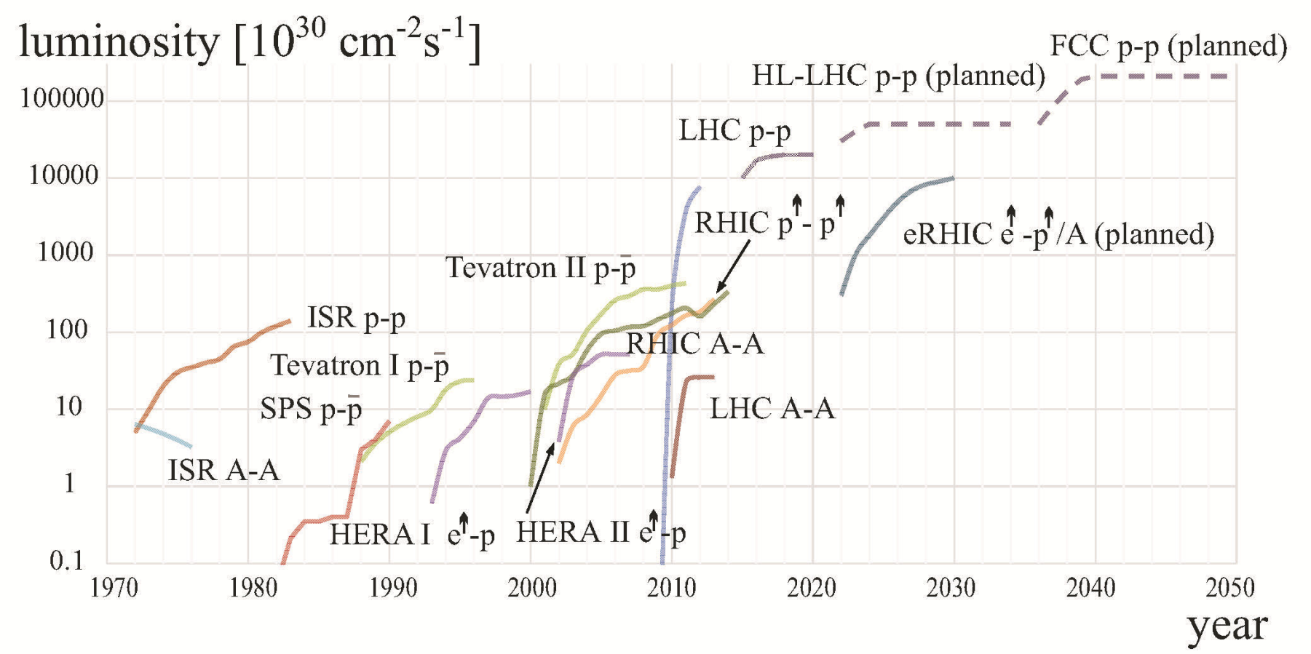
Hadron collider luminosity
The LHC is the latest in the series of the large hadron colliders after the ISR, SPS, Tevatron, HERA and RHIC.
The LHC pushes the luminosity frontier by a factor ~25 and the energy frontier by a factor ~7 wrt Tevatron.
LHC 2016
W. Fischer

Slide 9
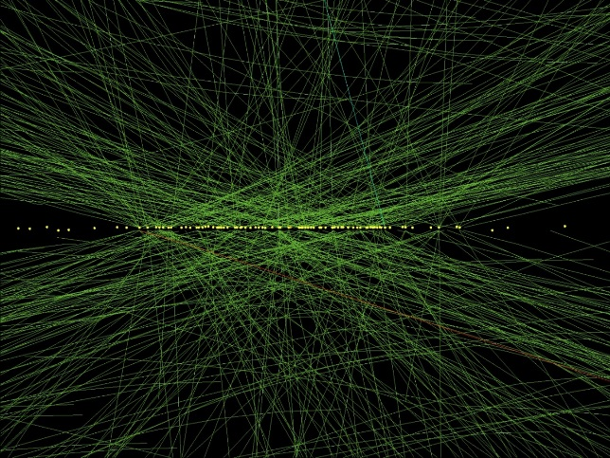
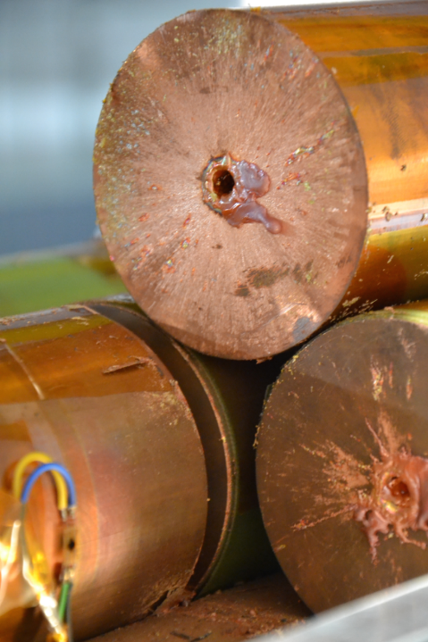
Event pile-up and stored energy
The LHC design parameters remained rather stable over time since the 1980’s, except for the luminosity (and intensity) that was pushed to ~1×10³⁴ cm⁻²s⁻¹ to compete with SSC.
  This implied an average number of collisions by bunch crossing of ~20 instead of 1-2 collisions that were the baseline for SSC.
CMS event with 78 collisions in one bunch crossing
VHECs are able to produce such high luminosities that the pile-up will move into the range of 100-500: it is a huge detector challenge to be able to analyze such events and extract useful physics from them !
Correlated to the high luminosity and beam energy, the energy stored in the beams becomes even more extreme than at LHC.
  ‘Star wars’ regime

Slide 10
VHEC challenges
Magnetic fields:
  Magnet design and protection.
  Cryogenic system.
Luminosity:
  Beam dynamics (stability, vacuum effects and synchrotron radiation).
  Stored energy (accelerator protection and beam loss control).
  Radiation to detectors and accelerator components.
  Event pile-up → for the experiments.
Dimensions:
  Tunnel location.
  Infrastructure.
  Injectors.

Slide 11
Parameter table
Comparison of key parameters of proposed very high energy hadron colliders.
  Please note that for some machines, there is more than one parameter set !
  Within a factor ~2 the bunch parameters are identical for all the designs > SSC.
Parameter | LHC | HE-LHC | SSC | VLHC | FCC-hh | SPPC
Circumference [km] | 27.7 | 27.7 | 87.1 | 233 | 100 | 54
Beam energy [TeV] | 7 | 14 | 20 | 78.5 | 50 | 36
Dipole field [T] | 8.33 | 16 | 6.6 | 11.2 | 16 | 20
Injection energy [TeV] | 0.45 | 0.45 | 2 | 9.8 | 1-3 | 2.1
Intensity / bunch [10¹¹ p] | 1.15 | 2.20 | 0.08 | 0.75 | 1.00 | 2.00
No bunches | 2800 | 2800 | 17424 | 37152 | 10060 | 5798
Intensity / beam [10¹⁴ p] | 3.2 | 6.2 | 1.3 | 27.9 | 10.6 | 11.5
Luminosity [10³⁴ cm⁻²s⁻¹] | 1 | 20 | 0.1 | 2 | 5 | 12
Stored beam energy [GJ] | 0.36 | 1.38 | 0.42 | 35 | 8.4 | 6.68
Synchr. rad. power [W/m/beam] | 0.18 | 3.2 | 1 | 4.7 | 30 | 58
FCC-hh & SPPC are the VHECs that are currently studied in detail

Slide 12
Outline
Introduction
Luminosity
Magnets
High intensity beams
Machine protection
Infrastructure and injectors

Slide 13
Collider luminosity
Expression for the luminosity L (for equal particle populations, Gaussian profiles and round beams) :
k, N, ε : beam properties
β∗ : property of the beam optics
F : beam dynamics
Population N
Population N
σ∗_{x},σ∗_{y} : transverse rms beam sizes - (σ*)² = β*ε
β* : betatron (beam envelope) function ⇔ optics
ε : beam emittance (phase space volume)
k : number of particle bunches per beam.
N : number of particles per bunch.
f : revolution frequency
γ = E/m.
F : geometric correction factor (crossing angles...).
* refers to the IP

Slide 14
Beam parameters
The intrinsic beam parameters are defined by the injectors:
  Bunch spacing (→ k) : minimum (design) = 5-25 ns (⇔ 1.5-7.5 m),
  Bunch intensity N: up to ~ 2×10¹¹ p/bunch,
  Bunch emittance ε : 1-3.5 mm mrad.
The quality of the beam is defined in the injector chain – it is an essential component of a VHEC.
For the LHC startup CERN has refurbished its injector chain to produce the bright LHC beams, a second upgrade wave is now in progress (to be completed in 2020) to more than double N and N/ε (brightness).
→ Presentation by M. Zerlauth (Monday)

Slide 15
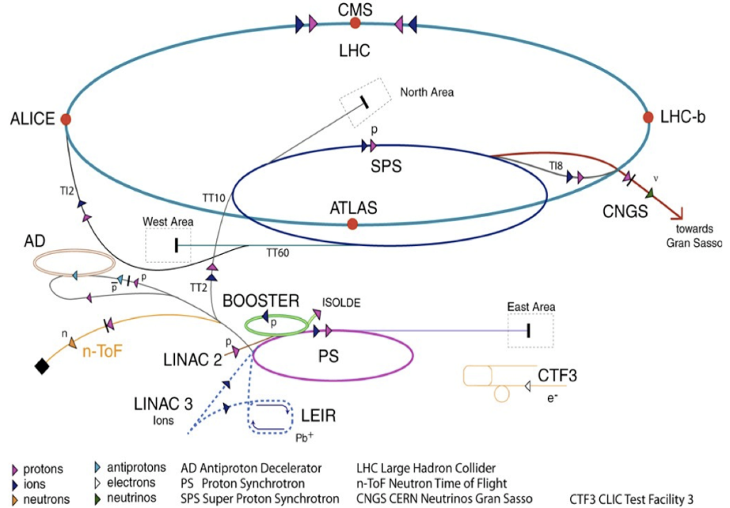
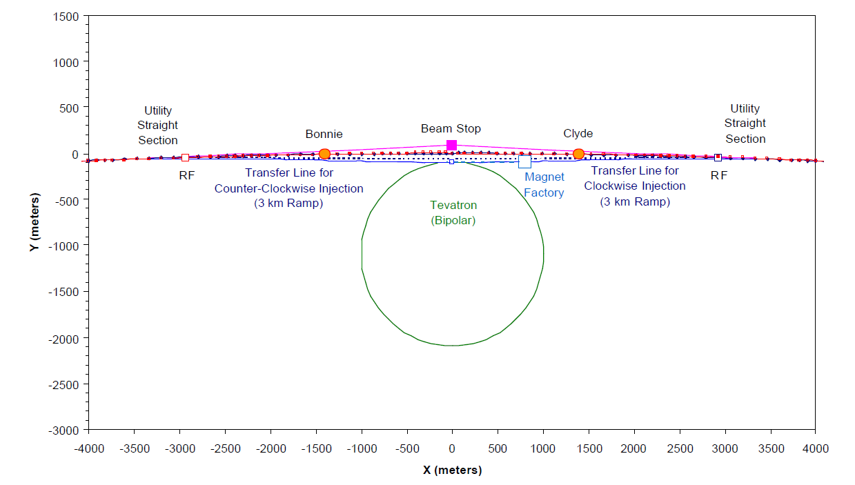
Injectors
A high energy collider requires a long and complex injector chain.
Two facilities in the World that can provide TeV beams : FNAL and CERN.
‘Green field’ adds extra cost...
FCC-hh
 | Max. P (GeV/c) | Length / Circ. (m)
LINAC2 | 0.050 | 30
Booster | 1.4 | 157
PS | 26 | 628
SPS | 450 | 6’911
LHC | 3’000 | 26’657
VLHC
SPPC

Slide 16
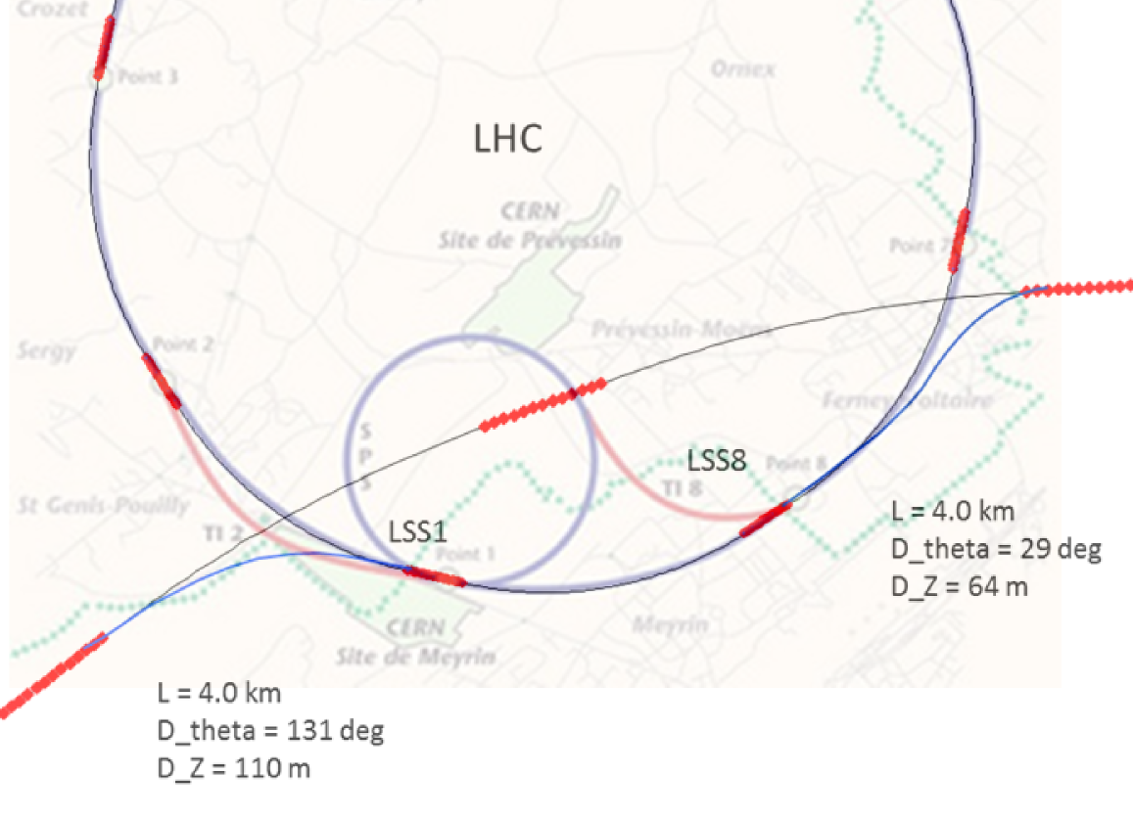
FCC injector chain
Main FCC injector options:
SPS → LHC → FCC
SPS/SPS_{upgrade} → FCC
SPS → FCC booster → FCC
Current baseline:
Injection energy 3.3 TeV with beams provided by a modified LHC.
Alternative options:
Injection energy around 1.5 TeV.
Compatible with: SPS_{upgrade}, LHC, FCC booster.
Worry for this option is the field range of > 30 in FCC: control of field errors at injection may be very tricky.

Slide 17
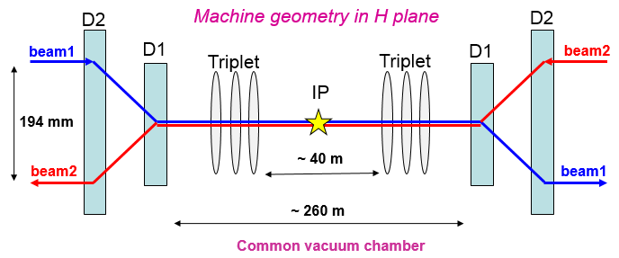
Interaction region
VHECs operate with 2 beams in separate vacuum chambers. They beams are merged into a single vacuum chamber only around the experiments.
All interaction region designs are similar.
  Already the SSC interaction region was conceptually similar to the newer VHECs, except that the rings were stacked vertically as opposed to horizontally for LHC, HE-LHC, FCC-hh.
LHC
SSC
D1,D2 :
Separation / recombination dipoles

Slide 18
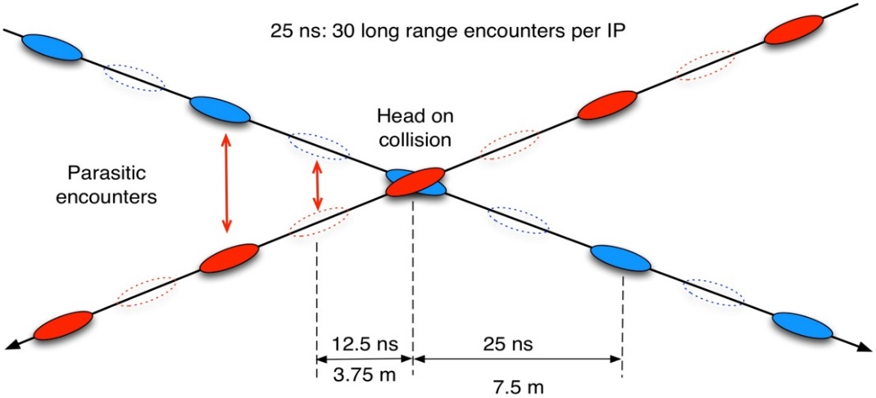
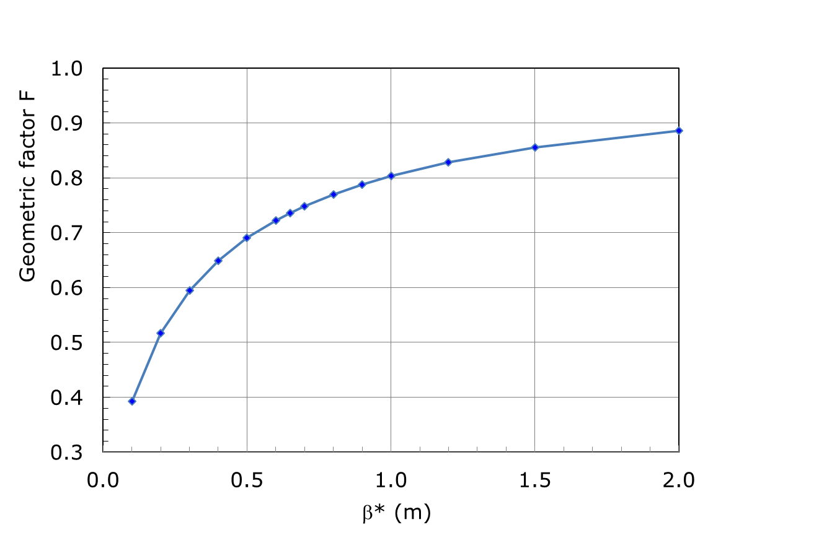
Collision point geometry
A crossing angle between the beams is needed to minimize the electromagnetic interactions (beam-beam effects) in the common vacuum chamber (final focus region).
  Min. separation ~10 beam sizes.
  30 encounters per IP at the LHC.
Consequences of colliding at an angle:
  Significant geometric luminosity reduction that depends on beam size and bunch length: steep function of the beam size (β* ε = σ^{∗2}).
  Reduction of the aperture.
2θ
LHC 2016 operation point
35% loss due to geometric effect

Slide 19
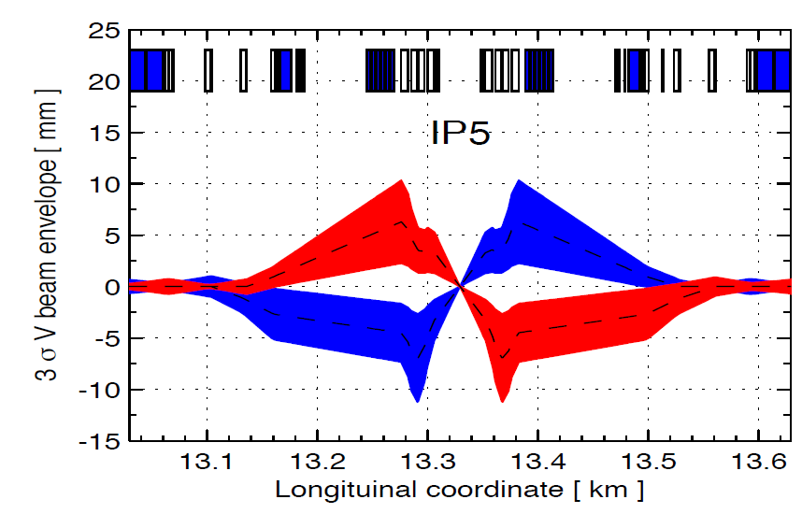
Collision point focusing
The minimum beam size (or beam envelope β*) is determined by:
  The mechanical aperture around the IP → need LARGE magnets,
  The crossing angle (θ ∝ k, N, 1/√β*),
  The margin to the aperture.
CMS
Maximum beam envelope ∝ 1/β*
LHC example
IP size ~ √β*

Slide 20
IR design challenges – FCC-hh
Design of interaction region
Distance from IP to first machine quadrupole L*=45 m.
Integrated spectrometers and compensation dipoles.
Optics and magnet optimization for beam stay clear (aperture) and collision debris.
  Magnet lifetime should be ≥ 3 years (from radiation damage).

Slide 21
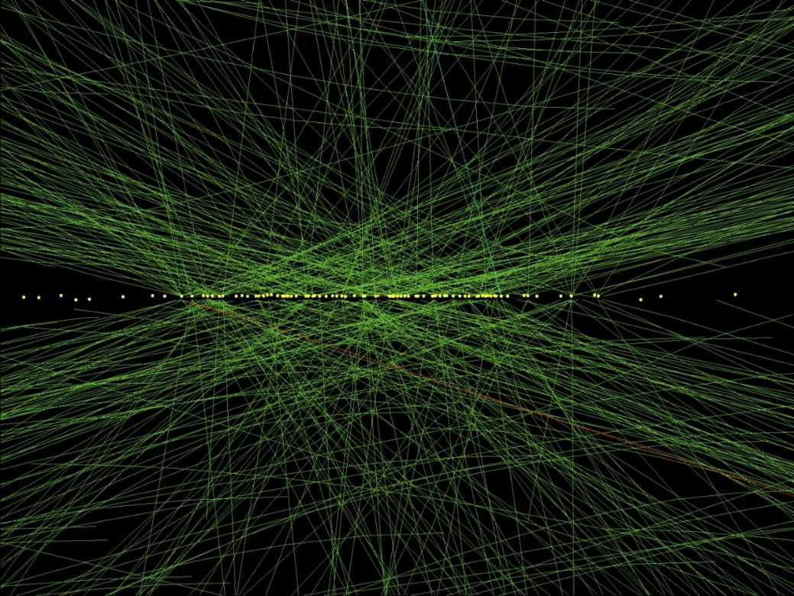
Event pile-up – LHC ‘legacy’
To compete with SSC, the LHC had to push the event pile-up significantly above 1-2 events per bunch crossing.
The LHC is currently operating with a peak average event pile-up of ~40 events/crossing (design ~27). But statistical fluctuations generate events that have many more events.
For the LHC luminosity upgrade HL-LHC, the number of events per crossing will be pushed to ~120 !
VHECs push the limit to ~500 !!
CMS event with 78 collisions

Slide 22
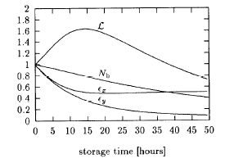
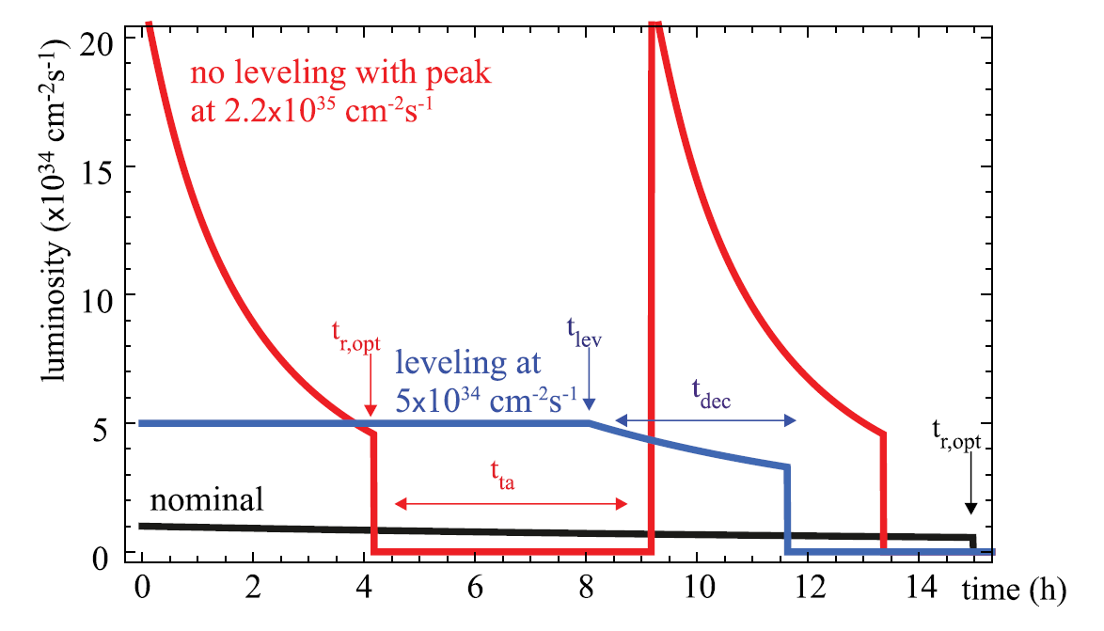
Luminosity levelling
VHECs (starting with LHC) enter a new regime for proton beams where synchrotron radiation is damping the beam sizes (transverse and longitudinal) of the colliding beams !
This can lead to a luminosity that initially increases as the damping (~1 hour at FCC-hh) is able to overcome the losses, providing ‘free’ performance gains.
VHECs (starting with high luminosity LHC upgrade HL-LHC) will be able to provide more luminosity than the experiments can ‘swallow’: opens the door to levelling the luminosity with beam offsets, β* etc at near constant value !
SSC luminosity evolution
Example of leveling at HL-LHC
D. Shulte et al,
PRSTAB 18, 101002 (2015)

Slide 23
Outline
Introduction
Luminosity
Magnets
High intensity beams
Machine protection
Infrastructure and injectors

Slide 24
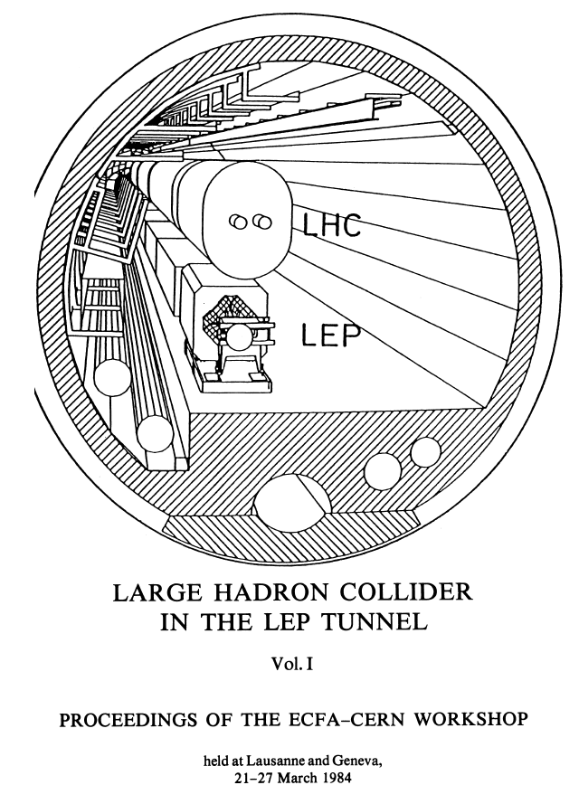
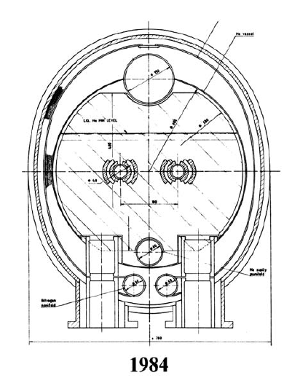
LHC legacy – 2-in-1
LHC design choices:
High magnetic fields – 8T,
  ⇒ super-conducting magnets
2 in 1 magnet design,
  ⇒ more complex magnet design,
  but only one single cryostat
Superfluid Helium.
Post-LHC designs are all based on the 2-in-1 concept.
The SSC designers opted for independent rings (2 separate cryostats) to be able to commission / operate one ring without the other.

Slide 25
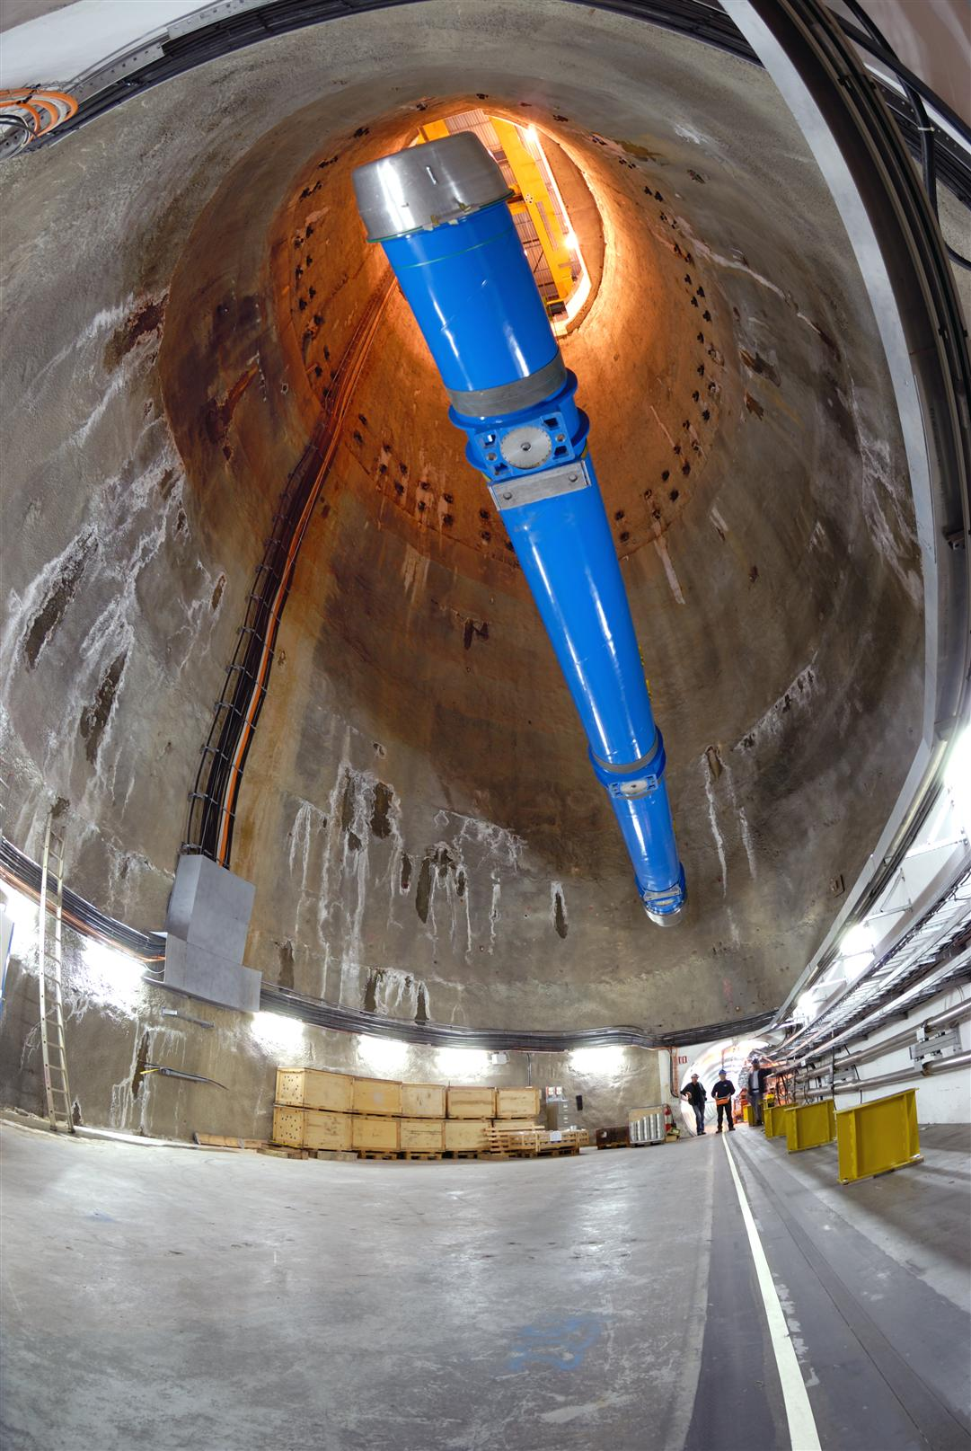
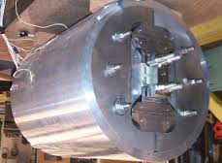
From concepts to accelerator magnets
While 8.3 T dipole magnets (LHC) have been produced by industry, there is a long road ahead to build 15-20 T accelerator grade magnets.
From many short prototypes to
longer prototypes,
‘hand-made’ magnets (by the Labs),
industrial production.
LBNL HD1 Nb₃Sn short prototype
LHC NbTi dipole lowered into the tunnel

Slide 26
Superconductors
Nb-Ti is the workhorse for 4 to 10 T:
  Reaches J ~2500 A/mm² at 6 T and 4.2 K or at 9 T and 1.9 K.
  Well known industrial process, good mechanical properties.
  Thousands of accelerator magnets have been built.
  10 T field in the coil is the practical limit at 1.9 K.
Nb₃Sn is the current road to 16 to 20 T
  Can reach up to J ~3000 A/mm² at 12 T and 4.2 K.
  Complex industrial process, higher cost, brittle and strain sensitive.
  ~25 short models for accelerator magnets have been built.
  ~20 T field in the coil is the practical limit at 1.9 K.
  Accelerator grade 11 T dipoles and high field quadrupoles in design phase for HL-LHC.
HTS materials: dreaming of 40 T (Bi-2212, YBCO)
  Current density is low, but very little dependence on the magnetic field.
  Used in solenoids, used in power lines – no accelerator magnets (only 1 model) yet.
Courtesy E. Todesco & G. De Rijk

Slide 27
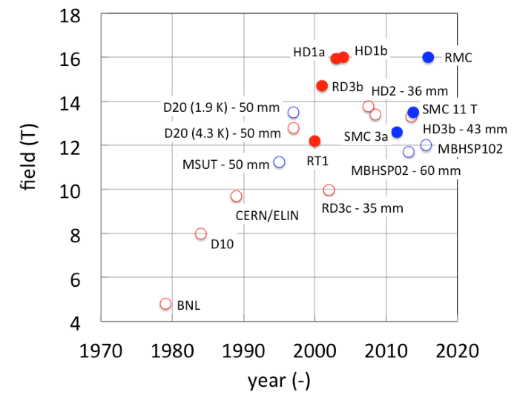
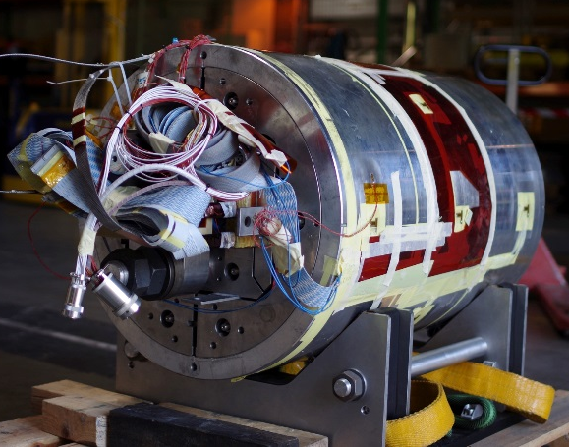
Highest “dipole” fields
G. De Rijk – FCC week Rome
LBNL HD1
Magnets with bore
Field records
CERN RMC
Record fields for SC magnets in “dipole” configuration

Slide 28
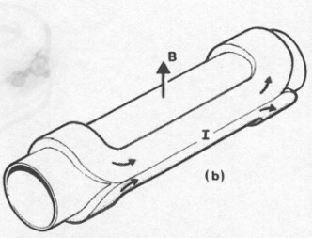
Accelerator magnets are special
Cylindrical volume with perpendicular field.
Dipoles, quadrupoles, etc,
Field quality:
Field quality formulated and measured in a multipole expansion,
Long dipole magnets ranging from 6 m (Tevatron) to 15 m (LHC). Often magnets are bend (9.14 mm sagitta for the LHC dipoles).
Artist view of a dipole, from M. N. Wilson « Superconducting Magnets »
CosΘ coil : J = J₀ cosΘ

Slide 29
FCC-hh magnet challenges and roadmap
FCC-hh baseline: 16 T Nb₃Sn technology for 100 TeV in 100 km
  Develop Nb₃Sn-based 16 T dipole technology
  With sufficient aperture of ~40 mm (LHC = 56 mm) and accelerator features (field quality, ability to protect, cycling operation).
  Learn from Nb₃Sn magnets in the LHC (HL-LHC 11 T dipoles).
  Technology push to achieve duplication of critical current density of Nb₃Sn.
  Possible goal: 16 T short dipole models by 2018 (World-wide collaboration).
  In parallel HTS development targeting 20 T
  HTS insert, generating 5 T additional field, ~40mm aperture and accelerator features.
  R&D goal: demonstrate HTS/LTS technology for building magnets with a field of 20 T.

Slide 30
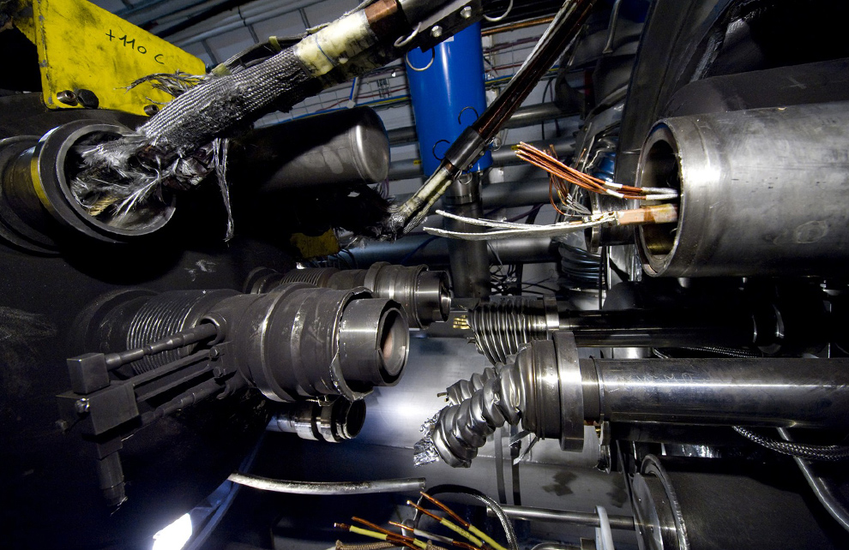
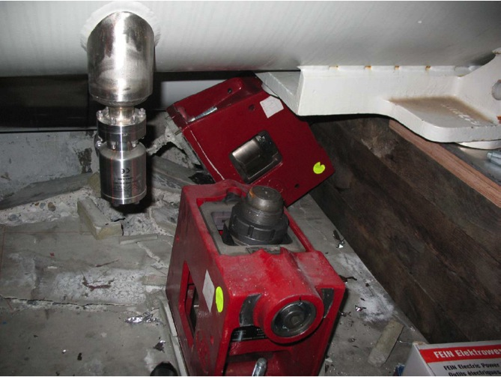
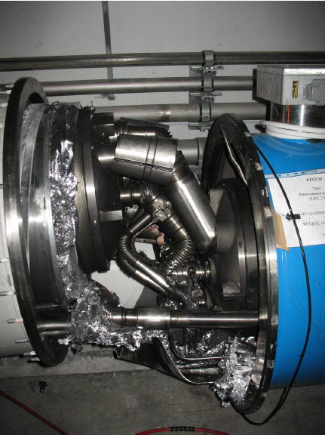
LHC incident – magnet protection
In 2008 a severe accident happened at the LHC without beam.
A magnet interconnect was defect and the electrical circuit opened. An electrical arc provoked a Helium pressure wave damaging ~600 m of LHC, polluting the beam vacuum over more than 2 km. Around 400 MJ were released in the incident (600 MJ stored).
Arcing at the interconnection
Magnet displacement
53 magnets had to be repaired –1 year of downtime
Over-pressure
The stored magnetic energy increases even further with VHECs – magnet protection and quality control will become even more critical !

Slide 31
Outline
Introduction
Luminosity
Magnets
High intensity beams
Machine protection
Infrastructure and injectors

Slide 32
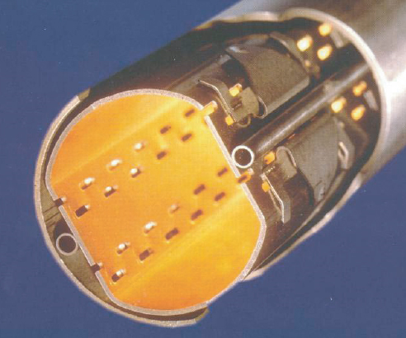
Synchrotron radiation
Synchrotron radiation (SR) from the proton beams is beneficial for luminosity (cooling) and diagnostics (profile measurements).
But SR also deposits heat inside a magnet that is operated at cryogenic temperature → very expensive to remove the heat at low temperature !
To protect the inner aperture of the magnet (at 1.9-4 K) a beam screen (BS) is inserted into the vacuum chamber as shielding against synchrotron radiation, image currents and also electron clouds.
20K-40K
2K
Beam
He cooling channel
At the LHC the BS is operated at 20-40 K for a total energy deposition of ~1.5 W/m
(0.2 W/m from SR)
LHC BS

Slide 33
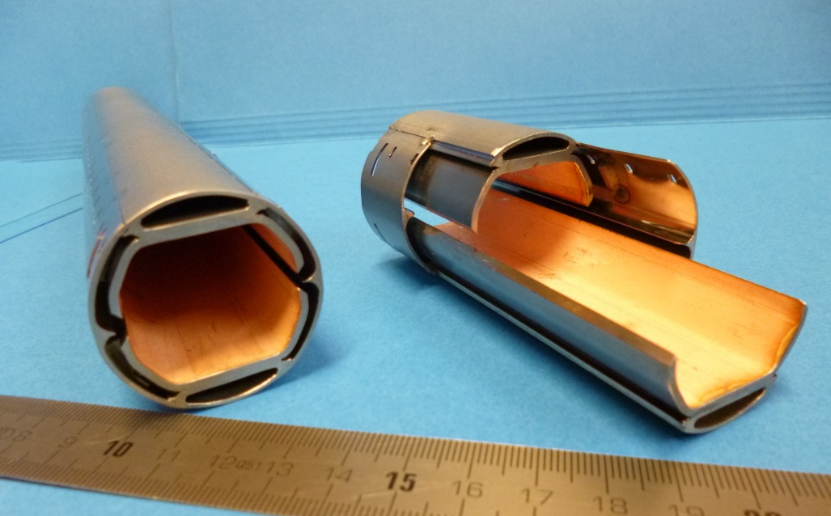
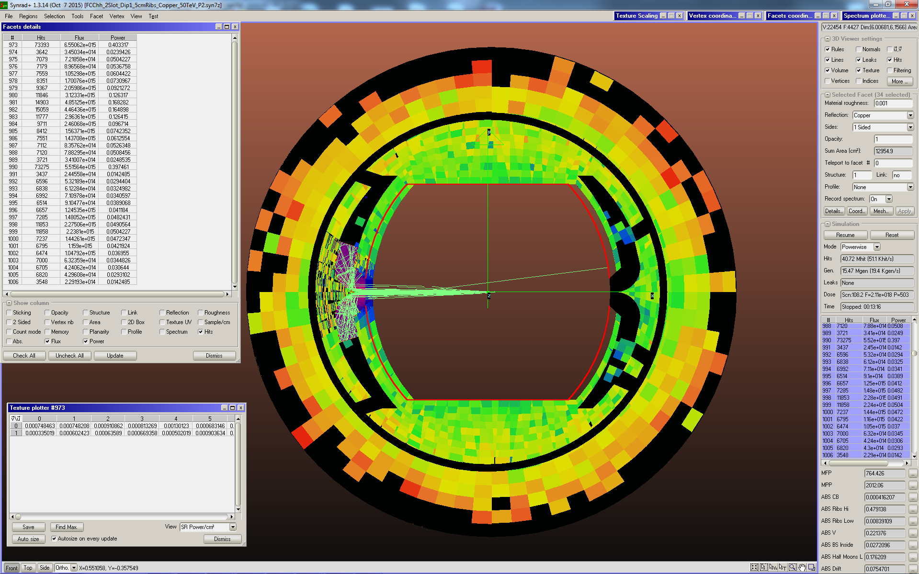
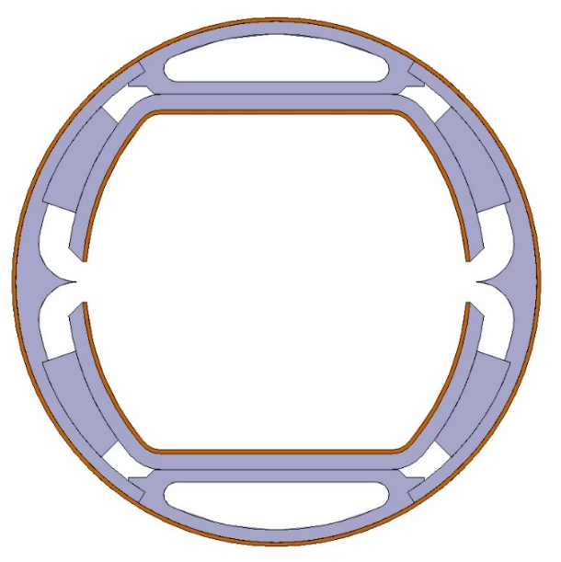
Beam-screens for FCC-hh
High synchrotron radiation load of protons @ 50 TeV:
~30 W/m/beam (@16 T) (LHC <0.2W/m)
5 MW total in arcs
Beam screen with ante-chamber
absorption of synchrotron radiation at 50 K to reduce cryogenic power
avoids photo-electrons, helps vacuum
FCC-hh beam screen prototype
Large cooling pipes
Thermal shunt
SR slits
SC coating ?
Photon distribution

Slide 34
Beam screen cooling at FCC-hh
L. Tavian, C. König,
Ph. Lebrun
Cross section determines length that can be cooled
16K beam-screen would require 300 MW for cooling
50K requires 100 MW → current baseline
For 4K magnets would prefer T > 100K
But more impedance to the beam (higher resistivity)

Slide 35
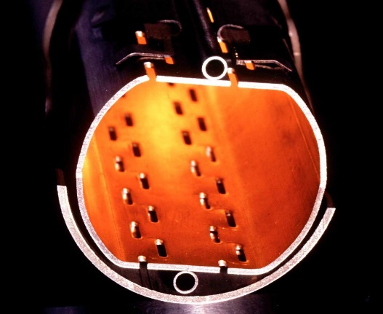
Electron clouds
Electron cloud effects:
  Vacuum pressure rise.
  Impact on beam quality (emittance growth, instabilities, particle losses).
  Excessive energy deposition on the vacuum chamber (~20K at LHC) → heat load on the cryogenic system.
Electron clouds affect all high intensity machines with positive bunch charge (e⁺ ⇔ B-factories).
Bunch N
liberates e-
Bunch N+1 accelerates e-,
multiplication at impact
Process repeats for Bunch N+2 …
e-
e-
++++++
++++++
++++++
N+1
N+2
N
e-
If the probably of emitting a secondary electron (Secondary emission yield [SEY]) above threshold
SEY>SEY_{th} ➔ avalanche effect (multipacting)
SEY_{th} depends on bunch spacing and population
20K-40K
Remedies:
  Conditioning by beam-induced electron bombardment (“scrubbing”) leading to a progressive reduction of SEY – LHC case.
  Vacuum chamber coating or shaping.
Beam
2K

Slide 36
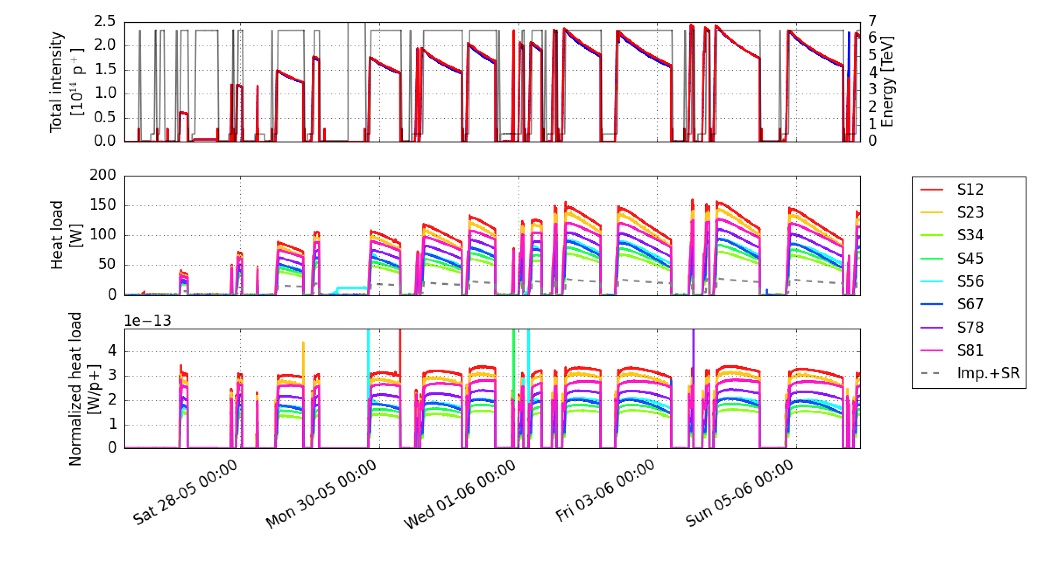
Electron clouds at LHC
Example of heat load to the LHC cryogenic system (per ~100 m of accelerator) due to electron cloud in regular operation.
LHC is operated ~ at the limit of the cryogenic cooling capacity of the BS !
Cooling capacity

Slide 37
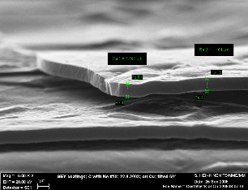
Electron cloud mitigation
Developments are ongoing to improve the vacuum chamber properties in terms of electron cloud for the LHC luminosity upgrade:
Carbon coating of surface
Laser treatment of surface (LESS)
P. Costa Pinto et al.
a-C
Geometry is very important !
LESS

Slide 38
Outline
Introduction
Luminosity
Magnets
High intensity beams
Machine protection
Infrastructure and injectors

Slide 39
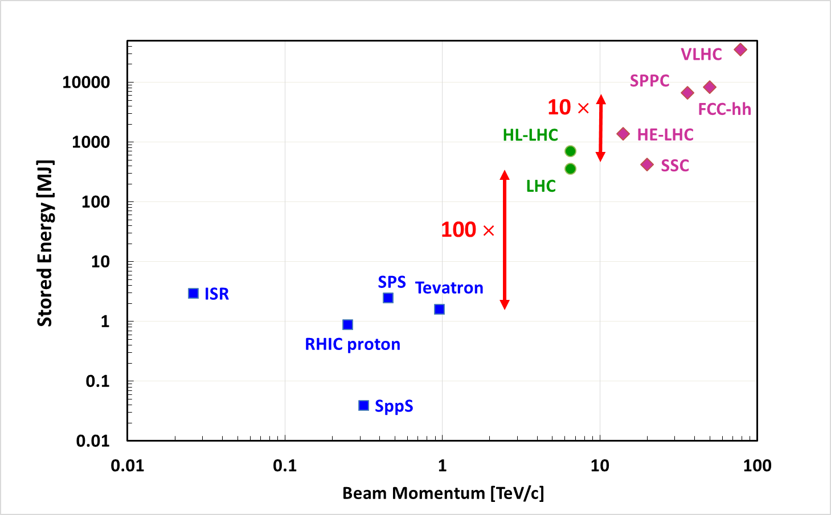
Stored energy: past – present – future
LHC pushed the stored energy from few MJs to > 100 MJs
The large hadron collider will make another step towards GJs
Onset of ‘serious’ damage

Slide 40


Stored energy challenge
Stored energy ~10 GJ per beam
  At least one order of magnitude higher than for LHC, equivalent to A380 (560 t) at nominal speed (850 km/h).
  Collimation, control of beam losses and radiation effects (shielding) important.
  Injection, beam transfer and beam dump very critical.
Damage of a beam with an energy of 2 MJ
Machine protection issues to be addressed early on!

Slide 41
LHC beam dumping system
A complex system, and yet it must be ultra-highly reliable!
It must not fail !
Beam 1
15 septum magnets deflect the beam vertically
Q5L
10 kicker magnets dilute the beam
Beam dump block
Q4L
15 fast ‘kicker’ magnets deflect the beam to the outside
≈ 900 m
Q4R
≈ 500 m
Q5R
quadrupoles
Beam 2

Slide 42
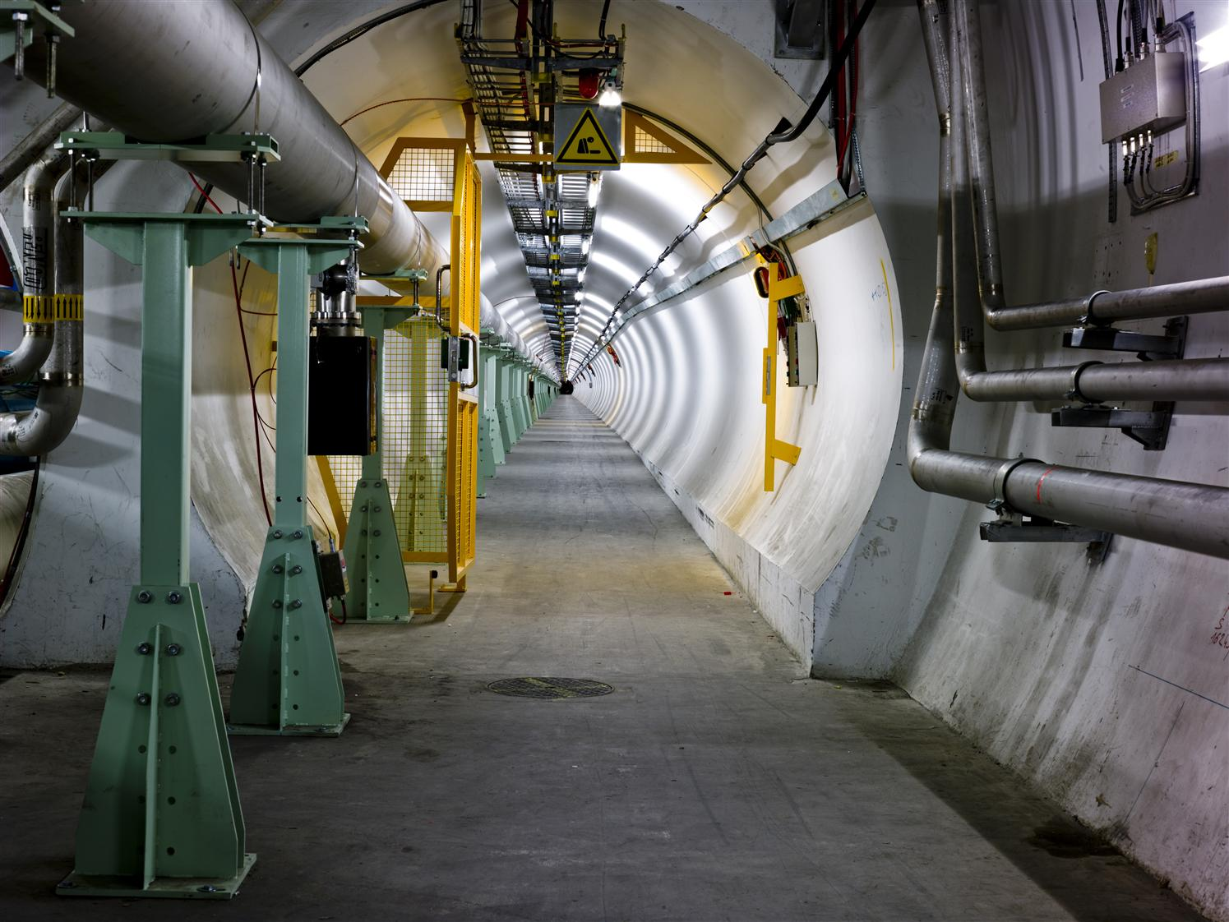
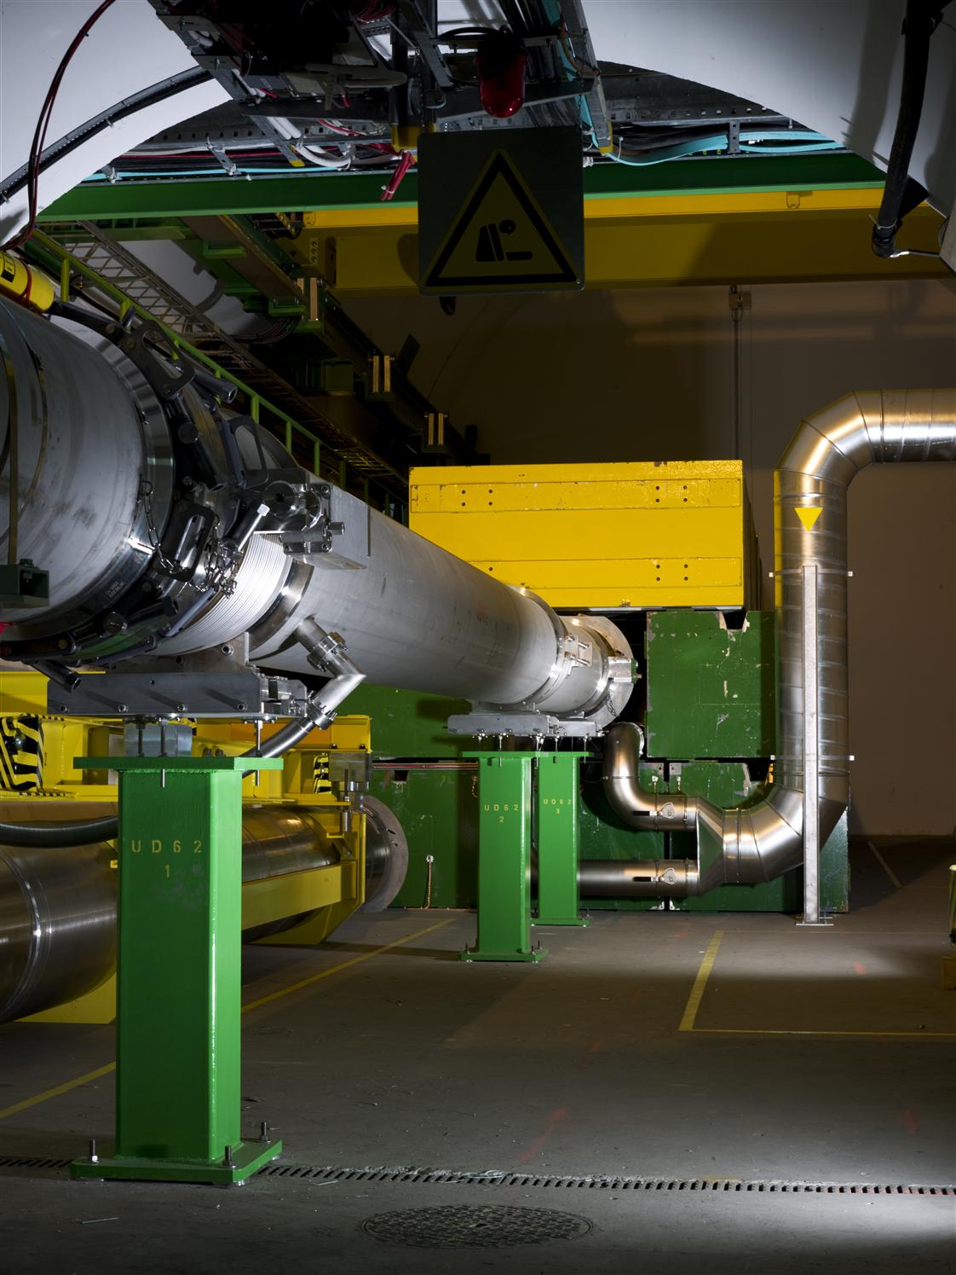
LHC dump line

Slide 43
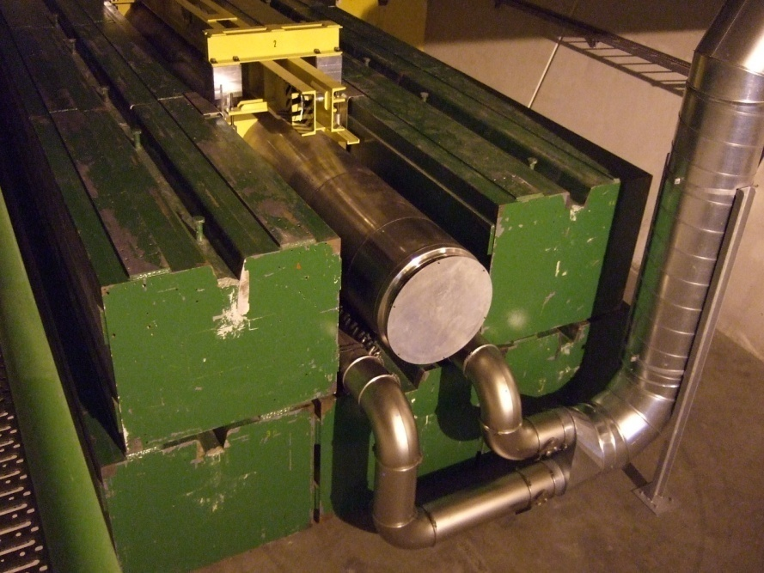
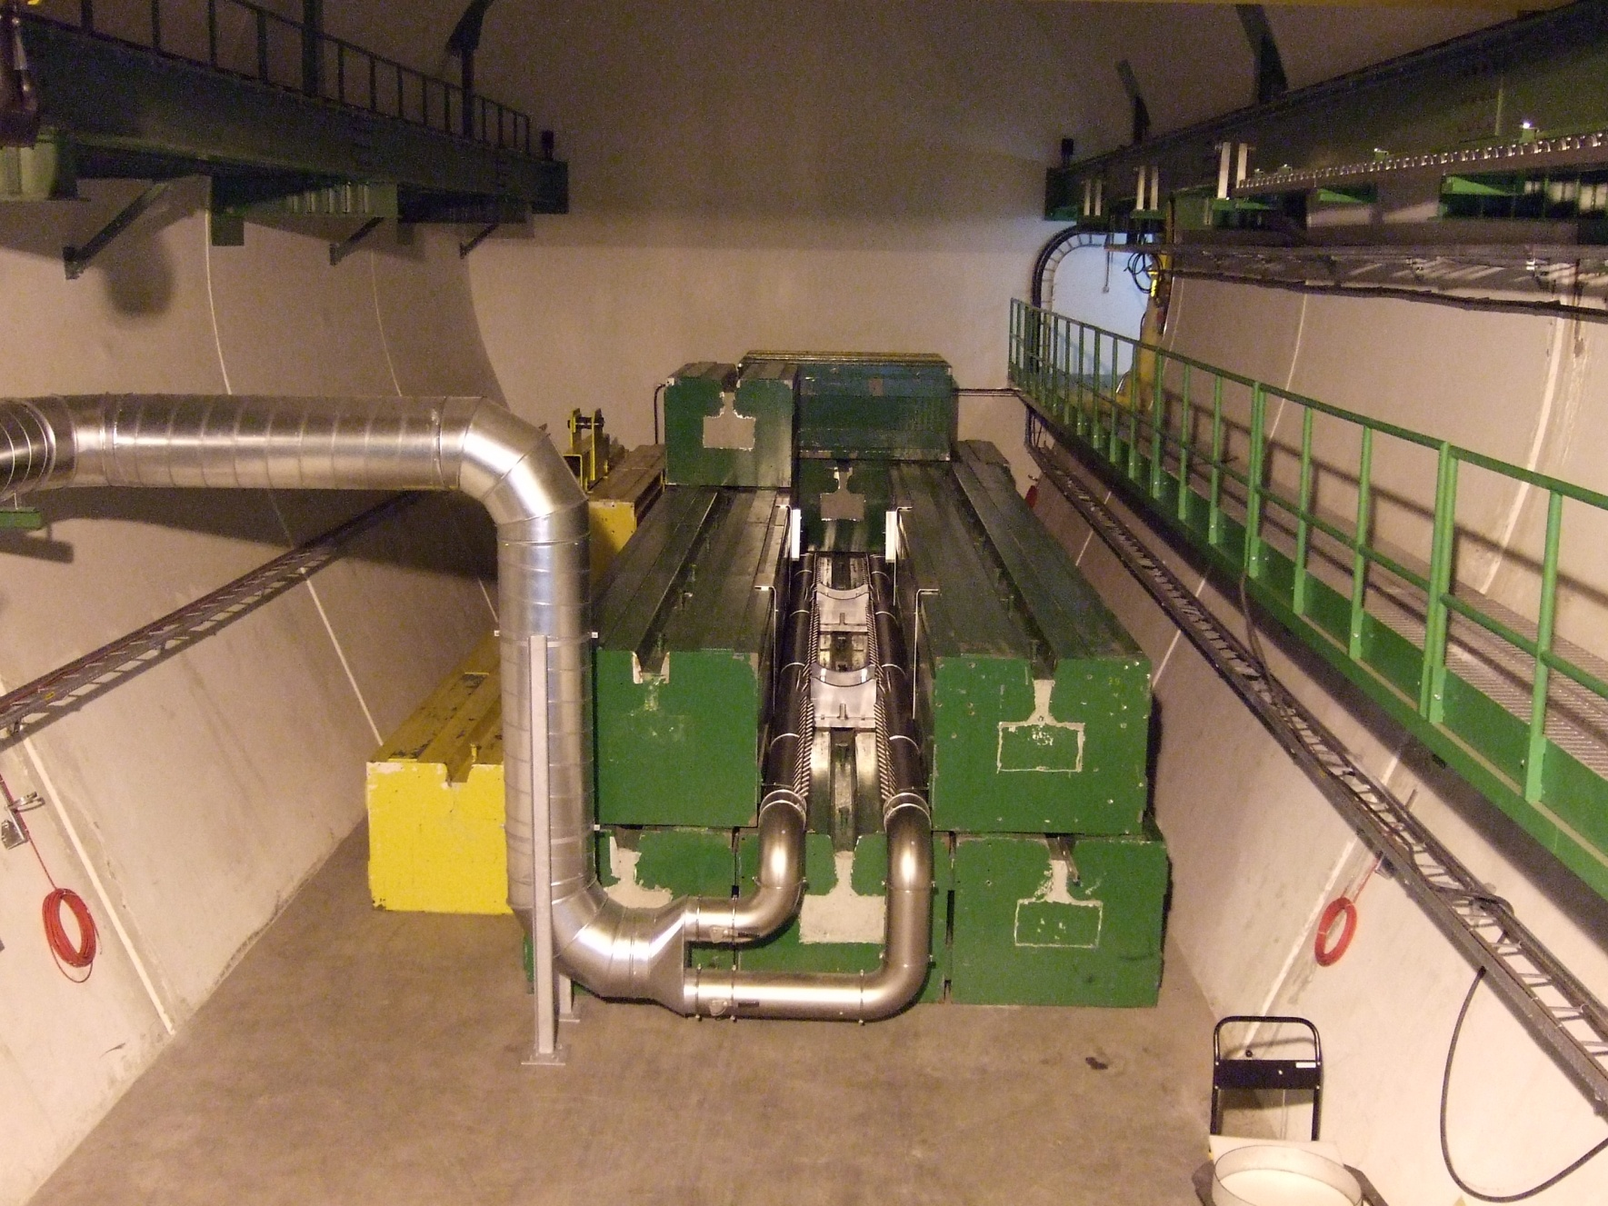
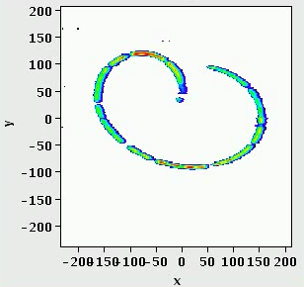
The LHC dump block
The dump block is the only LHC element capable of absorbing the nominal beam.
  The beam is swept over dump surface to lower the power density.
Without the sweep the beam could drill a hole with a depth of a few meters into the block !
Hydro-dynamic tunnelling
CERN visit McEwen
43

Slide 44
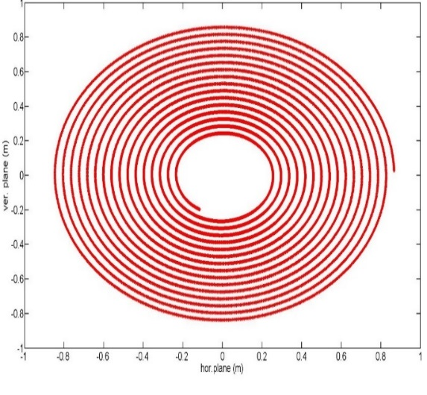
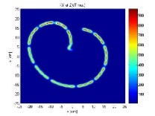
Dump and dilution - FCC-hh
F. Burkart et al.
2.5 km dump line
1.4 km dump insertion
2.8 km collimation insertion
10 mrad bend
Absorber
2m
Kicker
Septum
Dilution
LHC pattern (same scale)
Horizontal and vertical kicker system as in the LHC
~ 300 m long, ~150 kickers (→ advantage for failures).
Large magnet apertures required towards dump
Dilution is very critical, different solutions studied
Require up to 80cm radius for the diluted beam.

Slide 45
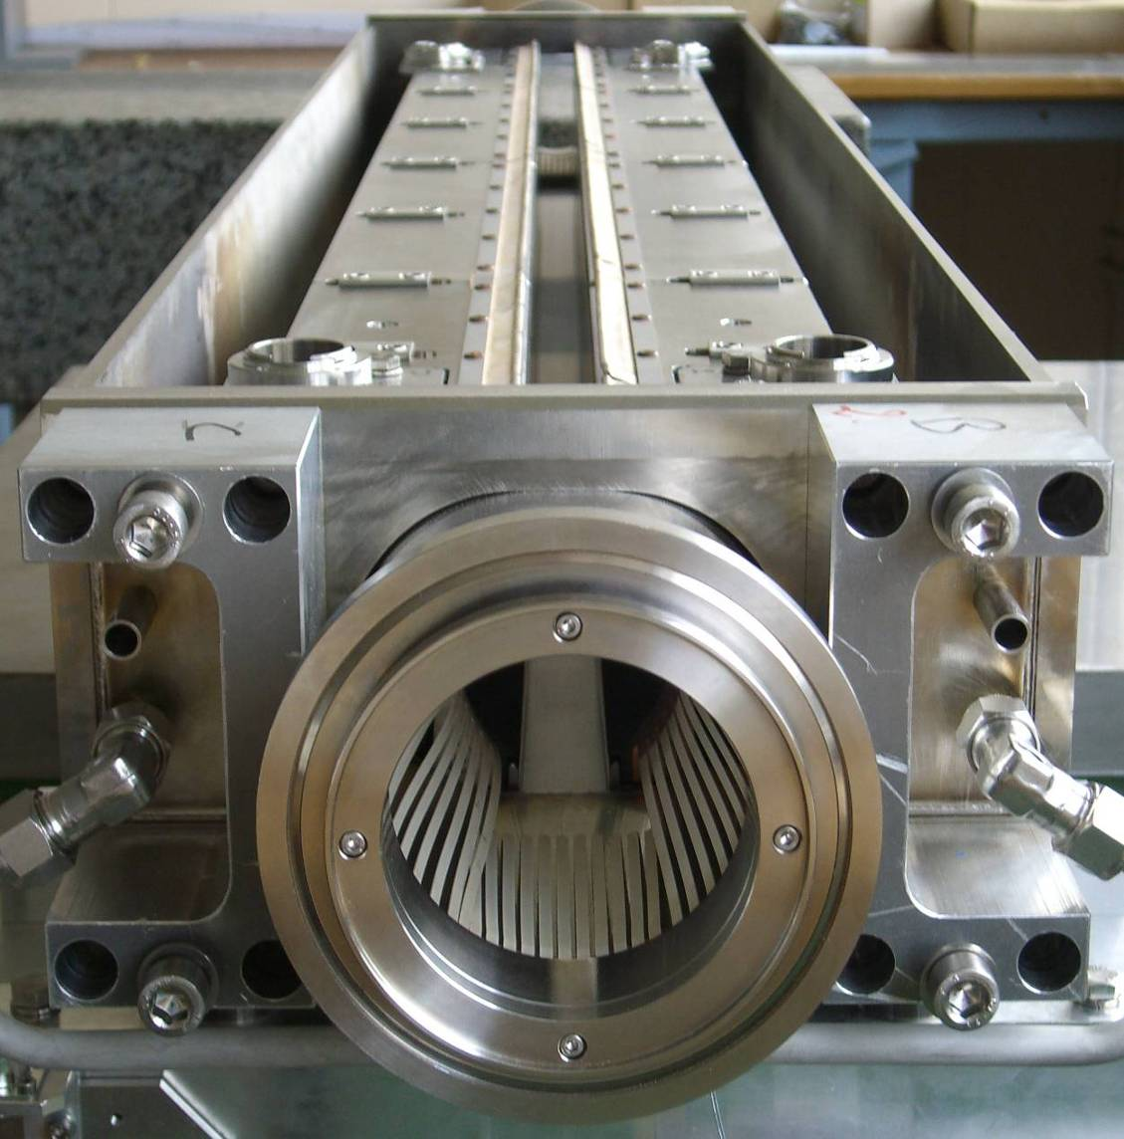
Beam collimation (cleaning)
The LHC is the first hadron collider to require a complex multi-stage collimation system to operate at high intensity.
  Previous hadron machines used collimators only for experimental background conditions.
Almost 100 collimators, mostly made of Carbon and Tungsten, protect the superconducting magnets against energy deposition from the beam
1.2 m
Dual role of collimators:
Halo collimation (cleaning)
Passive protection of the machine
beam

Slide 46
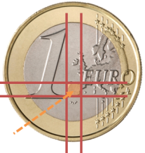
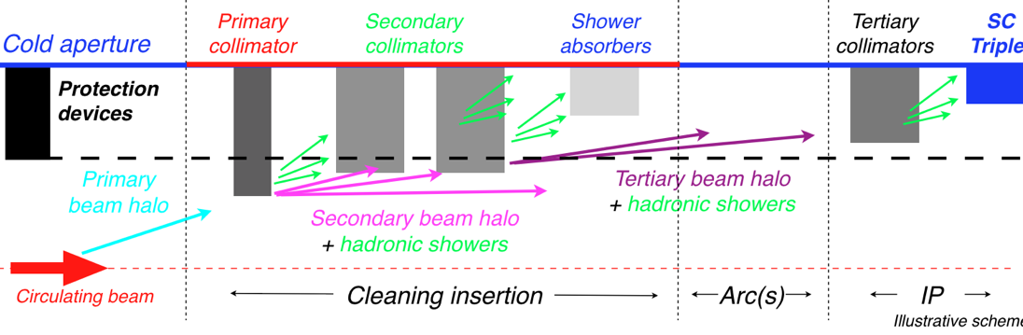
Multi-stage collimation systems
LHC primary collimator gap opening
To be able to absorb the energy of the high energy hadrons, a multi-stage collimation system is required – primary, secondary, tertiary.
  Demonstrated to work at the LHC – with excellent performance.
While for LHC the efficient is at the level of 99.95% or better, VHECs may require one order of magnitude better cleaning.
  Efficiency = fraction of protons lost from the beam that are intercepted.

Slide 47
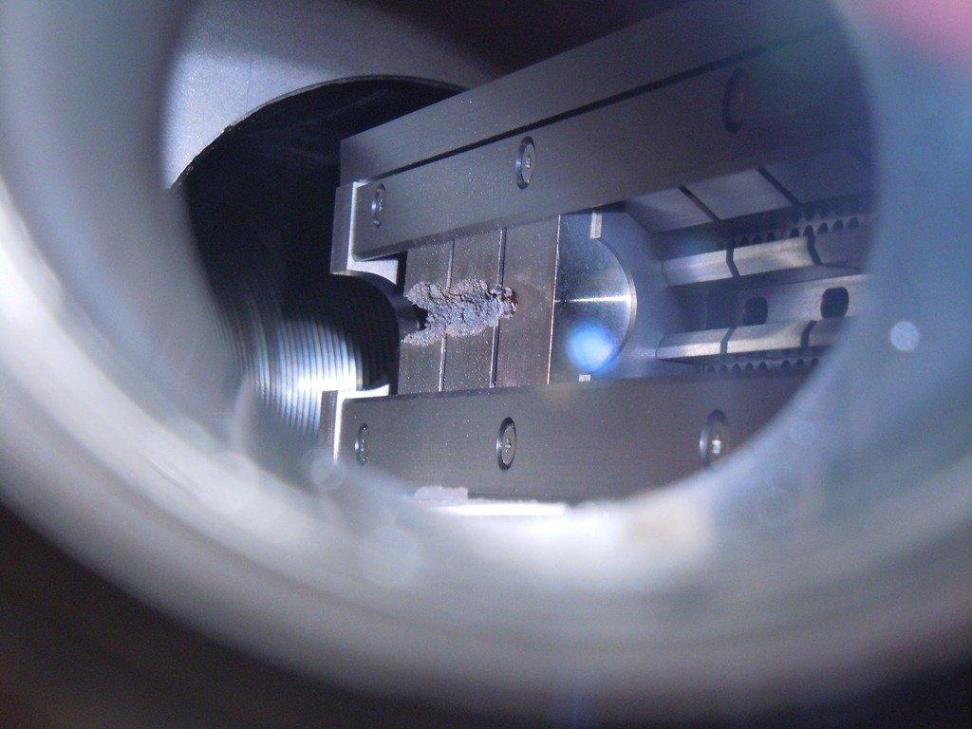
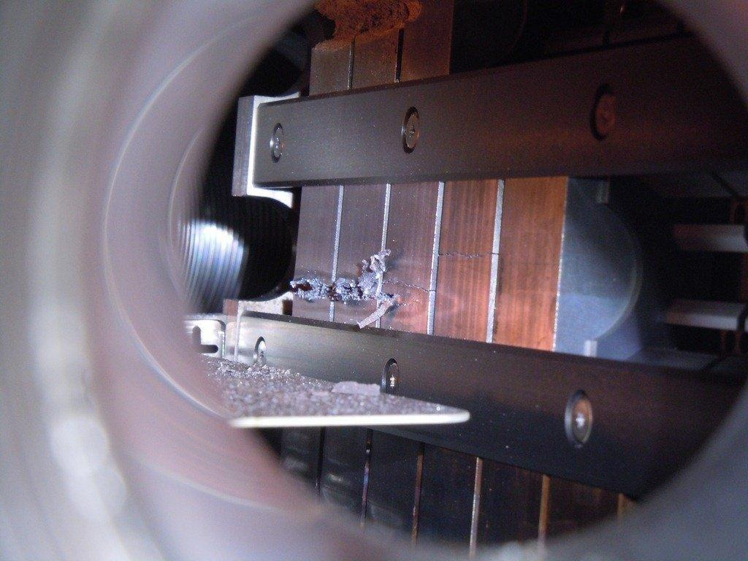




New collimator materials
Beam tests for new collimator materials:
- They should be robust (shock impacts) and good conductors
Courtesy A. Bertarelli (EN)
    Inermet 180, 72 bunches
  Molybdenum, 72 & 144 bunches
  Glidcop, 72 bunches (2 x)
  Copper-Diamond
  144 bunches
  Molybdenum-Copper-Diamond 144 bunches
  Molybdenum-Graphite (3 grades)
  144 bunches

Slide 48
A new regime
At the LHC the energy stored in the injected and circulating present a damage to any accelerator component around the beam line, but passive protection is available to mitigate all failure cases.
At the LHC such passive protection will survive the beam impacts in case of failure provided the machine is correctly setup and operate safely.
For the next generation VHECs, this may no longer the case due to the higher particle energy (more material to absorb the beams) and the higher stored energy: failures could lead to damage of the protection components.

Slide 49




Vicious little falling objects
LHC observed strange beam losses that where nicknamed UFOs (Unidentified Falling Objects).
According to the most credible theory, UFOs are dust particles that fall into the beam and generate beam losses due to inelastic collisions with the beam. These losses can quench a superconducting magnet.
  If the losses are too high, the beams are dumped to avoid a magnet quench (up to 20 times / year)
Vacuum chamber
Rate/h
Conditioning is observed over time, and rates come down.
At the LHC we are ‘lucky’ that the dump rates are acceptable, and the beam loss generally below dump threshold. This may NOT be the case for the more sensitive VHECs !
conditioning
Rate/h/intensity
A potential VHEC killer !

Slide 50
Outline
Introduction
Luminosity
Magnets
High intensity beams
Machine protection
Infrastructure and injectors

Slide 51

Tevatron
Installed in a 6.3 km tunnel
Depth: ~10 m
Tevatron
Main injector

Slide 52

LHC
Installed in the 26.7 km LEP tunnel
Depth: 70-140 m
Lake Geneva
LHC
SPS

Slide 53

FCC
Installed in a 80-100 km tunnel
Depth: 150-400m
LHC
FCC

Slide 54




Topographical constraints, critical areas
Lac Léman
300 – 372 m/mer
___ ∼ 260 m/mer
___ ∼ 170 m/mer
Massif du Jura
550 – 1720 m/mer
Lake crossing
Plaine du genevois
350 – 550 m/mer
Pré-Alpes du Chablais
600 – 2500 m/mer
Rhône & Usses canyons
Vallée du Rhône
∼330 m/mer
Mont Salève
550 - 1380
Valée de l’Arve
400 – 600 m/mer
Plateau du Mont Sion
550 – 860 m/mer
Mont Vuache
550 - 1100
Plateau des Bornes
600 – 850 m/mer
Vuache faults
Vallon des Usses
380 – 500 m/mer
Mandallaz
Bornes – Aravis
600 – 2500 m/mer

Slide 55



FCC 100 km possible siting
Mandallaz
20,800m
Lake
Geneva
Vallée de l‘Arve
Le Rhône
A tool developed by a consultant firm including all information on the geology is able to model the ring at varying depth, angle etc → layout optimization.

Slide 56

SSC and LHC tunnels
T. Sen
3.7 m
3.8 m
SSC tunnel
LHC tunnel
LHC & SSC tunnels quite similar in size.
Single tunnels represent a risk to personnel in case of fire or Helium release due to the long distance to an escape point → LHC experience…

Slide 57



FCC tunnel layouts
First studies launched on
Single vs. double tunnel
Ventilation (fire, Helium !)
Caverns, shafts, underground layout
Technical infrastructures
Safety, access
Transport, integration, installation
Operation aspects

Slide 58


Electricity consumption - CERN
The current CERN electricity consumption is around ~180 MW.
The LHC (with experiments) uses ~120 MW (~35 MW for cryogenics).
A VHEC would require an additional ~250-400 MW of power.

Slide 59

Operation and availability
Operating ever larger colliders increases the number of components (that can fail !) and the complexity of commissioning and of operation.
The LHC has demonstrated that huge cryogenics systems can operate with availability of 95% and higher.
The LHC also highlighted the importance of availability, good maintenance and design policies (redundancy): work on availability managed to gain an important factor in the operation efficiency and ultimately integrated luminosity.
Key factor for VHECs !
The main factor to increase the slope in 2016 is much better availability (almost a factor 2 !)

Slide 60

Summary
VHECs are the potential next generation discovery machines, there are currently 3 projects that are studied: HE-LHC, SPPC and FCC-hh.
VHECs present us with a number of challenges, the first one being to build ~16 T magnets to be able to run them.
Beam dynamics challenges are important but potential solutions are in sight.
Once technical aspects have been solved, the society impact will have to be considered: cost, energy consumption, impact on the environment, effect on property value etc.
P. Limon, VLHC seminar at Fermilab

Slide 61
A few selected references
T. Sen, SSC Parameter Review, Joint Snowmass-EuCARD / AccNet-HiLumi LHC workshop, February 21-22, 2013
The LHC Design Report, CERN-2004-003
The VLHC design study group, Design Study for a Staged Very Large Hadron Collider, Fermilab-TM-2149
P. Limon, Design Study for a Staged Very Large Hadron Collider, Fermilab-TM-2149, 2001
J. Tang et al, Concept for a Future Super Proton-Proton Collider, arXiv: 1507.03224v1 [hep-ex]
The Future Circular Collider Study, http://cern.ch/fcc
FCC week 2016, https://indico.cern.ch/event/438866/

Slide 63


LHC accelerator complex
 | Max. P (GeV/c) | Length / Circ. (m)
LINAC2* | 0.050 | 30
Booster* | 1.4 | 157
PS | 26 | 628
SPS | 450 | 6’911
LHC | 6’500 | 26’657
The proton journey from the source to injection into the LHC lasts ~7-24 seconds
LHC proton path
Beam 1
Beam 2
*: kinetic energy

Slide 64
Advanced super-conductors
400
Nb-Ti
Nb₃Sn
HTS
Ph. Lebrun

Slide 65



Beam Dump Considerations
8GJ kinetic energy per beam
Airbus A380 at 720km/h
2000kg TNT
400kg of chocolate
  Run 25,000km to spent calories
O(20) times LHC
Hydrodynamic tunneling
F. Burkart et al.
Simulation show beam will penetrate ~ 300 m in Copper, assuming no dilution.
→ Dilution required!

Slide 66
Collimation for FCC-hh
To protect machine and experiments,
At injection the machine aperture is tightest in the arcs, at collision energy in the magnets next to the experiments

