Slide 1

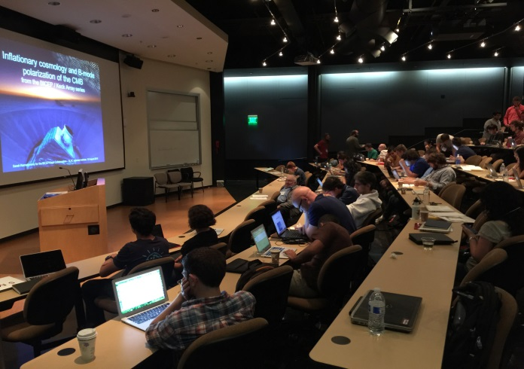
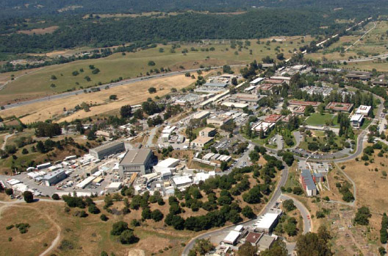
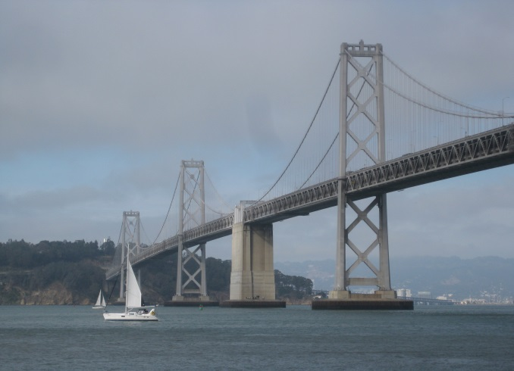
Welcome to the
44th SLAC SUMMER INSTITUTE !

Slide 2
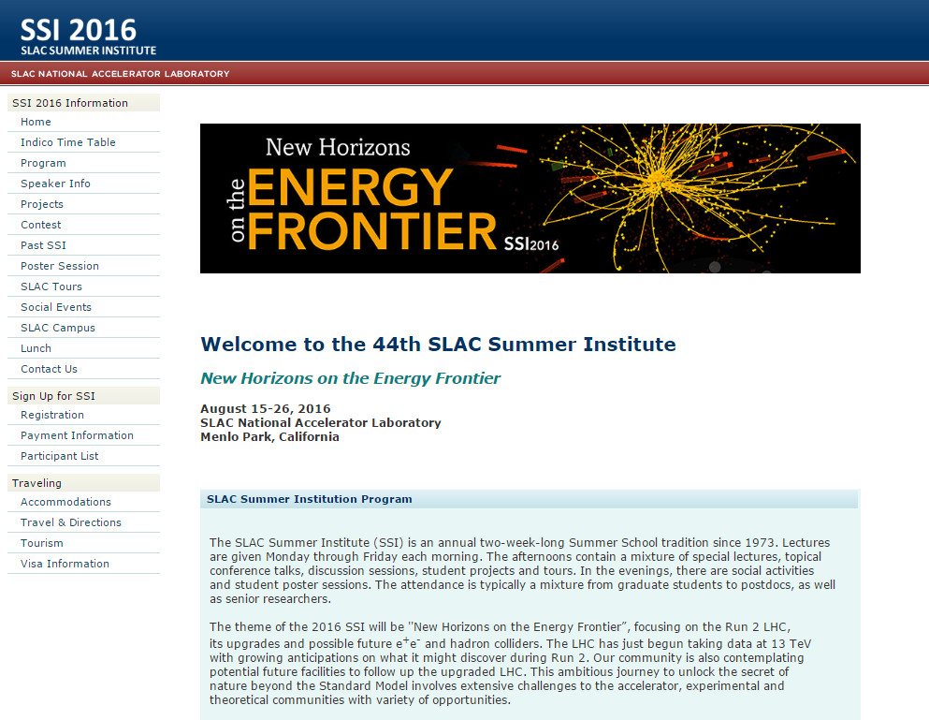

Hopefully everything you need to know is on the SSI webpage..
but let’s go through a few things……

Slide 3
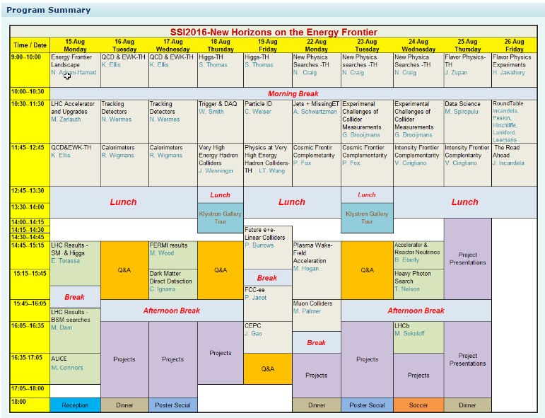
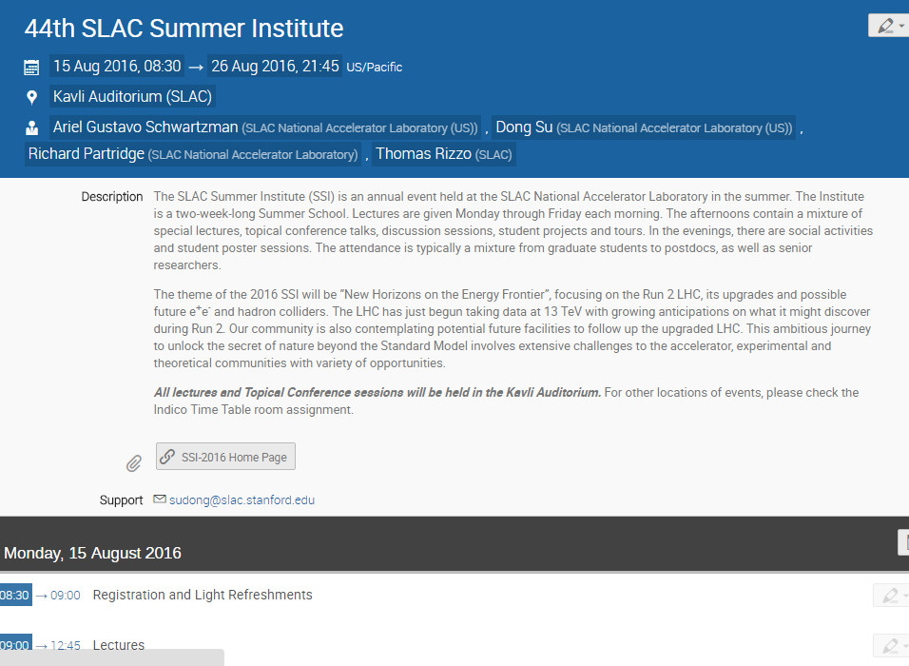
The schedule is available in 2 forms: as a spreadsheet & in full detail on Indico
The morning lectures & the afternoon talks will all be here in the Kavli
Auditorium
The afternoon Q&A and (initial & final) project sessions will also be held
here in the Kavli Auditorium
The reception & dinners will be held on the patio of the SUSB cafeteria

Slide 4
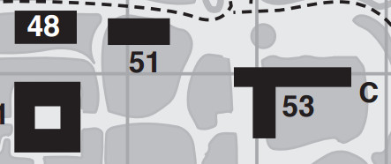
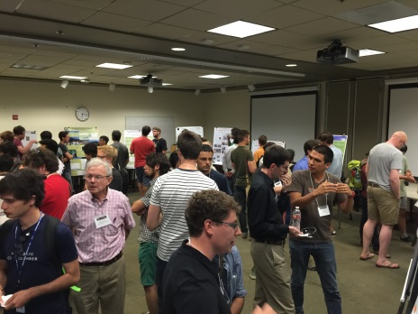
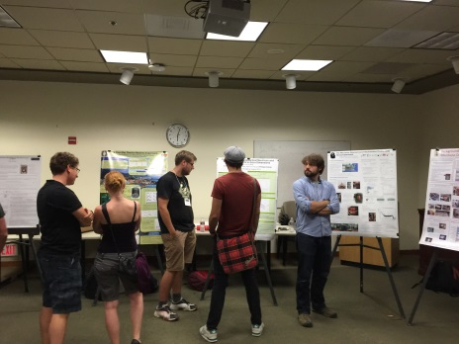
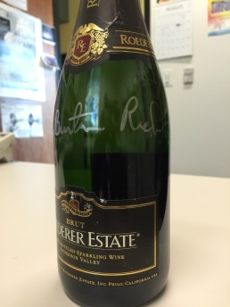
Kavli
The poster session will be
held in the SUSB (on 8/17 !)
ROB
SUSB
Lunch
The Contest Question: Every year we ask the students to answer a
broad-based ‘light’ question depending on the SSI subject. This year
the question is:
“ What discovery made during the next 5 years would do the
most to advance the field of high energy physics and why ?”
Place your answers in the big box (by 5PM 8/25) & a winner will be chosen
during the last nights dinner (after wine).. the winner gets a bottle of fine CA
bubbly signed by Nobel Prize winner Burton Richter on the last day.
To get the flavor: https://indico.cern.ch/event/200595/attachments/299542/418603/SSIContest2012.pdf

Slide 5
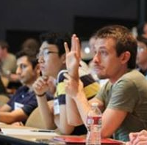
Q&A Sessions
These are intended for extensive questions so those during the
lectures & immediately afterward should be kept short & to the
point.. of course, other questions can also be addressed to the
speakers directly during breaks
Note that questions can also be submitted (anonymously) with
GoogleDocs via a link on the webpage & will be addressed in the
Q&A sessions

Slide 6
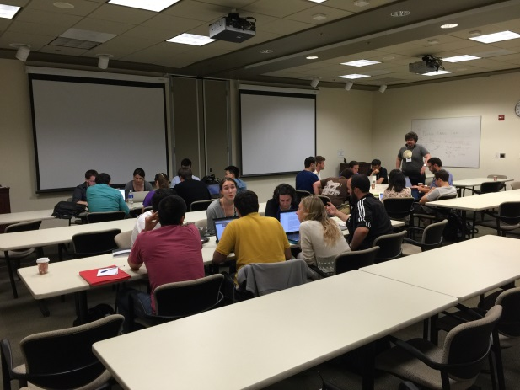
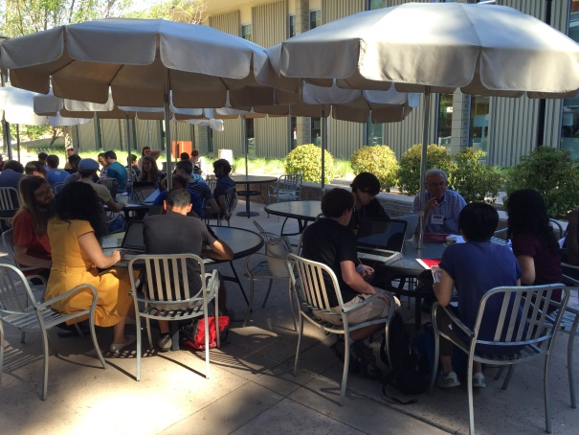
Projects:
Since 2013 we have incorporated projects conducted by teams
of students into SSI
We will provide a list of projects (to be posted later today or early
tomorrow on the SSI website -- so keep your eyes open!) & you pick
what looks interesting to you.. again, sign up using GoogleDocs on
the SSI website
Teams form around a given project & try to address the issues
Teams present their results on the final TH afternoon (8/25) &
the best team wins prizes
More details tomorrow afternoon @ ~4PM

Slide 7
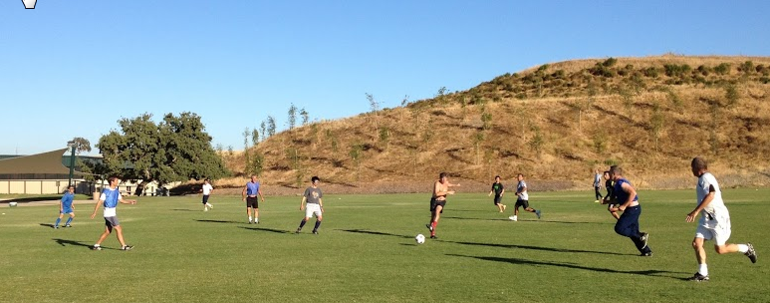
Odds & Ends
Sign up for tours at the registration desk (see schedule for times)
Be aware of next week’s soccer game between the SSI students
& the SLAC team…sign up to play or watch
Check the SSI “SLAC campus” page for info wrt printing, ATMs,
after hours access, etc.

Slide 8
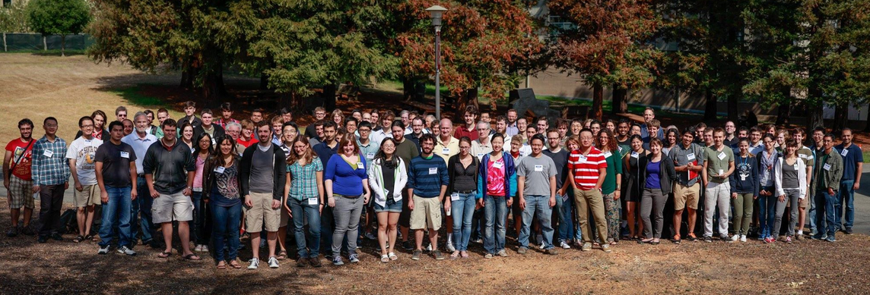
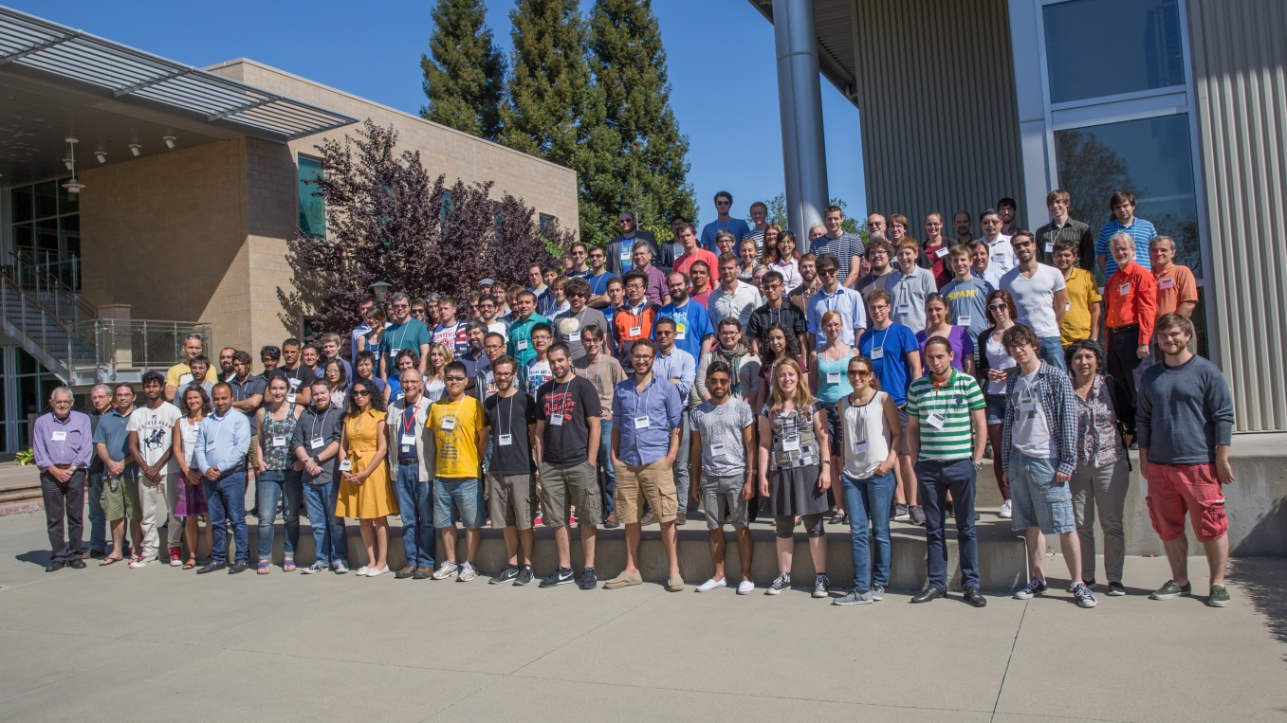
Group photo after the first lecture ↓

