Slide 1

Study of molybdenum oxide by means of perturbed angular correlations and mößbauer spectroscopy
EUROPEAN ORGANIZATION FOR NUCLEAR RESEARCH
Proposal to the ISOLDE and Neutron Time-of-Flight Committee
Juliana Schell^{1,2}
João Guilherme Martins Correia^{1,3}, Katharina Lorenz⁴, Marco Peres⁴, Carlos Díaz-Guerra⁵, H.P. Gunnlaugsson^{1,6}, Aitana Tarazaga⁷, Manfred Deicher²
1 ISOLDE-CERN, Switzerland
2 Universität des Saarlandes, Germany
3 Centro de Ciências e Tecnologias Nucleares (C²TN), Campus Tecnológico e Nuclear – CTN, Instituto Superior Técnico, Universidade de Lisboa, Portugal
4 Instituto de Plasmas e Fusão Nuclear, Campus Tecnológico e Nuclear – CTN, Instituto Superior Técnico, Universidade de Lisboa, Portugal
5 Dpto. Física de Materiales, Facultad de Ciencias Físicas, Universidad Complutense de Madrid, Spain
6 KU Leuven, Instituut voor Kern- en Stralingsfysica, 3001 Leuven, Belgium
7 Johannes Keppler University, Linz, Austria
Proposal Presentation CERN-INTC-2016-004 Dr. Juliana Schell 03.02.2016 - Universität des Saarlandes

Slide 2
OBJECTIVES
Studying the incorporation of selected dopants in MoO₃ by ion implantation using PAC and eMS.
SAMPLE PRODUCTION AND COMPLEMENTARY CHARACTERIZATION
Crystal structures by x-ray diffraction (XRD)
Chemical analyses by x-ray fluorescence (XRF)
BY OUR COLLABORATORS:
Dpto. Física de Materiales, Facultad de Ciencias Físicas
Universidad Complutense de Madrid, Spain
+
Johannes Keppler University, Linz, Austria
Samples‘s stoichiometry and composition by Rutherford backscattering spectrometry (RBS)/channeling (RBS/C)
Campus Tecnológico e Nuclear, Instituto
Superior Técnico, Universidade de Lisboa, Portugal
Proposal Presentation CERN-INTC-2016-004 Dr. Juliana Schell 03.02.2016 - Universität des Saarlandes

Slide 3
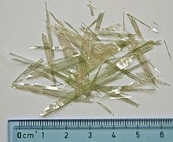
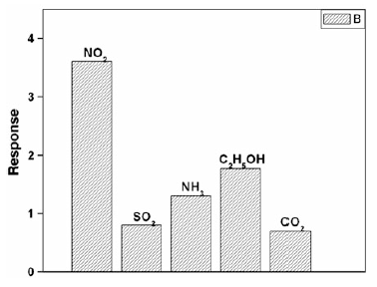
MoO_{x}, A “UNIVERSAL” MATERIAL
MoO₃
belongs to the family of 2D inorganic materials RT stable orthorhombic α-MoO₃ phase: (2.8 – 3.2 eV)
α-MoO₃
Solar cells, catalysis, gas sensing, lithium-ion batteries, field emission, photochromic and electrochromic devices.
Picture Source: Wikipedia
Sensor response to 500 ppm of gases
measured at 170°C of 10% wt
MoO₃-doped SnO₂ thin films
Picture source: Metal Oxide Nano-architectures and Heterostructures for Chemical Sensors Editors: Michael A. Carpenter • Sanjay Mathur, Andrei Kolmakov, Springers, 2013
Proposal Presentation CERN-INTC-2016-004 Dr. Juliana Schell 03.02.2016 - Universität des Saarlandes

Slide 4
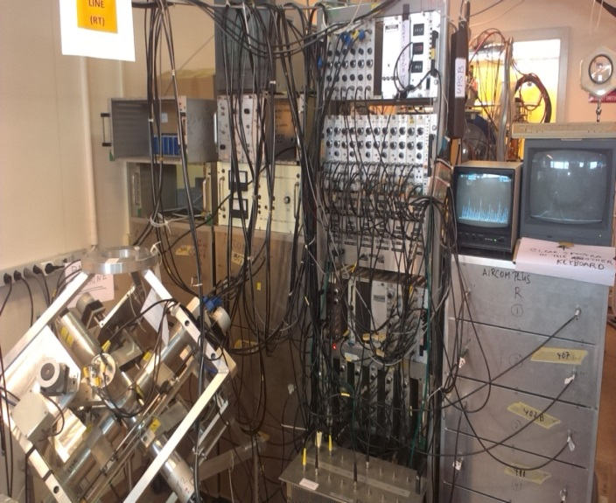
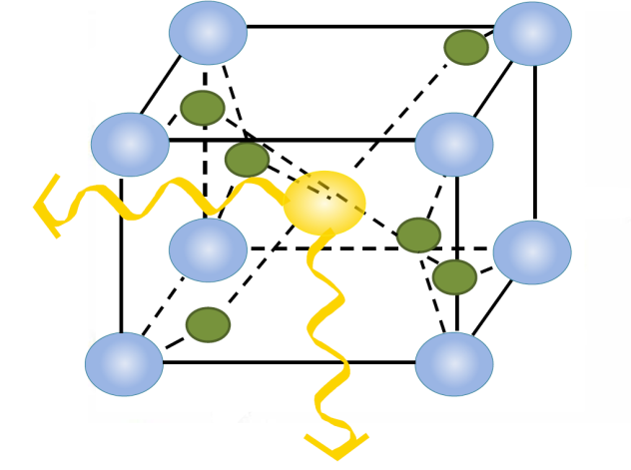
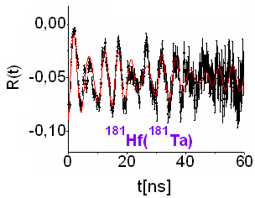
WHY PAC SPECTROSCOPY AT ISOLDE?
Atomic resolution delivers information on
Probe’s lattice location & annealing of implantation defects
Probes-host or probes-defects interactions
Probing electronic structure and electron polarization
Diffusion of probe atoms (dinamic interaction)
HOW?
As a function of
- sample stoichiometry with different impurities/doping
- annealing and measuring temperature from 1 – 1500 K
USING?
¹¹¹In⁽¹¹¹Cd), ^{111m}Cd⁽¹¹¹Cd)^{, 117}Cd⁽¹¹⁷In), ¹¹⁵Cd⁽¹¹⁵In)
Magnetic interaction:
γ₁
γ₂
Quadrupole interaction:
Coincidence
Proposal Presentation CERN-INTC-2016-004 Dr. Juliana Schell 03.02.2016 - Universität des Saarlandes

Slide 5
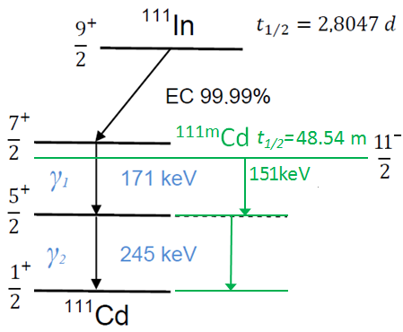
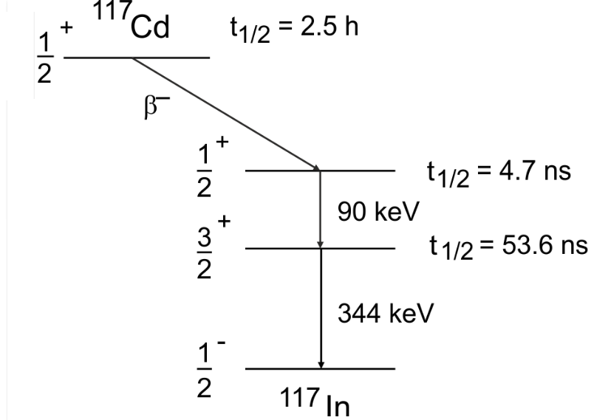
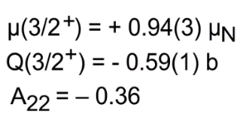
WHY THESE PAC ISOTOPES?
¹¹¹In⁽¹¹¹Cd), ^{111m}Cd⁽¹¹¹Cd)^{, 117}Cd⁽¹¹⁷In), ¹¹⁵Cd⁽¹¹⁵In)
2.2 d
¹¹⁵Cd
β⁻ 3.3%
3/2+ ; 5.78ns
μ(5/2⁺)= -0.766(3)μ_{N}
Q(5/2⁺)= +0.74(8)b
A₂₂ (^{111m}Cd) = 0.1786
A₂₂ (¹¹¹In) = -0.1782
μ(3/2⁺)= +0.74(13)μ_{N}
Q(3/2⁺)= -0.60(2)b
A₁ ~ 0.5
8%
492keV
E1
¹¹⁵In
Proposal Presentation CERN-INTC-2016-004 Dr. Juliana Schell 03.02.2016 - Universität des Saarlandes

Slide 6
WHY emission MÖßBAUER SPECTROSCOPY (AT ISOLDE)?
Complement of the PAC study:
Probe’s lattice location & annealing of implantation defects
Probes-host or probes-defects interactions
Valence(/spin) state of probe atom (X^{n+})
Diffusion of probe atoms (few jumps ~100 ns)
Binding properties (Debye-Waller factors)
HOW?
As a function of
- Sample stoichiometry
- Annealing and measuring temperature
USING?
- Complementary Fe and Sn probes
- Optically active Er and Eu elements
Proposal Presentation CERN-INTC-2016-004 Dr. Juliana Schell 03.02.2016 - Universität des Saarlandes

Slide 7
85.4s
WHY THESE eMS ISOTOPES?
⁵⁷Mn
2.4m
β⁻ 75%
26.8h
¹¹⁹In
¹⁶⁶Ho
β⁻ 93%
β⁻ 50%
3/2- ; 98.3ns
μ(3/2⁻)= -0.1549(2)μ_{N}
Q(3/2⁻)= +0.082(8)b
14.4keV
M1+E2
7/2+ ; 190ps
⁵⁷Fe
2+ ; 1.8 ns
μ(2⁺)= +0.649(10)μ_{N}
Q(2⁺)= -2.7(9)b
120 d
92%
763keV
E2
¹⁵¹Gd
6.56%
80.6eV
E2
EC 74%
7/2+ ; 9.6 ns
3/2+ ; 18 ns
μ(7/2⁺)= +2.591(2)μ_{N}
Q(7/2⁺)= +1.28(2)b
μ(3/2⁺)= +0.682(3)μ_{N}
Q(3/2⁺)= -0.128(7)b
2.85%
21.5keV
M1+E2
15%
23.9keV
M1+E2
¹⁶⁶Er
¹⁵¹Eu
¹¹⁹Sn
Proposal Presentation CERN-INTC-2016-004 Dr. Juliana Schell 03.02.2016 - Universität des Saarlandes

Slide 8

FEASIBILITY OF CURRENT PROPOSAL
¹¹¹Cd:MoO₃ γ-γ (151-243 keV)
PAC from decay of ^{111m}Cd
RT
100ºC
120ºC
μ(5/2⁺)= -0.766(3)μ_{N}
Q(5/2⁺)= +0.74(8)b
A₂₂ (^{111m}Cd) = 0.1786
A₂₂ (¹¹¹In) = -0.1782
200ºC
300ºC
observation of a dynamic atomic rearrangement of the dopant Cd with the defect as a function of temperature
Proposal Presentation CERN-INTC-2016-004 Dr. Juliana Schell 03.02.2016 - Universität des Saarlandes

Slide 9
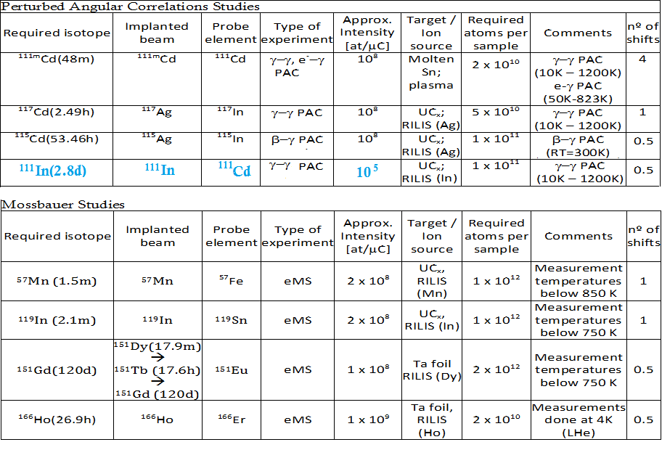
SUMMARY OF REQUESTED SHIFTS
Proposal Presentation CERN-INTC-2016-004 Dr. Juliana Schell 03.02.2016 - Universität des Saarlandes

Slide 10



FUNDING AGENCIES INVOLVED
BMBF
Bundesministerium für Bildung und Forschung
Erforschung kondensierter Materie mit Großgeräten
Ausbau und Unterhalt der Einrichtungen an ISOLDE/CERN
Germany, contract: 05K10TS2,
M. Deicher, J. Schell
FCT
Fundação para a Ciência e a Tecnologia
Caracterização de Materiais com Técnicas Nucleares Radioativas - sinergia e complementaridade aplicadas ao treino e desenvolvimento. Portugal, Project: CERN-FIS-NUC-0004-2015
K. Lorenz, J.G. Correia
MINECO
Ministry of Economy and Competitiveness
Consolider – Ingenio Project “IMAGINE”
Spain, Project MAT2012-31959, CSD2009-0013
C. Díaz-Guerra
FFG
Österreichische Forschungsförderungsgesellschaft funded projects
Competence Headquarters Program E2-Spattertech
Austria, Project: FFGP13222004
Proposal Presentation CERN-INTC-2016-004 Dr. Juliana Schell 03.02.2016 - Universität des Saarlandes

Slide 11
THANK YOU FOR YOUR ATTENTION!
Proposal Presentation CERN-INTC-2016-004 Dr. Juliana Schell 03.02.2016 - Universität des Saarlandes

