Slide 1

Physics coordinator report
2015 overview
2016 schedule
Safety & access
B. 508 & 275
Karl Johnston

Slide 2
2015
Protons to ISOLDE on 9 April
Physics started April 15
Low energy until October when HIE-ISOLDE started. Running period of 30 weeks.
Since 22nd October, in special “HIE-ISOLDE mode
471 Low Energy shifts requested
373 scheduled; 265 delivered ~70%
Delivered | 2015 | 2014 | 2012 | 2011
Protons | 9.4e19 | 5.5e19 | 11.5e19 | 8.05e19
Shifts for IS exp | 263 | 208.5 | 416 | 313.5
Shifts for LOIs | 4 | 6.5 | 15.5 | 16
REX shifts (IS +LOI) | Special | - | 221.5 | 190.5
Average IS shifts/day | 1.4 | 1.55 | 1.61 | 1.55

Slide 3
Beam time pie for 2015

Slide 4
Schedule for 2016

Slide 5
HIE-ISOLDE Experiments Workshop 1.2.2016
First conclusions
24 approved proposals ask for beam time in 2016
Full energy range of accelerator up to 6.0 MeV/u
Mass range from ¹⁸N up to ²²⁸Ra
MINIBALL configuration for Coulomb excitation and transfer reactions will be installed for 2016 campaign
Combination with SPEDE is available after successful stable beam commissioning in summer 2016
High number of experiments should be provided to user community
Everyone is eagerly awaiting the HIE-ISOLDE beams
Thanks to Peter Reiter

Slide 6
Outline of ISOLDE Schedule
20 weeks for dedicated LE physics, including negative ion run (~ 3 weeks in total)
LE beam requests are out and due by end of week 5.
Initial idea of demands and resources by end of next week.
12 weeks for HIE ISOLDE
HIE beam requests end of next week.
Setting up time needs to be taken into account.

Slide 7
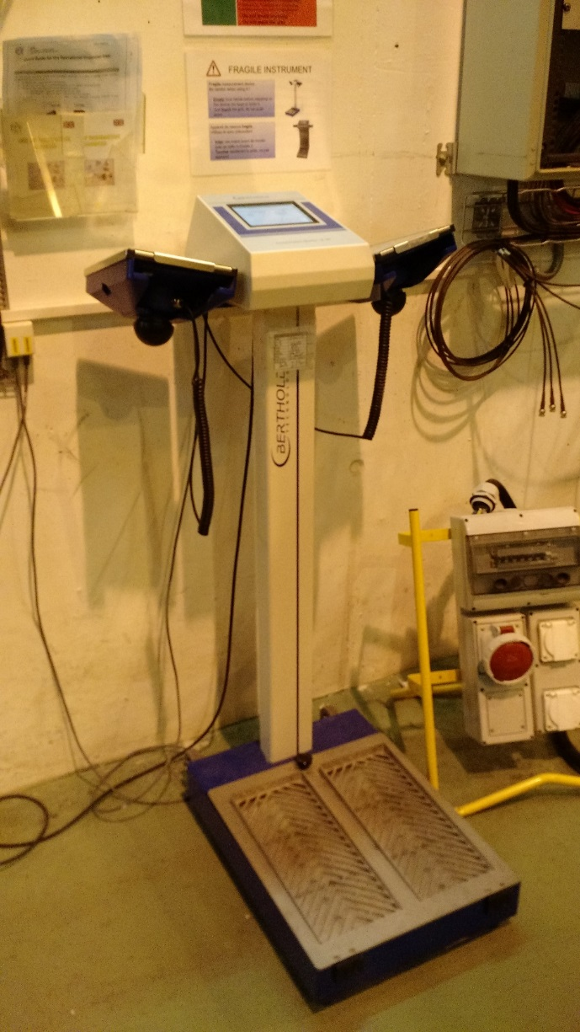
Safety and Courses
For all setups: both fixed and travelling:
safety clearance required before running
Courses in 2016 for all: (as for 2015)
  Online: general and ISOLDE RP, electrical awareness
  2-h ISOLDE RP
  1.5-h ISOLDE electrical safety.
  Hands-on courses take place on Tuesday afternoons. More sessions may be possible later in the year if necessary, e.g. during HIE-ISOLDE period.
  Some training under review e.g. electrical course.
  Need for refreshing courses etc (probably going to be electronic for the first renewal at least).
  Courses need to be validated in EDH and are now linked to access
Ongoing discussion: safety helmets and shoes?
Adopt better practice for controlling on leaving the hall…

Slide 8
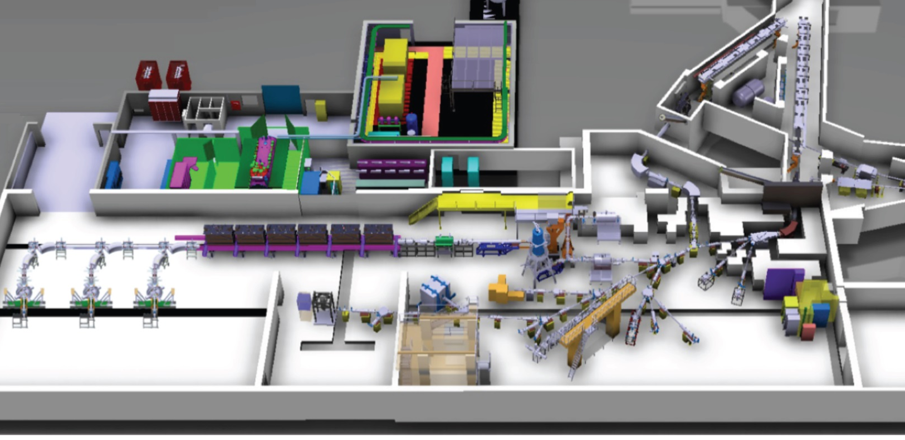
Access to ISOLDE
ISOWORK has been suppressed. Now only ISOHALL.
Access to HIE-ISOLDE recommended for only local physicists when moving equipment or dewars etc
Access for users is still at the Jura side.
  Tourniquet at 508 controls access to the hall in addition to access door in Building 508. Both operated via dosemeter.
  Door to the hall is no longer controlled by the CERN card.
SAS
Jura side

Slide 9
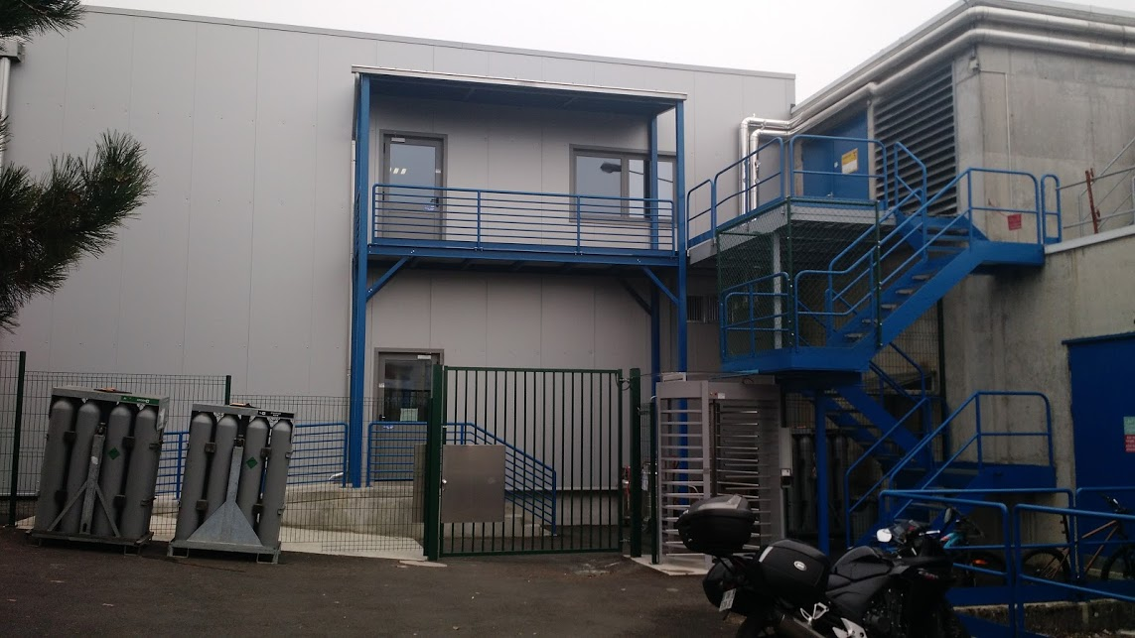
Must stay closed!

Slide 10
Visits to ISOLDE
ISOLDE as Controlled RP area:
Only professional visits allowed
  Our suggestion – university students, uni and school teachers, VIPs
Non-professional visits access on case-by-case basis
  High-school students above 16y
  Private-public visits: friends, family
No visits during the opening of beamlines or making high-intensity collections
All visits
  announced to myself, Richard, or Kara
  Included in weekly schedule
  discussed and approved or not in Tuesday Isolde technical meeting
  Dedicated calendar available https://espace.cern.ch/isolde-visits-info/_layouts/15/start.aspx#/Lists/Calendar/calendar.aspx
RP make a survey prior to each visit.
Wear helmets and closed shoes.

Slide 11
ISOLDE Visits: Nationality of visitor
2014
Total visitors: 745
2015
Total visitors: 857
Thanks to Kara lynch

Slide 12
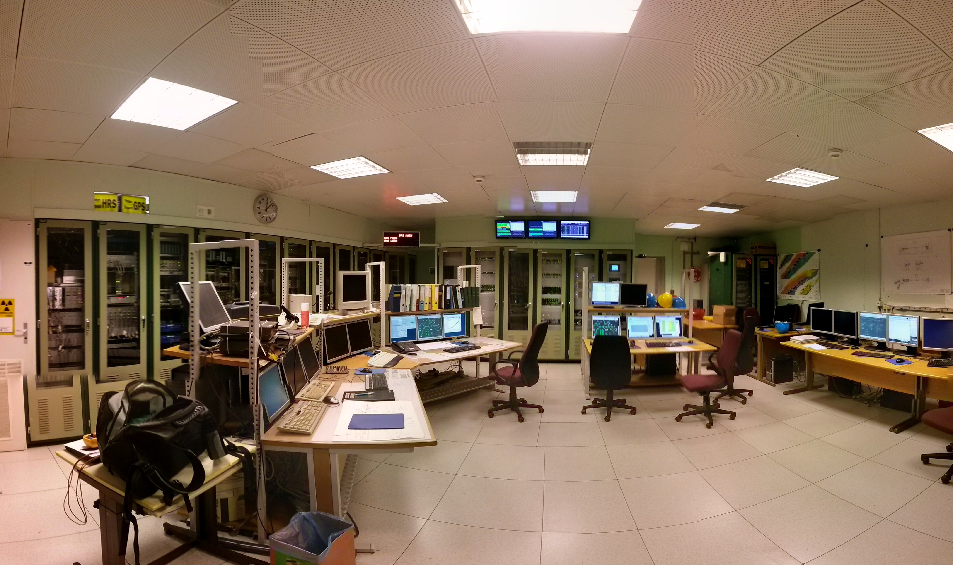
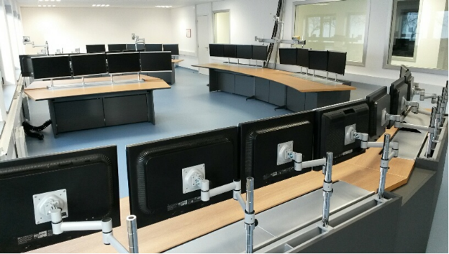
Building 508
Rack for p-request, beamgates and access in place.
Access keys modules will be installed in it this week
p-request and beamgates hardware is being prepared.
Ethernet re-connection of PCs is ongoing.

Slide 13
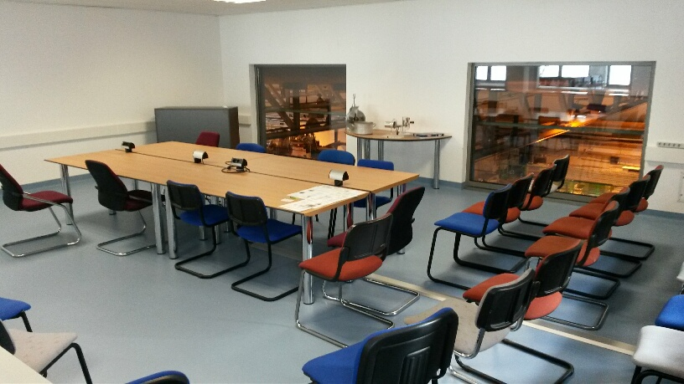
ISOLDE Visitors room

Slide 14
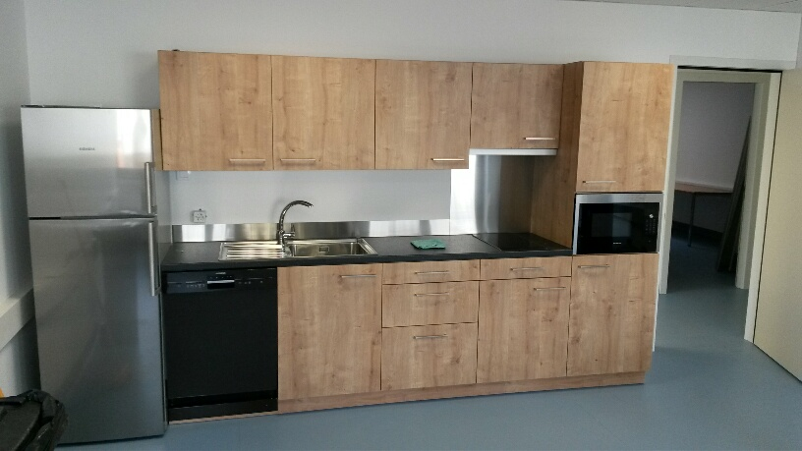
Building 508: Kitchen
Almost there….needs final plumbing

Slide 15
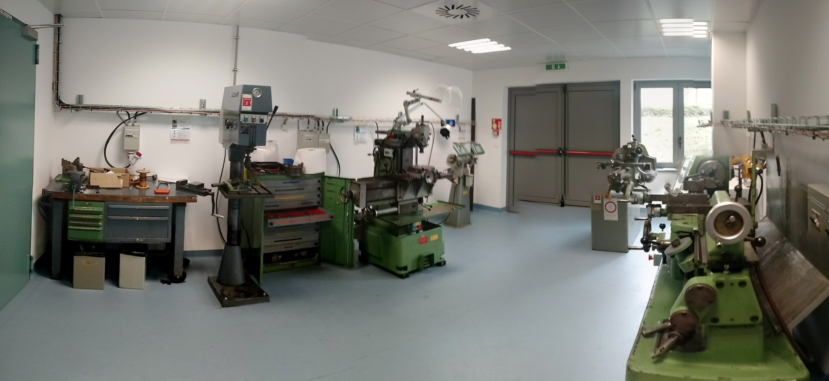
Tooling area available for users: requires clearance

Slide 16
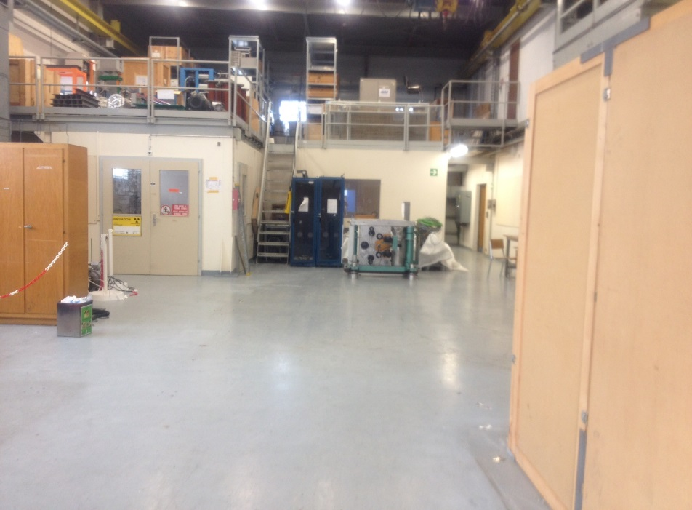
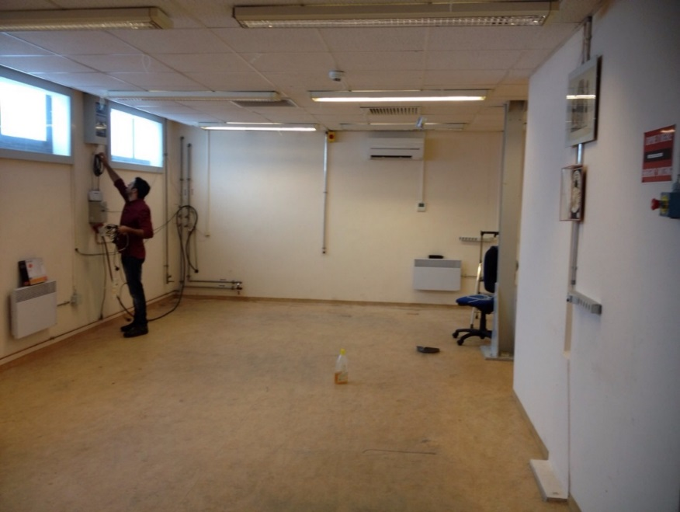
Offices: AD
AEGIS laser lab
g-BAR?
ASACUSA
test setup
Building 275
Offline lab almost ready (floor needs to be re-done).
De-classification is underway.
Requests for use are ready to be accepted.
Currently ISOLTRAP and beta-NMR will use some space and time.

