Slide 1

ISOLDE Technical Report
Richard Catherall EN-STI-RBS
ISOLDE Technical Coordinator
52nd INTC meeting
3rd February 2016

Slide 2
Outline
Target Developments
RILIS
Shutdown work progress
  Target Area
    MEDICIS Interface
    Frontend Modifications
    Ventilation
  ISOLDE experimental hall
    HT modulation tests
    Fast tape station status
Cold Check Out

Slide 3
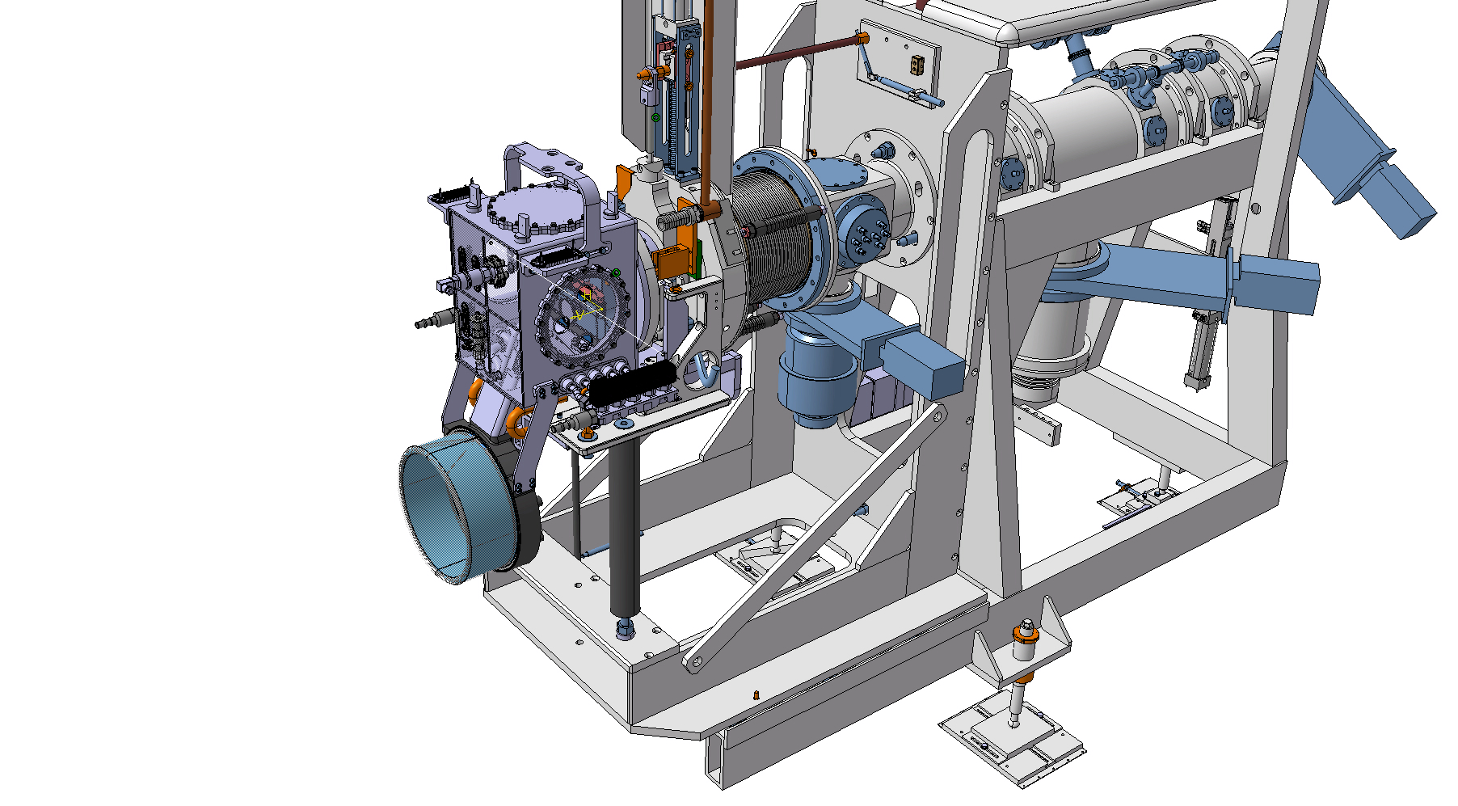
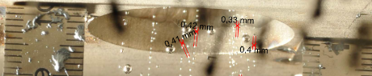
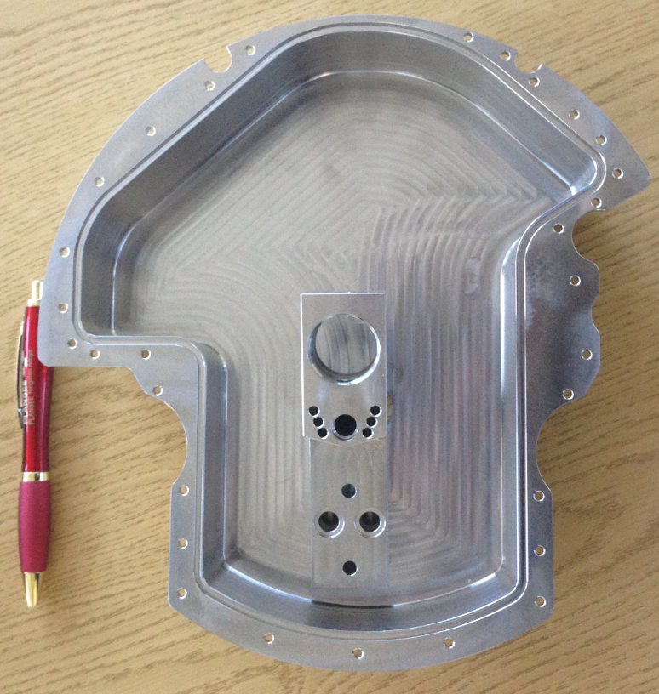
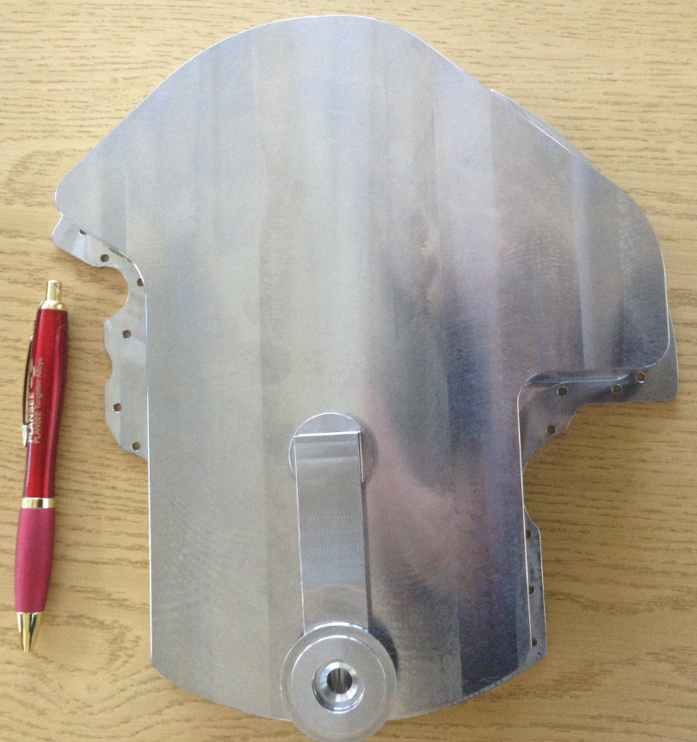
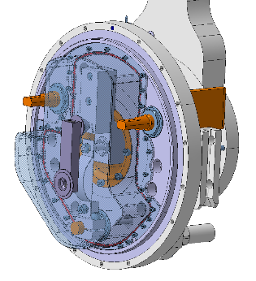

The LIEBE target
(Liquid Eutectic Lead Bismuth loop target for Eurisol)
Test for shower feasibility done:
  Minimum droplets size is 0.4 mm diameter (diffusion)
  Design finalized
  Manufacturing started
  Modifications at Front-End to be presented next Thursday – ENTM ALARA
  Full target manufacturing and assembly planned for April 2016
Improve exotic Hg beams by up to factor 10!
PhD Melanie Delonca

Slide 4
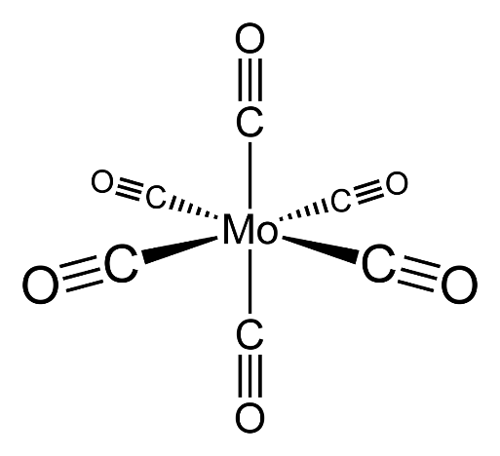
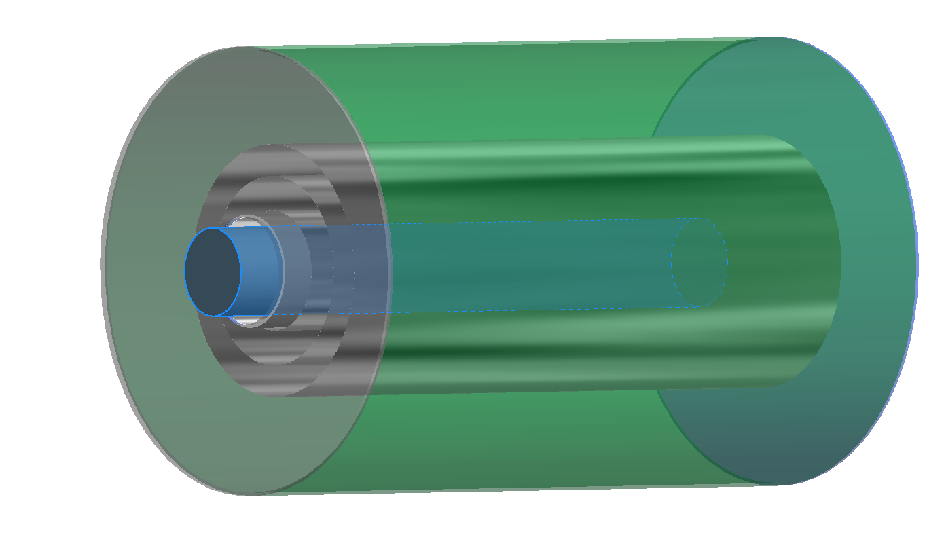
Carbonyl beams of refractory elements
CO (g)
Principle:
Mo
Carbonyle compounds
V(CO)₆
Cr(CO)₆
Mo(CO)₆
W(CO)₆
Tc₂(CO)₁₀
Re₂(CO)₁₀
Ru(CO)₅
Os(CO)₅
Co₂(CO)₈
Rh₂(CO)₈
Ir₄(CO)₁₀
Ni(CO)₄
1 |  |  |  |  |  |  |  |  |  |  |  |  |  |  |  |  | 2
H |  |  |  |  |  |  |  |  |  |  |  |  |  |  |  |  | He
3 | 4 |  |  |  |  |  |  |  |  |  |  | 5 | 6 | 7 | 8 | 9 | 10
Li | Be |  |  |  |  |  |  |  |  |  |  | B | C | N | O | F | Ne
11 | 12 |  |  |  |  |  |  |  |  |  |  | 13 | 14 | 15 | 16 | 17 | 18
Na | Mg |  |  |  |  |  |  |  |  |  |  | Al | Si | P | S | Cl | Ar
19 | 20 | 21 | 22 | 23 | 24 | 25 | 26 | 27 | 28 | 29 | 30 | 31 | 32 | 33 | 34 | 35 | 36
K | Ca | Sc | Ti | V | Cr | Mn | Fe | Co | Ni | Cu | Zn | Ga | Ge | As | Se | Br | Kr
37 | 38 | 39 | 40 | 41 | 42 | 43 | 44 | 45 | 46 | 47 | 48 | 49 | 50 | 51 | 52 | 53 | 54
Rb | Sr | Y | Zr | Nb | Mo | Tc | Ru | Rh | Pd | Ag | Cd | In | Sn | Sb | Te | I | Xe
55 | 56 | 71 | 72 | 73 | 74 | 75 | 76 | 77 | 78 | 79 | 80 | 81 | 82 | 83 | 84 | 85 | 86
Cs | Ba | La.. | Hf | Ta | W | Re | Os | Ir | Pt | Au | Hg | Tl | Pb | Bi | Po | At | Rn
3 U Foils, 25 µm
¹⁰⁵Mo production yield:
~ 10⁸ ions / uC
Proton beam
Neutron converter
Mo Container,
Filled with CO
PhD Jochen Ballof

Slide 5
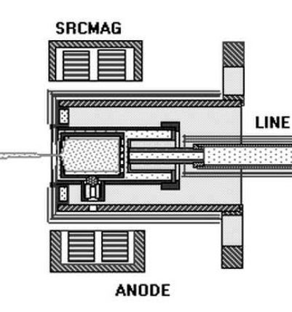
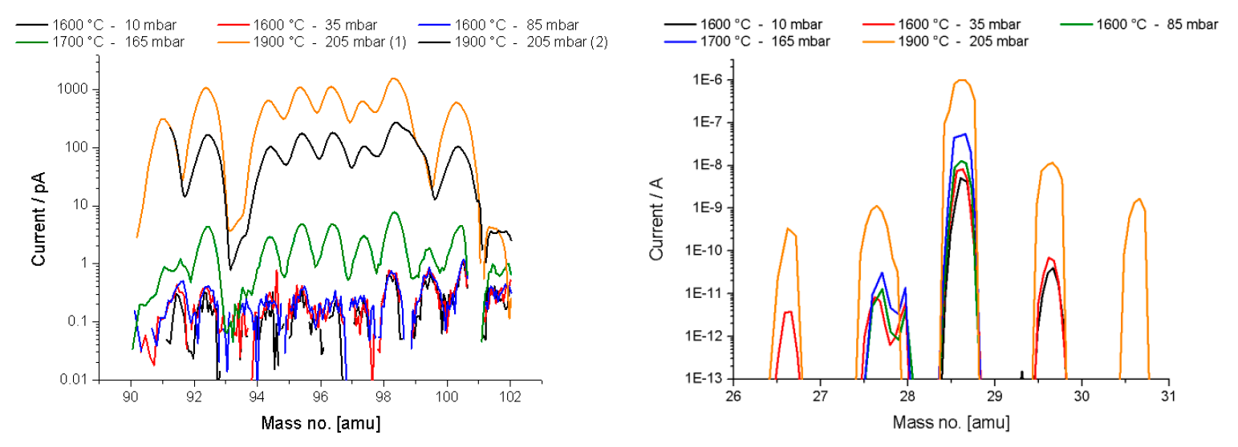
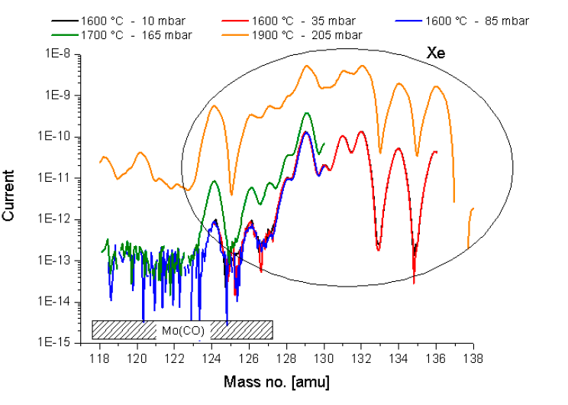
Carbonyl beams of refractory elements
Modified VADIS Ion source
Manometer
~ 200 mbar
Heating
~ 110 C
Calibrated leak
Mo(CO)6
Classic injection path (hot vadis)
Cathode
Extended copper cylinder
Water cooled target base
PhD Jochen Ballof

Slide 6

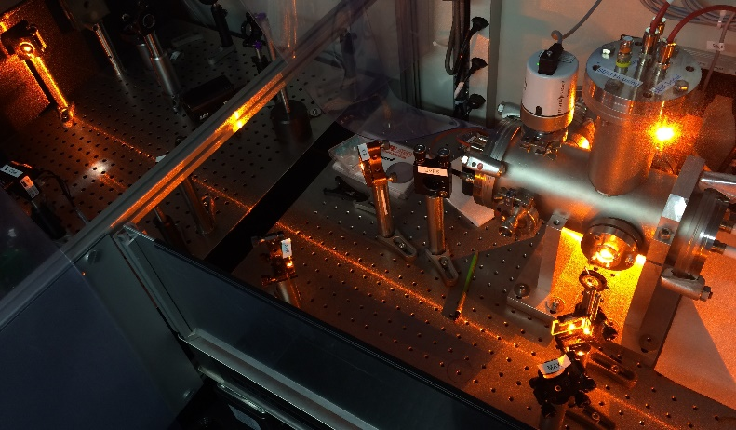
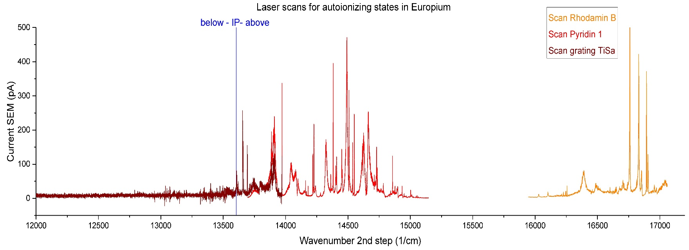
Eu scheme development at RILIS with PISA
Integrated PhotoIonization Spectroscopy Apparatus (PISA)
To be used as reference for in-source laser spectroscopy and ionization scheme development
Make use of RILIS set up during shut down
Enables exploratory scheme development at RILIS, prior to test with dedicated ISOLDE target
First candidate: Europium (Eu)
Scan of 2 different dye lasers and new grating TiSa
Many new autoionizing states discovered
Two promising schemes with dye or TiSa identified
Eu
585 nm to 918 nm
2nd step dye
IP 5.7eV
2nd step TiSa
311.14 nm
Slide by K. Chrysalidis
Autoionizing states in Europium -> most efficient scheme? More tests needed

Slide 7
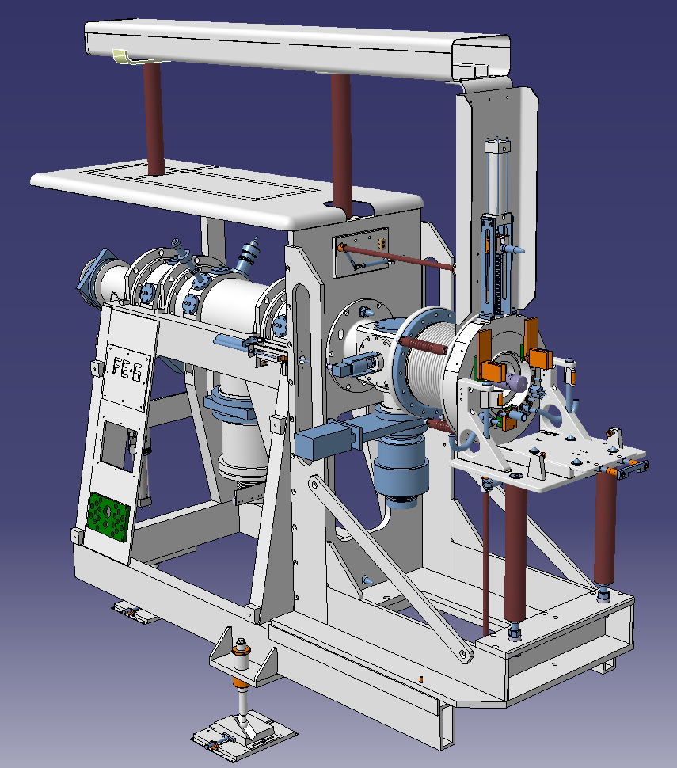
Target Area
MEDICIS Interface
Frontends … ALARA L3 intervention
  Annual Frontend maintenance
  Modification of target coupling table and its control
  Change of GPS target coupling piston
  Faraday cage piston exchange
  Preparation for LIEBE target tests
General maintenance
  BTY line checks
  Robot programming checks
  Ventilation

Slide 8
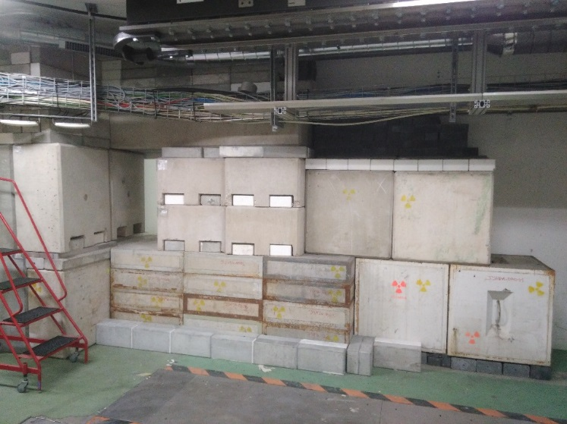
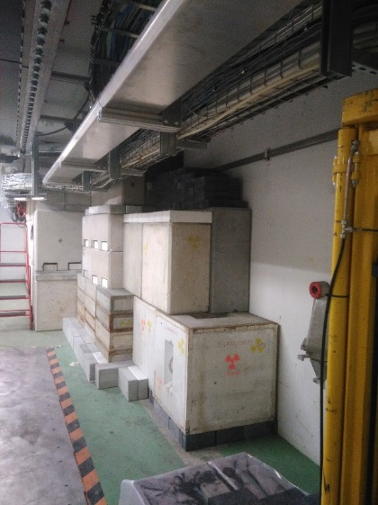
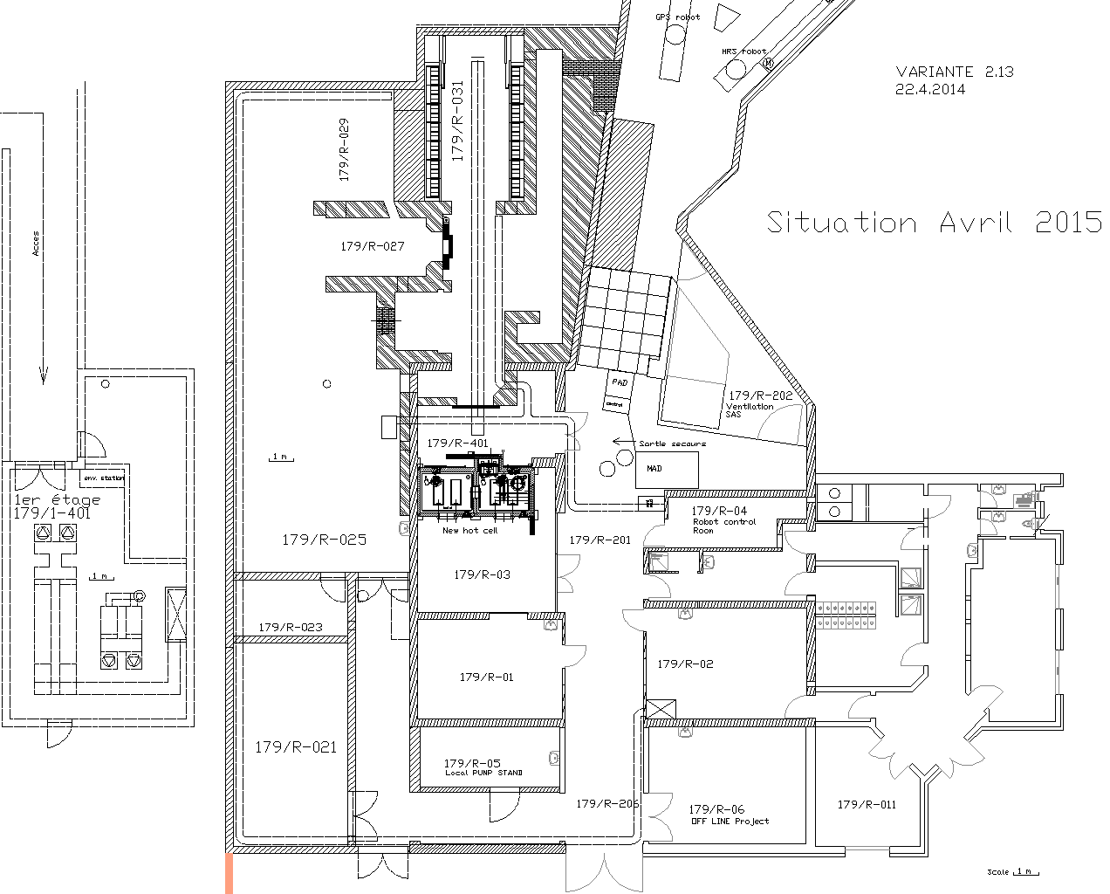
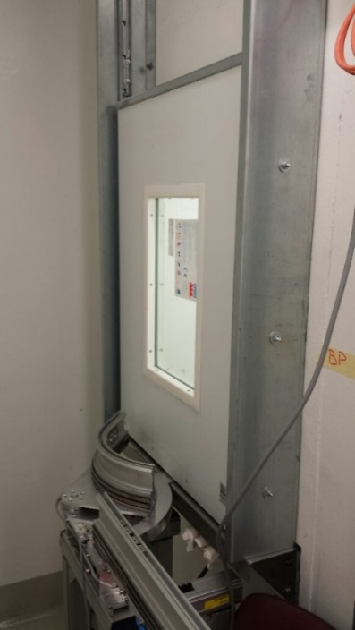
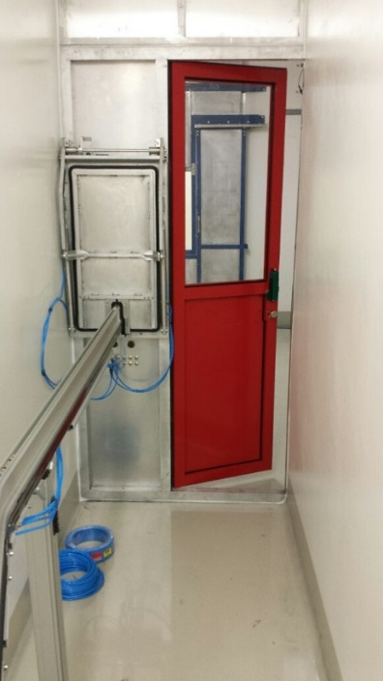
MEDICIS Interface
S. Marzari

Slide 9
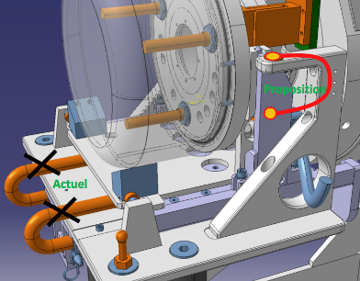
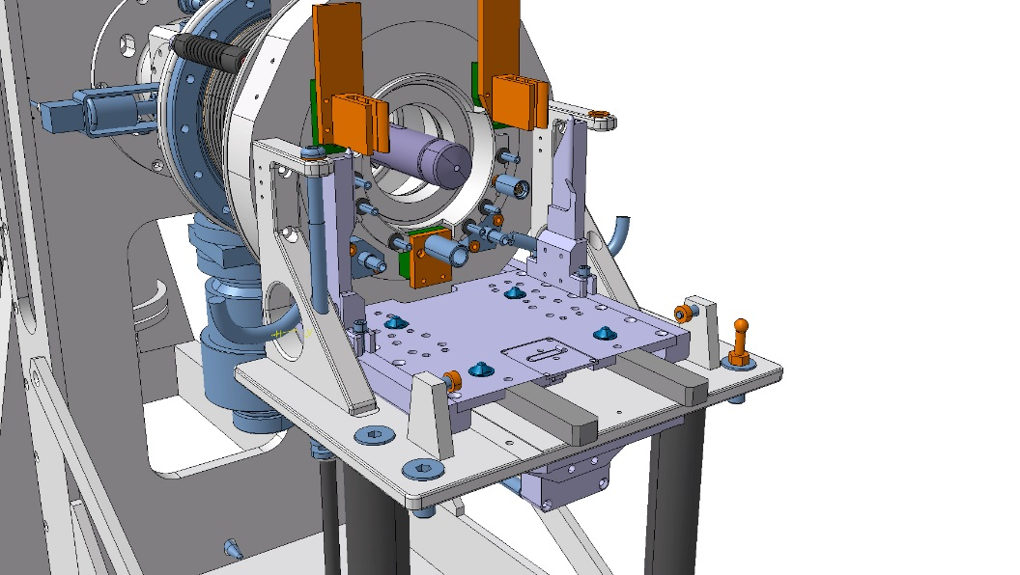


Frontend modifications/revision
Change coupling table
  Relieve forces on ball-bearings
  Introduce an adjustable end-stop for the same reason
  Profit to make minor changes for potentiometer and be compatible with LIEBE target

Slide 10
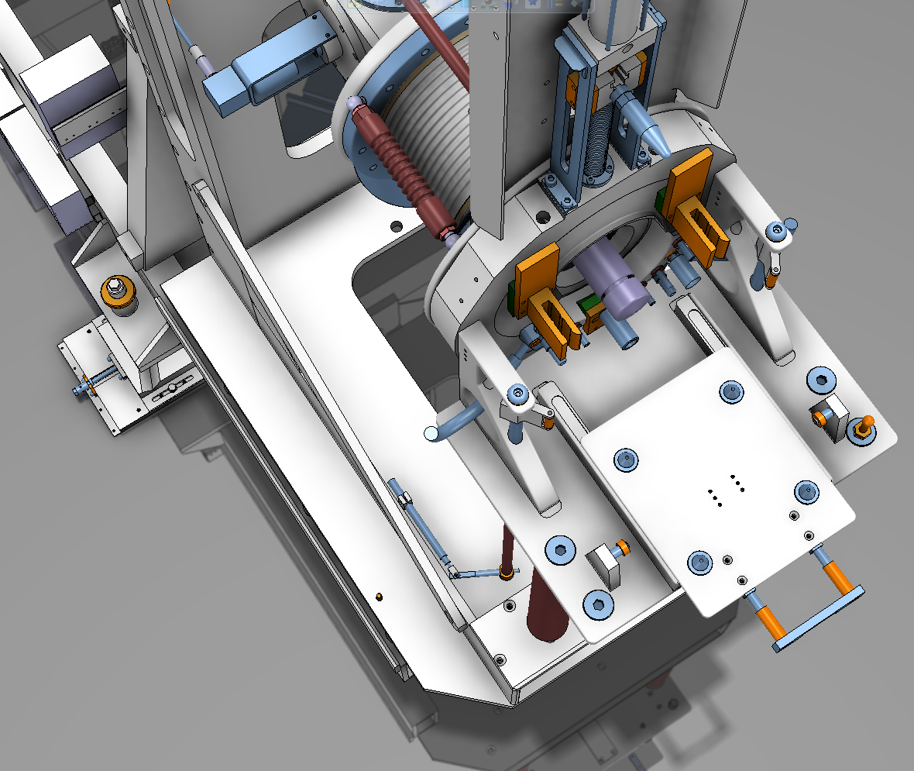
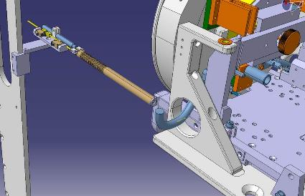
Frontend maintenance/revision
Modification of potentiometer
  Inability to confirm that target is correctly clamped due to too much hysteresis in rotational axis.
  Micro-switches will also be added for redundancy/verification
Potentiomètre linéaire
Rotated return

Slide 11
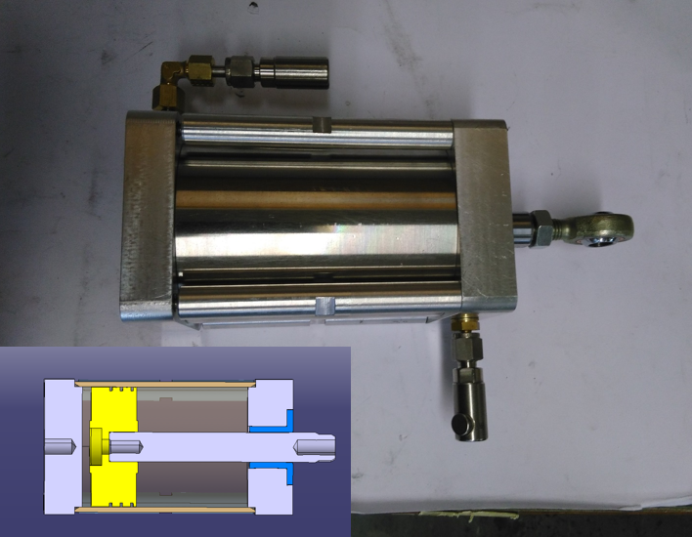
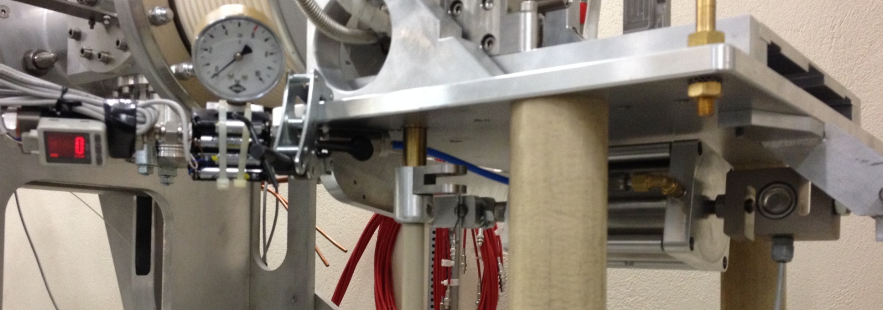
Frontend maintenance/revision
Exchange of GPS piston for new design (already done on HRS)
  Inability to clamp target
    Confusion with potentiometer feedback has led to unnecessary filling of exhaust gas tanks
  New design tested 1000 times off-line

Slide 12
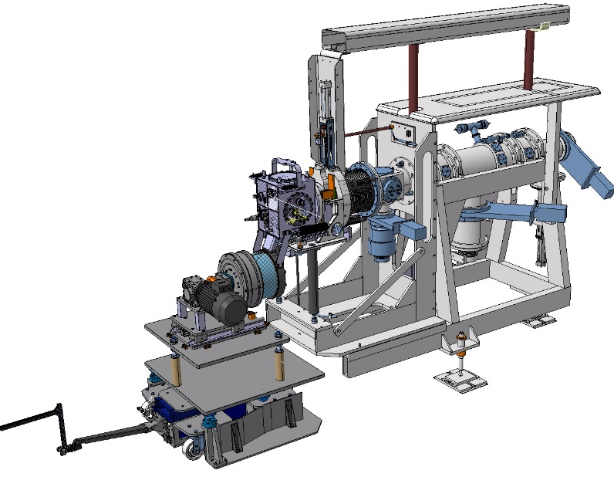
LIEBE target test preparations
Test on-line (GPS) planned for end of 2016
  Less risk for ISOLDE operation
Preparations need to be done during YETS
  To benefit from lower dose rates
Review in view of operation planned for June 2016
  Maybe a second ALARA L3 meeting required
Work includes
  FE modifications
  Cables through HT transfer tubes
  FE supports and guide for pump trolley
  Water connections
  Shelf position modifications
  Robot programming

Slide 13
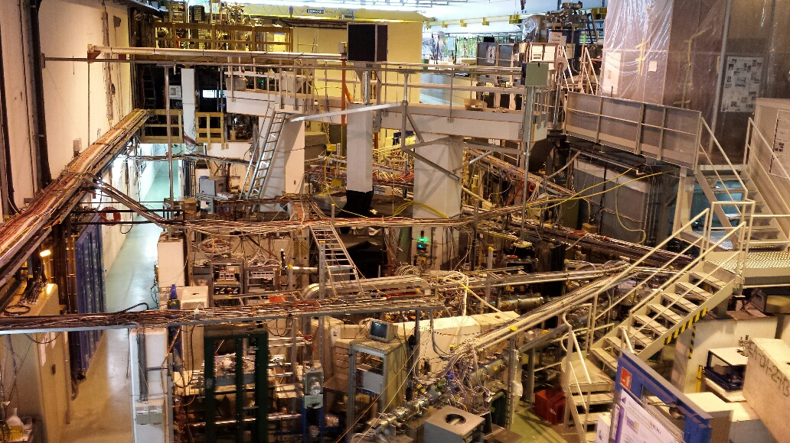
ISOLDE Hall
Upgrade of vacuum controls TE-VSC
Verification of beam instrumentation
  Will be done with beam in cold check out
Installation of Fast Tape Station
Separator areas
  Change of vacuum valve HRS section 2 and 3
  Laser window exchange HRS + GPS
HT Room
  HT maintenance
  Preparation for modulator tests

Slide 14
Fast Tape Station Installation
Status
  Mechanics: support chassis complete
          Most pieces have arrived
          Main vacuum chamber expected this week
  Detectors: Design complete and construction started
  Controls: ready and awaiting completion of mechanics
Endurance tests to be completed by March 2016
Installation at LA2 in March
Commissioning with calibration sources and then with beam throughout 2016
Remove old tape station and move to CA0 during EYETS

Slide 15
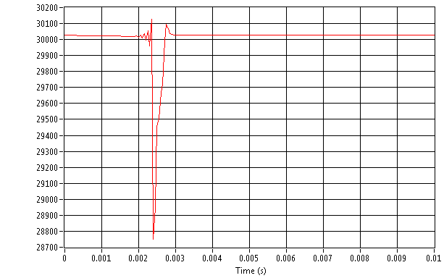
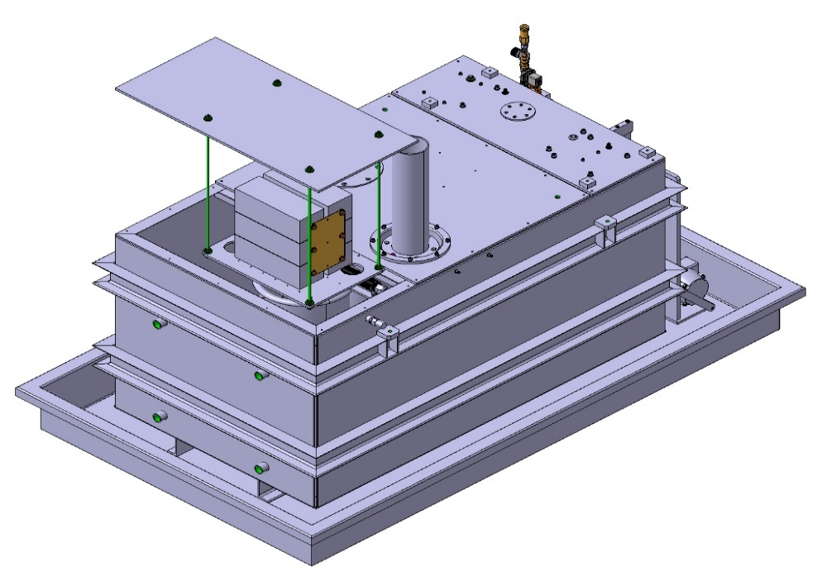
A new 60kV modulator for ISOLDE/HIE ISOLDE
A new modulator circuit has been developed with relatively low power components to provide a robust and accurate charging device capable of re-establishing the 60 kV with improved recovery time.
It has been designed especially to sustain the expected increases in beam energy (2GeV) and higher intensity beams for HIE-ISOLDE.
Modulator HT pulsing specifications
- Recovery times to within +/-1V with a simulated target of ~1ms. To be measured with neutron converter target at ISOLDE facility.
Maximum voltage overshoot < 0.2%
Power supply specifications
- HT set-point from 10kV to 60 kV with 1V resolution
- HT stability +/- 1V (external regulation)
- HT warm up delay (drift compensation) < 5 mn
Monitored signals
- HT recovery time signal acquired and monitored
- HT long term stability acquired and monitored
- Post-impact loading current acquired and monitored
MD at ISOLDE facility
The modulator characteristics have been measured in a simulated environment. To confirm our findings we aim to operate our new set-up installed in the HT room running in pulse operation mode with the ISOLDE target loads installed and with proton beam.
MD at ISOLDE facility will give the possibility to evaluate the new modulator. A mock-up can be installed in the present modulator tank by replacing the ASTEC power supply this way we can re-use the high precision ROSS divider.
Test in a simulated environment
Recovery time
Protons time
of arrival
New modulator 30kV recovery signal measurement
(Heinzinger HVPS 65kV – 40mA)
Test description at ISOLDE facility
The worst case scenario concerning ionization is the neutron converter target with the highest possible proton beam intensity (3.3e13ppp).
As the target is pre-charged at the moment of the beam impact, there is a risk of flash-over at the Isolde front end. The presence of Medicis target and its faraday cage can have an influence on this risk. This can be evaluated at the same time.
Our mock-up installation in ASTEC tank (ISOLDE HT room)
Thierry Gharsa TE-ABT

Slide 16
Cold Check Out
The most efficient way of testing machine operation is to run with stable beam
  Power convertors, HT, magnet controls, beam diagnostics, collimators …
Our goal is to make stable beam 1 month prior to taking protons
  1st March
All separator systems should be operational or in test phase
  Water cooling, controls, power convertors, BI etc
In parallel, RILIS will investigate laser ionisation schemes on specific stable beams.
NToF will be making samples of ⁷Be for their first physics run
Thank you for your attention

