Slide 1



Proposal: Beta-delayed neutron
spectroscopy of ⁵⁴Ca
Addendum of IS599

Slide 2
Index
Why beta-delayed neutron spectroscopy ?
IS599: ⁵¹⁻⁵³K ⁵¹⁻⁵³Ca
Physics case for ⁵⁴K ^{54,53}Ca
Beam-time request

Slide 3
Beta-delayed neutron spectroscopy
In exotic nuclei close to shell closures we can have very large Q values (15 MeV or more)
The beta decay can thus populate states below and above the neutron (and 2n) separation threshold
Where does the beta strenght go through(GT, FF) ?
Particle-hole to measure the shell energies in exotic nuclei

Slide 4
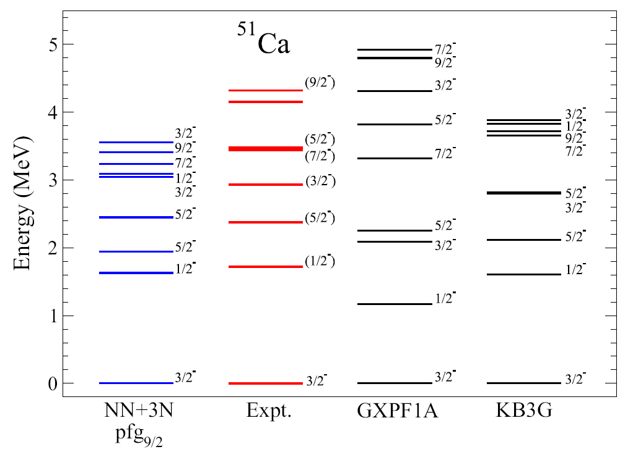
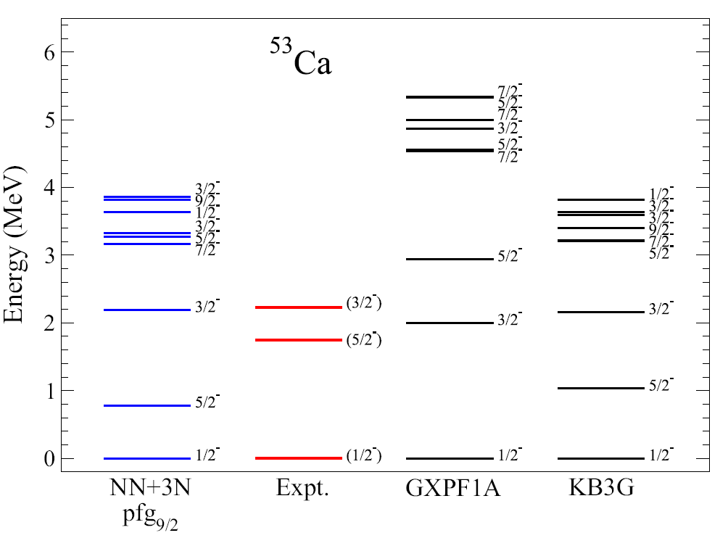
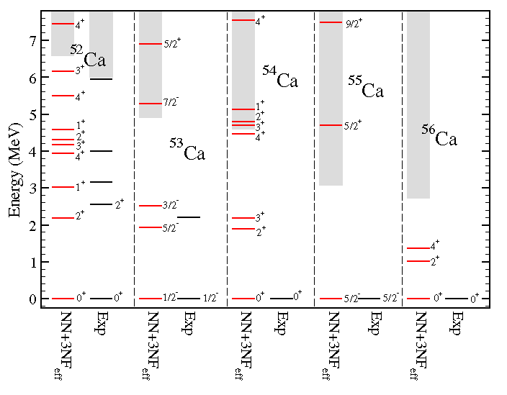
How are the ESPEs evolving in Ca isotopes?
J. D. Holt et al., PRC 90, 024312 (2014)
Different predictions going towards the N=34 for the f_{7/2} gap (different 3N forces + coupling to continuum)
G. Hagen et al., Phys. Rev. Lett. 109, 032502 (2012)

Slide 5
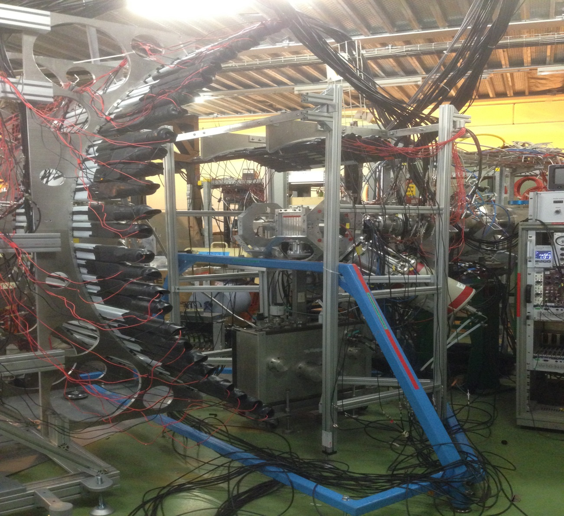
Experimental setup: VANDLE + IDS
VANDLE neutron array: ε: 10 %; σ: 80 keV (1 MeV)
Four clovers
High-efficiency beta detector (>80 %)
IDS tape
1 LaBr (Mr. Big)
Low rates

Slide 6
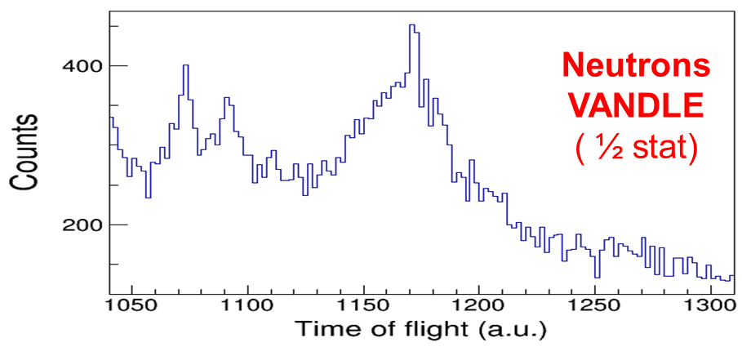
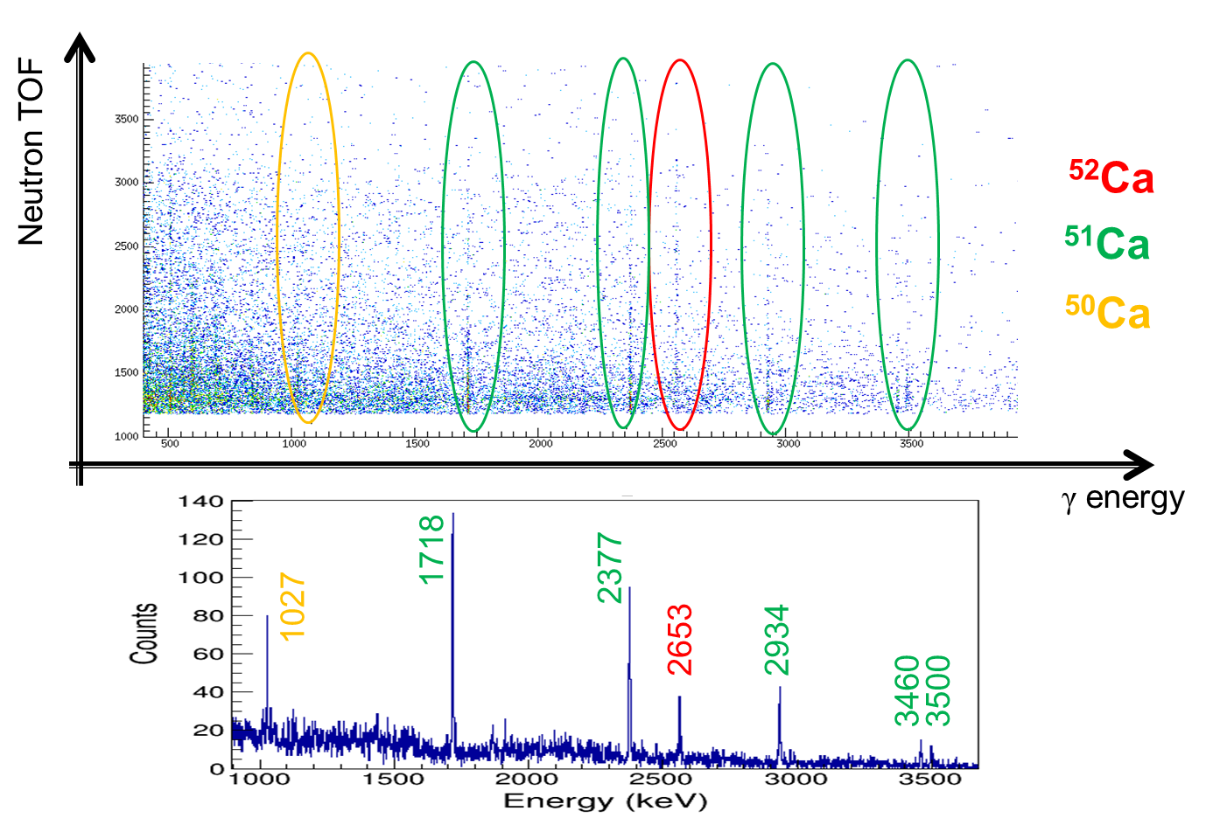
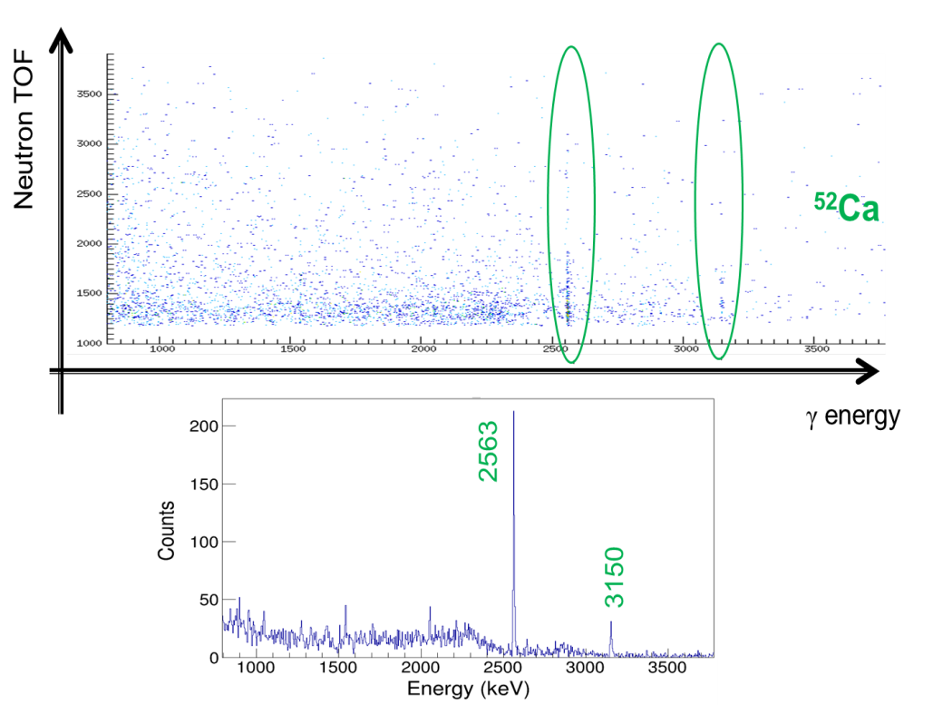
Very preliminary IS599 results
⁵³K decay
⁵²K decay

Slide 7
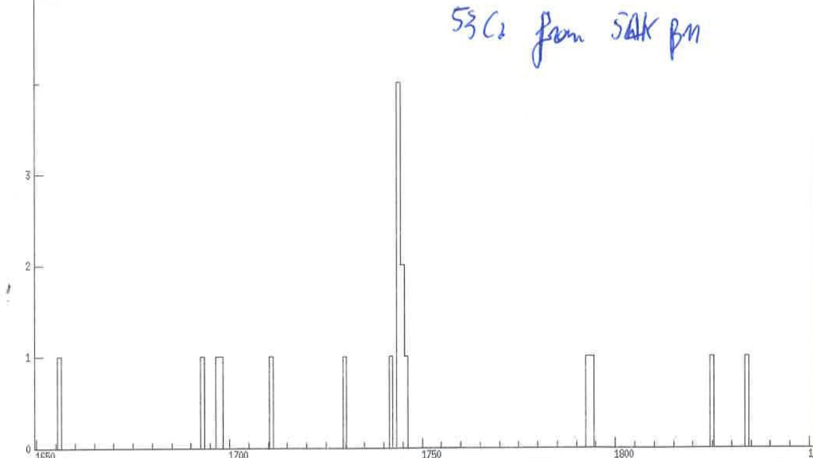
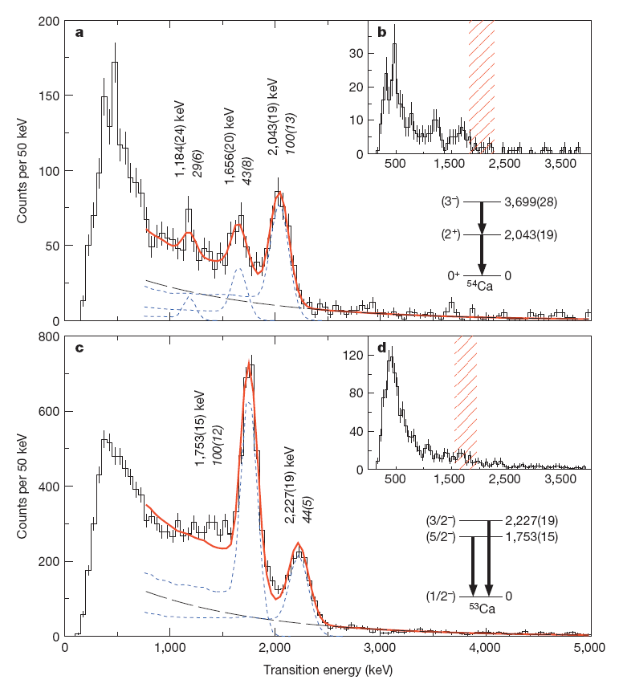
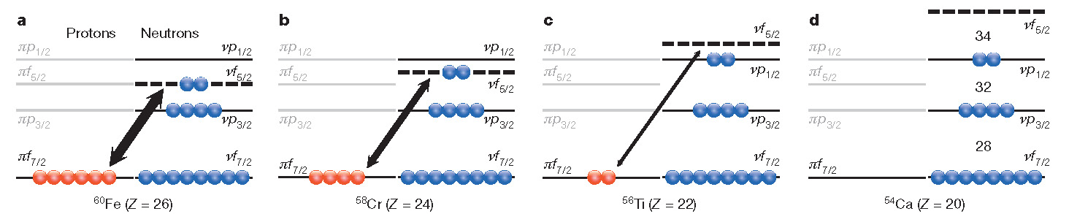
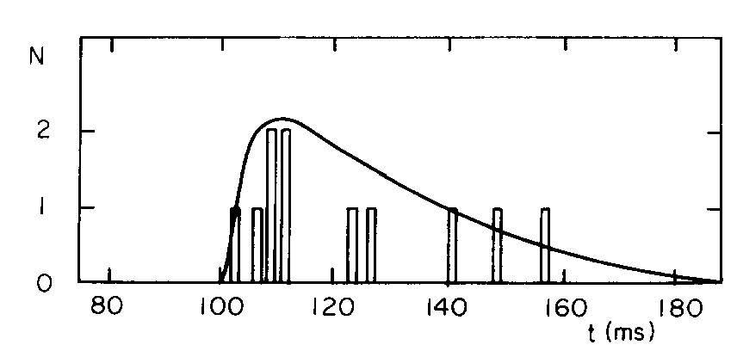
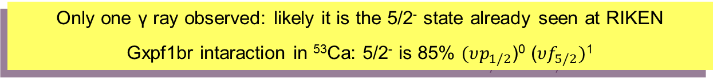
What we have observed: ⁵⁴K -> ^{54,53}Ca
Q-value 20 MeV !
γ IDS – VANDLE
53Ca @ RIKEN
8 hour run !
⁵⁴K β(n) decay
T_{½}= 10(5) ms
M. Langevin et al., PLB 130, 251 (1983)
Only one γ ray observed: likely it is the 5/2⁻ state already seen at RIKEN
Gxpf1br intaraction in ⁵³Ca: 5/2⁻ is 85% $(υp_{1/2}$)⁰ ($υf_{5/2})$¹
⁵⁴K: N=35 isotope. One neutron in f_{5/2} ?
Paring f_{5/2} = 1.2 MeV; Pairing p_{1/2} = 0.2 MeV : strong pair scattering across N=34
⁵⁴K 2⁻ ground state: <f_{5/2}> = 3; <p_{1/2}> = 0.8

Slide 8
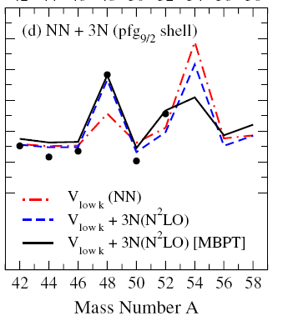
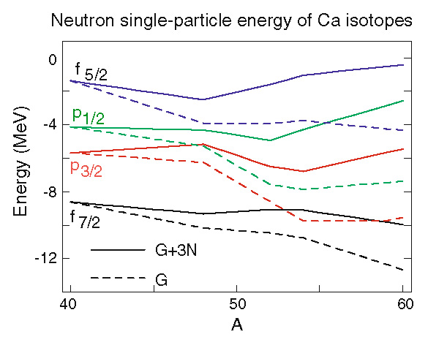
Three-body forces in Ca isotopes
Two-body forces cannot explain the N=28 SO shell closure
J. D. Holt et al., J. Phys. G: Nucl. Part. Phys. 39 (2012) 085111
Three-body forces: repulsion between f_{7/2} and p_{3/2},p_{1/2}, f_{5/2}
T. Otsuka and T. Suzuki, Few-Body Syst (2013) 54:891–896

Slide 9
The N=34 subshell closure
The N=34 subshell gap is created by the tensor force
D. Steppenbeck et al., Nature 502, 207 (2013)
2⁺ found at 2 MeV, consistent with the tensor + 3-body theory
Three-body forces reduce the N=34 gap by adding repulsion to p_{1/2} with respect to f_{5/2}
F. Wienholtz et al., Nature 498, 346 (2013)

Slide 10
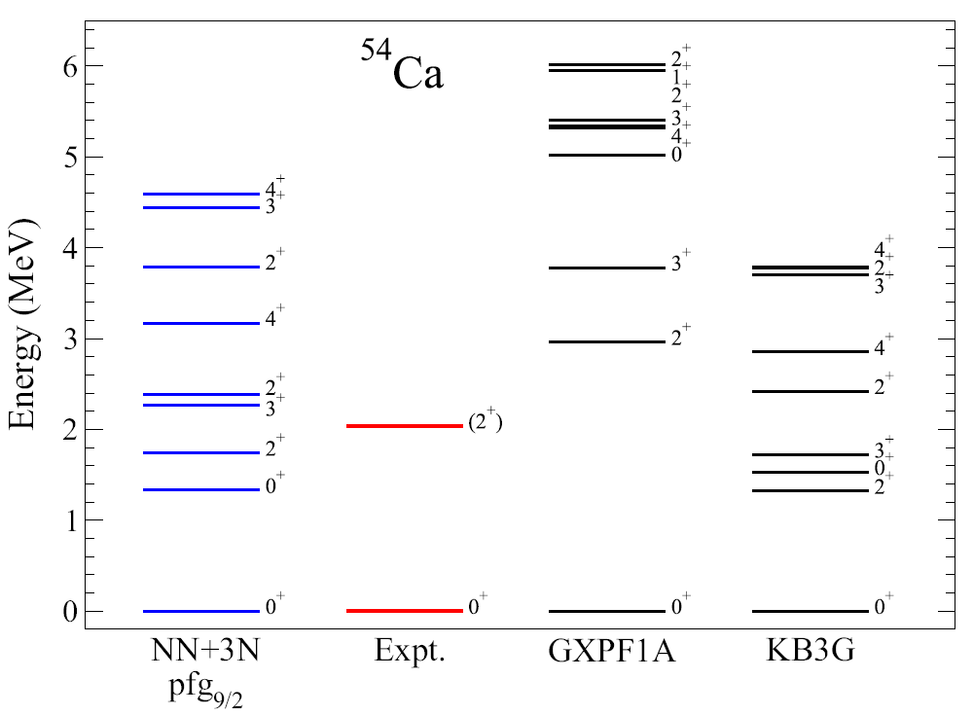
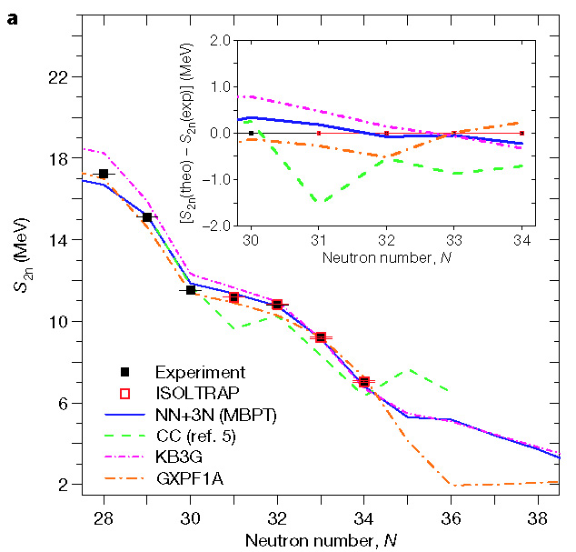
Physical motivation
«first principle»
«renormalized to ⁴⁰Ca mass»
2⁺ known, detailed spectroscopy: confirmation of 3⁻, 4⁺ (very different predictions for different 3-body force renormalization)
Neutron emission towards ⁵³Ca: distribution of the GT (shell closures) and scattering across N=34.

Slide 11



What we expect to see (1)
⁵⁴K β(GT) decay to ⁵⁴Ca
Calculations with the PSDPF interaction predict a 2⁻ ground state from ⁵⁴K (also from systematics)
Shell-model calculations also predict a strong population of 3⁻ states, close and above the S_{n}=4.4 MeV
After GT: holes in f_{7/2}, p_{3/2}, p_{1/2} , neutrons in f_{5/2}
f_{5/2}
GT
N=34
p_{1/2}
fp
p_{3/2}
N=28
Z=20
GT
f_{7/2}
sd
N=20
In the n-emission daughter ⁵³Ca, which states populated ? What is the fragmentation ? -> observing 10-20 % branches
$$GT: υp_{1/2}→{πp}_{1/2}$$
⁴⁸Ca
core
$$υp_{3/2}→{πp}_{3/2}$$
$$υf_{7/2}→{πf}_{7/2}$$
⁴⁰Ca
core

Slide 12
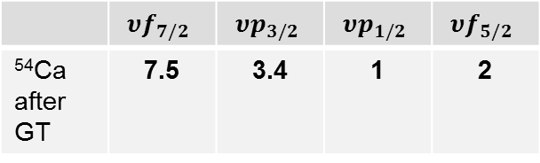
What we expect to see (2)
⁵⁴K β(GT) decay to ⁵⁴Ca
Large-scale shell-model calculation in the psdpf space with Antoine:
The most intense states are 3⁻
2⁺ at 1.4 MeV
2⁺ at 2 MeV
 | $$υf_{7/2}$$ | $$υp_{3/2}$$ | $$υp_{1/2}$$ | $$υf_{5/2}$$
⁵⁴Ca after GT | 7.5 | 3.4 | 1 | 2
Results:
From ⁵⁴Ca γ-ray spectroscopy: more detailed level scheme, comparison with different 3-body models
From neutron spectroscopy: GT distribution and neutron evaporation as a probe of N=34

Slide 13
Rates and spectroscopy
⁵⁴K rate (realistic, based on previous result plus some target improvements): 0.5 pps, (possible to improve with target optimized for fast release ?)
8% neutron efficiency, 90% β efficiency, 2 % γ efficiency
60-90 % neutron emission: around (1-2)·10⁴ neutrons detected in 7 days
10% feeding to excited ⁵⁴Ca states: around 200 γ rays from ⁵⁴Ca in 7 days; mainly 2⁺ and 3⁻, likely also 4⁺ states
Lifetime from neutrons and gammas
In total, 21 shifts (seven days) are requested

Slide 14
Collaboration
A. Gottardo¹, R. Grzywacz², M. Madurga³,
G. de Angelis⁴, F. Azaiez¹, D. Bazzacco⁵, G. Benzoni⁶, A. Boso⁵, Y. Deyan¹, M.-C.Delattre¹, P. Van Duppen⁷, A. Etilé⁸, S. Franchoo¹, C. Gaulard⁸, G. Georgiev⁸, S. Go², A. Goasduff⁴, F. Gramegna⁴,K. Kolos², M. Kowalska³, S. Ilyushkin⁹, G. Jaworski⁴, Y. Xiao², S.M. Lenzi⁵, J. Ljungvall⁷, P.R. John⁵, R. Li¹, S. Lunardi⁵, T. Marchi⁴, I. Matea¹, D.Mengoni⁵, V. Modamio⁴, A.I. Morales⁶, P. Morfouace¹, D.R. Napoli⁴, S. Paulauskas¹⁰, E.Rapisarda³, S. Roccia⁸, B. Roussier¹, C. Sotty⁷, I. Stefan¹ , S. Taylor², J.J. Valiente-Dobón⁴, D. Verney¹ , H. de Witte⁷, A. Algora¹¹, K. Riisager¹², A. Negret¹³, N. Marginean¹³, R. Lica¹³, C. Mihai¹³, R.E. Mihai¹³, R. Marginean¹³, C. Costache¹³, S. Nae¹³, A. Turturica¹³.
IDS collaboration
1 Institut de Physique Nucléaire Orsay, 2 University of Tennessee , 3 CERN, 4 INFN, Laboratori Nazionali di Legnaro
5 University of Padova and INFN Padova, 6 University of Milano and INFN Milano, 7 KU Leuven, 8 CSNSM Orsay, 9 Colorado School of Mines, 10 NSCL, 11 IFIC Valencia, 12 Aarhus University, 13 IFIN-HH, Bucharest

Slide 15
V. Somà

Slide 16
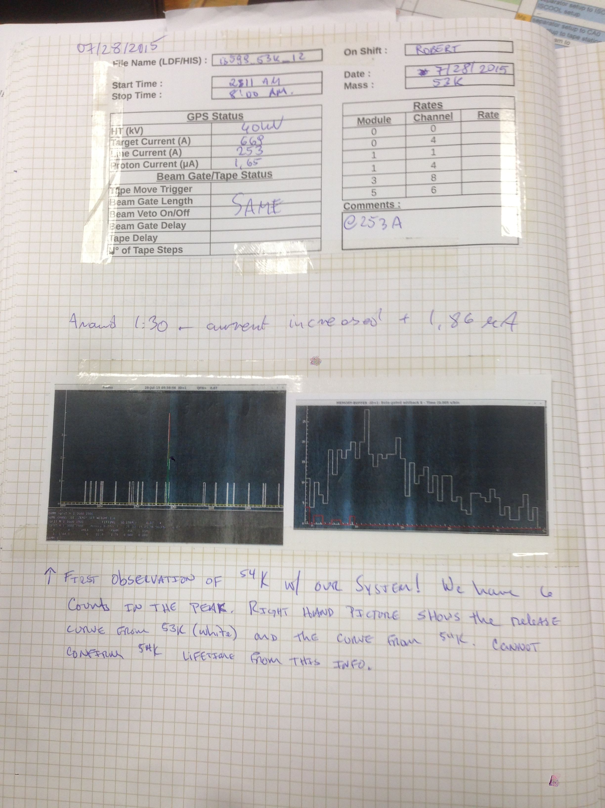
53K
Our result from gamma rays
54K

Slide 17
⁵⁴K -> ⁵³Ca: preliminary results (2)
T_{½}= 10(5) ms
Result from neutrons:
M. Langevin et al., PLB 130, 251 (1983)
53K
Our result from gamma rays
New proposal for dedicated experiment !
54K

