Slide 1
Experimental Interaction Region – WP3
General plans and updates
J. Abelleira-Fernandez, A. Alekou, E. Cruz-Alaniz,
L. van Riesen-Haupt and A. Seryi
FCC-hh BDS Meeting
January 29th, 2016

Slide 2
Tasks
Short-Term Tasks
Define corrector strengths needed to provide crossing scheme and for orbit correction.
Define misalignment errors.
Implementation of crab cavities.
Studies in length of the inner triplet.
Long-Term Tasks
Design IR and final focus for ultimate performance of FCC-hh.

Slide 3
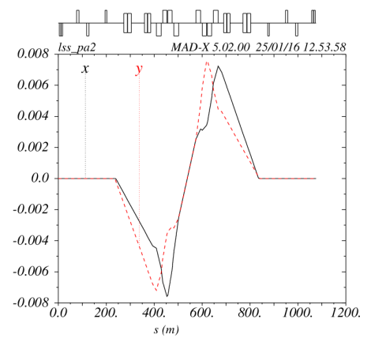


Correction-Scheme
Current scheme: 2 Correctors between the Q1 and Q2, after Q3 and before Q4. Providing crossing angle.
Include new correctors using HL-LHC as a initial design. Correct possible misalignment of the quadrupoles.
MCBXDH/V.A2RA
MCBXDH/V.3RA
MCBRDH/V.4RA
Correctors for orbit correction

Slide 4
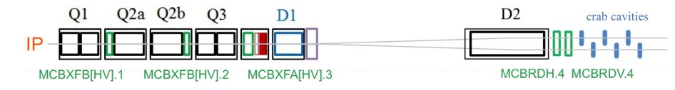
Crab Cavities
Implementation of crab cavities: Voltage, location, length.
Use as initial model crab cavities in the HL-LHC Model:

Slide 5
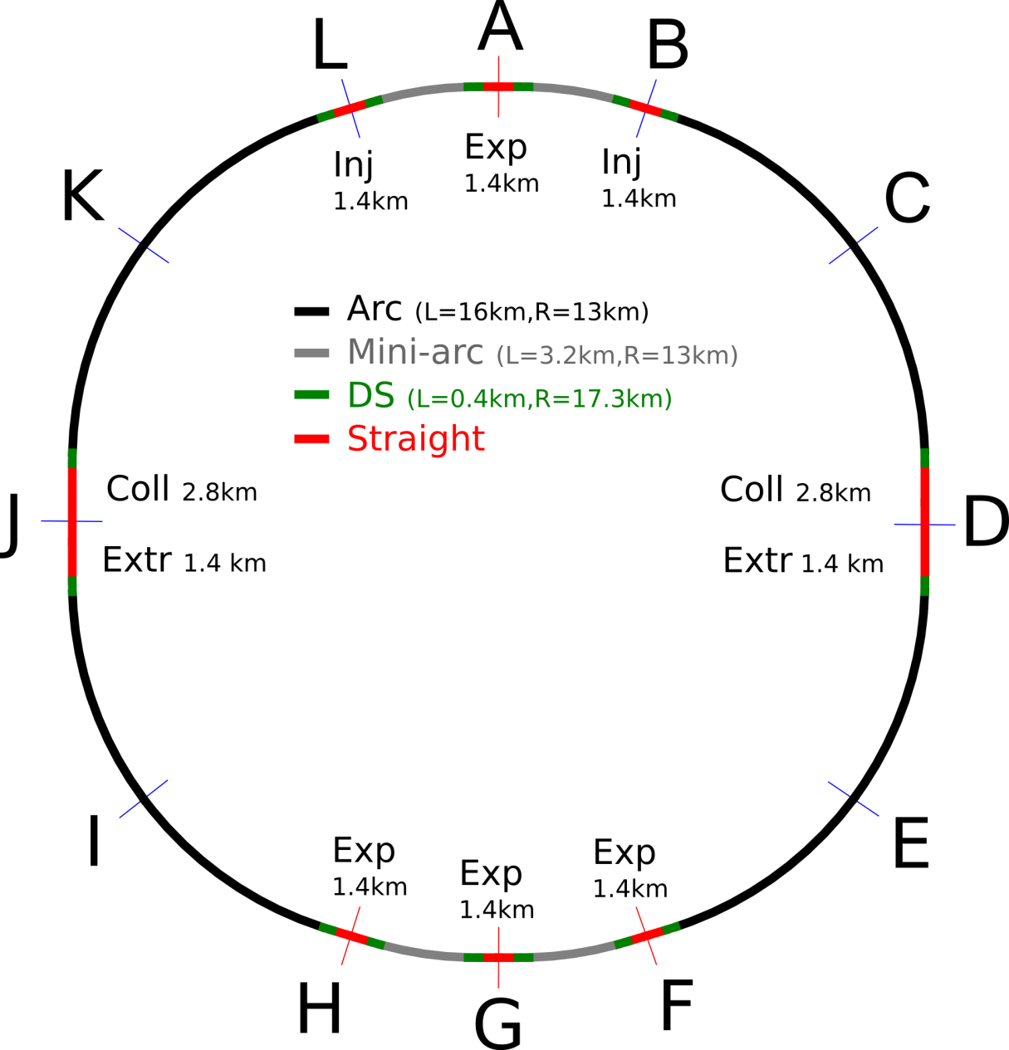
IR Design of Low Luminosity
Two high luminosity experiments (A and G). Ongoing design.
Two other experiments (H and F): Propose an initial design and explore possible options of luminosity (β*).

Slide 6
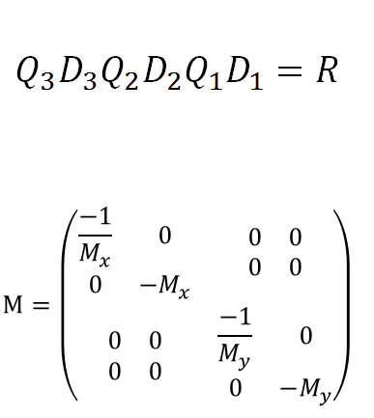
Thin-Lens Solution
Uses method based on Chao 92
  Three lenses and drifts to make arbitary transfer matrix
Work out thin lens layout to obtain required demagnifaction
Can be used to estimate initial conditions for MADX thick lens solution

Slide 7
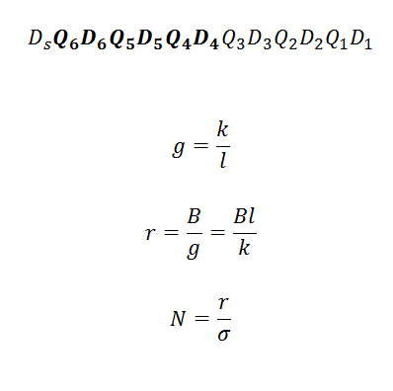
Thin-Lens Solution Aperture
When using more than three lenses there are free parameters
Can vary these parameters and calculate the apperture
Use algorithms to minimise apperture or beam stay clear

