Slide 1
Wedge experiment at MICE
David Neuffer FNAL
P. Snopok, T. Mohayai, … IIT

Slide 2
Outline
Motivation-Final Cooling for a High-Energy Collider
  small transverse emittances, larger longitudinal emittances
Final Cooling scenario with wedge exchange
  w /D. Summers & T. Hart
  emittance exchange
MICE – scale model experiment
  ~10X larger beam, absorber, emittance, …
  Similar dynamics ~ factor of 4 emittance exchange

Slide 3
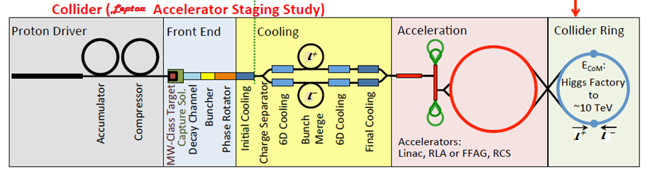
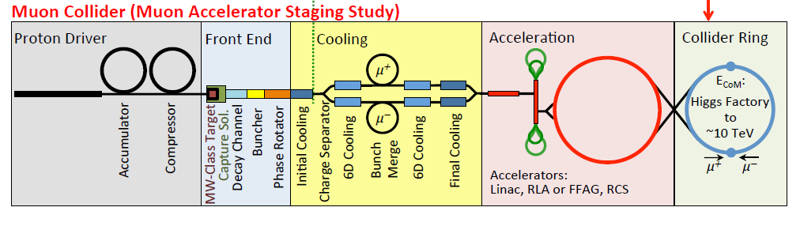
Towards multi-TeV lepton colliders
M. Palmer, FRXC3
Parameter | Unit | Higgs factory | 3 TeV design | 6 TeV design
Beam energy | TeV | 0.063 | 1.5 | 3.0
Number of IPs |  | 1 | 2 | 2
Circumference | m | 300 | 2767 | 6302
β* | cm | 2.5 | 1 | 1
Tune x/y |  | 5.16/4.56 | 20.13/22.22 | 38.23/40.14
Compaction |  | 0.08 | -2.88E-4 | -1.22E-3
Emittance (Norm.) | mm·mrad | 300 | 25 | 25
Momentum spread | % | 0.003 | 0.1 | 0.1
Bunch length | cm | 5 | 1 | 1
H. electrons/bunch | 10¹² | 2 | 2 | 2
Repetition rate | Hz | 30 | 15 | 15
Average luminosity | 10³⁴ cm⁻²s⁻¹ | 0.005 | 4.5 | 7.1

Slide 4
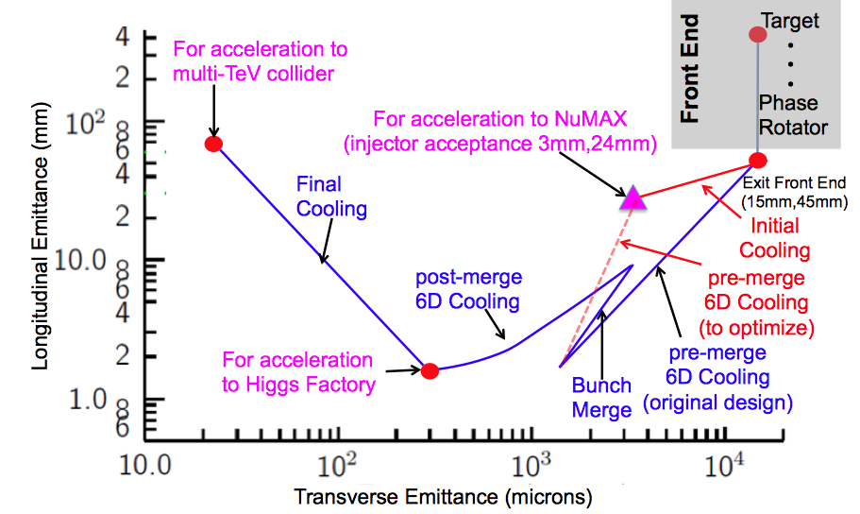
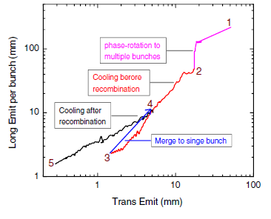
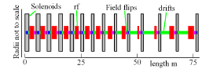
Final cooling baseline
(R. Palmer et al. IPAC12)
Final Cooling
  ε_{t,N} : 3.0 →0.25 ×10⁻⁴ m
  ε_{L} : 1.0→70mm
    expensive emittance exchange
solenoids, B → 30--50T
  H₂ absorbers,
  Low momentum

Slide 5
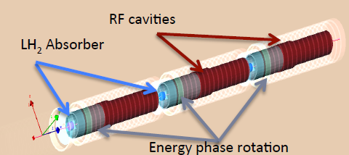
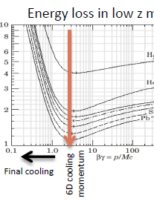
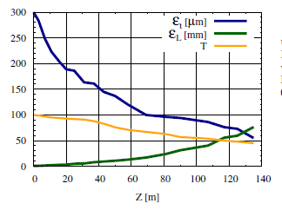
Detailed simulation of final cooling
(H. Sayed et al. IPAC14, PRSTAB 18)
G4Beamline simulation of final cooling scenario
  System is ~135m long
  ε_{t,N} : 3.0 →0.5 10⁻⁴ m
  ε_{L} : 1.0→75mm
    P_{l} :135 → 70 MeV/c
    B: 25 →32 T; 325➔ 20MHz
    not quite specs
  Transmission ~ 50%
Predominantly ε_{t,N} / ε_{L}
emittance exchange
Use explicit emittance exchange instead?

Slide 6
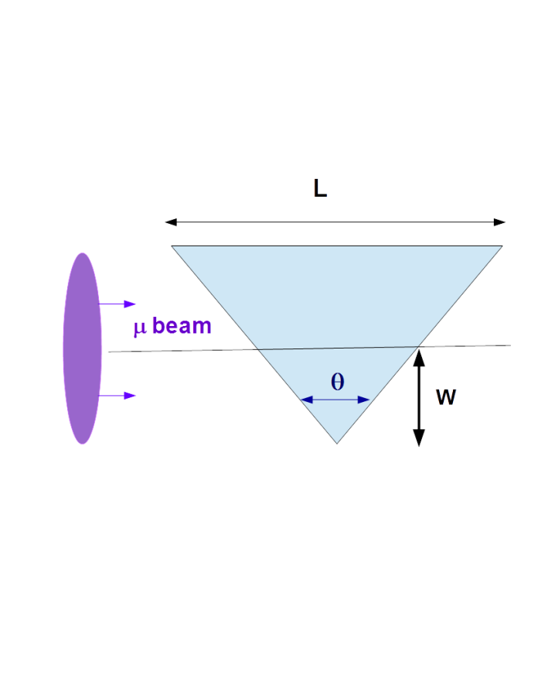
Variant: “thick” wedge emittance exchange
Use wedge to decrease ε_{x}
  By increasing δp/p
    increases ε_{L}, decrease ε_{x}
If δp/p introduced by wedge >> δp/p_{bea}
  can get large emittance exchange
Example:
  100 MeV/c; δp=0.5MeV/c
    ε⊥= 10⁻⁴m, β₀=1.2cm, Be wedge 0.6cm, 140° wedge
  obtain factor of ~5 exchange
  ε_{x} →0.2 ×10⁻⁴m; δp=2.5 MeV/c
Much simpler than equivalent final cooling section

Slide 7
“Thick” Wedge theory (MuCool-003)
Dispersion + wedge is product of two matrices (in x – dp/p)
δ′ = dp/ds 2 tan[θ /2]/p
variables are [x, δ] , where δ =dp/p
transport through wedge is transport of [x, δ] phase space ellipse, initially
becoming

Slide 8
Results of wedge analysis
new coefficients
new δp/p width (ε_{L,1} = ε_{L,0} (δ₁/δ₀))
new transverse emittance (ε_{x,1} = ε_{x,0} (δ₀/δ₁))
new β_{x}, η
By choosing η₀, δ’ (and δ₀, σ₀)
Can decrease ε_{x} and increase ε_{L} or vice versa

Slide 9
Can get large emittance exchange from single wedges
Set reference momentum at 100 MeV/c
  ε_{x} , ε_{y} → 10⁻⁴ m
  β_{x}= β_{y} = ~1cm
    ~1mm beam
    no initial dispersion η
      could be improved with matched η
Need small δp/p
  δp ~0.5 MeV/c
    obtain by lengthening and flattening bunch (ε_{L} = ~0.001m)
Need dense low-Z wedge
  Be (ρ=1.86) → Diamond
    (ρ=3.6 C)
    dp/ds =15.1 MeV/c /cm
  B₄C (ρ=2.52) also good
Evaluate in ICOOL
  wedge and beam definition, match
  emitcalc evaluates eigen emittances before/after
  a few cm transport

Slide 10
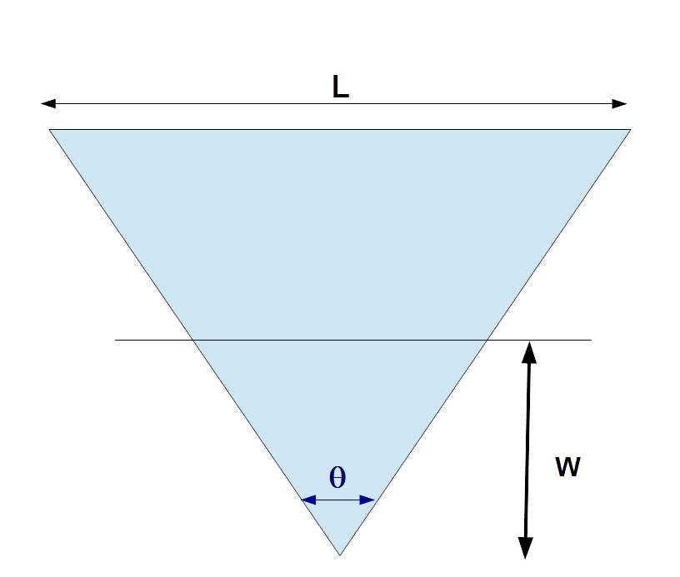
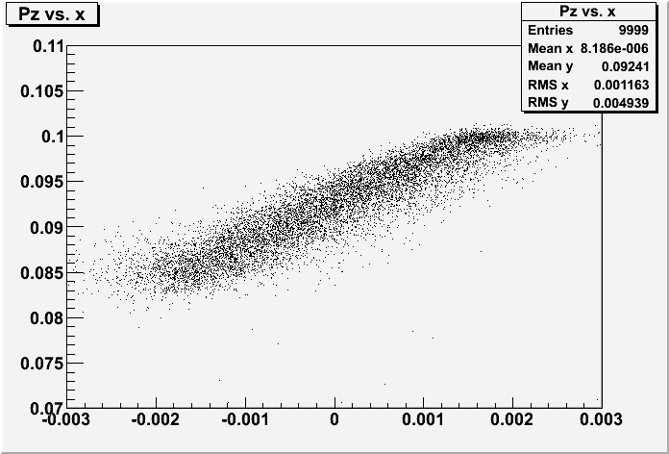
Numerical examples
Wedge parameters
  Diamond, w=1.75mm, θ = 100°(4.17mm thick at center)
  reduces ε_{x} by factor of 4.3, ε_{L} increases by factor of 7.0
    first half of wedge more efficient than second half …
Second wedge ?
  if matched to same optics (P_{z} → 100 MeV/c, σ_{E}→0.46 MeV)
    ε_{x} : 23 →27μ; ε_{y} :97 → 23 μ
z(cm) | P_{z} | ε_{x}(μ) | ε_{y} | ε_{L}(mm | σ_{E} MeV | 6-D ε increase
0 | 100 | 97 | 95.5 | 1.27 | 0.46 | 1.0
0.4 | 96.4 | 33.4 | 96.3 | 4.55 | 1.64 | 1.24
0.8 | 92.4 | 22.7 | 96.5 | 8.94 | 3.22 | 1.65
Pz – x plot

Slide 11
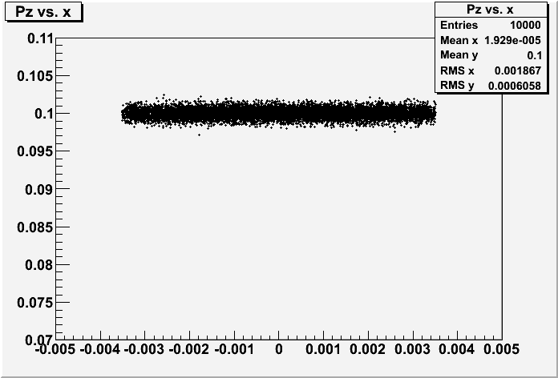
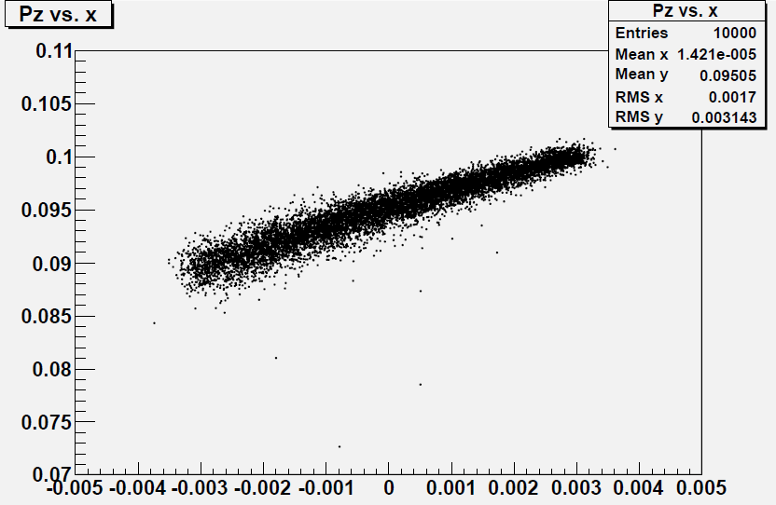
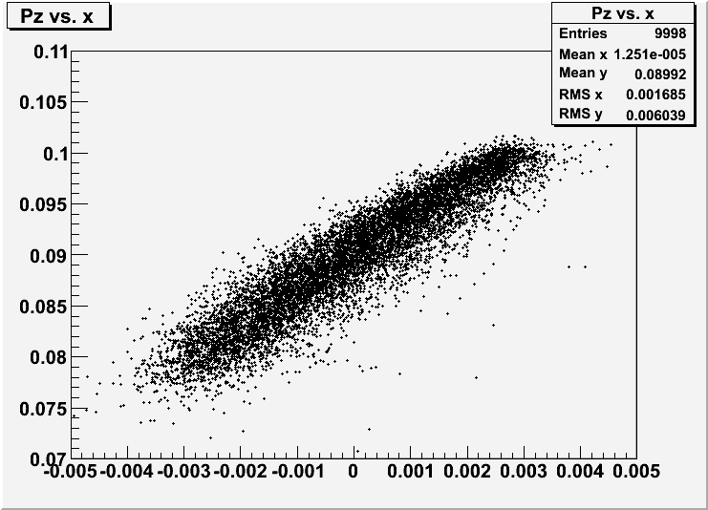
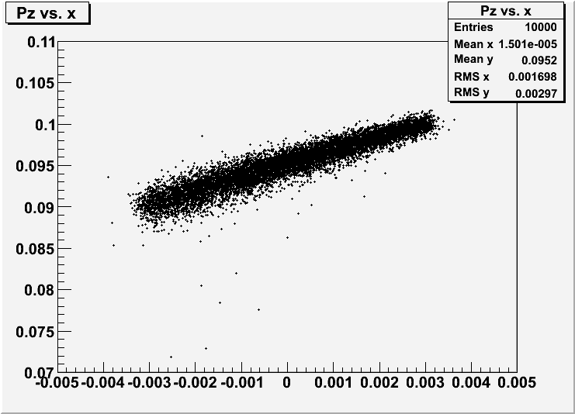
Parameter variations…
Go to larger initial beams, larger wedge
  β_{t}=2.6cm, ε_{t} =130μ
  Diamond, w=3.0mm, θ = 85°(5.6mm thick at center)
z(cm) | P_{z} | ε_{x}(μ) | ε_{y} | ε_{L} (mm) | σ_{E} MeV | 6-D ε increase
0 | 100 | 129 | 127 | 1.0 | 0.50 | 1.0
0.6 | 95.2 | 40.4 | 130 | 4.03 | 1.95 | 1.29
1.2 | 90.0 | 25.0 | 127 | 7.9 | 3.87 | 1.54
Pz – x plots

Slide 12
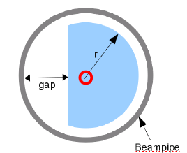
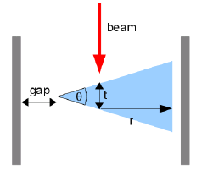
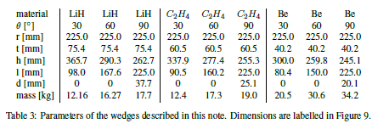
Scale model of final emittance exchange
Mice 290 (Rogers, Snopok, Coney, Janssen) considered adding wedges within the focus coil to explore emittance exchange
  LiH, CH₂, Be wedges, 3 angles
For final exchange scale demo, only need CH_{2,} 60° wedge
Use 200 MeV/c beam
  standard settings, zero η

Slide 13
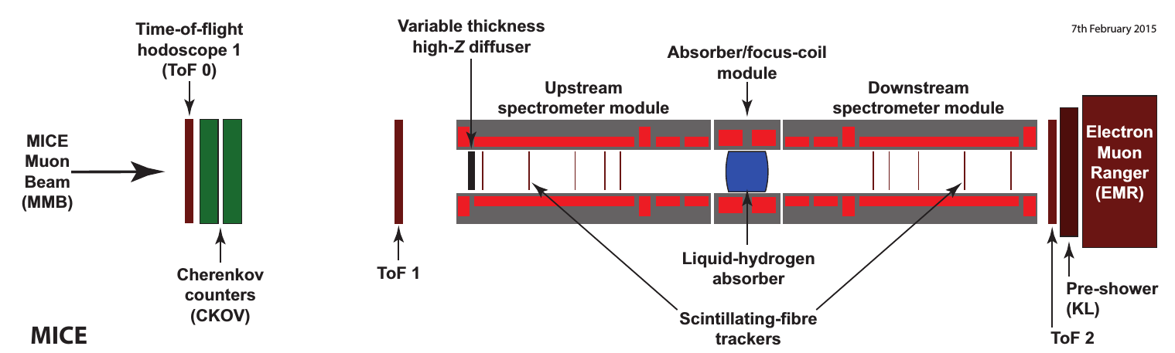
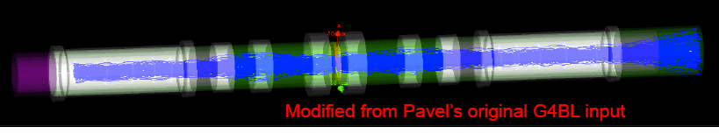
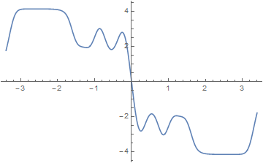
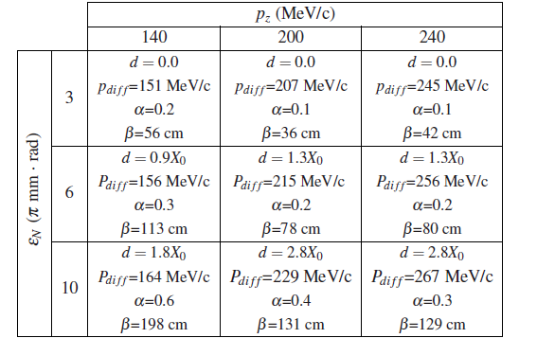
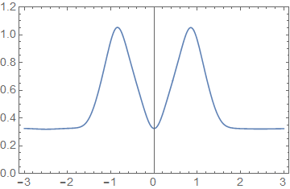
Mice experiment wedges
Step 4 geometry, fields
  4.14T solenoids
  β*= ~0.35m
Input Beam:
  200MeV/c 0-diffuser setting is best fit:
Wedge
B(s)
β⊥(s)
ε_{N,rms} = ~3 mm-R, select small energy spread
for reverse emittance exchange expt.

Slide 14
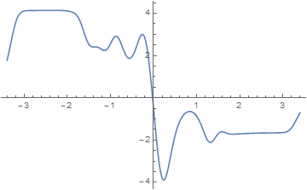
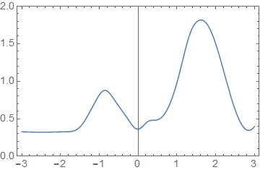
Mice experiment wedges (step 4-)
Step 4 geometry,fields
  4.14T solenoids
  β*= ~0.35m
With SSD M1 coil off
  mismatched downstream
  Keep β* manageable
    B → 1.7T
same lattice into wedge
  rematch after wedge
  β_{max} → 1.8m
Wedge
X
β⊥(s)

Slide 15
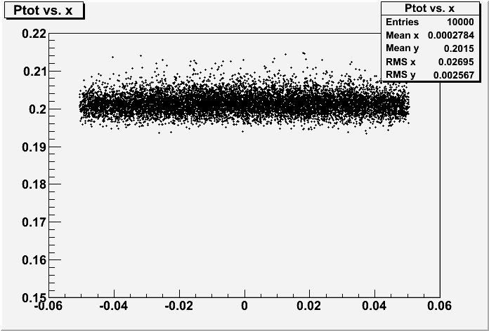
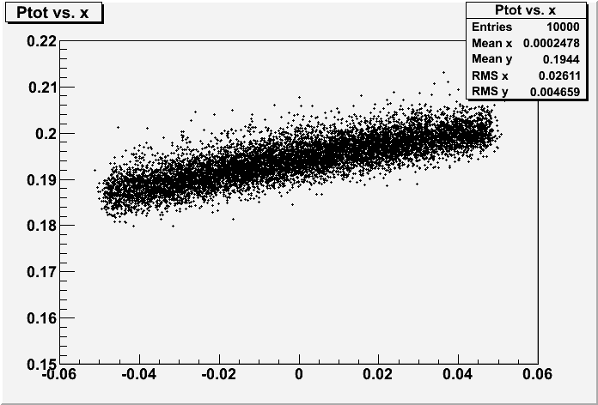
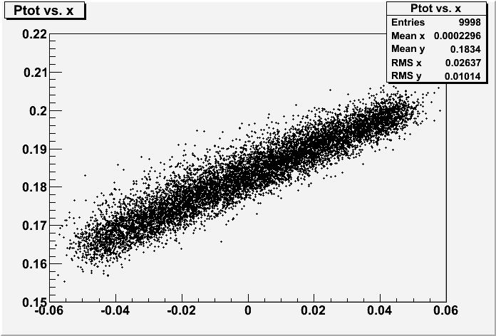
Parameters closer to MICE
Wedge at ~MICE parameters
  simplest case: Polyethylene wedge (C₂H₄)
  200 MeV/c beam β_{t}=36 cm, ε_{t} =3.04mm
  C₂H₄, w=5cm, θ = 60°(6 cm thick at center)
z(cm) | P_{z MeV/c} | ε_{x} (mm) | ε_{y} | ε_{L} (mm) | σ_{E} MeV | 6-D ε increase
0 | 200 | 3.04 | 2.99 | 2.90 | 1.82 | 1.0
6 | 193 | 1.44 | 3.02 | 6.82 | 3.86 | 1.13
12 | 182 | 0.76 | 3.00 | 14.27 | 8.63 | 1.23

Slide 16
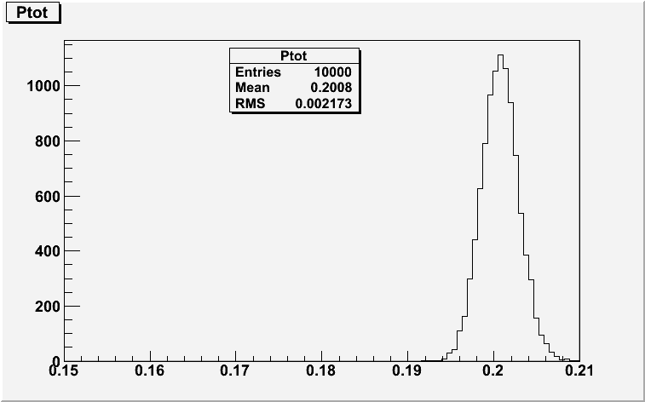
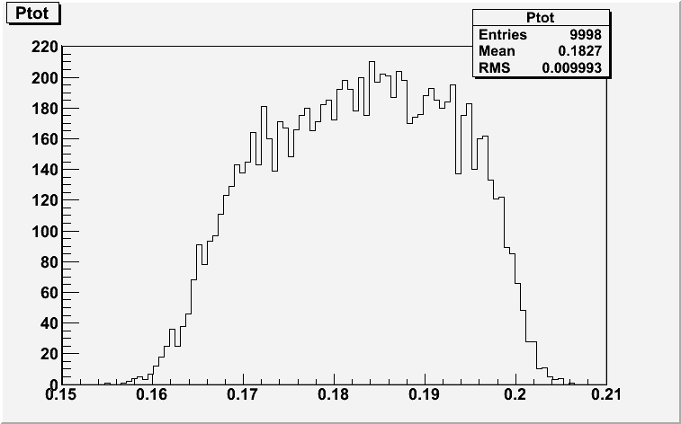
Proof of Principle wedge test
Simplest verification
  Does momentum spread increase match calculation?
Large effect
  σ_{P}: 2.0 → 10 MeV/c
6-D phase space eigenemittance reconstruction needed to see ε_{x} reduction
  x → x +η(δ p/p)
  more difficult

Slide 17
Advantages of experiment (Step 4+)
Simple hardware
  plastic wedge (not LiH or Be)
  Does not need rf
  step 4 beam configuration
Can we do without SSD M1 ?
  define initial beam in SSU
    match to wedge input
    focus to β* ~0.3—0.4 m
  measure change in δp
    agreement establishes scale model of final cooling scenario
6-D eigen emittance measurement would be better ….with SSD

Slide 18
Disadvantages
Beam comes out of wedge with x-y asymmetry
  β_{x} = ~0.1m, Dispersion η_{x} =~0.5m
    (β_{y} =~0.4m, η_{y} =~0)
MICE optics (solenoids) does not match
  6-D emittance measurement of beam may be difficult
    canonical eigenemittance calculation?
Optics matching (after wedge) is nontrivial

Slide 19
Summary
Thick Wedges could be important part of final cooling scenario
  Details depend on optimization and design studies
  An important part of collider scenario
    could be part of other particle sources
Experiment at MICE could demonstrate principle
  Large effect could be demonstrated
    (unlike baseline cooling demo)
  variation in input beam selection could also show longitudinal cooling
  other applications …

