Slide 1
Are we there yet?
Philippe Canal (FNAL) for the GeantV development team
G.Amadio (UNESP), Ananya (CERN), J.Apostolakis (CERN) , A.Arora (CERN), M.Bandieramonte (CERN), A.Bhattacharyya (BARC), C.Bianchini (UNESP), R.Brun (CERN), Ph.Canal (FNAL), F.Carminati (CERN), L.Duhem (intel), D.Elvira (FNAL), A.Gheata (CERN), M.Gheata (CERN), I.Goulas (CERN), R.Iope (UNESP), S.Y.Jun (FNAL), G.Lima (FNAL), A.Mohanty (BARC), T.Nikitina (CERN), M.Novak (CERN), W.Pokorski (CERN), A.Ribon (CERN), R.Sehgal (BARC), O.Shadura (CERN), S.Vallecorsa (CERN), S.Wenzel (CERN), Y.Zhang (CERN)

Slide 2
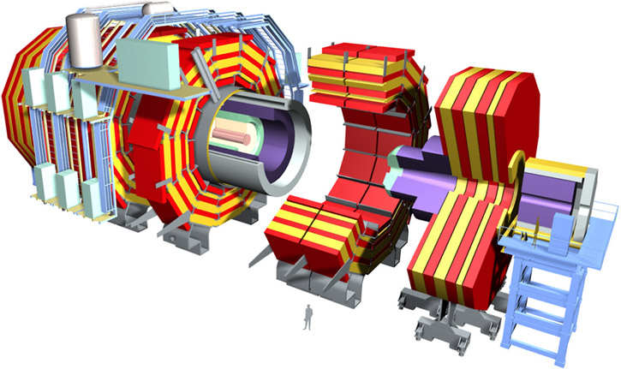
Yardstick: CMS With Tabulated Physics
Realistic Scale Simulation
pp collisions @ 14TeV minimum bias events produced by Pythia 8
2015 CMS detector
4T uniform magnetic field
  Decent approximation of the real
  solenoidal field
Low energy cut at 1MeV
‘Tabulated’ Physics
  Library of sampled interactions and
  tabulated x-sections
Same test (described above) run with both Geant4
and GeantV with various versions of the Geometry library.

Slide 3
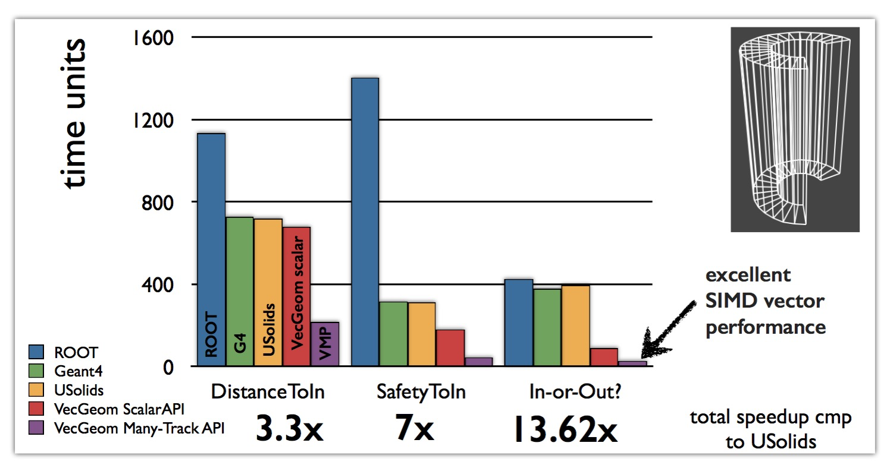
Geometry - VecGeom
Geometry takes 30-40% CPU time of typical Geant4 HEP Simulation
A library of vectorised geometry algorithms to take maximum advantage of SIMD architectures
Substantial performance gains also in scalar mode
Better scalar
code

Slide 4
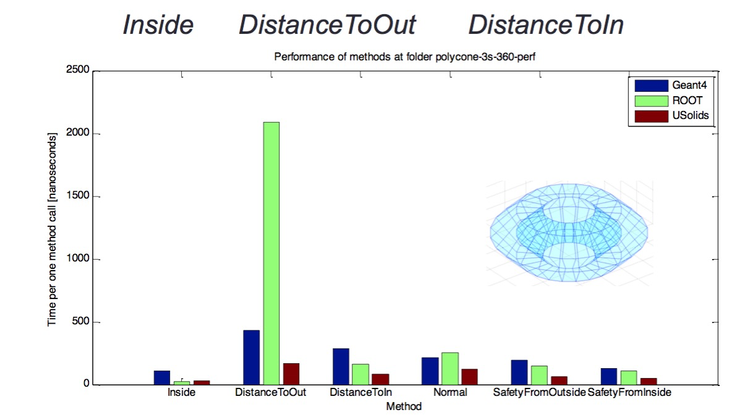
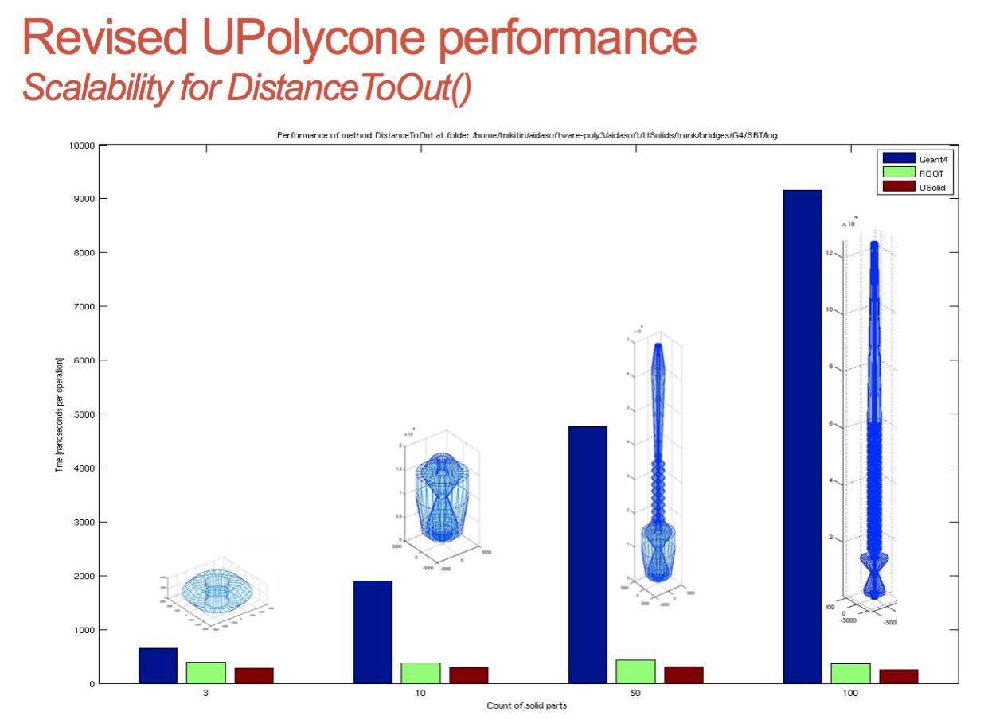
Example: Polycone
Speedup factor 3.3x vs. Geant4, 7.6x vs. Root • for most performance critical methods, i.e.:
It is today possible to run Geant4 simulations with Usolids/VecGeom shapes replacing Geant4 shapes (seamless to user)
VecGeom/USolids library is now shipped as an independent external library since release 10.2 of Geant4
USolids source code repository: gitlab.cern.ch/VecGeom/VecGeom
VecGeom/USolids is developed as part of the EU AIDA-2020 initiative.

Slide 5
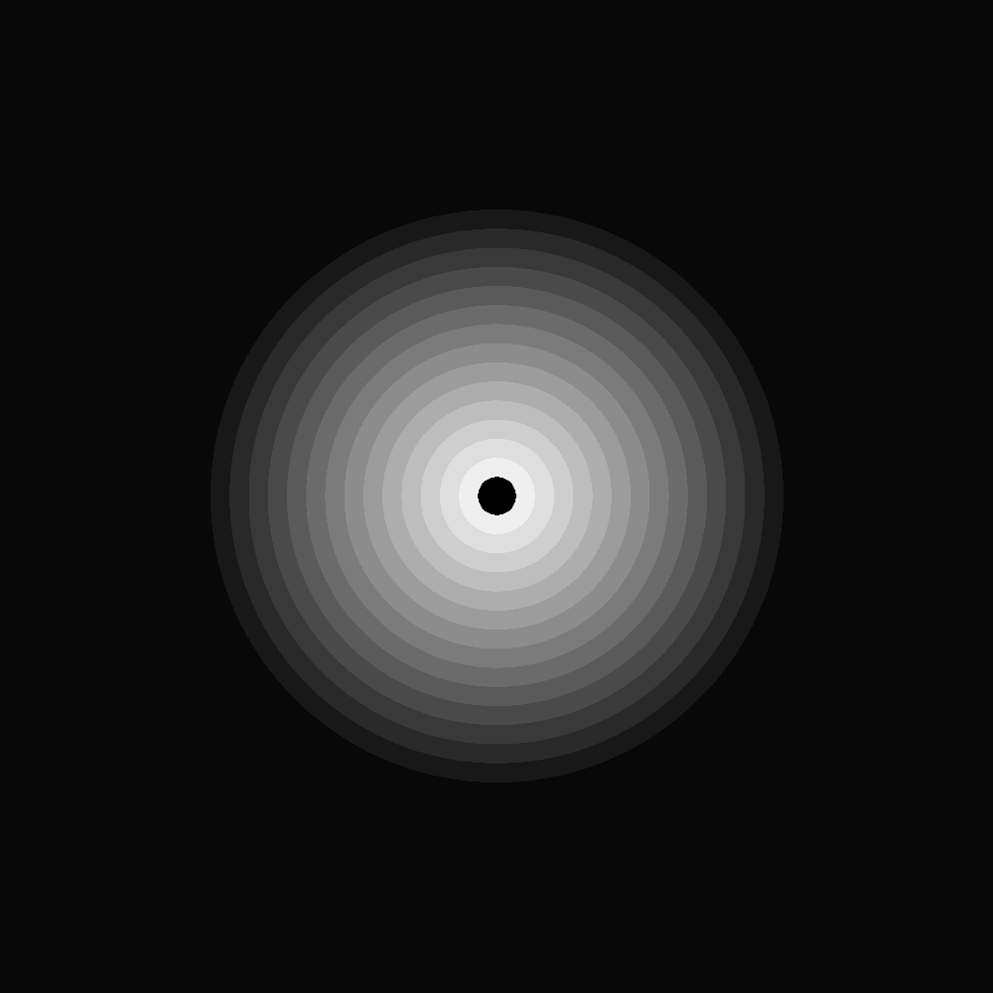
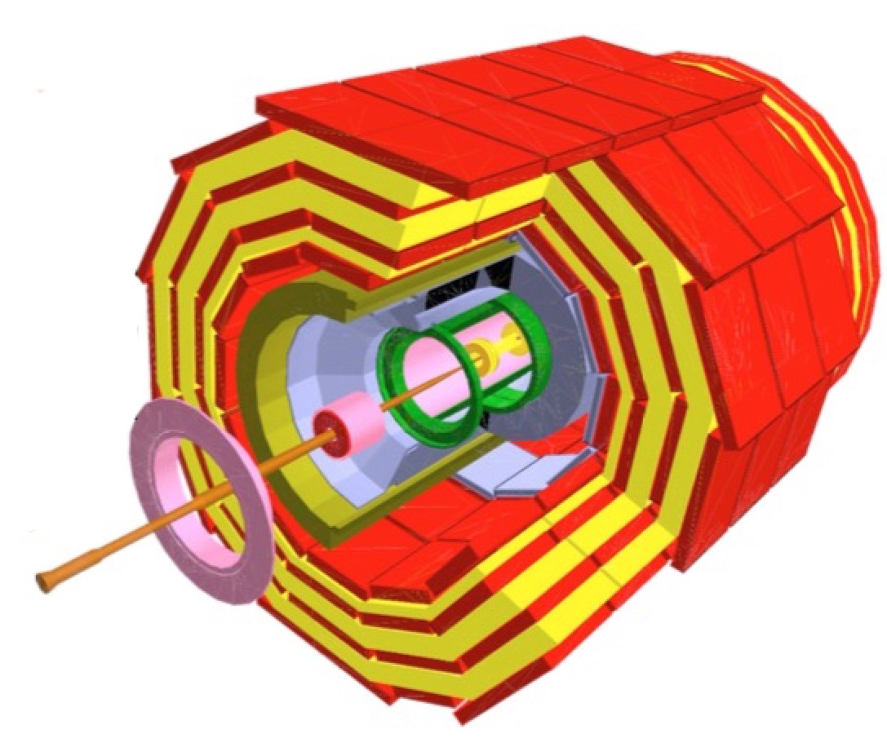
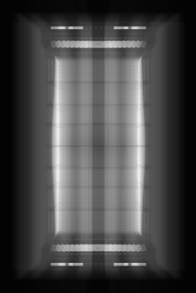
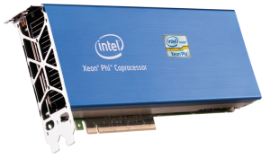
The X-Ray benchmark
The X-Ray benchmark tests geometry navigation in a real detector geometry
X-Ray scans a module with virtual rays in a grid corresponding to pixels on the final image
  Each ray is propagated from boundary to boundary
  Pixel gray level determined by number of crossings
A simple geometry example (concentric tubes) emulating a tracker detector used for Xeon©Phi benchmark
  To probe the vectorized geometry elements + global navigation as task
  OMP parallelism + “basket” model
OMP threads

Slide 6
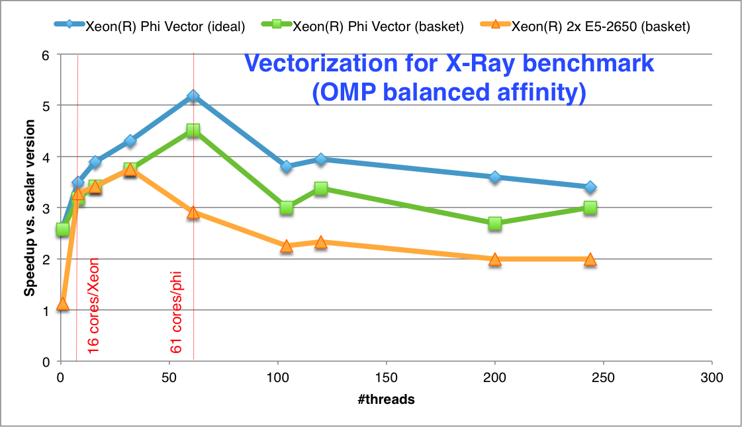
Vector performance
Gaining up to 4.5 from vectorization in basketized mode
  Approaching the ideal vectorization case (when no regrouping of vectors is needed)
Vector starvation starts when filling more thread slots than the core count
  Performance loss is not dramatic
  Better vectorization compared to the Sandy-Bridge host (expected)
Scalar case: Simple loop over pixels
Ideal vectorization case: Fill vectors with N times the same X-ray
Realistic (basket) case: Group baskets per geometry volume

Slide 7


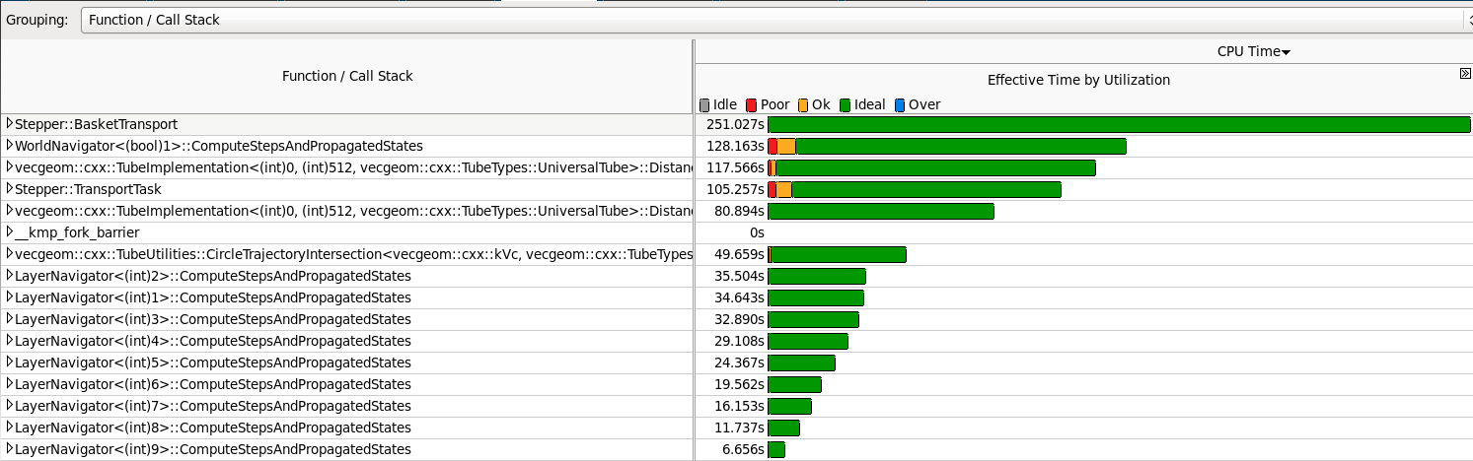
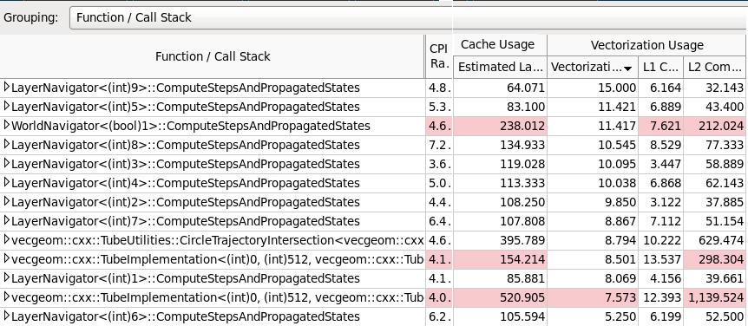
Results on the Xeon Phi
Ideal parallelism for the code “hotspot”
Vectorisation intensity in excess of 10 for the most computationally demanding portions of the code

Slide 8
I/O On HPC
Challenges:
Individual output inherently has variable size (different number of particles, vertices, etc.)
Variability furthered by compression
Preparing data for output is CPU intensive
In practice can not do parallel write to the same file
Usual solution does not scale to HPC
  i.e. write one file per process.
Solution being explored:
Extend “Buffer” mode to multiple nodes
Set up a tree of nodes sending upstream the prepared output
Sending data in chunk during processing to maximize parallelism
Only a few end nodes processes or threads actually write to disks
  Cardinality close to the number of physical disk

Slide 9
Putting It All Together - CMS Yardstick
Semantic changes
Scheduler | Geometry | Physics | Magnetic Field Stepper
Geant4 only | Legacy G4 | Various Physics Lists | Various RK implementations
Geant4 or GeantV | VecGeom 2016 scalar | Tabulated Physics Scalar Physics Code | Helix Cash-Karp Runge-Kutta
GeantV only | VecGeom 2015 VecGeom 2016 vector Legacy TGeo | Vector Physics Code | Vectorized RK Implementation

Slide 10
Putting It All Together - CMS Yardstick
Semantic changes
Scheduler | Geometry | Physics | Magnetic Field Stepper
Geant4 only | Legacy G4 | Various Physics Lists | Various RK implementations
Geant4 or GeantV | VecGeom 2016 scalar | Tabulated Physics Scalar Physics Code | Helix (Fixed Field) Cash-Karp Runge-Kutta
GeantV only | VecGeom 2015 VecGeom 2016 vector Legacy TGeo | Vector Physics Code | Vectorized RK Implementation
3
2
1

Slide 11
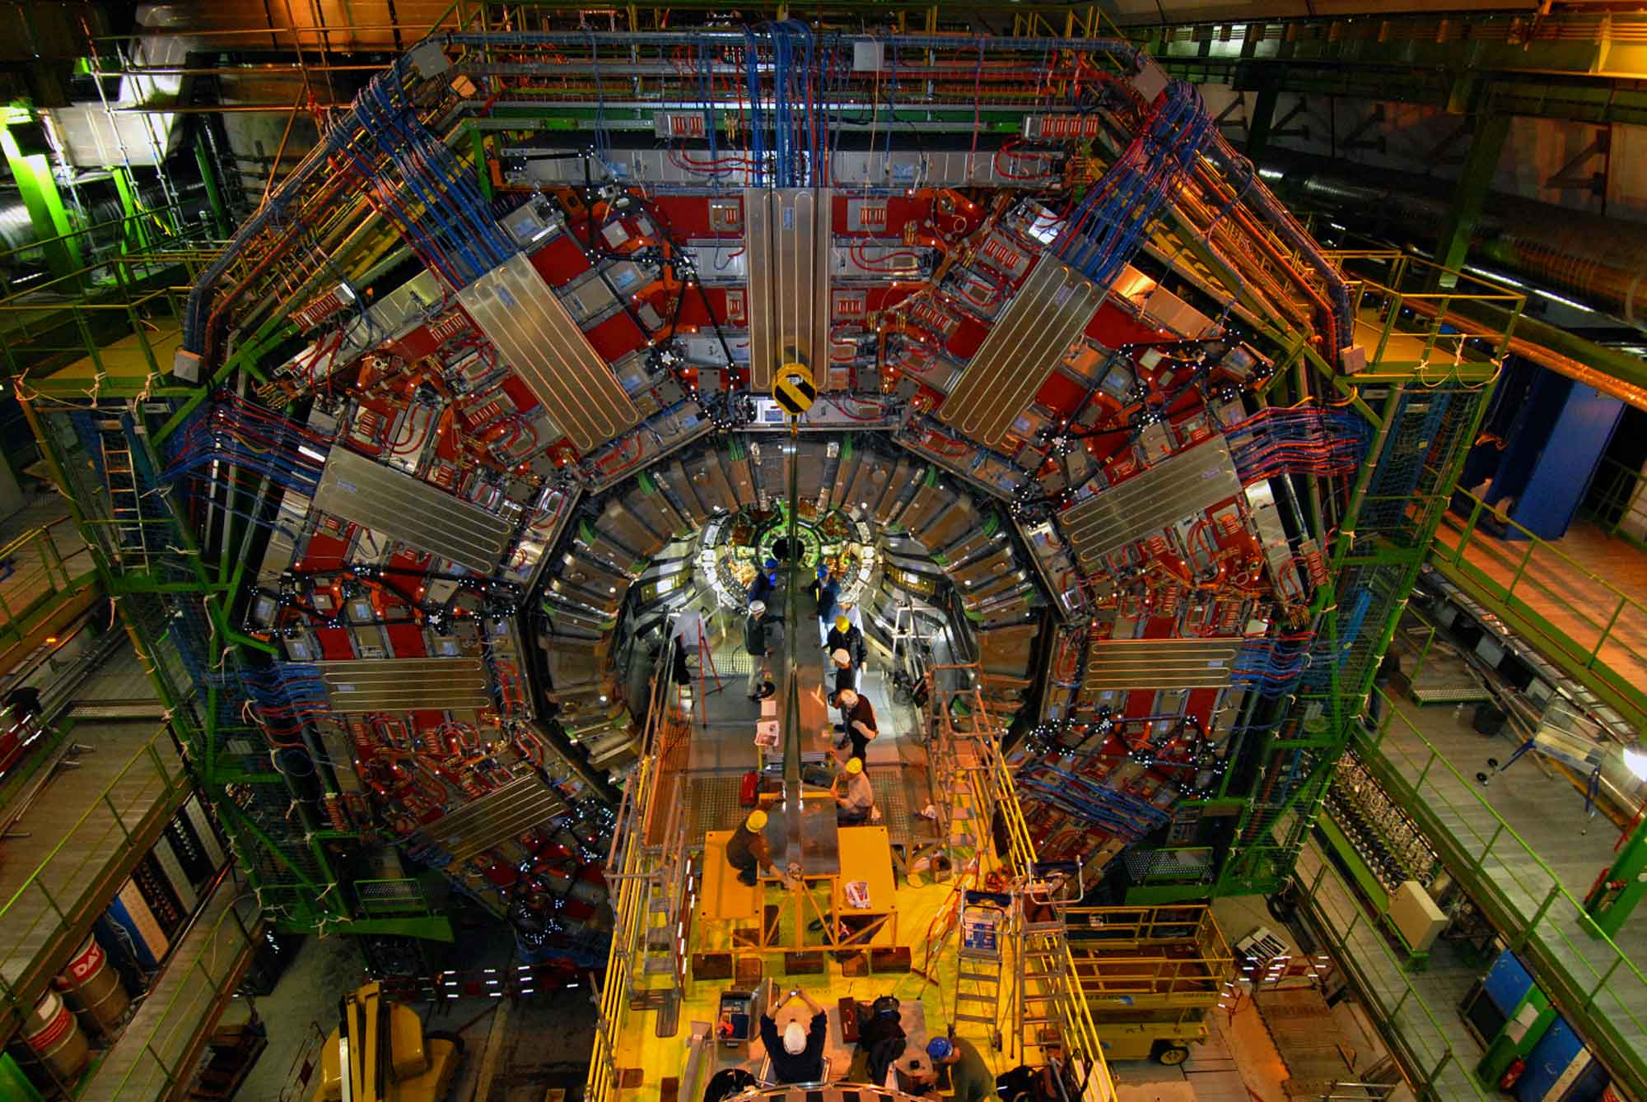
Putting It All Together - CMS Yardstick
Improvement Factors (total) with respect to G4
Legacy (TGeo) Geometry library:
  1.5 → Algorithmic improvements in infrastructure.
2015 VecGeom (estimate)
  2.4 → Algorithmic improvements in Geometry
Early 2016 VecGeom
  3.3 → Further Geometric algorithmic improvements and some vectorization
Some of the improvements can be back ported to G4
Overhead of basket handling is under control
Ready to take advantage of vectorization throughout.

Slide 12
 | g4 4T RK | gv 4T RK | diff | ratio | g4 0T | gv 0T
total | 1950 | 584 | 1366 | 3.339041096 | 802 | 289 | 513 | 2.775086505
init | 19.9 | 10.5 |  |  | 19.9 | 10.5
infra | 90.2 | 33.75 |  |  | 69.9
+touchabale | 36 |  |  |  | 31.8
PropagteTracksScalar |  | 193.6 |  |  |  | 71.2
PropagateTracks |  | 193 |  |  |  | 48
 |  | 386.6 |  |  |  | 119.2
TabPhys |  | 123.7 |  |  |  | 71.44
User | 13.9 |  |  |  | 10.6
TabPhys (AlongStep and PostSTep | 300.89 |  | 177.19 |  | 265.1 |  | 193.66
G4Transportation::PostStep | 192.2 |  |  |  | 177.6
* including
LocatePoint | 125 |  |  |  | 115.4
Touchable | 52 |  |  |  | 47.8
DefinePhysicalLength | 1356 | 386.6 | 969.4 | 3.507501293 | 286.66 | 119.2 | 167.46 | 2.404865772
Physics | 83.69 |  |  |  | 80.7
PropagateInField | 1083 | 133.6 | 949.4 | 8.106287425 | 0 | 0
rest | 189.31 | 253
diffs |  |  | 1318.79 |  |  |  | 371.26

Slide 13
PropagateTracks vs PropagateTracksScalar : (% is of the whole run).
with scalar nav: 25.2% / 32.5% ; 119s / 153s
with vector nav: 26.0% / 32.1% ; 125s / 155s
For the vector navigator GetSatety takes 15s.
The overhead inside ComputeTransportLength for the vector navigator is also noticeable ( 3.4s ) 3 navigator seems to be called in both cases and the time spend in them is similar (slighty faster for the vector navigator):
NewSimpleNav vector / scalar : 31.7s / 34.9s
HybridNav vector / scalar : 29.4s / 33.9s
SimpleABBox vector / scalar : 1.9s / 2.2s
This is 'because' most calls inside take the same time, for example GlobalLocator::LocalGlobalPoint and Polycone, Polyhedron's DistanceToIn and DistanceToOut The timing for Tube and Box does change:
Tube DistanceToOut vector / scalar : 1.08s / 1.93s (18.2 vs 39.9 10e6 calls)
Box DistanceToOut vector / scalar : 0.36s / 0.53s
Tube DistanceToIn vector / scalar : 0.39s / 0.23s !!!!! (5.8 vs 12.9 10e6 calls)
which obviously won't make a large difference. I do not why the vector tube DistanceToIn is seemingly slower. When looking at the assembly code (that vtune claim to correspond to Tube's DistanceToOut) it does look like the 'scalar' version is using vector instructions.

Slide 14
Vector Nav
Total: 598s
PropagateTracksScalar: 225s
PropagateTracks: 167s
GUFieldPropagator: 58s
ComputeTransportLen..: 75s
NavFindNextBound..: 71s
GetSafety: 15.3s
NewSimpleNav: 28s
HybridNav: 25s
SimpleABBox: 1.8s

Slide 15
VectorNav
NewSimpleNav Chunk: 26.3s
Self: 8s
LocateGlobalPoint: 5.4s
PolyconeImpl DistanceToOut: 2.4s
PolyconeImpl DistanceToIn: 1.7s
Polyhedron DistanceToOut: 1.6s
TubeImpl DistanceToOut: 1.0s
NewSimpleNav *without* vec: 30.35s
Self: 8.7s
LocateGlobalPoint: 7.3s

Slide 16
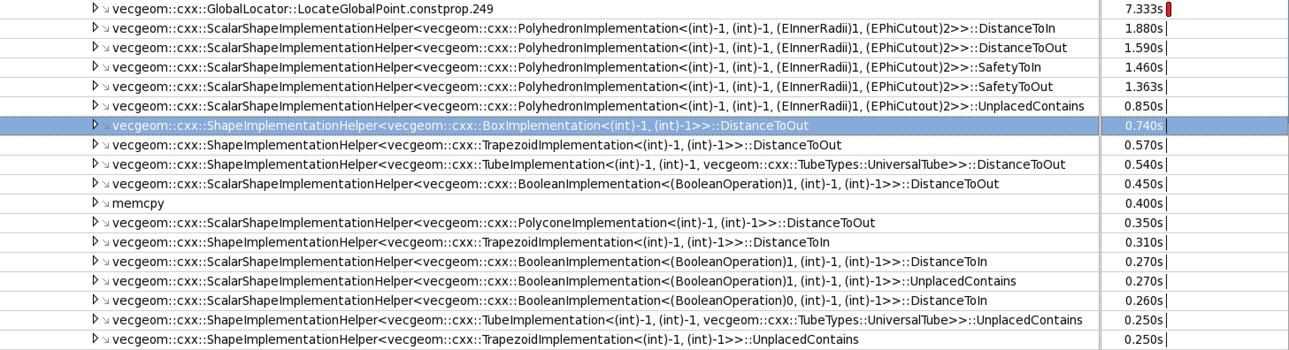
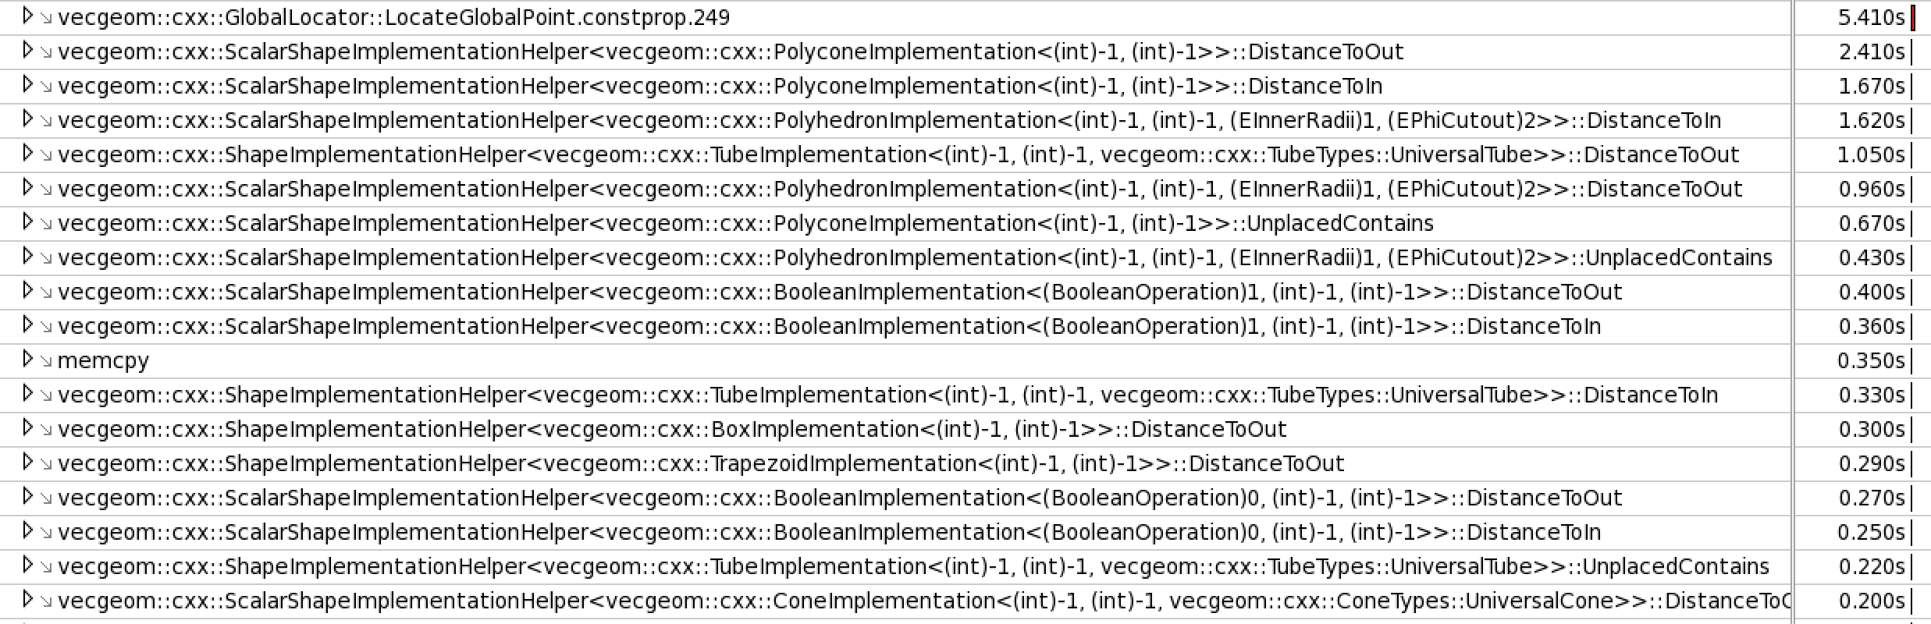

Slide 17
Thank you!

Slide 18
BACKUPS

