Slide 2
Session 8: (E)YETS and Long Shutdown 2 Strategy and Preparation
Chairman: José Miguel Jiménez / Scientific Secretary: J.Ph. Tock
Introduction
  by José Miguel JIMENEZ
LIU Activities during LS2, highlight of changes with respect to last year
  by Julie COUPARD
HL-LHC Activities during LS2, highlight of changes with respect to last year
  by Laurent TAVIAN
LHC Experiments Activities during LS2
  by Rolf LINDNER
Non-LHC Experiments Activities during LS2
  by Markus BRUGGER
First Feedback from Plan
  by Katy FORAZ
Framework schedule from EYETS 2016 to LS2
  by Marzia BERNARDINI
General Safety
  by Thomas OTTO

Slide 3
Long Shutdown 2 “Period” (LS2)
LS2 Team
José Miguel JIMENEZ Project Coordinator
Jean-Philippe TOCK Project Office Manager
Katy FORAZ Project Planning Coordinator
Mirko POJER Project PLAN Data Quality Manager
Lisette Van Den BOOGAARD Project Finance Officer
Thomas OTTO Project Safety Coordinator for LHC
Ana-Paula BERNARDES Project Safety Coordinator for Injectors
Stefanie SAPOUNTZI LS2 Committee Administrative Support
Samy CHEMLI LS2 Committee Scientific Secretary

Slide 4
Long Shutdown 2 (LS2) Project
Project Scope & Mandate of LS2 coordinator (1/2)
José Miguel Jimenez, LS2 Coordinator
The project scope covers all activities carried out and resources needed in the context of Long Shutdown 2 over the whole CERN accelerator facilities.
The mandate of the project coordinator includes:
  Prior to the start of the LS2, the definition of main works to be achieved over the LS2 and of potential options based on priorities given to activities. This study shall highlight in particular LS2 duration and resources needed for each option and be presented to the Directorate by Q3-2016 for final decision;
  The definition of a CERN-wide “resource-loaded planning”, ensuring the compatibility of resources and planning across the LHC Machine and LHC Experiments;

Slide 5
Long Shutdown 2 (LS2) Project
Project Scope & Mandate of LS2 coordinator (2/2)
José Miguel Jimenez, LS2 Coordinator
The preparation, coordination and follow-up till completion of all LS2 activities in the frame of the LIU, HL-LHC Projects and other CERN approved projects. Work packages will define:
  The work absolutely essential to achieve the LS2 objectives (activities which will bear a Priority 1-2), which execution will be closely followed up by the LS2 Coordinator;
  The work which can be postponed to the LS3 (activities which will bear a Priority >2), which impact on LS3 will be assessed by the LS2 Coordinator.
The flexibility to use the end-of-year technical stops before and after the LS2 to decrease the load of the LS2 is left at the discretion of the LS2 coordinator and is also part of the scope of the project.

Slide 6
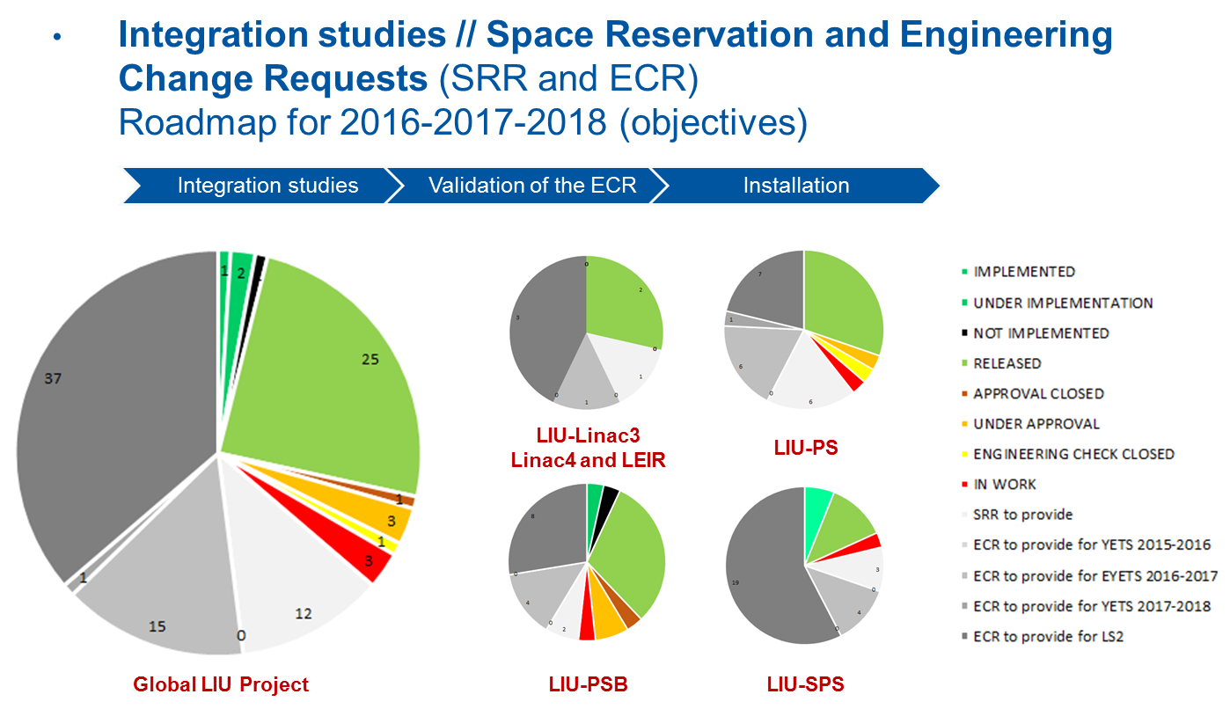
Session 8: (E)YETS and Long Shutdown 2 Strategy and Preparation
LIU Activities during LS2, highlight of changes with respect to last year
Julie Coupard, LIU Coordination
Katy Foraz, LS2 Project Planning Coordinator
On schedule…

Slide 7
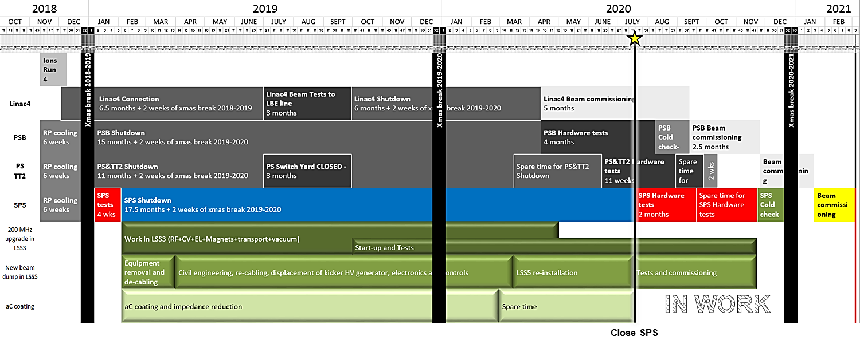
Session 8: (E)YETS and Long Shutdown 2 Strategy and Preparation
LIU Activities during LS2, highlight of changes with respect to last year
Julie Coupard, LIU Coordination
Katy Foraz, LS2 Project Planning Coordinator

Slide 8
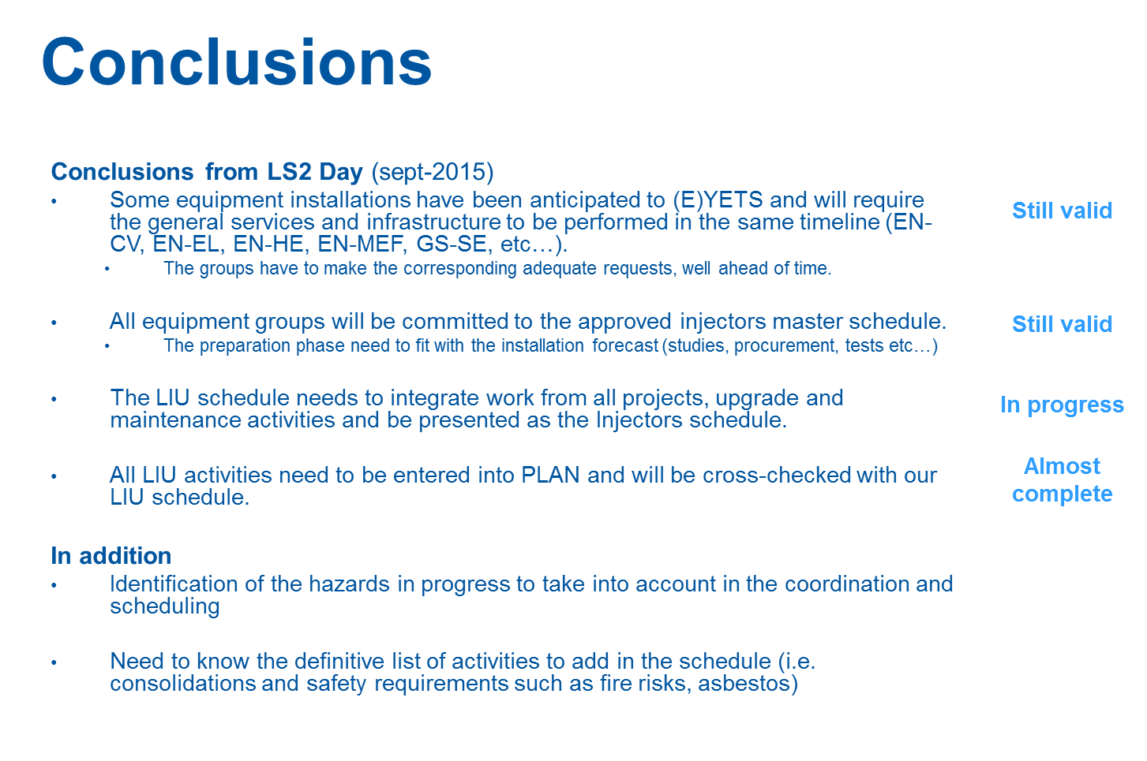
Session 8: (E)YETS and Long Shutdown 2 Strategy and Preparation
LIU Activities during LS2, highlight of changes with respect to last year
Julie Coupard, LIU Coordination
Katy Foraz, LS2 Project Planning Coordinator

Slide 9
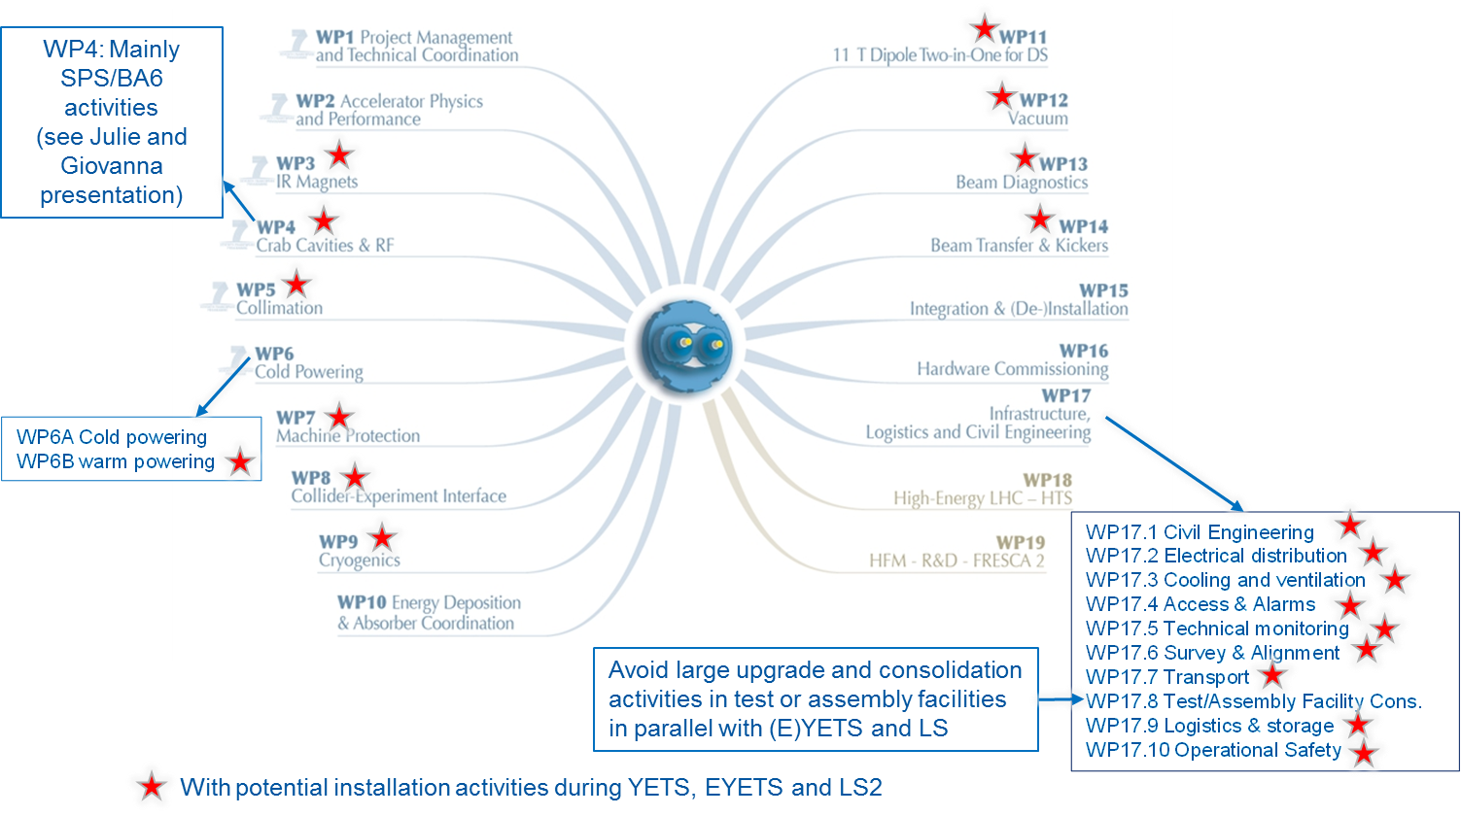
Session 8: (E)YETS and Long Shutdown 2 Strategy and Preparation
HL-LHC Activities during LS2, highlight of changes with respect to last year
Laurent Tavian, HL-LHC Project Office Manager

Slide 10
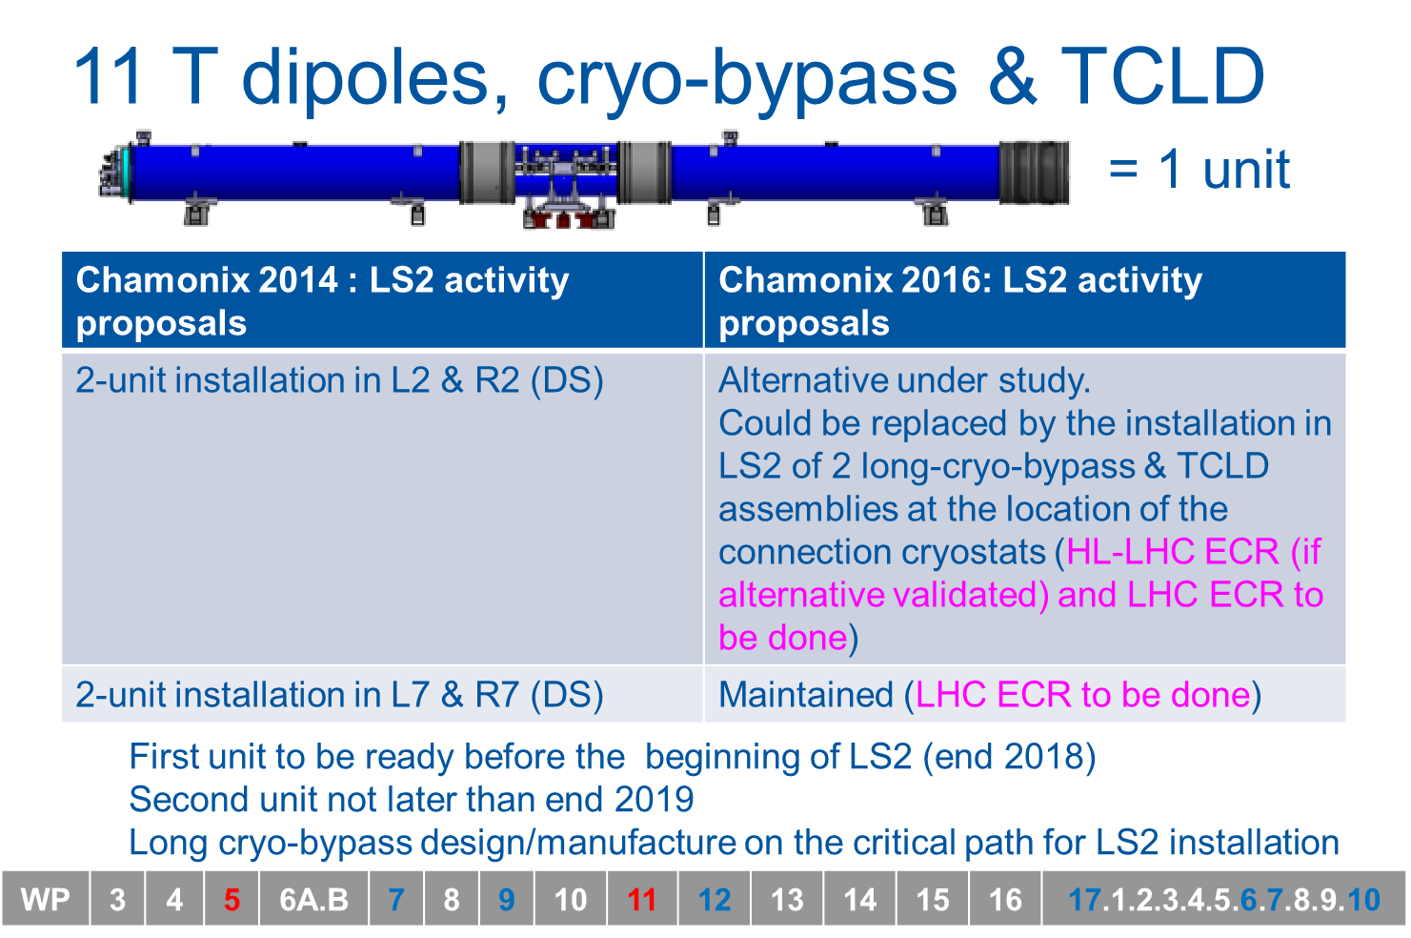
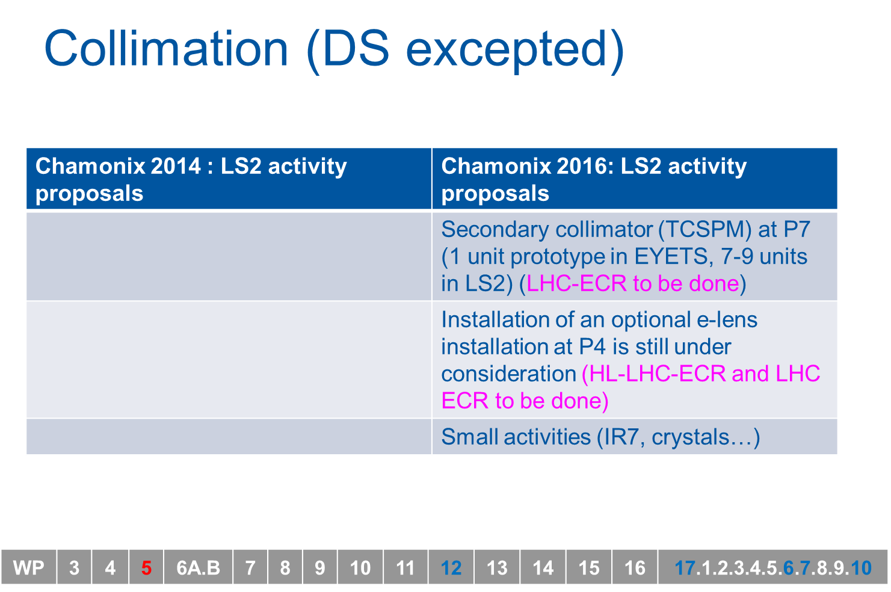
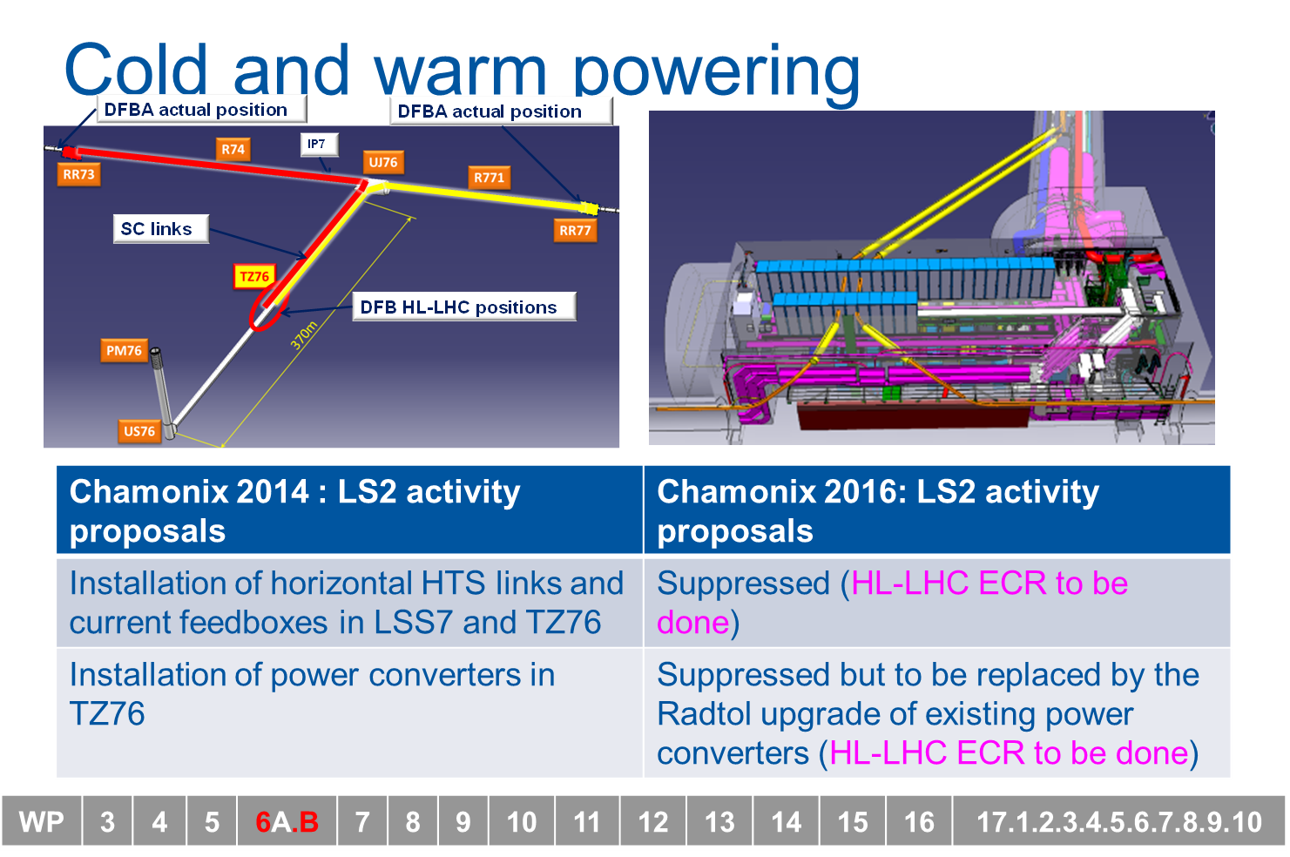
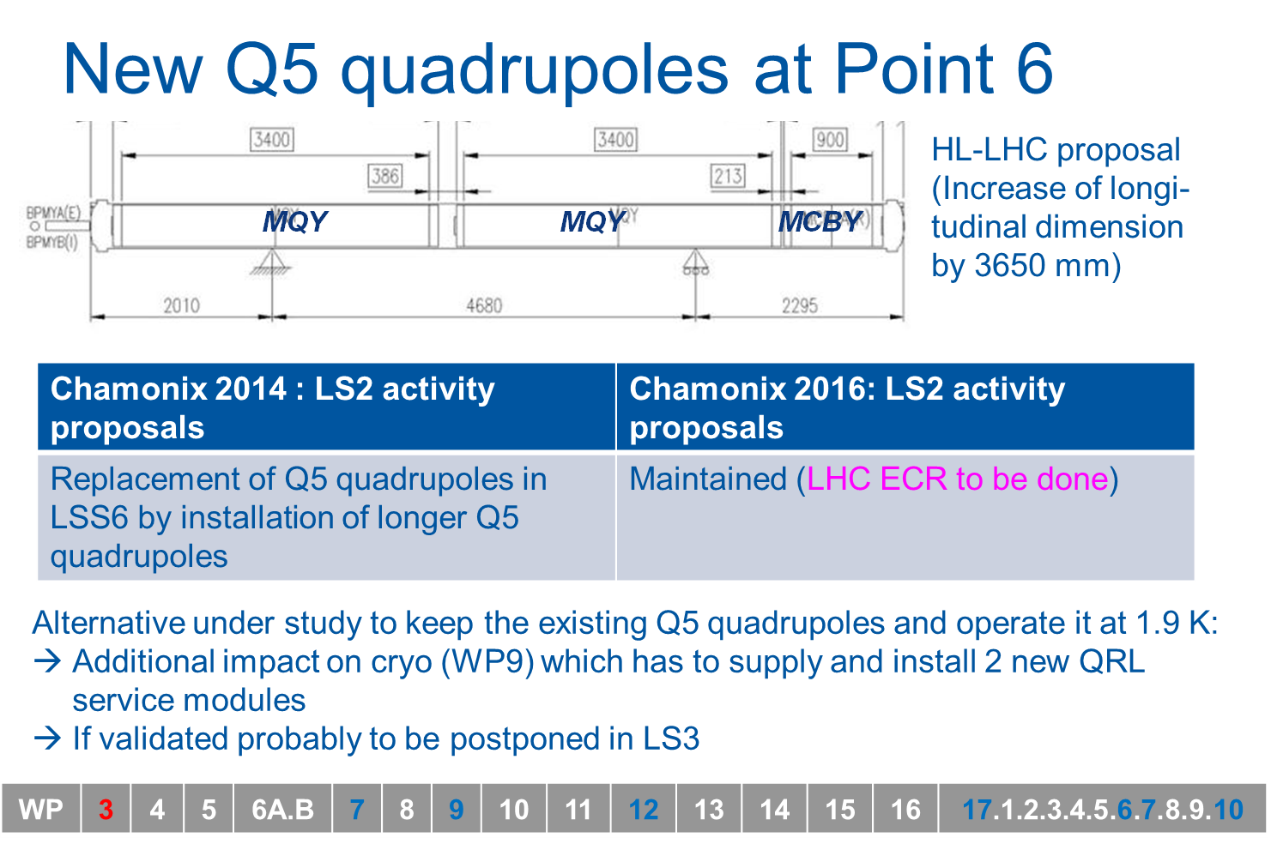
Session 8: (E)YETS and Long Shutdown 2 Strategy and Preparation
HL-LHC Activities during LS2, highlight of changes with respect to last year
Laurent Tavian, HL-LHC Project Office Manager

Slide 11
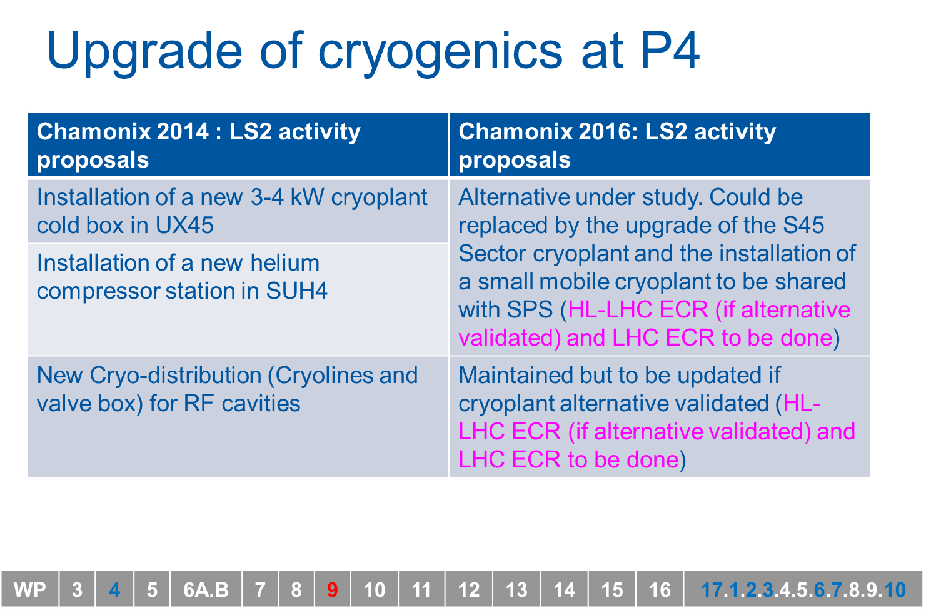
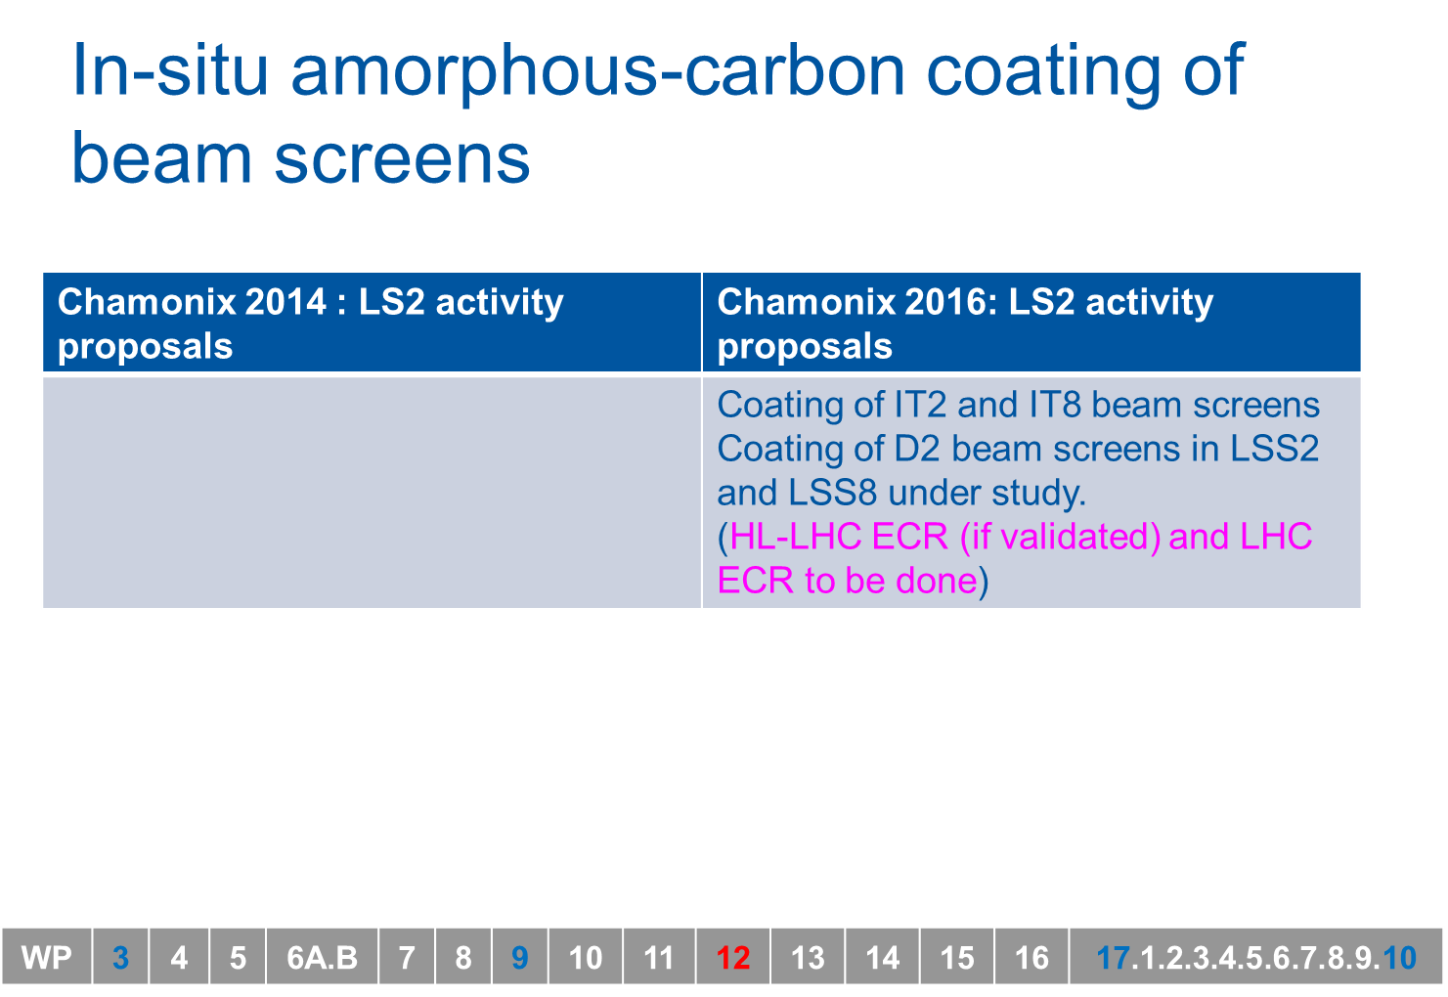
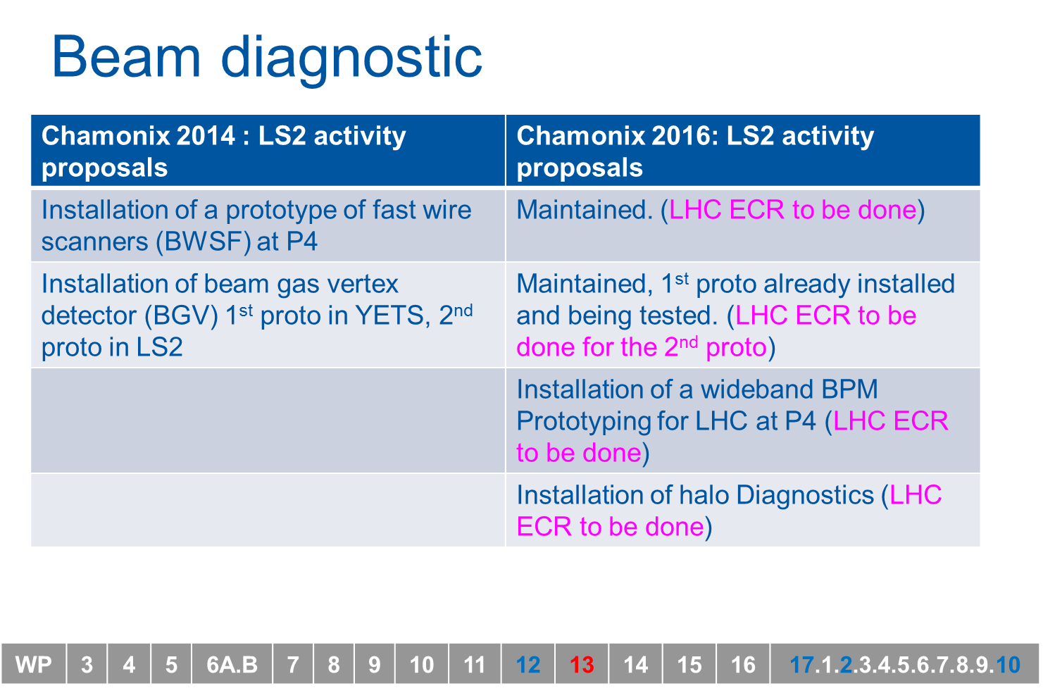
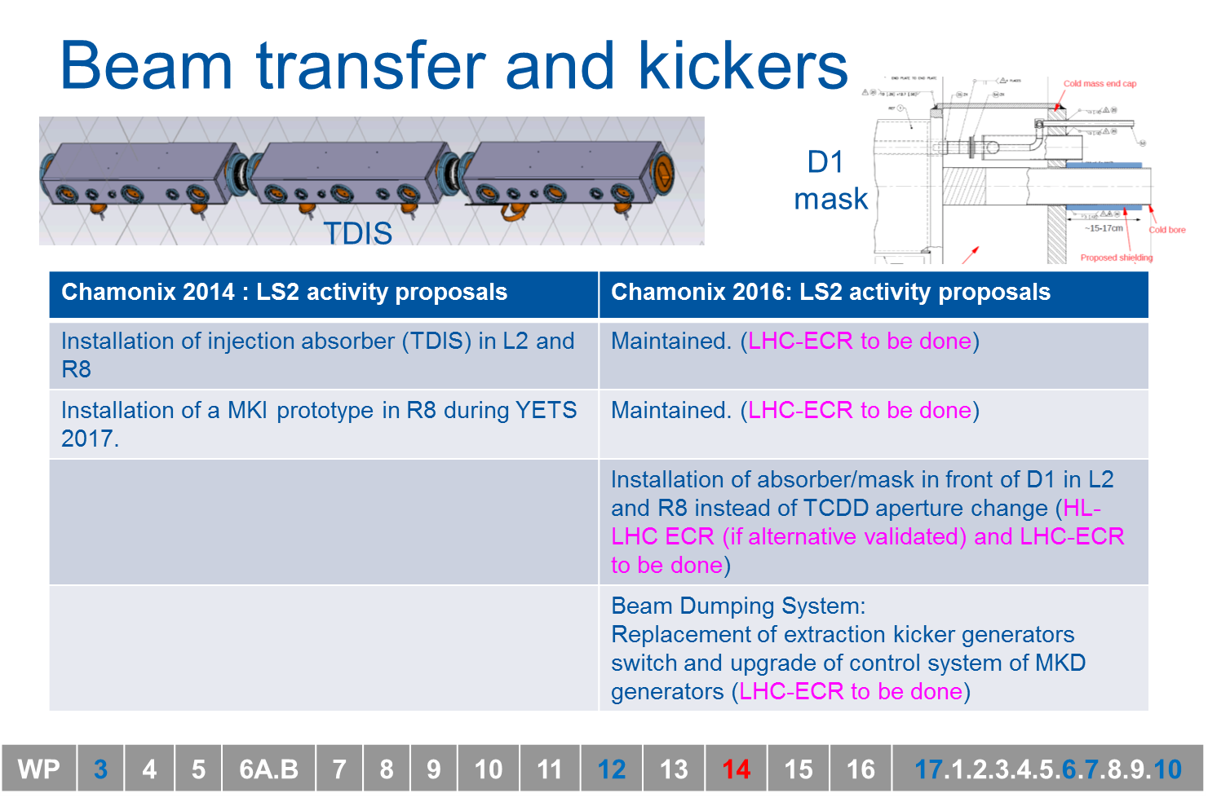
Session 8: (E)YETS and Long Shutdown 2 Strategy and Preparation
HL-LHC Activities during LS2, highlight of changes with respect to last year
Laurent Tavian, HL-LHC Project Office Manager

Slide 12
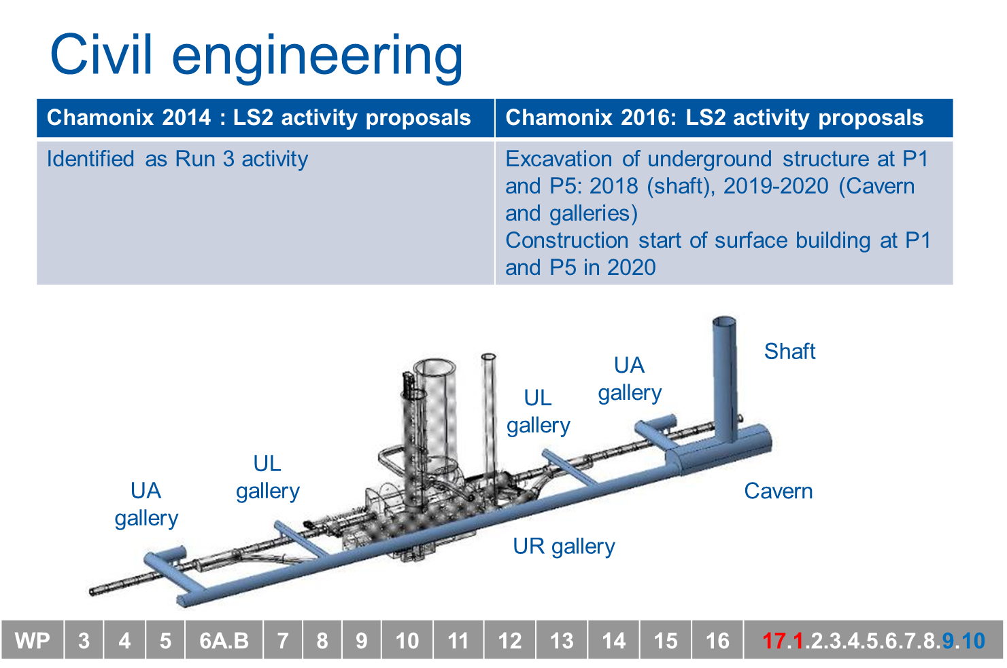
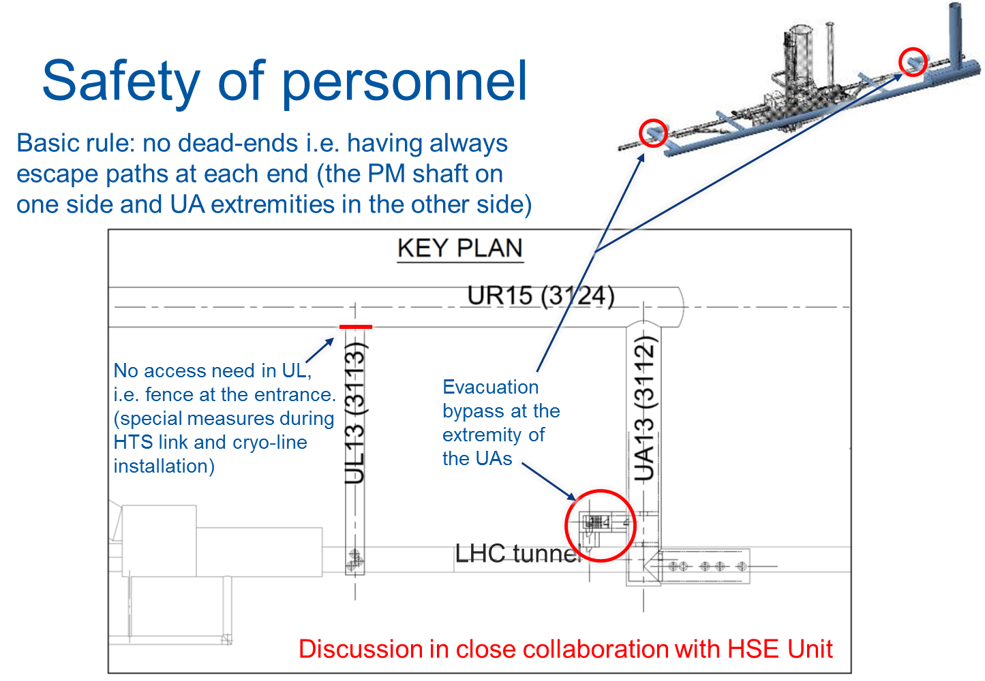
Session 8: (E)YETS and Long Shutdown 2 Strategy and Preparation
HL-LHC Activities during LS2, highlight of changes with respect to last year
Laurent Tavian, HL-LHC Project Office Manager

Slide 13
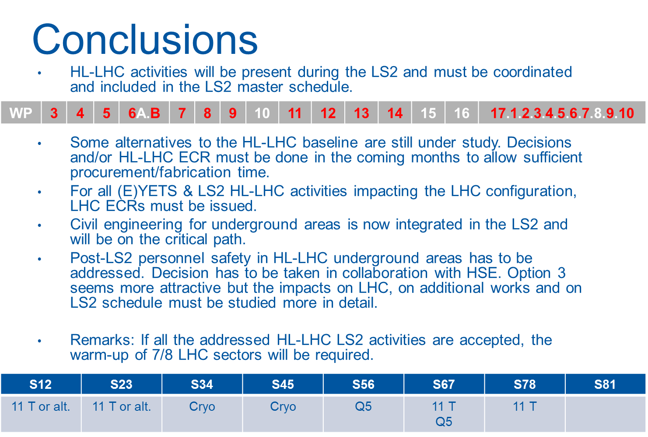
Session 8: (E)YETS and Long Shutdown 2 Strategy and Preparation
HL-LHC Activities during LS2, highlight of changes with respect to last year
Laurent Tavian, HL-LHC Project Office Manager

Slide 14
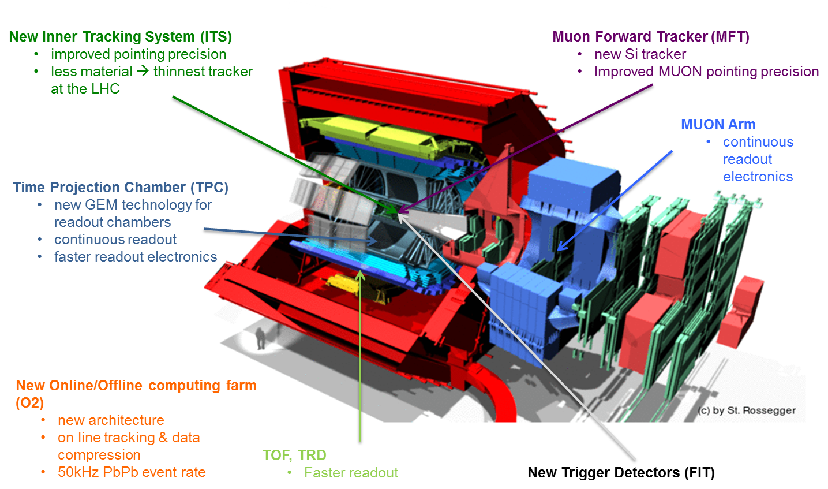
Session 8: (E)YETS and Long Shutdown 2 Strategy and Preparation
LHC Experiments Activities during LS2: ALICE
Rolf Lindner (LHCb) / Ludovico Pontecorvo (ATLAS) / Austin Ball (CMS) / Werner Riegler (ALICE)

Slide 15
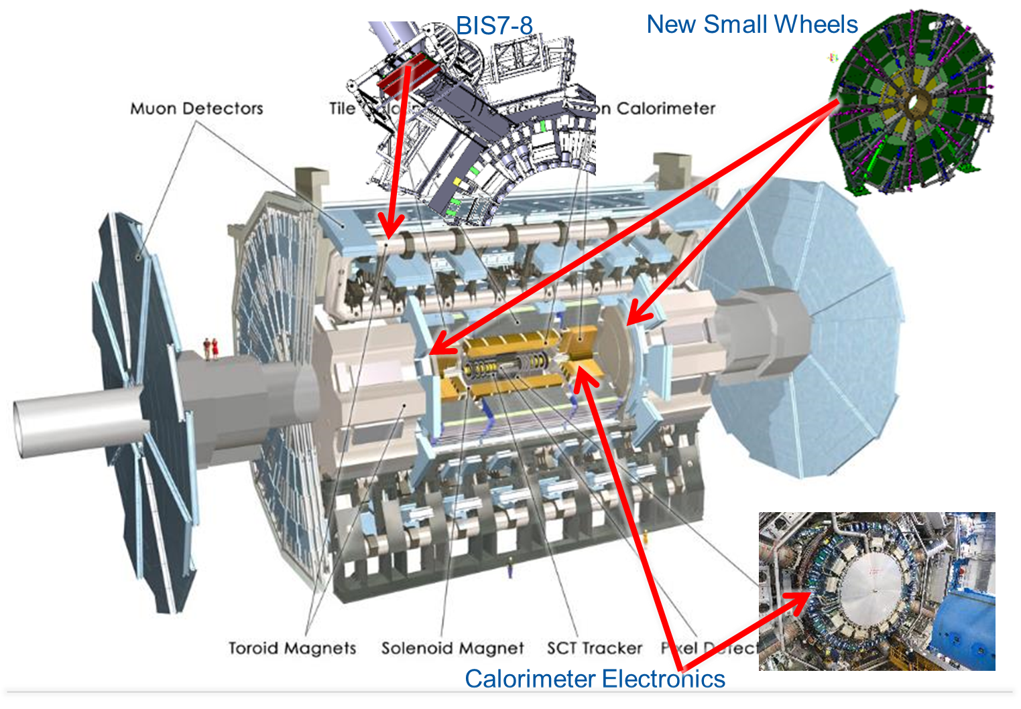
Session 8: (E)YETS and Long Shutdown 2 Strategy and Preparation
LHC Experiments Activities during LS2: ATLAS
Rolf Lindner (LHCb) / Ludovico Pontecorvo (ATLAS) / Austin Ball (CMS) / Werner Riegler (ALICE)

Slide 16
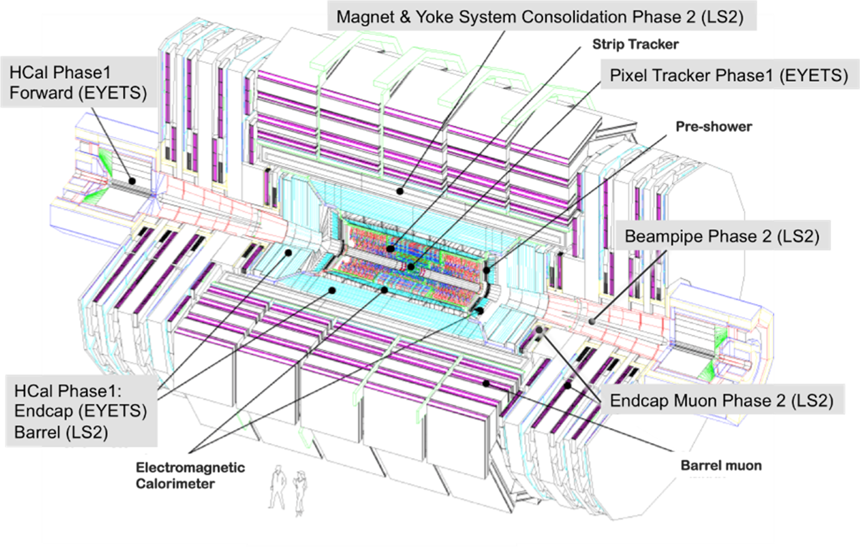
Session 8: (E)YETS and Long Shutdown 2 Strategy and Preparation
LHC Experiments Activities during LS2: CMS
Rolf Lindner (LHCb) / Ludovico Pontecorvo (ATLAS) / Austin Ball (CMS) / Werner Riegler (ALICE)

Slide 17
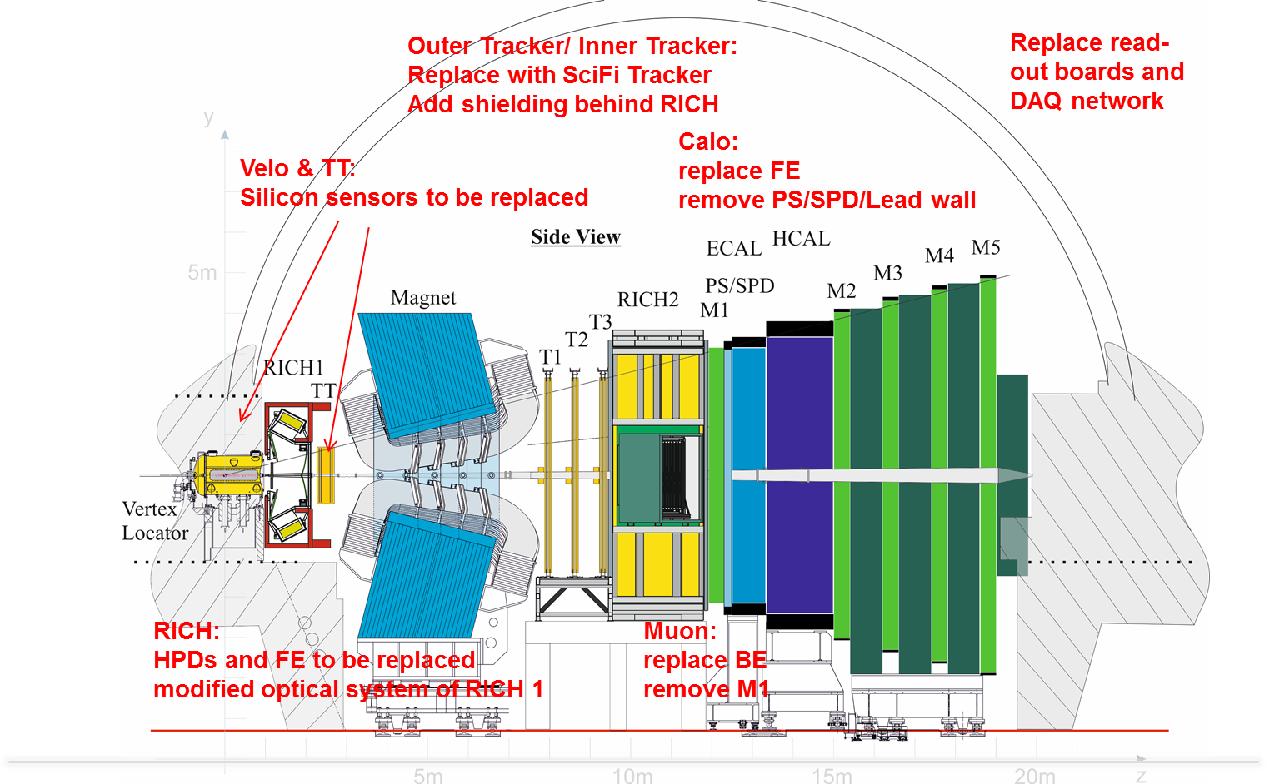
Session 8: (E)YETS and Long Shutdown 2 Strategy and Preparation
LHC Experiments Activities during LS2: LHCb
Rolf Lindner (LHCb) / Ludovico Pontecorvo (ATLAS) / Austin Ball (CMS) / Werner Riegler (ALICE)

Slide 18
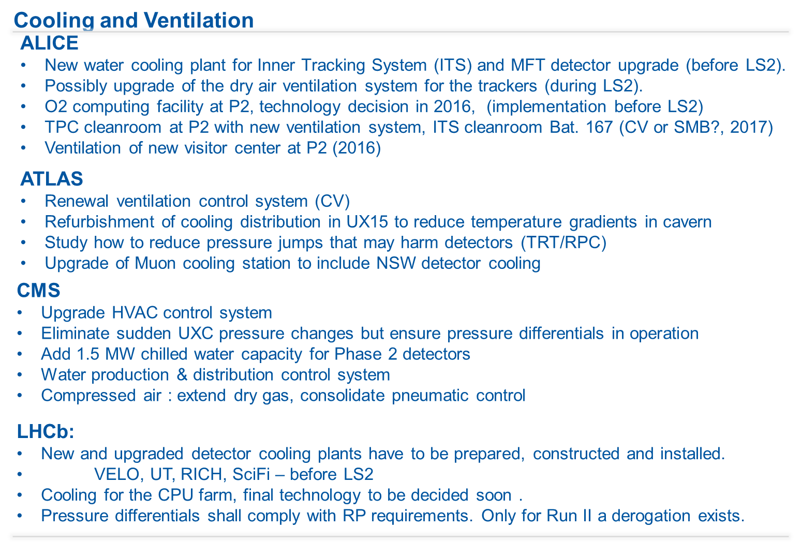
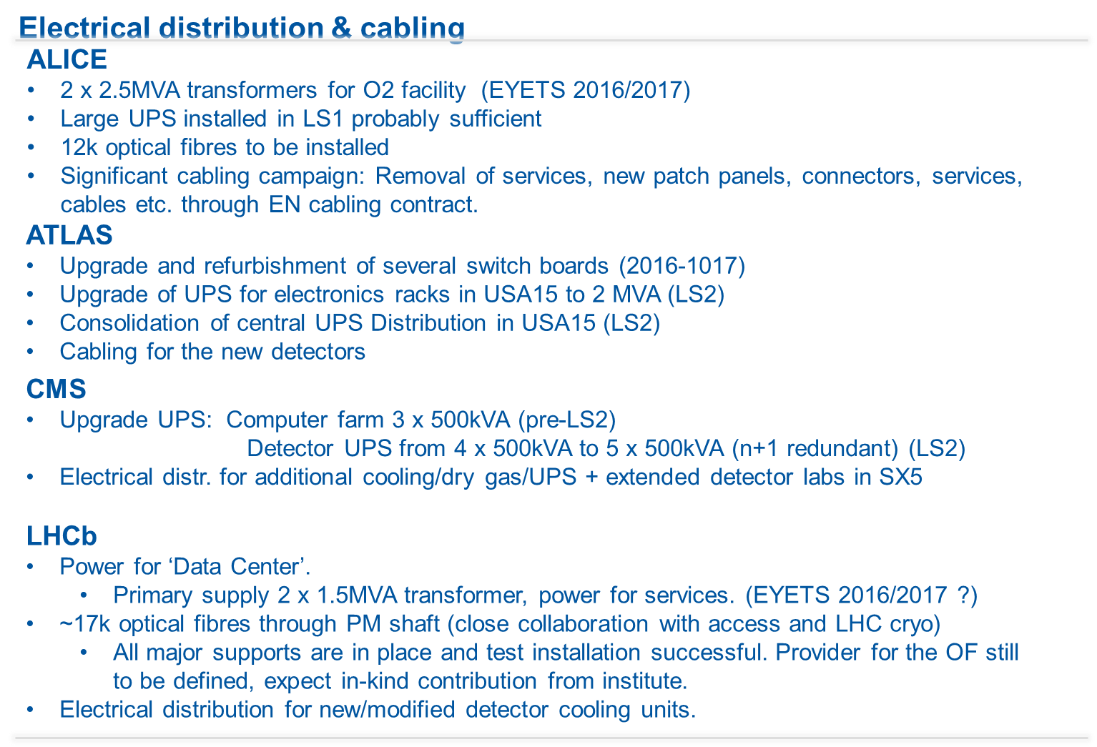
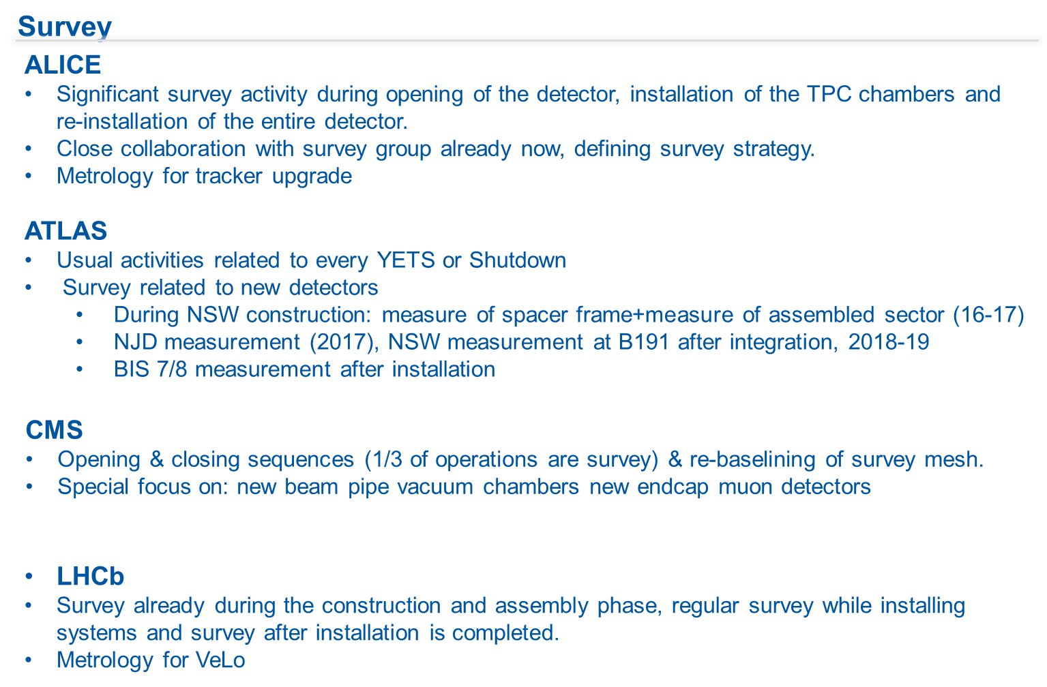
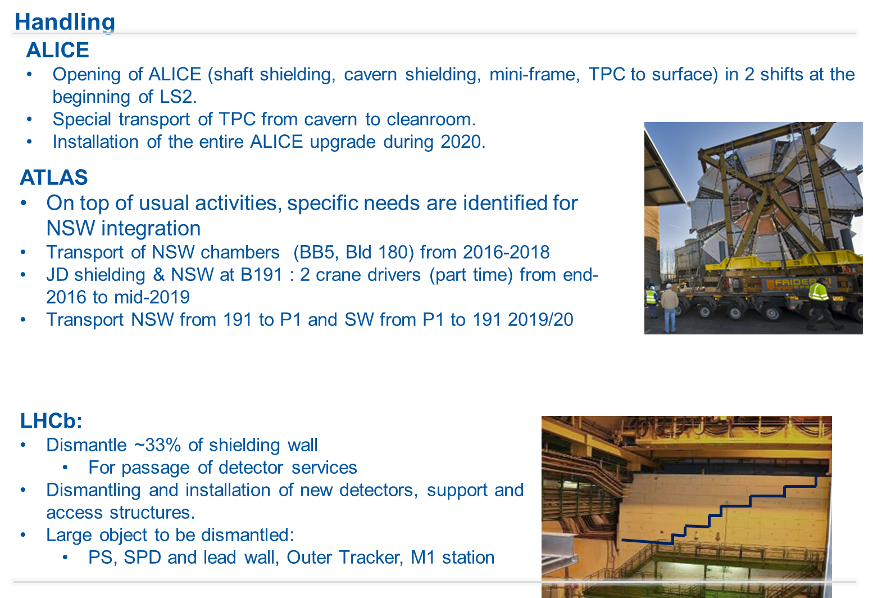
Session 8: (E)YETS and Long Shutdown 2 Strategy and Preparation
LHC Experiments Activities during LS2
Rolf Lindner (LHCb) / Ludovico Pontecorvo (ATLAS) / Austin Ball (CMS) / Werner Riegler (ALICE)

Slide 19
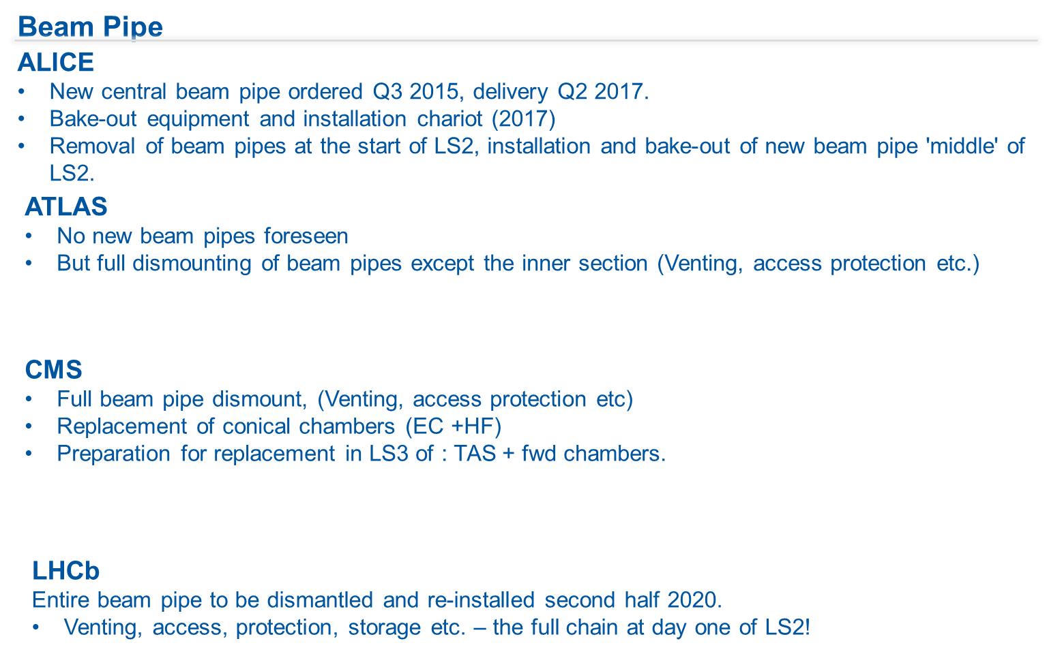
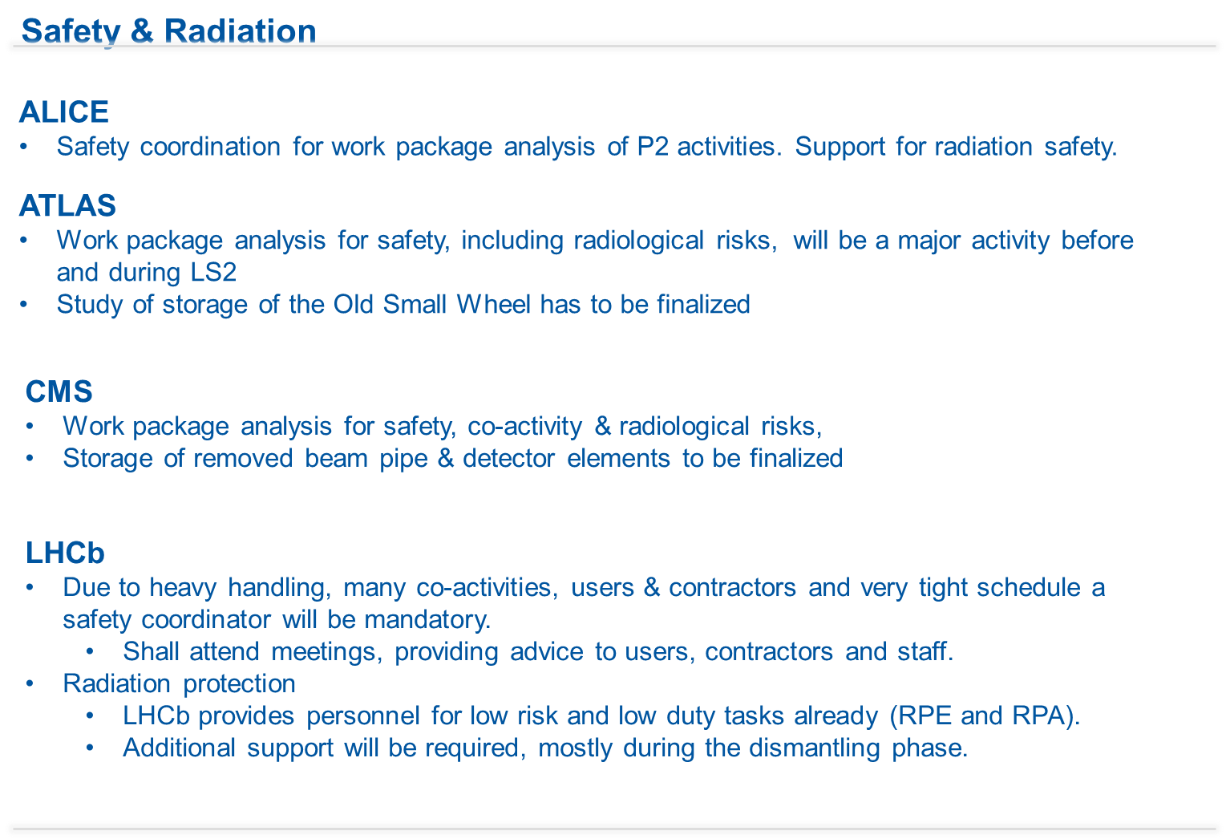
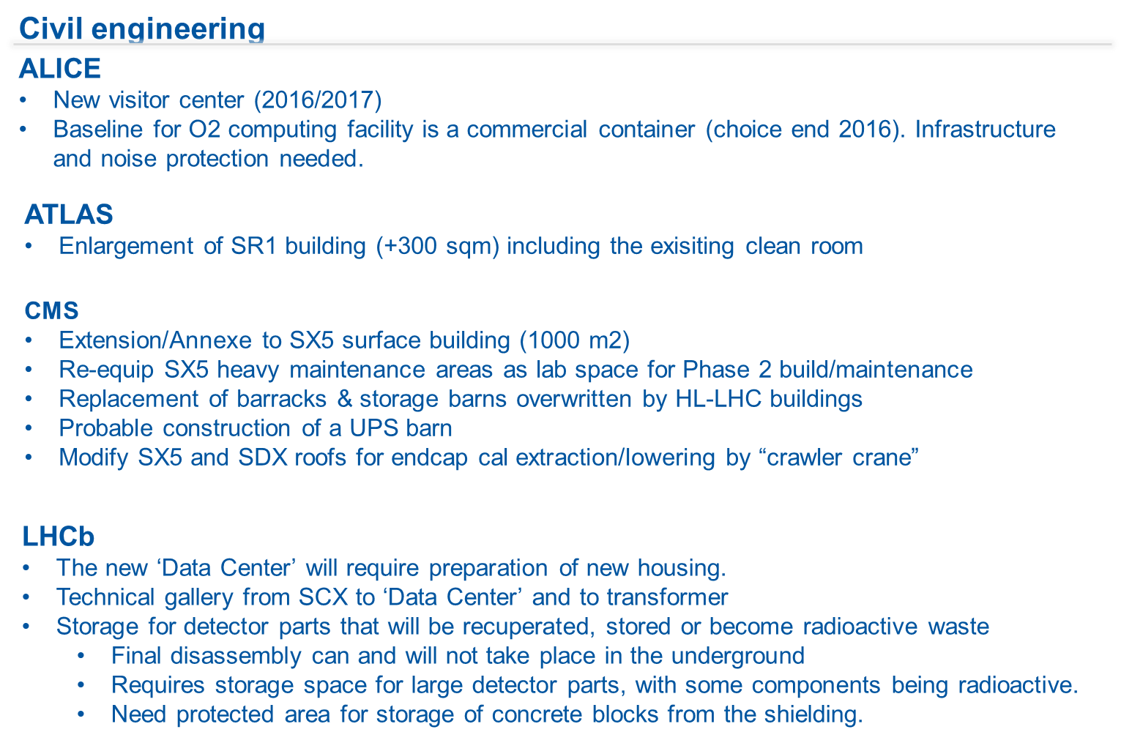
Session 8: (E)YETS and Long Shutdown 2 Strategy and Preparation
LHC Experiments Activities during LS2
Rolf Lindner (LHCb) / Ludovico Pontecorvo (ATLAS) / Austin Ball (CMS) / Werner Riegler (ALICE)

Slide 20
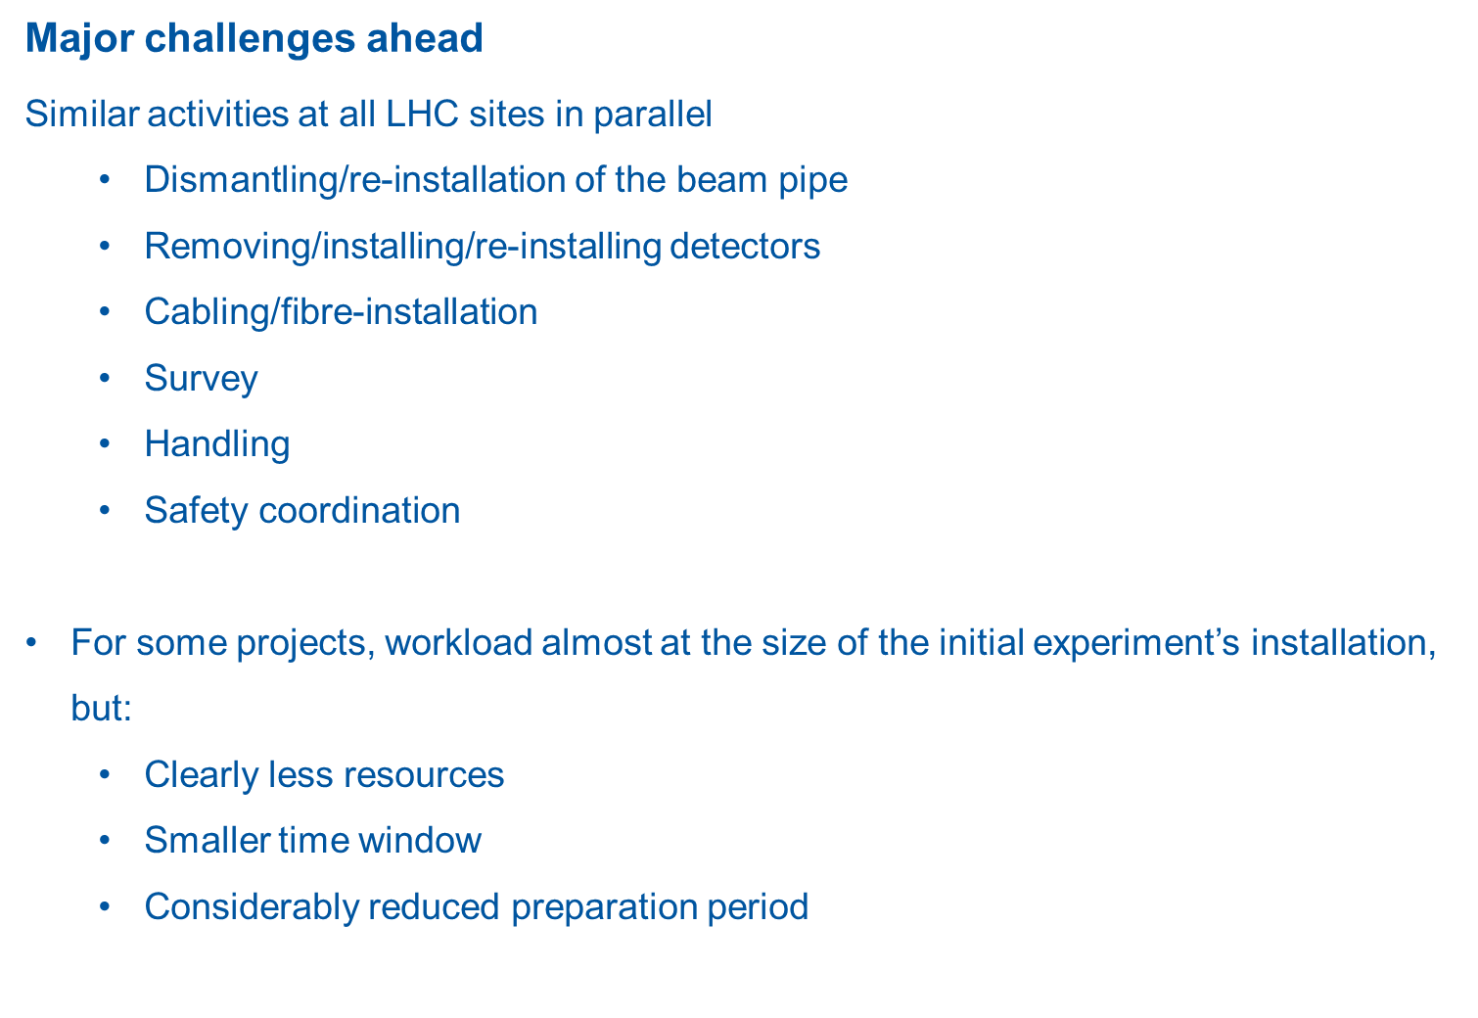
Session 8: (E)YETS and Long Shutdown 2 Strategy and Preparation
LHC Experiments Activities during LS2
Rolf Lindner (LHCb) / Ludovico Pontecorvo (ATLAS) / Austin Ball (CMS) / Werner Riegler (ALICE)
Where PLAN may help with parallelism…

Slide 21
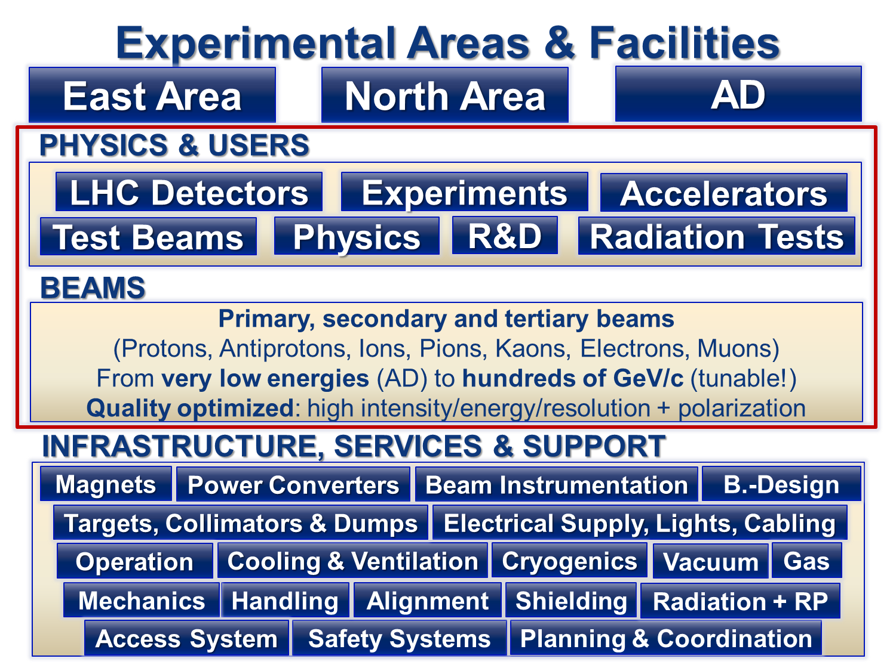
Session 8: (E)YETS and Long Shutdown 2 Strategy and Preparation
Non-LHC Experiments Activities during LS2
Markus Brugger, Experimental Areas Group Leader, EN Department
A good summary of the challenges…

Slide 22
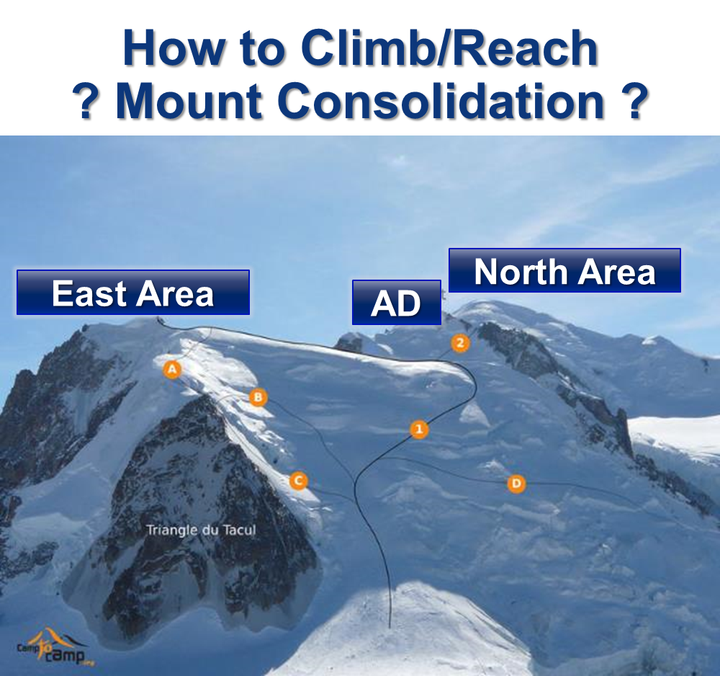

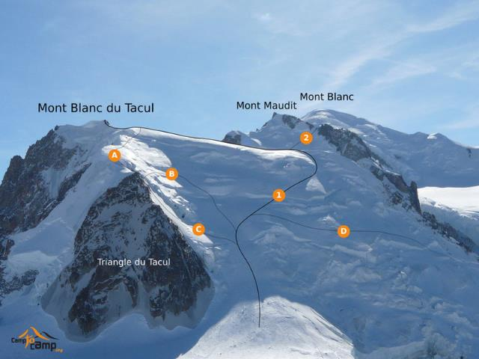
Session 8: (E)YETS and Long Shutdown 2 Strategy and Preparation
Non-LHC Experiments Activities during LS2
Markus Brugger, Experimental Areas Group Leader, EN Department

Slide 23
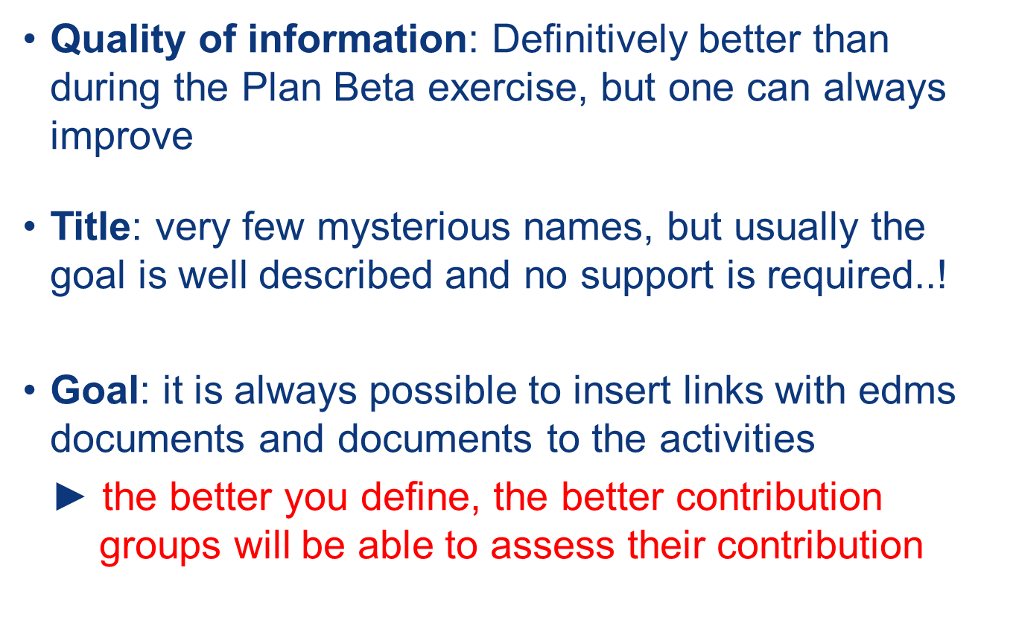
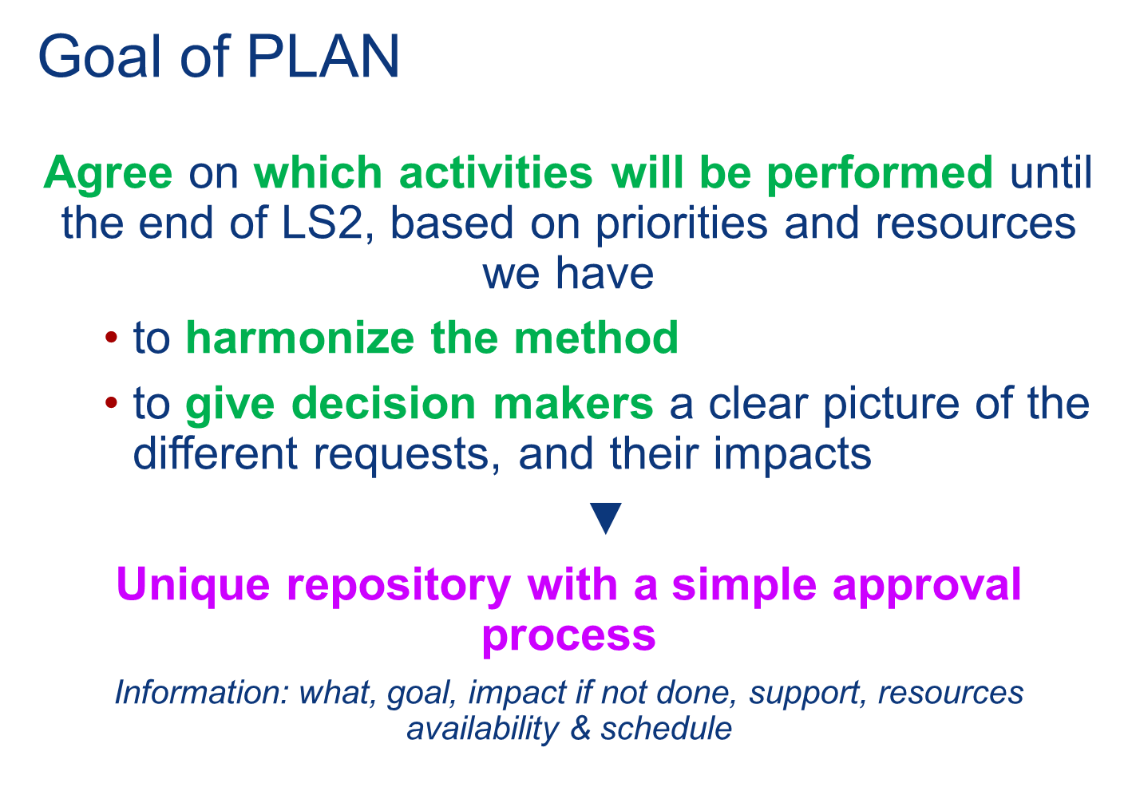
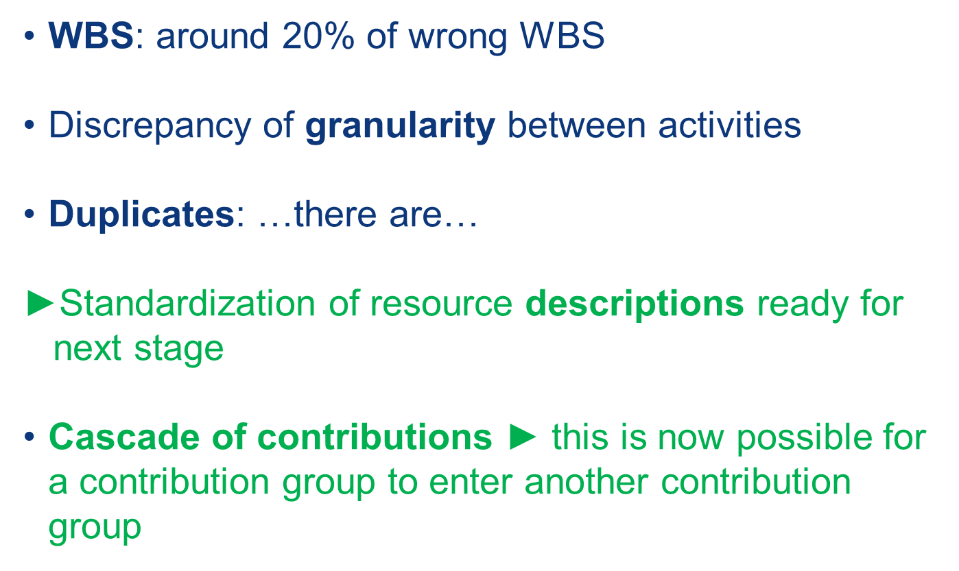
Session 8: (E)YETS and Long Shutdown 2 Strategy and Preparation
First Feedback from Plan
Katy Foraz, LS2 Project Planning Coordinator
Mirko Pojer, LS2 Plan Data Quality Manager
All Groups from all Departments are on-board
…more efforts needed on PLAN data Quality…

Slide 24
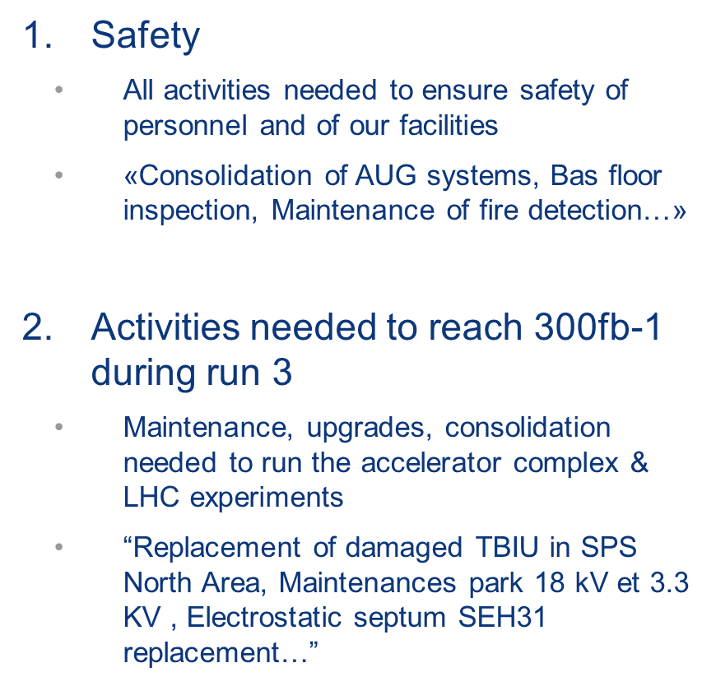
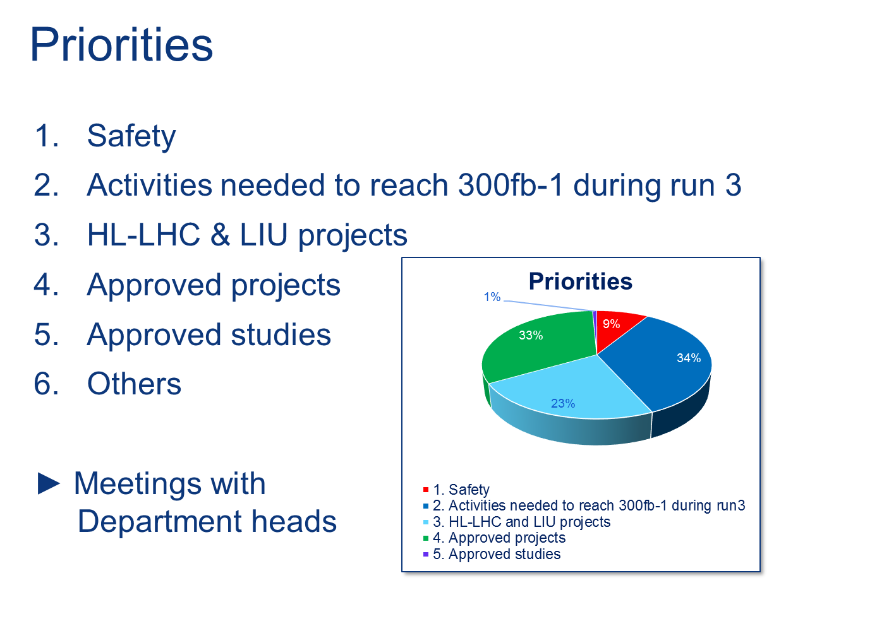
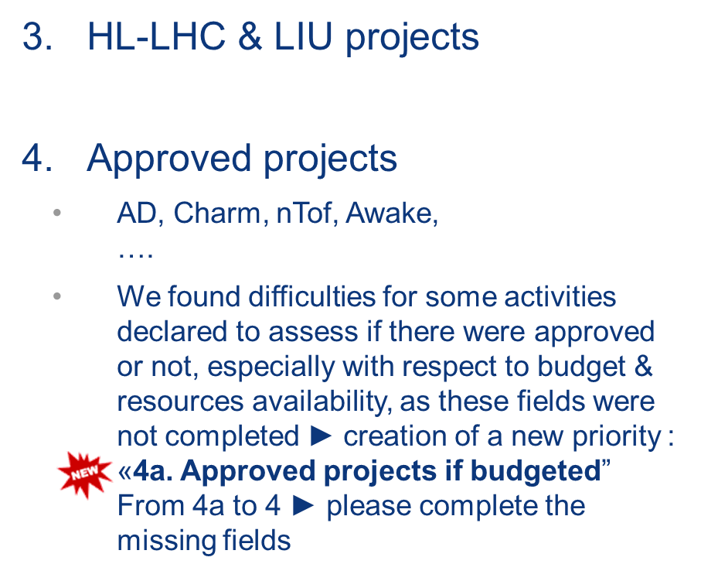
Session 8: (E)YETS and Long Shutdown 2 Strategy and Preparation
First Feedback from Plan
Katy Foraz, LS2 Project Planning Coordinator
Mirko Pojer, LS2 Plan Data Quality Manager
LS2 Coordinator & A&T Sector Director
…DHs and Project Leaders consulted…

Slide 25
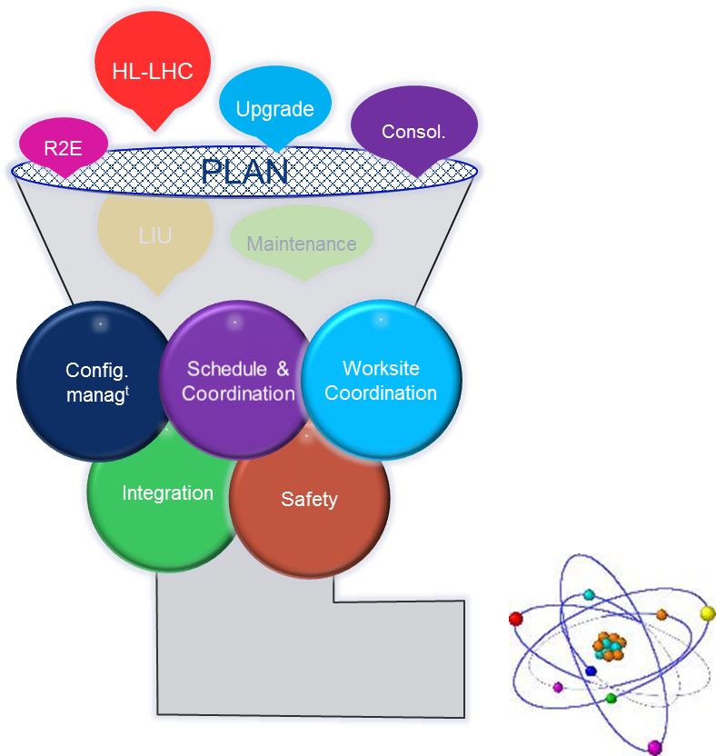
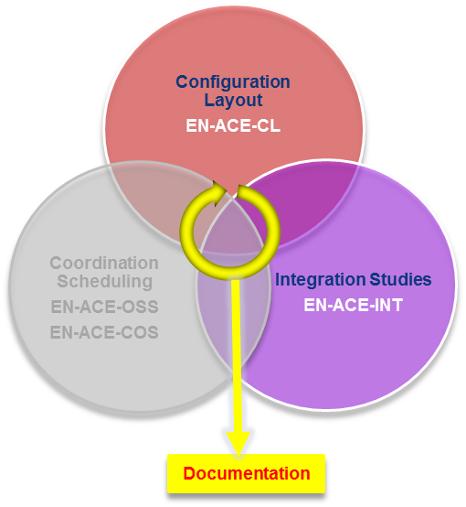
Session 8: (E)YETS and Long Shutdown 2 Strategy and Preparation
Framework schedule from EYETS 2016 to LS2
Katy Foraz, LS2 Project Planning Coordinator
Mirko Pojer, LS2 Plan Data Quality Manager
LS2 provides methodology for success…

Slide 26
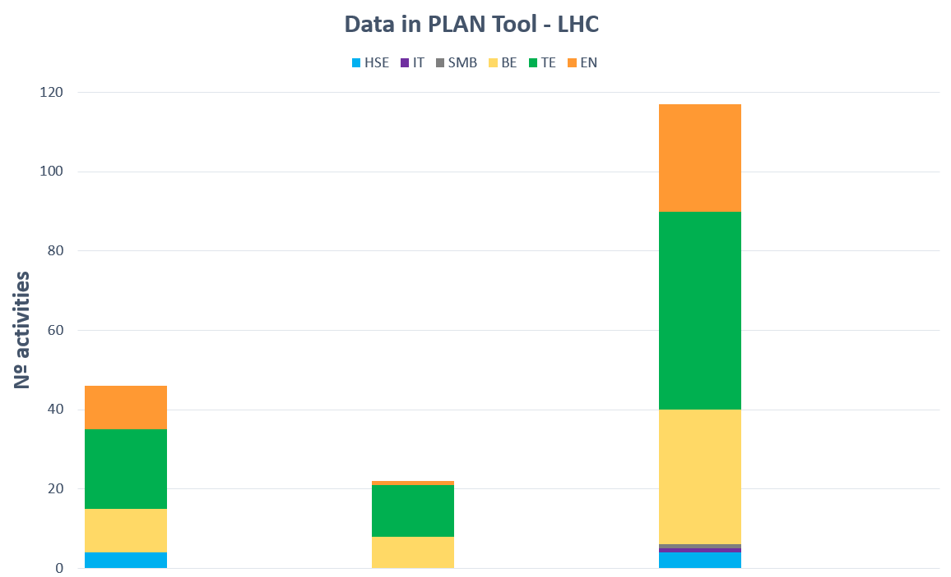
Session 8: (E)YETS and Long Shutdown 2 Strategy and Preparation
Framework schedule from EYETS 2016 to LS2
Katy Foraz, LS2 Project Planning Coordinator
Mirko Pojer, LS2 Plan Data Quality Manager
PLAN tool “mirrors” Requests & Affordability…
Maint
&
Upgrade
Maint
&
Upgrade
Cons
Maint
&
Upgrade
Cons
HL
Cons
HL
EYETS 2016-2017
YETS 2017-2018
LS2
…not weighted data, but huge numbers related to maintenance & upgrade

Slide 27
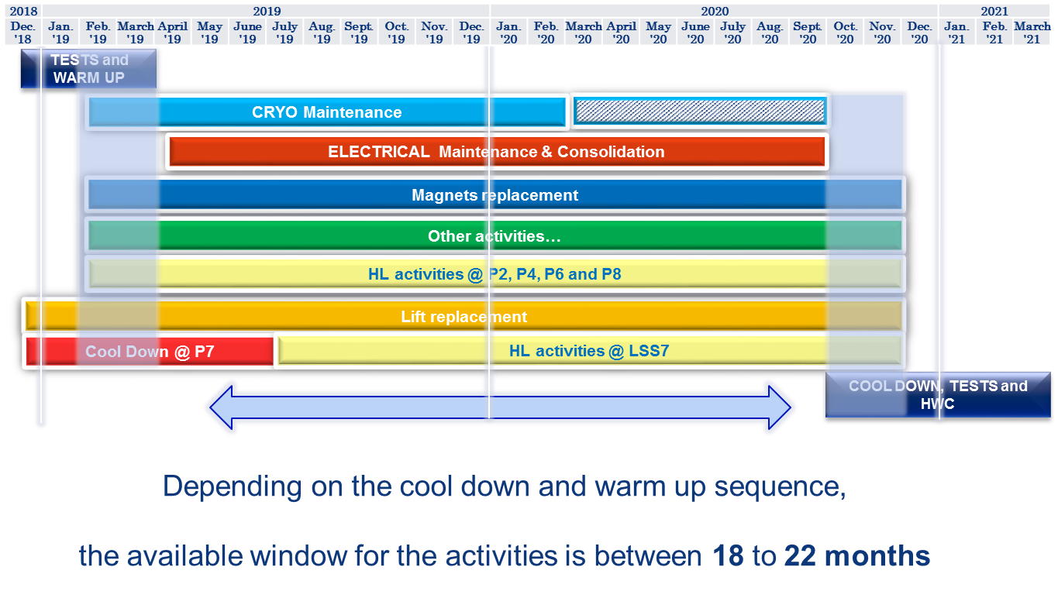
Session 8: (E)YETS and Long Shutdown 2 Strategy and Preparation
Framework schedule from EYETS 2016 to LS2
Katy Foraz, LS2 Project Planning Coordinator
Mirko Pojer, LS2 Plan Data Quality Manager
Draft Master Schedule skeleton is defined…

Slide 28
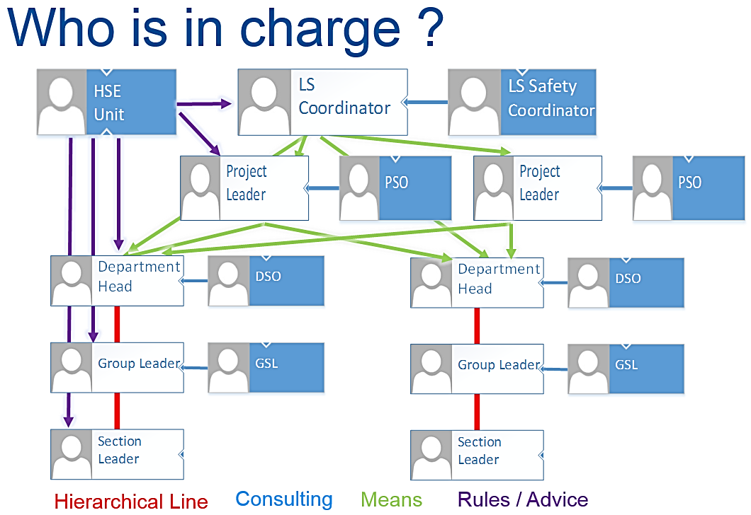
Session 8: (E)YETS and Long Shutdown 2 Strategy and Preparation
General Safety
Thomas Otto, LS2 Project Safety Coordinator for LHC
Ana-Paula Bernardes, LS2 Project Safety Coordinator for Injectors
Targets: Safety first… everywhere!
Continuity:
  with LS1 for Accelerator infrastructures
  Training & Readiness
Reinforced:
  Safety on Surface Buildings & Workshops
  In-situ waste sorting
  Grouping of radioactive transports

Slide 29
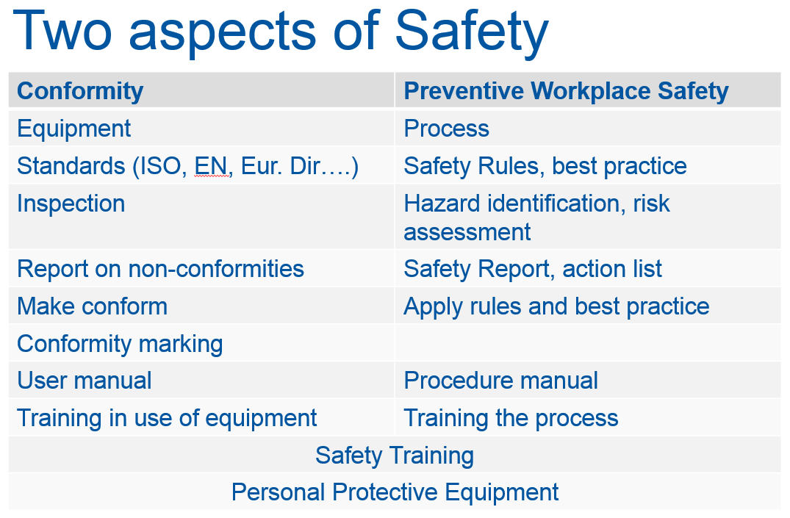
Session 8: (E)YETS and Long Shutdown 2 Strategy and Preparation
General Safety
Thomas Otto, LS2 Project Safety Coordinator for LHC
Ana-Paula Bernardes, LS2 Project Safety Coordinator for Injectors

Slide 30
Long Shutdown 2 (LS2) Project
Main milestones
José Miguel Jimenez, LS2 Coordinator
LS2 Committee (LSC)
Start of LSC
Committee
LS1
Post
Mortem
LS2
Day
PLAN
iteration
LS2
Day
LS2
Day
LS2
Readiness
Review
PLAN
is made
available
Consolidated
List of tasks
EYETS
to Director A&T
Final
validation
LS2
Main milestones for 2016:
  New iteration of PLAN tool
    EYETS / YETS / LS2
  Consolidated list of tasks
  EYETS to Director A&T
  Start of LSC Committee on 1st April’16
Consolidated
List of tasks
YETS
to Director A&T

