Slide 2
Operation of cryogenics for LHC detectors: what did we learn?
U. Wagner, CERN

Slide 3
Topics
Introduction ATLAS and CMS
Operation history 2011, 2012, 2015
  Availability data
    Reasons for down time
  Impurities and filter clogging
    Inbuilt impurity handling
    Filter clogging development 2011, 2012/13, 2015
Oil contamination 2015
  Identified reason
  Realised modifications

Slide 4
Topics
Introduction ATLAS and CMS
Operation history 2011, 2012, 2015
  Availability data
    Reasons for down time
  Impurities and filter clogging
    Inbuilt impurity handling
    Filter clogging development 2011, 2012/13, 2015
Oil contamination 2015
  Identified reason
  Realised modifications

Slide 5
ATLAS and CMS cryogenics
ATLAS
  Two separate cryogenic services
    LN₂ cooling system for the LAr calorimeter
    He cooling system for the superconducting magnets
      One refrigerator for 40 K – 60 K cooling; (Shield Refrigerator)
      One refrigerator for 4.5 K cooling; (Main Refrigerator)
      Two magnet systems
        One solenoid magnet cooled in thermosiphon mode
        Several toroidal magnets cooled by forced flow
In this presentation only the
Main Refrigerator (MR) is considered

Slide 6
ATLAS and CMS cryogenics
CMS
  One single cryogenic service
  One refrigerator for all loads down to 4.5 K
    One solenoid magnet cooled in thermosiphon mode

Slide 7
Topics
Introduction ATLAS and CMS
Operation history 2011, 2012, 2015
  Availability data
    Reasons for down time
  Impurities and filter clogging
    Inbuilt impurity handling
    Filter clogging development 2011, 2012/13, 2015
Oil contamination 2015
  Identified reason
  Realised modifications

Slide 8
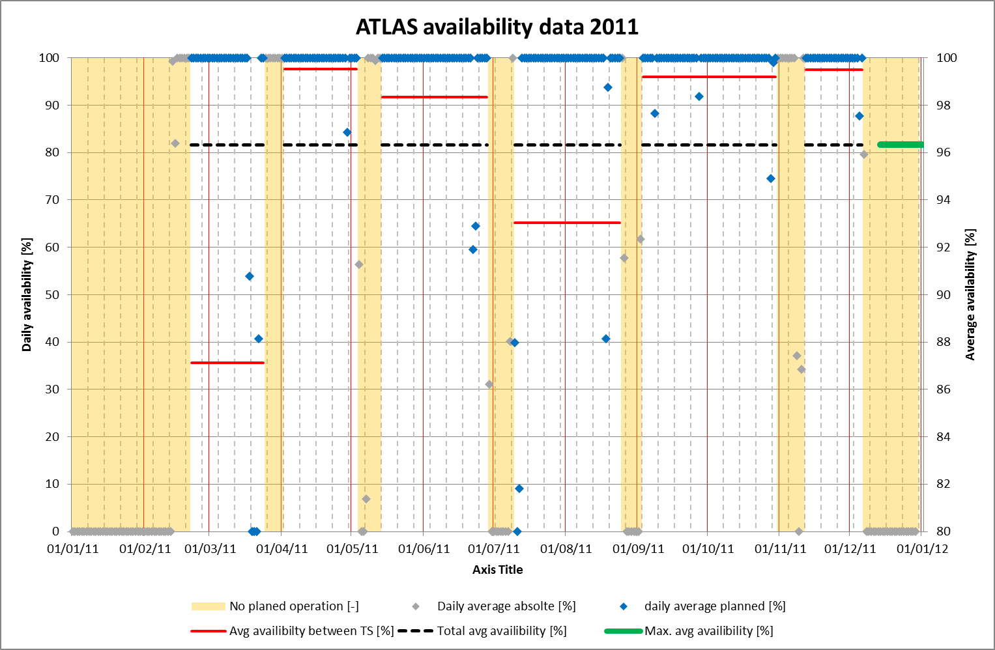
ATLAS availability 2011

Slide 9
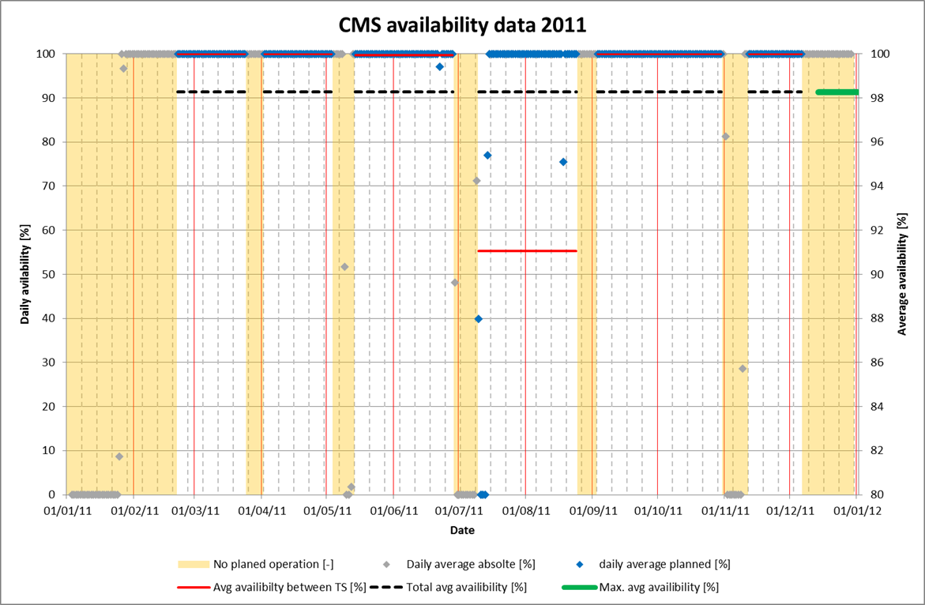
CMS availability 2011

Slide 10
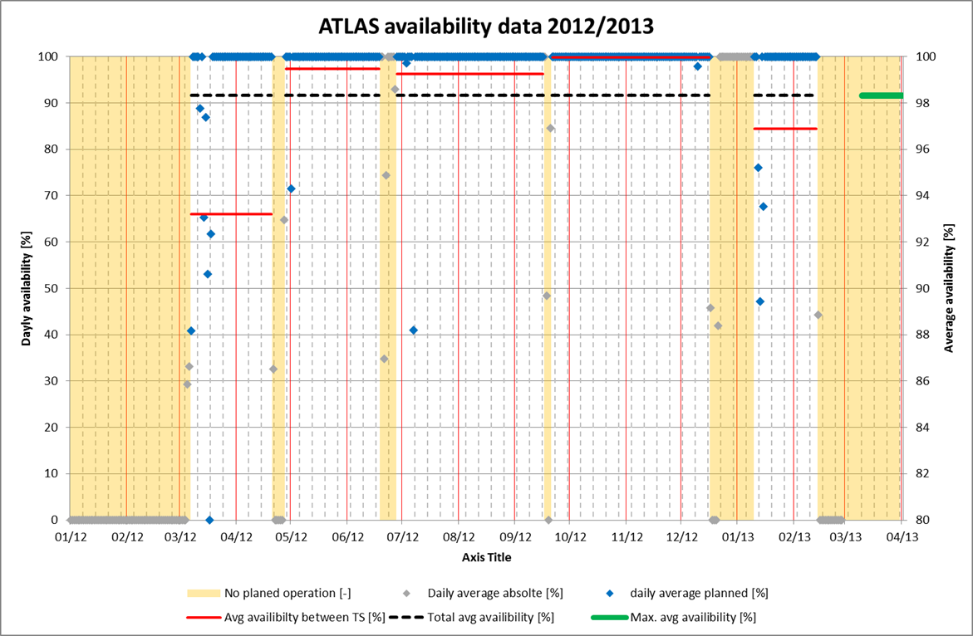
ATLAS availability 2012 / 2013

Slide 11
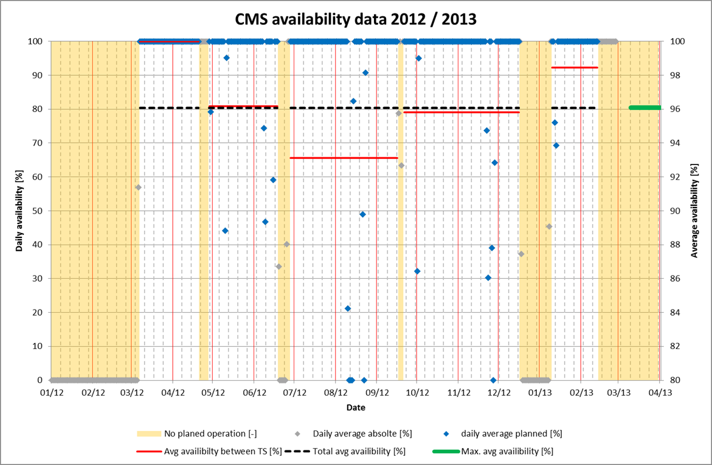
CMS availability 2012 / 2013

Slide 12
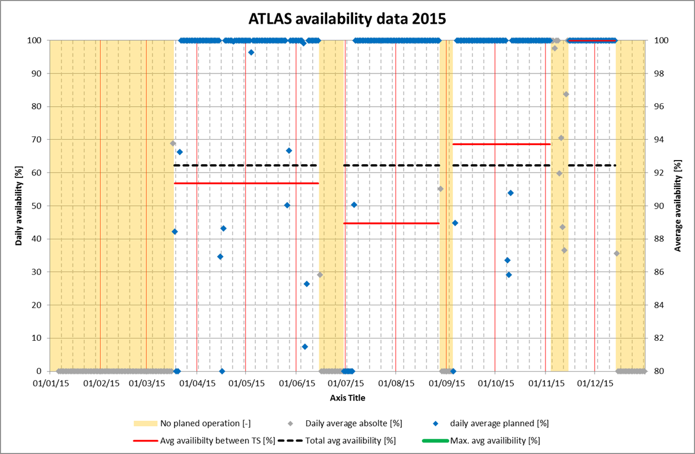
ATLAS availability 2015

Slide 13
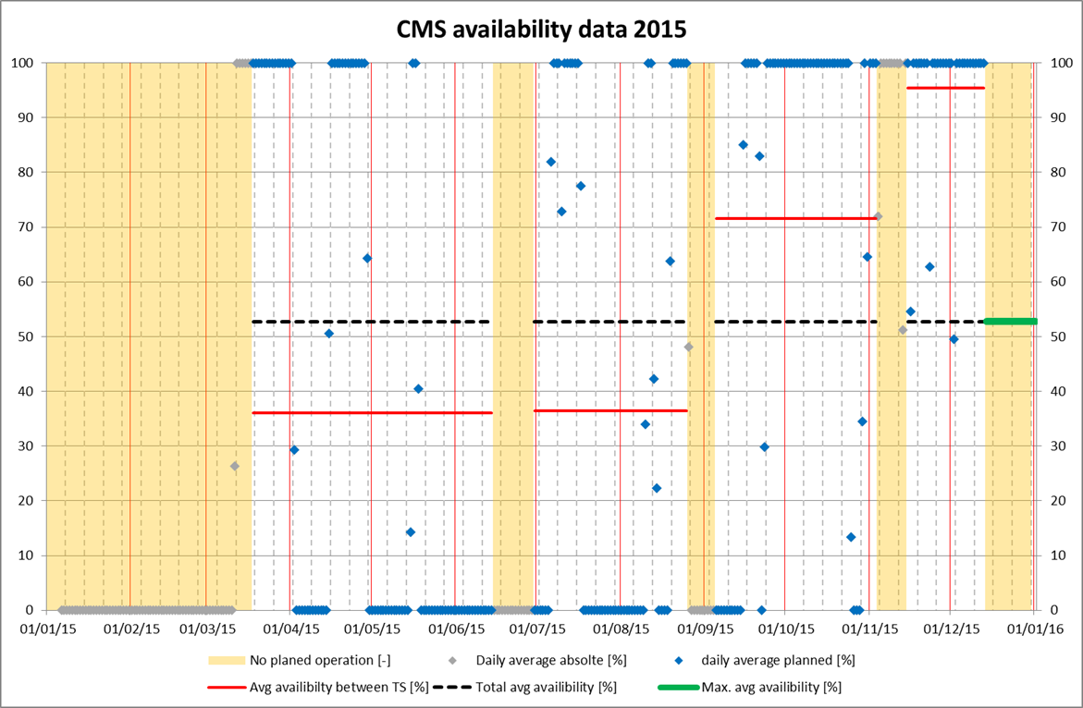
CMS availability 2015
!

Slide 14
Repetitive common reasons
Power cuts
  “Glitches”, typically <120 ms
  Long term cuts, typically >300 ms to black-out
Control& instrumentation
  Electrical contact error, element failure
  Mistakes or shortfalls in programmed controls
Human error
  Operating errors
  Errors during servicing, working on utilities
    Once closing by valve by unknown person
Impurity problems

Slide 15
Isolated reasons
Only experienced for ATLAS
  Cold pump problems
  Client perturbations
  Test without current and beam (2015)
  Voluntary signal suppression (2015)
  Late start-up after technical stop (2015)
Only experienced for CMS
  UPS problem

Slide 16
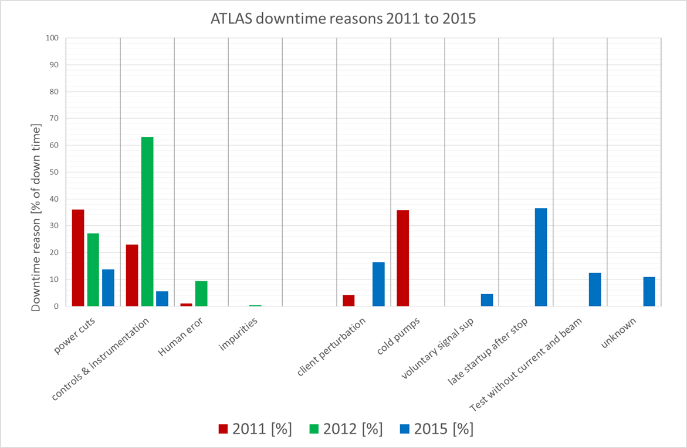
ATLAS downtime reasons

Slide 17
ATLAS modifications 2014
Power cuts
  2011 and 2012 all “glitches” lead to a stop of the installation
  Detailed fault chain analysis
  Readjustment of hard and soft safety to be tolerant to power losses of < 120 ms.
Result 2015
  No more installation stops due to short power loss.
  Now most of the glitches are seen by the client system.

Slide 18
ATLAS modifications 2014
Control and instrumentation
  Existing electrical cabinets removed and completely replaced
  Turbine speed measurement changed against more reliable and more precise equipment
    The original equipment was from 1990 and was “moved / modified” several times by CERN
      Documentation not up to date

Slide 19
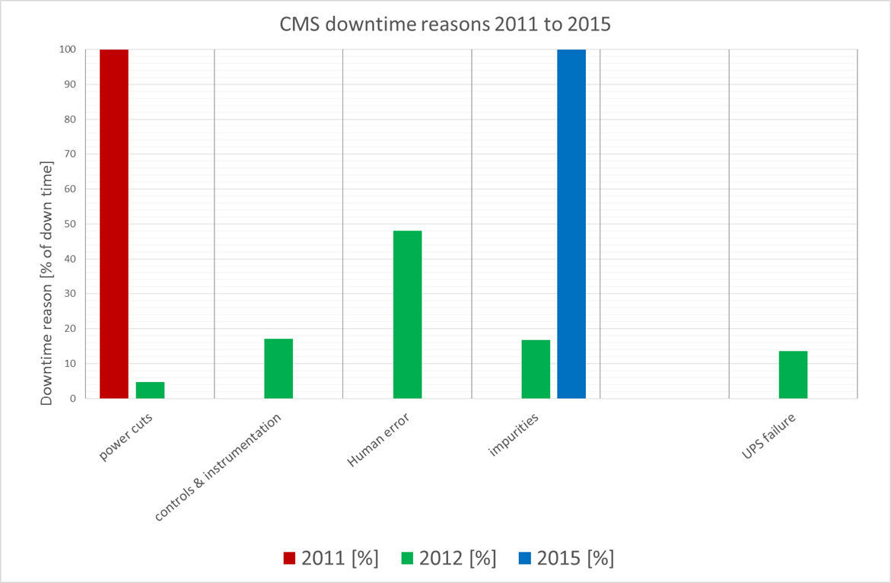
CMS downtime reasons

Slide 20
CMS modifications 2014
Nearly none
  Operation 2011 showed no real shortcomings
    Availability at 98.3%, only power cuts.
  Failing UPS system exchanged
    Was part of problematic batch
  Control and instrumentation problems due to failing temperature switch in hard-wired compressor safety.
    Hard wired safety chain modified.

Slide 21
Topics
Introduction ATLAS and CMS
Operation history 2011, 2012, 2015
  Availability data
    Reasons for down time
  Impurities and filter clogging
    Inbuilt impurity handling
    Filter clogging development 2011, 2012/13, 2015
Oil contamination 2015
  Identified reason
  Realised modifications

Slide 22
Inbuilt impurity handling
Solids
  The installations have filters
    More to protect delicate equipment than to remove a constant flow of solid impurities.
Liquids
  We rely on the final oil removal system for oil.
  We rely on the heat exchanger design for water.
  We rely on purges and oil adsorber heating to remove water during a start-up phase.
    Water from top-up oil.

Slide 23
Inbuilt impurity handling
Gasses
  Both refrigerators have one guard adsorber at 80 K.
  Neither has a by-pass
  Only the CMS adsorber can be isolated, requiring a cold box stop.
In short, this means there is virtually no impurity handling.
  CERN responsibility as specified accordingly.

Slide 24
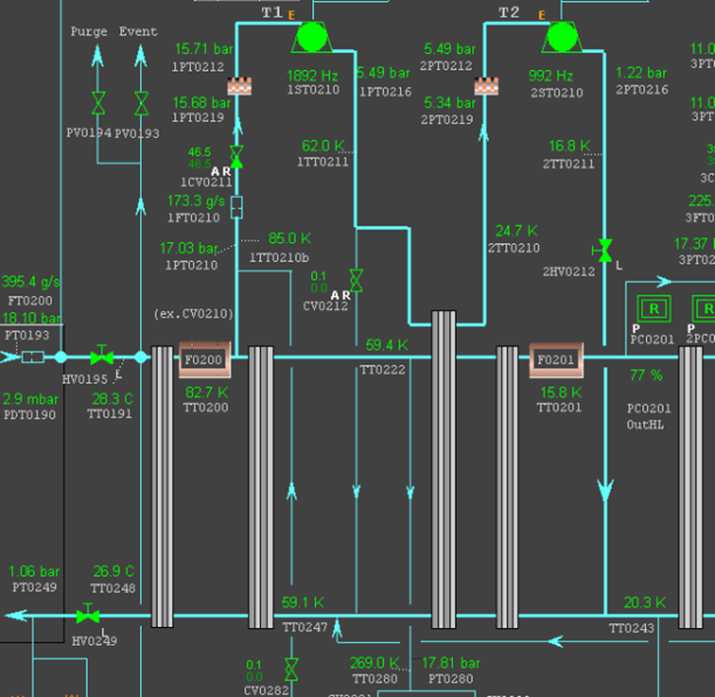
ATLAS MR 80 K adsorber

Slide 25
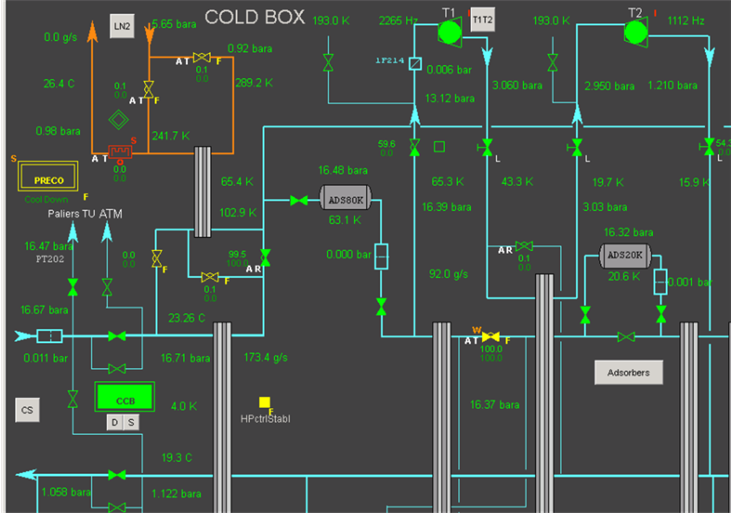
CMS 80 K adsorber

Slide 26
Inbuilt impurity handling
The 80 K adsorber will charge with N2/O2 impurities principally during the first cool down phase.
  At high partial impurity pressure
This adsorber will always be subject to temperature fluctuations.
  Due to operation interruptions, load changes
  At low partial impurity pressure
  Impurities will migrate to the adsorber outlet and finally desorb into the helium stream.

Slide 27
Filter clogging
Impurities passing the 80 K adsorbers will clog the turbine inlet filters.
  This happens regularly
  Small quantities of impurities are sufficient.
  In case of gaseous impurities, filter warm-up removes the clogging agent.
  In case of liquid impurities a persistent Δp off-set usually remains

Slide 28
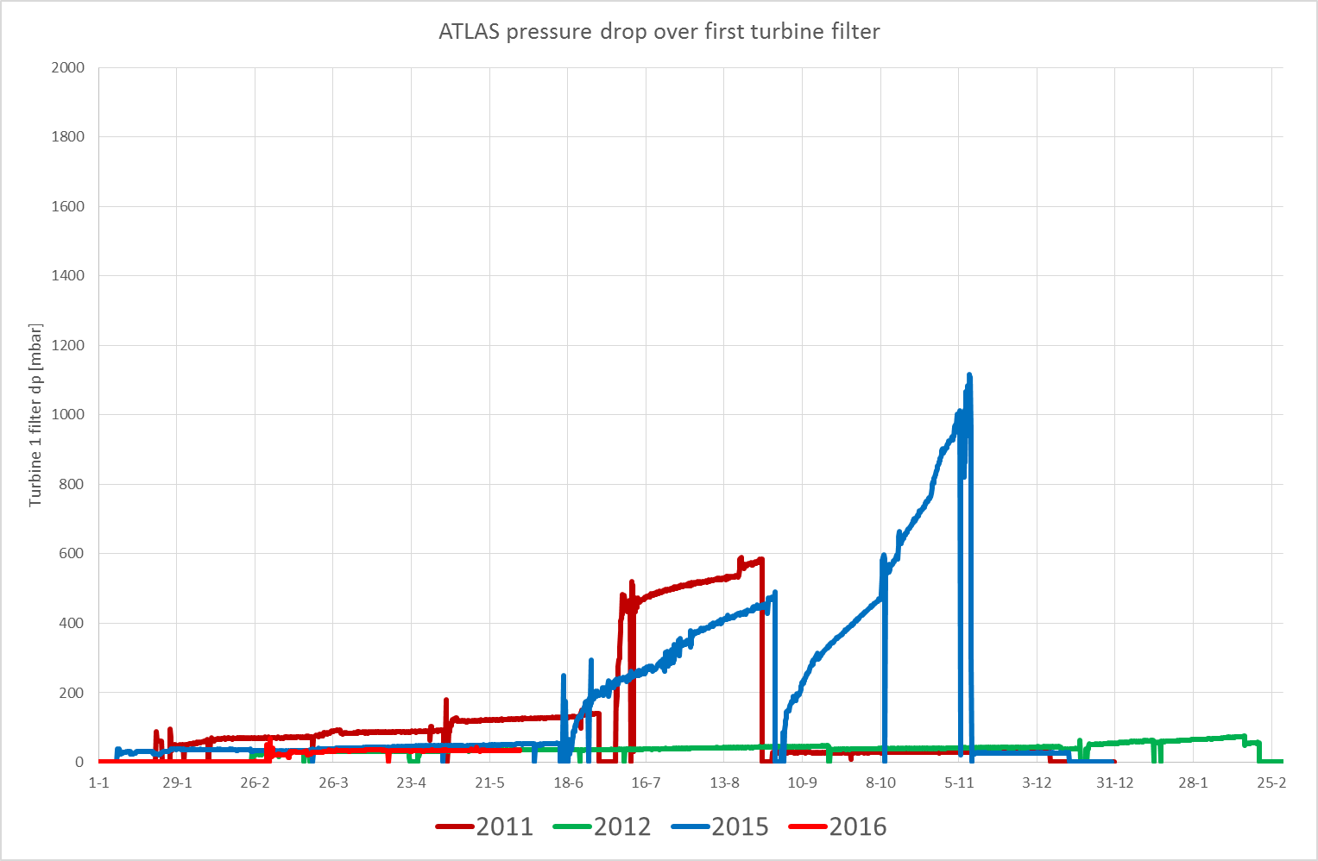
ATLAS filter clogging 2011 to 2015

Slide 29
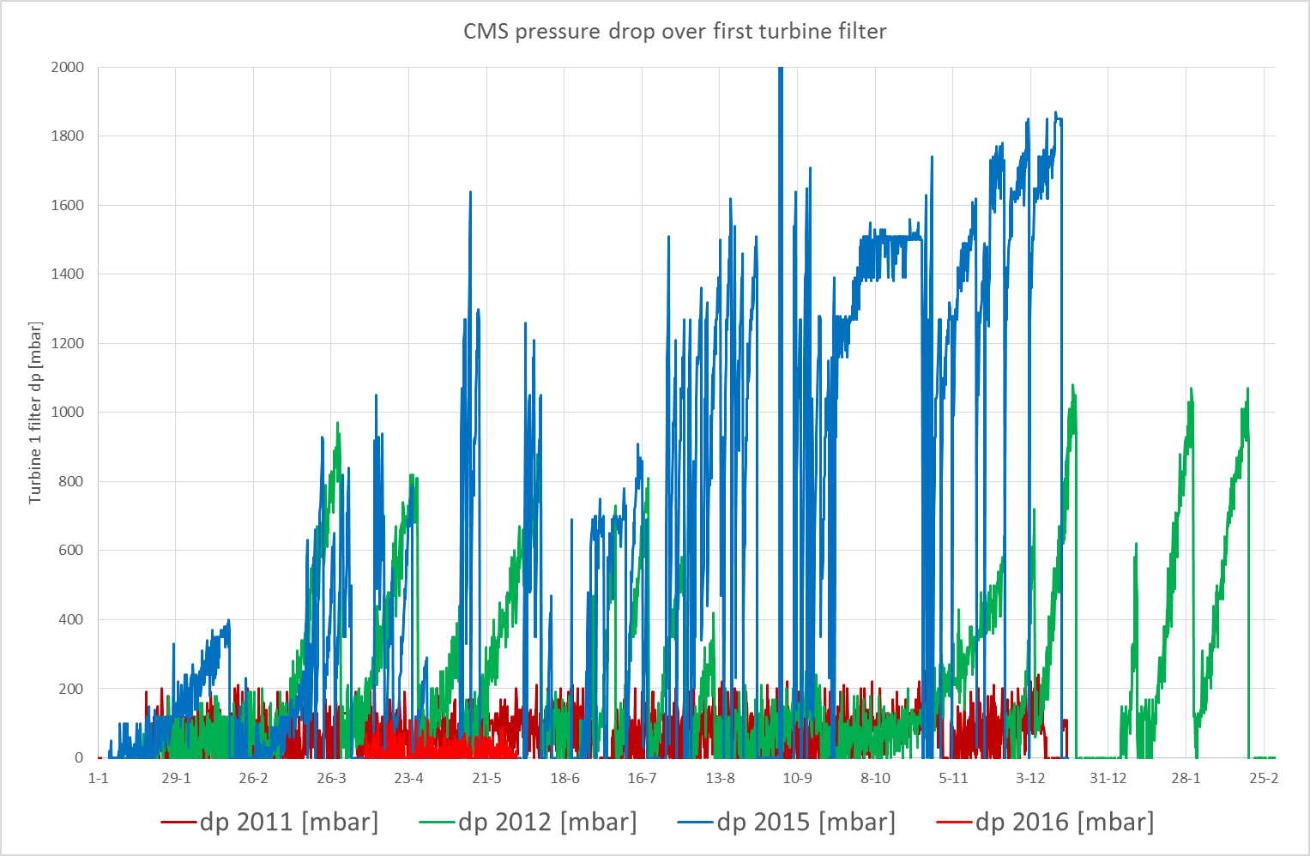
CMS filter clogging 2011 to 2015

Slide 30
Impurities conclusion
We live with impurities
  Valid for all our installations
  The absence of an adapted handling system for gaseous impurities is a nuisance.
Oil impurities in 2015 were NOT limited to CMS.
  We have seen the same effect in much smaller scale at ATLAS.

Slide 31
Topics
Introduction ATLAS and CMS
Operation history 2011, 2012, 2015
  Availability data
    Reasons for down time
  Impurities and filter clogging
    Inbuilt impurity handling
    Filter clogging development 2011, 2012/13, 2015
Oil contamination 2015
  Identified reason
  Realised modifications

Slide 32
Oil contamination 2015
The identified reason for the peak of oil contamination is a bad choice of the adsorbent material of the final oil adsorber.
  During the long shut-down in 2013 / 2014 all oil adsorbers were equipped with this adsorbent in the frame of preventive maintenance.
  The adsorbent material was changed from activated charcoal (coconut shell based) to activated coal (anthracite based)
  Reasons were cost driven combined with a total lack of understanding.
  We only noticed this change in late summer 2015.

Slide 33
Oil contamination 2015
The reason why the ATLAS system suffered much less lies in the difference of the respective oil treatment systems up stream of the adsorber.
  No unplanned down time due to oil contamination
Installations with well performing oil separators and coalescers suffered little.
Unfortunately the separator coalescer units for CMS were the worst ever receptioned at CERN.

Slide 34
Realised modifications at CMS
Exchange of the adsorbent material
  As well for ATLAS
Exchange of the final oil separator and coalescer stages.
  We really wanted to be on the safe side:
    We consciously over specified the amount of circulating oil.
    We asked for a generous design leading to low oil carry over from the separator.

Slide 35
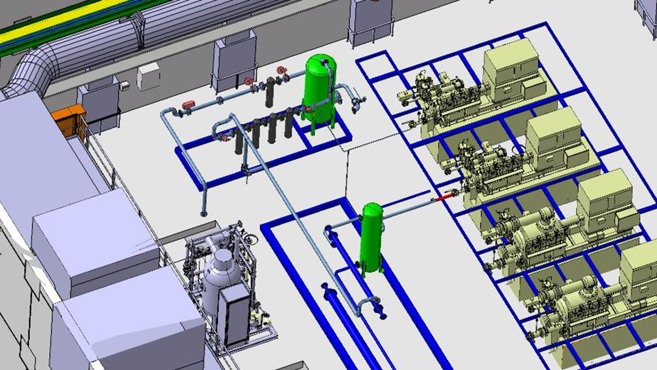
Original CMS oil removal system
Coalescer stage
Oil separator

Slide 36
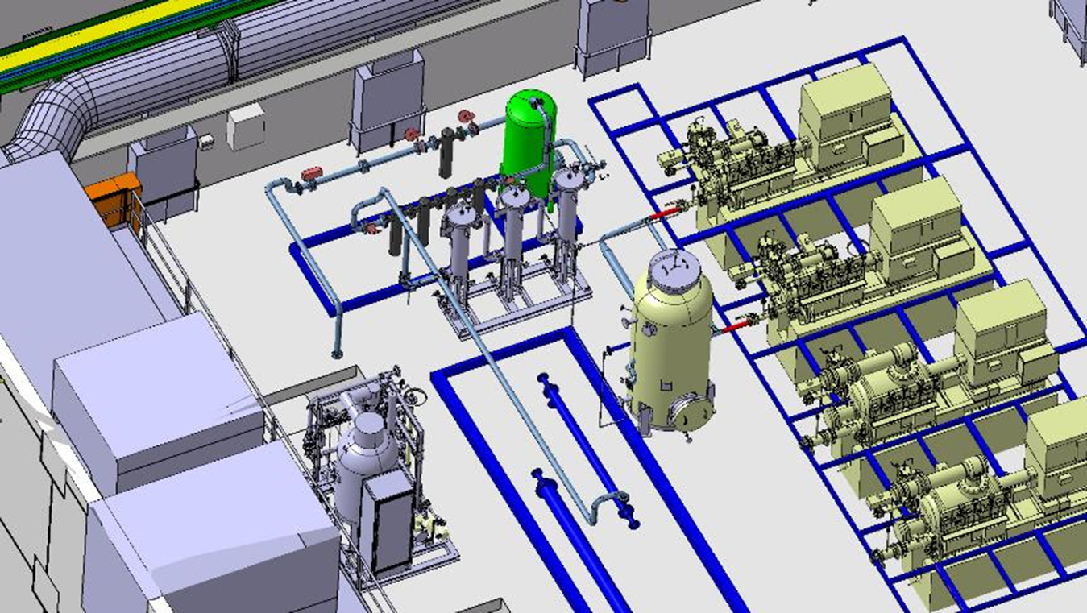
New CMS oil removal system
Coalescer stage
Oil separator

Slide 37
Measurement of oil carry over
Oil carry over from the separator.
  m1 = mc1 + mc2 + mc3
  CERN specification < 100 ppm mass
  Original system ~ 750 ppm mass
  New system ~ 20 ppm mass

Slide 38
Conclusions
What did we learn?
  For cryogenic systems that are supposed to accumulate long periods of uninterrupted operation, 80 K adsorbers need a means to be regenerated during the run.
  Be weary in case different / cheaper alternatives for spares or replacement material is proposed.
  The final oil separator is an important element in the final oil removal system.
    The bad performance of a separator cannot be recovered by adding coalescers.
    We seriously consider to tighten the specified limit of 100 ppm mentioned above.

