Slide 1
NuFact2016 SPC
160121

Slide 2
Today’s goal
Understand what is nufact
Understand what are expected to be done by us
Understand what did the last nufact looks like
  → Jorge
Collect your feedback on the program coordination
Today upto here. For next meeting,
(Deputy)chairs will make proposal of block time table and program
Collect feedback from WG conveners and SPC
Call speaker nomination from SPC

Slide 3
What’s nufact? NuFact2016 preamble
NuFact 2016
is the eighteenth in a series that started in 1999 as an important yearly workshop with emphasis on future neutrino projects.
The main goals of the workshop are to review the progress on studies of future facilities able to improve on measurements of the properties of neutrinos and charged lepton flavor violation as well as new phenomena searches beyond the capabilities of presently planned experiments. Since such progress in the neutrino sector could require innovation in neutrino beams, the role of a neutrino factory within future HEP initiatives will be addressed.
The workshops are not only international but also interdisciplinary in that experimenters, theorists and accelerator physicists from the Asian, American and European regions share expertise with the common goal of designing the next generation of experiments.
The NuFact16 workshop is divided into four Working Groups covering the following topics:
Working Group 1: Neutrino Oscillation Physics
Working Group 2: Neutrino Scattering Physics
Working Group 3: Accelerator Physics
Working Group 4: Muon Physics
NuFact16 will be preceded by the International Neutrino Summer School (INSS 2016) that will also be held in Quy Nhon, Vietnam from 17 to 30 July 2016.

Slide 4
What’s nufact? NuFact2014 preamble
The NUFACT Workshops on Neutrino Factories and Future Accelerator-based Neutrino Facilities have been established since 1999 as an important yearly workshop with emphasis on future projects. The main goals are to review progress on different studies for future neutrino oscillation facilities able to discover the mass hierarchy of neutrinos, CP violation in the leptonic sector, charged lepton flavour violation, and possible new phenomena. The workshops are interdisciplinary in that experimenters, theorists and accelerator physicists share expertise to achieve common goals.

Slide 5
Goal of nufact (in short)
Discuss physics and technology of future high-intensity accelerator based lepton (neutrino & muon) flavor experiments
  Next and next-next generation experiments
  Based on Present day experiences
Physics area
  Neutrino
  Mu flavor experiments (LFV, g-2,..)
  New phenomena
Technology scheme
  High-power (~MW and beyond) beam
  Muon storage ring
  Neutrino factory
  New technology?

Slide 6
NuFact organization
Scientific Program Committee
  Define science coverage of WS
  Define scientific goals of WS
  Appoint WG conveners
  Define Plenary program & Round table (questions)
    Poster sessions?
  SPC meeting during WS Thursday
    Feedback to next
Local Organizing Committee
  Local logistics, Venue, Web,
INSS: Their own organizing committee

Slide 7
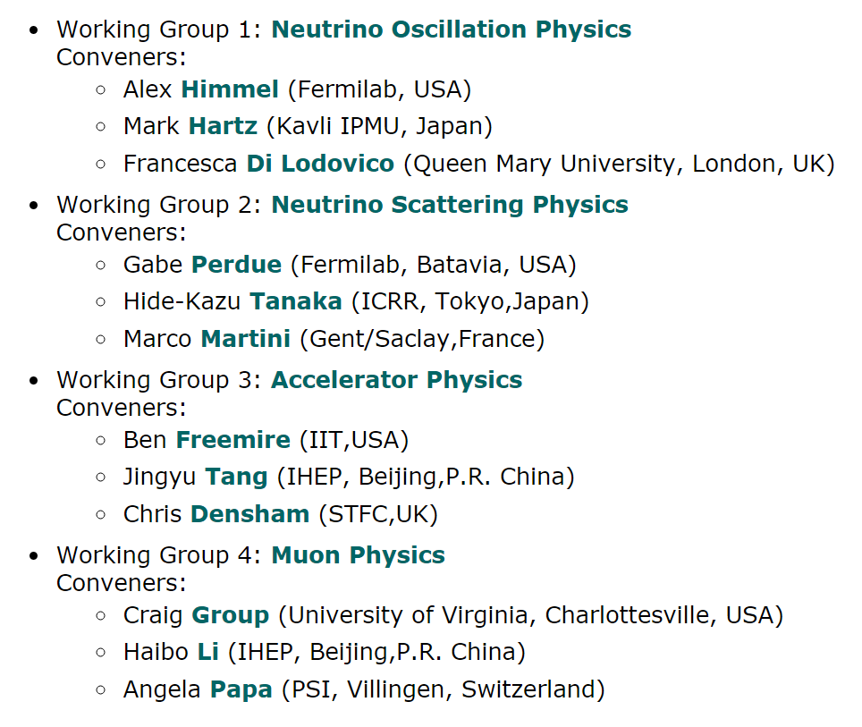

Slide 8
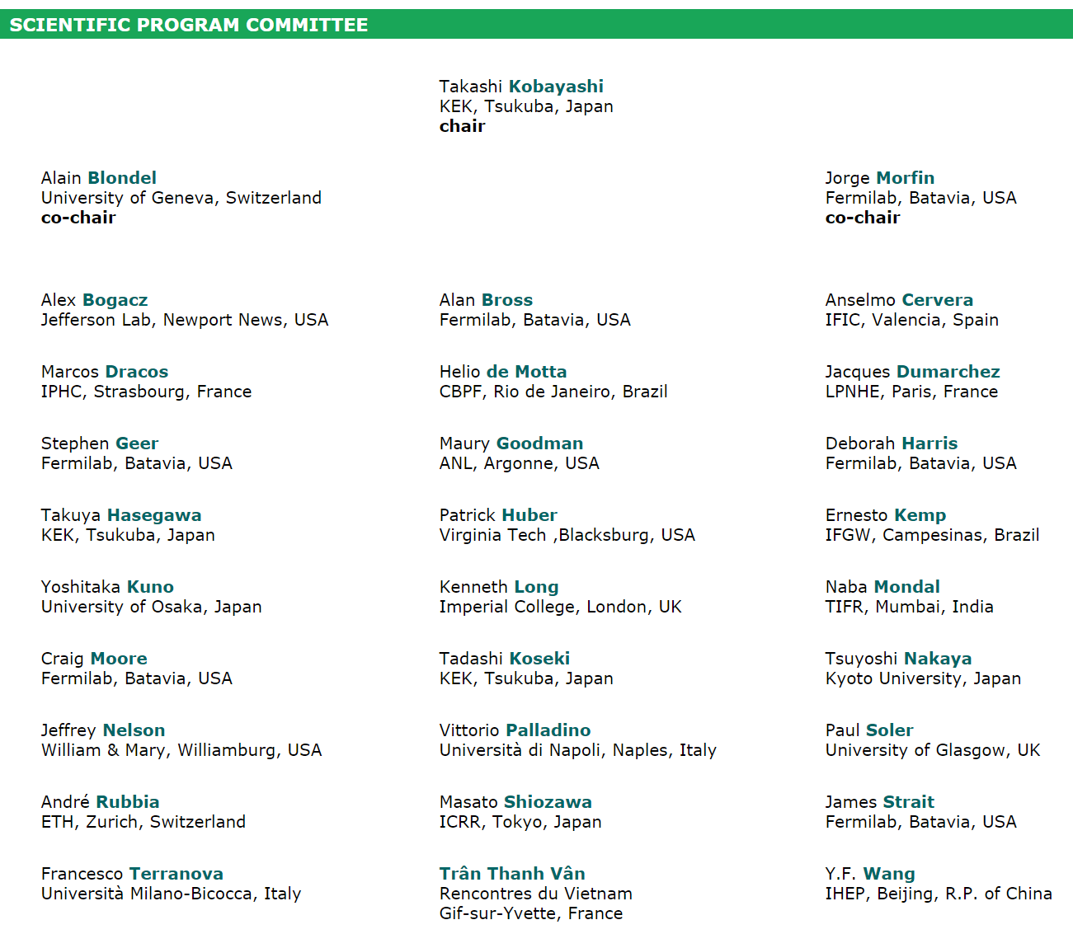
What we are.
(I am afraid I cannot do something)
NU
Need everyone’ help.
Thank you!
NU
ACC
ACC
NU
NU
NU
NU
NU
NU
NU
NU
NU
NU/UHCR
MU
NU
NU
ACC
ACC
NU
NU
NU
NU
NU
NU
NU/ACC
NU
General/LOC
NU

Slide 9
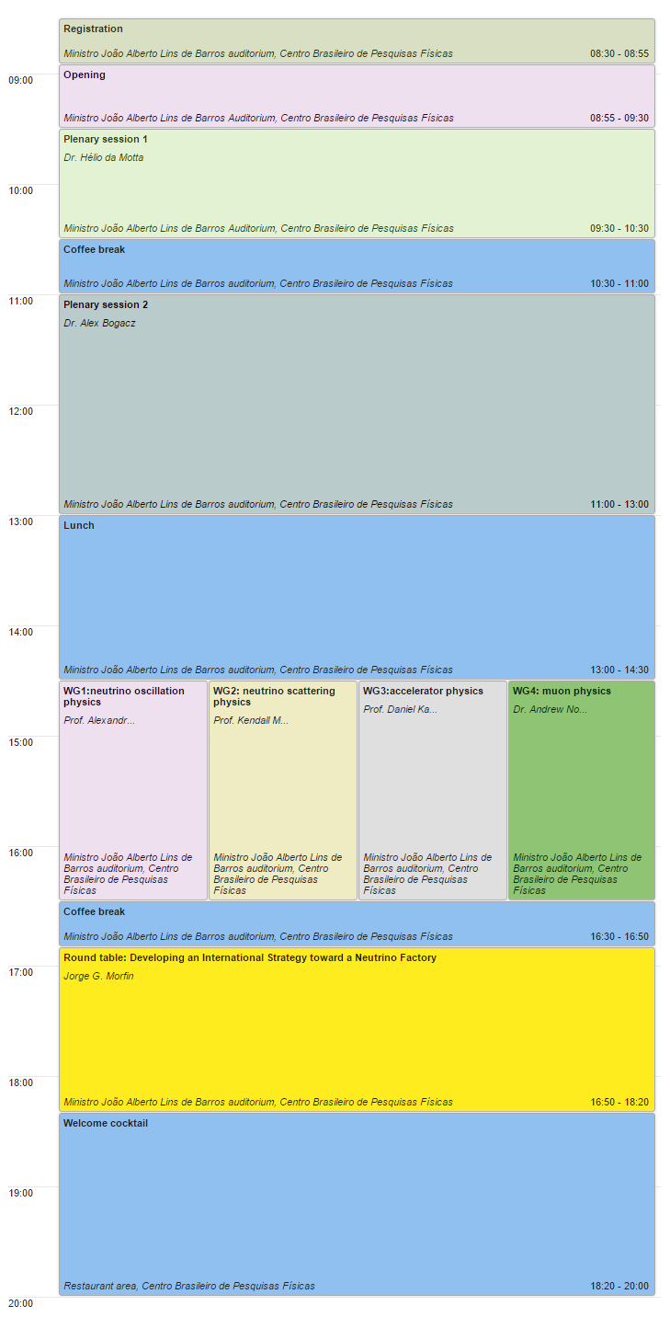
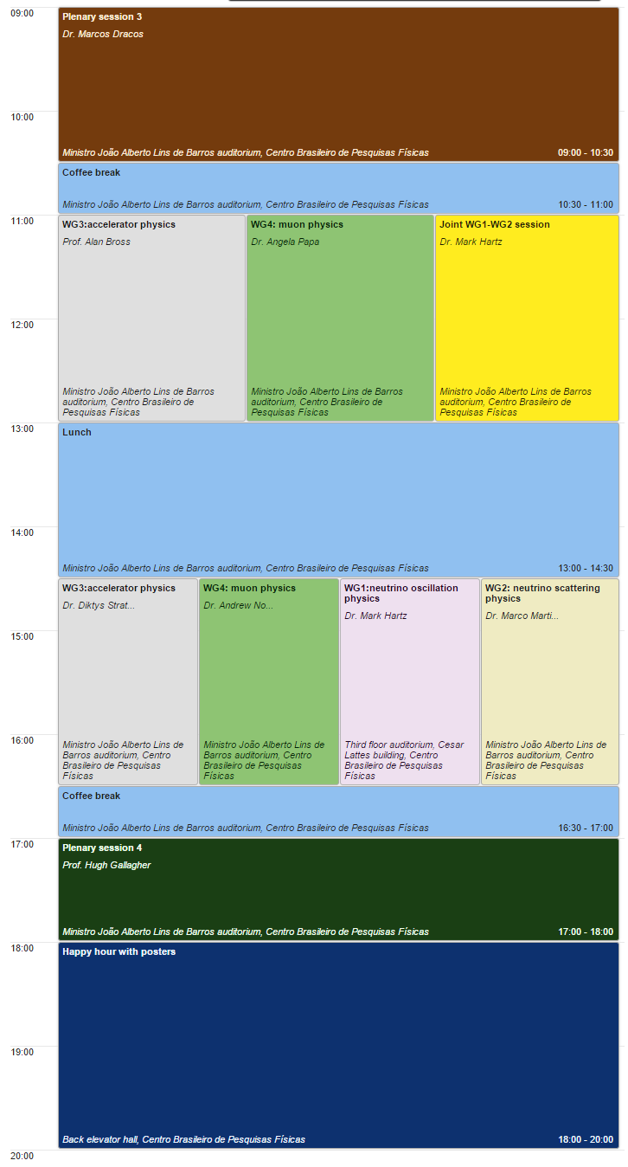

Glo nu fit/MOMENT/MAP/MICE
Each WGs plans
Overview
Theoretical, atm nu, nu int
NOVA/T2K

Slide 10
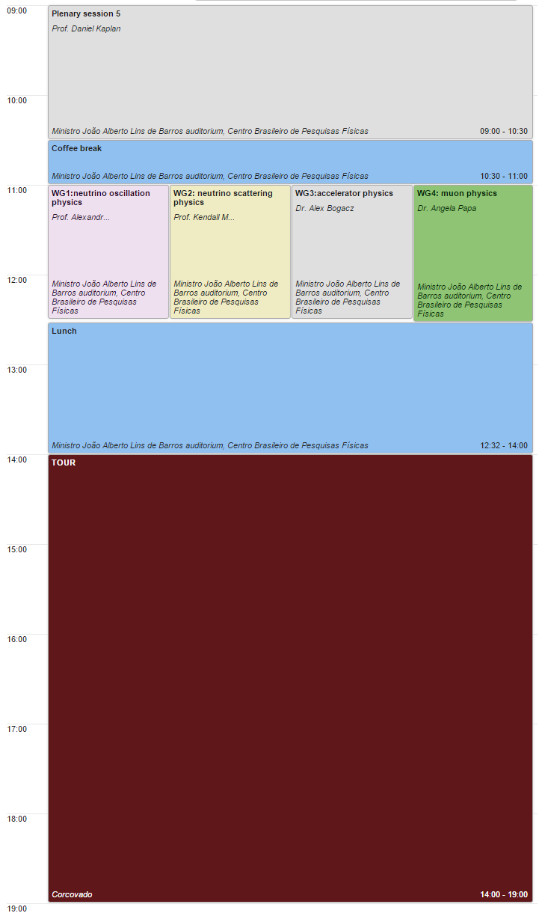
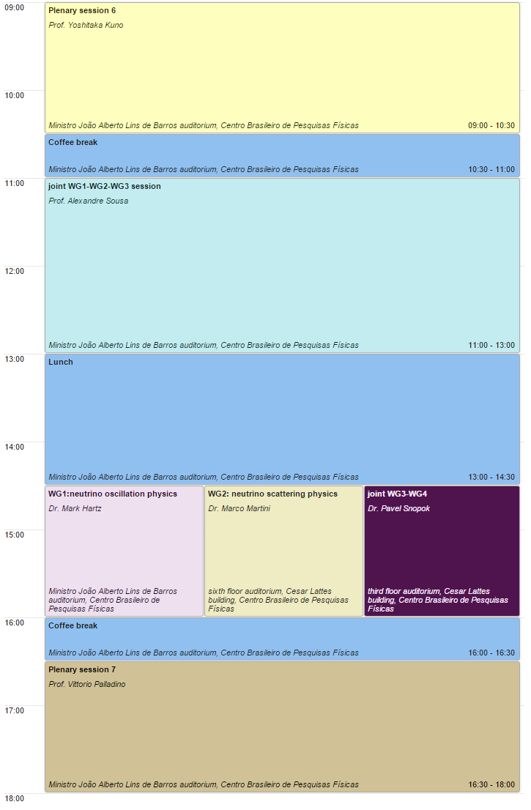
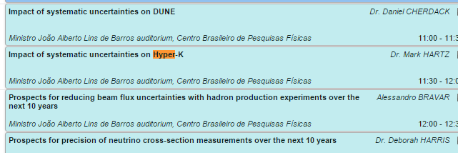
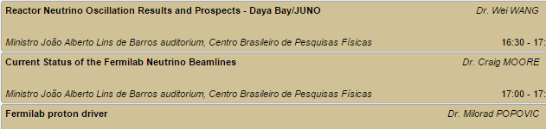
Muon overview (EDM, CLFV, generator
0n2b, theory (g-2/EDM/CLFV/LHC)
Daya Bay/JUNO, LBNF, FNAL p driver

Slide 11
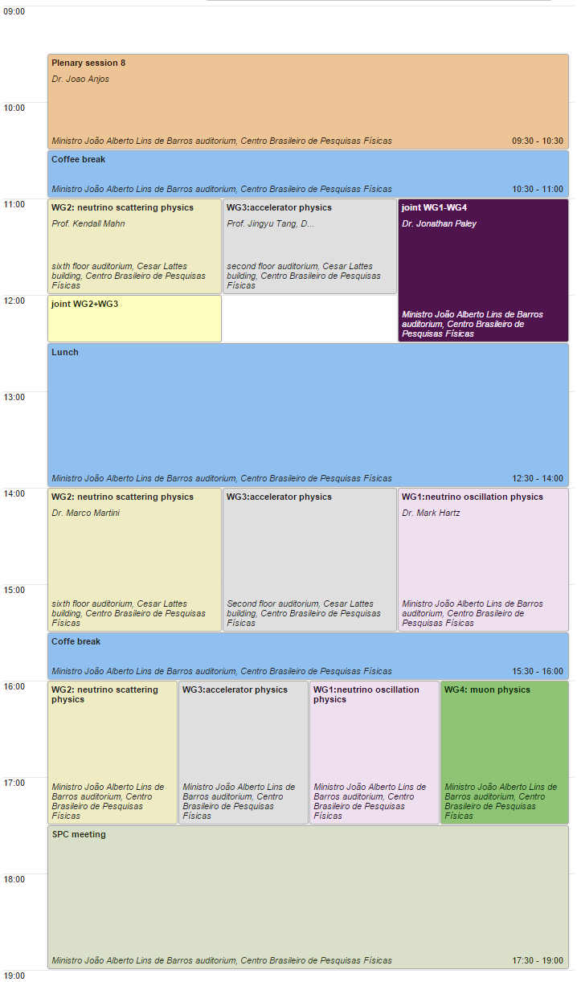
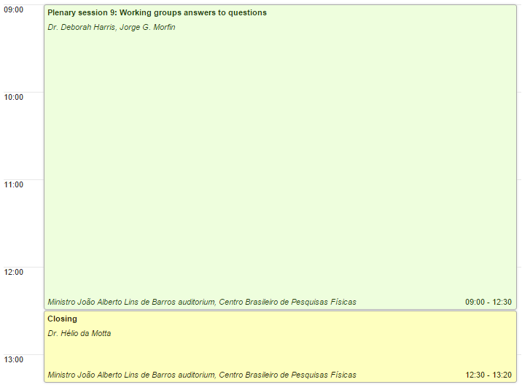

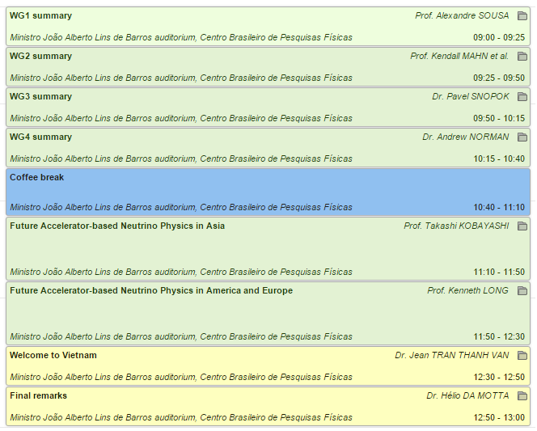

Slide 12
Some comments
Repetition rate?
  Really need every year?
Marge with other similar workshop?
  NBI?
I like to discuss on-site SPC meeting in Vietnam after experiencing all aspects of nufact (and troubles)

