Slide 1
Experimental validation of depth dose curves of a 67.5 MeV proton beam
José Ramos Méndez, PhD.
Department of Radiation Oncology, University of California San Francisco.

Slide 2
Outline
The proton Raw Beam line at Crocker Lab UC Davis.
Experimental setup.
Monte Carlo simulations.
Conclusions.

Slide 3
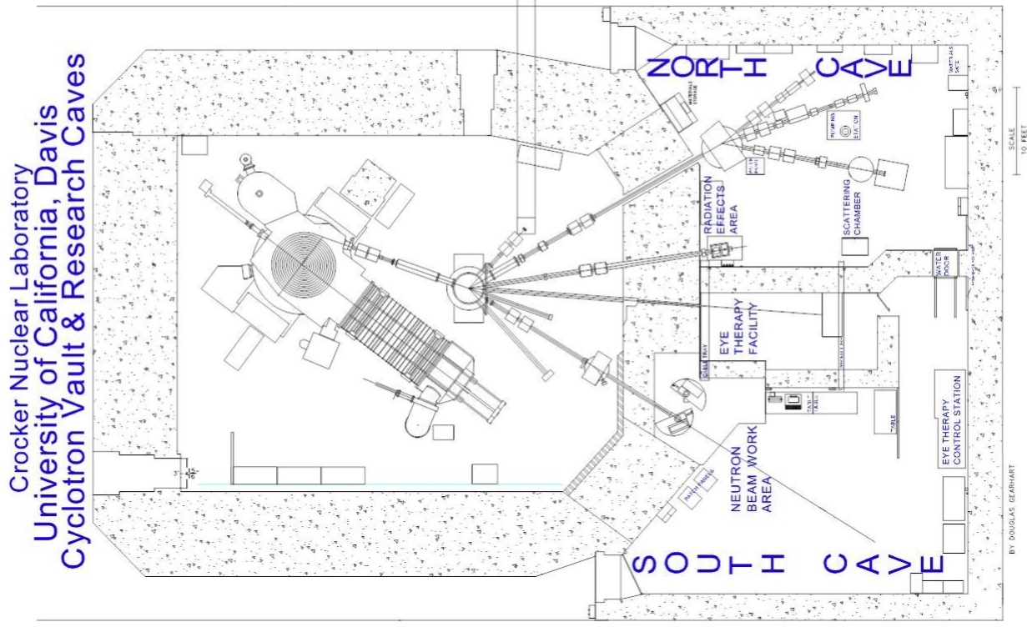
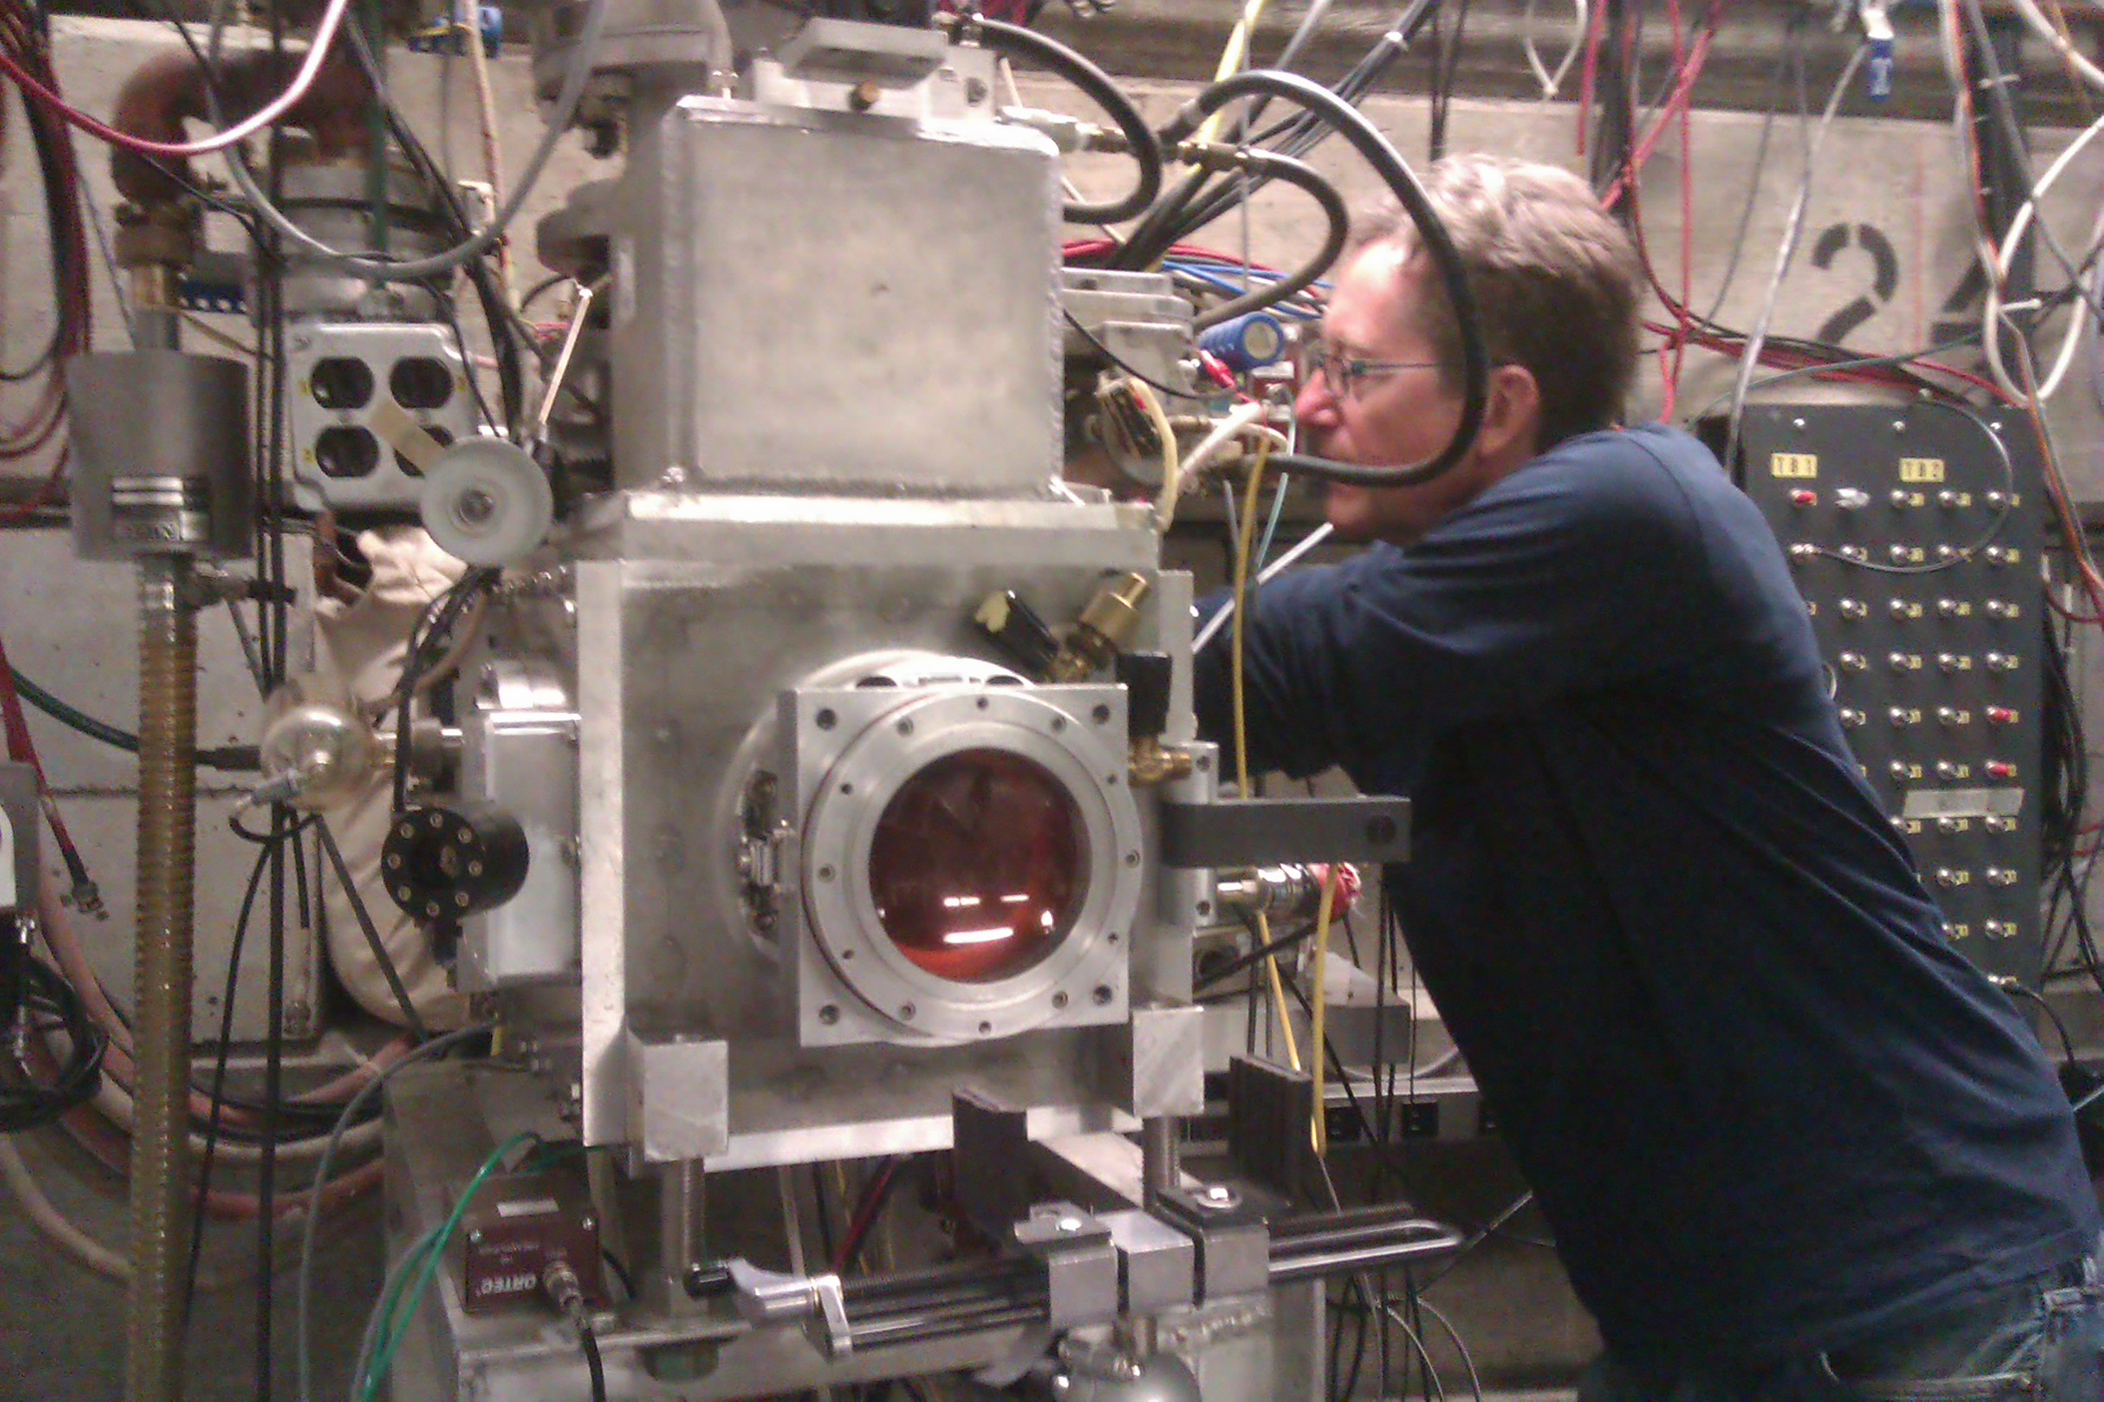
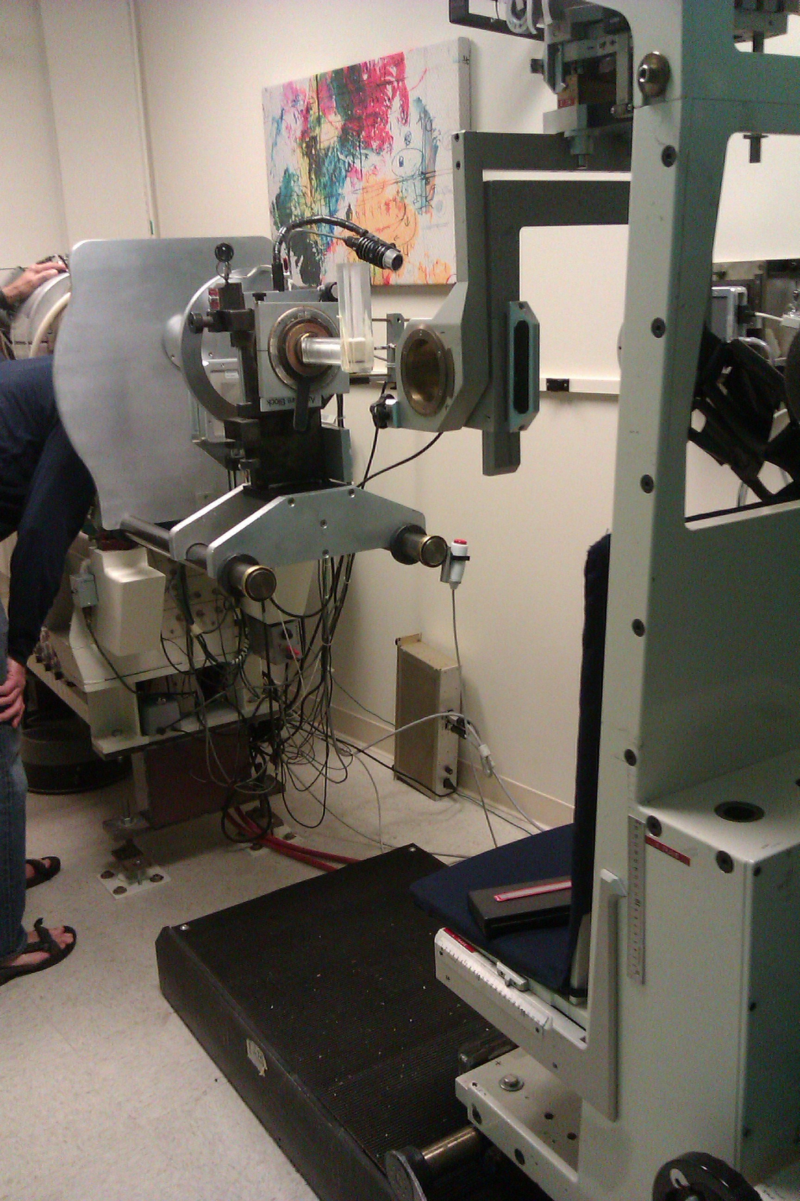
The proton Raw Beam line at Crocker Lab

Slide 4
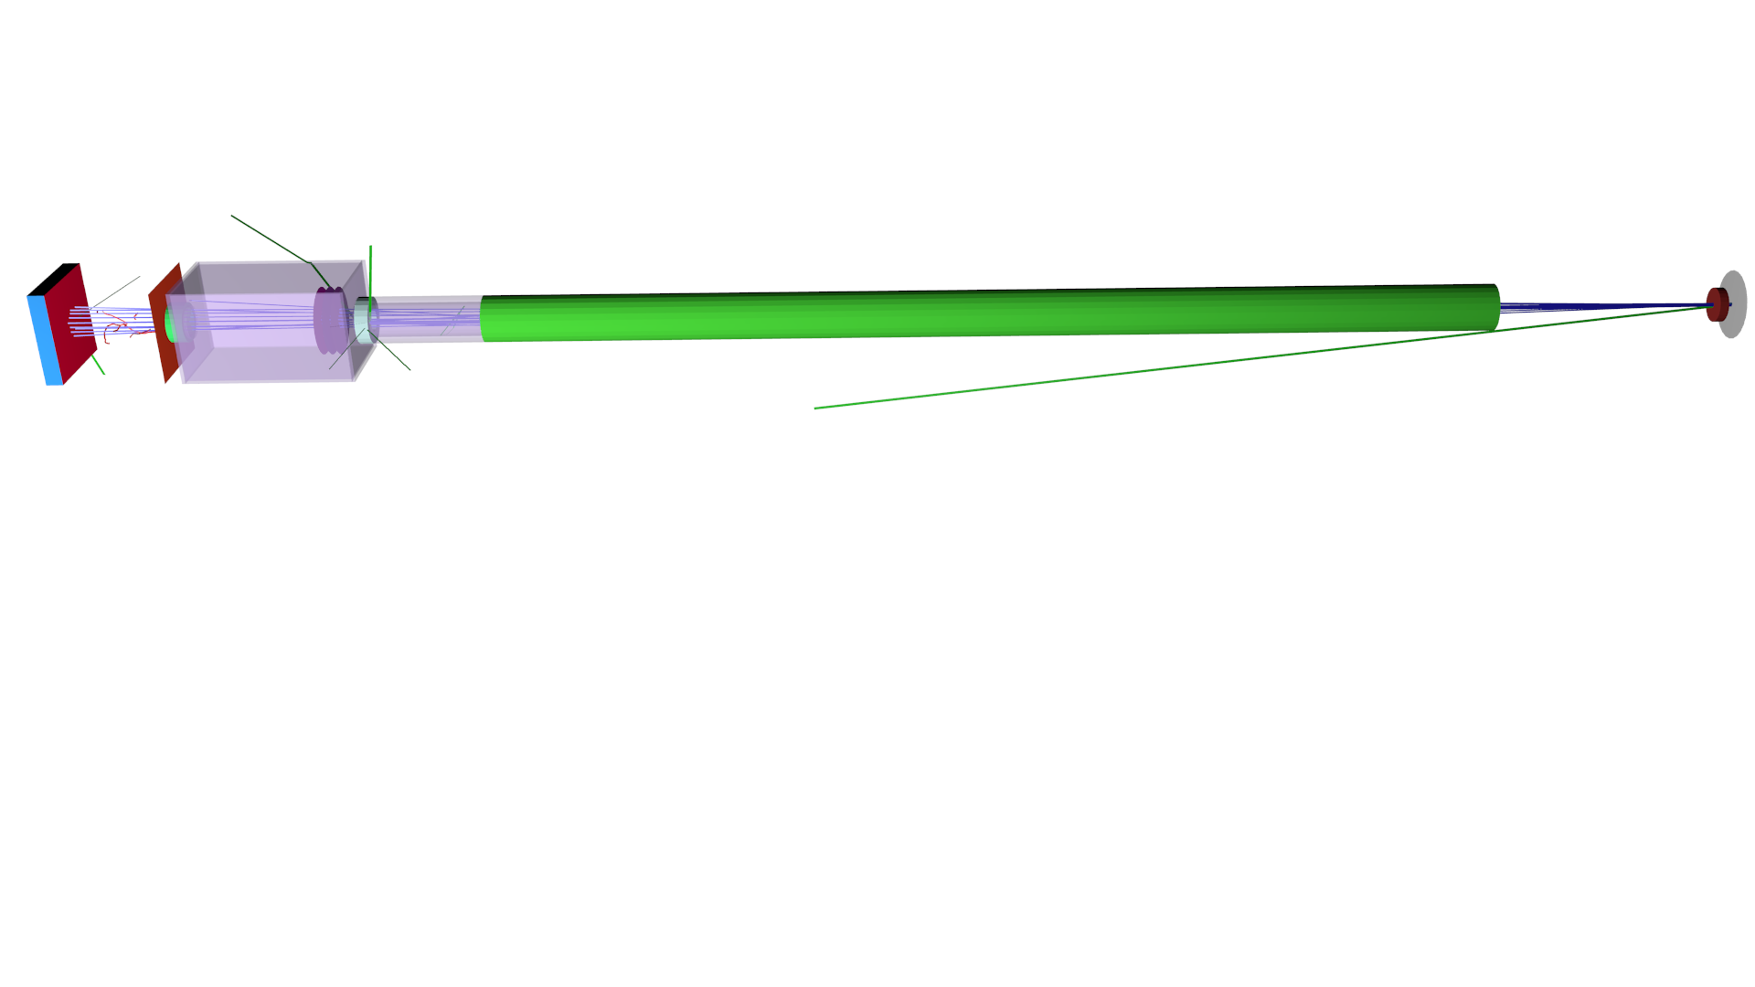
Experimental setup: proton beam and the raw beam line
The energy of the beam exiting the cyclotron was determined to be 67.5±0.1 MeV by using a TOF system.
An upper limit of 0.4 MeV on the FWHM was estimated with a CsI detector.
The Ionization curves curves were measured in a water tank, a 360 mm wide cube with a 0.25 mm thick Mylar (d=1.4g/cm³) wall on upstream side, positioned 300 mm from the exit window.
SEM
Kapton
Ta
Plug
Pipe
Collimator
Collimator
Water
0.0 m
5.0 m
B. Faddegon, J. Shin, C. Castenada, J. Ramos-Méndez and I. Daftari “Experimental depth dose curves of a 67.5 MeV proton beam for benchmarking and validation of Monte Carlo simulation” Med. Phys. 42(7) 4199-4209. (2015)

Slide 5
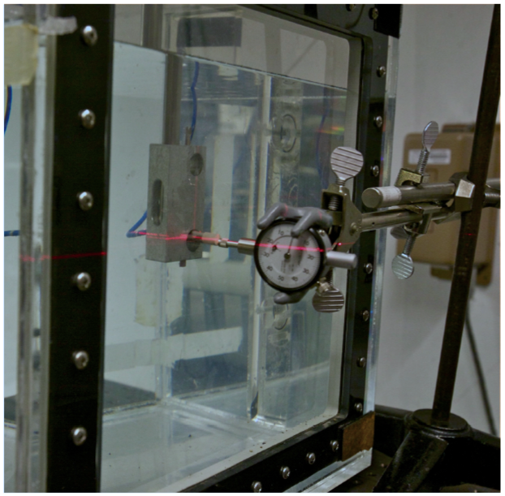
Experimental setup: proton beam and the raw beam line
A diode detector (PTW Dosimetry Diode E Type 60012) attached to a motorized stage was used to measured depth ionization curves with an accuracy of 0.15 mm.
Ionization curves were converted to depth-dose curves using published¹ water-to-silicon 70 MeV stopping power ratios.
Mylar window
PTW and stage
Water
Beam’s direction
Active
Distance gauge with
scale of 0.0254 mm
per scale division
PTW
Mylar
3.5mm
WET=0.71±0.15mm
¹Goma C, Andreo P and Sempau J “Spencer-Attix water/medium stopping power ratios for the dosimetry of proton pencil beams” Phys. Med. Biol. 58(8) 2509-2522 . (2013)

Slide 6
Monte Carlo setup
A Gaussian 67.5 MeV proton beam with 0.4 MeV of sigma.
The beam line source was simulated as a uniform 5 mm x 10 mm oval spot with zero divergence.
The dose was scored in a stack of plates of 0.05 mm thick and 5 mm side with enough histories to achieve 0.5% of statistical precision or better
Dimensions and materials are provide in reference [1]
SEM
Kapton
Ta
Plug
Pipe
Collimator
Collimator
0.0 m
5.0 m
[1] B. Faddegon, J. Shin, C. Castenada, J. Ramos-Méndez and I. Daftari “Experimental depth dose curves of a 67.5 MeV proton beam for benchmarking and validation of Monte Carlo simulation” Med. Phys. 42(7) 4199-4209. (2015)

Slide 7
Physics list for proton therapy applications
As suggested in [1] and lately in [2]
G4EMStandardPhysics_option3 or G4EMStandardPhysics_option4
G4DecayPhysics
G4IonBinaryCascadePhysics
G4HadronElasticPhysicsHP
G4StoppingPhysics
G4RadioactiveDecayPhysics
Production cut for all particles of 0.05 mm
220 DEDX and Lambda bins from 100 eV to 500 MeV
Results from simulations using Geant4.10.1.p02 and Geant4.10.2 are shown.

Slide 8
Effect of the production cut at beam plug

Slide 9
Effect of the production cut at beam plug

Slide 10
Validation with experimental data
G4.v.10.1.p02
G4.v.10.2

Slide 11

Quantification
An analytical expression described in [1], based on the cylindrical function D_{x} was fitted to the experimental and Monte Carlo data to estimate the range and spread of the Bragg curves
Φ₀ represents the primary fluence, R₀ (in cm) is the range at the distal 80% of the Bragg peak, σ (in cm) is the standard deviation of a Gaussian range spectrum that includes range strangling, and ε is the fraction of primary fluence contributing to the “tail” of the energy spectum
[1] Bortfeld Thomas “An analytical approximation of the Bragg curve for therapeutic proton beams” Med. Phys. 24(12) 2024-2033. (1997)

Slide 12
Quantification
Thin foil | Φ₀ | R₀ (mm) | σ(mm) | ε
v.10.1-Opt3 | 2.034 ± 0.001 | 37.025 ± 0.001 | 0.467 ± 0.001 | -0.028 ± 0.000
v.10.1-Opt4 | 2.057 ± 0.001 | 37.023 ± 0.001 | 0.470 ± 0.001 | -0.036 ± 0.000
v.10.2-Opt3 | 2.015 ± 0.001 | 37.024 ± 0.001 | 0.480 ± 0.001 | -0.024 ± 0.000
v.10.2-Opt4 | 2.091 ± 0.001 | 37.010 ± 0.001 | 0.486 ± 0.001 | -0.020 ± 0.000
Thin foil | Φ₀ | R₀ (mm) | σ(mm) | ε
v.10.1-Opt3 | 2.541 ± 0.005 | 34.729 ± 0.002 | 0.473 ± 0.001 | 0.023 ± 0.001
v.10.1-Opt4 | 2.614 ± 0.004 | 34.726 ± 0.002 | 0.477 ± 0.001 | 0.008 ± 0.001
v.10.2-Opt3 | 2.393 ± 0.004 | 34.718 ± 0.002 | 0.484 ± 0.001 | 0.020 ± 0.001
v.10.2-Opt4 | 2.609 ± 0.004 | 34.714 ± 0.002 | 0.481 ± 0.001 | 0.011 ± 0.001

Slide 13
Quantification
I=78 eV
Thin foil | ΔR₀ (mm) | Δσ(mm) | ΔPeak-to-plateau
v.10.1.p02 – Opt3 | 0.230 ± 0.151 | 0.002 ± 0.012 | -0.04 ± 0.18
v.10.1.p02 – Opt4 | 0.231 ± 0.151 | -0.000 ± 0.012 | -0.02 ± 0.18
v.10.2 – Opt3 | 0.231 ± 0.151 | -0.011 ± 0.012 | -0.05 ± 0.18
v.10.2 – Opt4 | 0.245 ± 0.151 | -0.015 ± 0.012 | 0.13 ± 0.18
Thick foil | ΔR₀ (mm) | Δσ(mm | ΔPeak-to-plateau
v.10.1.p02 – Opt3 | 0.273 ± 0.156 | 0.027 ± 0.006 | 0.27 ± 0.14
v.10.1.p02 – Opt4 | 0.275 ± 0.156 | 0.026 ± 0.006 | 0.27 ± 0.14
v.10.2 – Opt3 | 0.280 ± 0.156 | 0.022 ± 0.006 | 0.04 ± 0.14
v.10.2 – Opt4 | 0.289 ± 0.156 | 0.021 ± 0.006 | 0.28 ± 0.14

Slide 14
Conclusions
Benchmark Bragg curves were measured and compared with Monte Carlo simulations for a 67.6±0.1 MeV proton beam incident on Ta with 0.15 mm accuracy.
The production cut value plays an important role and could lead to nonphysical undulations at the plateau region.
The I-value of 78 eV proved sufficient for calculating the depth penetration, and thus the stopping powers used in the Monte Carlo simulations within 0.8% for both version of Geant4.
Given a 3 eV increase in the I-value results results in 0.6% [1] decrease in stopping power of protons in water, suggesting an I-value of 80-83 eV. Published I-values for water vary with recently used values ranging from 73 to 82 eV, see e.g. [2]
[1] C. Goma, et. Al “Spencer-Attix water/medium stopping power ratios for the dosimetry of proton pencil beams,” Phys. Med. Biol. 58, 2509-2522, (2013)
[2] Paganetti “Range uncertainties in proton therapy and the role of Monte Carlo simulations” Phys. Med. Biol. 57, R99-R117 (2012)

Slide 15
Conclusion: The I-value
I=83 eV
Thin foil | ΔR₀ (mm) | Δσ(mm) | Δ Peak-to-plateau
v.10.1.p02 – Opt3 | -0.067 ± 0.150 | -0.004 ± 0.012 | -0.04 ± 0.18
v.10.1.p02 – Opt4 | -0.066 ± 0.150 | -0.006 ± 0.012 | -0.03 ± 0.18
v.10.2 – Opt3 | -0.064 ± 0.150 | -0.005 ± 0.012 | -0.10 ± 0.18
v.10.2 – Opt4 | -0.051 ± 0.150 | -0.021 ± 0.012 | 0.17 ± 0.18
Thick foil | ΔR₀ (mm) | Δσ(mm) | Δ Peak-to-plateau
v.10.1.p02 – Opt3 | -0.001 ± 0.150 | 0.016 ± 0.006 | 0.27 ± 0.14
v.10.1.p02 – Opt4 | -0.004 ± 0.150 | 0.022 ± 0.006 | 0.28 ± 0.14
v.10.2 – Opt3 | -0.001 ± 0.150 | 0.021 ± 0.006 | 0.08 ± 0.14
v.10.2 – Opt4 | 0.014 ± 0.150 | 0.017 ± 0.006 | 0.28 ± 0.14

