Slide 1
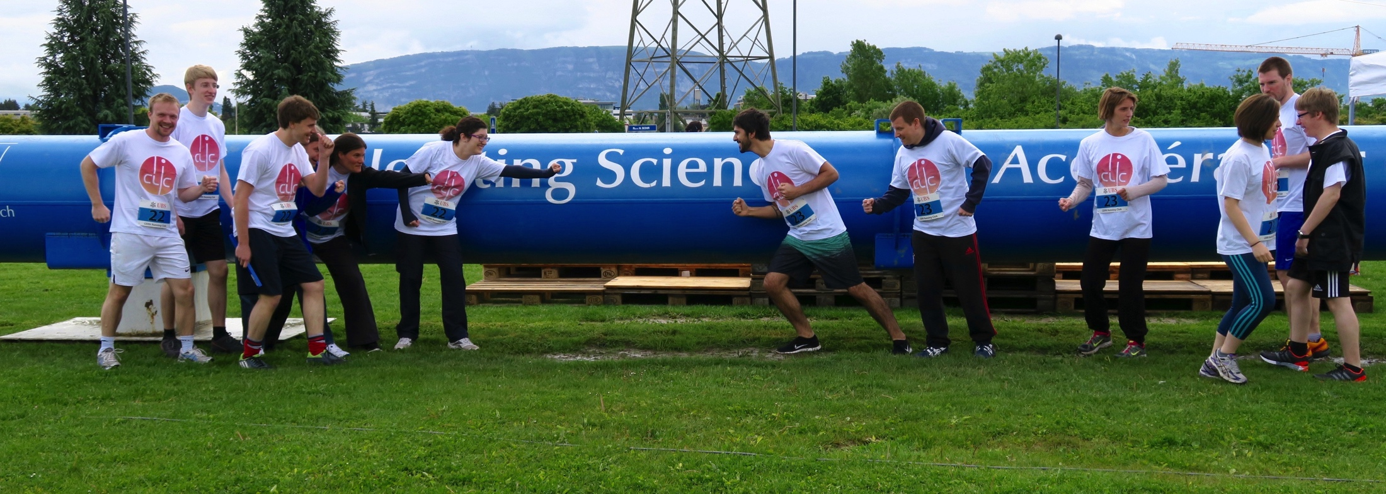
CLICdp welcome and news
Lucie Linssen, CERN
CLICdp meeting, August 30 2016

Slide 2
this CLICdp meeting
CLICdp 2-day meeting:
67 registrants (56 in 2015, 44 in 2014, 47 in 2013)
38 presentations (all plenary)
Topical sessions and conveners:
Physics and Analysis (Victoria Martin, Rosa Simoniello, James Wells)
Detector Optimization (Konrad Elsener, Frank Simon)
Software (Aidan Robson, Andre Sailer, Huong Lan Tran)
Vertex / Tracker R&D (Mathieu Benoit, Daniel Hynds, Andreas Nurnberg)
FCAL / ECAL / HCAL R&D (Yan Benhammou, Naomi van der Kolk, Eva Sicking)
Presentations on possible tasks/activities to be taken up by the collaboration
See next 2 talks by Andreas Nürnberg and Philipp Roloff
For further discussion in this room and at the IB meeting

Slide 3
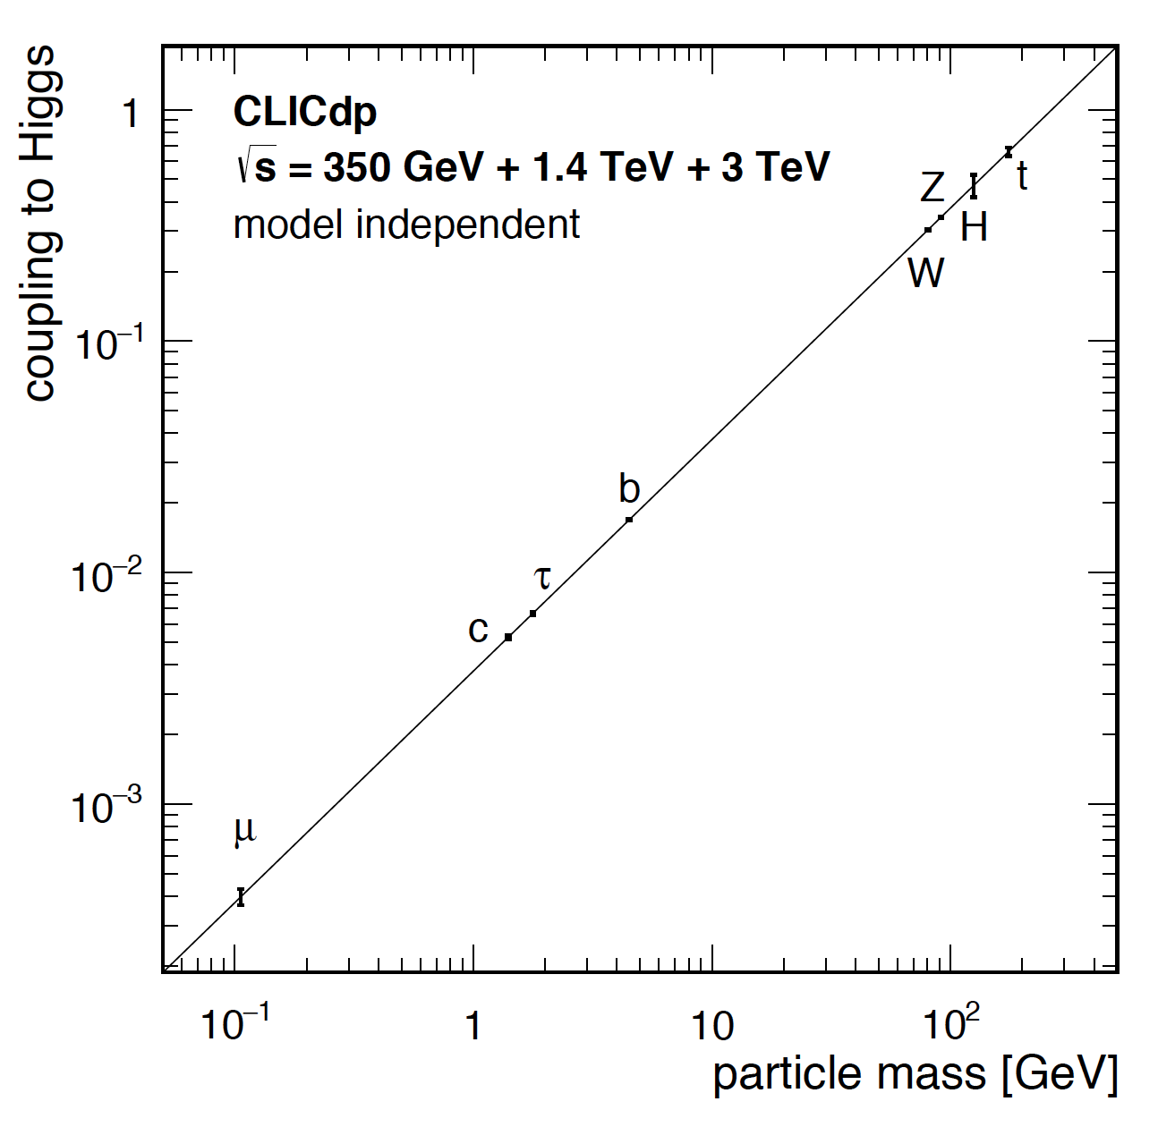

Published collaboration-wide documents
Higgs Physics at the CLIC Electron-Positron Linear Collider
40 pages, 123 authors
CLICdp collaboration paper
>25 independent full simulation Higgs analyses !
  CLICdp-Pub-2016-001 and submitted to EPJC yesterday
  arXiv:1608.07538 on 29/8/2016
Updated Baseline for a Staged Compact Linear Collider
57 pages, 517 authors, 63 institutes
CLIC and CLICdp collaboration paper
  Published as a CERN yellow report CERN-2016-004
arXiv:1608.07537, on 29/8/2016
Congratulations to all of you who contributed !
Please use plots and figures from these official publications !

Slide 4
CLICdp documents in preparation for next European Strategy
CLICdp reports serving as ingredients for a CLIC summary report:
Updated Baseline for a Staged Compact Linear Collider (380 GeV, 1.5 TeV, 3 TeV) ✔
  arXiv:1608.07537, CERN-2016-004
  Higgs Physics at the CLIC Electron-Positron Linear Collider ✔
  arXiv:1608.07538, CLICdp-Pub-2016-001 and submitted to EPJC yesterday
The new optimised CLIC detector model CLICdet ✔
  CLICdp note in preparation https://edms.cern.ch/document/1572676/
An overview of CLIC top physics
  CLIC top physics publication in 2017
Extended BSM studies (hopefully also motivated by LHC discoveries)
  CLIC BSM publication by 2017/2018.
CLIC R&D report => with main CLIC technology demonstrators
  Summary publication(s) in 2017+2018
Plan for the period ~2019-2025 in case CLIC would be supported by next strategy
  2017/2018, note to be included in CLIC summary report for the Strategy

Slide 5
Upcoming CLIC/LC events
2016
CALICE collaboration meeting, September 14-16, Arlington
http://www.uta.edu/physics/meetings/hep/calice/
FCAL workshop, September 16-20, Tel Aviv
http://alzt.tau.ac.il/~fcal/2016/index.html
Linear Collider workshop LCWS16, December 5-9, Morioka
http://lcws2016.sgk.iwate-u.ac.jp/
2017
CLIC workshop 2017, March 6-10 2017, CERN
Proposed scheme for CLICdp => same as in 2016
Tuesday afternoon 7/3 to Friday 10/3 at noon
Linear Collider top workshop 2017, June 7-9 2017, CERN
Please note in your agendas !

Slide 6
Dinner and workshop photo
Workshop photo
Afternoon coffee break, today 15:30 hrs => terrace of Restaurant #1
CLICdp dinner
Tonight at Restaurant le Bois Joly, Crozet, France
Bus leaves at 19 hrs, outside the CERN reception building #33
Contribution of 45 Euro => payment to Kate Ross in cash, thanks!
Look at the back-up slide to remember which dinner option you took

Slide 7
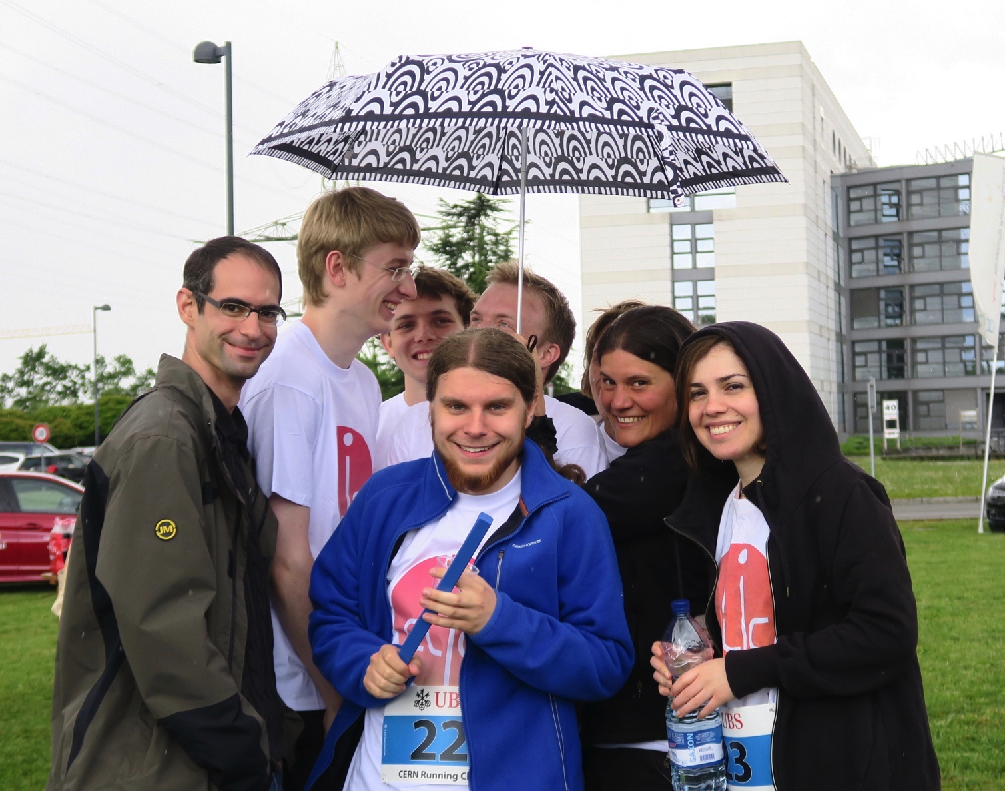
Any questions?
Have a nice meeting !

Slide 8
Backup slides

Slide 9
Our dinner choices
Bois Joly
30/8/2016

