Slide 1
Fundamental Power Couplers (FPC)
04 February 2016
Eric Montesinos

Slide 2
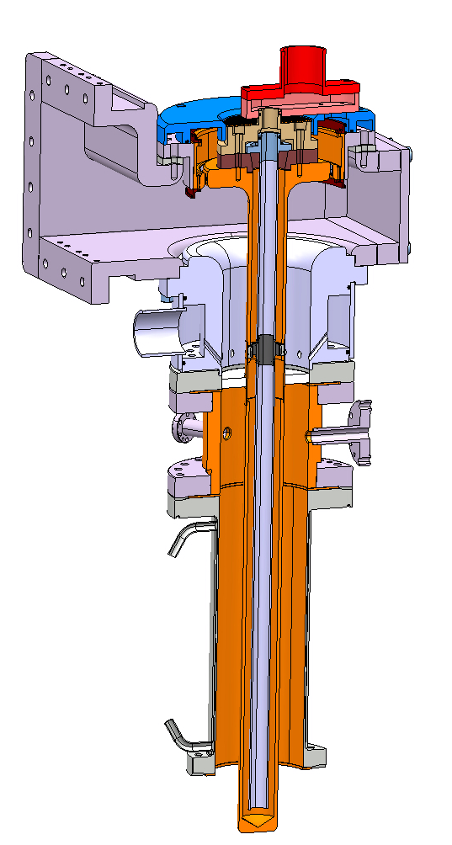
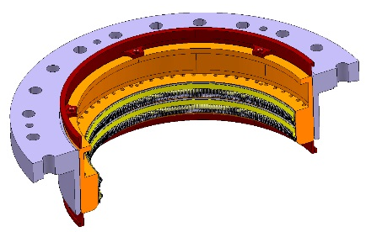
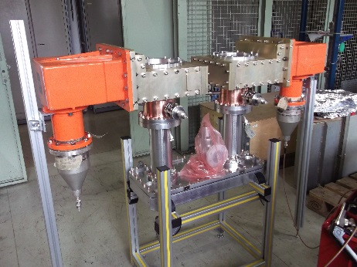
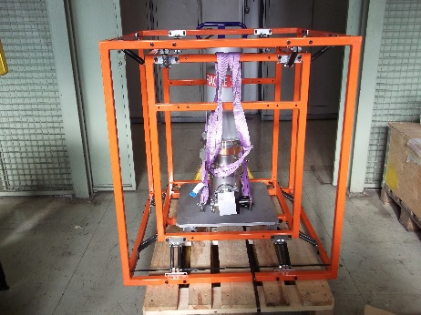
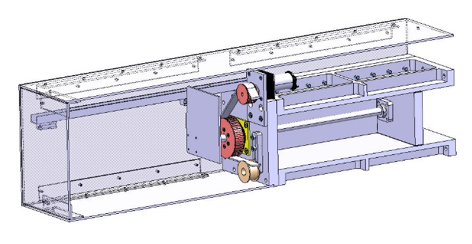
SRF-HG-WP1: Power Couplers for High Gradient Cavities
SPL coaxial disk window FPC
HV capacitor for DC polarisation
Project/Study/Program – work package | High-Gradient - Power Couplers for High-Gradient Cavities
CERN work package leader/linkperson | Eric Montesinos (BE-RF)
Construct 4 FPC operating at 704 MHz for a 4-cavity cryomodule suitable for a RF high-power test of up to 4 cavities in parallel at 2K
Test box
Tasks | Main Deliverables | Deadline
Task 4 | 4 FPC ready for clean room | End 2016
Task 6 | 4 FPC onto cryomodule | Mid-2017
Manpower/Budget * |  | 2016 | 2017 | 2018 | 2019 | 2020
Budget [kCHF]
 | Requested | 150 | 100
Manpower [FTE]
 | Engineer (ENG) | 0.2 | 0.2
 | Technician (TEC) | 0.25 | 0.25
 | FSU (FSU) | 0.5 | 0.5
Transport frame
Variable WR1150 short-circuit

Slide 3
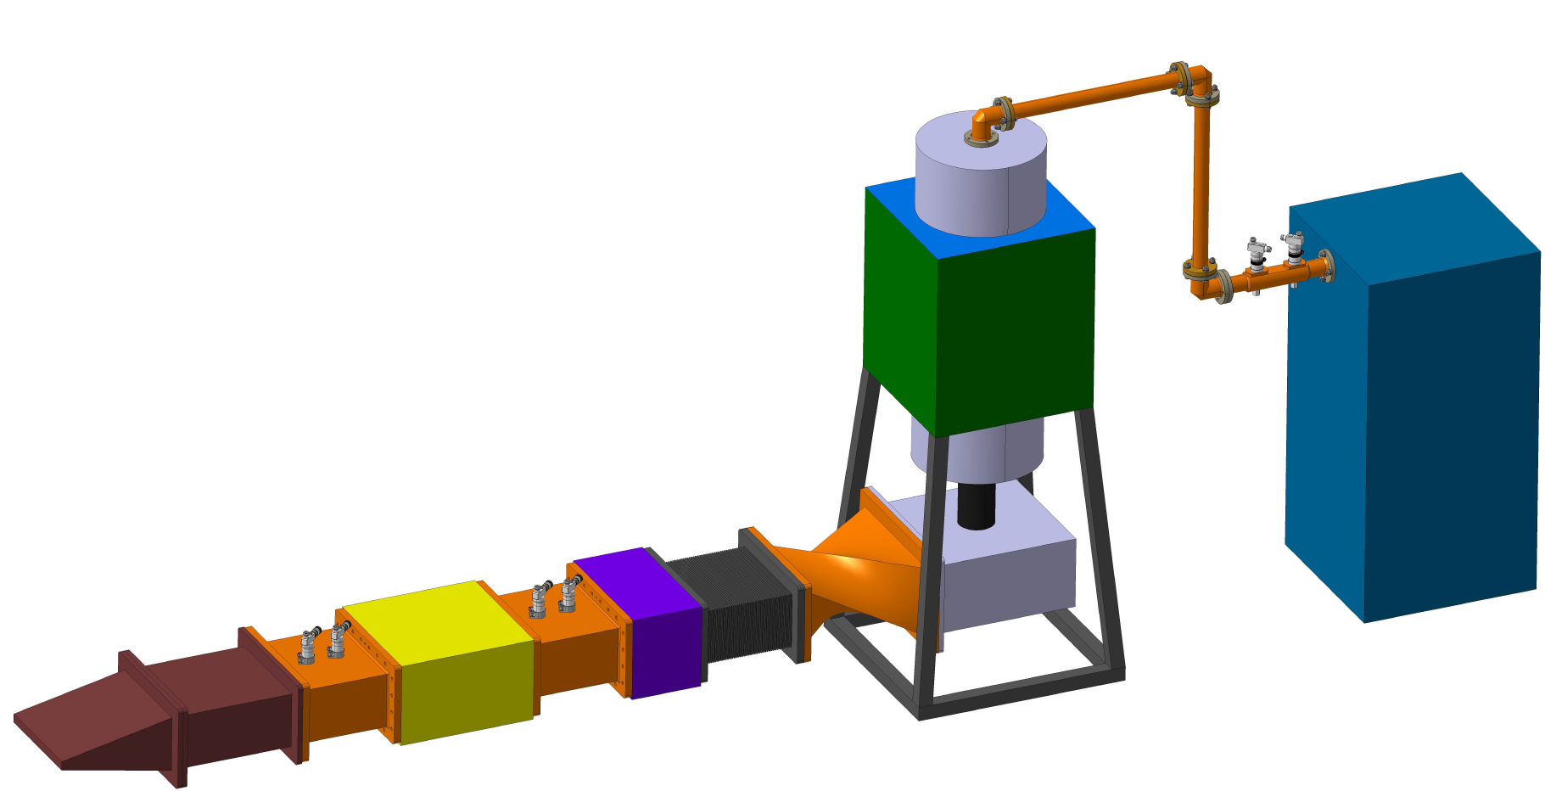
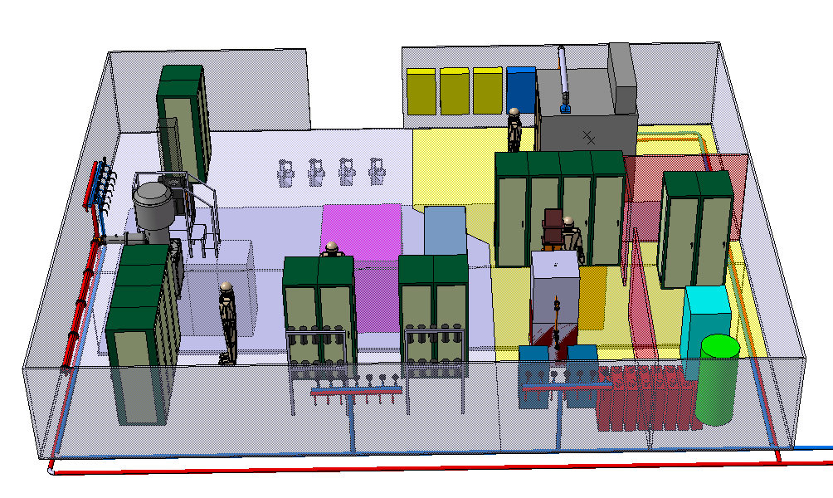
SRF-HG-WP8: High Power IOTs
Project/Study/Program – work package | High-Gradient – High-Power IOTs
CERN work package leader/linkperson | Eric Montesinos (BE-RF)
External Linkperson (if applicable) | Mats Lindroos, Morten Jensen
Collaboration Contract (if applicable) | K1577/AB, Addendum 19,20
Collaboration Institute (if applicable) | ESS
Construct a test bench to allow qualification of a MB-IOT. The test bench will be compatible with L3 Communications MB-IOT and with Thales/CPI MB-IOT.
Tasks | Main Deliverables | Deadline
Task 1 | Mechanical drawings, electrical schematics (all orders already placed) | May 2016
Task 2 | Wire test | July 2016
Task 3 | FAT report | Ocotber 2016
Task 4 | SAT report | June 2017
Task 5 | Wire test | August 2017
Task 6 | FAT report | October 2017
Task 7 | SAT report | June 2018
Manpower/Budget |  | 2016 | 2017 | 2018 | 2019 | 2020
Budget [kCHF]
 | Requested | 600 | 100 | 80
Manpower [FTE]
 | Engineer (ENG) | 0.5 | 0.2 | 0.2
 | Technician (TEC) | 0.2 | 0.1 | 0.1
 | Fell/PJAS (FEL) | 1 | 1 | 0.5
 | FSU (FSU) | 2 | 0.5 | 0.1
* Budget = 300 (SPL) + 300 (FCC) + 180 (Thales)

Slide 4














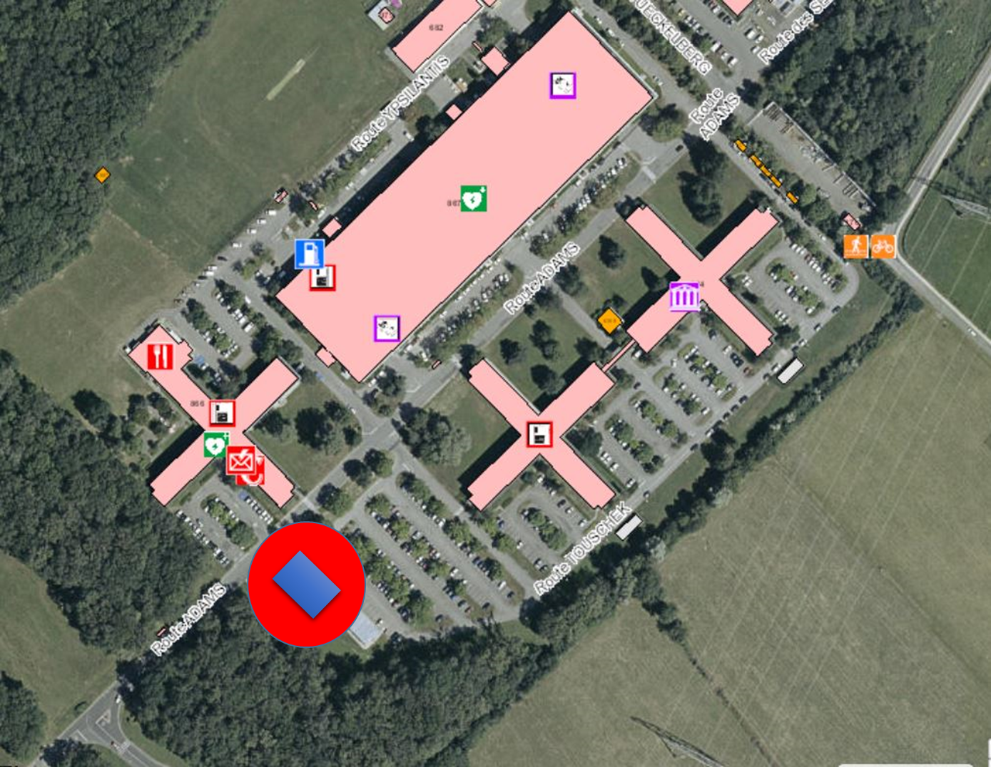
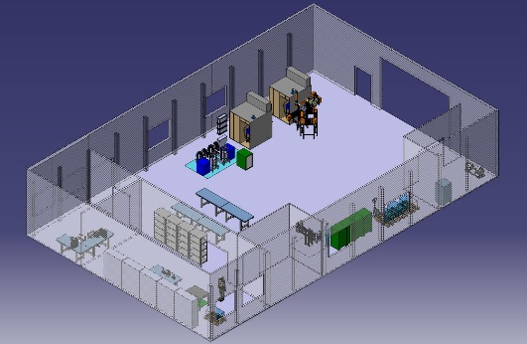






(SRF-)FPC-WP: FPC for SRF and NC
FPC at CERN | MHz | kW | NC | SRF
SPS800 | 800 | 150 | X
SPS200 | 200 | 500 | X
LHC | 400 | 500 |  | X
ESRF | 352 | 300 | X
SOLEIL | 352 | 300 |  | X
APS | 352 | 300 | X
SPL disk | 704 | 1000 |  | X
SPL cylindrical | 704 | 1000 |  | X
Linac 4 | 352 | 750 | X
Hie-Isolde | 101 | 0.1 |  | X
Crab SPS | 400 | 50 |  | X
SPL 3.0 | 704 | 2000 |  | X
ILC | 1300 | 1000 |  | X
RFQ medical | 750 | 100 | X
WWFPC meeting #1 - 2015
Project/Study/Program – work package | FPC
CERN work package leader/linkperson | Eric Montesinos (BE-RF)
External Linkperson (if applicable) | WWFPC list
Collaboration Institute (if applicable) | WWFPC team
Design, construction, tests of various FPC (NC and SRF). R&D for FPC and associated devices.
Topics (non exhaustive list)
Ceramic material
Brazing (active brazing, metallisation, size of ceramic, …)
Coating (TiOx, TiNx, low SEY, no coating, …)
Cryomodule integration
Cleanliness specific, how to design, how to clean and up to what requirements
Assembly in clean room, specific tooling
Test boxes
Resonant ring(s): single 100 kW source for 1 MW (1 ring) to 10 MW (2 rings)
RF power source(s) from 100 MHz to 1.5 GHz
Conditioning processes
Transportation
FPC
new building
FPC to come | MHz | kW | NC | SRF
LIU 200 | 200 | 1000 | X
LIU 800 | 800 | 250 | X
LHC 2.0 | 400 | 2000 |  | X
Crab LHC | 400 | 100 |  | X
LHC/FCC | 200 | 500 |  | X
LHC/FCC | 400 | 400 |  | X
LHC/FCC | 800 | 300 |  | X
Manpower/Budget |  | 2016 | 2017 | 2018 | 2019 | 2020
Budget [kCHF]
 | Building | 150 | 1250
 | RF power |  | 350 | 350
 | FPC R&D | 100 | 100 | 100 | 100 | 100
Manpower [FTE] (BE + EN + TE)
 | Engineer (ENG) | 1 | 1 | 1 | 1 | 1
 | Technician (TEC) | 1 | 1 | 1 | 1 | 1
 | Fell/PJAS (FEL) | 1 | 1 | 1 | 1 | 1
 | FSU (FSU) | 1 | 1 | 1 | 1 | 1
16 m x 25 m
SRF
SPL
LHC

