Slide 1

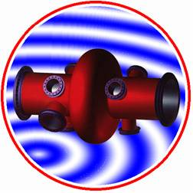
LHC ACS OPERATION
P. Maesen

Slide 2
LHC ACS Presentation
He tank
Main Coupler Penning gauge
Cavity B
Cryostat

Slide 3
- What means LHC ACS OPERATION ?
  Following hardware commissioning for technical stops.
  Restarting after technical stops
  Following LHC physics with OP
  Close cooperation with Cryo operation
  Taking care of Vacuum
  Organising maintenance
  Manpower

Slide 4
- Following hardware commissioning for technical stops.
Weekly meeting with EN/MEF-LPC team
Organise TSs with all the other groups concerned
Struggle to obtain all the condition for conditioning etc.
Protect manpower from incident and prevent material from degradation
Distribute information to the RF colleagues.
Creating IMPACTs for accesses

Slide 5
- Restarting after technical stops.
Cooling down starting from warm modules.
Patrol and close LHC PT4 zone 8 for RF tests
Restart RF power with Klystrons DC : 60 kV/9A
Check main interlocks and software consistency
Start careful conditioning up to 2MV/cav and up to 250 kW CW
Give hands to RF/FB once ready for operation

Slide 6
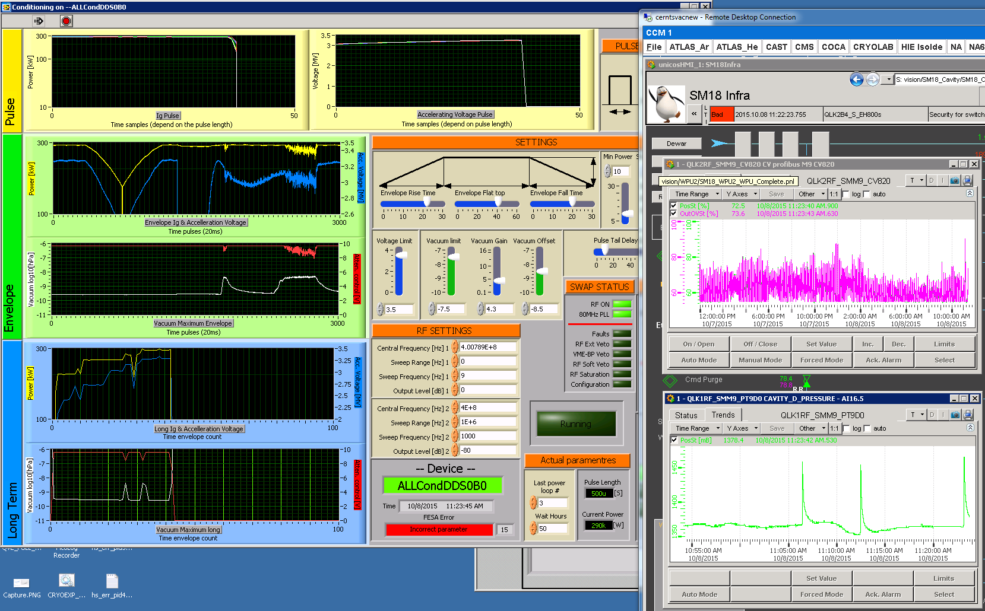
Quench followed by cavity detuning
Small quenches with He pressure peaks during high field and power pulsed conditioning

Slide 7
- Following LHC physics with OP.
CCC morning meeting with OP
Being aware of the last events
Analysing future needs being compatible with the equipment characteristic
Helping new operators
Participating in the LHC power piquet role
Following up beam and energy increase with MPP

Slide 8
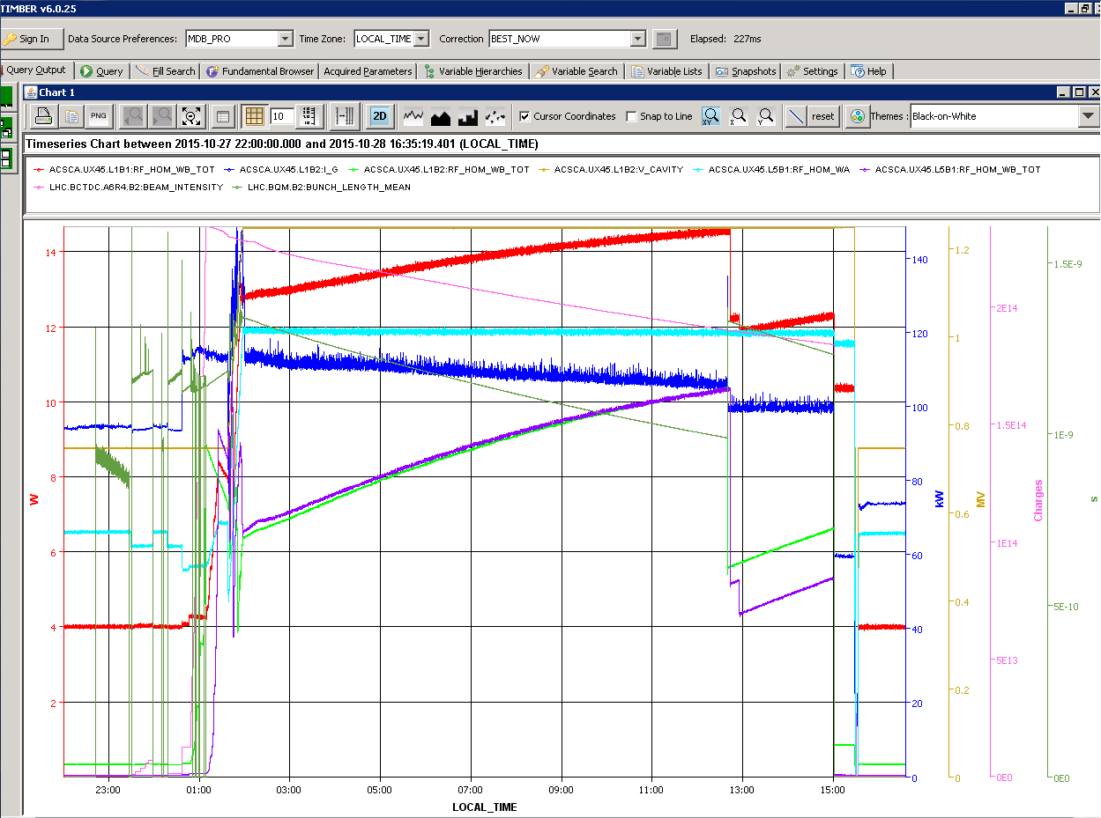
Power in HOMs with higher intensity and shorter bunches in 2015

Slide 9
- Close cooperation with Cryo operation
Cryo modules fed in // with magnets
LHC ACS are the weakest equipment connected to the Cryo lines
Delicate cool down from 300 kelvin with distribution lines liquid at 4.5 k
Helping new Cryo operators
Participating in upgrades, R2E mitigation etc.
Dealing with 3 safety valves He release /year
Following up Beam and energy increase

Slide 10
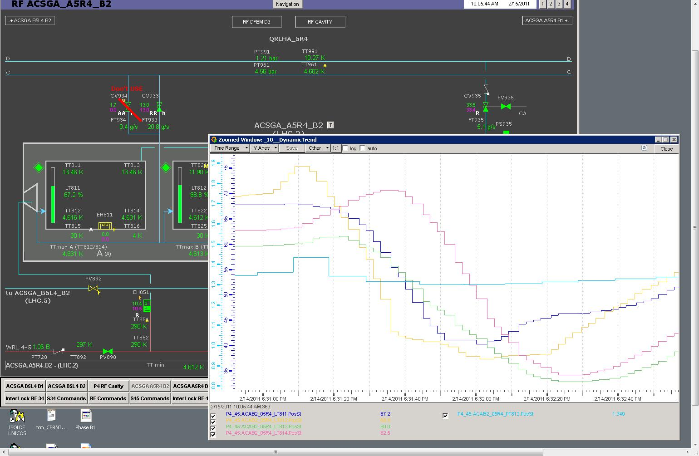
ACS M1.B2 level gauges during C3.B2 quench

Slide 11
- Taking care of Vacuum
Most delicate status of the Cryo-modules
LHC ACS are very sensible to dust
Trying to educate VSC people to our risks
Following up correct pumping during warm up
Tracking possible start of leak
Following up beam increase load and scrubbing

Slide 12
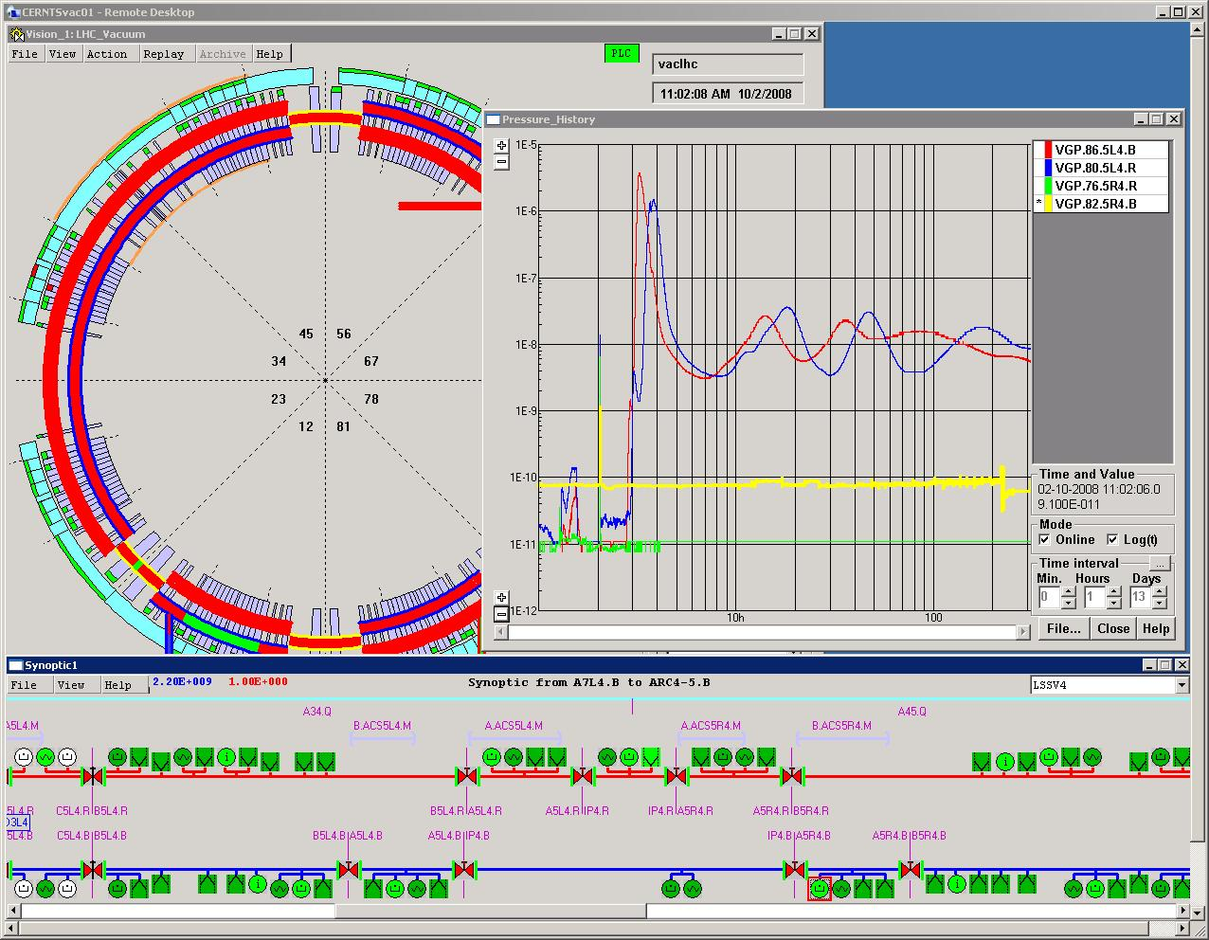
ACS modules Vacuum during 2008 incident
Not really wondering

Slide 13
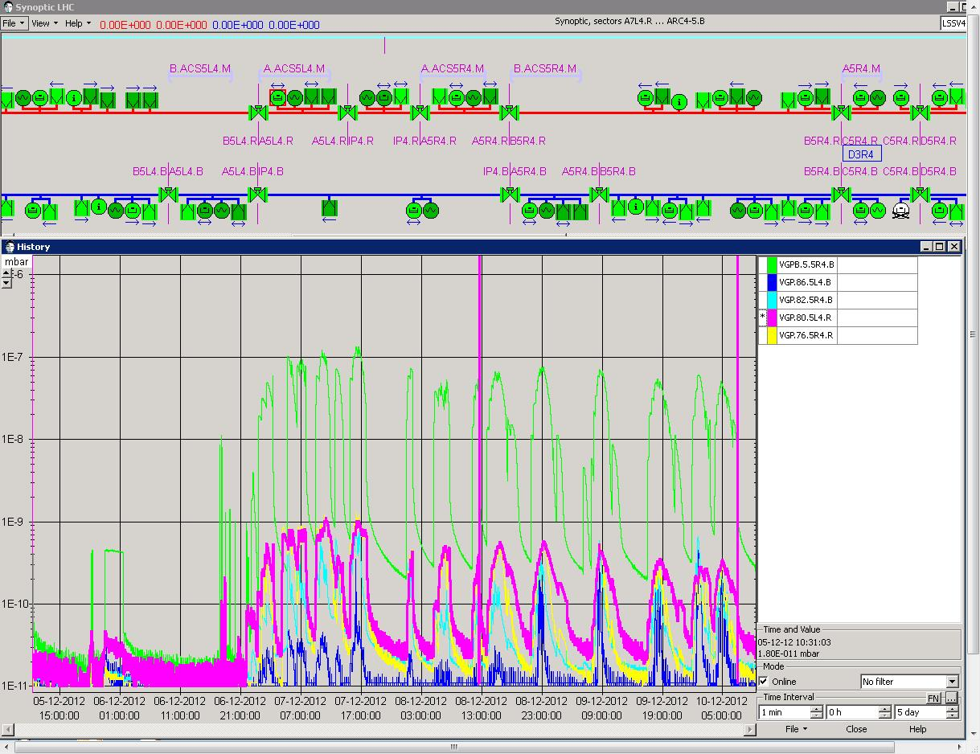
ACS modules Vacuum during scrubbing

Slide 14
- Organising maintenance
Check up during TS
Trying to determine aging components
Keeping spare parts in good shape
Applying maintenance and revalidation
Ensuring safety with Cryo and power condemnation
Applying RP rules as RSSO
Keeping test places operational

Slide 15
  - Manpower
60 % of my time
¼ of year piquet role in SRF
2 x 10 % of technician for TS and spare parts
? for training and keeping the know how

