Slide 1
LHC RF Spare Cryomodule Project Overview 04 Feb 2016
M. Karppinen BE-RF-SRF

Slide 2
LHC Cryomodule project goals
The main goal is to minimize LHC downtime due to possible failure in the installed cryomodules by having stock of fully conforming spare units
Re-establishment of Cu-Nb cavity technology at CERN ranging from cavity and cryomodule design to modern fabrication methods and related infrastructure
Time scale 2015-2018

Slide 3
Project deliverables
CM #2 recovered Nov-15
Cavity #19 to validate/re-process Mar/May-16
Practice cavities (spinning) x 2 May-16
As-built design folder Jun-16
Inventory of CM parts & tooling Jul-16
Model cavities (electro-hydr.) x 2 Oct-16
Dressed cavities^{(*} x 4 Jan-17
New spare cavities x 10 Dec-17
Cavity trains for CM6-7 integration Feb-18
^{*)}He-tank design revision (TBC)

Slide 4
Project infrastructure
Cavity cell production line
Half-cell & cut-off fabrication, He-tank assembly (EN-MME)
Chemical processing (TE-VSC)
L/HPWR (BE-RF)
Nb-sputtering (TE-VSC)
Tuning (BE-RF)
Cavity acceptance tests
Metrology (EN-MME)
Optical inspection (BE-RF)
Warm RF testing (BE-RF)
Vertical and horizontal RF testing at 4.5 K (BE-RF)
Cryomodule assembly line
Spare storage & logistics (BE-RF)
Cavity unit (BE-RF)
Cryomodule (BE-RF)

Slide 5
Responsibilities:
BE-RF:
Project coordination
Budget
Cavity design
Acceptance tests
Couplers, LLRF etc.
Spare storage & logistics
Cryomodule assembly
Operation
EN-MME:
Design office
Material supply and characterization
Cavity fabrication
Metrology
Cryomodule design & integration
Cryomodule manufacture
TE-VSC:
Chemical processing
Thin film R&D
Nb-coating
Vacuum vessel design

Slide 6
BE-RF+DO Manpower (FTE)

Slide 7

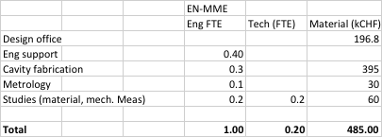
TE-VSC & TE-MME

Slide 8
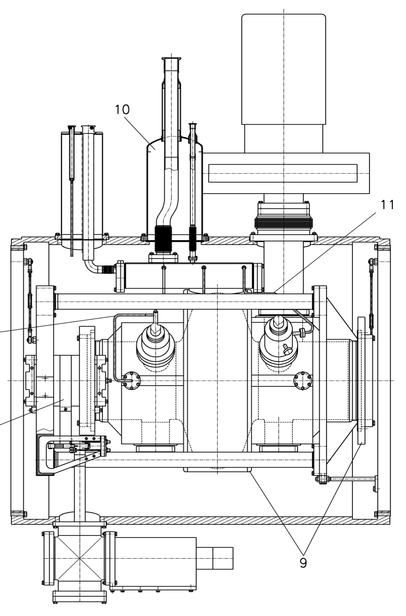
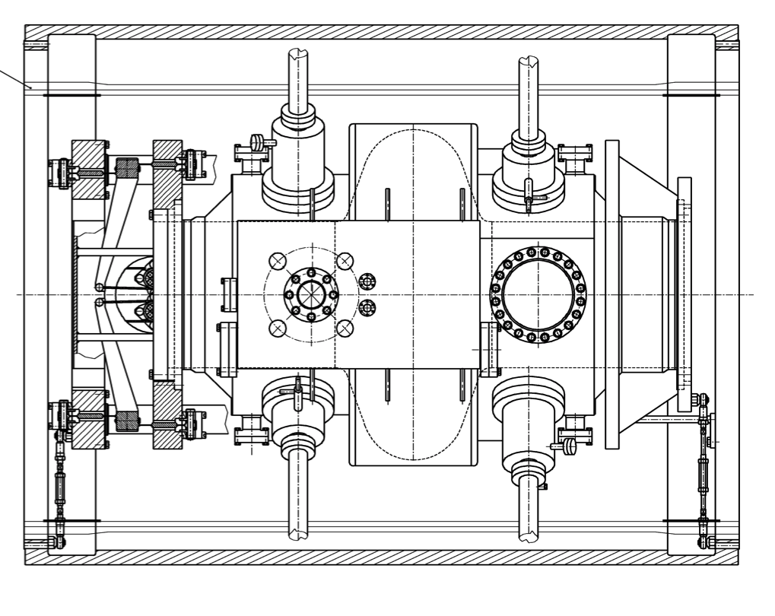
LHC Cavity Unit

Slide 9
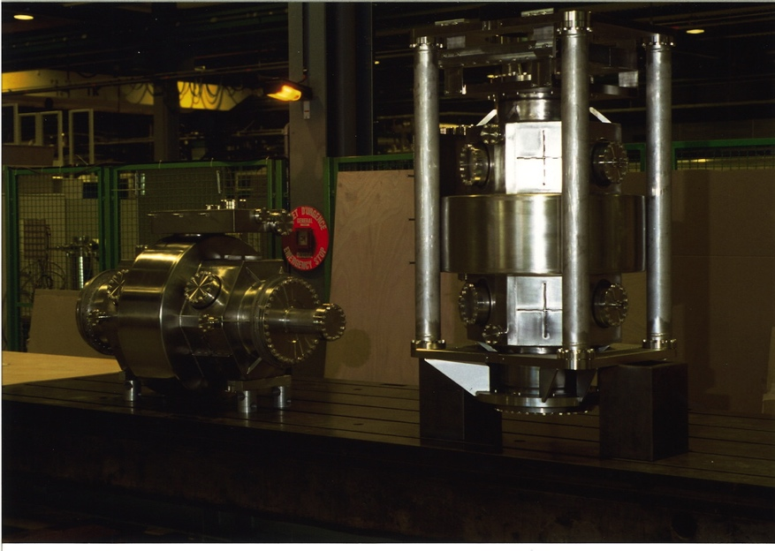
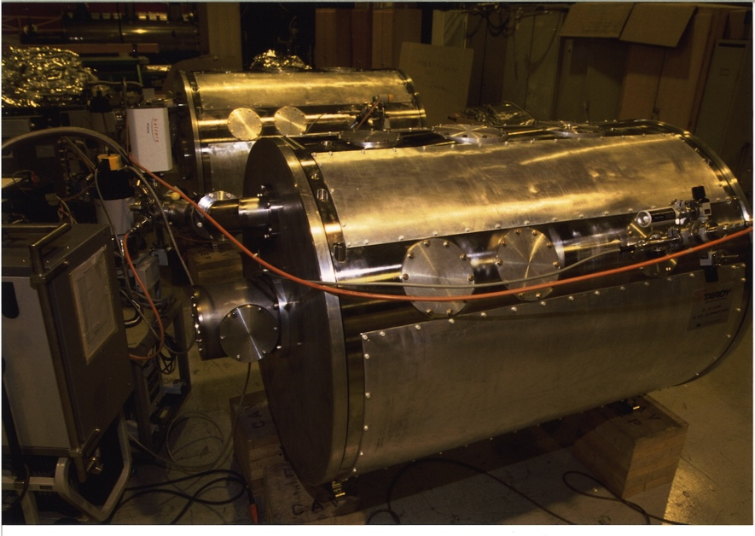
Cavity Unit

Slide 10
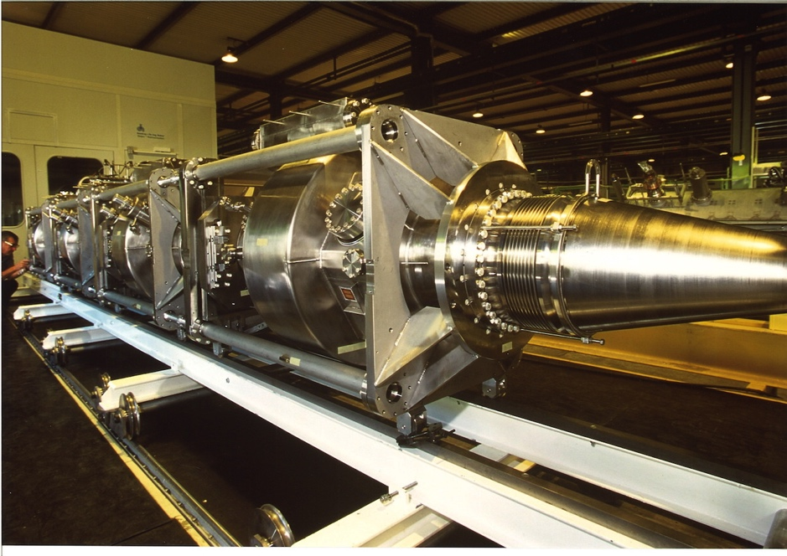
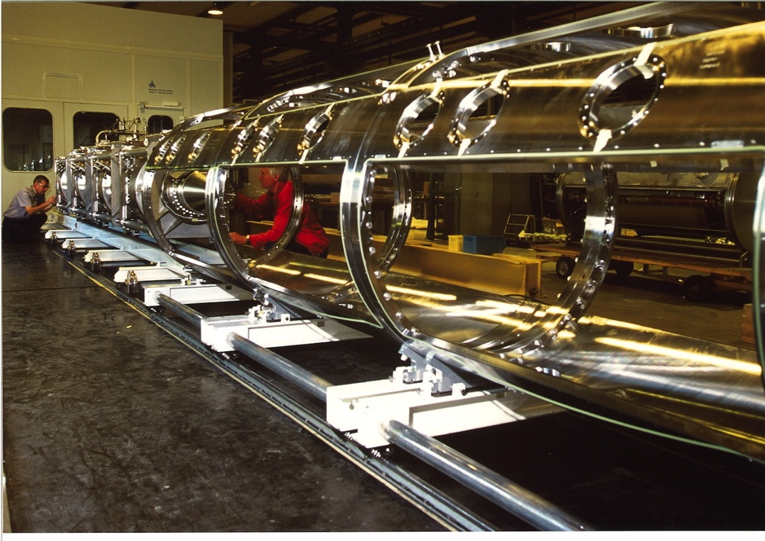
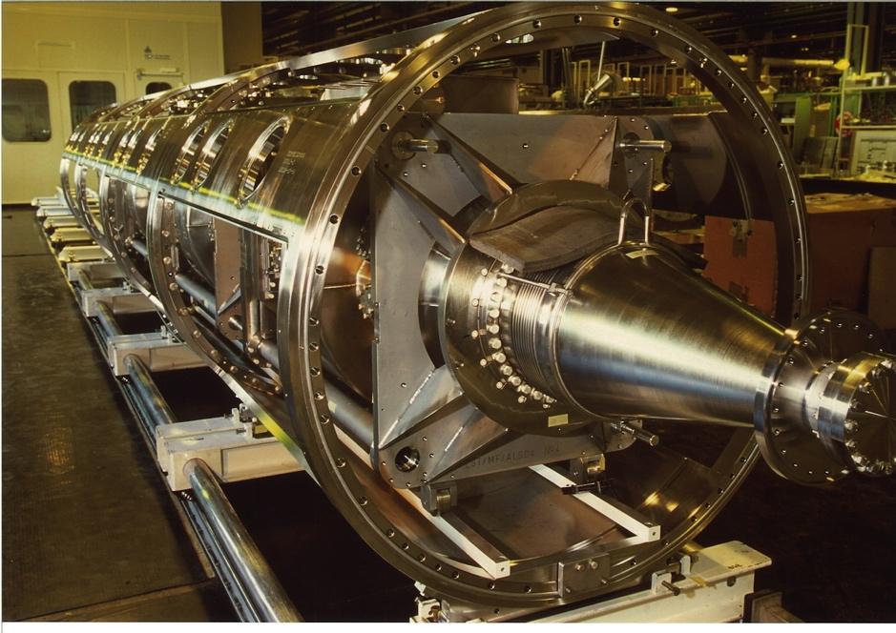
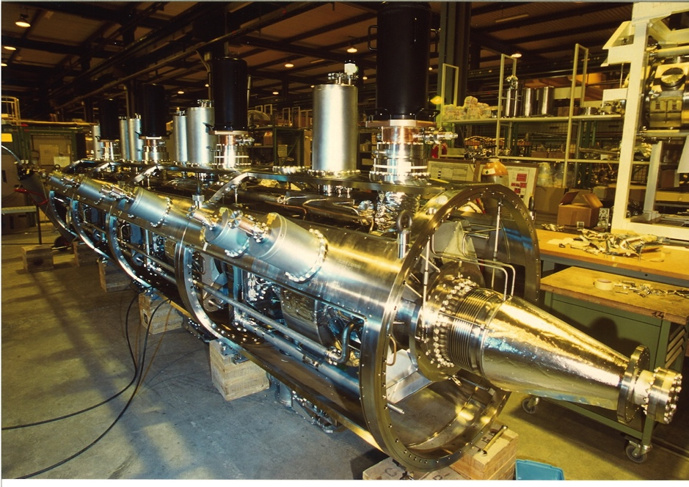

Slide 11
